Slide 1
Ad-hoc Space Data Coordination Group for GFOI
Report on 1st Year Progress
Stephen Ward, Ake Rosenqvist, John Faundeen, Frank Martin Seifert, Brian Killough

Slide 2
Context for SDCG
Broad recognition that CEOS needs to support delivery by GEO (pre-2015)
GFOI seen as a model for end-to-end delivery by GEO: a big win?
Emphasis on physical outcomes from CEOS in support
2011 Plenary endorsed: The CEOS Strategy for Space Data Coverage and Continuity in Support of the GEO Global Forest Observations Initiative (GFOI) and Forest Carbon Tracking (FCT) Task
Ad-hoc SDCG established to implement the strategy

Slide 3
Context for SDCG
Establishment of SDCG signals to IPCC and UNFCCC that institutional will exists to support data supply for a GFOI
The strategy will demonstrate that the technical capacity exists to acquire and supply EO data for GFOI and manages expectations of countries as to what that data is

Slide 4
The CEOS Data Strategy for GFOI
Creation of a living global archive of spatio-temporally consistent data for each sensor type, that responds to GFOI information requirements
Element 1: A baseline, coordinated global data acquisition strategy (wall-to-wall) involving a number of ‘core data streams’ that can be used free-of-charge for GFOI purposes.
Element 2: Coordinated national data acquisition strategies in response to national needs assessments undertaken in the course of GFOI implementation.
Element 3 Data supply in support of FCT activities, including coverage of the National Demonstrators and technical studies.

Slide 5
Accomplishments
Achieved a critical mass of participation by agencies responsible for core and contributing missions:
Co-chairs: USGS, ESA, NSC
Secretariat: DCCEE
Members: CNES, CONAE, CRESDA, CSA, DLR, INPE, JAXA, NASA
Pending invitations: ISRO, KARI, ASI
CSA hosted SDCG-1 in March 2012
USGS hosted SDCG-2 in September 2012
Australia will host SDCG-3 in February 2013
Notes:
Quick reminder to Plenary that ‘Core’ is based on the principle of openly available and free of cost to the user.
‘Contributing’ missions either have a cost element and/or are part of a Public-Private Partnership arrangement.

Slide 6
Accomplishments
The current planning is focused on Element 1 of the Strategy: A baseline, coordinated global data acquisition strategy involving a number of ‘core data streams’ that can be used free-of-charge for GFOI purposes:
Systematic and sustained wall-to-wall acquisitions of forested areas globally – consistent with national reporting commitments and GFOI requirements of national forest information systems
Phased implementation plan – gradual geographical expansion as new satellite missions become operational
Current planning focused on observation coordination only – data distribution issues to be addressed separately

Slide 7
Progress
Basis for strategy planning
National reporting requirements, translated into (forest) information products, are defined in the GFOI Methods & Guidance Document. Product definitions and EO monitoring requirements confirmed with IPCC and GOFC-GOLD.
GFOI observation strategy to provide EO data sets that accommodate countries to generate the products
Characterising the plans for supporting missions and coordination of their acquisition strategies
GFOI strategy recognises that different sensor types (optical; C-, X- and L-band SAR) provide complementary thematic information

Slide 8
Progress
Global Baseline Acquisition strategy development
Input from member agencies
Business-as-usual (BAU) observation plans
Strategic mission objectives (e.g. regional focus)
Mission acquisition capabilities and constraints
SDCG = BAU + Δ
Multi-mission gap analysis
Development of mitigation plan proposals for each mission and each epoch to bridge spatial and temporal gaps
Iterative collaborative process to achieve a sustainable best-effort coordinated acquistion strategy

Slide 9
Current challenges
Data availability
2012 low-water mark for CEOS mission availability (loss of CBERS-2, ALOS, Landsat 5, Envisat, within past 1.5 yrs)
Procedures for large-scale gap filling and data provision by commercial missions not yet in place.
Near-future however looks positive! (CBERS-3, LDCM, Sentinels, ALOS-2 potentially in orbit within next year)
Strategy development
Difficulties to assess capacity and development of detailed plans for missions not yet in orbit.
Many key parameters still TBD also by agencies themselves (BAU plans, ground station network, record/downlink capacities, etc.)
CEOS Data Strategy document inevitably a living document that will be continuously refined as new missions become operational.

Slide 10
Tools for strategy planning
Aiming to develop visualisation tools to communicate results and support quantitative conclusions
Flexible to report at all scales
Easily adapt analysis to changes in plans
Integration of cloud cover and available light statistics
Significant support from NASA/SEO – adapting the COVE tool to do the job

Slide 11
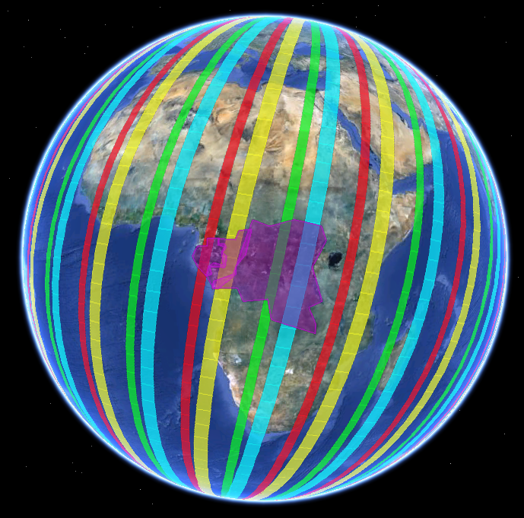
GFOI Data Acquisition Planning
Theoretical one-day instrument coverage (COVE output) for Landsat-7, LDCM, Sentinel-2A (notional) and Sentinel-2B (notional) over the African Congo Basin region. Full coverage in 2015 theoretically possible in <4 days without clouds and >10 days with clouds.
Notes:
The CEOS Systems Engineering Office (SEO) will utilize its CEOS Visualization Environment (COVE) tool to assess coverage vs. GFOI requirements.
COVE is a browser-based tool utilizing Google-Earth for forecasting satellite sensor coverage for 90+ missions. COVE is uniquely suited to support SDCG and GFOI data acquisition planning.
Analyses will consider core mission availability, data access, seasonality (precipitation) and cloud cover.
The overall requirement is wall-to-wall coverage of all GFOI regions to generate specific GFOI products (A₁₂₃, B₁₂₃, C₁₂).
It is expected that a combination of optical and SAR imagery will be needed to meet the requirements.

Slide 12
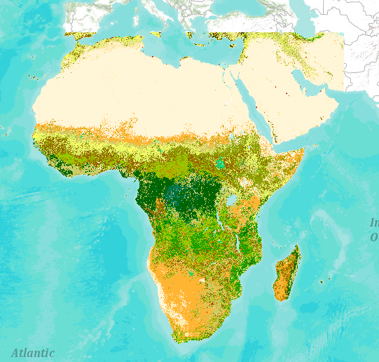
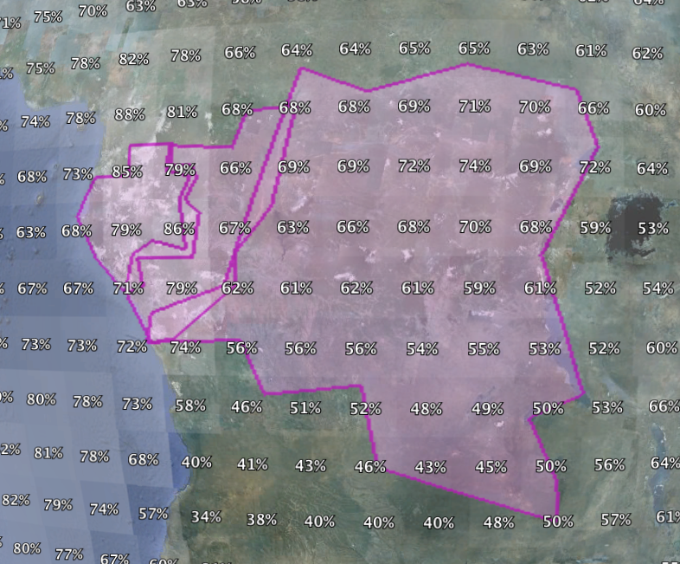
Forest and Cloud Overlays
GlobCover overlay showing dense forested regions in the Congo Basin.
Cloud Cover overlay shows average annual cloudiness for the Congo Basin region. 67% average cloudiness over forested areas will significantly impact optical scene acquisitions.

Slide 13
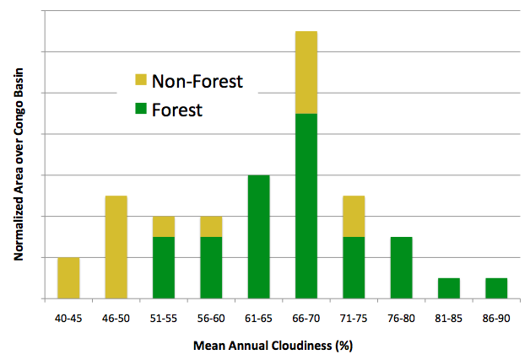
Impact of Clouds
Forested areas with high average cloudiness (>50%) are considered “hotspots” for optical imagery planning.
For example ... Landsat-7 has a 16-day repeat cycle. It is unlikely that this one mission will acquire monthly clear-sky images if the cloudiness is over 50%.
Multiple optical missions combined with SAR are required to meet imaging requirements over cloudy regions.
HOTSPOT
The majority of the Congo Basin area is a “hotspot” with forests and high cloudiness (>50%). These regions will require multiple optical and SAR missions to meet GFOI requirements.

Slide 14
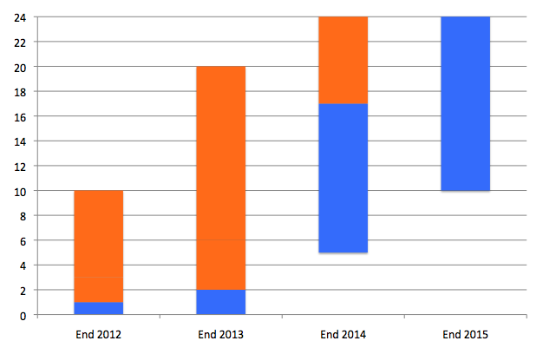
Congo Basin – Analysis Example
Business as Usual Plan Augmented Plan (example)
Max=38
Max=55
Number of acquisitions per year
12 (monthly)
Augmentation of the BAU Plans are required to provide monthly imagery in all cloud conditions
4 (seasonal)
1 (annual)
Landsat-7
Landsat-7 LDCM Sentinel-2A Sentinel-2B
Example assumes Landsat and Sentinel acquire 100% of images over the target region
Landsat-7 LDCM
Landsat-7 LDCM Sentinel-2A

Slide 15
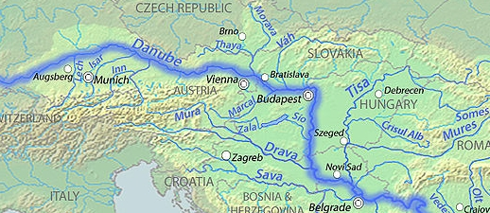
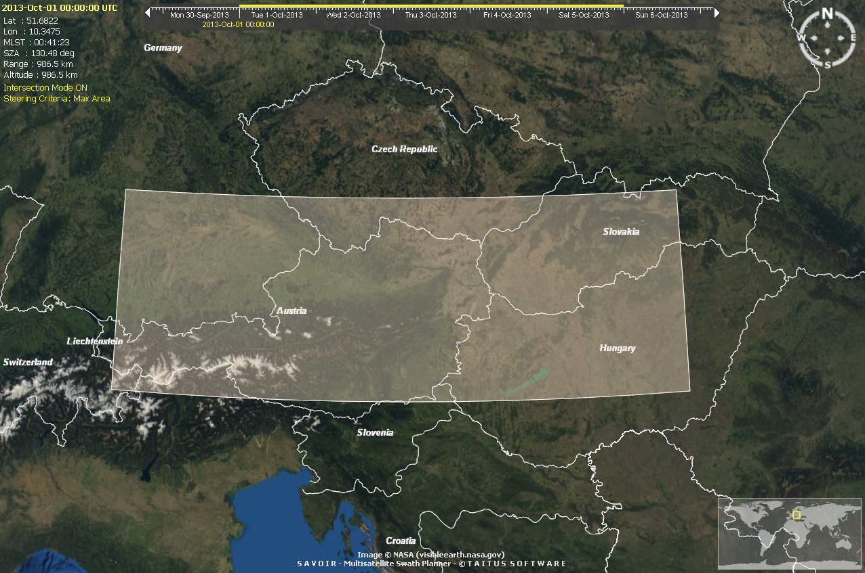
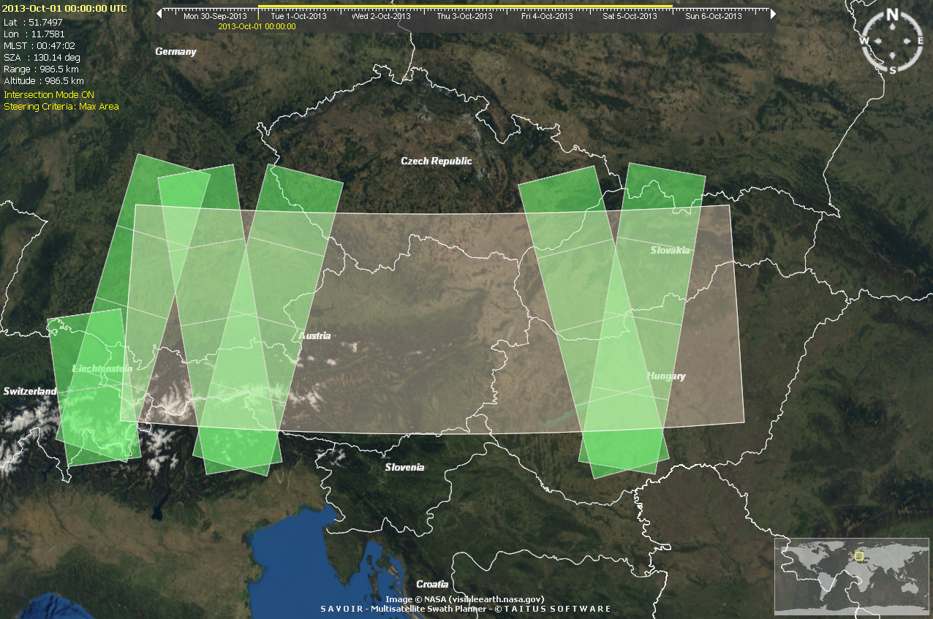
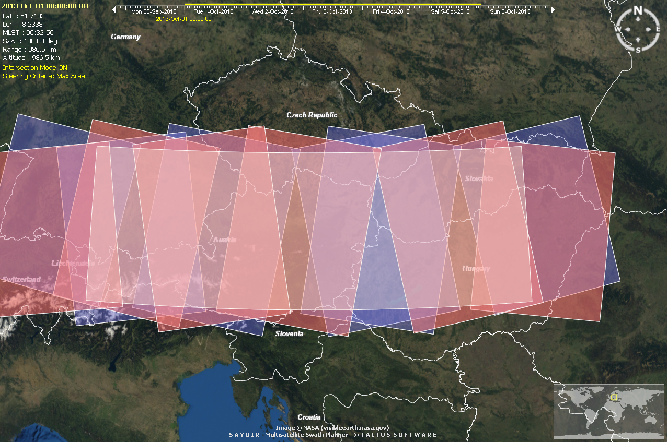
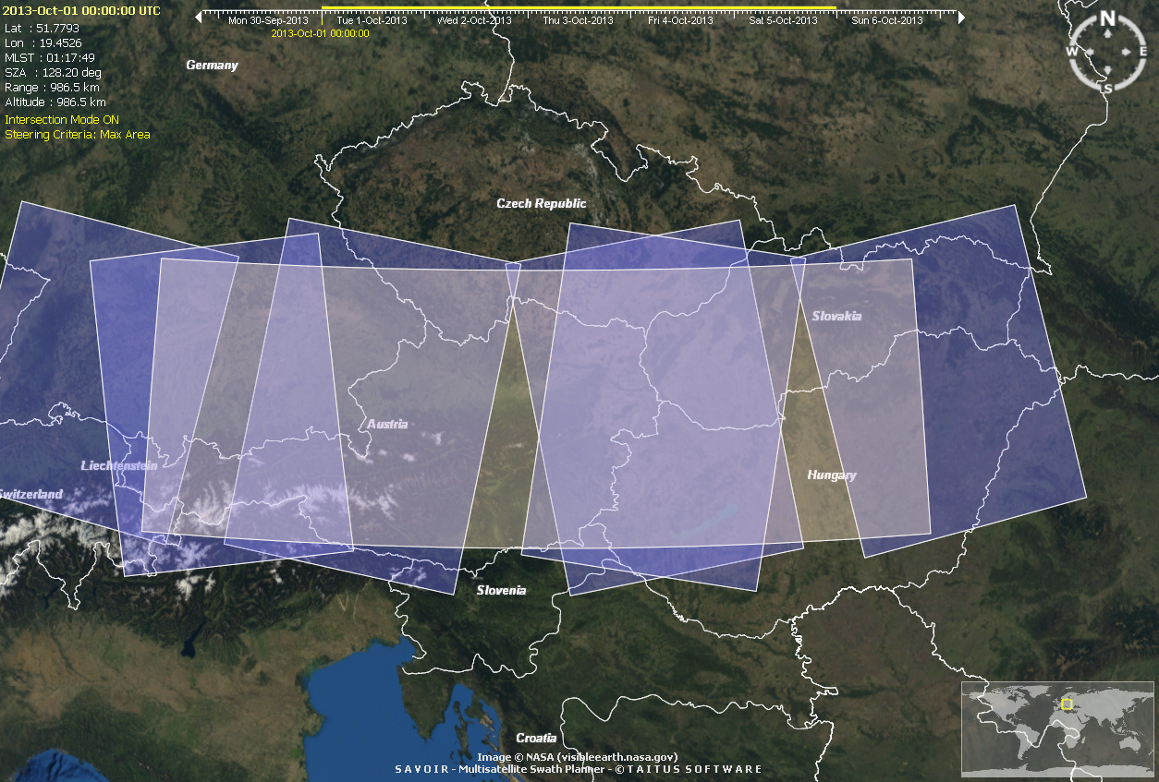
GFOI Data Acquisition Planning
- SAR sensors
Until 2012:
ENVISAT
2013+:
Sentinel 1A
2015+:
Sentinel 1A+B

Slide 16
Next steps
SDCG has more work to do on the baseline global strategy and in development of the tools for its reporting and visualisation
Seek Plenary approval for a further year of operation with the goal of completing the Element 1 strategy for review by SIT-28
Provide initial support to GEOGLAM as tasked at SIT-27: indicative of the importance of the SDCG role in the CEOS/GEO geometry

