Slide 1


Land Surface Imaging
Virtual Constellation
P.G. Diwakar, ISRO
Julio Dalge, INPE
John Faundeen, USGS

Slide 2

Past Accomplishments
  Refocused Terms of Reference
  Updated Work Plan
  Portal Migrated
    From NOAA to USGS
  Addressing CSS & SEO Study Recommendations
    Flow
    Inclusion of SAR Missions
    Addition of Tools (INPE Orthorectify)
  Workshop
    Following SIT-27 @ La Jolla, CA
      Confirmed Support & Direction

Slide 3
Past Accomplishments
  LSI Explorer
    Cross-Catalogue Queries
      NASA
      NOAA
      China
      INPE
      JAXA
      USGS
      ISRO (coming)
      CCRS (coming)
    Direct Data Access (dependent on Agency data policies)

Slide 4
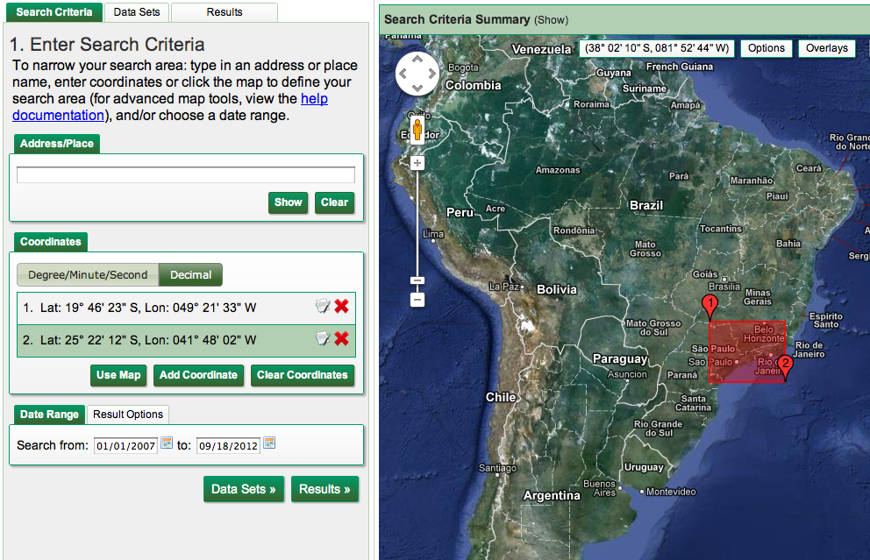
Past Accomplishments – LSI Explorer
Notes:
LSI Explorer Entry page. Simple spatial/temporal interface. Select area of interest, indicate date range, and then proceed to Data Sets.

Slide 5
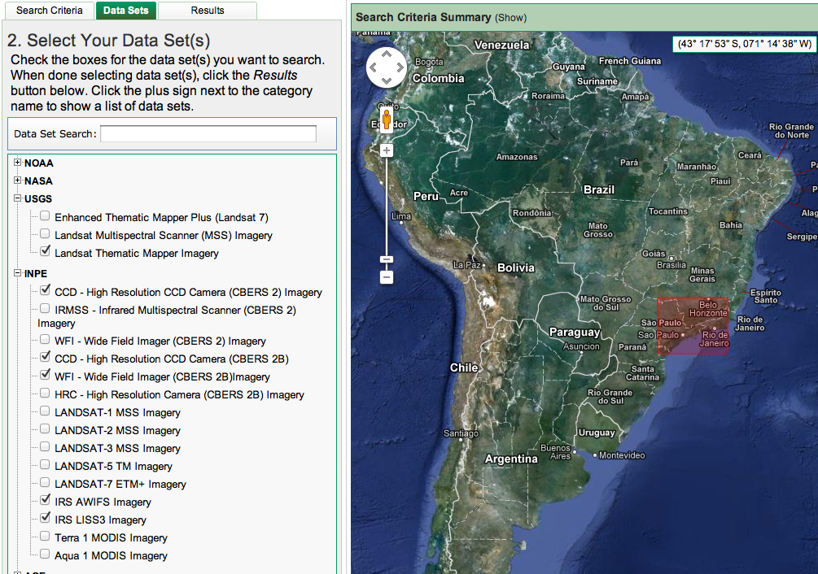
Past Accomplishments – LSI Explorer
Notes:
Select Data Sets from multiple CEOS agencies to query against.

Slide 6
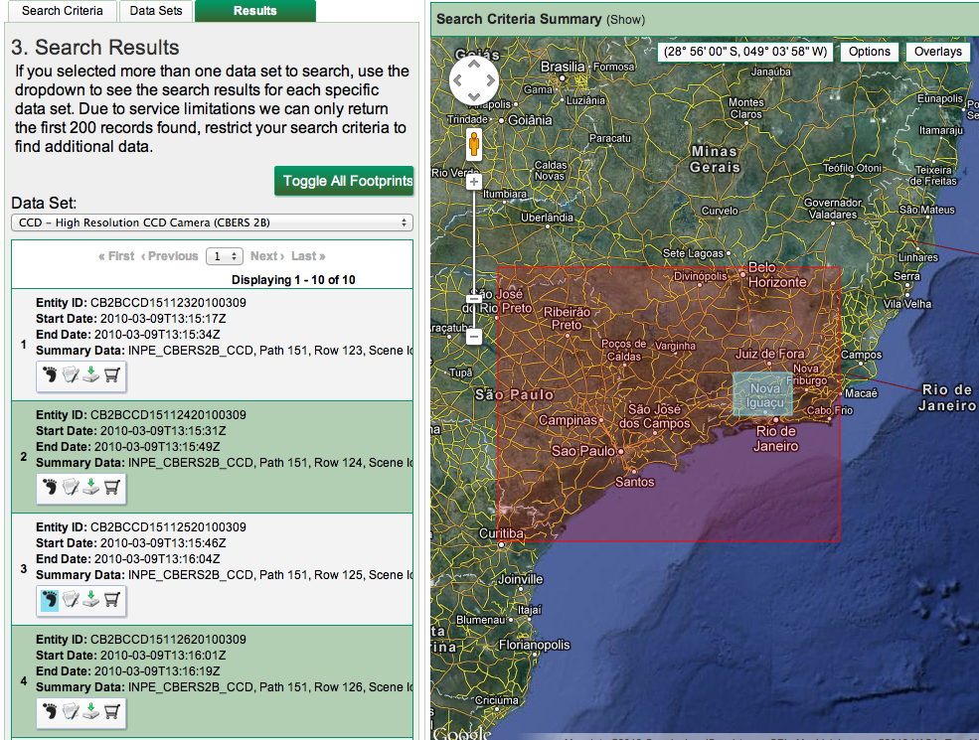
Past Accomplishments – LSI Explorer
Notes:
Showing query results from INPE. Also showing record No. 3 footprint on the map. Larger rectangle is the area of interest.

Slide 7
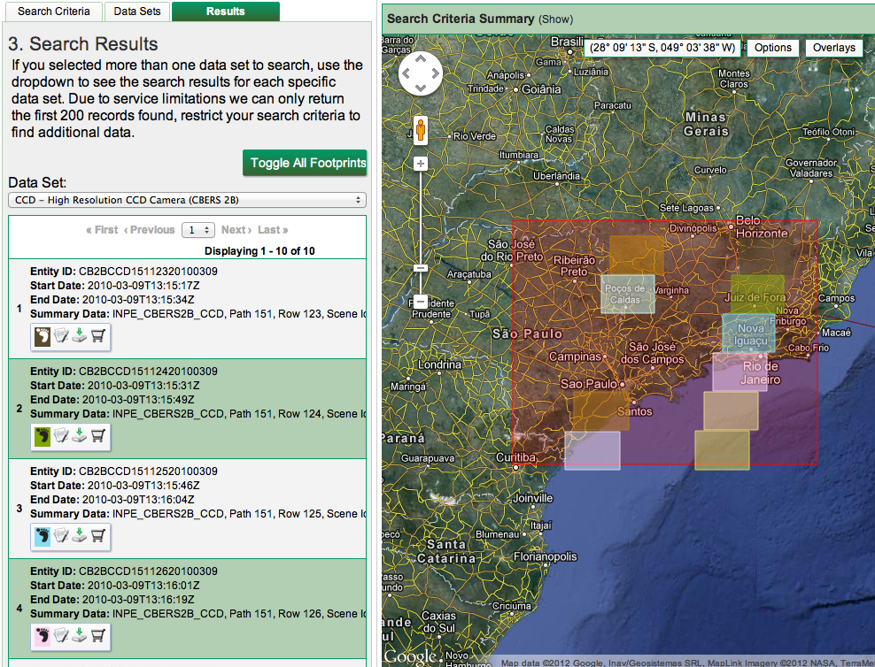
Past Accomplishments – LSI Explorer
Notes:
Showing all footprints that the query retrieved.

Slide 8
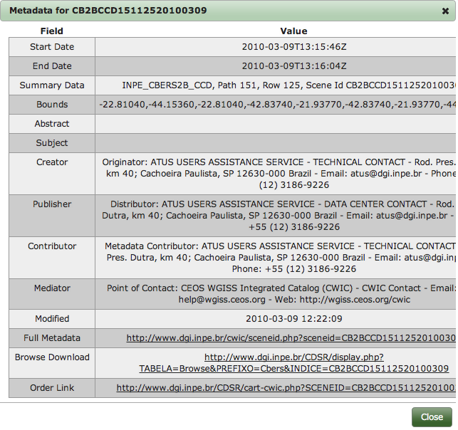
Past Accomplishments – LSI Explorer
Notes:
Showing additional information for the INPE record. Note Order Link at bottom.

Slide 9
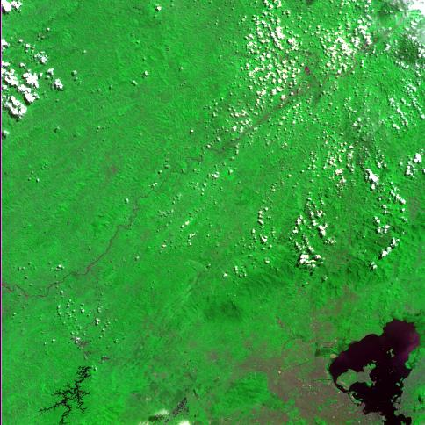
Past Accomplishments – LSI Explorer
Notes:
Showing INPE browse image.

Slide 10
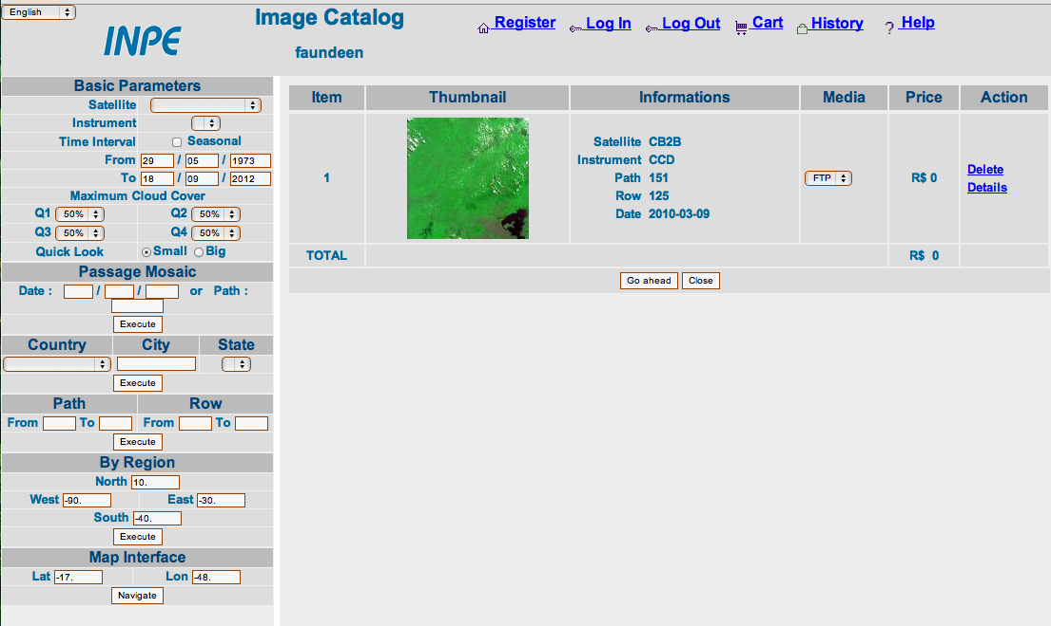
Past Accomplishments – LSI Explorer
Notes:
Showing INPE order interface accessed from LSI Explorer.

Slide 11
Past Accomplishments – LSI Explorer
Notes:
Once registered in the INPE system, simply close out the shopping cart which results in the email above being received to pull the actual data.

Slide 12
Current / Future Challenges
  Refine Web Site
  Add More Tools
  Add Additional Terrestrial Data Sets
  Begin Distribution of Terrestrial ECVs
  Possible Workshop @ SIT-28
  http://lsiexplorer.cr.usgs.gov

Slide 13
Decision sought / Way forward
  Endorse Refocused Terms of Reference
  Endorse Work Plan
  Encourage Agencies to Support LSI
  Facilitate HMA and CWIC Connectivity

