Slide 1
Annual Report on CEOS Implementation of the GEOSS Space Segment
Michael Freilich, NASA, SIT Chair Agenda Item #12

Slide 2
Agenda
Part 1: 2012 CEOS Accomplishments and Lessons Learned
Review of the CEOS Annual Work Plan ... What did we set out to accomplish in 2012?
CEOS-GEO Actions ... What actions did we establish to accomplish these goals?
CEOS is generally making excellent progress on CEOS-GEO Actions that are tightly coupled to the CEOS Work Plan’s goals and objectives
CEOS progress is uneven and/or in many cases unclear on lower visibility CEOS-GEO Actions that may not be as tightly coupled to the CEOS Work Plan
Part 2: CEOS involvement in the GEO Work Plan Tasks and Components
CEOS Leadership roles
IN-01-C2 Task Objectives and Accomplishments
Part 3: Virtual Constellations Progress on Key CEOS Priorities

Slide 3
Part 1: CEOS Work Plan and Actions
Improved Coordination of Space Agency Activities Related to Climate
CEOS Response to the GCOS Implementation Plan (IP). Agenda Item 25, CEOS Action (CL)
Development of Fundamental Climate Data Records (FCDRs) and release of the ECV Inventory survey. Agenda Item 26, CEOS Action (CL)
Continued cooperation with GEO, GCOS, WMO, and CGMS in the development of a space-based system to support climate. Agenda Item 26 (Climate Architecture and ECV Inventory)
Further alignment of the Virtual Constellations objectives as building blocks of the space-based climate information strategy. Part-3 of this presentation.
CEOS-GEO Actions related to Climate
There are 7 actions related to Climate
Other actions not noted above are: Climate Data Record Reanalyses, Climate Model Intercomparison Projects, and Greenhouse Gas Cal-Val.
All of these actions directly address the Work Plan objectives above.

Slide 4
CEOS Work Plan and Actions –Page 2
Progress Towards Established CEOS-GEO Priorities
CEOS leadership within and support to the GEO Forest Carbon Tracking (FCT) and the Global Forest Observations Initiative (GFOI), including the establishment of the Space Data Coordination Group (SDCG). Agenda Items 15 and 16. CEOS Action (CL)
Continued development of the CEOS Strategy for Carbon Observations from Space by the Carbon Task Force (CTF). Agenda Item 14, CEOS Action (CL)
Advancement of CEOS Data Democracy activities within the reorganized CEOS Working Group on Capacity Building and Data Democracy (WGCBDD). 3 CEOS Actions (ID-02)
Further alignment of the CEOS Virtual Constellation objectives to the GEO 2012-2015 Work Plan Tasks. Part-3 of this presentation.
Continued support of the GEOSS Common Infrastructure (GCI) and an increase in GEO Data Collection of Open Resources for Everyone (GEO DataCORE) datasets. WGISS Report, Agenda Item 29 and SEO Report, Agenda Item 32. 2 CEOS Actions (ID-01)
Integrated approach to disaster management, including support to the Geohazards Supersites initiative. Agenda Items 17 and 18, 8 CEOS Actions (DI) including: Gap Analyses, Web Service Framework, Volcanic Ash, Supersites, Caribbean Pilot, African Flood and Health Pilot.
Continued support to the Joint Experiments on Crop Assessment and Monitoring (JECAM) initiative. CEOS Action (AG)
Continued CEOS leadership of, and support to, the Quality Assurance for Earth Observations (QA4EO) initiative. 2 CEOS Actions (IN-02)

Slide 5
CEOS Work Plan and Actions – Page 3
Considering CEOS Support to Further Key GEO Priority Initiatives
Exploratory dialogue on support to the GEO Global Agricultural Monitoring (GEOGLAM) initiative. Agenda Item 20
Continued dialogue on potential CEOS contributions to integrated water cycle products and services. 2 CEOS Actions (AG), 1 CEOS Action (HE), 5 CEOS Actions (WA)
Continued dialogue on potential CEOS contributions to the GEO Biodiversity Observation Network (GEO BON). CEOS Action (BI)
Continued and Enhanced CEOS Outreach to Key Stakeholders: GEO, COP, UNFCCC, SBSTA, G8/G20, and Others
Engagement, attendance, and where appropriate, participation and presentations at key meetings. Agenda Items 32 and 34.
Maintenance of the Missions, Instruments and Measurements (MIM) database. Agenda Item 33, Continuing well... thanks to ESA.
Publication of the CEOS Newsletter. Continuing well... thanks to JAXA
CEOS presence at the Rio+20 Summit, including the delivery of the CEOS Earth Observation Handbook. Rio+20 supported. Handbook not delivered due to Customs. CEOS Action ID-04.
Further review and, as appropriate, adoption of recommendations from the 2011 CEOS Self-Study. Agenda Items 6, 7, 8

Slide 6
CEOS Work Plan and Actions – Page 4
Facts and Figures from the CEOS-GEO Actions Tracker
50 Actions for 2012
3 closed (2 successfully)
47 remain open
35 actions with updated reporting in the past 2 months
12 actions with no recent reporting (in many cases, many months)
2 actions were re-mapped
“Educated Guess” Assessment on Progress of Open Actions
24 Actions with good progress/at or near milestones
13 Actions with limited progress
8 Actions with no progress and little/no relevant reporting
Difficult to Assess Progress for the Full Range of CEOS-GEO Actions
Due to infrequent/unclear reporting and obsolete information
-- A new philosophy toward “CEOS Actions” may be needed --

Slide 7
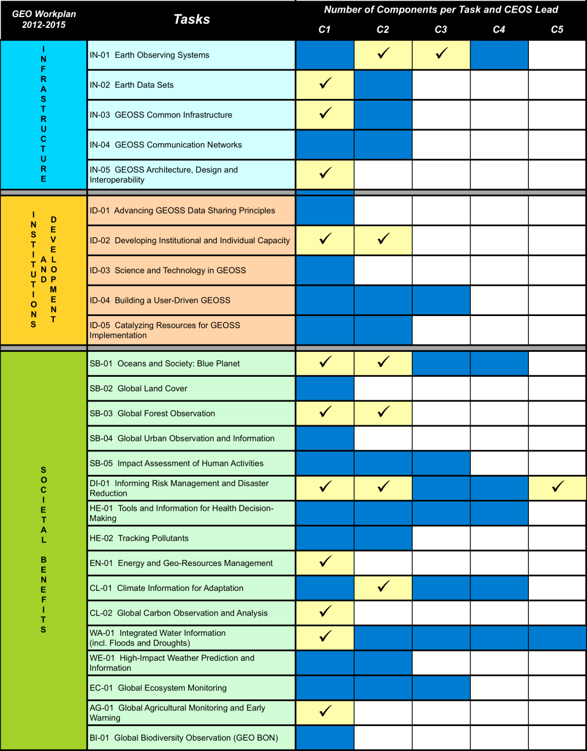
Part 2: CEOS Roles in the GEO Work Plan
Infrastructure (IN)
4 of 5 Tasks
5 of 11 Components
Institutions and Development (ID)
1 of 5 Tasks
2 of 9 Components
Information for Societal Benefits
8 of 16 Tasks
12 of 40 Components
CEOS is making a significant contribution to GEO through its leadership roles, actions and accomplishments

Slide 8
IN-01-C2 Component
CEOS Leads the IN-01-C2 Component (Space-based Earth Observing Systems), which includes these 7 elements ...
Promote rapid development of CEOS Constellations (CEOS Constellation Leads)
Develop an arctic hydrometeorological satellite network (ROSKOSMOS)
Explore synergies with the Earthmapper constellation for global high resolution observations (Surrey Satellite Technology, LTD - SSTL)
Establish and upgrade ground station capacity in Africa for CBERS (INPE)
Promote the AfricaGeoSat-1 Project (SA Dept of Science and Technology)
Establish actions securing ECV data from satellites (CEOS WGClimate)
Promote space missions to fill gaps from the loss of key instruments (i.e., Envisat, AURA) (CEOS Constellation Leads)
Approximately quarterly status reports within the IN-01-C2 Component are desired by CEOS to support the IN-01 Task, IIB, and GEO.

Slide 9
IN-01-C2 Highlights
CEOS Virtual Constellations
CEOS has advanced its Virtual Constellations to improve data access and interoperability in the fields of Land Surface Imaging; Atmospheric Composition; Ocean Colour Radiometry; Ocean Surface Topography; Ocean Surface Vector Wind; and Precipitation.
A new Virtual Constellation for Sea Surface Temperature (SST-VC) has been established, building upon the work of the Group for High-Resolution Sea-Surface Temperature (GHRSST). Plan to publish an IOCCG report with Level-1 Ocean Colour Radiometry requirements by the end of 2012.
New Essential Climate Variable (ECV) Inventory
CEOS, CGMS, and WMO have established a new ECV inventory database to capture climate data record products from space agencies in an effort to identify and address gaps in a sustained climate architecture. These groups have also continued efforts towards defining a Climate Monitoring Architecture for space-based observations, and further developed a draft strategy document.
Progress on CBERS ground stations in Africa and Spain
Brazil (INPE) and China (CRESDA) are proceeding with plans to establish and upgrade CBERS ground stations in South Africa and Spain by November 2012. New ground receiving stations could be set up for CBERS-3 data (launch scheduled for December 2012) in Hartebeeshoek, South Africa (MOU between China, Brazil and South Africa (SANSA), and in Maspalomas, Spain (MOU between Spain (INTA) and Brazil). Brazil, France and Gabon are joining forces to develop the SEAS Gabon project, which will deploy an antenna and operational ground station for receiving data in West Africa.

Slide 10
Next Steps and Issues
IN-01-C2 Management Plan Obtain progress reports from the 7 sub-elements including those 3 with CEOS leadership. Monitor the progress of 5 CEOS actions linked to IN-01-C2.
Metrics and Mapping Work with the Infrastructure Implementation Board (IIB) to develop a set of Performance Indicators to assess progress on GEO Tasks. Recently completed mapping of task outputs to Strategic Targets.
Management Issues (1) GEO to identify a lead for the IN-01-C3 component (Coordination across Surface-based and Space-based Observing Systems) (2) Lack of reporting from ROSKOSMOS and SSTL.
Task Progress Issues (1) Lack of approval for AfricaGEOSat-1 Project.

Slide 11
Part 3: CEOS Constellations
IN-01: Earth Observing Systems
C2: Development and Coordination of Space-based Observing Systems
Promote rapid development of the “CEOS Constellations Concept”. Observations from Virtual Constellations provide higher temporal, spatial, and spectral resolution, as well as improved data management and dissemination. Virtual Constellations are under development in seven areas: Precipitation, Atmospheric Composition, Land Surface Imaging, Ocean Surface Topography, Ocean Colour Radiometry, Ocean Surface Vector Wind, and Sea-Surface Temperature

Slide 12
SIT approach to VCs in 2012
Presumption that VCs have a key role supporting delivery of GEOSS space segment outcomes
3-year outcomes defined in support of 2015 GEO horizon
Consistent with CEOS Self Study VC Report recommendations
Sharp-end emphasis (inc. climate architecture)
Stronger top-down direction and target setting – aided by stronger feedback and support mechanisms
More integrated approach, priority-driven
Stronger feedback and support mechanisms
First dedicated VC workshop at SIT-27 meeting
Regular SIT Chair telcons with VC leads
Systematic representation of VC issues on SEC (compilation report)

Slide 13
Our VCs
Oceans
Ocean Surface Topography: NASA & EUMETSAT
Ocean Surface Vector Winds: NOAA, EUMETSAT & ISRO
Ocean Colour Radiometry: NASA, ESA & ISRO
Sea Surface Temperature: ESA & NOAA
Land
Land Surface Imaging: USGS, INPE & ISRO
Atmosphere
Precipitation: NASA & JAXA
Atmospheric Composition: NASA & ESA

Slide 14
Ocean Surface Topography
Key outcomes
Development of Jason-3 as continuation of the reference time series, and planning for Jason-CS
Sea level ECV support
OST Implementation Plan
Progress
Jason-3 launcher selected, target launch date December 2014, Jason-CS satellite phase B on going, program approval process initiated by agencies
Engagement of OST Science Team (OSTST) as VC home
Issues
How do we transform the OSTST from a multi-agency funding-driven construct into a CEOS mechanism for international involvement. (analogue to GHRSST for SST)?
Need to encourage involvement in the OSTST from agencies that fly “complementary missions” that are not presently formal members of OSTST (e.g. ESA).

Slide 15
Ocean Surface Vector Winds
Key outcomes
OSVW data continuity (& reprocessing etc)
Cross-calibration of OSVW sensors
Improved utilisation in forecasting and warning services
User Training courses
Progress
Engaging the IOVWST to leverage programs and resources
Training courses continuing
Issues
Want clear direction in context of CEOS Implementation Plan
Operational requirements are as critical as climate

Slide 16
Ocean Colour Radiometry
Key outcomes
ECV development
In-situ OCR White Paper
Progress
Standing ECV WG established by IOCCG
INSITU-OCR White Paper circulated
Issues
CEOS Agency review and support for INSITU-OCR
IOCCG Report: Mission Requirements for Future Ocean Colour Sensors – relevant agencies to reflect in planning
Resources a challenge

Slide 17
Sea Surface Temperature
Key outcomes
ECV support
VC Portal
Improved SST calibration, inter-calibration, and validation
Training activities for satellite SST practitioners
Progress
First VC meeting
Implementation Plan endorsed by SIT
Plan activities initiated including ECV pilot
All data being made available via CEOS IDN/CWIC
Issues
Participation essential for the new VC

Slide 18
Land Surface Imaging
Key outcomes
Mid Resolution Guidelines document
Support to GFOI & JECAM
Progress
Reassessment of scope and direction (inc radar)
Exploring partnership with SDCG for GFOI needs etc
Addressing CSS and Portal Study points
Cross-catalogue and data access provision
LSI Explorer
http://lsiexplorer.cr.usgs.gov
Issues
Welcome direction on priorities from SIT
Participation

Slide 19
Precipitation
Key outcomes
Deployment of GPM phase constellation satellites, maintaining continuity with TRMM, and advocacy of post-GPM phase PC
Precipitation ECV support – Response to GCOS Action A-8 - Ensure continuity of satellite precipitation products
PC Data Portal and links to CEOS Water Portal
Progress
GCOM-W1 launch; M-T SAPHIR and MADRAS data availability
Phase 1 of data portal development
Issues
Resources
Participation

Slide 20
Atmospheric Composition
Key outcomes
Multi Sensor Volcanic Eruption Alert System
Implementation of Geostationary AQ Constellation Paper recommendations
ECV support – starting with Total Ozone
Limb scattering ozone profile measurement coordination
Potential implementation of GHG-relevant recommendations from CEOS Carbon Strategy Report
Progress
Excellent progress in implementation of web-based volcanic alert system
AQ Paper work underway and societal benefits study planned
Issues
Resources

Slide 21
Common issues - discuss
Resources
Multiple VCs looking at SST model of alignment with GHRSST – suggesting existing VC arrangements and resources not commensurate with their objectives?
Participation
The global challenges being addressed by the VCs requires coordination of all available observing systems
Participation status survey by SIT Team identified the systems of China, India and Russia as the most frequent omissions that would bring significant capability to the GEOSS Space Segment
Direction
Some VCs less clear than others as to their purpose and outputs
LSI and OSVW would welcome clarity and context of a master plan
New planning documents must address this and engage VCs in development
Information systems
SIT Vice Chair has proposed a study of more consistent capabilities

