Slide 1
CEOS Self-Study Implementation Initiative
Common Understanding of Major Meetings
“Major Meetings” Team

Slide 2
CSS Key Recommendation
“Develop coordinated objectives and formats for the CEOS Plenary meeting, SIT meeting(s), and SEC telecons to encourage discussion and decision-making.
Balance reporting with strategic discussions that engage and utilize participation from all CEOS functional groups.”

Slide 3
Detailed CSS Findings and … a few Additional Ones
Objectives:
Not always clear definition of the purpose, main objective(s), and participating audience for each meeting on the CEOS annual calendar. Not always clear distinction between the objectives & expected outcomes of the Plenary and those of the SIT meetings.
Agenda:
Not always clear distinction between the purpose or reason for having each meeting (what it seeks to accomplish overall) AND outcomes (i.e., actions and decisions) that result from its discussions.
Redundancy between SIT Tech. workshop and Plenary meeting.
Use of SIT and Plenary meetings for routine, redundant reporting is a missed opportunity to make progress on issues of strategic relevance.
Frequency & Timing:
OK in general except that some critical discussions take place only every 6 months (at Spring SIT or Autumn Plenary), delaying some key decisions.
Format:
Physical presence at all major meetings (except SEC telecons) might cause financial difficulties for some Agencies.

Slide 4
Current Major CEOS Meetings
MEETING | WHEN | ATTENDANCE
CEOS GEO Actions Workshop | January-February | Physical attendance by mainly technical experts & scientists few CEOS Principals CEOS Principals are invited but not required 40-50 participants
Strategic Implementation Team Meeting (SIT) | March-April | Physical attendance by mainly CEOS Principals or their designees supported by technical experts & scientists 60-70 participants Preceded or followed by optional side-meetings
SIT Technical Workshop | September | Physical attendance by mainly technical experts & scientists CEOS Principals are invited but not required 40-50 participants Preceded or followed by optional side-meetings
CEOS Plenary | October-November (before GEO Plenary) | Physical attendance by mainly CEOS Principals supported by a few technical experts & scientists 60-70 participants Preceded by optional side-meetings
CEOS Secretariat | Monthly | Mostly teleconferences CEOS Secretariat representatives
Major CEOS Meetings:
Not specific to a WG, VC, project, ..
Participants from across various CEOS entities
Notes:
CEOS Meetings that are not specific to a WG, VC, project, .. and that are attended by representatives of the various CEOS entities

Slide 5
Team Members
Current CSSII Team:
Call for new team members
fresh minds
ready to participate actively to the team’s work, e.g., provision of written inputs for final report.
 | NAME | AGENCY , FUNCTION
Co-leads: | Ivan Petiteville | ESA, ex-CEO
 | Tim Stryker | USGS, future ex-CEO
Members: | Marcía Alvarenga, Julio Dalge | both INPE and ex-CEOS Chair team
 | Jacob Sutherland | NOAA, WGCapD vice-Chair
 | Christine McMahon-Bognar | NASA, SIT Team

Slide 6
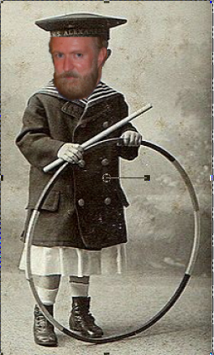
Achievements
Brainstorming has started just after SIT Technical workshop
exchange of mails, 2 telecons incl. with SIT team
Some preliminary ideas suggested…
CEOS meetings have been shaped through an iterative process during almost 30 years:
Current situation cannot be so bad !!
No revolutionary ideas but rather appropriate adjustments ..

Slide 7
Post-Plenary Timeline and Objectives
Additional thinking is needed in the coming weeks..
Presentation of preliminary recommendations in January 2013 to a limited CEOS audience (e.g., CEOS Secretariat)
Consolidation and final presentation to the CEOS Principals, at the SIT-28 meeting (Spring 2013)

Slide 8
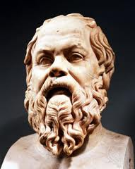
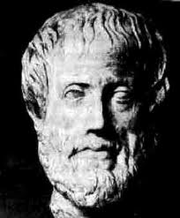
Still further thinking required ..
400 BC
400 BC
Socrates
To do is to be ..
THANK YOU !!!
Plato
To be is to do ..
50 years …
Frank Sinatra
Do-be-do-be-do
2300 years !!!

