Slide 1
CSS Implementation Initiative - CSSII
~90 minutes for this CEOS Self Study discussion
Reports to the Plenary (40 mins)
Decisions by the Plenary (10 mins)
  Adoption of the Membership and Participation Report
  [Essential Questions]
Discussions (40 mins)
Focus – between now and Plenary 2013 - is on developing, documenting, and adopting CEOS organizational refinements to make CEOS more effective

Slide 2
CSSII Session OUTLINE
Overview: Overall status and plans from now to Plenary 2013
Brief reports on plans from 3 topical teams
  “Major Meetings”
  “Roles and Responsibilities”
  “Decision-making Processes”
Membership and Participation Study Report – Adopt
Overall discussion on path forward
  Essential Questions
  Milestones and future meetings
  Involvement
  General approach

Slide 3
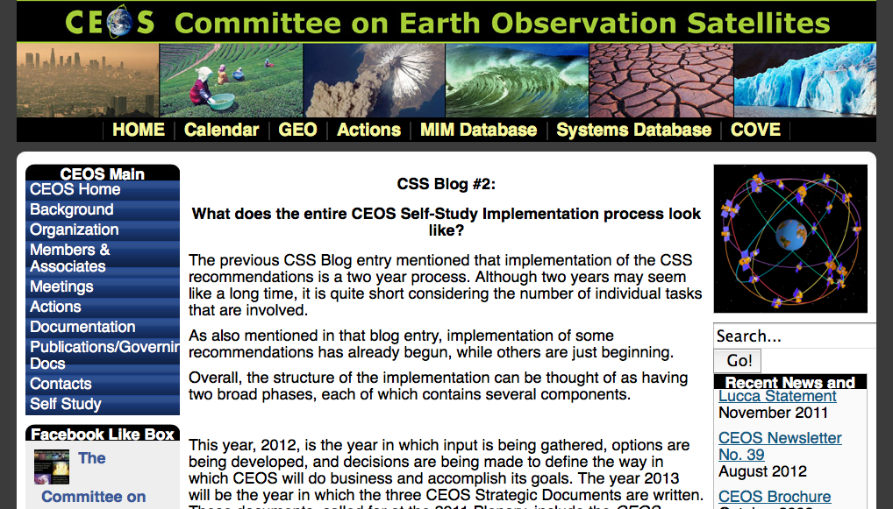
Full implementation timeline and more information can be found on the CEOS website:

Slide 4
CEOS Self-Study:
Five Key Recommendations
Strategic Objectives:
  - Document CEOS principles and priorities
Decision-making and New Initiatives:
  - Develop a process for selecting new initiatives
Organizational Functions:
  - Articulate functions needed to accomplish mission
  - Consider modifying current structure to better suit functions
Membership and Participation:
  - Develop process for acceptance of new members
  - Find out why some members are not participating
Meeting Objectives:
  - Reduce redundancy, balance reporting with discussion/decisions

Slide 5
Lucca Plenary and La Jolla SIT-27:
Producing 3 New Guiding Documents
Strategic Guidance Document (10-12 year longevity)
  Compilation of Top-Level Objectives and CEOS Principles
  Informed by Essential Questions activity (Pat J-J leading)
  (SIT Chair responsibility)
CEOS Governance and Processes (5-7 year longevity)
  Governance, mapping organizational responsibilities to CEOS activity classes
  Processes and responsibilities for setting priorities
  Processes for approving new initiatives
  (SIT Chair responsibility)
Work Plan (3-year longevity, updated annually)
  Main focus on substantive coordination, science, and user-benefit activities
  May also include strategic and organizational studies
  Annual evaluation of progress presented at Plenary
  (SIT Chair responsibility “delegated” to CEO/DCEO)

Slide 6
CSS Implementation: Overview
CSS Implementation: Two years, two phases
Phase 1: Reports/Implementation of easy-consensus
matters
Develop options for core/substantive issues
(Plenary 2011 – SIT-28)
Phase 2: Develop CEOS Guiding Documents
(Plenary 2012 – Plenary 2013)

Slide 7
CSSII Progress Since the La Jolla SIT-27
Membership and Participation Study/Report completed
CSSII ½-day workshop in association with SIT Technical meeting, Sept 2012 (Reston, VA)
Definition and approach for the 3 documents
Establishment of 3 teams to study/provide options for key elements of the Structure and Governance Document
  Major meetings
  Roles and Responsibilities for CEOS/DCEO, SEO, VC, WG, SBA
    Primary R&R for Plenary, SIT were established at SIT-27
  Decision-making processes
Preliminary definition of Essential Questions to inform the Strategic Guidance/Principles and Priorities Document

Slide 8
Phase 2: Develop CEOS Guiding Documents
Timeline: Plenary 2012 - Plenary 2013

Slide 9
CEOS New Guiding Documents
Strategic Guidance Document
  Compilation of Top-Level Objectives and CEOS Principles
  (SIT Chair responsibility)
CEOS Governance and Processes
  Governance, mapping organizational responsibilities to CEOS activity classes
  Processes and responsibilities for setting priorities
  Processes for approving new initiatives
  (SIT Chair responsibility)
Work Plan
  Main focus on substantive coordination, science, and user-benefit activities
  May also include strategic and organizational studies
  Annual evaluation of progress presented at Plenary
  (SIT Chair responsibility “delegated” to CEO/DCEO)

Slide 10
How will the documents get written?
SIT Team will appoint a steering committee to oversee each document
  Volunteers requested at this plenary
Content informed by working team options/inputs and iterative discussions with full CEOS membership
Professional writer (on contract now) will help with overall document format/design, copy editing, style, production, organizing community input – but NOT substance

Slide 11
DISCUSSIONS of document
contents/substance
Substantial decisions made by Plenary consensus (although not necessarily at the annual Plenary)
The key will be iterative discussions and input – regarding options, document sections, full draft documents
  Draft reports, sections, etc. made available well prior to finalization
  Focused discussion sections
    Associated with most planned CEOS meetings
    Will consider special additional opportunities (Feb, June, July 2013)
    Will arrange for remote participation
    Written email inputs welcome at any time – will establish POC for each document

Slide 12
Topical Team Updates
Meetings
Roles and Responsibilities
Decision-making Processes

Slide 13
CEOS Meetings Report
Charge: Common Understanding Of (Major) Meetings:
Analyze the flow of the CEOS year and the kinds of business that need to be
accomplished in each major meeting;
Suggest options for to improve meeting utility, to ensure a balance between
reporting and discussion/decision-making, and to ensure that the needs of
Working Groups and Virtual Constellations are met;
Consider the current number, schedule, and structure of major meetings to
balance strategic discussions, status reports, and decision-making.
Plenary, SIT meetings, SEC telecons

Slide 14
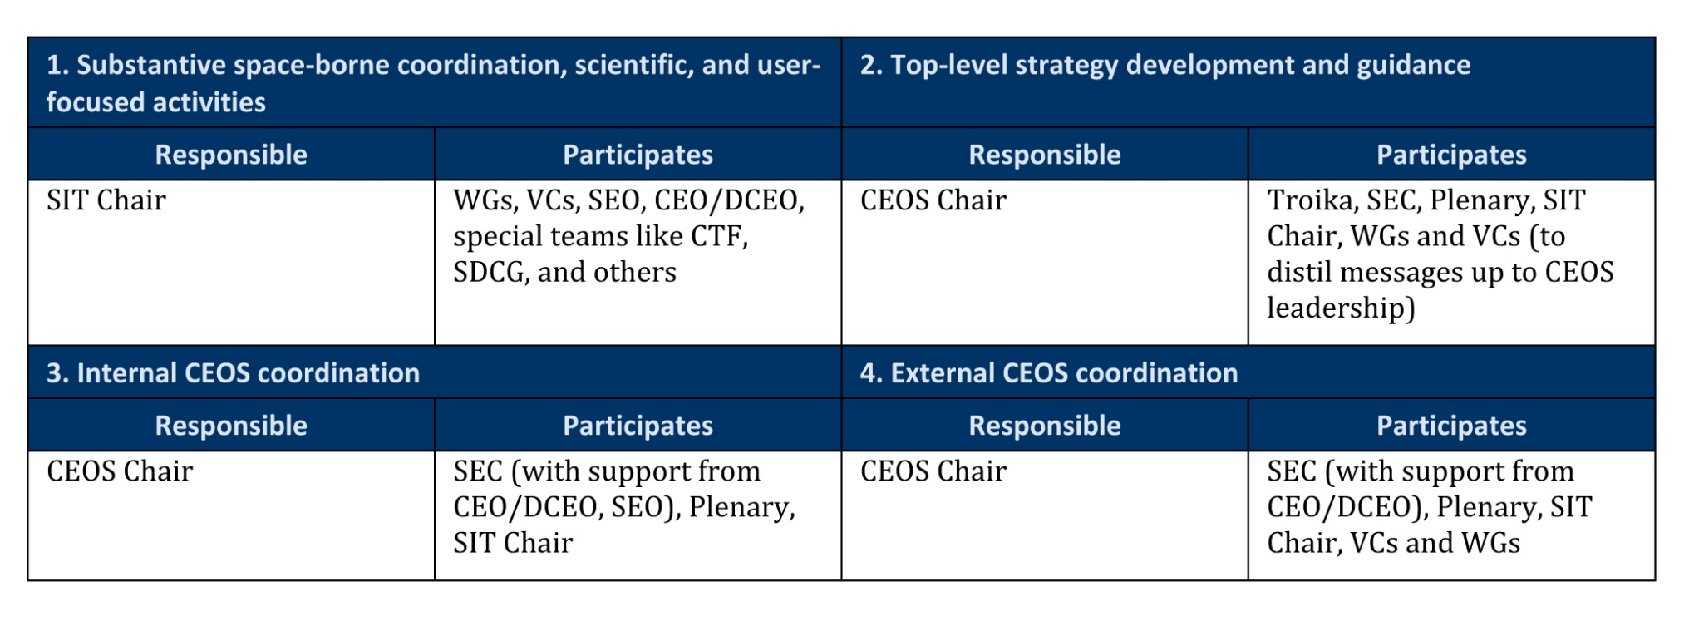
CEOS Core Business R&R
Top-level responsibilities were defined and agreed upon
at the La Jolla SIT-27 meeting:
CEO, DCEO, SEO are the only full-time CEOS officials
Working Groups, Virtual Constellations, SBAs
Identify both core business and roles/responsibilities
Utilize CSS, existing Terms of Reference

Slide 15
Decision-Making Processes Report
CEOS Self-Study: Key Recommendation on Decision-making and New
Initiatives
“Develop a process for reviewing and selecting new activities with
consideration for CEOS objectives and available resources.”
Charge: CEOS Decision-making Process:
Develop a suite of options for CEOS decision-making processes;
Identify needed governance requirements and responsibilities for
implementation of that process, addressing
a) selection of new projects and how to adjudicate among multiple
candidate projects when resources preclude doing all;
b) approaches for CEOS to decide whether a project is within our scope and
mandate, or would be better handled by another organization; and
c) criteria for sunsetting old projects when and if appropriate;

Slide 17
Study on Membership & Participation

Slide 18
Membership & Participation Study
Objectives:
To better understand why some CEOS members and associate members, including important CEOS partner organizations, are not currently participating in CEOS activities;
To propose concrete steps to encourage, empower and support full engagement in CEOS activities by the widest possible range of CEOS members.

Slide 19
Membership & Participation
The Study on Membership and Participation was initiated at the 2011 CEOS Plenary as part of the CSS implementation.
The Membership and Participation Team met via telecon over the first eight months of 2012.
Early results and a draft report were shared at SIT-27.
The final report containing findings and recommendations was shared prior to the 2012 Plenary.
The action requested of Plenary is to approve the report and implement approved recommendations.
The findings and recommendations from the Membership & Participation Final Report will inform the development of the CEOS Guiding Documents (Governance and Processes) as well as immediately influencing CEOS leadership actions.

Slide 20
M&P Team Members
Mark Dowell
Vivek Singh
Brent Smith
Tim Stryker
Patricia Jacobberger-Jellison (Chair)

Slide 21
M&P Study Approach
Extract relevant findings from the 2011 CEOS Self-Study Report (including Study Team Reports);
Obtain and synthesize input from M&P Team Members;
Coordinate M&P Study with CEO/DCEO/SEO efforts to update the CEOS contact database;
Assess CEOS membership list to understand distribution of active and inactive members (including associates), and prioritize for subsequent interviews;
Review past CEOS meetings minutes, attendance lists, and notes as an independent measure of broad member participation;
(Continued next slide)
Notes:
Extract relevant findings from the 2011 CEOS Self-Study Report (including Study Team Reports) (complete);
Obtain and synthesize input based on collective CEOS experience of M&P Team Members (complete);
Coordinate M&P Study with CEO/DCEO/SEO efforts to update the CEOS contact database (ongoing);
Assess CEOS membership list to understand distribution of active and inactive members (including associates), and prioritize for subsequent interviews (complete);
Review past CEOS meetings minutes, attendance lists, and notes as an independent measure of broad member participation (ongoing);
Develop questions and background material for conducting interviews (complete);
Re-establish contact with inactive members and conduct interviews (make new contacts where necessary) (ongoing);
Interview a selection of active members to better understand their reasons for being active in CEOS (ongoing);
Synthesize results and develop recommendations for consideration by CEOS leadership, including follow-up by CEOS leadership, and invitation to next Plenary (preliminary report here; final report to come).

Slide 22
M&P Study Approach:
Develop questions and background material for conducting interviews;
Make contact with selected inactive members to better understand their reasons for being inactive;
Interview a selection of active members to better understand their reasons for being active;
Synthesize results and develop recommendations for consideration by CEOS leadership, including follow-up by CEOS leadership, and invitation to next Plenary.
NB: A key recommendation of the M&P Final Report is for CEOS Leadership to initiate individualized, one-on-one contact with inactive members and associates in order to re-engage them.
Notes:
Extract relevant findings from the 2011 CEOS Self-Study Report (including Study Team Reports) (complete);
Obtain and synthesize input based on collective CEOS experience of M&P Team Members (complete);
Coordinate M&P Study with CEO/DCEO/SEO efforts to update the CEOS contact database (ongoing);
Assess CEOS membership list to understand distribution of active and inactive members (including associates), and prioritize for subsequent interviews (complete);
Review past CEOS meetings minutes, attendance lists, and notes as an independent measure of broad member participation (ongoing);
Develop questions and background material for conducting interviews (complete);
Re-establish contact with inactive members and conduct interviews (make new contacts where necessary) (ongoing);
Interview a selection of active members to better understand their reasons for being active in CEOS (ongoing);
Synthesize results and develop recommendations for consideration by CEOS leadership, including follow-up by CEOS leadership, and invitation to next Plenary (preliminary report here; final report to come).

Slide 23
Findings and
Recommendations

Slide 24
M&P Study:
Four Broad Themes
Contact management
Alignment of CEOS with particular members’ agency or organizational goals
Institutional barriers and impediments
“Invisible Participation”
Notes:
Preliminary analysis of the CEOS membership list, supported by M&P members’ insights and recollections, reveal a wide range of reasons why members become inactive. These reasons can be divided into four very broad categories:
Contact management
Alignment of CEOS with particular members’ agency or organizational goals
Institutional barriers and impediments
“Activity with invisibility”

Slide 25
Contact Management:
Issue:
Individuals Move or Retire & Institutional Contact is Lost
Recommendation:
Establish Secondary Points of Contact where lacking
Work to support CEOS visibility to members at organizational levels
Make it easy and routine for members to provide contact updates
Notes:
On one end of the spectrum, individuals retire and/or move into different agencies or roles, and the connectivity to CEOS is lost when they do so unless there is a known secondary point of contact and/or institutionalization of the membership, including a shared sense of the benefit of CEOS membership within the agency in question.
Given the dynamic nature of membership and participation, especially in a completely voluntary/participatory organization like CEOS, routine contact management will always be a challenge. In the very short term, this challenge can be ameliorated through establishment of both primary- and secondary points of contact wherever possible. In the longer term, CEOS may wish to look at ways to ensure that member organizations will realize benefit from active participation in CEOS, so that CEOS is valued at an institutional level in member organizations.

Slide 26
Alignment of CEOS with Institutional Goals or Objectives:
Issue:
Members may join/become active to participate in a specific, time-limited activity, after which their participation ends or reduces
Recommendations:
Understand this as a positive organizational dynamic
Facilitate and encourage continued involvement by understanding and articulating the value proposition of CEOS to member organizations
CEOS Leadership should initiate one-on-one contacts with inactive members to re-engage them
Notes:
At the other end of the spectrum, examination of the patterns of membership activity showed that seven or eight currently-inactive CEOS members joined CEOS to participate in a very specific activity – IGOS – and when that activity drew to a close, so did their participation in CEOS. Those members are now active in GEO, but they did not remain active in CEOS (this is especially pertinent for UN organizations). Of this latter group, there is a sense through casual conversation that they remain supportive of CEOS even though they no longer participate directly.
As CEOS takes on new activities, it may be expected that similar patterns could recur, and any such “loss” of active members should not necessarily be viewed as a negative; in contrast, it can be construed as beneficial if CEOS is viewed as a group where other organizations can gather at will to accomplish specific goals that are relevant to them. No value judgment is made here as to which is the correct course. However, if CEOS should decide that it is important to re-activate members who participated for a particular goal, purpose, or activity, CEOS will need to be able to articulate and demonstrate to those organizations the value proposition of CEOS, i.e. not just the benefit to CEOS of having these members engage, but the benefit that accrues to a member agency or organization through its participation in current CEOS activities.
In order to better understand this aspect of membership and participation, it is essential that the M&P Study not only reach out to inactive members, but also to include conversations with members who have remained active, especially among smaller agencies and organizations, to understand the value that they place upon CEOS membership. This is the activity alluded to in Step 8 of the “Approach” section above.

Slide 27
Institutional Barriers and Impediments:
Issue:
Lack of resources (travel funds, personnel to devote to CEOS activities) is an ongoing challenge to members
Recommendations:
Continue leveraging major meetings with side meetings
Continue using telecons where possible
Continue exploring the use of telecommunications technology for virtual meetings
Notes:
Lack of resources to come to meetings and participate in activities is a known challenge for some members and associates. Travel funds are chronically limited, and smaller organizations also have limited human resources to devote to the business of an organization like CEOS. In the current world budget climate, it is likely that resource constraints will remain a considerable challenge for many if not all CEOS members, as they do for other consultative and professional organizations as well.
CEOS already conducts monthly Secretariat meetings via telecon, and CEOS leverages its in-person major meetings through the inclusion of VC, Working Group and other side meetings. In the short term, CEOS may also wish to develop new ideas and to look at ways to increase the use of other successful mechanisms, including greater use of telecommunications technology, and/or holding side meetings at appropriate international conferences.

Slide 28
“Invisible Participation:”
Issue:
Strong anecdotal evidence suggests that members active at particular working levels but not Plenary are overlooked as a whole
Recommendations:
CEOS must recognize and value the contributions of members who participate in only those parts of CEOS that are of relevance to them
Consider instituting a policy of recording attendance and participation for all working level activities to ensure that participation is not overlooked
Establish a central repository for attendance lists so that participation is more readily visible to CEOS leadership
Notes:
There is anecdotal evidence that some members / associates are active in working groups and possibly other working-level interactions and activities, but not at the Plenary level, and there is strong anecdotal evidence that such participation tends to be overlooked when CEOS talks about membership and participation. A better assessment on the extent of such participation will be forthcoming when the review of past meeting notes, minutes, and attendance lists is complete (although as a caveat, the existence of those materials is itself incomplete, so a perfectly clean dataset is not possible at this time).
In any case, it is crucial that CEOS recognize and value the contributions of members who participate in only those parts of the organization that are of relevance to them. An immediate step that CEOS could take to ensure that there is no “activity with invisibility” would be to institute a policy going forward of recording who participates in any and all CEOS meetings, including Plenary, SIT, Working Groups, Virtual Constellations, SBAs, and any associated groups, and establishing a central repository for meeting notes and attendance lists so that the information is accessible to CEOS leadership. It would also be valuable to CEOS if members were to take an action to ensure that existing past lists currently held in disparate locations be gathered and placed in that repository. A complete list of annual participation would also help to support the ongoing efforts of the CEO/DCEO/SEO to maintain up to date contact information.

Slide 29
O
DISCUSSION
Overall Approach
Priorities and Initiatives
Essential Questions

Slide 30
Deciding New CEOS Projects
CEOS needs a formal decision-making process to choose new projects, recognizing the need for ensuring quality, integrity, and timeliness of deliverables, and accommodating realistic estimates of CEOS capabilities and resources
The decision-making process must also address how we determine which activities are within CEOS’s scope, vs. those better done by other bodies
.
Similarly, since decisions are taken by general acclamation, the status of activities that do not receive unanimous support must be unambiguous.
Because of the scope and impact of this topic, and the diversity of opinion regarding solutions to it, it is crucial that we develop options for consideration, rather than a single closed-form solution, to be deliberated by the Plenary.
We should draw as needed upon the CEOS Self-Study Synthesis Report and Annexes as well as other CEOS documentation

Slide 31
Essential Questions

Slide 32
Essential Questions
Initial Essential Questions were proposed at the 2011 CEOS Plenary.
Additional Essential Questions were proposed by CEOS members and associates at and after SIT-27.
The list of all Essential Questions submitted was distributed and posted as CSS Blog #3.
The request to Plenary is to approve the list of questions.
The next step after approval will be to develop answers to the questions, using input from CEOS members and associates.
The answers to the CEOS Essential Questions will inform the development of the CEOS Strategic Documents.

Slide 33
Essential Question #1:
What are CEOS’s scope and purpose?
  Does CEOS conduct sustained, long-term, routine data provision, or does it demonstrate feasibility of space measurements and spin off long-term operations to other groups?
  Does CEOS develop actual “CEOS Satellites” as opposed to its coordination role in developing requirements, Virtual Constellations and providing multi-lateral coordination of satellite systems?

Slide 34
Essential Question #2:
What is the Value of CEOS to others, and how do others view, support, and engage with CEOS?
  Internally, what benefits, tangible or otherwise, does an organization gain through active CEOS membership?
  Externally, what benefits, tangible or otherwise, do governments, society, and users/partners gain through the existence of CEOS?
  In both cases, how does CEOS ensure that those benefits are commensurate with the level of investment (in time, human capital, financial commitments)?

Slide 35
Essential Question #3:
What are CEOS’s essential relationships and outcomes?
  What are the most valuable external relationships that CEOS maintains or should maintain?
  What are the most valuable outcomes that CEOS provides and/or enables for its user communities?
  How would CEOS’s mission & goals be affected if key stakeholders or partners were substantially changed, or if they ceased to exist?

Slide 36
Essential Question #4:
  What factors or scenarios pose the greatest risk to CEOS’s ability to achieve its objectives?

Slide 37
Essential Question #5:
  What factors or elements are absolutely essential to ensure that CEOS is a vital, well-functioning organization?

Slide 38
Essential Question #6:
  How does CEOS define, and evaluate strategic success in meeting its objectives and its specific activities?

Slide 39
BACKUP

Slide 40
Schedule (1)
2012
  Continue to produce on existing CEOS substantive activities
  Conduct Membership Task Force Study – implement resulting process
  Continue, expand, and refine Meeting Objectives clarification and implementation
  Address and answer “Essential Questions” (definition of success, scope of CEOS, …)
  Use utmost discipline to limit adoption of new CEOS substantive activities/objectives
  Identify and task teams to write the 3 Guiding Documents
  Possibly initiate Strategic Guidance Document

Slide 41
Schedule (2)
2013
  Continue to produce on existing CEOS substantive activities
  Continue Membership Task Force implementation
  Continue Meeting Objectives clarification and implementation
  Produce, evaluate, and adopt 3 Guiding Documents:
    Strategic Guidance Document
    “CEOS Governance and Processes”
    Work Plan (3-year longevity, updated annually)
    Adopted at 2013 CEOS Plenary

Slide 42
CSS Major Themes
Five major themes emerged through the 2011 CEOS Self-Study:
    CEOS Strategic Objectives -> Essential Questions
    Decision-making and New Initiatives
    Organizational Functions
    Membership and Participation
    Objectives of Meetings
These were accepted as topics for action/implementation.

Slide 43
Response: Study on Membership and Participation
Status: Complete
Timeline:
Study initiated - Plenary 2011
Preliminary report presented - SIT-27
Input solicited from selected members and associates - Aug-Sep 2012
Final report circulated - October 2012
Report presented for adoption - Plenary 2012
Q: How did WGs, VCs & others engage?
A: CSS Study Team Reports were inputs to frame & guide the study.

Slide 44
Phase 1: Develop Options
Timeline: Plenary 2011 through SIT-28

Slide 45
Response: CEOS Essential Questions
Status: Underway
Timeline:
White paper circulated and questions identified - SIT-27
Questions circulated / input to draft answers solicited - September 2012
Draft answers circulated - October 2012
Discussion and decision - Plenary 2012
Q: How can CEOS membership engage?
A: Members/associates are strongly encouraged to provide input into draft answers.

Slide 46
Response: Structure and Governance 1 & 2:
Top-Level Responsibilities, and Essential Business & Core Activities
Status: Part 1 = complete. Part 2 = beginning
Timeline:
White paper posted - September 2012
Team Leadership and initial members identified - SIT Tech 2012
Draft Options developed - Sep - Oct 2012
Preliminary draft options presented - Plenary 2012
Options presented for selection / adoption - SIT-28

Slide 47
Response: Study on Options for a CEOS Decision-making Process
Status: Beginning
Timeline:
White paper posted - September 2012
Team Leadership and initial members identified - SIT Tech 2012
Draft Options developed - Sep - Oct 2012
Preliminary draft options presented - Plenary 2012
Options presented for selection / adoption - SIT-28

Slide 48
10 SEPT WORKSHOP SESSION SUMMARY
Working-level discussions, reports on key substantive topics
  Decision-making processes
  Organization, Roles and Responsibilities (2nd-level)
  Meeting purpose/cadence/structure
Approach for further working-level developments (REPORTS TO INFORM DOCUMENTS)
  2 co-chairs for each topic, initial committee volunteers
  Interim committee status at CEOS Plenary in Bangalore
  Discussions/workshop/reports at SIT Actions Meeting, Jan 2013; final discussions/submissions at SIT-28
  Consideration of additional workshops in association with CEOS meetings
Document Approaches
  SIT-led steering group for each document
  Informed by reports, Plenary-level discussions (not necessarily only held at CEOS Plenary)
  Professional writer (no content decisions, organizational/copy-editing skills)
  Complete in time for broad dissemination before, and adoption at, 2013 Plenary

Slide 49
Overview - Principles
CEOS continues to be a productive, active, important, and strong organization
CEOS’s ongoing and substantive coordination, scientific, and applications-/user-focused activities will not be curtailed as we address Self-Study recommendations
All proposed organizational and governance changes will be placed before the existing CEOS Plenary for concurrence
The organizational and process changes arising from the Self-Study will be accomplished by November, 2013
  CEOS leadership positions filled in the interim will be based on the present organization/process, with re-evaluation by the incumbents upon CEOS Plenary adoption of any governance changes

Slide 50
Organizational Functions Report
CEOS Self-Study: Key Recommendations on Organizational Functions
“Articulate the organizational functions and relationships that CEOS needs in order to
perform and sustain its work, and consider whether modification of the leadership
structure and organizational elements is needed to support these functions. Clarify
roles and responsibilities for CEOS Leadership at all levels.”
Charge: CEOS Essential Business/Core Activities:
Identify the main responsibilities of the CEO, DCEO, SEO, Working Groups, Virtual
Constellations, and SBA Coordinators, using the information gathered in the CEOS
Self-Study and Annexes, and to highlight areas where responsibility is
a) unclear,
b) overlapping, or
c) where there are important areas where no one has responsibility; and
Develop a suite of options for addressing unclear areas, overlaps, and gaps.

Slide 51
REPORTS/COMMITTEES
Organization, Roles, Responsibilities (2nd –level)
  Kerry Sawyer, Paul Counet – Co-Chairs
Decision-making processes (priorities, adjudication of new initiatives, new sub-organizations)
  Tim Stryker, Steven Hosford – Co-Chairs
Meetings (annual cadence, structure/objectives, virtualization(?))
  Ivan Petiteville - Chair
Options, not point solutions
Based on CSS Report and Annexes – not full new studies
Reports will inform the Documents

Slide 52
Organizational Functions:
Clarifying Roles and Responsibilities
CSS recommendations regarding deficiencies in the current structure arise from a lack of specificity in the responsibilities of the present CEOS sub-organizations
  CEOS Plenary
  CEOS SIT
  CEO
  WG, VC, SBA Teams, SEO
  We have evolved to a focus on “who participates in CEOS activities,” without specifying “what sub-organization is responsible for carrying out the activity.”
We must assign responsibility for each of the 4 basic activities that span the range of CEOS endeavors:
  Substantive space-borne coordination, scientific, and user-focused activities (“CEOS Contributions/Accomplishments”)
  Top-level strategy development
  Internal CEOS coordination
  External CEOS coordination

Slide 53
Membership and Participation Issues
CEOS is a volunteer organization with more objectives and aspirations than resources
Our objective must be to maximize the contributions and sustained, constructive participation of all members/associates, not to limit the involvement only to those who are contributing and participating at a high level
We must focus on ENGAGING, EDUCATING, and EVALUATING members, especially those who are new or participating at a sub-optimal level
CEOS SIT has convened an ad hoc task group to address this issue (overseen by Pat J-J)

Slide 54
Timeline:
Dec 2011 | Convene M&P Team
Jan – Mar 2012 | M&P Team Telecons & Fact-Finding
Late Mar 2012 | “First Look” Report at SIT-27
Apr – July 2012 | Team telecons continued
Aug – Sept 2012 | Synthesis of Results
October 2012 | Presentation of M&P Final Report
Notes:
The goal was to have preliminary results ready for distribution prior to SIT-27. This initial report contains the approach, statement of progress and outcomes of study team deliberations and information-gathering efforts. An important component of the M&P study is the collection of direct information from inactive members through a sequence of interviews, which is a process that takes time. In order to balance SIT-27 schedule constraints against the time required to develop thoughtful questions and conduct interviews with inactive members and other sources of input, the work of the M&P Team will continue after SIT-27, and this initial report will be followed by a final report at the conclusion of the interview process.

