Slide 1
CEOS Executive Officers Report
2012 and Beyond
T. Stryker and K. Sawyer

Slide 2
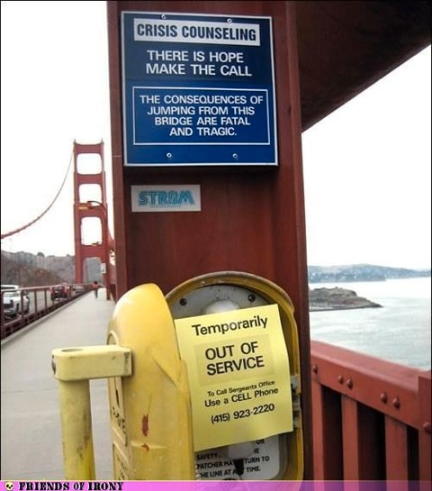
Your CEO Team -- 24/7….
…. a Phone Call Away
Failure is Not an Option!

Slide 3
Anticipated 2012 Accomplishments:
A Macro View
Continuity of effort across all major lines of activity (external and internal)
Support enhanced strategic focus of key CEOS leadership meetings and related long-term priorities
Maintain strong CEOS support to GEO under its new Work Plan
Support implementation of priority CEOS Self-Study recommendations (as agreed by CEOS leadership)
Maintain insight into key CEOS community needs and priorities, and assist as time/capacities allow

Slide 4
Actual 2012 Accomplishments:
A Micro View
Liaison, Advice, and Deliverables for CEOS Leadership
CEOS Chair , SIT Chair, and SEO (weekly)
Secretariat teleconferences and related actions (monthly)
WGs, VCs, SBA Teams, Troika, ad hoc groups (routinely)
CEOS Work Plan development and coordination
Develop Timetables for action; coordination with key CEOS Task/Action Leads
Ensure successful implementation of CEOS Priority activities
CEOS coordination with external stakeholders and CEOS POCs
Group on Earth Observations
Secretariat Director and Expert Staff
CEOS representation to GEO Implementation Boards/Task Forces
GEO Work Plan liaison/coordination, actions tracking and reporting
GEO Post-2015 organization and priorities
Other key stakeholders
UNFCCC and GCOS
WCRP
UN CBD
(UN ISDR)
Regular reporting, editing, and analysis

Slide 5
Current and Future Challenges
Accretion of duties as dedicated (full/nearly-full time) CEOS representatives
Due diligence in supporting ongoing and new CEOS priorities
Managing evolving relationships with key stakeholders
Careful delineation of CEOS leadership roles/responsibilities
Continued evolution of interactions with major stakeholders
Evolution and Institutionalization of CEO Role

Slide 6
Decisions Sought/Way Forward
Full CEOS leadership engagement/resourcing for all CEOS organizational elements
Maximize Value of WGs and Impact of VCs
Coordination of EO missions
Maximize EO data sharing and applications development
Increase CEOS membership participation to maintain/enhance CEOS capacity
Continued importance of dedicated “CEOS staff”
Systems Engineering Office
Executive Officer (and Deputy?)
Clarity in roles/responsibilities vis-à-vis other CEOS contributors
Long-term stability and credibility of CEOS

Slide 7
It is a pleasure working with so many dedicated and professional colleagues in CEOS. Thank you for all your time, expertise, and leadership!

