Slide 1
Big Data and Cloud Initiatives at NOAA
Kenneth S. Casey: Deputy and Acting Director, NCEI Data Stewardship Division
Ed Kearns: NOAA Chief Data Officer
Jeff de la Beaujardiere: NOAA Data Management Architect
Eric Kihn: Director, NCEI Center for Coasts Oceans and Geophysics
Future Data Architectures Big Data Workshop
National Oceanic and Atmospheric Administration

Slide 2
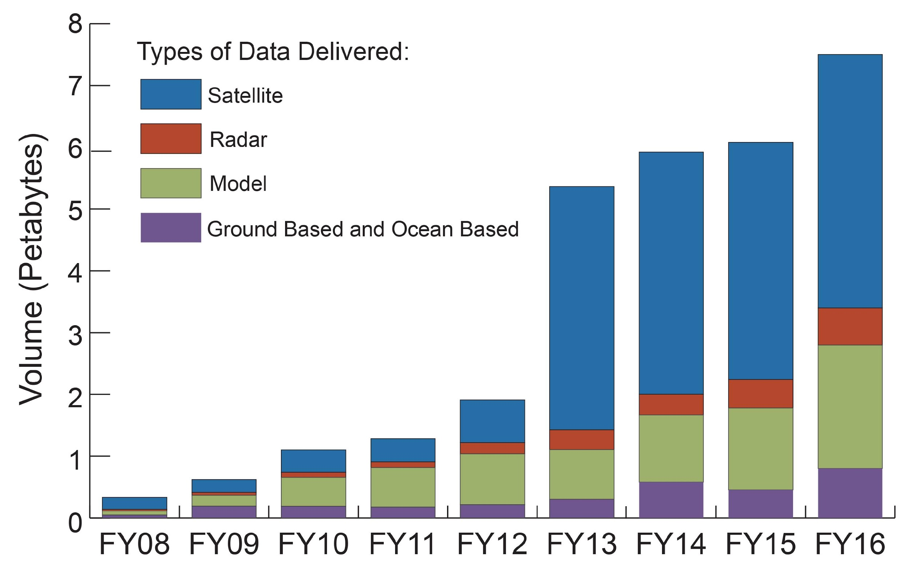
NOAA’s Big Data Challenges - Data Access

Slide 3
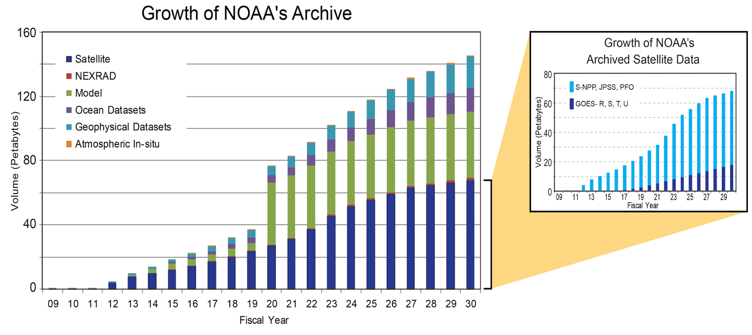
NOAA’s Big Data Challenges - Archive Growth

Slide 4
NOAA’s Big Data Challenges - Diversity
NOAA collects, maintains, analyzes, produces, and serves a tremendous variety of data
From the surface of the sun to the bottom of the sea, and everything in between
From ships and satellites and radar and divers in the water and drifting buoys and autonomous platforms and …
Over 65,000 collections in our catalog with billions of data granules, provided by thousands of organizations, spanning centuries and the globe...

Slide 5
So What Are We Doing About It?

Slide 6
Getting Organized and Getting Started

Slide 7
Getting Organized
NOAA Environmental Data Procedural Directives
Data Management Planning
Data Access
Data Documentation
Data Citation
NOAA Procedure for Scientific Records Appraisal
Data and Publication Sharing for Grants, Coop. Agreements, and Contracts
NOAA Data Catalog and OneStop
https://data.noaa.gov/onestop
NOAA Environmental Data Management Community
EDM Committee, EDM Workshops, Line Office Data Management Working Groups
Open Data Framework...

Slide 8
We Are Making Big Data FAIR
F
A
I
R
Findable
Accessible
Interoperable
Reusable
AGU FAIR Data Principles

Slide 9
NOAA’s Open Data Framework^{30,000 ft}
Data Producers and Operators
Data Managers and Data Scientists
Data Consumers and the Public
Data Ingest Services
Data Management Services
Data Access Services
Data Collection
Data Storage and Processing Services

Slide 10
NOAA’s Open Data Framework^{30,000 ft}
Data Producers and Operators
Data Managers and Data Scientists
Data Consumers and the Public
Data Ingest Services
Data Management Services
Data Access Services
Data Collection
Data Storage and Processing Services
Data Storage and Processing Services
Data Storage and Processing Services

Slide 11
NOAA’s Open Data Framework^{30,000 ft}
Data Producers and Operators
Data Managers and Data Scientists
Data Consumers and the Public
Data Ingest Services
Data Management Services
Data Access Services
Data Collection
Data Storage and Processing Services

Slide 12
So the cloud has a lot of appeal, but how do we get started and make it a reality?

Slide 13
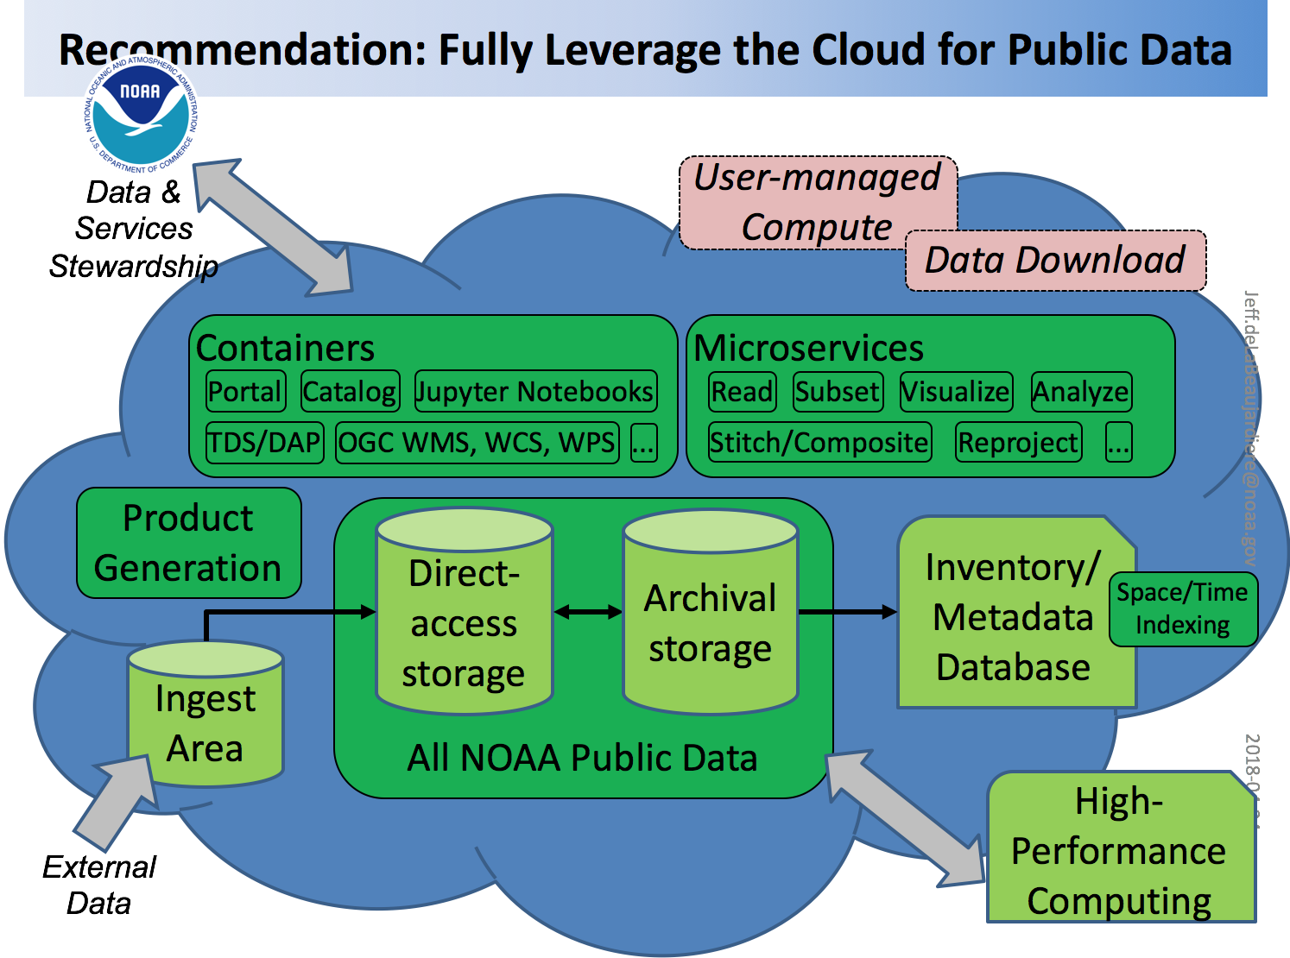
Emerging detailed view, fresh from this week’s NOAA EDM Workshop
Not just containerizing VMs but looking at “microservices” and cloud-native capabilities

Slide 14
Getting Started: NOAA Cloud Projects
Google Mail/Calendar/Drive
NOAA Cloud Sandbox
AWS and Azure Blanket Purchase Agreement
Cloud Pilots at NCEI
NESDIS Secure Ingest Gateway Pilot
CLASS Backup in AWS Glacier
NESDIS Cloud Strategy development
NOAA Big Data Project
NCEI = National Centers for Environmental Information
AWS = Amazon Web Services
CLASS = Comprehensive Large Array-data Stewardship System

Slide 15
Big Data Project
Experiment with Industry via Cooperative Research and Development Agreements
5 separate, identical agreements – extending to Apr 2019
Industry provides access to NOAA’s open data to all users
Data remain open, are not to be sold
Collaborators monetize services based on data
Uses open data to combine 3 powerful resources:
NOAA’s science and subject matter expertise
Industry’s data storage and cloud expertise
Industry’s user-focused tools and processing

Slide 16
NOAA
Data Expertise
CRADA Collaborators
Infrastructure Expertise
BDP
Ecosystem
End User
Wider Consumer Community
Third Party Partner
Value-Added Services

Slide 17
Augmentation,
not replacement
of services
Fair and Level
Access
Leverages
expertise of
NOAA and
industry
No Net Cost
to Taxpayers
Data remain
free and open
Collaborators
monetize services,
not data
Leverage the value of NOAA’s data to increase their utilization

Slide 18
Uses
Information Consumers
Decision Support Tools
3rd Parties
Cloud Platforms
NOAA Data and Expertise
18
Industry Builds What It Needs to Support Its Users

Slide 19
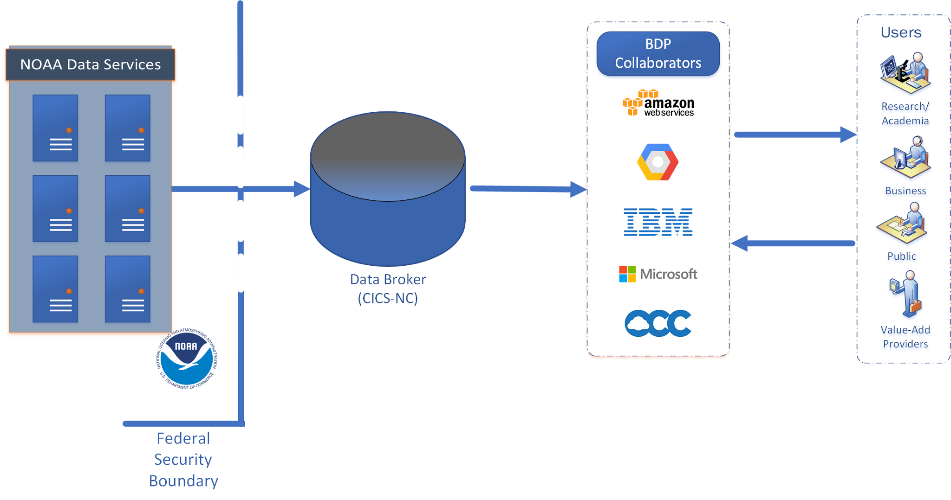
Leveraged a Data Broker
Improves Cybersecurity Posture and Facilitates Data Upload
One-to-Many, Limited by Cloud Infrastructure Only
One-way transfer out of federal systems. Only trusted users inside security boundary
Distributing a single copy of data can support all users. Reallocate resources to support the mission
Notes:
Improving NOAA's Cybersecurity Posture
Currently: Users access federal systems for distribution
Some mission-critical systems offer public access to data
External users have access inside federal security boundary
Potential: All data access occurs in non-federal system
Reallocate security assets and staffing to focus on mission-critical systems
Only verified trusted users granted access to federal systems

Slide 20
Big Data Project
Collaborators’ Offerings
35+ NOAA datasets are now available
AWS
https://aws.amazon.com/noaa-big-data/
Google Cloud Platform
https://cloud.google.com/bigquery/public-data/
https://explorer.earthengine.google.com/#index
IBM
https://noaa-crada.mybluemix.net/
Microsoft
No public services to date
Open Commons Consortium
http://edc.occ-data.org/

Slide 21
There is measurable, latent demand
for NOAA data
Access to NOAA data files on cloud platforms has resulted in increased usage of NOAA’s data
Exchange of expertise is critically important
Integration of NOAA data into industry tools is most effective

Slide 22
Increased Usage of NOAA Data via BDP
NEXRAD on AWS stats (270 TB)
2.3x increase in usage over past
Redirected orders from NOAA to AWS as option
Ansari et al, BAMS 2017
GHCN-M and GSOD on Google (< 0.1 GB)
800,000 data requests between Jan and Apr 2017
1.2 PBs of data delivered, ~10-100x increase
No redirects - completely organic utilization!
GSOD = Global Surface Summary of the Day
GHCN-M = Global Historical Climatology Network-Monthly
Notes:
NCEI’s total dissemination volume is around 2.4 PB/quarter. This has increased ~0.5 PB/quarter over last year.
GSOD = Global Surface Summary of the Day
GHCN-M = Global Historical Climatology Network-Monthly

Slide 23
Cloud platforms provide significant advantages for public access
Vastly improved level of service for users:
Essentially unlimited access capacity
Substantially faster, in many cases
Translation of earth science data to more readily consumable forms
Better Cybersecurity posture for NOAA systems immediately realizable - use “data broker”
Reduced loads on NOAA systems

Slide 24
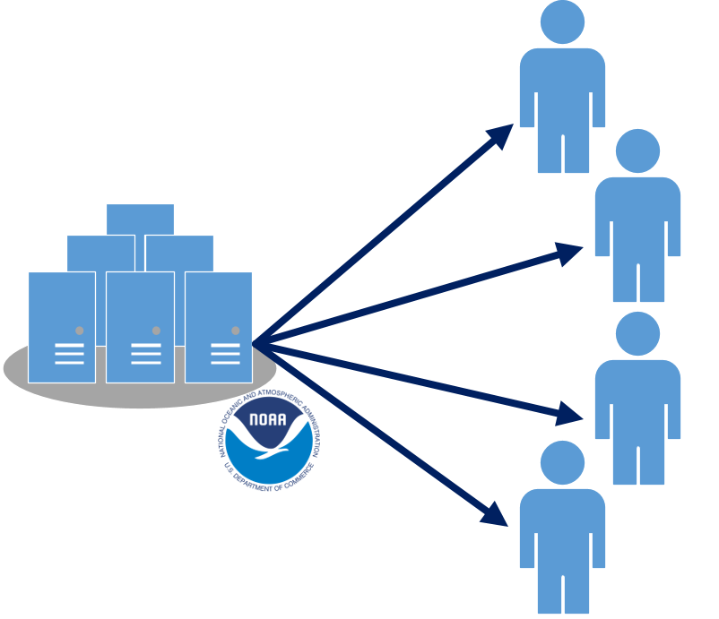
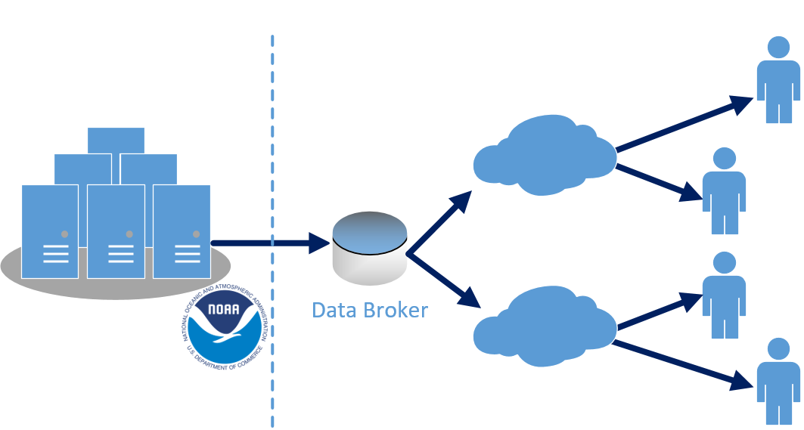
Advantages of
Cloud Platforms
Scalability | Cutting-Edge Tools
Surge capacity without unnecessary cost | Tools reduce barriers to data utilization
NOAA Wins | End User Wins
Reduced Server Burdens | Faster time to utilization

Slide 25
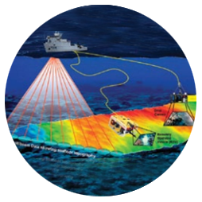
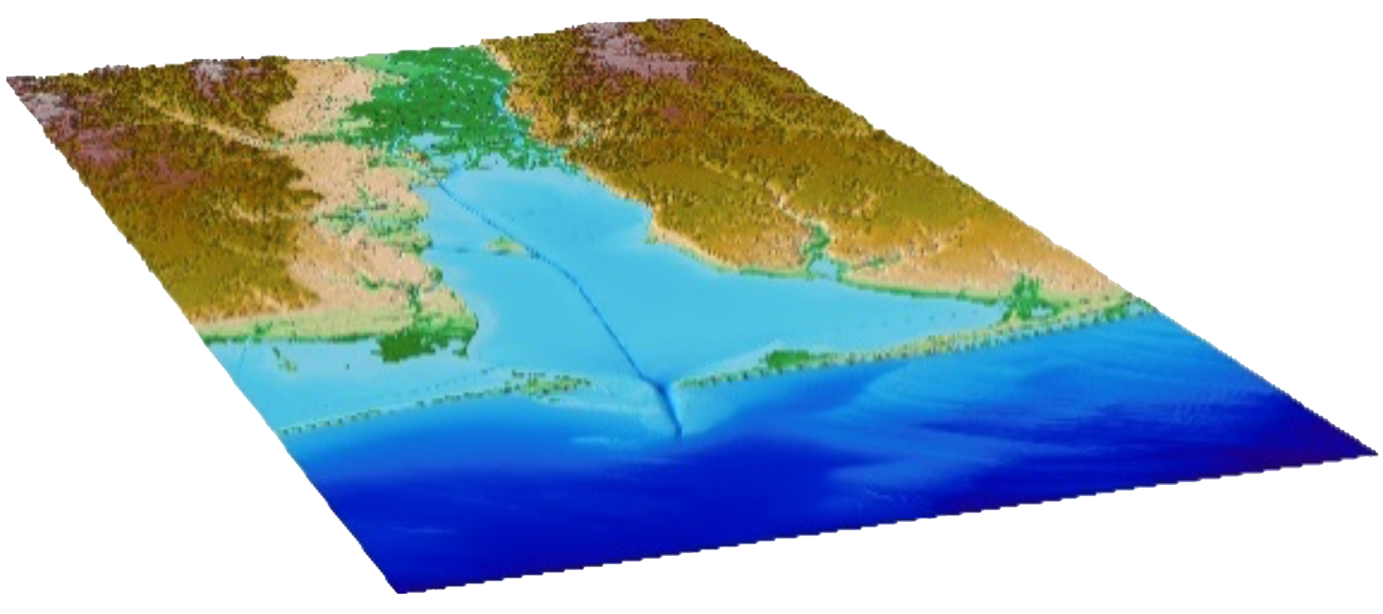
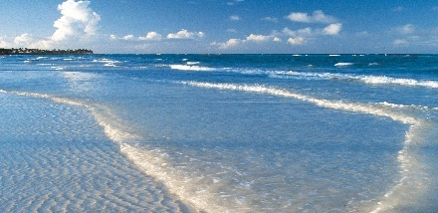
NOAA/NCEI Example:
Cloud Could Improve “Last Mile” Efforts
FUNDAMENTAL DATASET (bathymetry)
INTEGRATE
ENHANCE
ASSESS
PRODUCT/SERVICE
Shoreline
Topographic
Bathymetric
Convert to common datums
Assess the datasets for quality and accuracy
Data cleaning
Build and evaluate the DEM
Coastal Digital Elevation Model (DEM)
BENEFIT TO THE NATION
National Ocean Service
Help mitigate coastal hazards and improve community preparedness
PRESERVATION

Slide 26
BDP Lessons Learned
1. Totally free storage and distribution for all users and all NOAA data through partnerships with industry is not sustainable under the current model
Access versus Dissemination
2. The key asset that NOAA brings to the BDP is not its data, but its expertise to understand and support the data
Notes:
The Collaborators are all employing different business models that offer realistic options for a future sustainable strategy.

Slide 27
More Lessons Learned
3. NOAA owns data quality and must provide continuous and reliable stewardship of the data it is publishing to the Collaborators’ systems for the BDP to succeed
4. A defined commitment and level of service are needed by both NOAA and the Collaborators to support their respective business models, including the “data broker” role
Notes:
Someone has to do the labor of translating the data and then loading the data into the tools, but it may not matter who does it.
The CRADA has proven to be a good venue to discuss new tools and approaches that may be applied for utilization of the data.

Slide 28
Future Directions of the BDP
NOAA is concluding the CRADA / Experimental Phase of the project in Apr 2019.
All BDP Collaborators are still engaged.
Gathering requirements from inside NOAA.
What is the proper business model to sustain the Partnerships & public data access on the commercial cloud?
What is the optimal service model?

Slide 29
Big Data Project Summary
The Big Data Project works with its CRADA Collaborators to publish NOAA data to their platforms
The Collaborators provide services to enable data use
Though available stats are limited, the BDP has seen increases in data usage from 2 to 100 times
The BDP is exploring how to effectively scale the value of NOAA subject matter experts by leveraging Collaborators’ tools, in which the data are most understandable and usable
Notes:
Before
researchers could not have tahe entire dataset usable in one place
retrospective data were found in one place, realtime in another
realtime data access required special links, relationships, and/or payment
had to use smaller chunks (limited time, limited places) to develop new ideas
had to move 10’s of TB across networks, and store them somewhere
had to maintain their own compute power to utilize the data
statistical or probabilistic products were incomplete, not as accurate
could not develop comprehensive products easily (e.g. CONUS-wide)
industry did not have equal access to government data
NOAA researchers had advantageous access
After
All data -- old to new -- available for free, in one place
can use all available data to develop new ideas
no need to move any data at all across networks
processing and visualization resources on AWS are integrated with storage
Can develop comprehensive, accurate statistical and probabilistic products
industry has equal access to government data
all industry, public, academic have equal access to the government data

Slide 30
Wrap Up
NOAA has Big Data challenges, by every definition of the term
We are addressing these challenges by getting organized, and getting started
Building a NOAA Environmental Data Management Community and an Open Data Framework…
...With the commercial cloud as a clear part of that future
Cloud pilots, cloud strategy plans, and the Big Data Project leading the way
Lessons learned will guide operational cloud deployments

Slide 31
Any Questions?
Kenneth.Casey@noaa.gov +1-301-713-4849

Slide 32
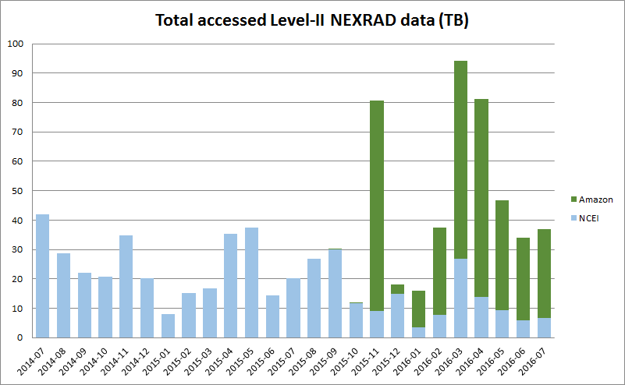
NEXRAD Weather Radar Data
start BDP
TB accessed
AWS
NOAA
AWS: Oct ‘15 https://s3.amazonaws.com/noaa-nexrad-level2 (1991+)
OCC: Jun ‘16 http://occ-data.org/NOAANEXRAD/ (2015+)
(S. Ansari et al, 2016)
Notes:
Archived NEXRAD data are mostly optimized for preservation, not access and utilization (except in some select cases)
The utilization of entire NEXRAD archive never before realized
All NEXRAD data are publicly available, but difficult to use
unwieldy size (270 TB compressed, 850 TB uncompressed) and specialized format (radial volume scan files)
reside on NOAA’s tape archive, relatively slow to access
Many industry users of both realtime and archived NEXRAD data
Multiple derivative uses possible - hail, rain, snow, tornados, etc.
NOAA had recently reprocessed 2001-2012 NEXRAD Level-II
half of the dataset still resided on disk at the
Cooperative Institute for Climate and Satellites in NC (CICS-NC)
easy to jump-start initial delivery

Slide 33
Big Data Project Methodology
01
Business Discovery
CRADA Collaborators & any Third-Party Partners work together to identify datasets of interest & develop business cases
BDP
02
Initial Technical Discussion
Develop a strategy for data delivery from NOAA to BDP Collaborators
03
In-Depth Data Discussions
Engage NOAA SMEs, BDP Collaborators for technical interchanges
04
Product Development
Collaborators and their Partners create services
Develop markets & financial opportunities based on NOAA data
Generate revenue and profits
05
Augmented NOAA Services
NOAA continues all of it’s existing data services
No interruption of existing services to customers, but new options
BDP activities are an augmentation of existing services

