Slide 1
Digital Earth Australia
Dr Trevor Dhu
Program Director Digital Earth Australia
Notes:
1. Operational objectives of the initiatives
2. Achievements so far (e.g. new enriched services provided, improvement of performances, new users, etc.)
3. High-level operational issues and how they are addressed including
a. Mitigation of lock-in risk
b. Economic benefit targeted/achieved
c. Characteristics of contractual agreements used
d. Risk sharing approach pursued
e. Business models of commercial partners – additional services

Slide 2
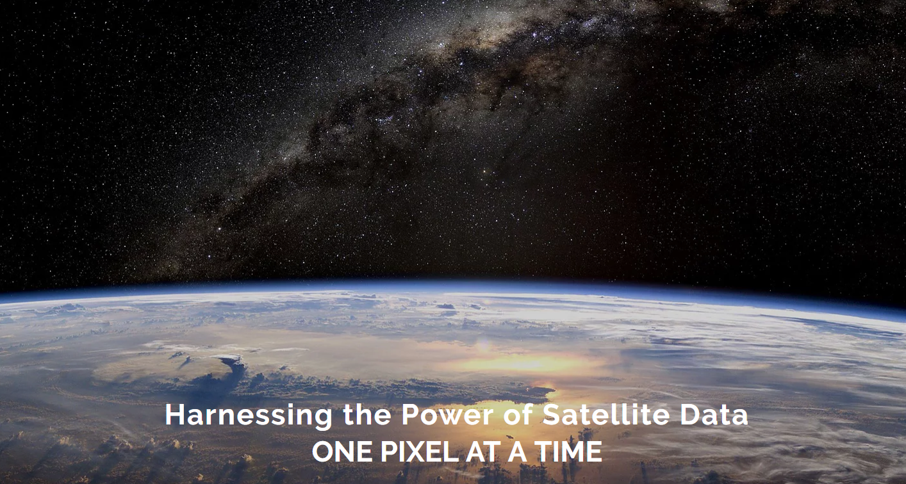

www.opendatacube.org

Slide 3

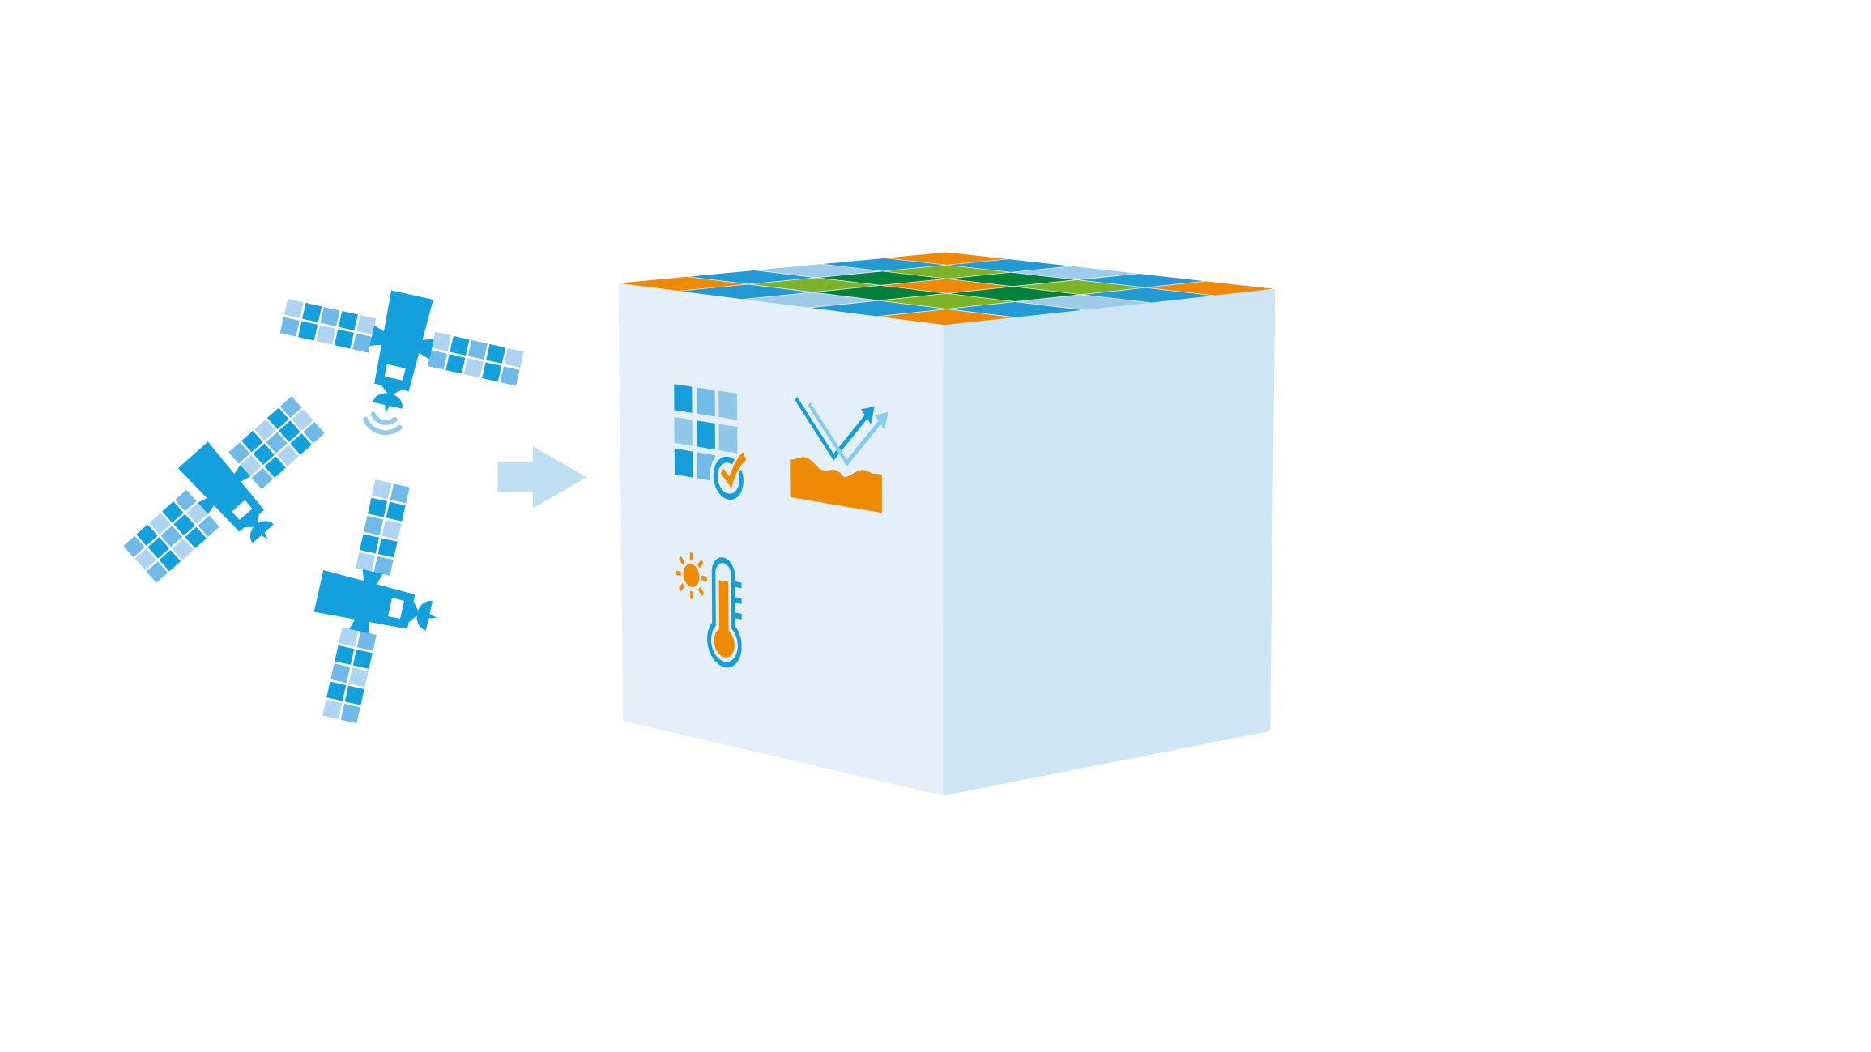
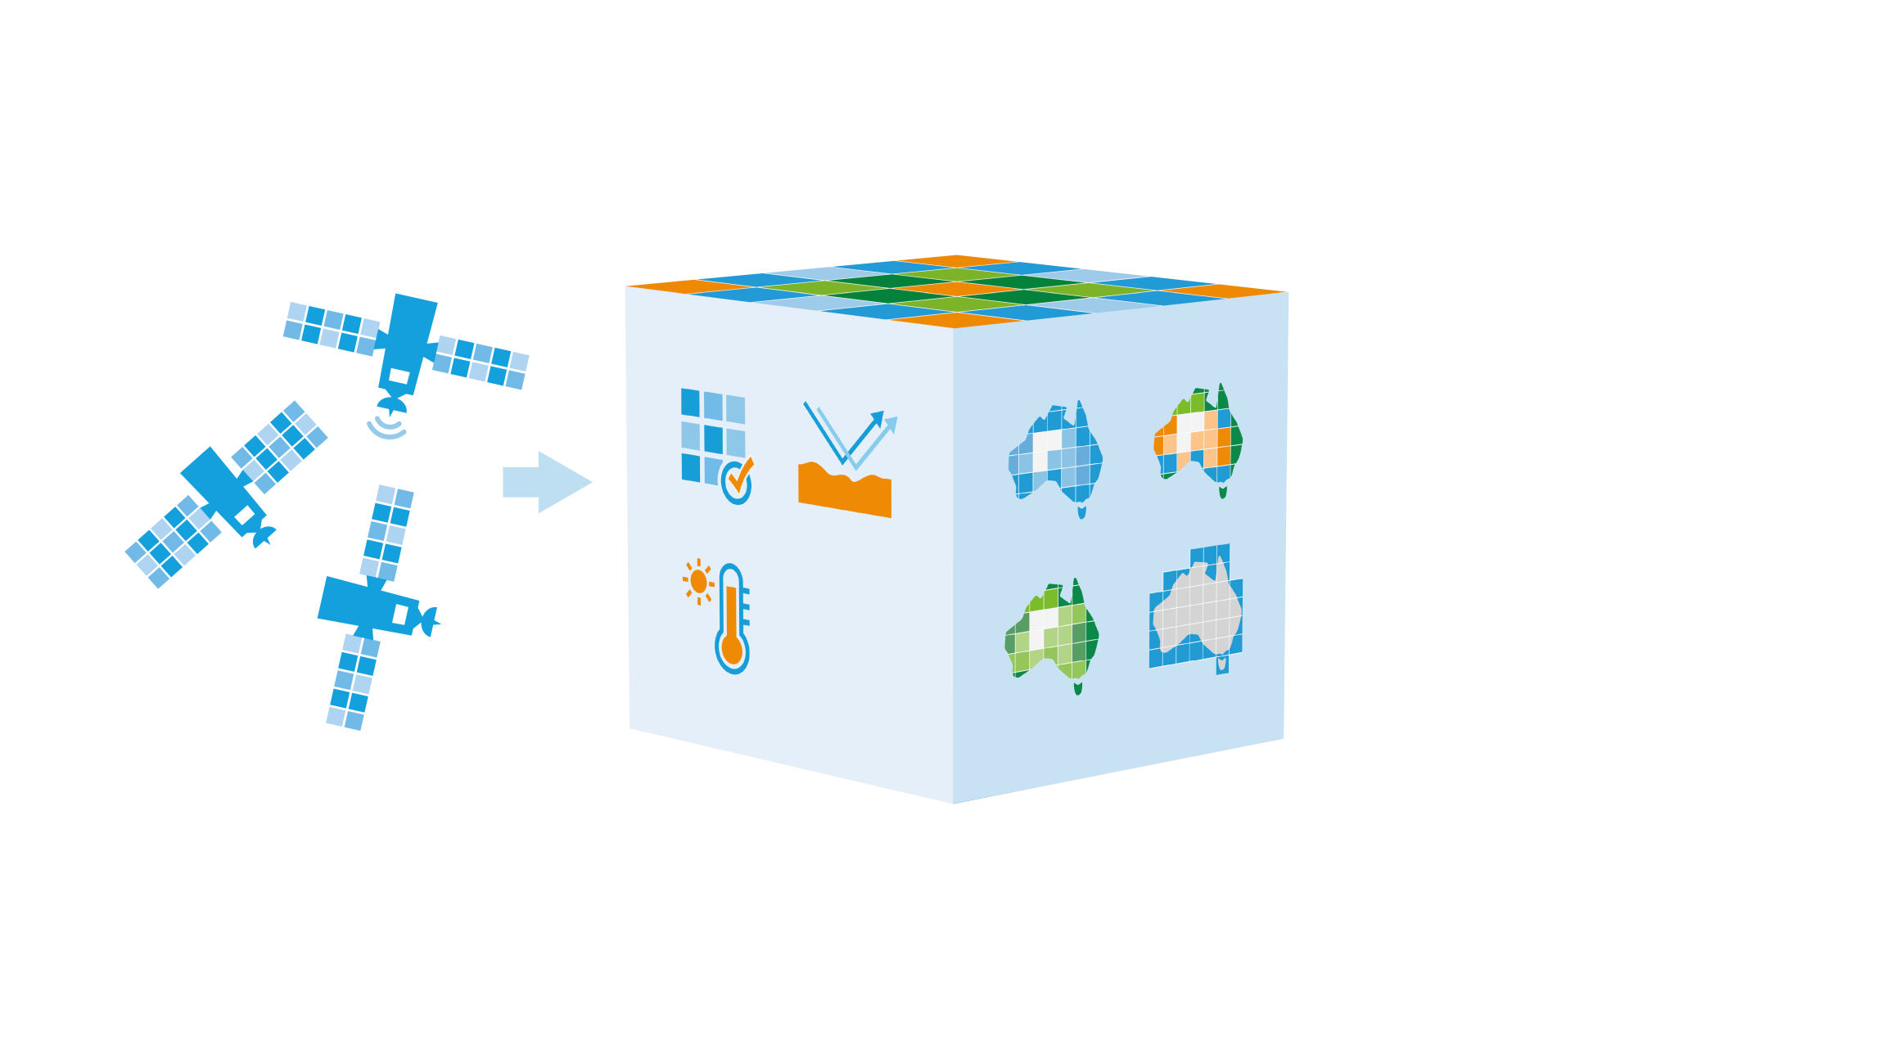
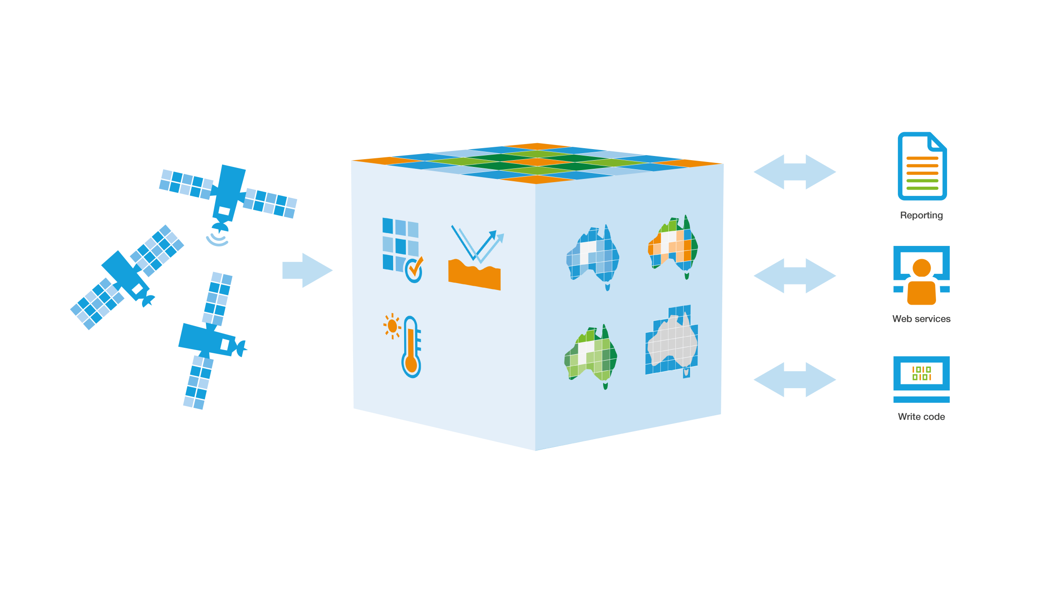
What is Digital Earth Australia?

Slide 4
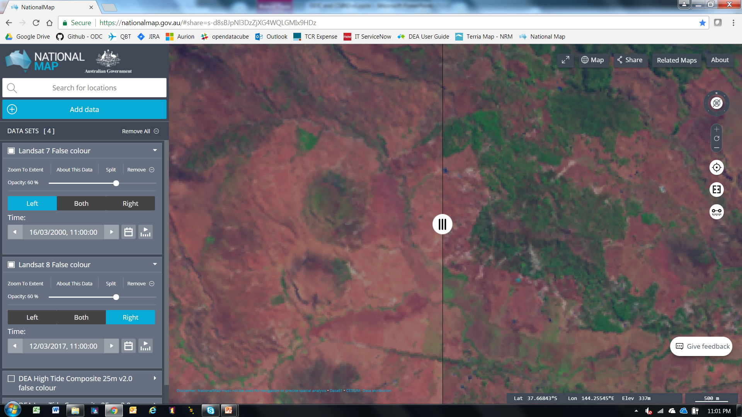

Slide 5
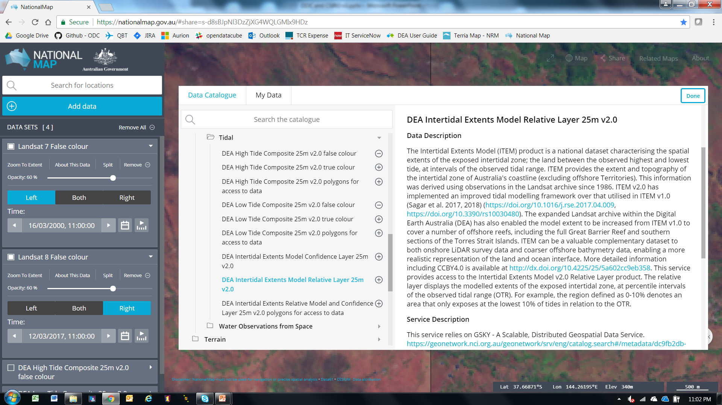

Slide 6


Digital Earth Australia – Why?
DEA will improve the efficiency and effectiveness of the Australian Government’s investments and improve how we manage our natural resources.
Implemented on Australia’s National Computational Infrastructure
DEA will support innovation and growth in the digital economy and drive increased productivity across a wide range of sectors.

Slide 7
Unlocking the value of satellite data
Kate Williams, Leader – Location Intelligence, GHD
“We don’t do a lot of remote sensing work … [as] processing data before even starting the analysis work makes it cost prohibitive …”

Slide 8
Unlocking the value of satellite data
Ian Miller, Chief Technology Officer, Spatial Vision
“The cost of managing all of that data is so great that it is not viable for small and medium size client projects.
To be brought to that scale of project, someone else needs to collect, collate, calibrate and provide it in easy to consume and analyse format.
This can unleash the value of the data to an enormous number of challenges in Australia”

Slide 9
Industry’s requirements for DEA
Commercially standard service levels (99.9%)
Flexible access to HPC capability; and
Speedy, reliable delivery of analysis ready data.

Slide 10
Industry’s requirements for DEA
Commercially standard service levels (99.9%)
Flexible access to HPC capability; and
Speedy, reliable delivery of analysis ready data.

Slide 11
AWS Pilot
Australia is implementing a continental scale pilot on AWS in order to test
Data hub and data synchronisation technologies
Implementation of GA’s ARD processing pipelines
Ingestion of data into an Open Data Cube and subsequent continental scale processing of data.
Ultimately the purpose is to model future costs and understand the feasibility of our proposed architecture on a commercial cloud.

Slide 12
Industry’s requirements for DEA
Commercially standard service levels (99.9%)
Flexible access to HPC capability; and
Speedy, reliable delivery of analysis ready data.

Slide 13
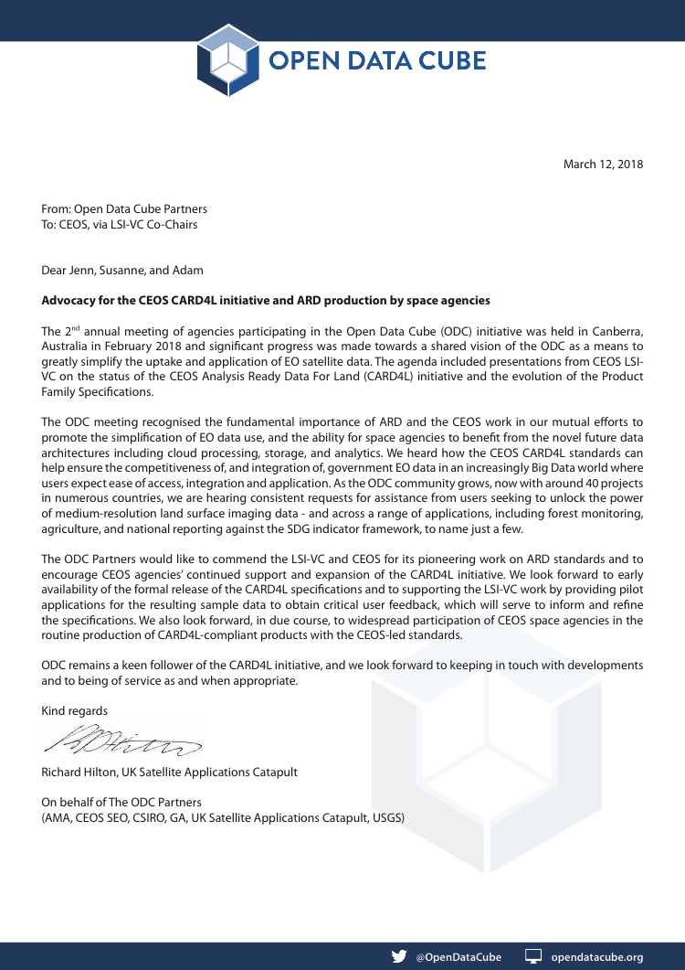
www.opendatacube.org

Slide 14



CSIRO’s Open DataCube Activities: Update
Image courtesy of Digital Earth Australia, Geoscience Australia
Alex Held | Matt Paget | Robert Woodcock
April 2018
Astronomy and Space Science | Land and water | Mineral Resources

Slide 15
CSIRO Priorities
Science-to-industry implementation – Incremental-, and disruptive technologies: e.g. Wifi
Support for the Open Data Cube Partnership
  Development of baseline ‘core’ ODC platform with ODC partners
  Focus on key DC Projects (e.g. Vietnam, NZ, Taiwan, CAS-RADI
  CEOS DataCube activities world-wide – SAR Cube implemenation
But also, enhance use-, of/and access to DataCube technology by wider academia, geospatial industry and start-ups in Australia and wold-wide (eventually)

Slide 16
Update: Asia Pacific - Open Data Cube Initiatives
Vietnam
  Began engagement in Dec 2016, following CSIRO’s role as Chair of CEOS in 2015/16
  MOU signed with Vietnam National Space Center and Vietnam Academy of Science and Technology. VNSC in turn have an MOU signed with FIPI (for REDD+)
  Five visits for technical, strategic and application exchanges in 2017 (4 to Vietnam, 1 to Aust)
  Hardware, resources and initial training complete. Implementation in 2018
China
  Initial technical and strategic discussions over two visits (1 to China, 1 to Aust)
  Linked to broader satellite ground station and regional EO training centres, likely under ‘Belt & Road’
New Zealand
  Proposal accepted by Centre for Space Science Technology (start-up associated with NZ Space)
  First technical workshop in Nov 2017, sponsored by NZ
Taiwan
  Collaboration between National Taiwan University and National Space Program Organization
  Technical exchange visit in July 2017, sponsored by NTU
Singapore, India, Seychelles
  Early stage collaboration discussions and technical exchanges

Slide 17
What would a “ODC-Inside” business model look like ?
Provides access on pay-per-use basis to multi-sensor + end-to-end processing workflows
Scalable: Servicing multiple clients at same time
Clients can use CSIRO solutions (applications) and data, or BYO (bring your own) analysis tools and data
Clients desire to use CSIRO validated data analytics research outcomes
Simple, easy financial transaction for use and access of platform (ie App Store/UBER)

Slide 18





Opportunities offered by Different Platforms
Super computer - NCI
  Collaboration between GA, CSIRO and NCI
Amazon Web Services (AWS)
  Files in S3 + single EC2 instance
  Arrays in S3 + scalable EC2 (CSIRO)
Desktop
  Github code
  Linux, Mac, Windows

Slide 19

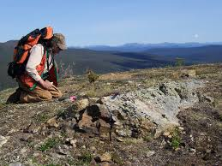
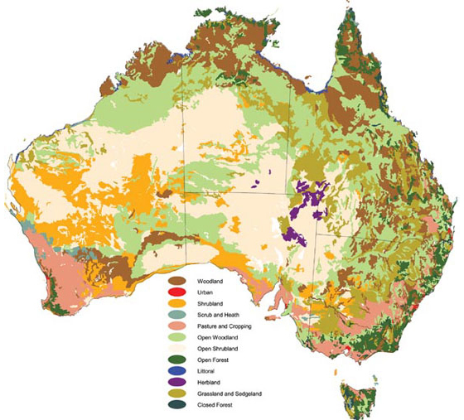



Testing the Business Model
Who we spoke to – over 40 companies and potential users
Mining
BHPB
Rio Tinto
AngloGold
Juniors (Cauldron Energy, BM mining)
Doray Minerals
Roy Hill
Mellardo & Co
Quantitative Group
Leapfrog x 2
Maptek
SA Geological Survey
Geoscience Australia
Business Foundations (AusIndustry)
JK Research Centre UQ
Curtin Uni
Environment
International
CEOS
ESA
Govt
Murray Darling Basin Authority
Geoscience Australia x 3
Dept. Environment
Consultants
EOMap
Agriculture
Industry
Sugar Research Australia
Consultants
WILMAR
Govt
ABARES x 2
Research
Andries Potgieter (UQ)
Andrew Robson (UNE)
Yvette Everingham (JCU)
CSIRO
Minerals
Workshops
Anonymous
Land & Water
David Lemon
Finance & BD
(pending)
Market Analysts
CSIRO
Mike Andreas

Slide 20

What we learnt
Customers value CSIRO’s deep science and techncial expertise and validated research
Many of the customer’s pains parallel our own internal pains - we have more data and tools available than we initially thought
There are many operational components that are valid across multiple market segments
Customers are interested in smaller, well defined transactions to access platform data and capabilities and receive our ‘products’

Slide 21
Talking to industry
Analytics: Barriers as perceived by industry
Upfront cost of organising Government and Industry data ready for analysis
Large scale R&D investment considered high risk:
  new data integration techniques are unproven and difficult to validate;
  there is a very large choice of algorithms and often only one can be trialled with no clear way of prioritising.
It is difficult to incorporate a new technique into the broader decision- making workflow of an organisation.
Large computational capacity is not a normal part of the EO data industry, which is often smaller, specialised companies with limited resources.

Slide 22
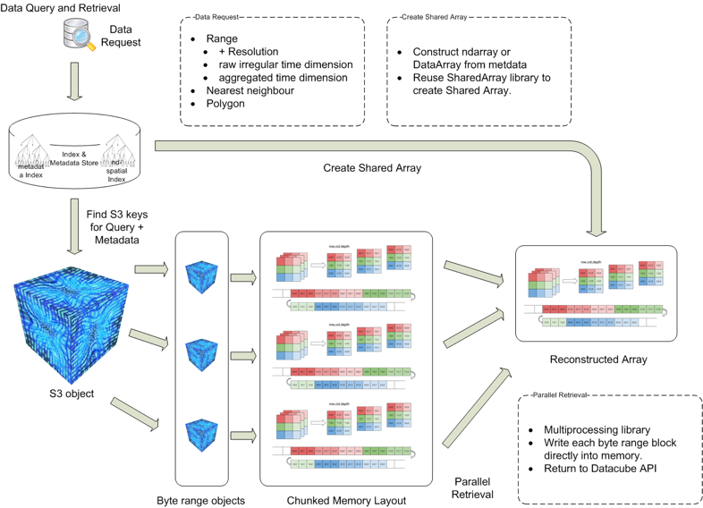
CSIRO’s Open Data Cube Implementation on AWS – S3 Arrays
AWS
  Fast, scalable, accessible, durable
  Industry ecosystem
EO data on Cloud
  Aligned with S3 principles – objects not files
  Take advantage of I/O concurrency
  No change to Applications – S3 driver
Execution engine
  exploiting Cloud elasticity
  EC2 Spot instances – cheap Top 500?
Notes:
CSIRO’s innovative Cloud services
Performance achieved through distributed data arrays in the S3 Object storage – high levels of parallel IO and Compute that work for a lot of EO use cases.
Costs vary but you can buy a top 500 scale compute capacity on the AWS Spot market for US$1000 per hour (which is insanely cheap!).
Importantly being on AWS its part of a broader business ecosystem which is important for industry to exploit our EO contribution to the overall business process.

Slide 23

Next Steps
CSIRO’s Commercial DataCube Pilot: the “Earth Analytics Industry Innovation Hub”
  Initially start as a ‘Business within the business”
    Learn how to monetise and operate discrete transactions and revenue flow to research team and partners
  Affirming science and valuing contribution
Acceleration
  Market opportunity assessment and pricing needs refinement
  Maturing outcomes to an acceleration pitch
Status
  Alpha-testing + Python Jupyter Notebooks
  Limited data and 3-4 applications initially
  Keen to collaborate with interested ODC partners

Slide 24

  Dr Alex Held
  Director, CSIRO Centre for Earth Observation
  e Alex.Held@csiro.au
  Dr Robert Woodcock
  Senior Principal Research Consultant
  e Robert.Woodcock@csiro.au
    Matt Paget
    Data and Systems for Earth Observation
    e Matt.Paget@csiro.au
Astronomy and Space Science | Land and water | Mineral Resources

Slide 25
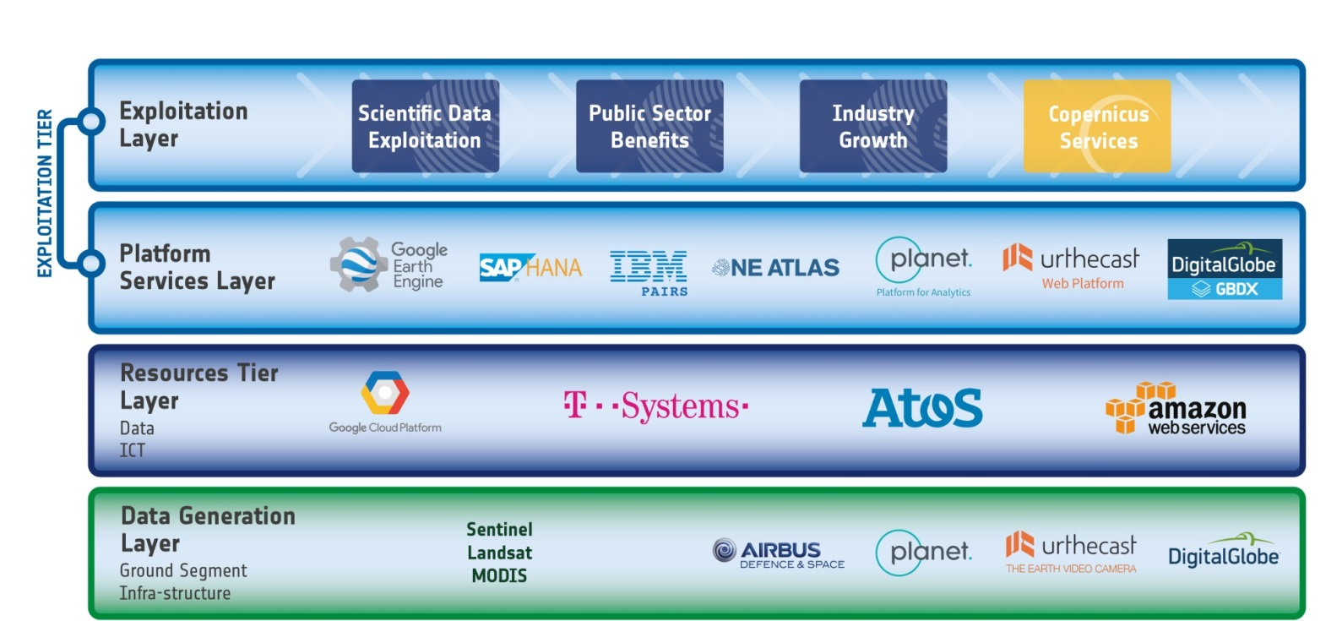
FDA Concept

