Slide 1
DIAS Information Day
CEOS Future Data Architecture Big Data Workshop
EUMETSAT – ECMWF – MERCATOR OCEAN DIAS
Paul Counet
EUMETSAT
26 April 2018

Slide 2













DIAS – Background
All DIAS responds to requirements approved in December 2016 by the EC.
WE TOO !
Front
office service
Front
office service
Front
office service
Front
office service
Front
office service
Front
office service
Front
office service
Front
office service
Front
office service
Front
office service
Front
office service
Data Distribution Services
Data/Information Access Services
(DIAS)
Land
Data Distribution Core Services
S1
Marine
S2
S3
S4
S5
S6
Sentinel
Data
Service Information
Atmosphere
Emergency
Security
Climate
Sentinels
Service Information
Sentinel Data
ESA
Sentinel Data
EUMETSAT
Contributing Missions
In-Situ Data
Sentinel Data
ESA
Sentinel Data
EUMETSAT

Slide 3
So, what is exactly the DIAS ?
It is a platform which :
Provides easy, cost efficient and reliable access to resources (products, storage, tools, computing ...), while retaining the open and free access to Copernicus data and information.
Offers access to model data, in-situ data and other satellite products;
Allows users to apply own processing to data;
Makes available scientific expertise and technical user services to make best use of the data / to develop own capabilities;
Builds bridges from research to business;
Promotes innovation and industry competitiveness, including SMEs;
Enables the development of new markets benefiting from Earth Observation.
Notes:
Reduce to bullets

Slide 4
Our DIAS is somewhat different
  Our DIAS is build around the idea that data shall remain close to technical and scientific expertise of the entities handling the data
  → EUMETSAT has partnered with Copernicus services on Ocean, Atmosphere and Climate to build an operational DIAS providing data and technical + scientific expertise on the data
  Our consortium has the expertise of the 3 partners, in terms of running operational user-driven systems, using high technology, big data,…
  While developed by industry, the partners remain responsible to specify the architecture of their DIAS.

Slide 5
Our DIAS is somewhat different
We comply to the same requirements with a specific approach:
  User-centric, operational focus → User feedback is part of the development
  Capitalises on existing & strongly structured user communities of the 3 organisations → we want to bring our users to the DIAS;
  Federating rather than duplicating → Future-proof in a world of cloud initiatives, secures access to distributed knowledge and data;
  2-phases development for risk reduction → proof of concept, User feedback, operational full implementation;
  Can be see as a „transition“ integrating services from 3 organisations → variety of future scenarii are possible;
  Large involvement of industry and in particular SMEs → avoid monopole, provide a level playing field, create opportunities for SMEs;
  Operational Continuity, even when changing suppliers → Transparent Users migration, no lock-in, preserving user investments

Slide 6
What makes our DIAS special ?
User-orientation – Our goal :
  Bring to our current users the benefits of DIAS
  Secure Operational Continuity
  Integrate the User Services with the expert knowledge of the 3 organisations
  Facilitate the transition from research to business with an „incubator“ environment
  To SMEs : provide a place to develop, grow and sell their products under foreseeable and stable conditions.
  Seamless integration with monitoring and forecasting capacities of partners

Slide 7
What makes our DIAS special ?
Builds on work done by the partners for their own operational systems
  Uses solutions developed by the partners (e.g CDS of ECMWF, Pathfinders of EUMETSAT) → designs and implementations are available & verified.
The Interfaces to the users (e.g. APIs) are here to stay:
  Interfaces for access/hosting/front offices, etc.. are those being developed for the EUMETSAT data services:
    Operational – compatible with the needs of operational meteorology
    Maintained and evolved long term to guarantee continuity for our users
    Applicable/CFIs to the DIAS Contractors: secures level playing field, good competition and „seamless“ migration of users in case of provider change

Slide 8

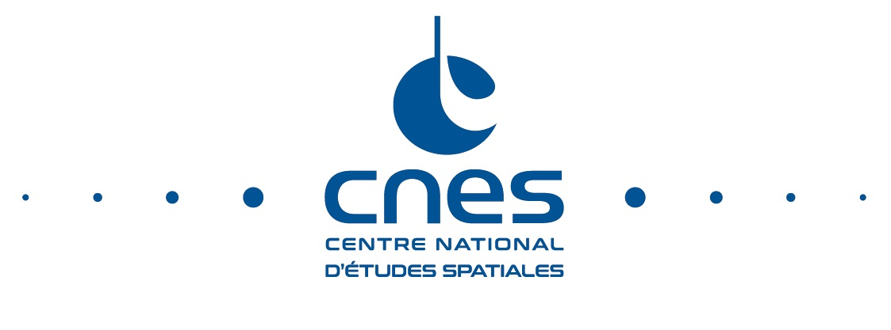
What makes our DIAS special ?
Integrated while being Distributed :
  Storage, Computing, tools, experts knowledge,… are distributed and will remain so
  Our DIAS integrates these aspects and enhances them by its elasticity capability
Federative and Open by nature:
  The solution is generic and replicable to other nodes, federating platforms for mutual benefit – connection of any data centre is possible
  Possibilities are :
    via interconnect → currently working with
    national initiatives (Copernicus Collaborative
    GS of CNES, DLR)
    by using hosting space via elasticity

Slide 9
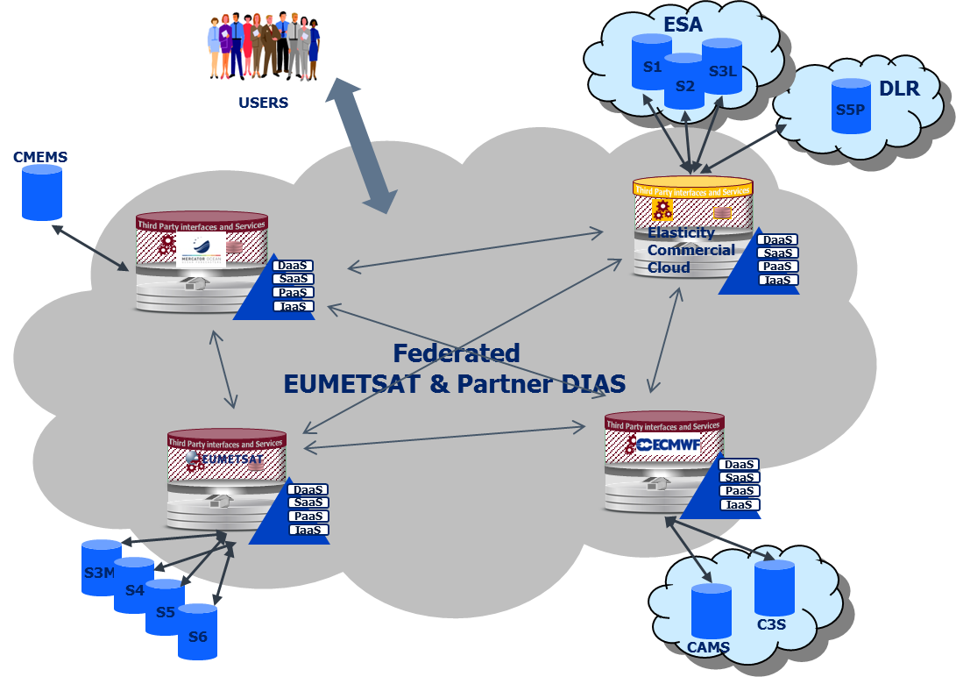
A distributed infrastructure …

Slide 10
A distributed infrastructure …
A distributed system allowing efficient access to geographically distributed data and products
The internal distributed infrastructure is based on a network of 3 instances forming a private cloud. These can support both computing and storage.
This private cloud can be then scaled-up via an external elastic cloud ready to absorb peaks of requests for computing or storage resources. The whole forms an operational hybrid cloud;
Interoperability is secured through the use of recognised international standards and established common practices such as HMA.
Vendor independence, based on Open Source solutions.

Slide 11
A distributed infrastructure …
Points of Presence (PoPs) are deployed at the three partners premises (EUMETSAT, ECMWF, M-O) hosting a clone of the EUMETSAT Information Centric Service Infrastructure (ICSI)
Elasticity provided implemented via public cloud
PoPs and elasticity cloud are high speed interconnected (LAN speed) and interoperate on Platform as a Service (PaaS) Layers
Each site ensures access to its data and core capabilities via a brokerage layer from the ICSI platform clone
→ We do not move big volumes of data
→ Data remains where the expertise is
The users interacts via a central portal

Slide 12
An incremental Development and implementation process…
Authorisation
to Proceed
V0 release
Pre- existing industrial
Design
V0 impl. , test & Ops
support framework
(EUMETSAT)
Procurements
Industry
KOMs
V1 release
V1 impl. & Test
V2 release
V2 impl. & Test
V3 release
Target industrial
V3 impl. & Test
Framework (ECMWF
-
EUMETSAT
-
Mercator)
Operations preparation, Operations, User uptake support
...
2017
2018
2019
2020
Notes:
Reduce to bullets

Slide 13
… Linked to a specific Procurement Logic
The DIAS will be implemented operationally via few industrial procurements
  ITT 1 : DIAS Services and Operations
  ITT 2 : Processing, data access and Tools SW
  ITT 3 : DIAS system Engineering, Validation
  ITT 4 : User Uptake Marketing
  ITT 5 : User Support Services

Slide 14
Rationale behind this approach
Criteria retained for splitting into procurements
  Compatible with the EC goals on industry´s involvement, including transition of more responsibility to the private sector, including role of SMEs
  V2, V3 scope can be adapted depending on user uptake → cost control and continuous availability of best expertise
  Self-contained responsibility areas allowing efficient management by the contractor
  Opening the competition / Avoid future monopole situations
  Favor participation of SMEs with dedicated expertise (focused ITTs)

Slide 15
WekEO: The proposed ITTs
ITT | Scope | Comments /Rationale
ITT-1: DIAS Services and Operations | Provision of operational DIAS services Provision of commercial cloud services Provision of network infrastructure Provision of Web Services, reference Front Office, Sys Admin & IT support to users, link to user support office. Provision/operation of virtual environments and toolboxes Integration/hosting, operation of CFI elements (Tools, SW packages maintained by the partners) Implementation & Test of engineering changes Operational reporting | Includes commercial exploitation of the DIAS
ITT-2: Processing, Data Access and Tools SW | Implementation, test and maintenance of the Data Processing, Access functions and the CFI tools | Includes SW for interfacing DIAS with existing partner´s systems and tools
ITT-3: DIAS System Engineering, Validation | DIAS System engineering & consistency/compliance DIAS services Validation in support to the partners Defining evolution / engineering changes based on User Feedback | Independent from the DIAS Service Provider (securing independent Validation)
ITT-4/5 User Uptake Marketing and User Support (one or several ITTs) | User Uptake, identification of potential/new user communities, Marketing, Communication Integrator of the specific user Support functions @ MO, ECMWF, EUMETSAT | Interface to ITT-1 and to the existing User Support function Independent from ITT#1 Contractor.
SCOPE OF TODAY´S
INDUSTRY DAY

Slide 16
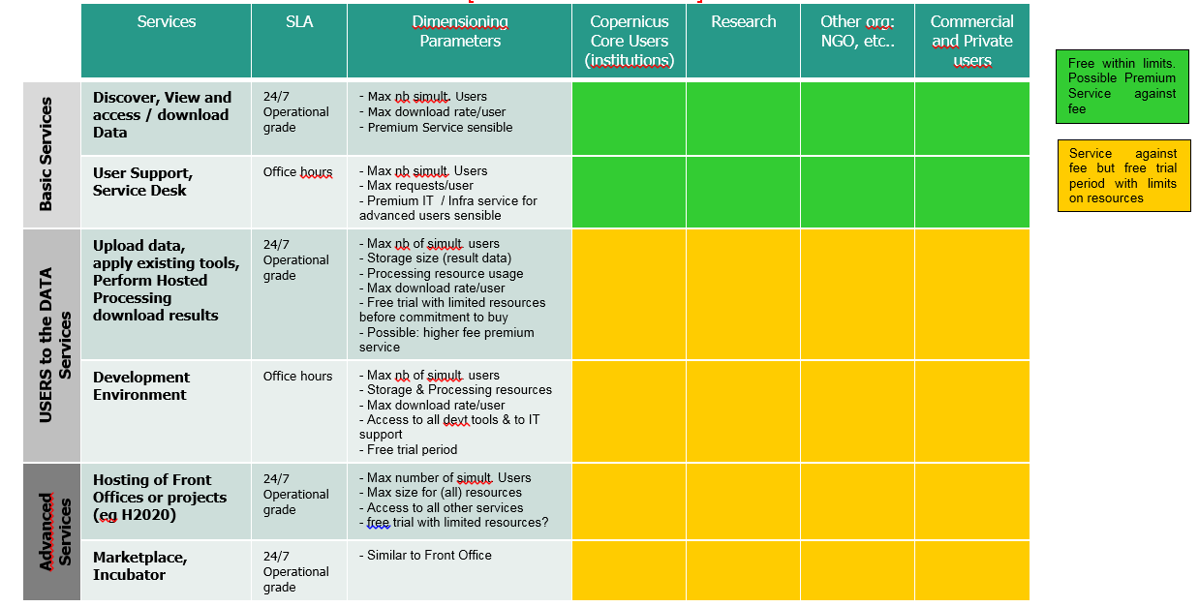
Offered Services – Preliminary (under discussion with EC)
+ Incubator !

Slide 17
Overall schedule
V0 Released at Baveno
V1 Contract kick-off: 1st October 2018
6 months for delta-design and implementation
V1 ORR (operational readiness review): 31st March 2019
V2 release : Q4/19
V3 release : Q2/20
End baseline contract: Dec 2021
End last option: Dec 2023 (subject to approval by EC)

Slide 18
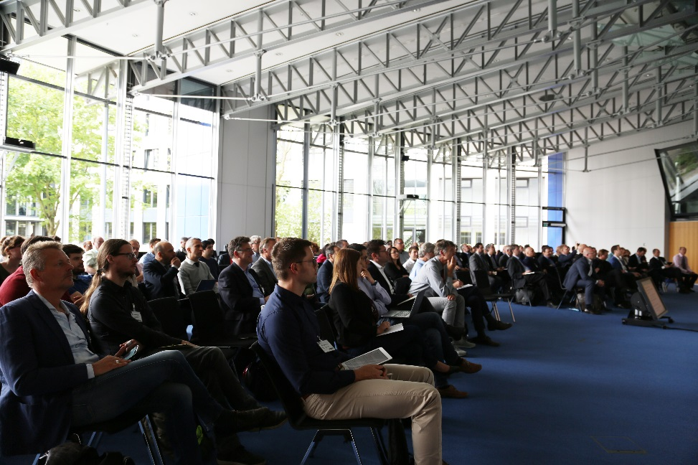

Any Questions ?
140 representatives from Industry attended the Industry Day which took place in EUMETSAT on 24 April

