Slide 1
Earthdata Cloud 2021
Kevin Murphy
April 2018

Slide 2
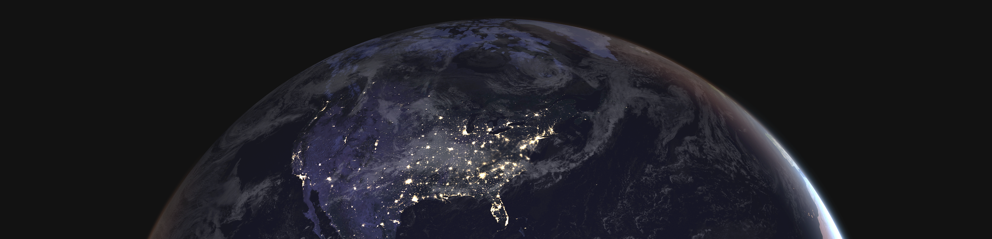
Earthdata Cloud 2021
Improve the efficiency of NASA’s data systems operations
Prepare for planned high-data-rate missions
Increase opportunity for researchers and commercial users to process PBs of data quickly without the need for data management/movement

Slide 3




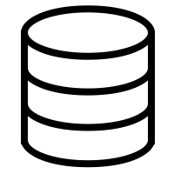
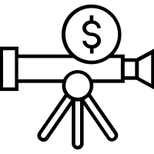
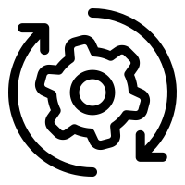




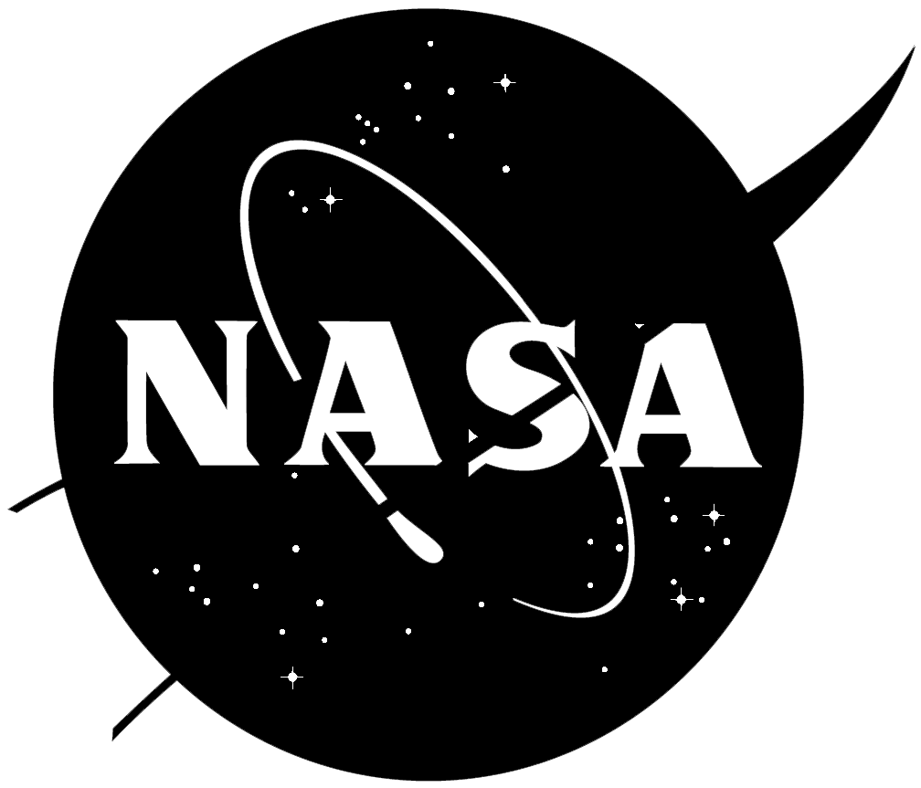



Focused on evaluation and planning for a cloud migration in 4 areas
Compliance, Security, Cost Tracking
Core Archive Functionality and Processing
End-User Application Migration
Commercial Cloud Partnerships

Slide 4
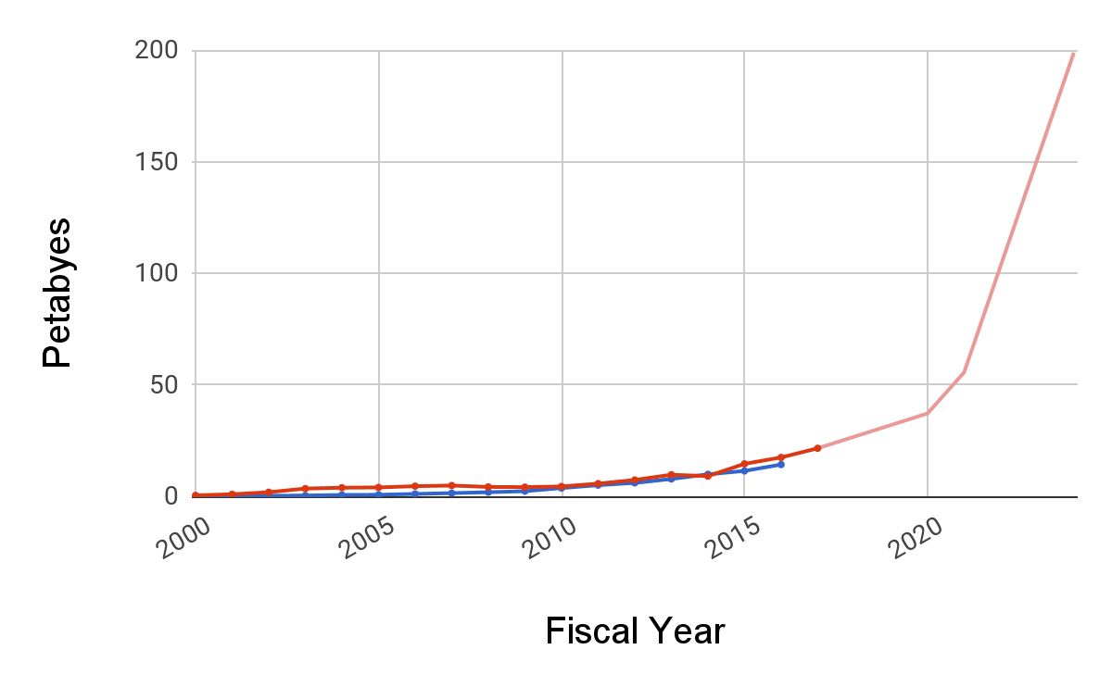

Data Rates Drive System Evolution

Slide 5
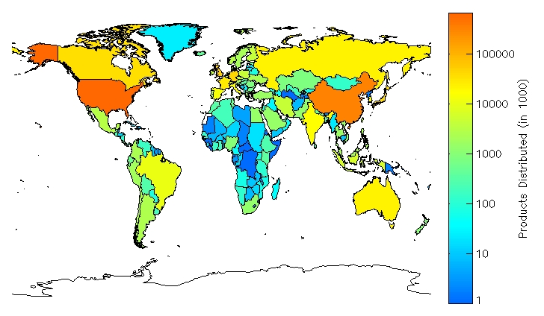

Slide 6
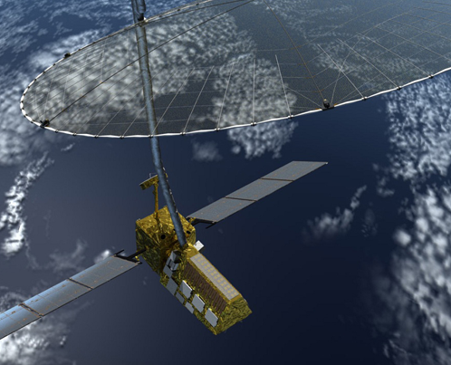
80 TBs/day
generation
400 TBs/day
reprocessing
Most networks can’t handle sustained 50 Gbps
Processing times for creating scenes, times to create time-series
300 GB
Granules
150 PBs @ 50 Gbps
processing speed for months

Slide 7
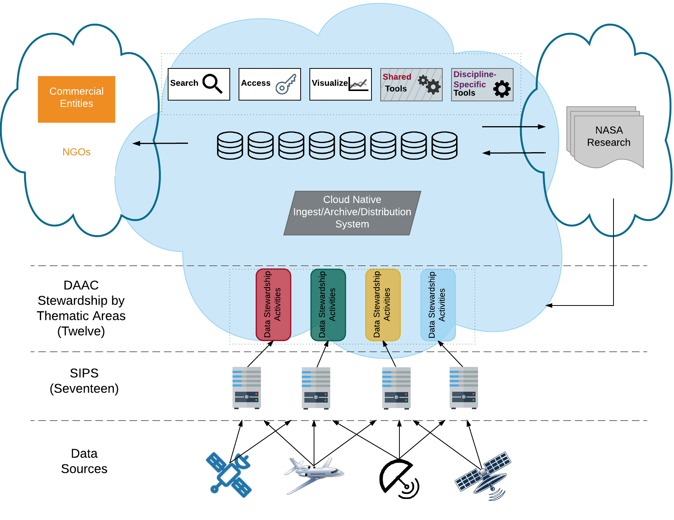
EOSDIS Cloud Architecture - 2021
CEOS
Users access and can process PBs of data quickly without the need for data
USGS, NOAA
Organized, well-documented, consistently formatted, and error free data lake
Open Data + Open Source Software + Open Architecture
Notes:
Discipline specific support and tools (All data)
Workflow specialization by DAACs
Processing next to data for anyone
Clear integration path for new technology
Data reformatting tools available via APIs
Supports global distrubition

Slide 8

So we made this thing.
Getting Started with Cumulus https://cumulus-nasa.github.io/
Cumulus Code Base: https://github.com/cumulus-nasa

Slide 9
What is Cumulus?
Lightweight, cloud-native framework for data ingest, archive, distribution and management
Goals
Provide core DAAC functionality in a configurable manner
Enable DAACs to help each other with re-usable, compatible containers (e.g. data retrieval, metadata extraction, metrics delivery)
Enable DAAC-specific customizations

Slide 10
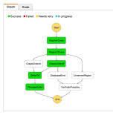
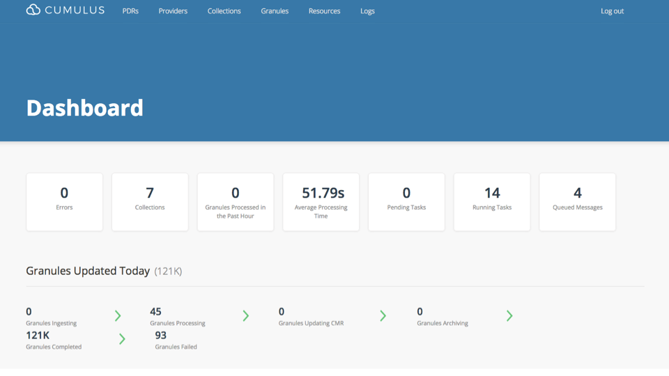
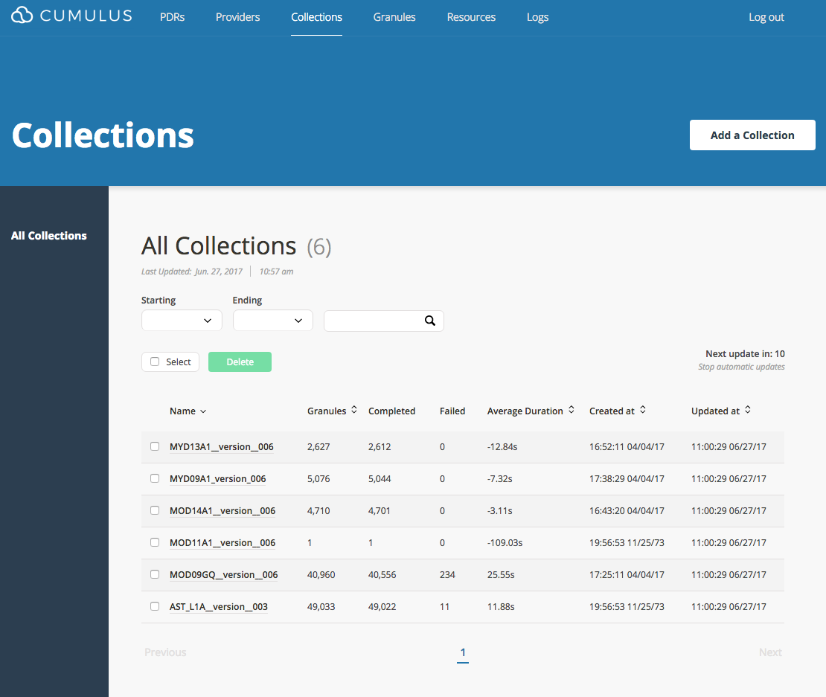
Cumulus Major System Components
A lightweight framework consisting of:
Tasks a discrete action in a workflow, invoked as a Lambda function or EC2 service, common protocol supports chaining
Orchestration engine (AWS Step Functions) that controls invocation of tasks in a workflow
Database store status, logs, and other system state information
Workflows(s) file(s) that define the ingest, processing, publication, and archive operations (json)
Dashboard create and execute workflows, monitor system

Slide 11
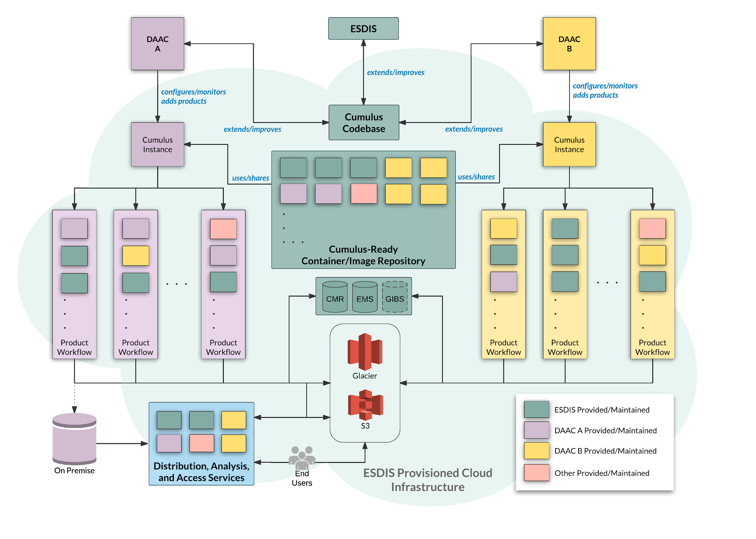
Notes:
AKA the big picture
Direct
Reduced O&M costs (AWS negotiations)
Minimize data movement to compute
Ability to scale to increasing data streams
Indirect
Efficiencies gained via sharing
Reduce design, development, purchase of redundant code/components/infrastructure
Transparency of processes
Improve knowledge sharing

Slide 12
Avoiding Vendor Lock-in
(who owns this data? what if you have to move it?)

Slide 13

Data Transfer Risk
What if you have to move the data?
Right now, AWS is the only NASA-approved commercial cloud vendor. As more options become available we will investigate them.

Slide 14
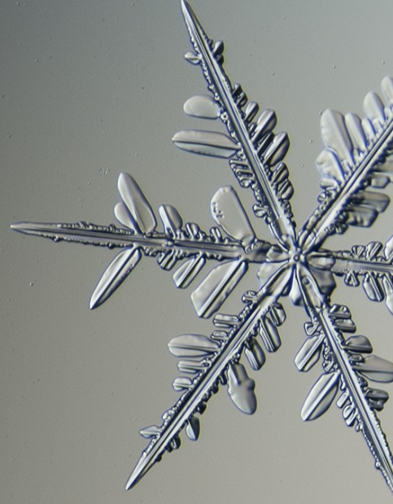
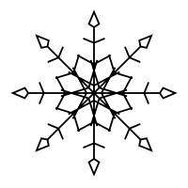
Application Transfer Risk
Step Functions is an AWS-specific product!
Cumulus’ backbone is a workflow processing engine. This is not a unique problem that Amazon alone has solved. There are (many) free and open source, alternatives.
We own the boxes, always, the arrows between those boxes are replaceable.

Slide 15

Infrastructure Transfer Risk
Compute, Serverless, Queueing, etc
Again, this is not a unique problem. Every major competitor in the cloud space has alternatives:
Serverless: Qinling, Google Cloud Functions
Queues: Zaqar, RabbitMQ
etc, etc

Slide 16


Knowledge Transfer Risk
We are training everyone in AWS
This is a real problem. Effectively leveraging the AWS console is its own skillset. People may become unwilling to be retrained if we have to migrate. But we have faced this problem before.

