Slide 1
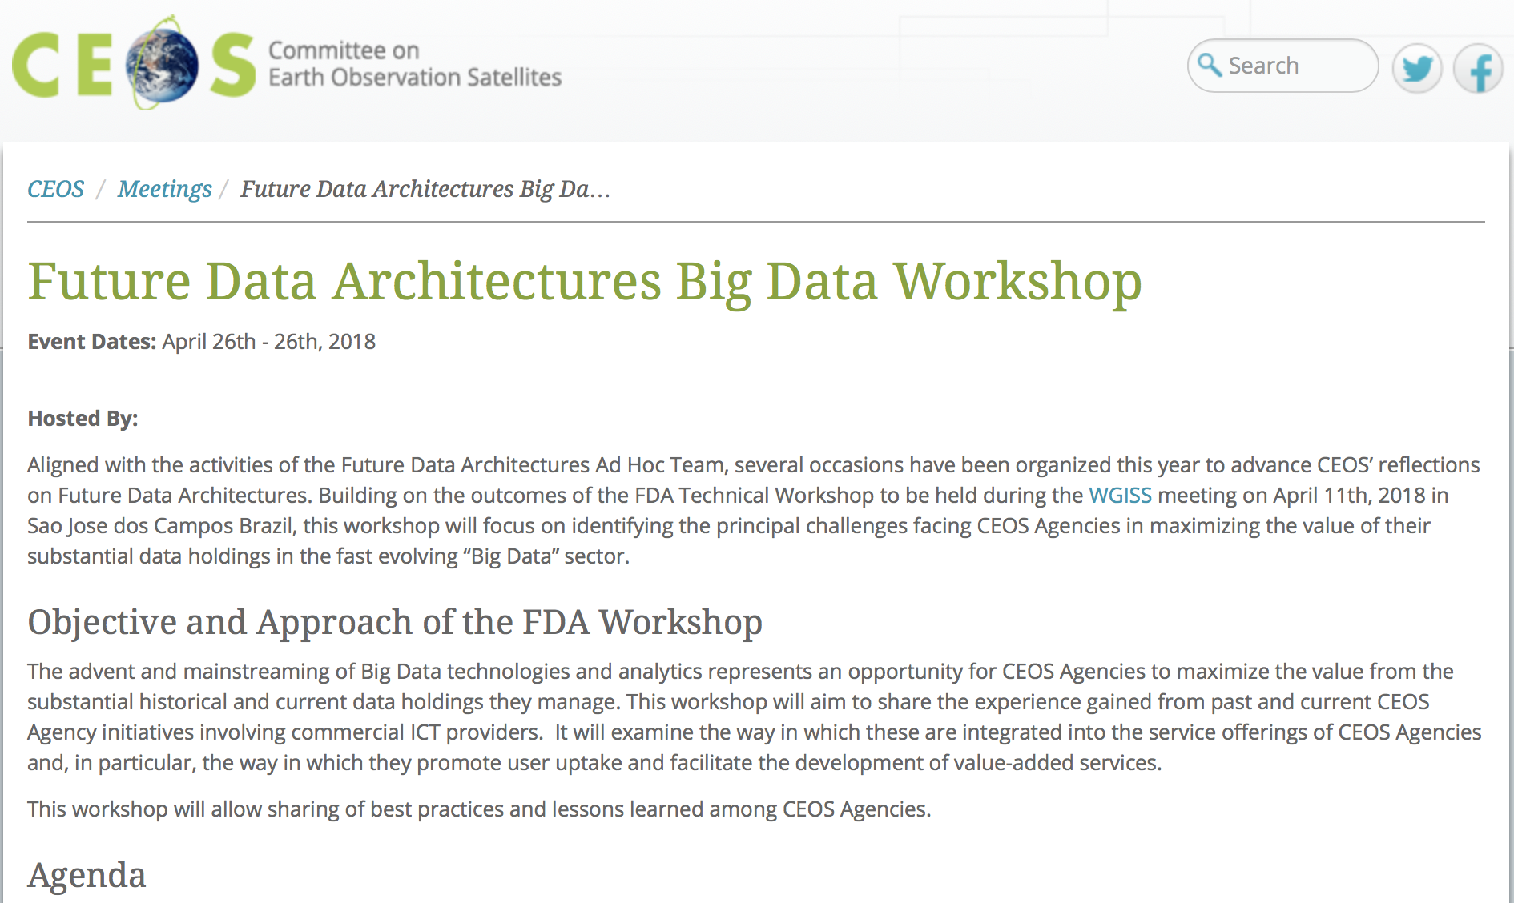
DIAS Implementation
N. Hanowski / EOP-G / nicolaus.hanowski@esa.int

Slide 2
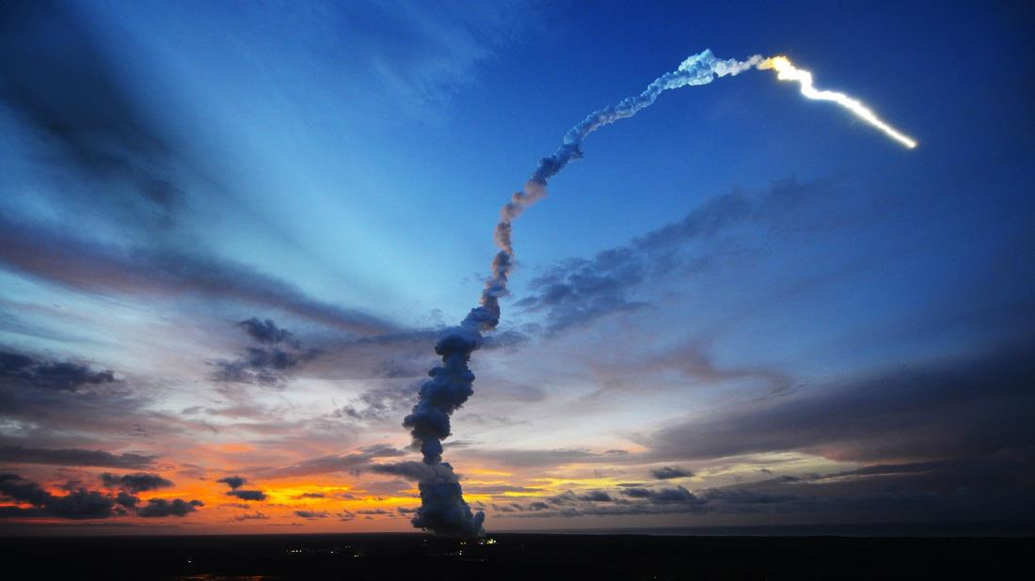
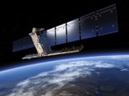
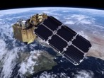
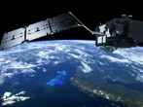
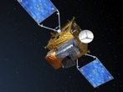
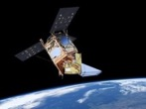
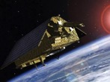
Sentinel Launches
S-1
S-2
S-3
S-4
S-5P
S-5
S-6
Radar
High Resolution Optical
Medium Resolution Optical & Altimetry
Atmospheric Chemistry (GEO)
Atmospheric Chemistry (LEO)
Atmospheric Chemistry (LEO)
Altimetry
A
3 Apr. 2014
A
23 Jun. 2015
A
16 Feb. 2016
A
2021
A
13 Oct. 2017
A
2021
A
2020
B
25 Apr. 2016
B
6 Mar. 2017
B
2018
B
2027
B
2027
B
2025
C
2022/23
C
2022/23
C
2023
C
> 2027
D
> 2022/23
D
> 2022/23
D
> 2023
→ already generating 15 Tbytes per day !

Slide 3
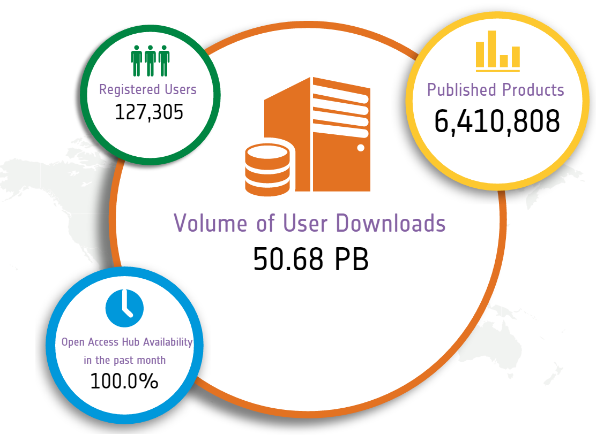
Sentinel Open Access Data Hub
Statistics on
5 March 2018
scihub.copernicus.eu

Slide 4
Registered Sentinel Users
Copernicus User Uptake
The real number of users is much higher but unknown due to the free, full & open data policy.

Slide 5
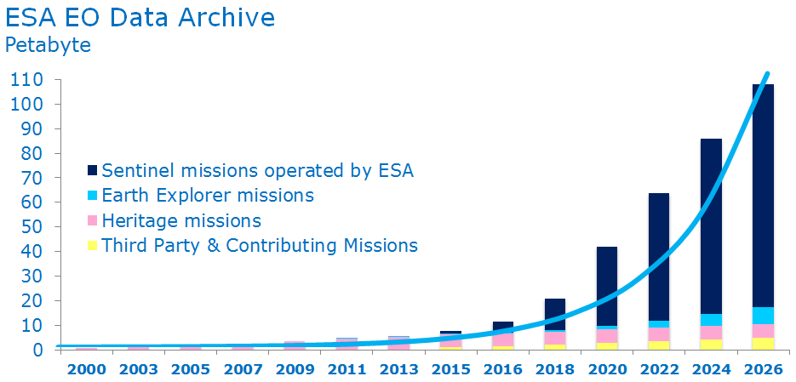
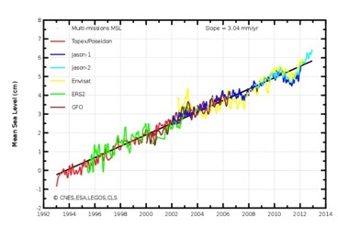
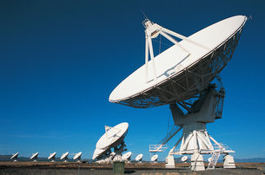
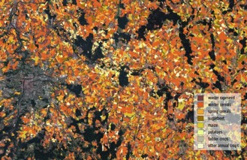
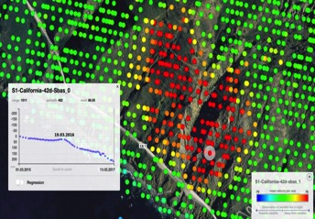
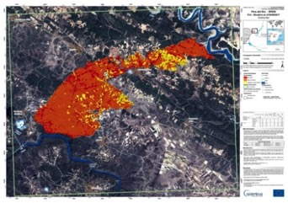
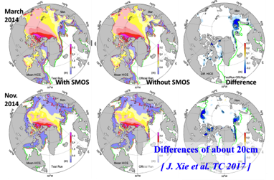
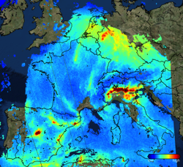
Sentinel Satellite Data Challenges
Data volume
Data continuity
Data sharing
Data quality
Innovation
Timeliness
Mission synergies
Uniqueness
Notes:
General message: operating the Sentinel satellites is very complex because of the many parameters that have to be taken into account and reconciled. This is extra challenging by the fact that Copernicus is an operational constellation and, the fact the Sentinel satellites are state-of-the-art technology (big data challenge & innovation challenge).
Examples per challenge:
Data volume: Copernicus is generating vast volumes of data (now 14 TB / day), which will lead to an exponential increase of ESA’s Data Archive. Acquiring this data and managing it requires technical and scientific expertise regarding data storage and processing.
Data Continuity: Copernicus is an operational system, meaning that data continuity should be ensured between different generations of a Sentinel mission, but also when Copernicus takes over an operational service, as S-6 will do for ocean altimetry, for instance.
Data sharing: the full and open free data policy means that data should be shared with various stakeholders, to this effect ESA is implementing the CollGS with MS
Data quality: Copernicus is a system on which policy-makers rely to get accurate information, such as for instance info on agricultural data in support of the EU Common Agricultural Policy. This means data quality must be guaranteed.
Innovation: Sentinel satellites are enabling innovation thanks to their scope and operational character, allowing us e.g. to monitor the effects of earthquakes, landslides and other natural phenomena in a way that was not feasible before (in terms of revisiting time & accuracy).
Timeliness: is always critical but since the Sentinels provide data for things like the Emergency Management Service (e.g. forest fires, floods etc), timeliness is a matter of saving lives.
Synergy between EO missions: e.g. Copernicus Marine Environment Monitoring Service (CMEMS) uses SMOS data for increased accuracy. In general Copernicus has a great value and potential also for scientific purposes.
Uniqueness: some Sentinels, such as S-5P, offer capabilities that are very unique, giving Europe a strategic advantage. Also in the expansion of the CSC, there will be unique capabilities, such as anthropogenic CO2 monitoring.

Slide 6
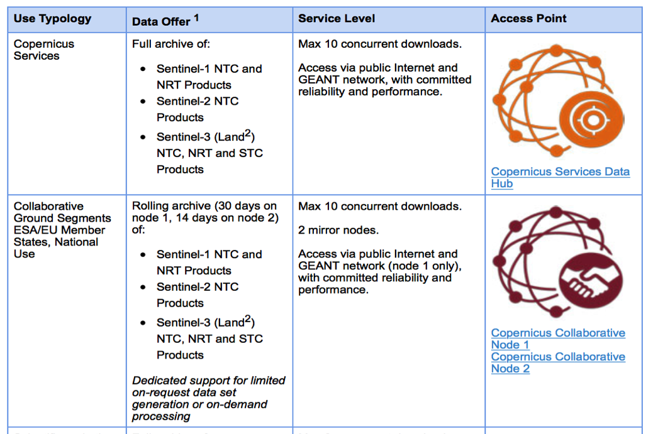
Sentinel Data Access Hubs

Slide 7
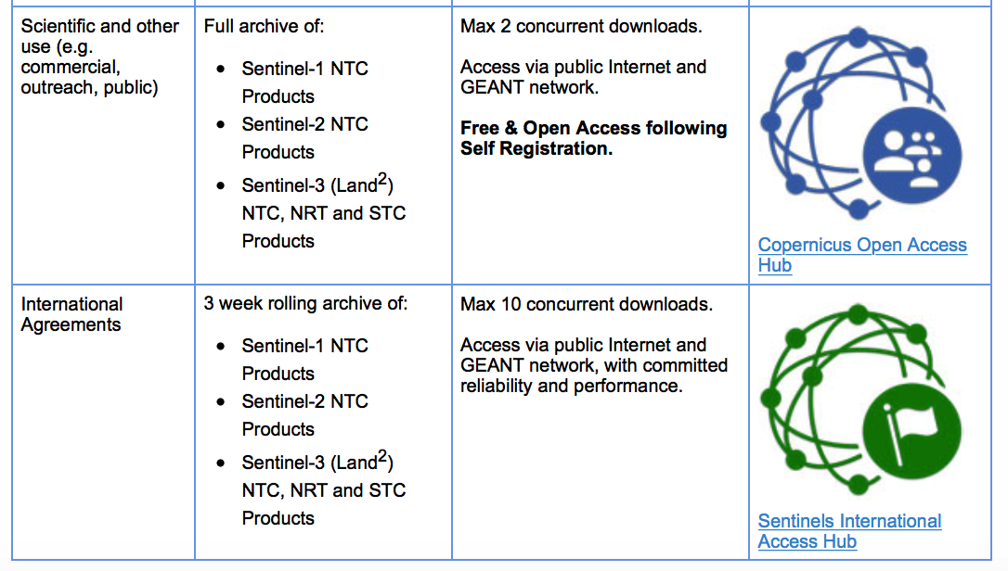
Sentinel Data Access Hubs

Slide 8
Earth Observation Data – The User Perspective
“Am I using the latest version of the dataset?”
“I don’t like the official dataset but I have a good idea for improving it.”
“My computation takes too much time!”
“I cannot do all what I want with the tool box.”
“I don’t have enough space to store all my TB data.”
“How to share my results (few GB of data) with my peers?”
“Where do I find in-situ data to validate my results?”

Slide 9
DIAS – Creating an EO Data Ecosystem
Copernicus Data and Information Access Services
Common DG-GROW-ESA approach to EO data exploitation with Copernicus at its core
Create & enable European EO Data ecosystem for research & business
Started in June 2017
Notes:
Copernicus has a huge economic potential for Europe, and in order to maximise its exploitation, the EC and ESA have set up DIAS
Closes the European “gap” between Data Generation and Exploitation layer
4 DIAS are being established through ESA / 1 through EUM
Building on the principles and mechanisms identified in G/S evolution strategy
DIAS is one of the cornerstones of the partnership & aligned programming between DG-GROW and ESA.
Implementing the “EO-Innovation Europe” concept in full complementarity with the COM initiatives notably the Copernicus Data and Information Access Services

Slide 10
DIAS Rationale
DIAS are initiatives triggered by COM and ESA and implemented by industry:
Consortia have the responsibility of designing their business strategy
ESA & COM maximize the benefit and ensure measurable performance e.g.
all Sentinel data shall be accessible from all DIAS (not necessarily available locally on-line)
Equivalent of 2 years locally available is expected by the 4 consortia
It is the role of DIAS consortium to attract users and meet their expectations.
The objective of the DIAS is not to duplicate the Schi-Hub, but rather to create the appropriate environment for developing front end services using IT services, based primarily on Sentinel data, but also on other EO and non EO data;

Slide 11
4 DIAS Consortia and Points of Contact
Typically: EO service provider + IT infrastructure provider
Anne Chanié
anne.chanie@airbus.com
Alek Cesarz
alek.cesarz@creotech.pl
Guido Vingione
guido.vingione@serco.com
Jean-Baptiste Lavedrine
jean-baptiste.lavedrine@atos.net
Notes:
It

Slide 12
DIAS High level components
End user
User of free DIAS services or of services provided by Third-parties
ALL DIAS offer cloud computing & storage resources to be procured by Third-parties for further data processing.
Third-Party: User implementing and/or operating an application or service using the DIAS computing and/or storage resources based on the data available
Copernicus DIAS interfaces
All DIAS offer IaaS resources, data, information and additional services to Third-parties under a publically available service offer.
Each DIAS may offer additional services or data at any point in time depending on the respective business model and user needs.
DIAS Provider: In charge of DIAS Back-Office Services & Interfaces operations & of providing Third-parties with the access to the DIAS computing and storage resources
Copernicus Data & Information
Other EO and non-EO data
User data integrated into DIAS

Slide 13
DIAS Status
Following an Invitation to Tender issued by ESA in January 2017, 4 DIAS contracts were signed by ESA and the respective DIAS providers on 14 December 2017 in Brussels in the presence of the EC.
The 4 DIAS contracts were effectively kicked-off on 15 December 2017.
The foreseen 6 months of preparatory activities (phase-in), before the start of the operations phase, are now on going.
A DIAS Information session took place in Brussels on 7 February 2018, with a presentation by each of the DIAS providers.
The start of the DIAS operations is planned to be announced during the 20th anniversary of the Baveno Manifesto in June 2018.
Notes:
It

