Slide 1
Outcomes of FDA Workshop Working Group on Information Systems and Services (WGISS)
Committee on Earth Observation Satellites
Mirko Albani, ESA, WGISS Chair
FDA Workshop
Boulder, CO, USA
26 April 2018

Slide 2
WGISS
Background and ongoing activities

Slide 3
WGISS Scope
WGISS is a subsidiary body supporting CEOS
Promotes collaboration in the development of systems and services that manage and supply Earth Observation data;
Creates and demonstrates prototypes supporting CEOS and Group on Earth Observation (GEO) requirements;
Addresses the internal management of EO data, the creation of information systems and the delivery of interoperable services.
The activities and expertise of WGISS span the full range of the information life cycle from the requirements and metadata definition for the initial ingestion of satellite data into archives through to the incorporation of derived information into end-user applications.
Notes:
Recent advances in technology open the floor for new and innovative approaches for data exploitation and use and require an adaptation and evolution of the approaches, infrastructures and services provided by CEOS agencies. WGISS contribution and role in providing a forum for technical exchange and sharing, and for the definition and prototyping of common and interoperable approaches and architectures for data management and exploitation will become more and more central for CEOS agencies and for CEOS as a whole in support to the achievement of its objectives

Slide 4
WGISS Structure

Slide 5
Interoperability and Use
FDA Themes supported via WGISS
CEOS Analysis Ready Data (ARD)
Develop and provision CARD4L-compliant optical and/or SAR products
Examine ARD for ocean and atmosphere domains
Interoperable Free and Open Tools
Continue supporting the CEOS Data Cube (CDC) initiative
Demonstrate new technologies through ongoing support of ‘pilot projects’ and consideration of alternate candidate architectures
Data, Processing, and Architecture Interface Standards
Develop standards for pixel-level data discovery, access, and common analytical processing requests (e.g., cloud free mosaics of ARD) exploiting EO satellite data among various CEOS exploitation platforms
Analytical Processing Capabilities
Prototype portable web-based analytical processing APIs/Web Services that work across CEOS exploitation platforms in full computing environments for time series and other analysis
User Metrics
Develop a data use metrics framework through which agencies can contribute to how EO data is being used, rather than just downloaded data quantities
Block A: Analysis Ready Data, CARD4L and interoperable products
Block B: Agency roles in stimulating EO “use-environments”
BLOCK B
BLOCK C
Block C: Earth Observation Resources Analysis and User Metrics

Slide 6
CEOS Work Plan 2018-20
FDA Actions Involving WGISS
FDA-5: Promote awareness of FDAs (support WGCapD)
FDA-8: Establish a common description of Future Data Architecture functional blocks and identify interfaces and interoperability approaches. (support FDA AHT)
FDA-9: Inventory and characterise existing FDAs operated by both public and private entities including the standards and approaches they use (e.g. Data Cubes, Exploitation Platforms, Copernicus DIAS, etc)
FDA-10: Finalise inventory of Software and Tools available or used at CEOS agencies for EO data exploitation and use focusing on Open Source but remaining as broad and inclusive as possible and implement a mechanism for discovery and access
FDA-11: Organise several sessions/workshops to share lessons learned and outcomes from FDA systems and platform pilots and Interoperability Projects (with FDA AHT)
FDA-13: Develop a User Metrics Best Practice

Slide 7
WGISS FDA Workshop Outcomes

Slide 8
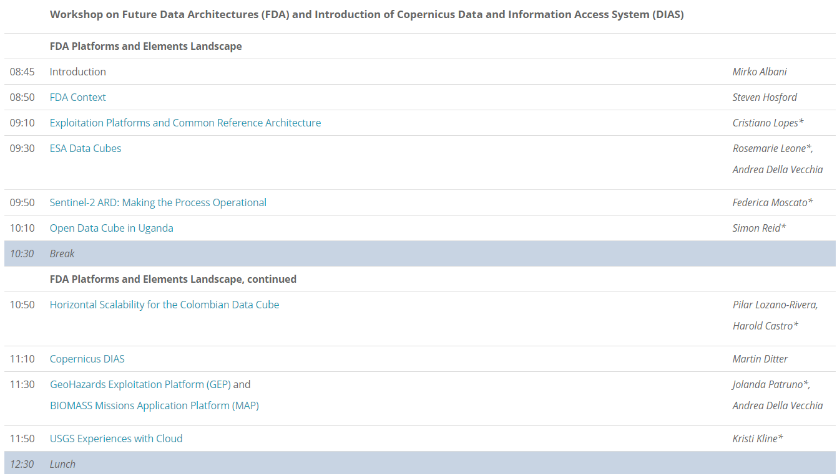
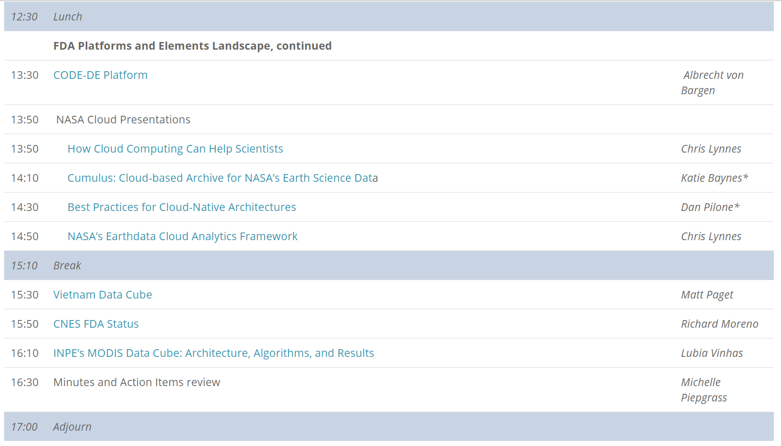
Relation with CEOS Work Plan
FDA-11: Organise several sessions/workshops to FDA-AHT/
share lessons learned WGISS
WGISS-45, FDA workshop, 11/04
SIT-33, 24-25/04
FDA Big Data Workshop, 26/04 Boulder
SIT Technical Workshop, 12-13/09

Slide 9
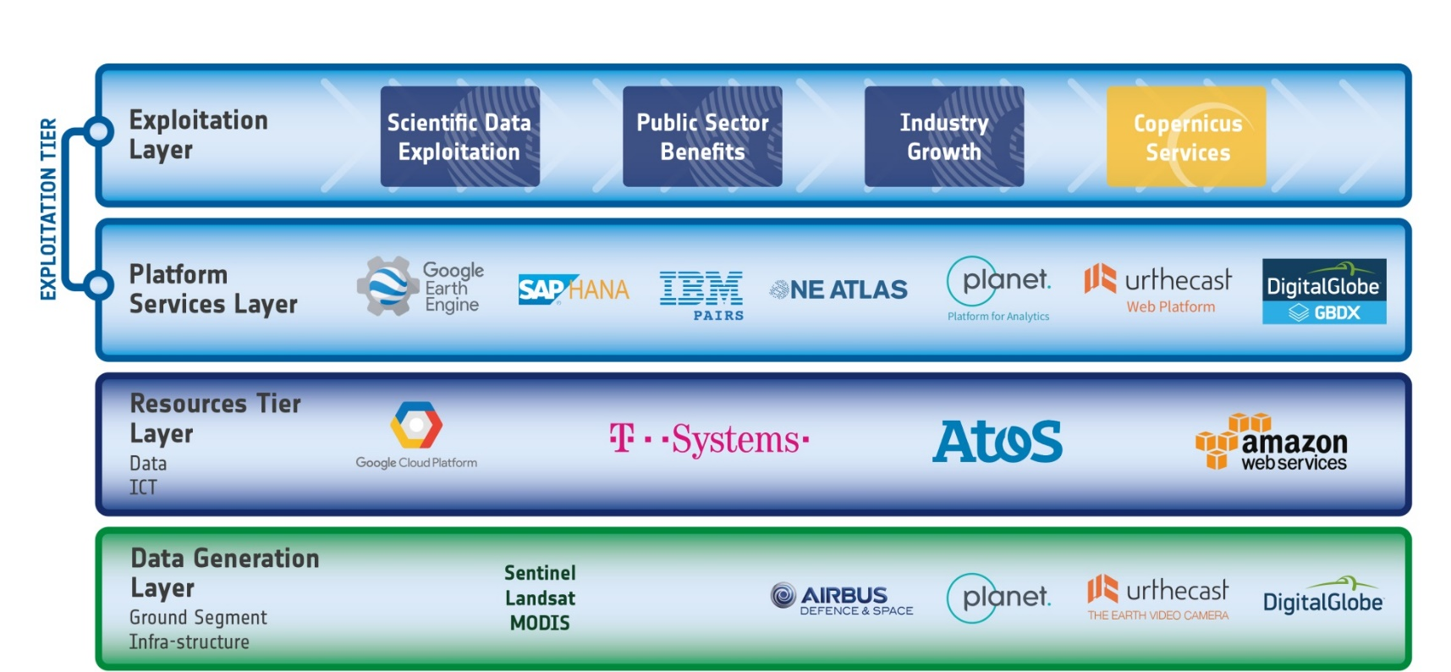
FDA Functional Blocks
Different descriptions of FDA “functional blocks”
Need to work toward common representation/terminology in order to define interfaces and, ultimately, need for standards
ESA
Chris Lynnes
NASA EOSDIS
Notes:
Analytics Optimized Data Store

Slide 10
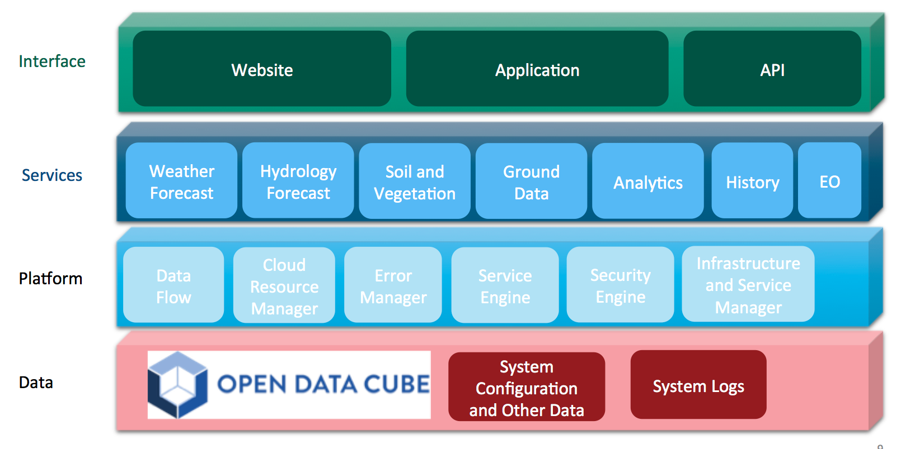
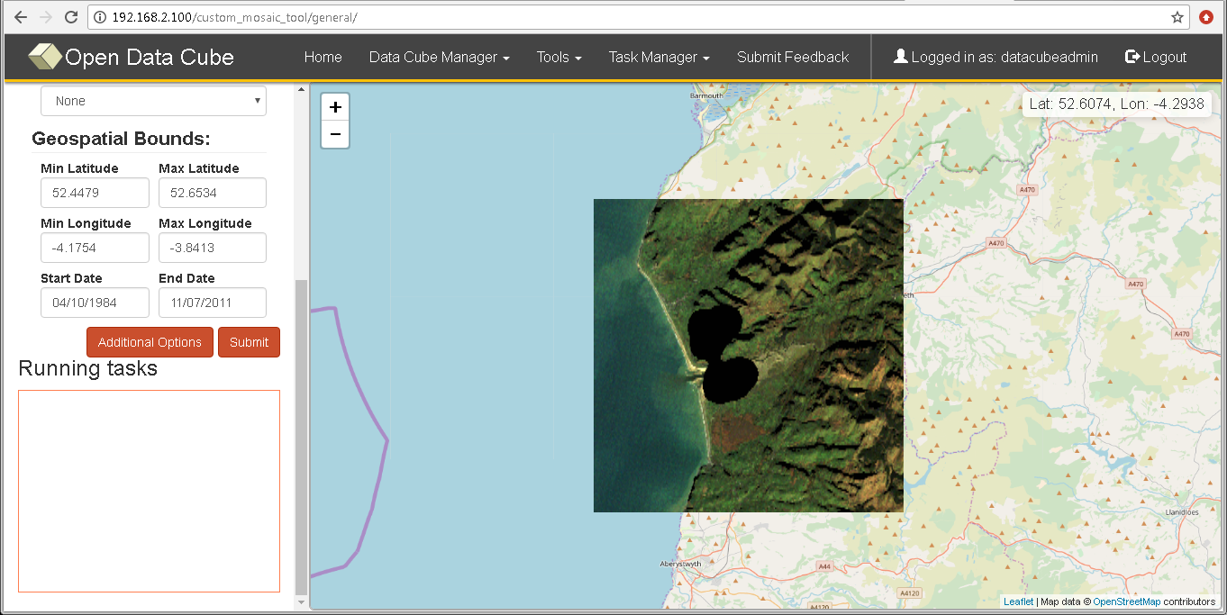
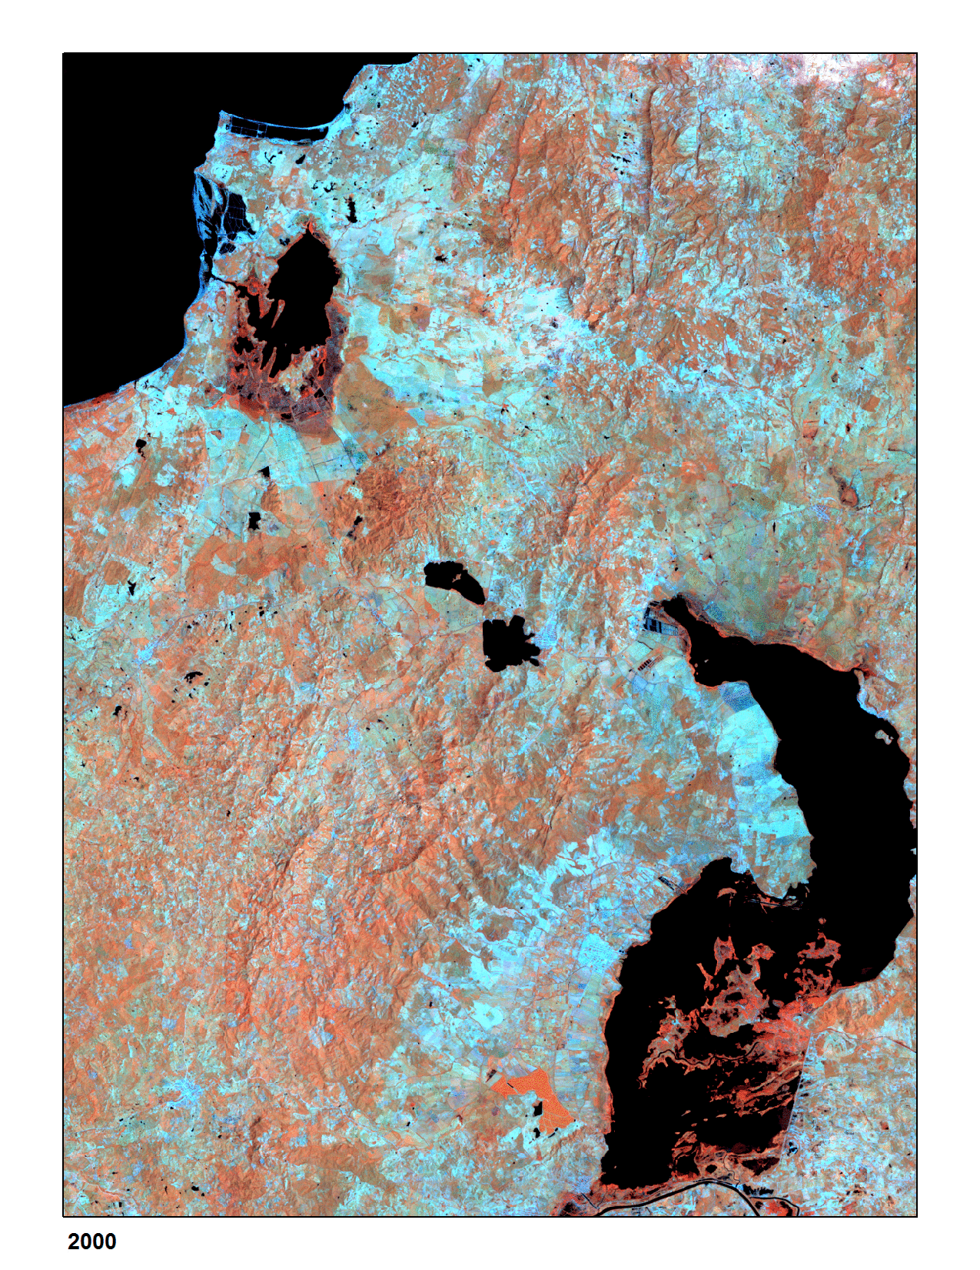
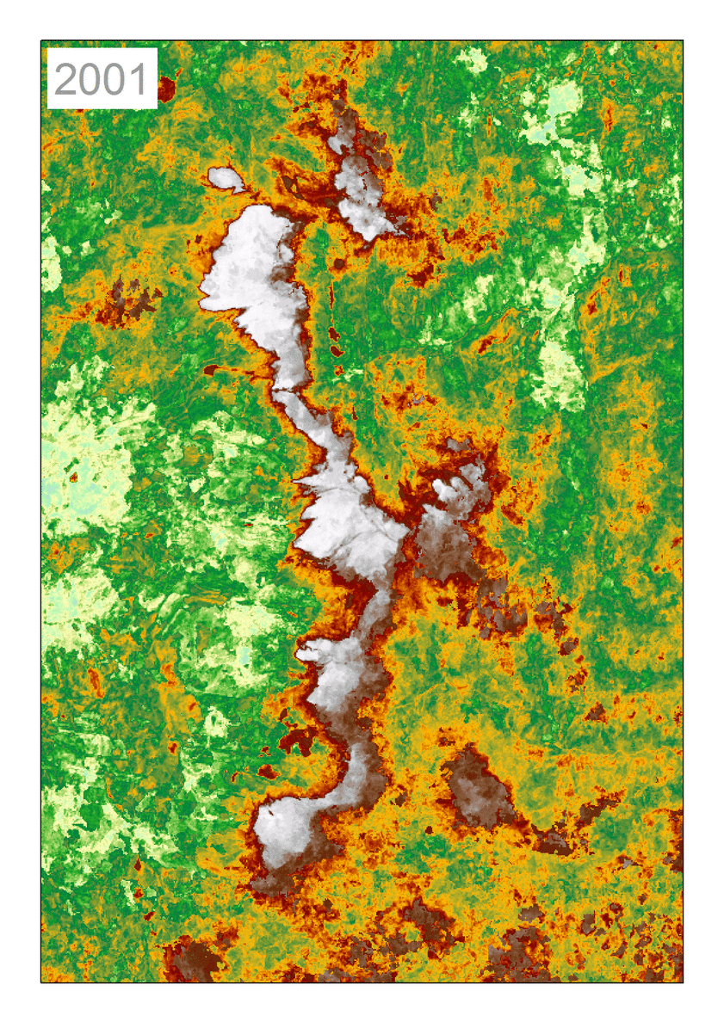
Data Cubes
WALES
UGANDA
VIETNAM

Slide 11
Data Cubes Dynamic Gridding
Agreement on a standard grid will significantly ease use and performance of data cubes.
… but it is a very ambitious task across data providers and application communities.
Investigation on a complementary approach to address:
Application communities complain about “loss of information” and about the method used for aggregation/ subsampling
Data duplication for use by datacube is prohibitive for space data (Processing cost is going to zero, storage cost doesn’t !!!)
Can we keep space data in original format and generate the gridding/ projection on-the-fly?
With the user selecting the grid and the projection/aggregation/subsampling method?

Slide 12
DIAS based functional chart
End user: customer to third-party services
FIVE DIAS PROVIDERS
Funded by
third-parties
Front
office service
Front
office service
Front
office service
Front
office service
Front
office service
Front
office service
Front
office service
Anne Chanié
anne.chanie@airbus.com
Front
office service
Front
office service
Front
office service
Alek Cesarz
alek.cesarz@creotech.pl
Front
office service
Copernicus DIAS interfaces
DIAS
funded
Guido Vingione
guido.vingione@serco.com
Contact for EUMETSAT DIAS
will be published once
commercial provider is selected
Copernicus Data & Information
Other EO and non-EO data
User data integrated into DIAS
Jean-Baptiste Lavedrine
jean-baptiste.lavedrine@atos.net

Slide 13
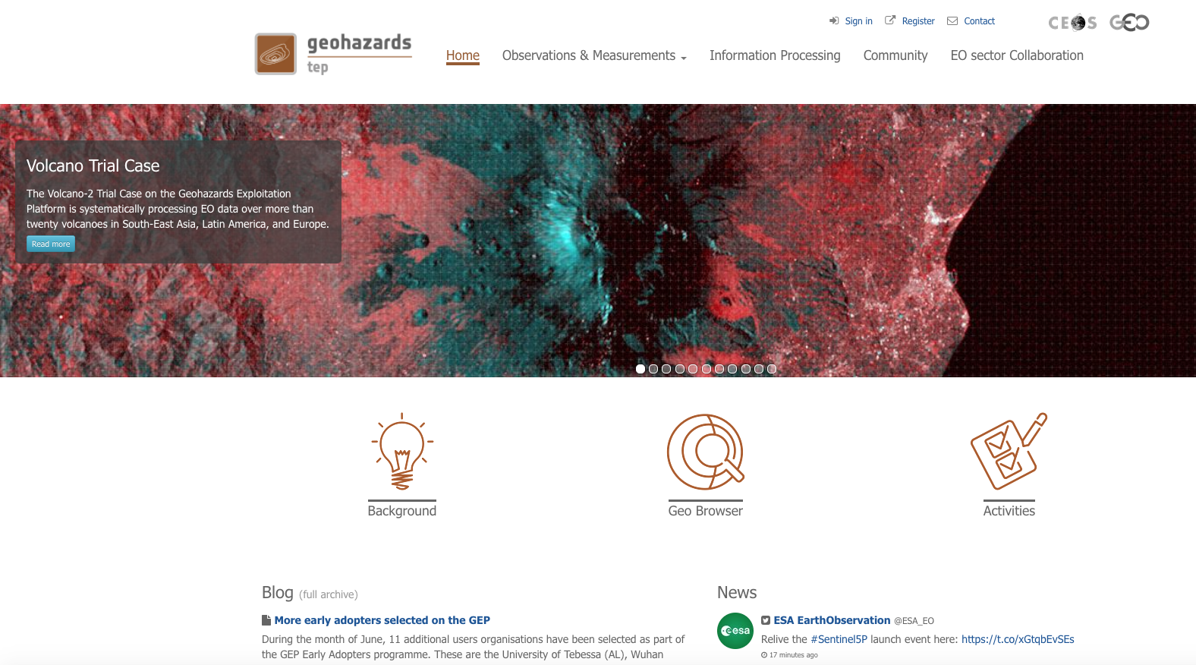
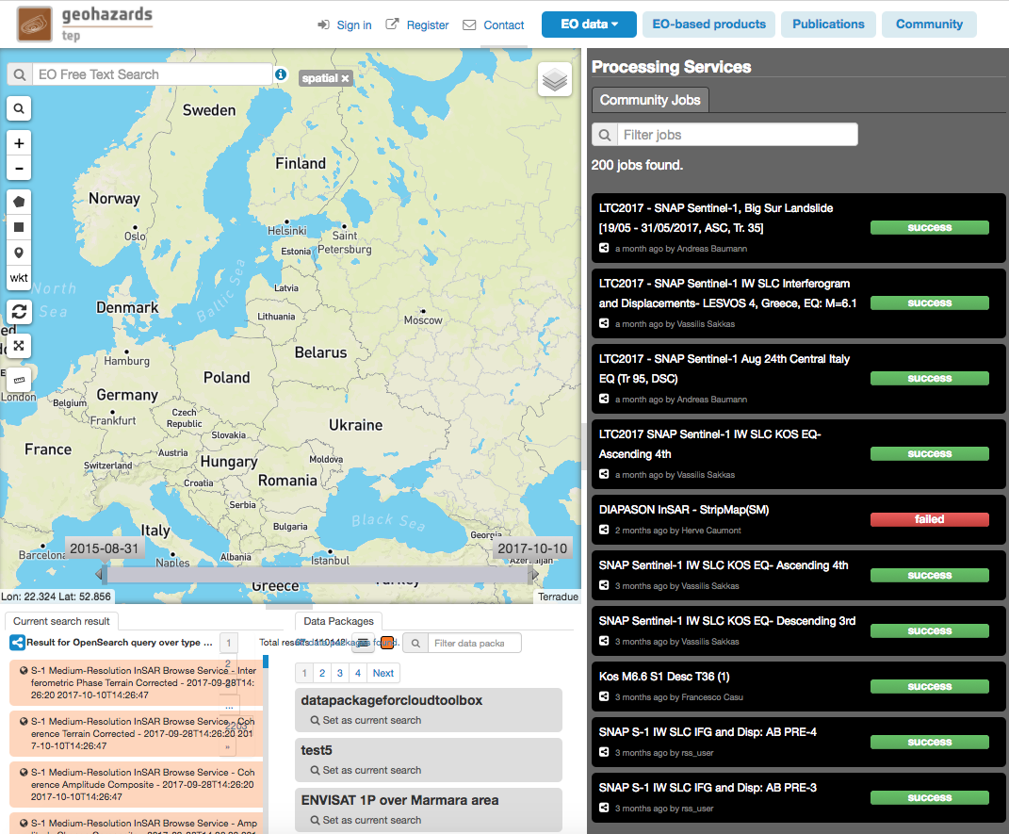
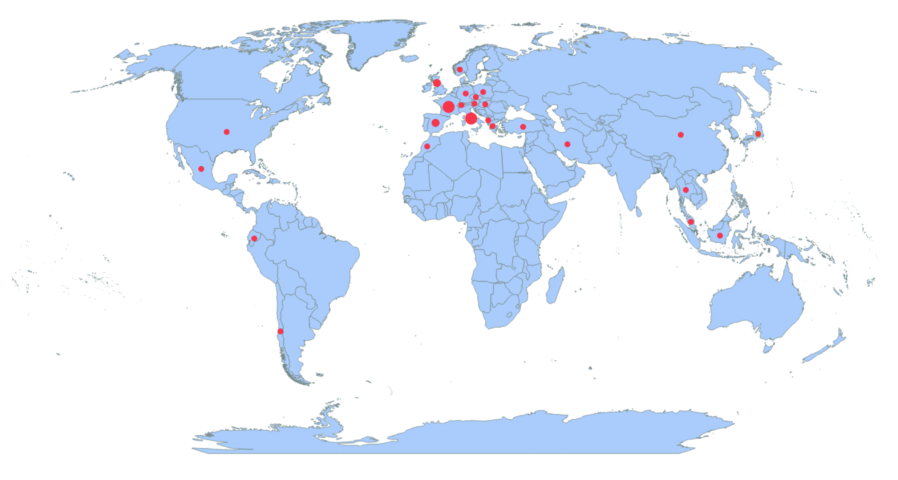
Thematic Exploitation Platforms:
Example Geohazards
Country | Number of User organisations
FR | 13
IT | 11
ES | 10
UK | 7
GR | 4
DE | 3
CH | 2
TR | 2
US | 2
AT | 1
CL | 1
CN | 1
CZ | 1
DK | 1
DZ | 1
EC | 1
HU | 1
JP | 1
ID | 1
IR | 1
MA | 1
ML | 1
MX | 1
NO | 1
PL | 1
TH | 1
Total | 71
820 registered users

Slide 14
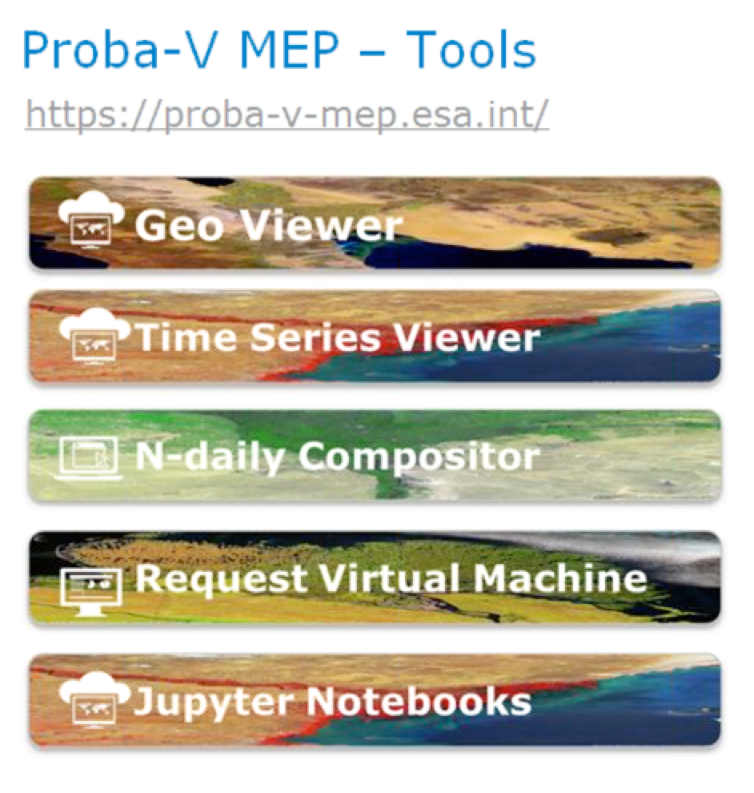
Mission Application Platforms
ESA-NASA multi-Mission Analysis Platform for improving global aboveground terrestrial carbon dynamics
ESA NASA MEP
NASA Mission
Data
NASA Mission
Tools&Visu
ESA-NASA
Missions
Community
ESA Mission
Data
ESA Mission
Tools&Visu
NASA Mission
Processing
resources
ESA Mission
Processing
resources

Slide 15
Copernicus Data and Exploitation Platform - Deutschland
code-de.org
830 users

Slide 16
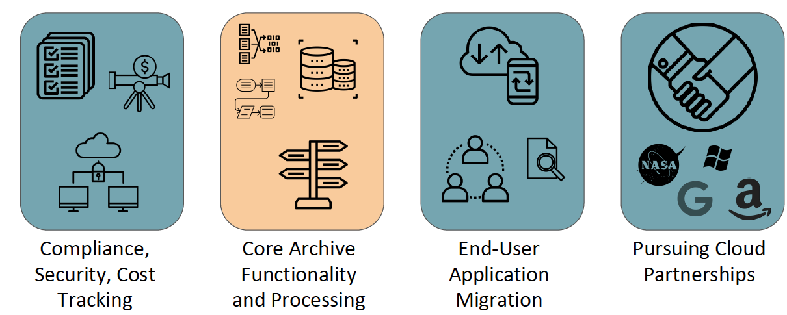
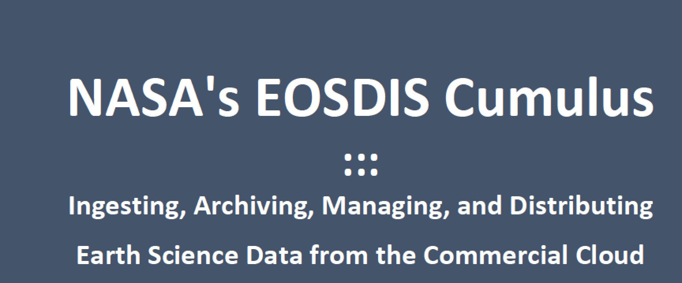
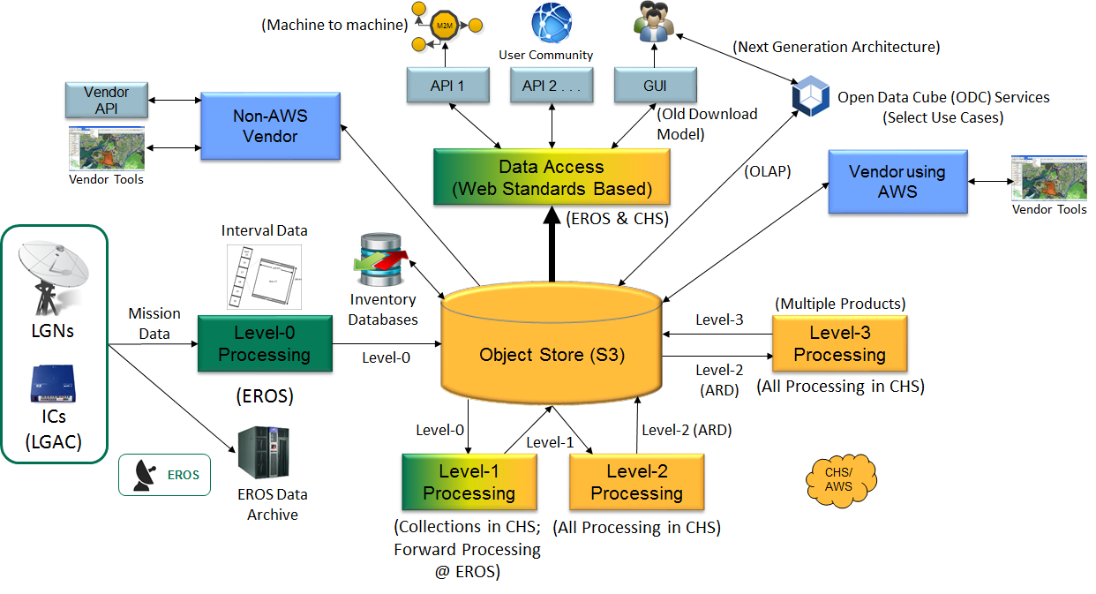
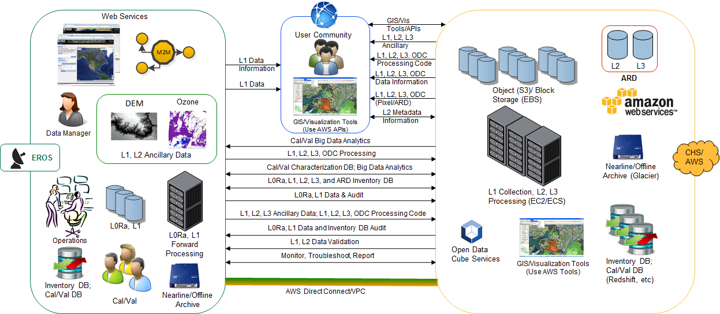
Moving to Cloud: some experiences

Slide 17
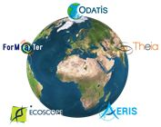
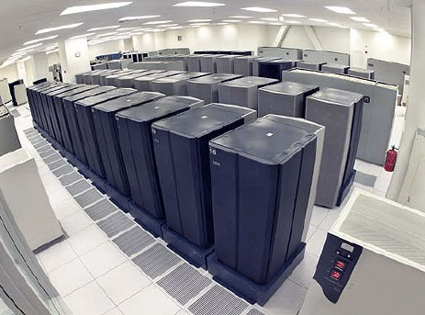
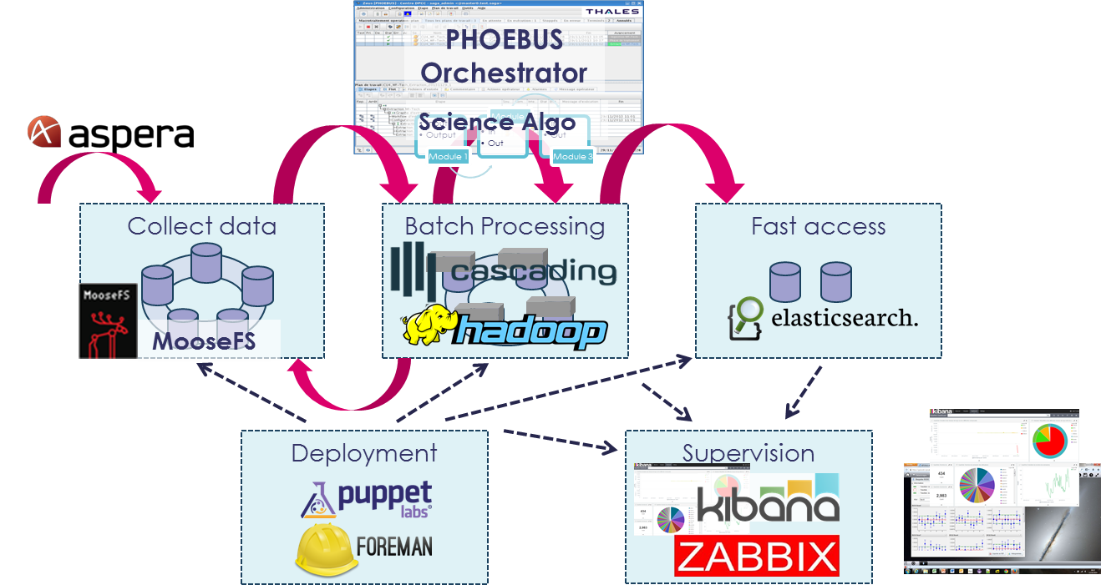
FDA examples (CNES)
Research Infrastructure “Earth system”
Built above French “Data and services centers”
Objective : foster research and application
across Earth System thematic areas
PEPS : French Copernicus Collaborative Ground-Segment
Mirror of Sentinel 1, 2 and 3 data
Data distribution / Hosting of processing and services
2 examples of ground systems based on big data technologies
GAIA ground-segment
CLS ground-segment
EOSC
DIAS
…
CNES - Direction du Numérique, de l'exploitation et des Opérations

Slide 18
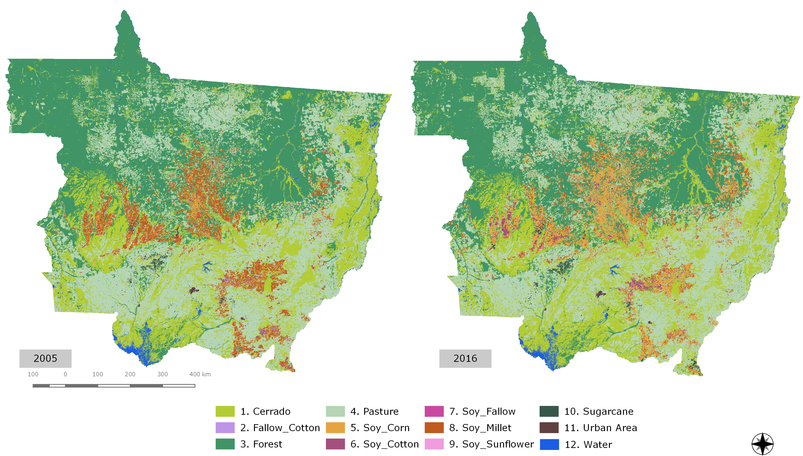
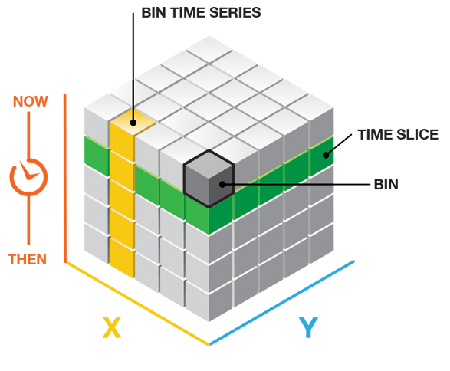
INPE’s e-sensing project
Mato Grosso – Brazil’s agricultural frontier
Not all data cubes are alike!
Deep learning trainning example
Samples for Mato Grosso (2,200): 3 layers of 512 neurons, ”elu” activation, dropouts (40%, 40%, 30%), adam_optimizer
Land change dynamics (2001-2017)

Slide 19
Summary from WGISS FDA Workshop
More and more agencies are experimenting with FDAs
This experimentation brings clear evidence of significant potential benefits
Varying implementations can induce huge variations in functionalities and costs (up to factor 15)
Consensus that a common architectural model and terminology will:
facilitate interagency dialog
enable identification of interfaces
enable work on standardisation once interfaces identified
FDA-8: Establish a common description of Future Data Architecture functional blocks and identify interfaces and interoperability approaches
Consensus that an inventory of “EO use environments” is a useful exercise that will provide insight into the EO ecosystem
FDA-9: Inventory and characterise existing FDAs

Slide 20
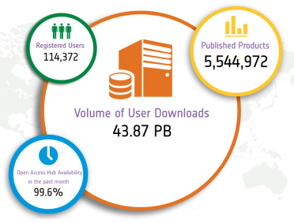
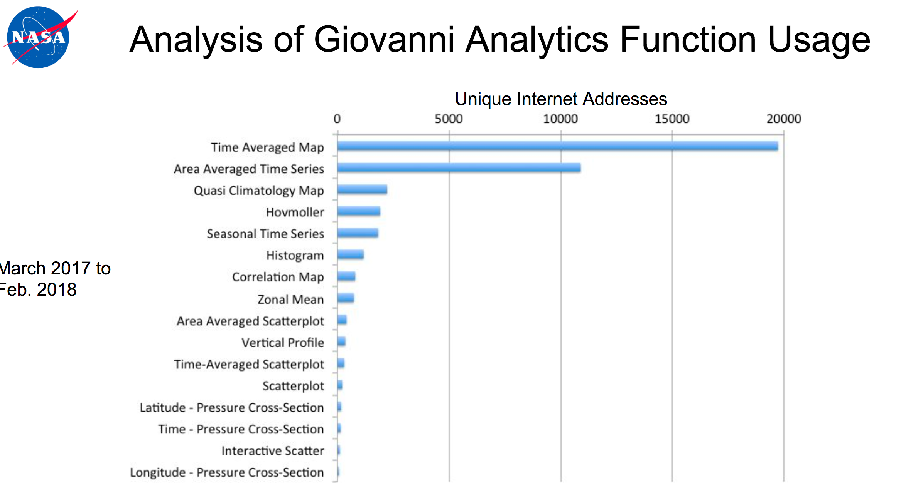
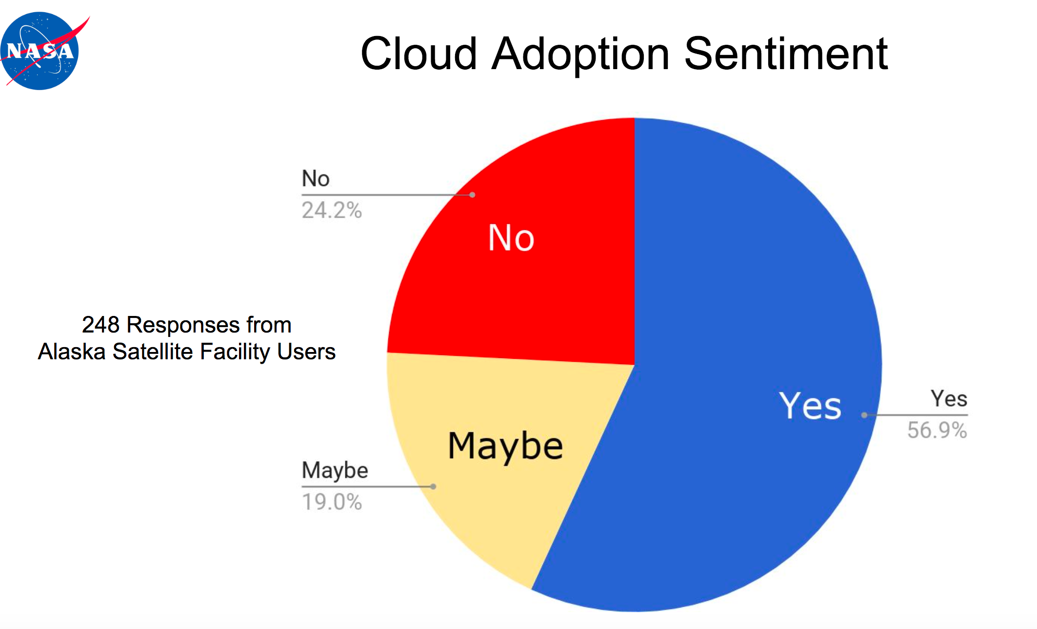
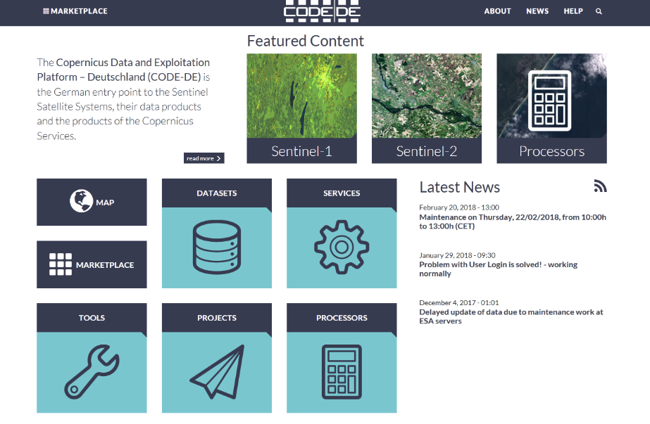
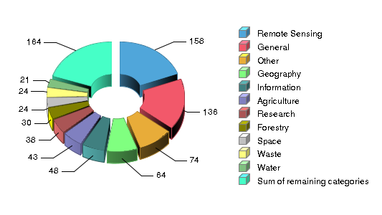
Report from WGISS - User Metrics
Presentations from several agencies (ESA, NASA, DLR) on current practice
Work on best practice across interested agencies
Need to define purpose and choose a subset of metrics to structure inventory of EO Resources
WGISS action on ESA
Panel Session at GEO Data Providers Workshop on 3rd May
1-100
100-199
200-399
400-799
>800
Number of user projects
Persistent Identifiers and Personal data Protection
FDA-13: Develop a User Metrics Best Practice

Slide 21
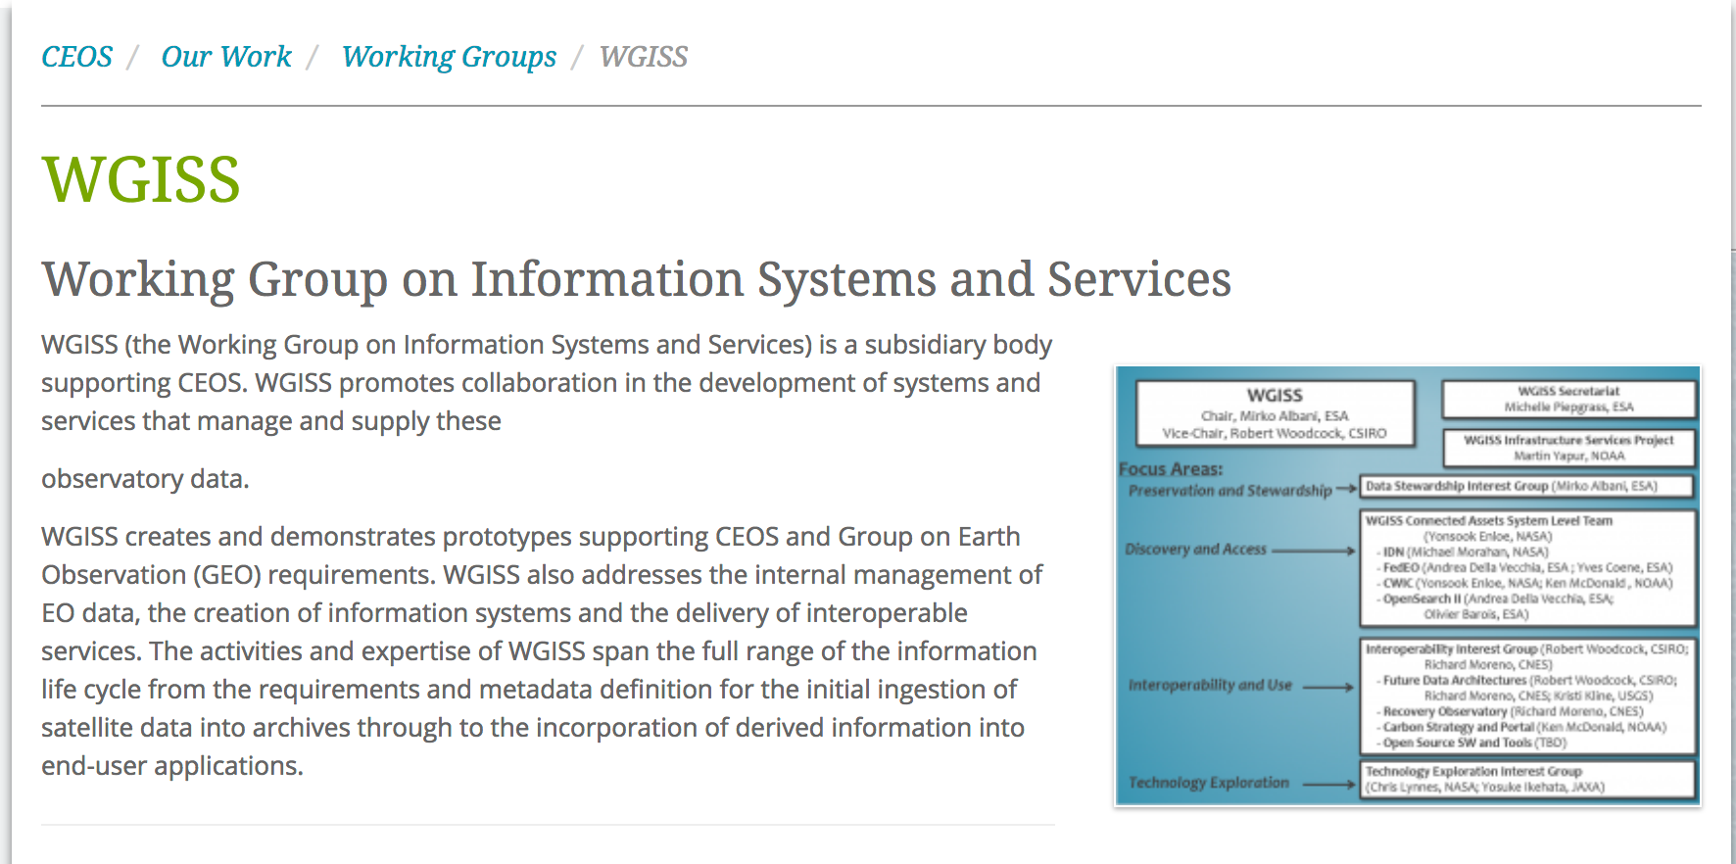
WGISS FDA Workshop Material
http://ceos.org/ourwork/workinggroups/wgiss/
http://ceos.org/meetings/wgiss-45/

