Slide 1
Copernicus DIAS Objectives
Committee on Earth Observation Satellites
European Commission CEOS 2018 Chair team
FDA Big Data Workshop
26th April 2018

Slide 2
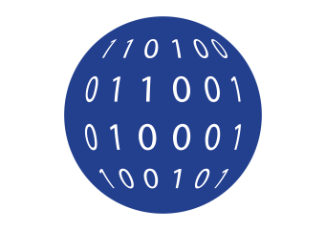
Copernicus - Challenge
Massive amounts of data
Full, open and free-of-charge
Ease of access and use
Different types of dissemination infrastructures
Member States Collaborative GS
New technology developments
ICT and EO cross-fertilisation
Interoperability with non-EO datasets
Public programmes as enablers
Growth and jobs in downstream sector
Over 10 Petabyte/year of new data
with just Sentinels-1, -2 and -3 fully operational
(data are downloaded many times over)

Slide 3
DIAS Objectives
Easy and user-­friendly; access to all Copernicus data and information
Maximise uptake and exploitation of Copernicus/ EO data in an efficient environment
DIAS as an enabler: stimulate the emergence of an ecosystem that facilitates activities by 3rd parties
Bring together research & operational, supply & demand, different data sources and know-how
Commission bears large part of common costs, defragmentation, increased efficiency and cross-fertilisation
Notes:
Easy and user-­friendly; access to all Copernicus data and information
Maximise uptake and exploitation of Copernicus/ EO data in an efficient environment
DIAS as an enabler: stimulate the emergence of an ecosystem that facilitates activities by 3rd parties
Bring together research&operational, supply&demand, different data sources (both EO and non­‐EO) and know-how (EO, ICT, thematic)
Commission bears large part of common costs, defragmentation, increased efficiency and cross-­fertilisation

Slide 4
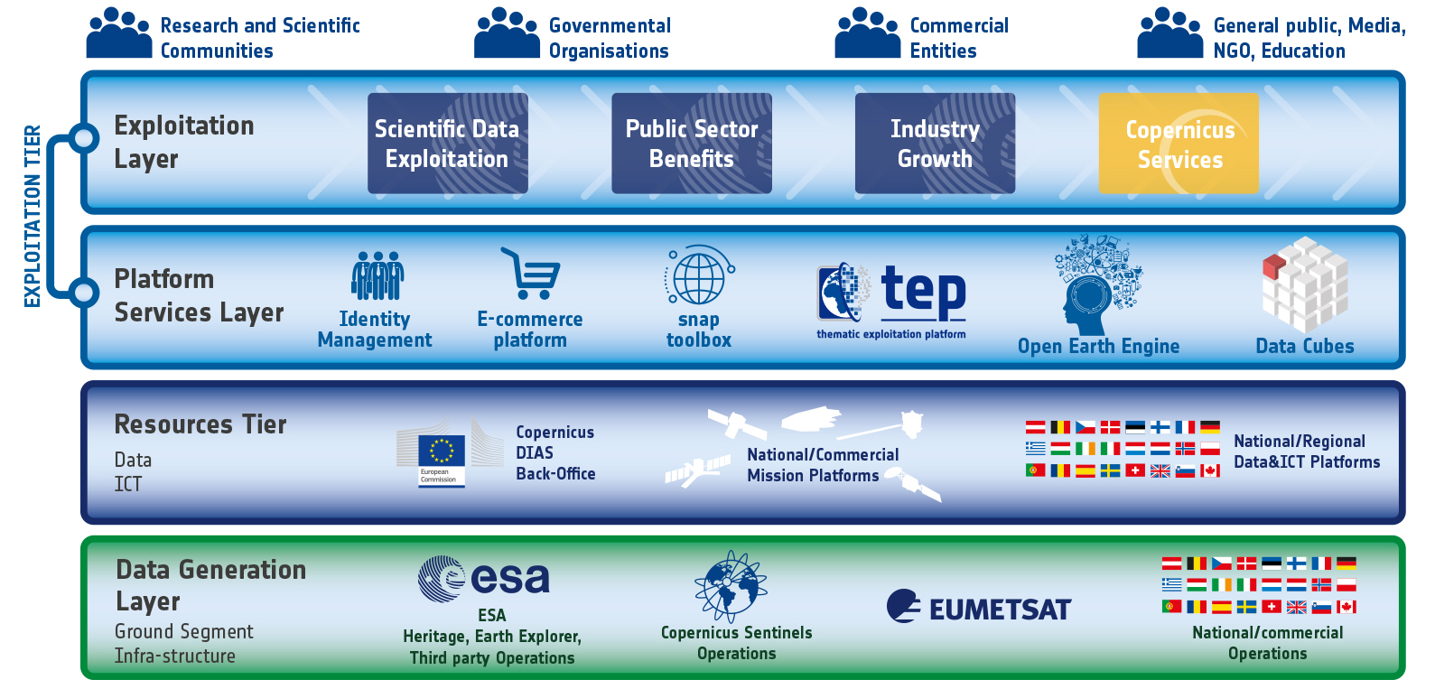
DIAS within the EO Ecosystem

Slide 5
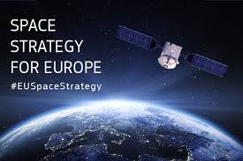
DIAS Core Principles
Access must be open and non-discriminatory
Operation must be fair and obey competition rules including for institutional demand
Transparency of governance and reporting
Must promote Copernicus brand
Intellectual property must be protected

Slide 6
Functional Requirements & More
Find the link to functional requirements here
Functional Requirements state the Copernicus - defined mandatory services
Copernicus Distribution Services
Copernicus Data and Information Access Services (DIAS)
And more … this focuses on DIAS-based, additional services in response to user demand
Responds to bespoke user needs
E.g. added data, tools, compute …
More
User
DIAS Mandatory Functions

Slide 7
DIAS - Functional Context
End user: customer to third-party services
Funded by
third-parties
Copernicus Services & user uptake
Copernicus Data & Information Access Services
Open Science Cloud & GEOSS Common Research and Innovation Projects (H2020)
Infrastructure (GCI)
Front
office service
Front
office service
Front
office service
Front
office service
Front
office service
Front
office service
Front
office service
Front
office service
Front
office service
Front
office service
Front
office service
Heritage Data (LTDP+), Earthnet
EOEP-5 EO Science for Society
EarthWatch CCI, InCubed
Copernicus DIAS interfaces
DIAS
funded
EU MS & participating countries
National/commercial missions data access
Sentinel Collaborative Ground Segment
Copernicus Data & Information
Other EO and non-EO data
User data integrated into DIAS
Third-party
Users
&

Slide 8
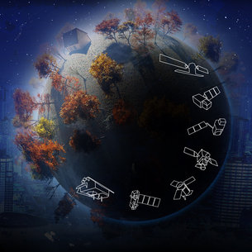
DIAS Mandatory (public) Functions
Data holdings*
Sentinel data (-1, -2, -3, -5p)
Copernicus Services Information
Selection of Third party data
Services
Discovery and View services, Basic downloads
Basic Programming / application environment
Free/open source tools
Basic user support services
* Temporal and geographic coverage may differ from one DIAS provider to another

Slide 9
DIAS Other Functions
Commercial Offers
Data
Hosting of Third Party data (e.g. Commercial, Institutional data)
Services
Advanced development and application environment
ICT resources (Storage & processing power)
Advanced/commercial tools
Third Party business hosting
Market place for Third Party value- adding services
* Temporal and geographic coverage may differ from one DIAS provider to another

