Slide 1
Opening Remarks
Committee on Earth Observation Satellites
European Commission CEOS 2018 Chair
FDA Big Data Workshop
26th April 2018

Slide 2
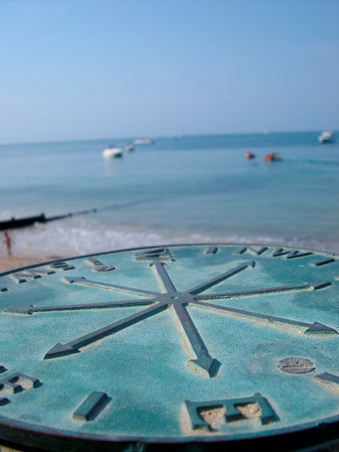
Objectives
Share experience and best practices related to CEOS agency initiatives involving commercial Information & Communication Technology (ICT) providers – SEO feedback
How are such these initiatives integrated into the overall service offering of CEOS agencies?
Are they effective in serving our user communities and facilitating development of value-added services?
What benefit can be drawn in the domain of user uptake?
What ARD products and features are needed in this context?
How do we maintain and develop links to current and future user communities?

Slide 3
Common Challenge
Common challenge
Massive amounts of data
Full, open and free-of-charge
Ease of access and use
Different types of dissemination infrastructures
Member States Collaborative GS
New technology developments
ICT and EO cross-fertilisation
Interoperability with non-EO datasets
Public programmes as enablers
Growth and jobs in downstream sector
Over 10 Petabyte/year of new data
with just Sentinels-1, -2 and -3 fully operational
(data are downloaded many times over)

Slide 4
Our Response: DIAS - Objectives
Easy and user-­friendly; access to all Copernicus data and information
Maximise uptake and exploitation of Copernicus/ EO data in an efficient environment
DIAS as an enabler: stimulate the emergence of an ecosystem that facilitates activities by 3rd parties
Bring together research & operational, supply & demand, different data sources and know-how
Commission bears large part of common costs, defragmentation, increased efficiency and cross-fertilisation
The Copernicus DIAS has been conceived with the active involvement of the EU Member States
Notes:
Easy and user-­friendly; access to all Copernicus data and information
Maximise uptake and exploitation of Copernicus/ EO data in an efficient environment
DIAS as an enabler: stimulate the emergence of an ecosystem that facilitates activities by 3rd parties
Bring together research&operational, supply&demand, different data sources (both EO and non­‐EO) and know-how (EO, ICT, thematic)
Commission bears large part of common costs, defragmentation, increased efficiency and cross-­fertilisation

Slide 5
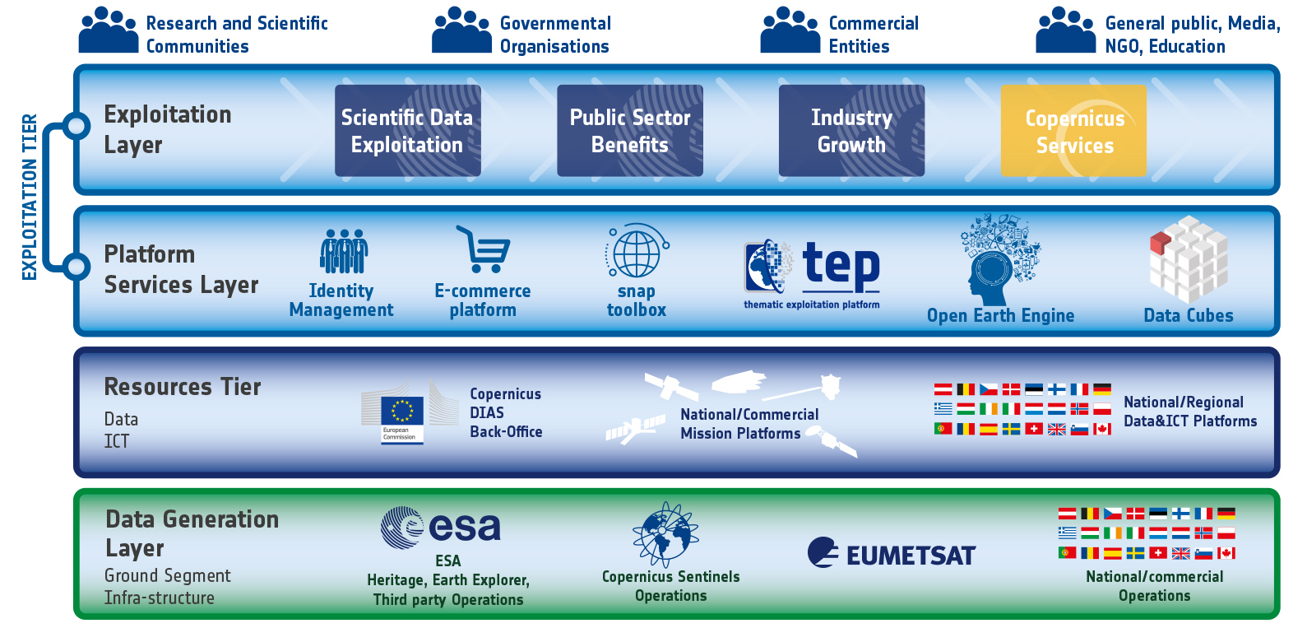
DIAS within the EO Ecosystem

Slide 6
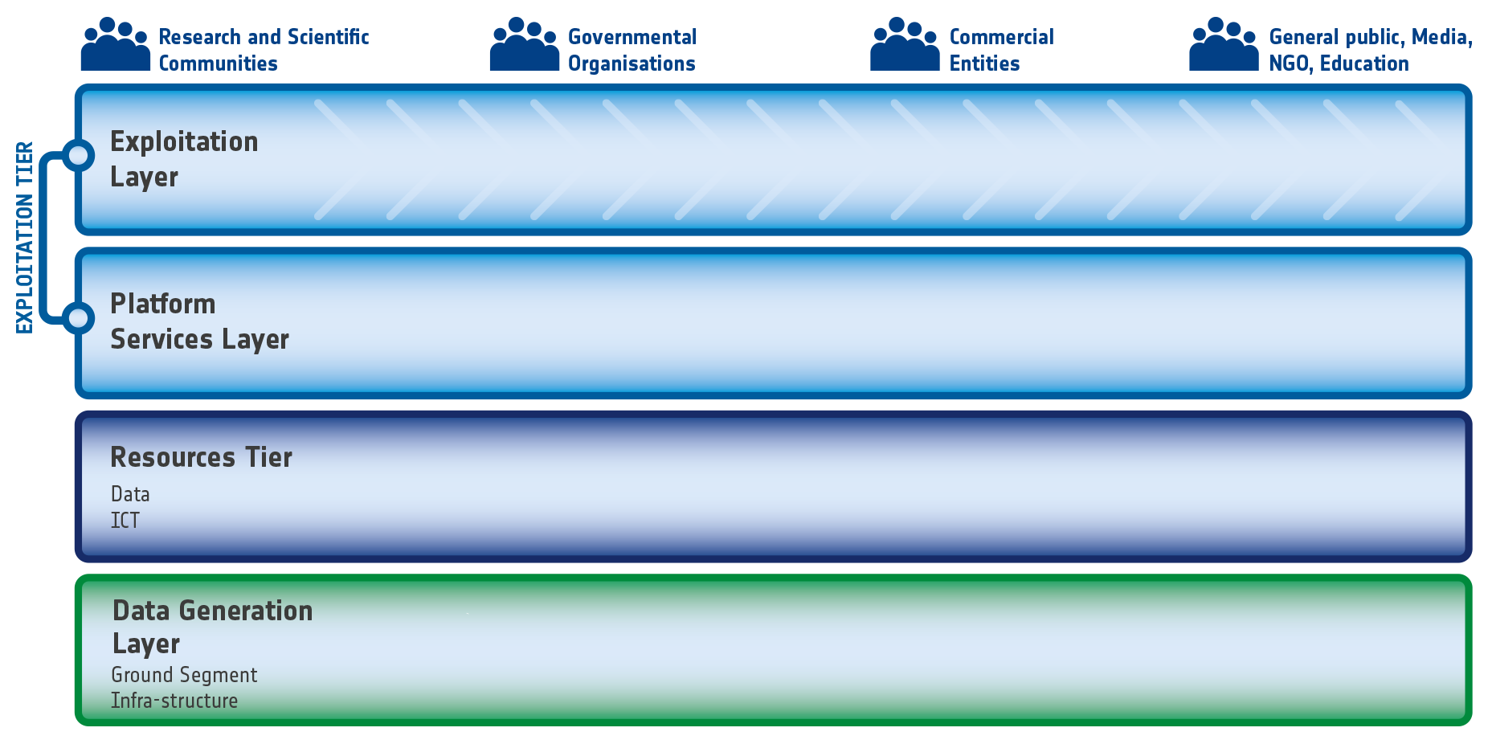
A common vision of FDA structure?
Your project here
Your project here
Notes:
Could we build on this simplified structure to develop a common terminology and vision on the FDA architecture?

Slide 7
Expected Workshop Results
Key elements towards a comprehensive inventory of initiatives including their features and a return on experience from CEOS agencies
A good understanding of data and data-features best suited to be exposed in such environments so to create maximum impact
Copernicus is designed to deliver decision-ready information through its six services
Complementary information products could be generated based on ARD products made available through CEOS agencies
Progressing the understanding of best practices in user management to provide a firm link between our actions and user needs
Elements for a SWOT analyses based on an open exchange on the distribution of roles between the public and private sectors
Notes:
CEOS Mission Statement:
CEOS ensures international coordination of civil space-based Earth observation programs and promotes exchange of data to optimize societal benefit and inform decision making for securing a prosperous and sustainable future for humankind.
To this end, the primary objectives of CEOS are:
• To optimize the benefits of space-based Earth observation through cooperation of CEOS Agencies in mission planning and in the development of compatible data products, formats, services, applications and policies
• To aid both CEOS Agencies and the international user community by, among other things, serving as the focal point for international coordination of space-based Earth observation activities, including the Group on Earth Observations and entities related to global change
• To exchange policy and technical information to encourage complementarity and compatibility among space-based Earth observation systems currently in service or development, and the data received from them, as well as address issues of common interest across the spectrum of Earth observation satellite missions

