Slide 1


Overview of JAXA water-related satellite missions
T. Kubota, R. Oki, and M. Kachi
Earth Observation Research Center (EORC)
Japan Aerospace Exploration Agency (JAXA)

Slide 2
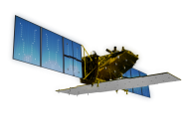
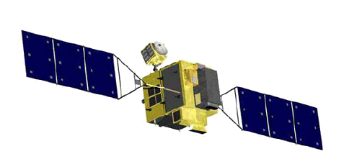

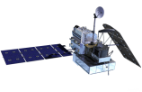
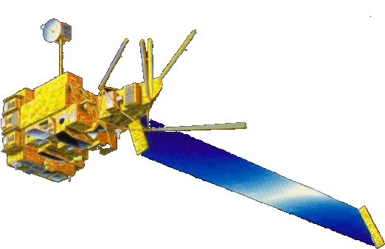


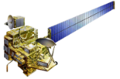
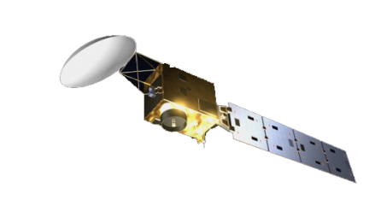


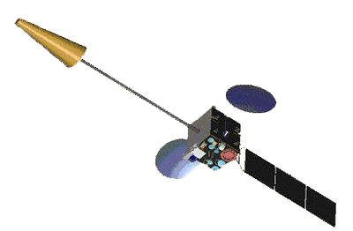
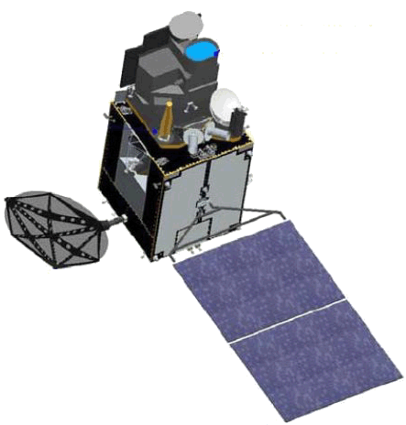
JAXA Earth Observation Satellite missions
Targets (JFY: Apr-Mar) |  | 2012 | 2013 | 2014 | 2015 | 2016 | 2017 | 2018 | 2019 | 2020 | 2021 | 2022
Disasters & Resources JERS1/OPS, SAR (1992-1998) ADEOS-I/AVNIR ALOS/AVNIR2, PALSAR (2006-2011)
Climate System Water Cycle ADEOS-I/AMSR (1996-1997) Aqua/AMSR-E (2002-2010)
Climate change ADEOS-I/OCTS (1996-1997) ADEOS-II/GLI (2003)
Greenhouse gases
[Land and disaster monitoring]
ALOS-2 / PALSAR-2
ALOS-4
ALOS-2CIRC
ISS/CIRC
ALOS-3
TRMM / PR 1997-2015
[Precipitation 3D structure]
Feasibility study
DPR F/O
with NASA
GPM / DPR
with NASA
[Wind, SST , water vapor, precipitation]
AMSR2-F/O
GCOM-W / AMSR2
[Vegetation, aerosol, cloud, SST, ocean color]
GCOM-C / SGLI
[Cloud and aerosol 3D structure]
with ESA
EarthCARE
[CO_{2,} CH_{4,}
GOSAT / FTS, CAI 2009~
GOSAT-3
[CO_{2,} CH₄, CO]
with MOE
GOSAT-2
JMA meteorological satellites
MTSAT-1R (Himawari-6)
MTSAT-2 (Himawari-7)
[Cloud, aerosol, SST]
[Cloud, SST]
Himawari-8/AHI
Himawari-9 (standby)
Mission status
On orbit
Development
Study
Pre-phase-A

Slide 3
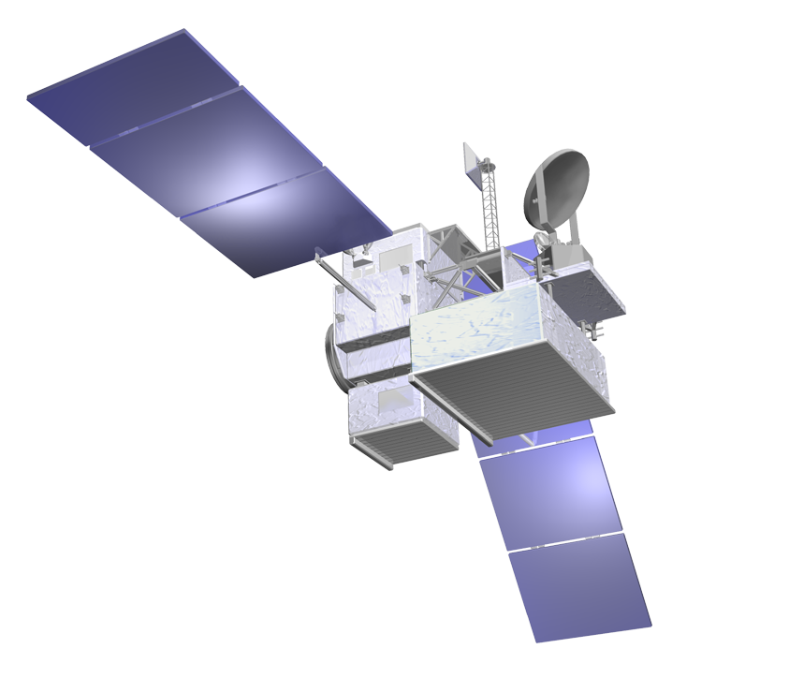
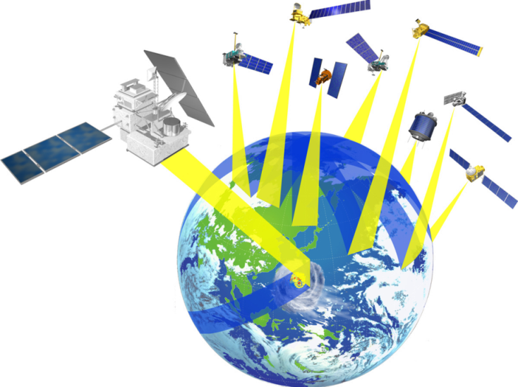
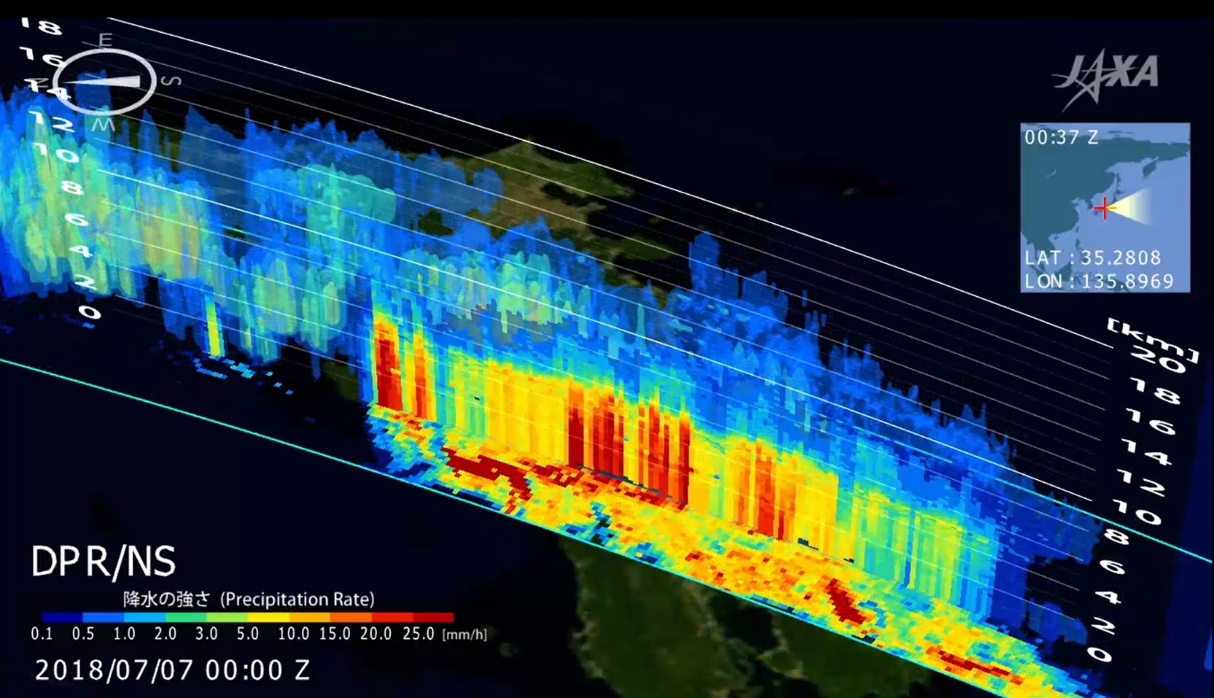
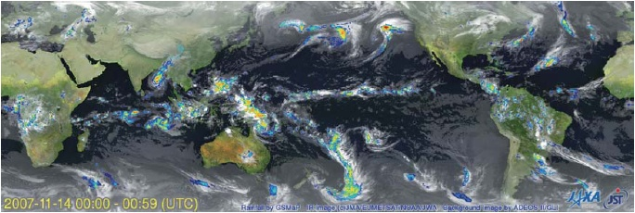
Global Precipitation Measurement (GPM)
GPM Core Observatory
GPM is an international mission consisting of the GPM Core Observatory and Constellation Satellites for high accurate and frequent global precipitation observation.
  Core Observatory: developed under NASA and JAXA equal partnership.
  Constellation satellites: provided by international partners (includes Megha-Tropiques, GCOM-W1).
Dual-frequency Precipitation Radar (DPR)
  developed by JAXA and NICT
  DPR is composed of two radars: KuPR & KaPR
GPM Core Observatory was successfully launched at Tanegashima, Japan on Feb. 2014.
All GPM standard products were released on September 2014.
GMI (Microwave Imager)
KuPR: 13.6GHz radar (phased array)
KaPR: 35.5GHz radar (phased array)
DPR
Constellation
Satellites by international partners, e.g.,
Megha-Tropiques, GCOM-W, ..
Core
Observatory
by NASA-JAXA
Notes:
GPM is an international mission consisting of the GPM Core Observatory and Constellation Satellites for high accurate and frequent global rainfall observation.
- Core Observatory: developed under NASA and JAXA equal partnership.
- Constellation satellites: provided by international partners (includes GCOM-W1)
Dual-frequency Precipitation Radar (DPR)
- developed by JAXA and NICT
- the most sophisticated precipitation radar
- 3D structure of rainfall
- simultaneous dual-frequency observation to detect even weak rainfall and snowfall.
GPM Core Observatory will be launched in early 2014.

Slide 4
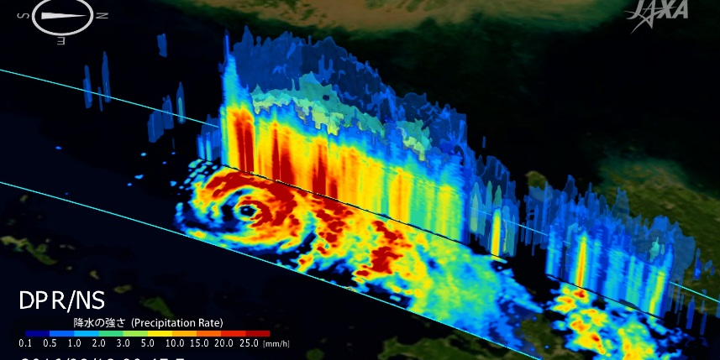
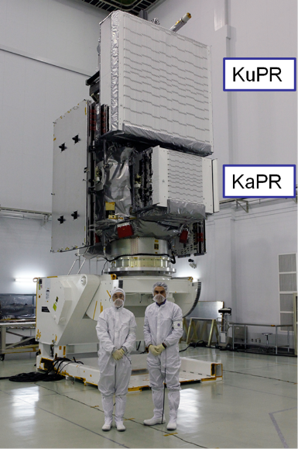
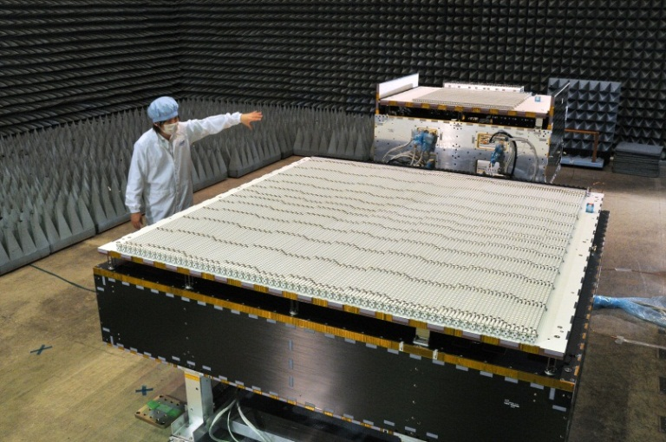
Dual-frequency Precipitation Radar (DPR)
3-dimensional precipitation observation by the GPM/DPR

Slide 5
JAXA GPM Products
Level | Product | Physical value | unit | coverage | resolution
1 | KuPR L1 | RX Power Profile | orbit | 245km | 5km (horizontal), 125m (vertical)
 | KaPR L1 | RX Power Profile | orbit | 125km | 5km(horizontal), 125/250m (vertical)
2 | KuPR L2 | Radar reflectivities, Sigma-zero,Rain Type, BBH, Precipitation rate, etc. | orbit | 245km | 5km (horizontal), 125m (vertical)
 | KaPR L2 | Radar reflectivities, Sigma-zero,Rain Type, BBH, Precipitation rate, etc. | orbit | 125km | 5km (horizontal), 125m (vertical)
 | DPR L2 | Precipitation intensity profile, DSD, etc. | orbit | 245km | 5km (horizontal), 250m (vertical)
 | DPR/GMI Combined L2 | Precipitation intensity profile, Surface precipitaion, etc. | orbit | 125km | 5km (horizontal), 250m (vertical)
 | DPR Latent Heating L2 | Latent heating profile, Rain type, etc. | orbit | 245km | 5km (horizontal), 250m (vertical)
3 | DPR L3 | Surface precipitation, Time info., etc. | daily | Global | 0.1-deg
 |  | Surface precipitation (DPR only), BB, Radar reflectivities, etc. | daily | Global | 0.25-deg
 |  | Surface precipitation (Ku, Ka, DPR), BB, Radar reflectivities, histgram, etc. | Monthly | Global | 0.25-deg
 | DPR/GMI combined L3 | Average Precipitation distribution, etc. | daily, monthly | Global | 0.5-deg
 | DPR Latent Heating L3 | Latent heating profile, etc. | daily, monthly | Global | 0.5-deg, 19-layer (TBD)
 | Global Precipitation Map (GSMaP) | Rainfall map, gauge-calibrated rainfall, etc. | hourly, monthly | Global | 0.1-deg

Slide 6
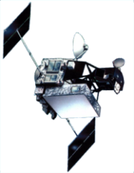
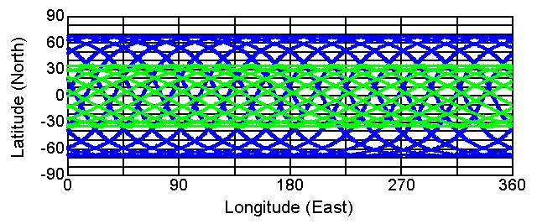
Spaceborne Precipitation Radar data record
1995
2000
2005
2010
2015
2020
TRMM/PR
(by JAXA/NICT)
1997-2015
Ku-band（13.8GHz)
World first spaceborne precipitation radar
Significant improvement of the global rain estimation
Deeper understanding on the tropical precipitation systems
long term global precipitation record
GPM/DPR
(by JAXA/NICT)
2014-
Ku-band（13.6GHz）
Ka-band（35.5GHz）
Upgrade the TRMM/PR: Improvement of accuracy by the dual frequency radar
Apply to higher latitude
Apply to flood warning systems using Combined product of radar, MWR and IR
1-day orbits of TRMM(PR) and GPM-Core(DPR)
17 years observations using Precipitation radar (PR) on the TRMM
→To be extended by GPM to longer time period and mid/high latitudes

Slide 7
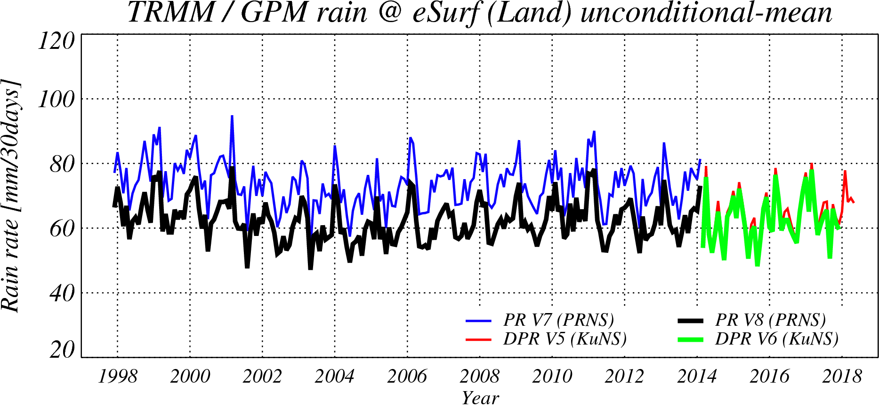
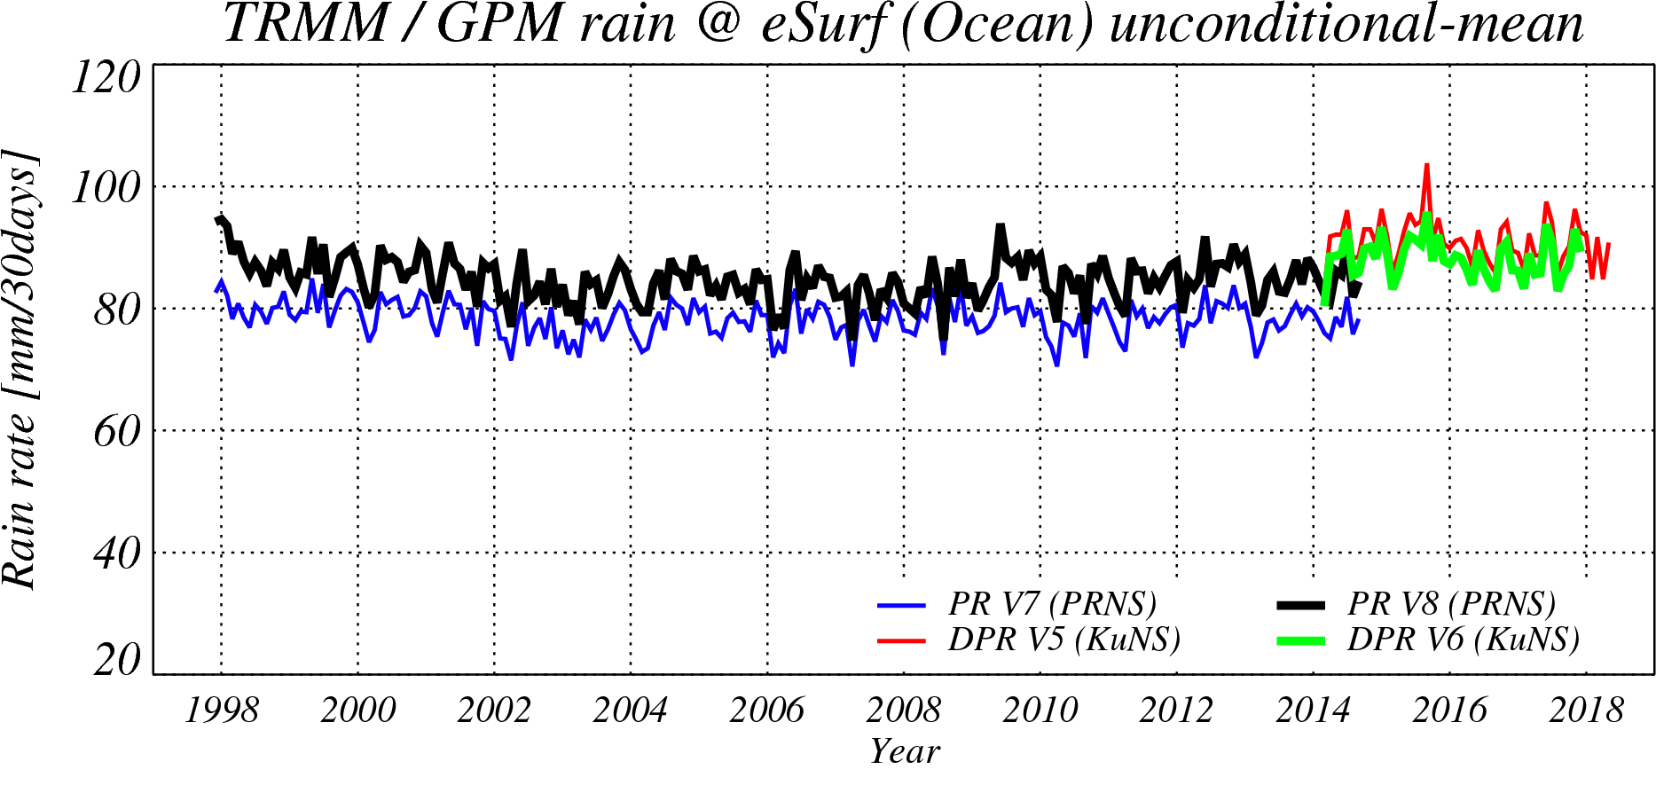
Better continuity of the TRMM/PR (1997-2015) and the GPM/DPR (2014-)
GPM/DPR’s calibration factors was changed in V05 released on May 2017, and TRMM/PR’s calibration factors was also changed in TRMM/PR-L1 V8 (GPM TRMM V05) L1 released on Oct. 2017.
Better continuity was realized in the TRMM/PR-L2 V8 (GPM TRMM V06) and GPM/DPR-L2 V06 released in Oct. 2018, by using common L2 algorithms between the TRMM/PR and the GPM/KuPR.
Over-land surface precipitation rates averaged in 35S-35N.
Over-ocean surface precipitation rates averaged in 35S-35N.
PR V7
KuPR V5
KuPR V5
PR V8
PR V7
KuPR V6
PR V8
KuPR V6
1998
2018
1998
2018
Notes:
The last topic of precipitation radar is about developing long period radar precipitation record from TRMM/PR to GPM/DPR.
The first big task we had to overcome was calibration of DPR and PR.
The sigma0 level of early version of GPM’s Ku radar, that is V04 was here.
But we reconsidered the method of calibration itself and updated as V05, here.
Then we also applying the same method to the TRMM/PR’s level 1 data.
As the result, better continuity was realized between GPM/Ku V05 and the TRMM/PR V8 and also looks reasonable comparing the other independent instruments.
We already released their level 1 data, last year.

Slide 8

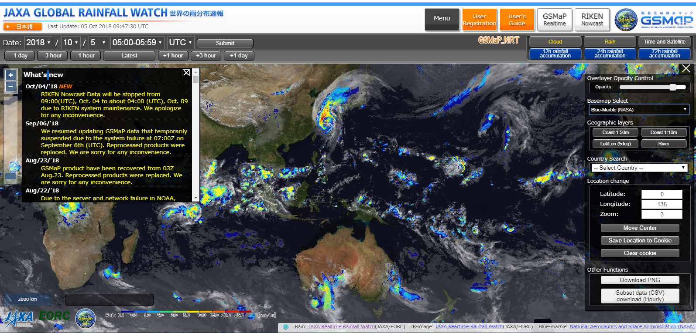
Global Satellite Mapping of Precipitation (GSMaP)
http://sharaku.eorc.jaxa.jp/GSMaP/
We renewed our website!
Registered users:
4261 users
114 counties
(Oct. 2018)
GSMaP is a blended Microwave-IR product and has been developed in Japan for the GPM mission.
  U.S. counterpart is “IMERG”
  GSMaP (v6) data was reprocessed as reanalysis version (GSMaP_RNL) since Mar. 2000 period , and was open to the public in Apr. 2016, and new version, GSMaP (v7) was released in 17 Jan. 2017.
  We submitted a book chapter (Kubota et al. 2018) to review the GPM-era GSMaP products (in the Springer Book on Satellite Precipitation).
Notes:
Global Satellite Mapping of Precipitation (GSMaP) is a blended Microwave-IR product and has been developed in Japan toward the GPM mission. U.S. counterpart is “IMERG”
Proto-type version has been in operation in JAXA since 2007.
“GPM-GSMaP” data were released on Sep. 2014.

Slide 9
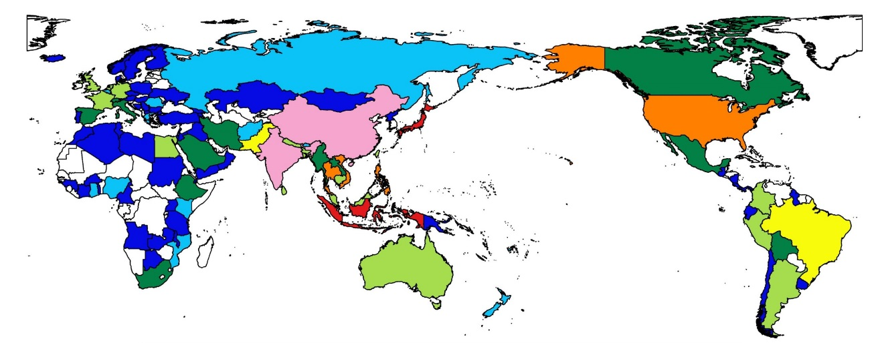


Increasing GSMaP users
Now we have about 4300 users from 114 countries registered for the GSMaP data distribution.
GSMaP registered users
The number of GSMaP registration users
(data analysis users)
4000
Registration number
Sep. 2008
Sep. 2018
About 4261 registered users from
114 countries at the end of Oct.2018
Oceania 2%
Africa 4%
Europe 6%
Americas 9%
number of GSMaP registration users for each country
Japan
33%
Asia
(except for Japan)
46%
There are many users from overseas.
79% users are originated from Asian countries.

Slide 10
GSMaP Product list
The GSMaP products mainly consist of “standard product,” “near-real-time product,” and “real-time product”.
Product name | Variables | Resolution | Latency | Update interval
Standard product | Hourly Precip Rate (GSMaP_MVK) | Horizontal: 0.1×0.1 deg. lat/lon Temporal: 1 hour | 3 days | 1 hour
 | Gauge-adjusted Hourly Precip Rate (GSMaP_Gauge)
Near-real-time product | Hourly Precip Rate (GSMaP_NRT) |  | 4 hours
 | Gauge-adjusted Hourly Precip Rate (GSMaP_Gauge_NRT)
Real-time product | Hourly Precip Rate (GSMaP_NOW) |  | 0 hours | 0.5 hour

Slide 11
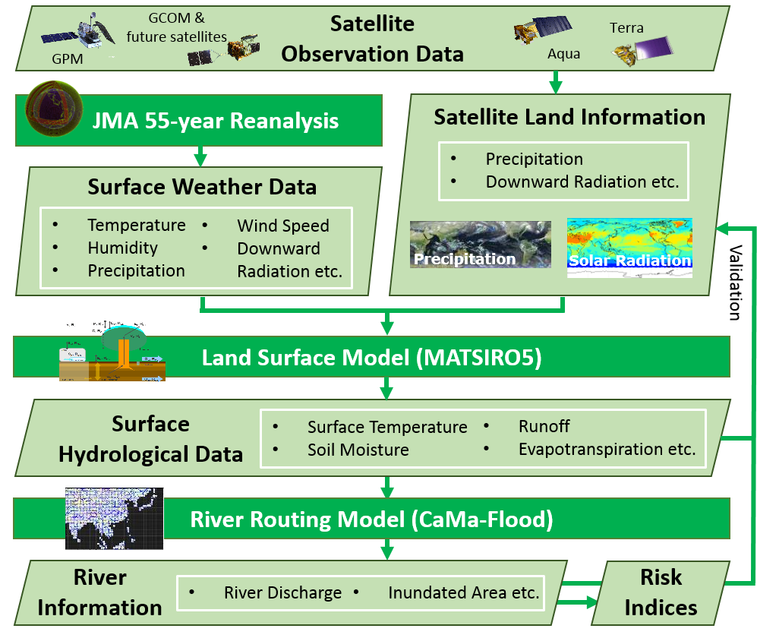
Global Hydrological Simulation System; Today’s Earth
JAXA has developed the global hydrological simulation system “Today’s Earth” under the joint research with University of Tokyo.
Over 50 hydrological variables simulated through 3 different experiments (shown below) are now accessible through the web page and ftp site.
https://www.eorc.jaxa.jp/theme/water/
Exp. name | Spatial resol. | Temporal resol. | Period | Latency | Forcing
JRA55 ver. | 0.5-deg (land) 0.25-deg (river) | 3 hourly, daily, monthly | 1958-present | About 3.5 days | JRA55 reanalysis
MODIS ver. | 〃 | 〃 | 2002-present | About 20 days | JRA55 reanalysis （radiation→MODIS）
GSMaP ver. | 〃 | 〃 | 2000-present | About 5 days | JRA55 reanalysis （precip.→GSMaP）

Slide 12
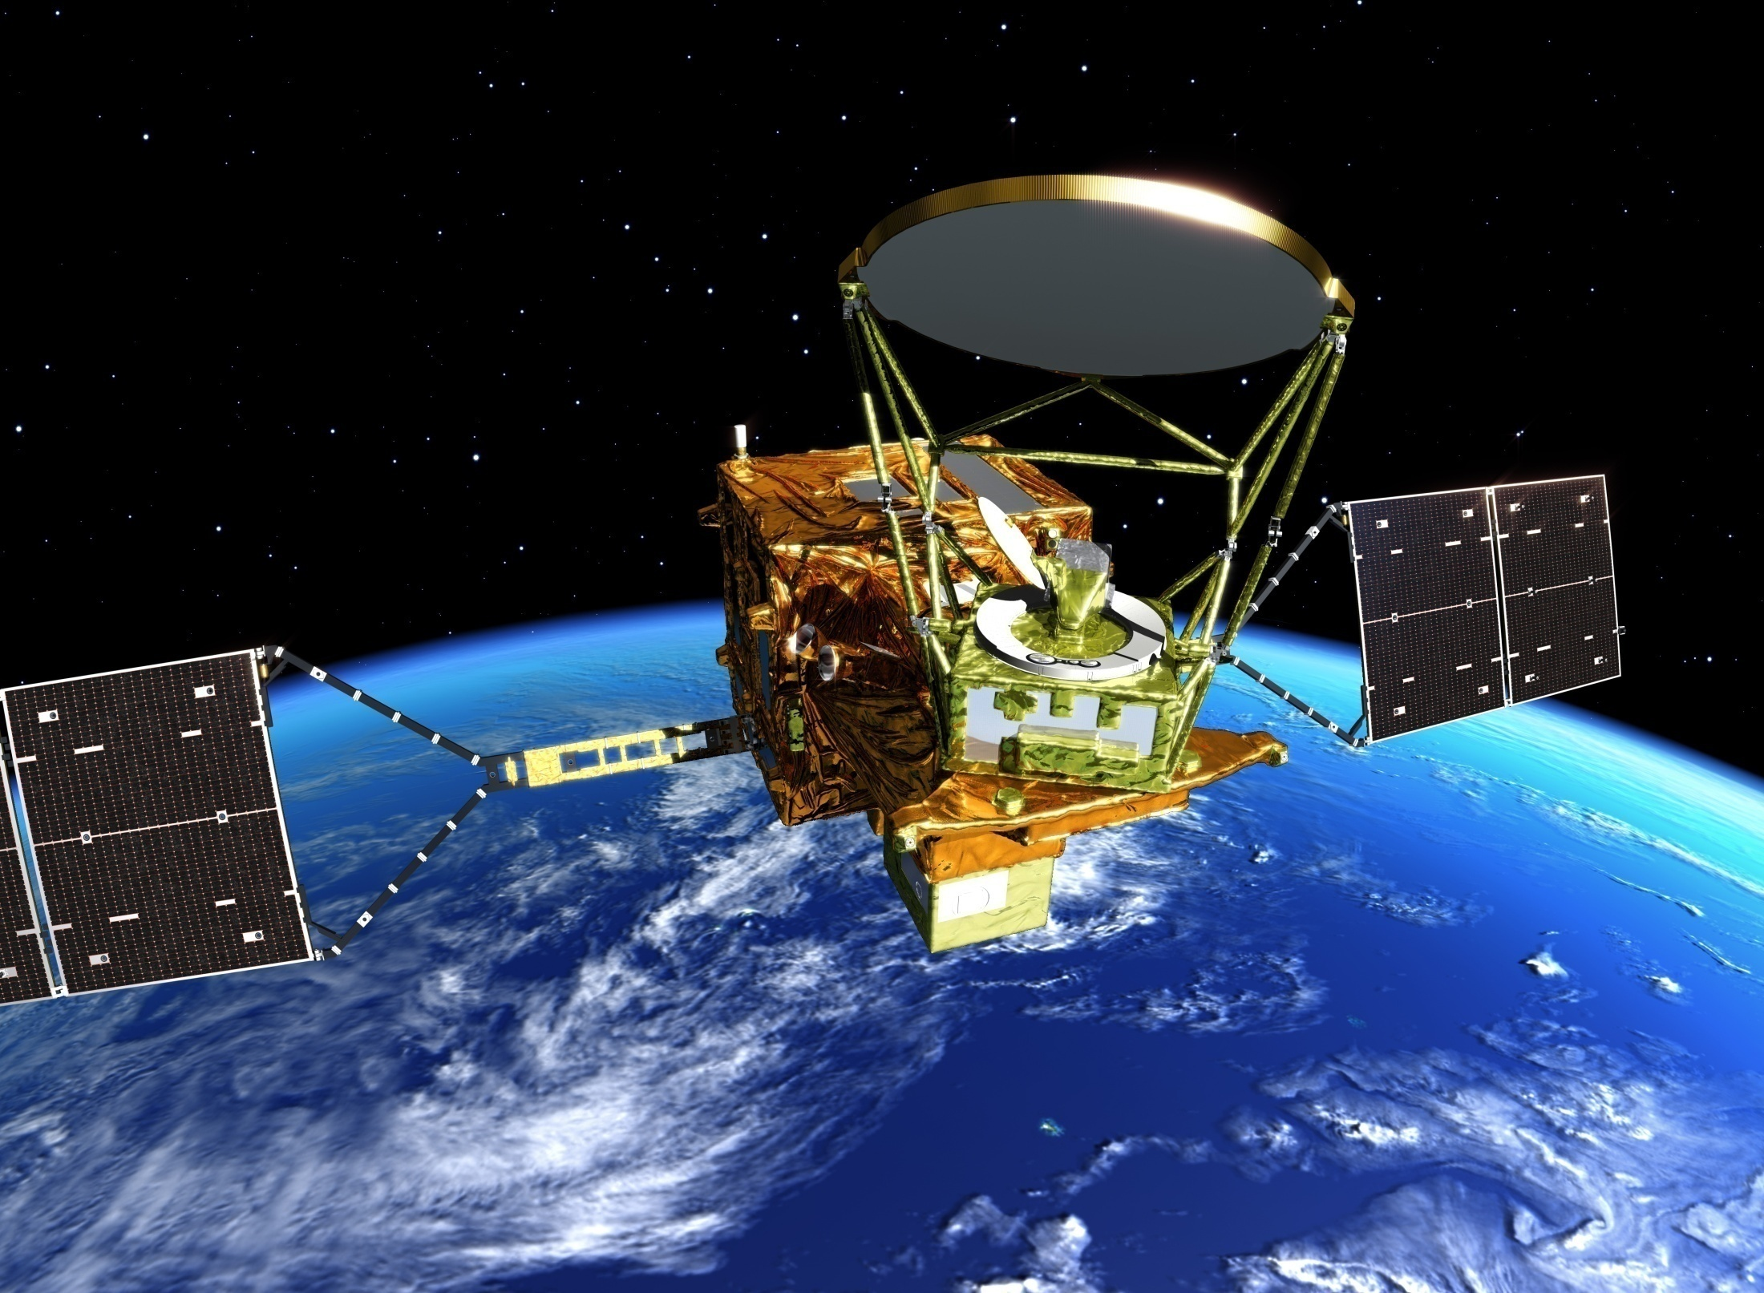
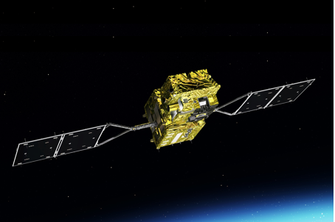
Global Change Observation Mission (GCOM)
GCOM-W (“SHIZUKU”)
GCOM-C (“SHIKISAI”)
GCOM-W with AMSR2 joins A-train and succeeds Aqua/AMSR-E.
SGLI on GCOM-C is multi-bands imager in the morning orbit, like MODIS on Terra.
Instrument | Advanced Microwave Scanning Radiometer-2
Orbit | Sun Synchronous orbit Altitude：699.6km (on Equator) Inclination: 98.2 degrees Local sun time: 13:30+/-15 min
Size | 5.1m (X) * 17.5m (Y) * 3.4m (Z) (on-orbit)
Mass | 1991kg
Power gen. | More than 3880W (EOL)
Launch | May 18, 2012
Design Life | 5-years
Instrument | Second-generation Global Imager
Orbit | Sun Synchronous orbit Altitude：798km (on Equator) Inclination: 98.6 deg. Local sun time: 10:30+/- 15min
Size | 4.6m (X) * 16.3m (Y) * 2.8m (Z) (on orbit)
Mass | 2093kg
Power gen. | More than 4000W (EOL)
Launch | Dec. 23, 2017
Design Life | 5-years
11

Slide 13
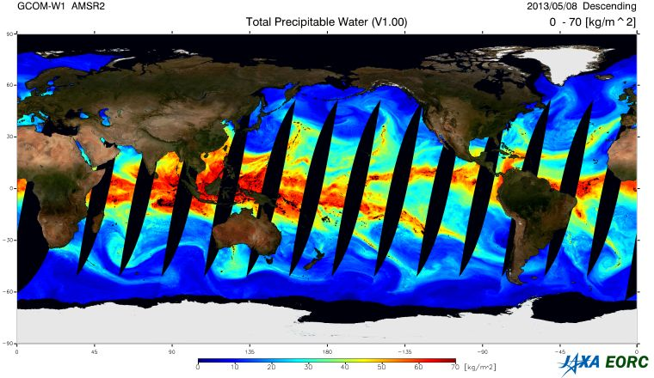
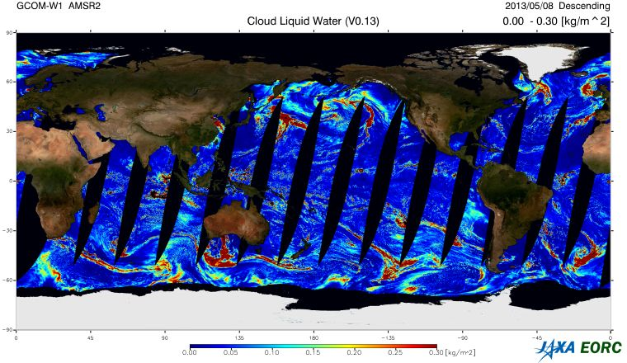
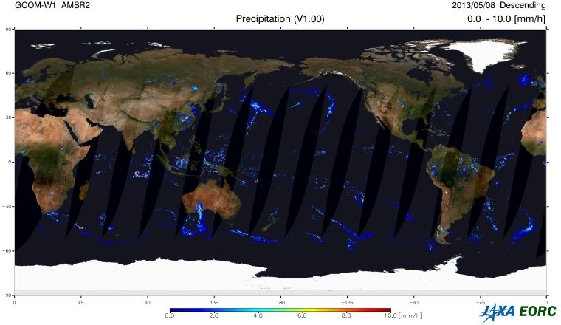
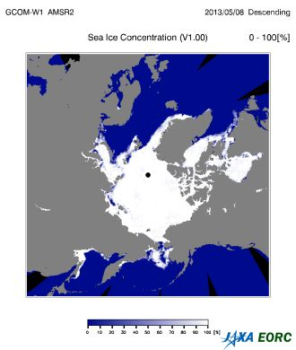
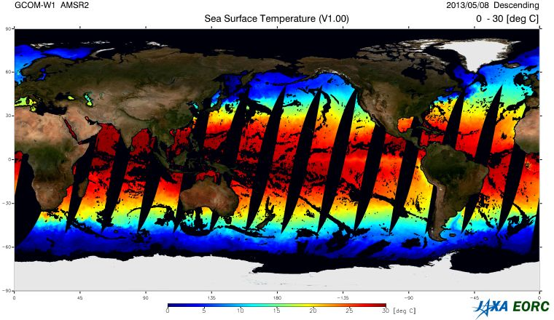
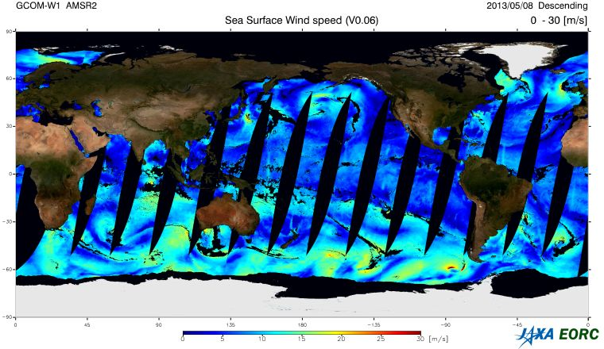
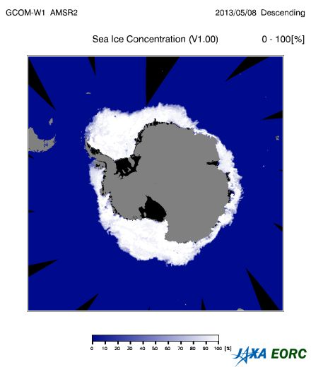
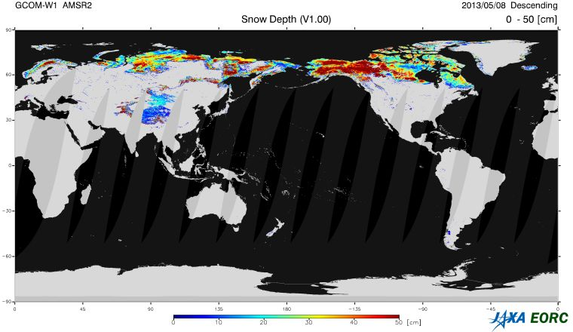
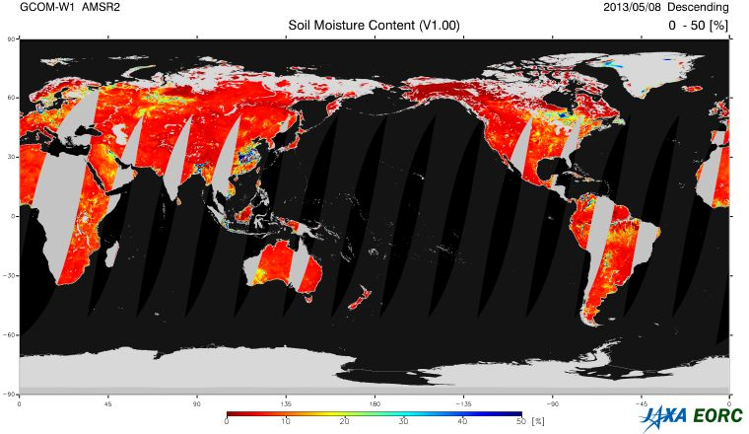
GCOM-W/AMSR2 Geophysical Variables
→ AMSR-E(9.5yrs)+AMSR2 (Jul. 2012-)
Integrated Water Vapor
Integrated Cloud Liquid Water
Precipitation
Sea Surface Temperature
Sea Surface Wind Speed
Sea Ice Concentration
Snow Depth
Soil Moisture Content
Descending Orbit on 5 May, 2013

Slide 14
AMSR2 Standard Products
https://www.gportal.jaxa.jp/gp/
Product |  | Coverage | Resolution | Release Accuracy | Standard Accuracy | Target Accuracy | Validation Result | Latest version
Brightness Temperature |  | Global | 5-50km | ±1.5K | ±1.5K | ±1.0K (bias) ±0.3K(random) | < 1.4 K | Ver.2.2
GEO | Total Precipitable Water | Global Ocean | 15km | ±3.5 kg/m² | ±3.5 kg/m² | ±2.0 kg/m² | 1.5 kg/m² | Ver.2.1
 | Cloud Liquid Water | Global Ocean | 15km | ±0.10 kg/m² | ±0.05 kg/m² | ±0.02 kg/m² | 0.04 kg/m² | Ver.2.1
 | Precipitation | Global (except high latitude) | 15km | Ocean ±50 % Land ±120 % | Ocean ±50 % Land ±120 % | Ocean ±20 % Land ±80 % | Ocean 48% Land 86% | Ver.2.1
 | Sea Surface Temperature | Global Ocean | 50km | ±0.8 ºC | ±0.5 ºC | ±0.2 ºC (zonal mean) | 0.5 ºC < 0.2 ºC (zonal) | Ver.3.0
 | Sea Surface Wind Speed | Global Ocean | 15km | ±1.5 m/s | ±1.0 m/s | ±1.0 m/s | 1.0 m/s | Ver.3.0
 | Sea Ice Concentration | Ocean in high latitude | 15km | ±10 % | ±10 % | ±5% | 9 % | Ver.3.0
 | Snow Depth | Land | 30km | ±20 cm | ±20 cm | ±10 cm | 18 cm | Ver.2.1
 | Soil Moisture | Land | 50km | ±10 % | ±10 % | ±5 % | 4 % | Ver.3.0

Slide 15
AMSR2 Research Products and Accuracy
http://suzaku.eorc.jaxa.jp/GCOM_W/research/resdist_j.html
Products | Area | Resolution | Target accuracy | Status
All-weather sea surface wind speed | Ocean | 60 km | ± 7 m/s for strong wind (>17m/s) | Ver.3.0 released 4.07 m/s
High-resolution (10-GHz) SST | Ocean | 30 km | ± 0.8 ºC | Ver.3.0 released 0.55 ºC
Soil moisture and vegetation water content based on the land data assimilation | Africa, Australia (at first stage) | 25 km | soil moisture: ± 8% vegetation water: ± 1 kg/m² | Under development
Land surface temperature | Land | 15 km | forest area: ± 3 ºC nondense vegetation: ± 4 ºC | Ver.1.0 released 3 ºC (forest) 4 ºC (nondense vegetation)
Vegetation water content | Land | 10 km | ± 1 kg/m² | Under evaluation
High resolution sea ice concentration | Ocean in high latitude | 5 km | ± 15 % | Under evaluation
Thin ice detection | Global | 15 km | ± 80 % (answered correctly) | Consideration to release 92.4 % for Okhotsk sea
Sea ice moving vector | Ocean in high latitude | 50 km | 2 components: 3 cm/s | Under evaluation
Total Precipitable Water over Land | Land (except ice and vegetation) | 15 km | ± 6.5 kg/m² | Newly Proposed 2.59 kg/m² vs. GPS
Released to public
To be released
Newly proposed

Slide 16
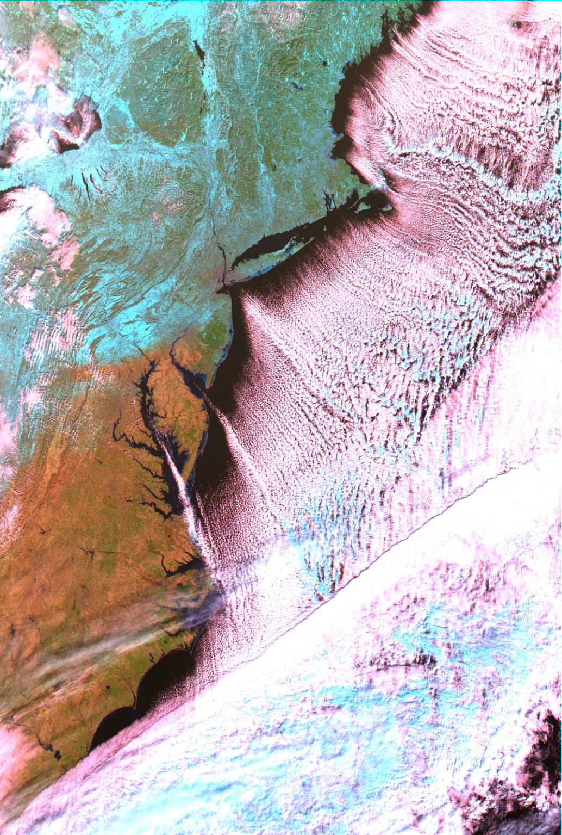
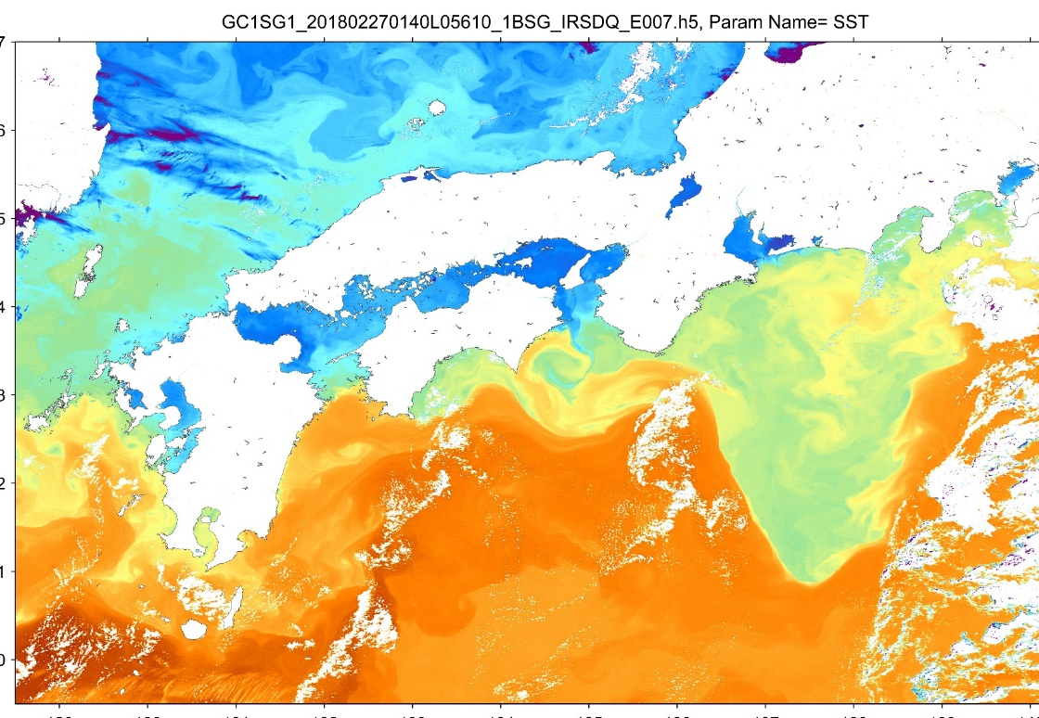
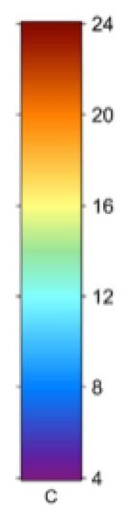
GCOM-C/SGLI images
launched on Dec. 2017
Light blue color shows snow cover areas
◀ East Coast of the USA
(Snow coverage on 1 Jan., 2018)
New York
▾ Southwestern of Japan
(Sea Surface Temperature on Feb. 27, 2018)
Washington DC
R:1.6um,
G: 0.86um,
B: 0.67um

Slide 17
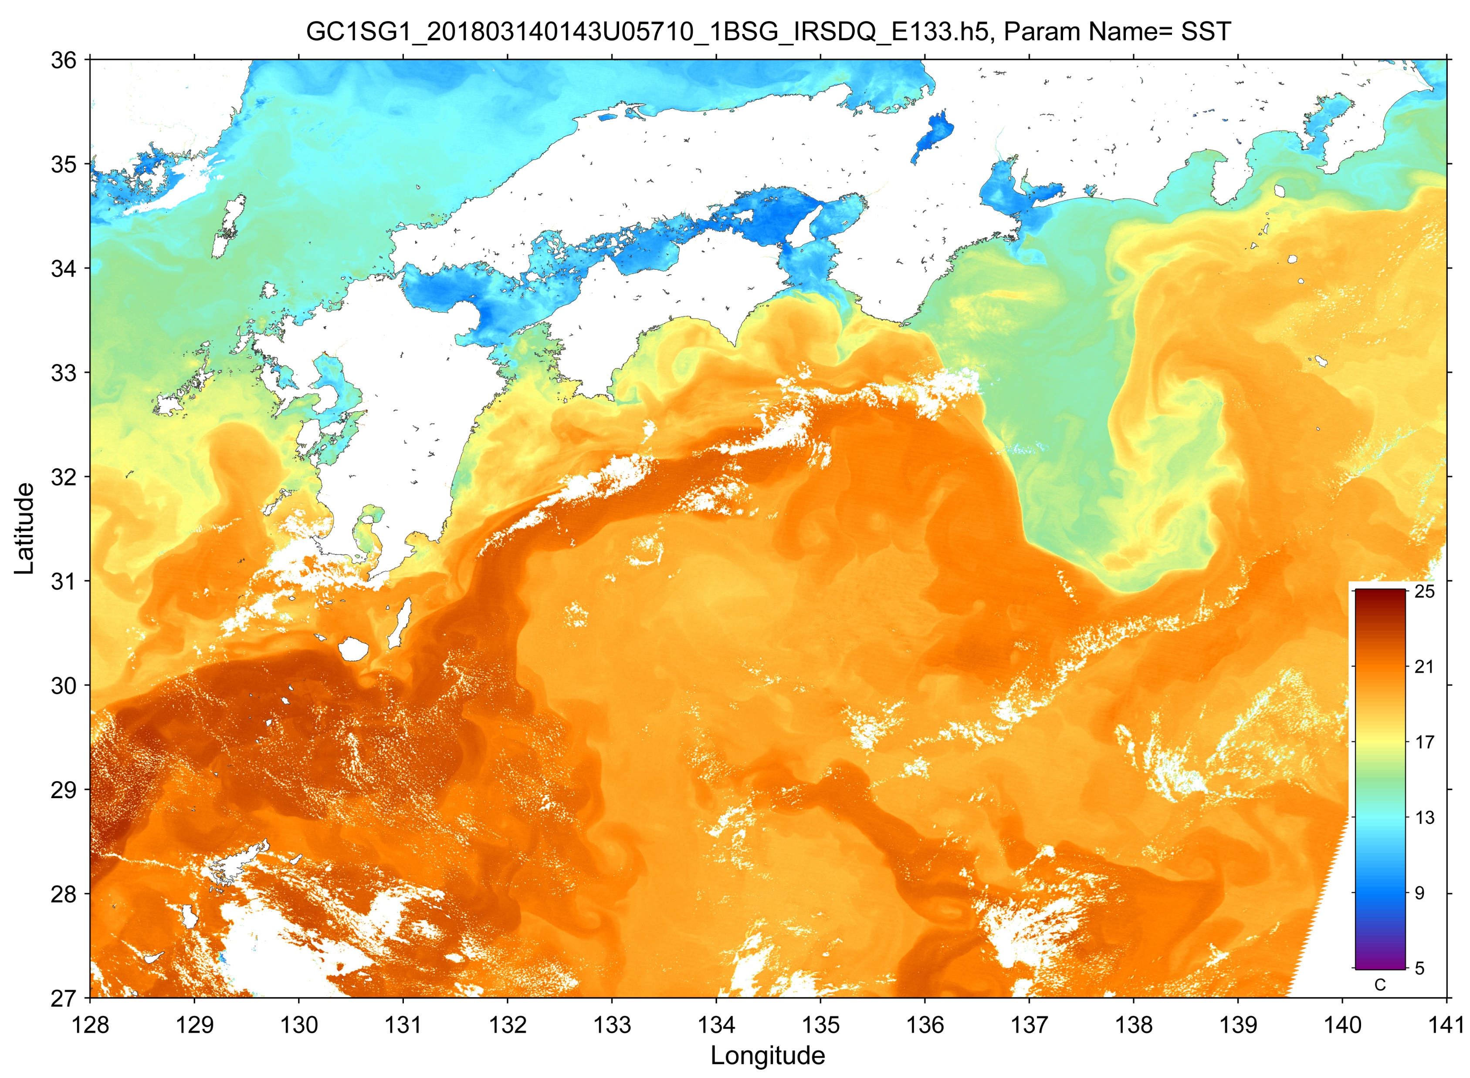
GCOM-C observation: 250-m SST
2018/03/14
16

Slide 18
GCOM-C/SGLI: standard products
Area | Group | Standard Product | Grid Size
Common | Radiance | Top-of-atmosphere radiance (including system geometric correction) | VNR, SWI: Land/coast: 250 m, offshore: 1 km, polarimetry: 1 km TIR: Land/coast: 500 m, offshore: 1 km
Land | Surface reflectance | Precise geometric correction | 250 m (equal-area grid (EQA) tile)
 |  | Atmospheric corrected reflectance | 250 m (EQA tile)
 | Vegetation and carbon cycle | Vegetation index | 250 m (EQA tile)
 |  | Shadow index
 |  | Above-ground biomass | 1 km (EQA tile)
 |  | Vegetation roughness index
 |  | Fraction of absorbed photosynthetically active radiation | 250 m (EQA tile)
 |  | Leaf area index
 | Temperature | Surface temperature | 250 m (EQA tile)
Atmosphere | Cloud | Cloud flag/Classification | 1 km (EQA tile)
 |  | Classified cloud fraction | 1 km (EQA tile), 1/12 deg (global)
 |  | Cloud top temp/height
 |  | Water cloud optical thickness/effective radius
 |  | Ice cloud optical thickness
 | Aerosol | Aerosol by non-polarization | 1 km (EQA tile), 1/12 deg (global)
 |  | Aerosol over the land by polarization
Ocean | Ocean color | Normalized water leaving radiance | 250 m (coast), 1 km (offshore), 1/24 deg (global)
 |  | Atmospheric correction parameters
 |  | Photosynthetically available radiation
 | In-water | Chlorophyll-a concentration | 250 m (coast), 1 km (offshore), 1/24 deg (global)
 |  | Suspended solid concentration
 |  | Colored dissolved organic matter
 | Temperature | Sea surface temperature | 500 m (coast), 1 km (offshore), 1/24 deg (global)
Cryosphere | Area/distribution | Snow and Ice covered area | 250 m (EQA tile), 1 km (EQA tile)
 |  | Okhotsk sea-ice distribution | 250 m (scene)
 | Surface properties | Snow and ice surface temperature | 250 m (EQA tile), 1 km (EQA tile)
 |  | Snow grain size of shallow layer

Slide 19
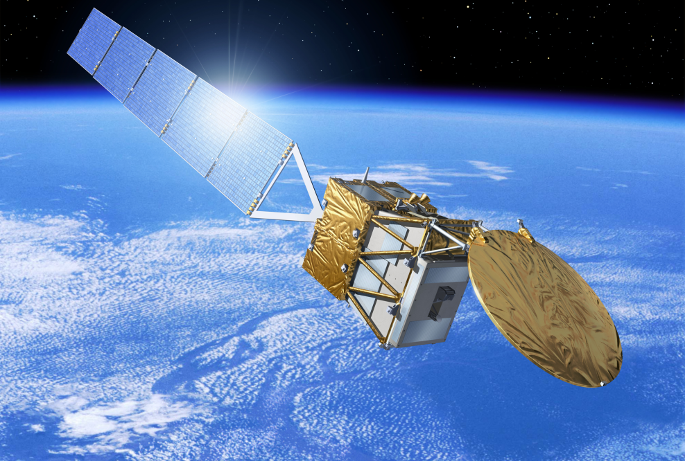



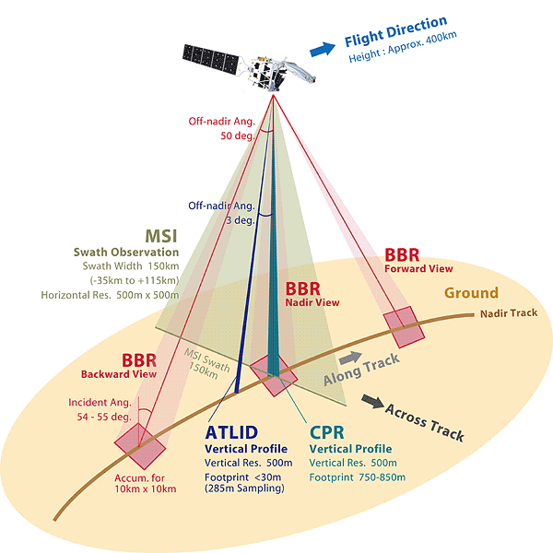
Earth Cloud Aerosol and Radiation Explorer (EarthCARE) with ESA
Future
Synergetic Observation by Four Instruments on Global Scale
Three-dimensional structure of aerosol and cloud including vertical motion
Radiation flux at top of atmosphere
Aerosol – cloud – radiation interactions
CPR
MSI
BBR
Observation Instruments on EarthCARE
ATLID
CPR Cloud Profiling Radar
CPR
ATLID Atmospheric Lidar
Copyright ESA
ATLID
MSI Multi-Spectral Imager
MSI
BBR Broadband Radiometer
BBR
Institutions | ESA/NICA/JAXA
Mission Duration | 3-years
Mass | Approx. 2200kg
Orbit | Sun-synchronous sub-recurrent orbit Altitude: approx. 400km Mean Local Solar Time (Descending): 14:00
Repeat Cycle | 25 days
Orbit Period | 5552.7 seconds
Semi Major Axis | 6771.28 km
Eccentricity | 0.001283
Inclination | 97.050°

Slide 20
Status of AMSR2 follow-on sensor (AMSR3)
Future
GCOM-W AMSR2 is now flying more than six years exceeding designed life.
In response to users’ requests, AMSR2 follow-on mission has been in pre-project phase (Phase A) since September 1, 2018.
  Mission Definition Review (MDR): April to June 2018
  Project Preparation Review: July 2018
The new satellite will become a joint mission of AMSR2 follow-on sensor and GOSAT-2/TANSO-2 successor sensor (advanced spectrometer to monitor greenhouse gases).
  Orbit definition is currently under negotiation with TANSO-2 successor mission but we will keep early afternoon orbit around 13:00 or 13:30 in LT
AMSR2 follow-on sensor (AMSR3) specification
  Almost equivalent sensor specification to the current AMSR2 (antenna size, channels) except additional higher frequency channels of 166 & 183 GHz for snowfall retrievals and water vapor analysis in NWP
  New products including snowfall, TPW over land, high-resolution SST, all-weather sea surface wind speed & high-resolution sea ice concentration

Slide 22
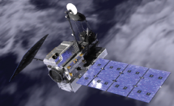
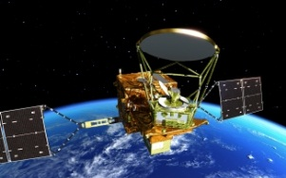
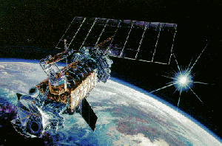
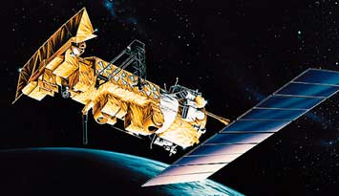
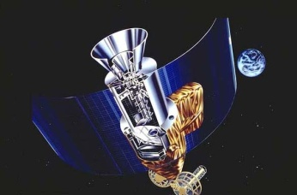
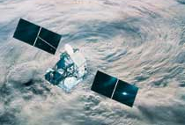
Overview of GSMaP Algorithm
PMW (Imagers & Sounders)
Good: high-frequent (wide swath, multi-satellites)
Bad: cannot measure vertical structure (need info. from radar)
GPM-Core
GMI
GCOM-W
AMSR2
DMSP
SSM/I, SSMIS
NOAA/MetOp
AMSU
GSMaP Microwave Radiometer Retrieval Algorithm
infrared (IR Imagers
Precipitation Radars
Rainfall Data from each
Microwave Radiometer
Data Base
Geostationary
Satellites
TRMM
PR
Merged Microwave
Rainfall Data
Microwave-IR Merged Algorithm (CMV, K/F)
Global Rainfall Map
+ Gauge-calibrated
Rainfall Map
(0.1 degree grid, Hourly）
GPM-Core
DPR
（Okamoto et al. 2005, Kubota et al, 2007, Aonashi et al. 2009, Ushio et al. 2009, Shige et al. 2009, Kachi et al. 2011, Kubota et al. 2018）
http://sharaku.eorc.jaxa.jp/GSMaP/
Notes:
GSMaP projet has started to produce highly-accurate and high-frequent global rainfall map toward GPM in 2002 using TRMM and other satellites, and since 2007, near-real-time version of GSMaP has been operated in JAXA. In September 2014, GSMaP became Japanese GPM standard product.

