Slide 1
Copernicus Global Land Service for Water Observation from Space
CEOS Freshwater from Space Workshop
14 November 2018, Delft
Lionel Zawadzki, Joël Dorandeu – CLS
Michael Cherlet – DG JRC

Slide 2






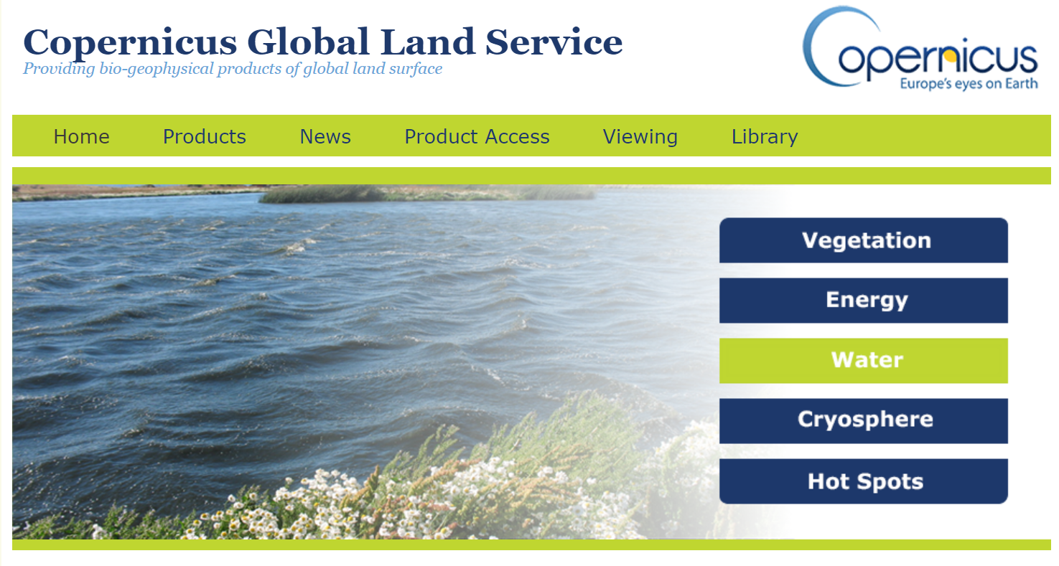

Copernicus
Entrusted Entity
https://land.copernicus.eu/global

Slide 3
The water component: an emerging Copernicus Global Land Operational Service to answer societal challenges
1st phase start with vegetation and energy products
2014
2015
2nd phase start with water and cryosphere products
2017
Water & Cryosphere products available in Near-Real time
Ramp-Up
2013
2016
2018

Slide 4


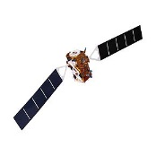
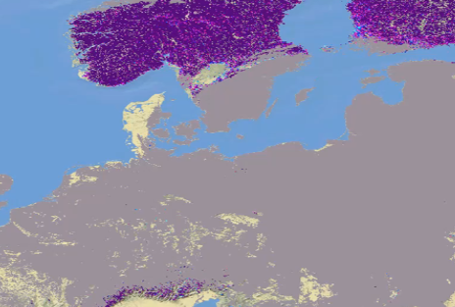

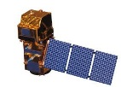
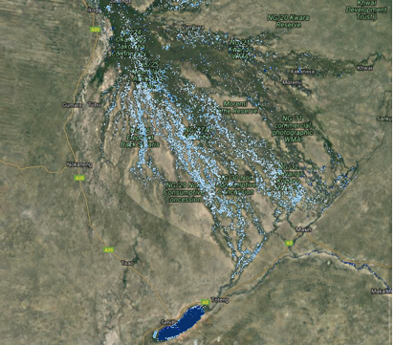

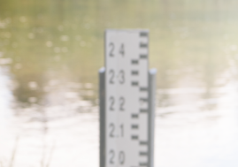

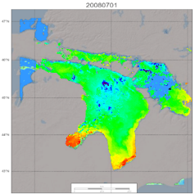
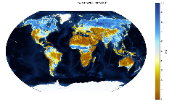
The Copernicus Global Land Water & Cryosphere Core Service
Lake Ice Extent
Snow Water Equivalent
Snow Cover Extent
Copernicus Global Land
Core
Service
Areas of Water Bodies
Space Data
In Situ
Downstream
services
End Users
and Applications
Lakes, reservoirs and rivers Water Level
Lake Water Quality
Lake Surface
Water Temperature
Soil Water Index
Open and free / NRT + long term / Operational / validated-documented

Slide 5

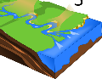






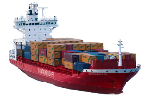


Water Governance
Estuaries
Downstream Services
Risk Management
Health
Agriculture
Global Land Operations
Civil Engineering
Energy
Transportation
Aquatic Ecosystems
Drinking Water

Slide 6
User Uptake in the Copernicus Global Land Service
A high potential of downstream applications for the Water CGL Service:
A large variety of thematic areas (downstream applications)
Strong impact in the socio-economic sector (drinking water, energy, transport…)
Objective:
  maximise the benefit of the Water services to applications and end users
  Ensure that products and services are fit for purpose
Developing the link with the user community:
Awareness
Reach the already existing user community:
Engage users in the Service definition and validation process (User workshops, User Requirement Documents, Gap analysis, Surveys, External reviews)
Consider needs at different levels: Member States, Decision Makers, Intermediate Users, End Users

Slide 7

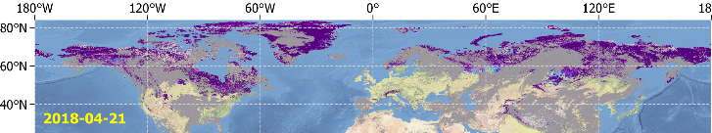
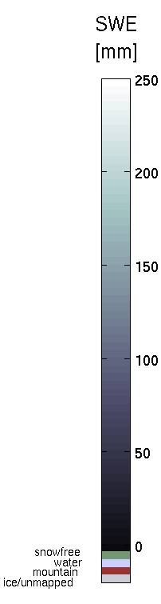
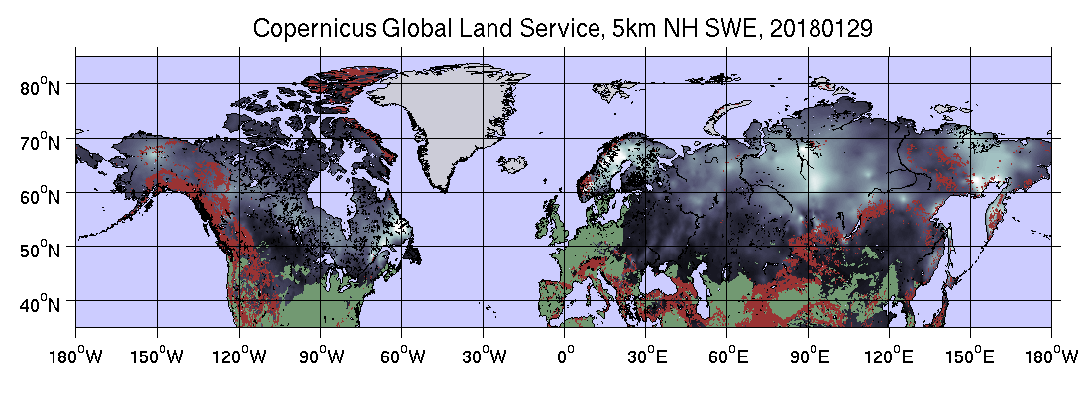
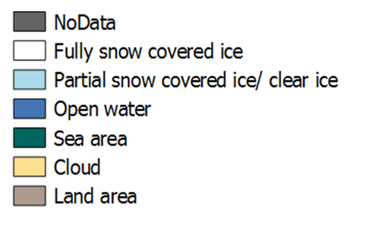
Products description: Collection Cryosphere
Product | Resolution | Domain | Remote Sensing Data | Foreseen evolutions | Illustration
Snow Cover Extent V1 | 500m, daily | Pan-European | Terra MODIS, Suomi-NPP VIIRS | Short-term: Transition to Sentinel-3 SLSTR (V2.1) Long-term: Higher resolution with new satellite missions
Snow Cover Extent V2 | 1km, daily | Northern Hemisphere | Suomi-NPP VIIRS
Snow Water Equivalent | 5km, daily | Northern Hemisphere | DMSP F17 SSMIS | Higher resolution (1km) with new satellite missions
Lake Ice Extent V1 | 250m, daily | Baltic | Terra MODIS | Higher resolution with new satellite missions
Lake Ice Extent V2 (in dev) | 500m, daily | Northern Hemisphere | Sentinel-3a (SLSTR)

Slide 8
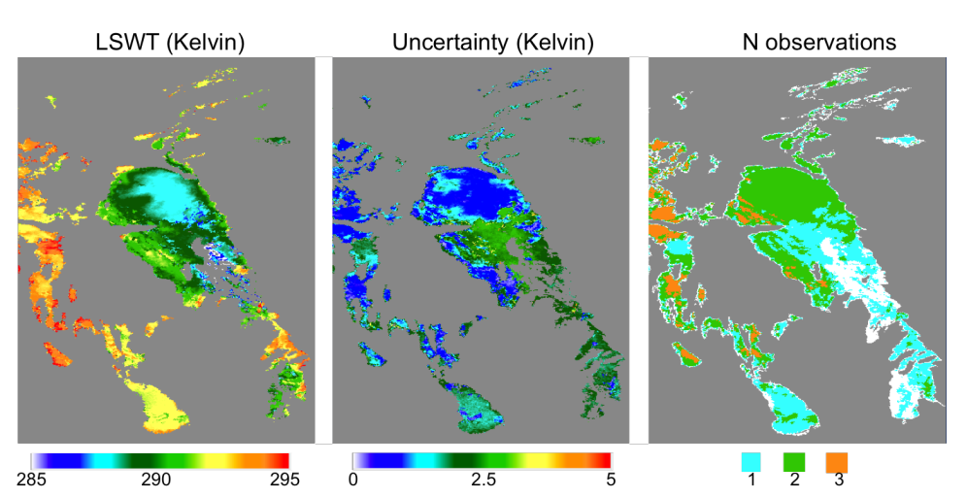
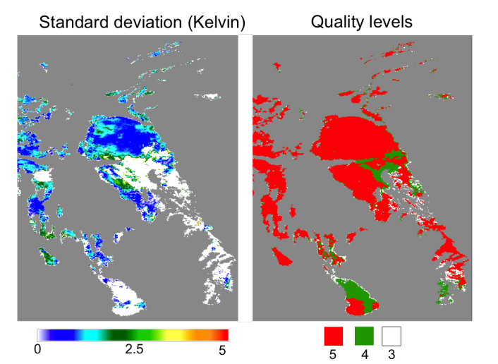
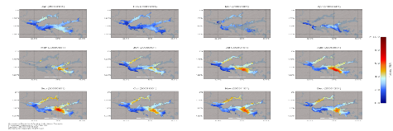
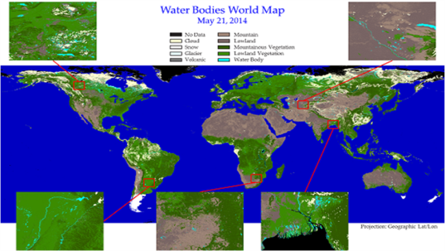
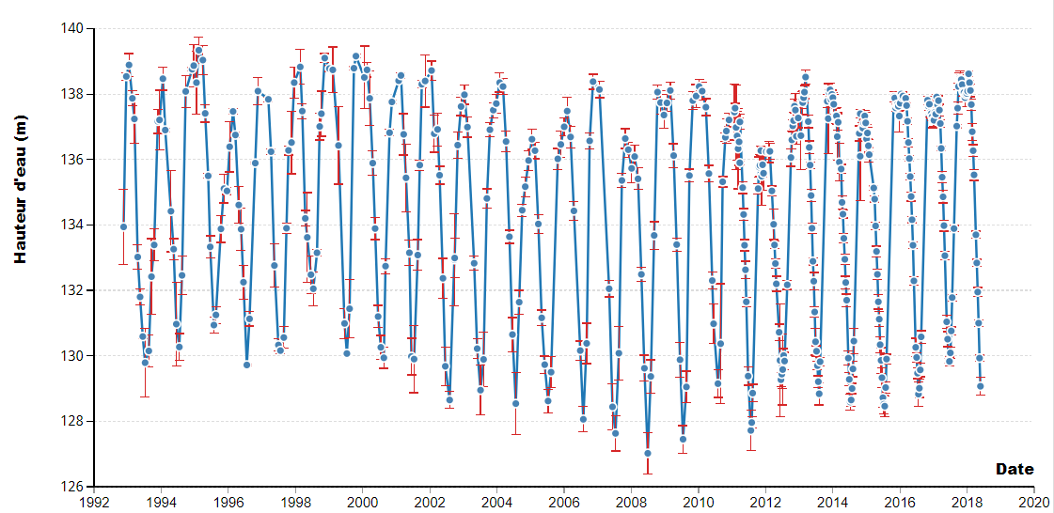
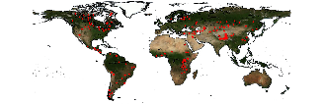
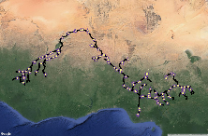
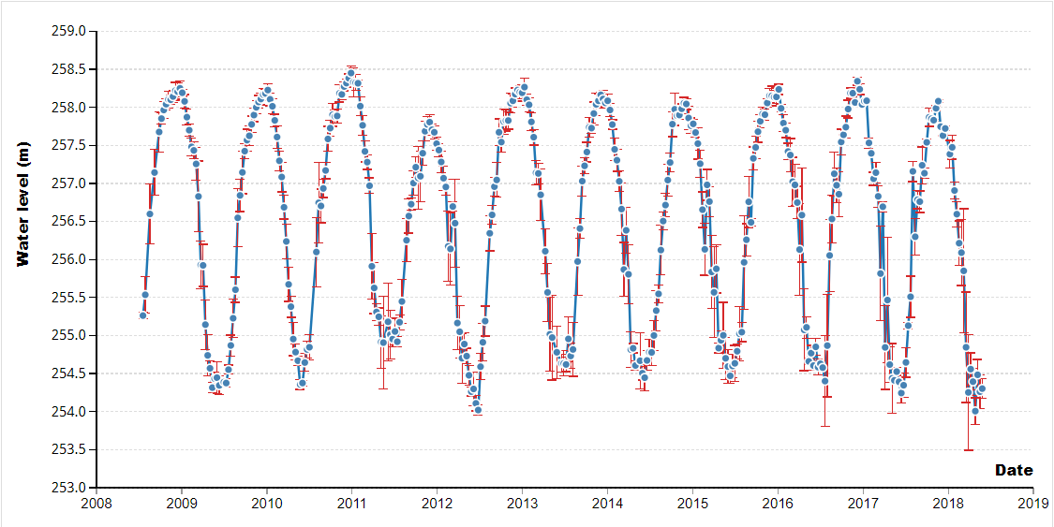
Products description: Collection Water
Product | Resolution | Domain | Remote Sensing Data | Foreseen evolutions | Illustration
Lake Surface Water Temperature | 1km, 10days | Global (~1000 lakes) | Sentinel-3 SLSTR | More water bodies and higher resolution with new satellite missions
Lake Water Quality (reflectance, turbidity, Trophic State) | 1km/300m/100m (in dev), 10days | Global (~1000 lakes) | Sentinel-3 OLCI
Area Of Water Bodies | 1km/300m, daily | Global | Proba-V | higher resolution with new satellite missions (Sentinel-2)
Lake and Reservoir Water Level | 1-to-10day | Global (~100 lakes) | Jason-3, Sentinel-3 SRAL | More lakes and reservoirs, improved time resolution with new satellite missions and algorithms
River Water Level | 10-to-27day | Global (~250 stations) | Jason-3, Sentinel-3 SRAL | More rivers, improved time resolution with new satellite missions

Slide 9

Products description: Collection Vegetation
Product | Resolution | Domain | Remote Sensing Data | Foreseen evolutions | Illustration
Soil Water Index | 0.1°, daily | Global | METOP/ASCAT | higher resolution with new satellite missions

Slide 10
Currently: Sentinel-3 SLSTR (very low noise, two-point calibrated dual-view radiometer) is very suitable for the operationel monitoring of medium/large lakes surface water temperature
Users demand: operational monitoring of smaller lakes than can be achieved with current ~1 km IR sensors.
The 250m of VIIRS is already good (though not used in the service yet): extra channels, higher IR resolution.
Combining with regular (<weekly) well-calibrated ~100 m would enable order of magnitude change in number of lakes accessible to thermal remote sensing
→ Opening up new applications in tourism, thermal plume monitoring, etc
Water Surface Temperature
Water Quality

Slide 11
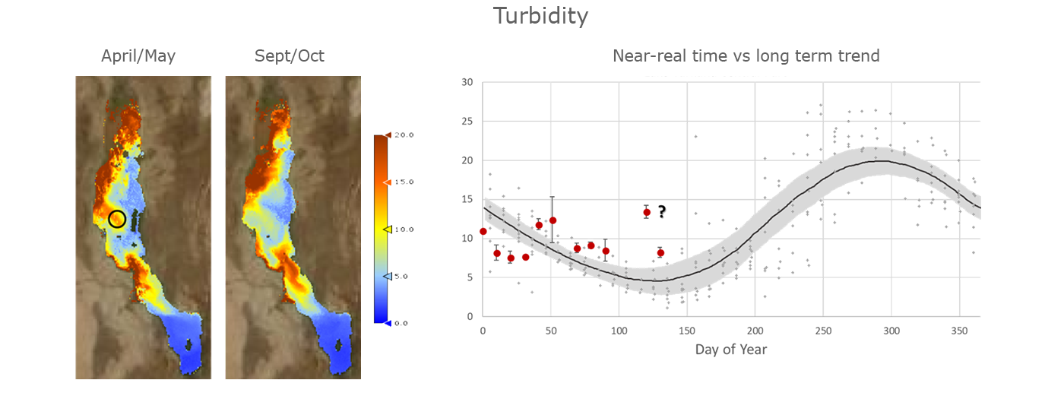
Acknowledgement of the utility of shortwave infrared bands and the fundamental importance of bands in the infrared.
Having well intercalibrated sensors help to combine different instruments rapidly and enlarge the temporal resolution.
Sensors with spatial resolution in the –at least- 100m range but spectral and radiometric properties typical of the most ocean colour sensors: calibrated, high SNR, thermal bands for better cloud detection (as well as cloud height and cloud shadow detection).
Investment in long term radiometric reference stations in situ at strategic and diverse inland water sites, in the order of 50-100 global stations. → Immediate requirement to capitalize on current satellite capability
Water Surface Temperature
Water Quality
Water Level

Slide 12
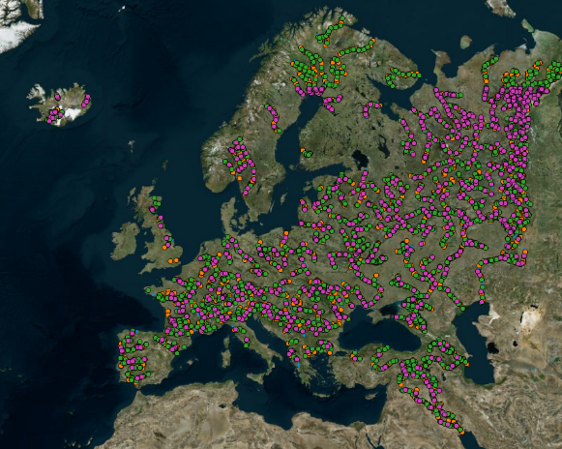
Increasing the density of the water monitoring network is the main focus of service evolution and must be ensured by the future altimetry missions:
Continuity of existing missions (w/ tandem phases) to ensure long-term accurate monitoring
Improved accuracy with new sensors / technologies (e.g. Unfocused SAR, focused SAR)
Improved coverage with new sensors (e.g. SWOT, WISA), constellations…etc
Nb: Water level is a proxy to discharge and water storage
Water Quality
Water Level
Water Bodies
Upcoming (2019) monitored water level “virtual” stations

Slide 13
Outlook
Currently, the service is mostly build on Sentinel-3a but also Terra MODIS, VIIRS, SSM/I, Jason-3. Short-term evolutions include the integration of Sentinel-3b
Short-term evolution (few years): improve resolution of products to the resolution of Sentinel-2, improve temporal resolution when relevant
Wished Long-term evolutions (decade):
  Monitor rivers, wetlands, floodplains → requires higher resolution sensors
  Add new variables: storage, discharge, floods indicators
  Assimilation in hydrological models, forecasts, monitoring of water from source (glaciers, lakes…) to the outlet (sea, lake...)

Slide 14
Outlook
Operational requirements:
  maintain the current orbits without discontinuity
  Intercalibration/Tandem phases between successive missions
  Complementarity with the maintenance/development of the in situ observation network is essential. In situ data also concerns space for dissemination.
  Accurate reference ancillary data: land/water mask (GSWE), DEMs, propagation/geophysical correction such as troposphere, ionosphere, earth/pole/water tides, clouds…etc

Slide 15
Outlook
Complementarity between lower-accuracy frequent revisit of (e.g. nano-satellites constellation) and higher-accuracy less frequent revisit (historical approach)
Improving the technology (accuracy / resolution) is essential to meet user requirements and should be done ensuring the continuity and consistency of products.

