Slide 1
CEOS expert for Freshwater observations from Space
WMO activities in Water monitoring
Remote presentation, November 2018
Dominique Berod, Chief of division of Basic Systems in Hydrology

Slide 2
The World Meteorological Organization
WMO is the authoritative voice of the United Nations on weather, climate and water. WMO mandate includes:
Facilitate worldwide cooperation in the field of meteorology and hydrology and their application to the benefit of all;
Promote the establishment and maintenance of systems for the rapid exchange of data information in meteorology, climatology and hydrology;
Promote standardization of observations and ensure the uniform publication of observations and statistics;
Further the application of meteorology, climatology and hydrology to development issues (transportation, water management, agriculture, etc.);
Encourage research and training, and assist in coordinating their international aspects.
WMO HQ in Geneva, Switzerland
Notes:
As a specialized agency of the United Nations, WMO is dedicated to international cooperation and coordination on the state and behaviour of the Earth’s atmosphere, its interaction with the land and oceans, the weather and climate it produces, and the resulting distribution of water resources.
Founded in 1873 as the International Meteorological Organization (IMO), it became in 1950 a UN specialized agency.
It provides its services and includes as Members 191 countries and territories

Slide 3
Water challenges require solutions based on sound facts, information and data, but:
Insufficient Capacity of current monitoring networks
Quality of data not always known
Many data not shared
Low visibility and recognition of Hydrological Services

Slide 4
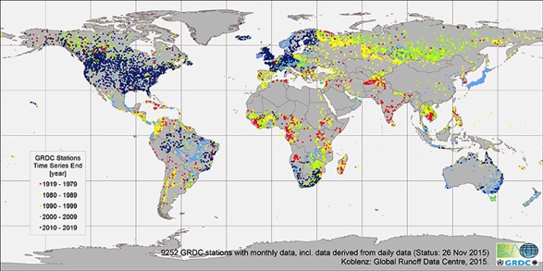
National hydrometry networks
Hydrometry networks are: 1. Essential and 2. Insufficient

Slide 5
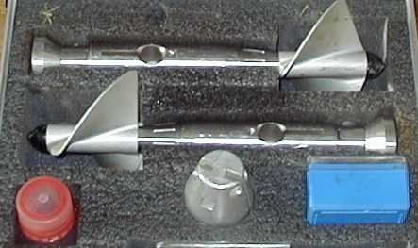
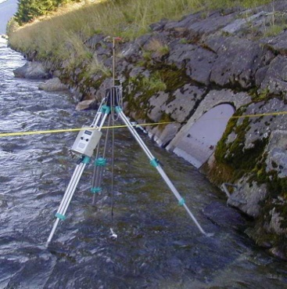
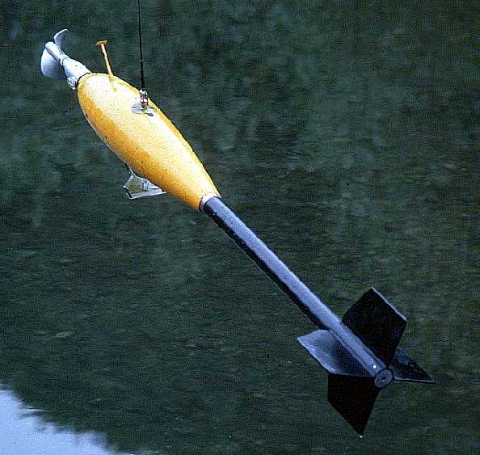
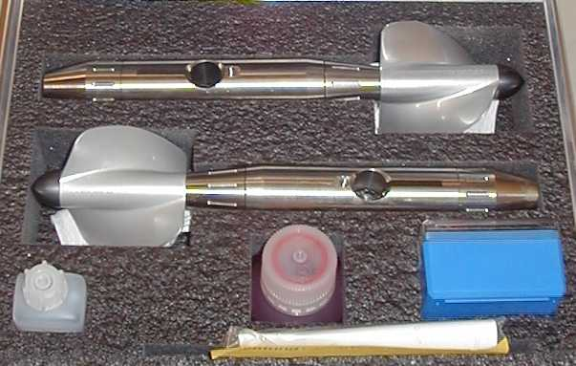
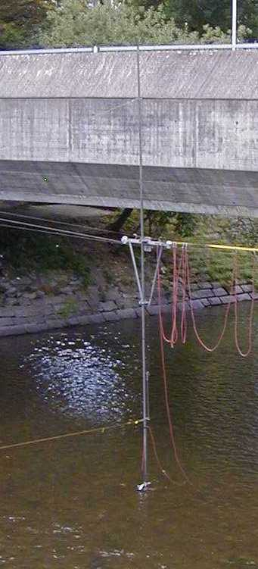
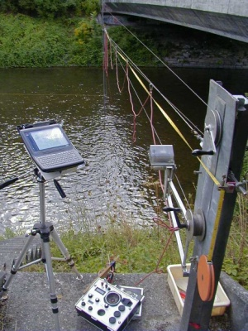
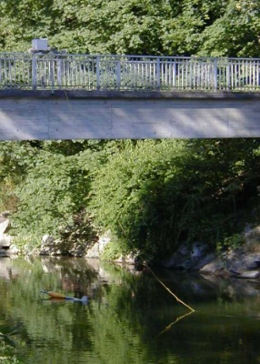
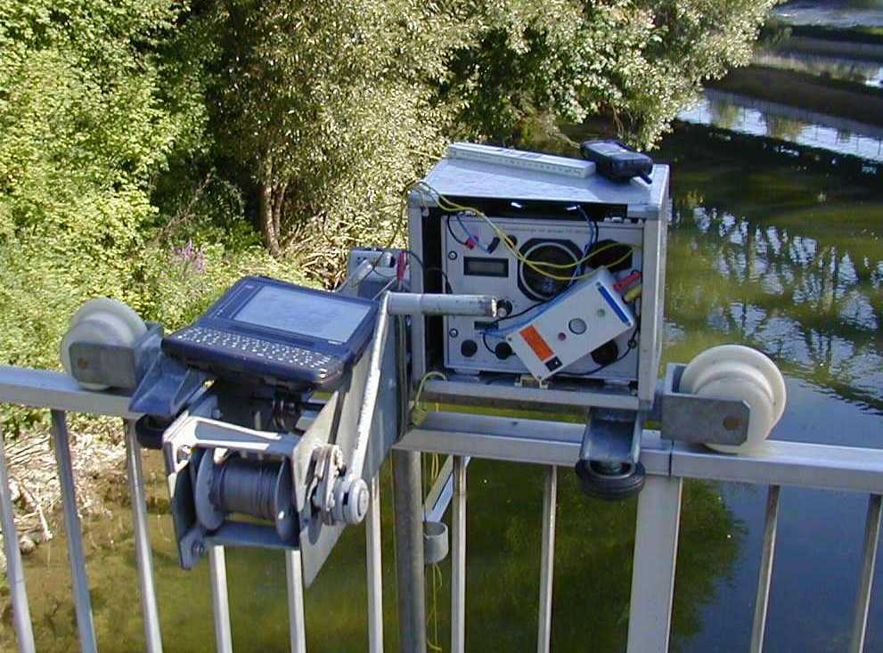
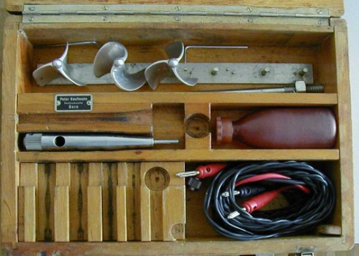
Example of flow measurement
Diameter: 12cm
Slope: 0.25 ( 1 rotation equals 0.25 m)
Velocity max: Normally calibrated to 5 m / s but higher veloceties up to 10 m/s would be feasable.
Velocity min: about 3 cm / s
Width W
Measured cross section
Volume of water
Flow velocity v
Water surface
Depth : D
x
Specific flow of a vertical:
Diameter: 8 cm
Slope: 0.25 ( 1 rotation equals 0.25 m)
Velocity max: Calibrated to 4 m / s higher veloceties are not feasable.
Velocity min: About 4 to 5 cm / s
Current meter 4 cm diameter mounted on a rode from a tripod.
12 cm diameter rotor mounted on the sinker (55 kg)
River bed
Specific flow f of verticals
Discharge:
Riverbed
Measured velocities
y
W
Diameter: Three 4 cm rotors
Slope: 0.010 , 0.025 and 0.050 for the three different rotors
Velocity max: Calibrated to 3.5 m / s higher veloceties are not recomended.
Velocity min: About 5 cm / s
Current meter 8 cm diameter mounted on a bar transported by a cable way.
Current meter 12 cm diameter mounted on a sinker from a bridge.

Slide 6
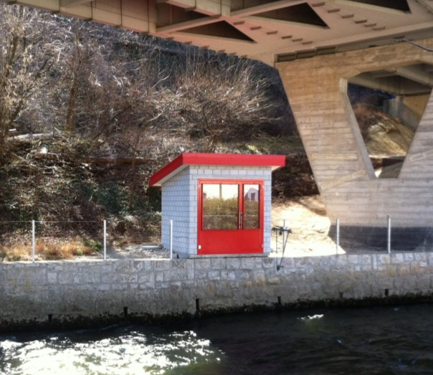
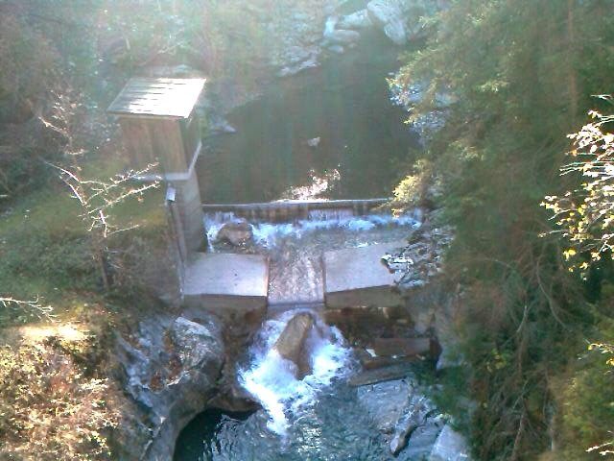
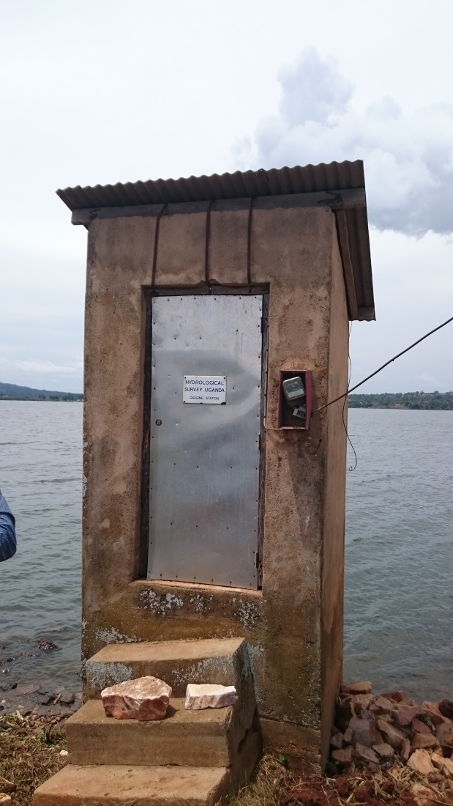
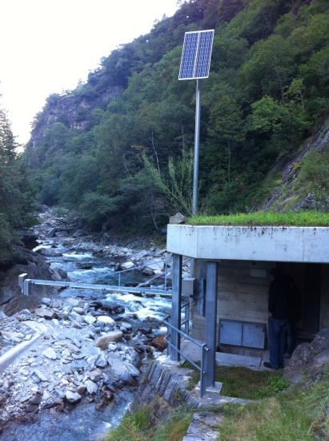
Example of measuring stations

Slide 7
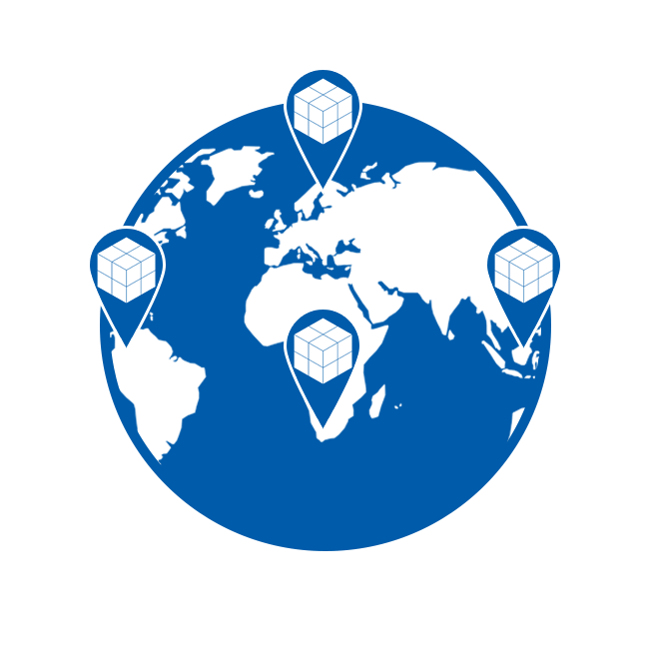
Activities in Hydrology
DATA PRODUCTION & COLLECTION | DATA PROCESSING & STORAGE | DATA VISIBILITY & AVAILABILITY | DATA RESCUE & SERVICES
World Hydrological Cycle Observing System (WHYCOS) Standardisation and quality management QMF | Meteorological, Climatological and Hydrological (MCH) Database Management System | WMO Hydrological Observing System (WHOS) Global Data Centers WaterML 2.0 | Global Data Centers: Global Runoff Data Centre (GRDC), International Data Centre On Hydrology Of Lakes And Reservoirs (HYDROLARE) & International Groundwater Resources Assessment Centre (IGRAC)
HYDROHUB, the WMO GLOBAL HYDROMETRY SUPPORT FACILITY
MODELLING & FORECASTING
EARLY WARNING DISSEMINATION
DECISION SUPPORT
RESPONSE TO WARNING
CAPACITY BUILDING

Slide 8
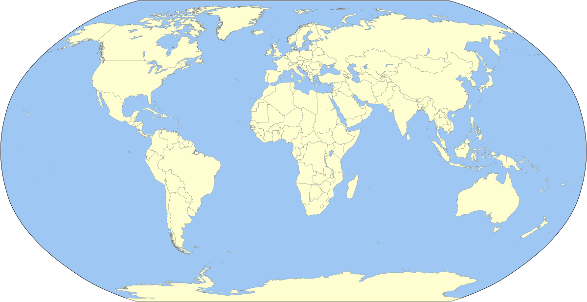
The World Hydrological Cycle Observing System (WHYCOS)
Artic-Hycos
2014- ongoing
Aral – Hycos
2006– on going
Med-Hycos
1997-2001
HKH-Hycos 2009-on going
Carib-HYCOS
2007 – on going
Niger-Hycos 2005 – on going
Senegal-Hycos 2007-on going
Mekong-Hycos 2006-2012
AOC-HYCOS 2000-2002
IGAD – Hycos
2011 – on going
Volta-Hycos 2006 – on going
Pacific-HYCOS 2006 – on going
Congo-Hycos 2010-on going
SADC-HYCOS Phase II 2005-2009
SADC-HYCOS Phase I 1998-2001
Notes:
Med- Hycos: 1997 – 2001 Eighteen countries from the Mediterranean rim participated in the project implementation (1997-2001) (Albania, Algeria, Bosnia and Herzegovina, Bulgaria, Croatia, Cyprus, France, Greece, Italy, Malta, Macedonia (FYR), Morocco, Romania, Serbia and Montenegro, Slovenia, Spain, Tunisia, Turkey)
SADC-HYCOS Phase I June 1998 to August 2001. Eleven countries from the Southern African Development Community (Angola, Botswana, Lesotho, Malawi, Mozambique, Namibia, South Africa, Swaziland, Tanzania, Zambia, and Zimbabwe) participated in the project.
AOC-HYCOS 2000 – 2002 covering twenty-two countries of Western and Central Africa, Between 2000 and 2002 WMO implemented a Pilot Phase in cooperation with eleven countries from the region (Burkina Faso, Cape Verde, Chad, Gambia, Ghana, Guinea, Mali, Mauritania, Niger, Nigeria, and Senegal)
Niger-Hycos (2005-on going)The active watershed of the Niger River is shared between nine West and Central African countries, namely Benin, Burkina Faso, Cameroon, Chad, Côte d’Ivoire, Guinea, Mali, Niger and Nigeria. The inactive basin essentially concerns Algeria, Mali and Niger.
Volta-Hycos (2006 – on going) Benin, Burkina Faso, Côte d'Ivoire, Ghana, Mali, Togo
Mekong-Hycos 2006-2012, he objective of Mekong-HYCOS is to establish and operate a real-time flood information system in the Mekong basin with Cambodia, Lao, Thailand and Vietnam as participating countries.
Pacific-HYCOS 2006 participating countries were Cook Islands, Federated States of Micronesia, Fiji Islands, Kiribati, Marshall Islands, Nauru, Niue, Palau, Papua New Guinea, Samoa, Solomon Islands, Tonga, Tuvalu and Vanuatu
Aral – Hycos 2006 -now :Kazakhstan, Kyrgyz Republic, Tajikistan, Turkmenistan, Uzbekistan
SADC-HYCOS Phase II 2005-2009
Carib-HYCOS 2007- eight countries concerned (Barbados, Cuba, Dominican Republic, Guadeloupe, Hait, Jamaica, Martinique, Trinidad and Tobago)
Senegal-HYCOS 2007 – on going: la Guinée, le Mali, la Mauritanie et le Sénégal
Hindu Kush Himalaya-HYCOS (HKH) 2009 – on going Bangladesh, Bhutan, Nepal and Pakistan
Congo-Hycos 2010 – on going: Cameroon, Central African Republic, Congo and the Democratic Republic of Congo,
IGAD-Hycos : 2011 – on going : Burundi, Djibouti, Ethiopia, Kenya, Rwanda, Somalia, South Sudan, Sudan and Uganda
Artic-Hycos: 2014 – on going Canada, Denmark, Finland, Iceland, Norway, Russian Federation, Sweden and United States of America

Slide 9
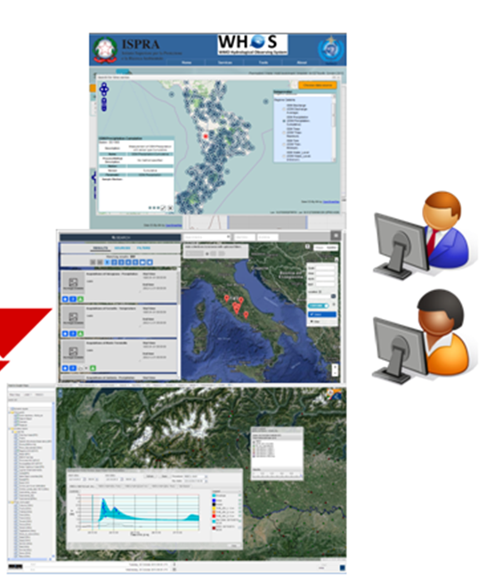
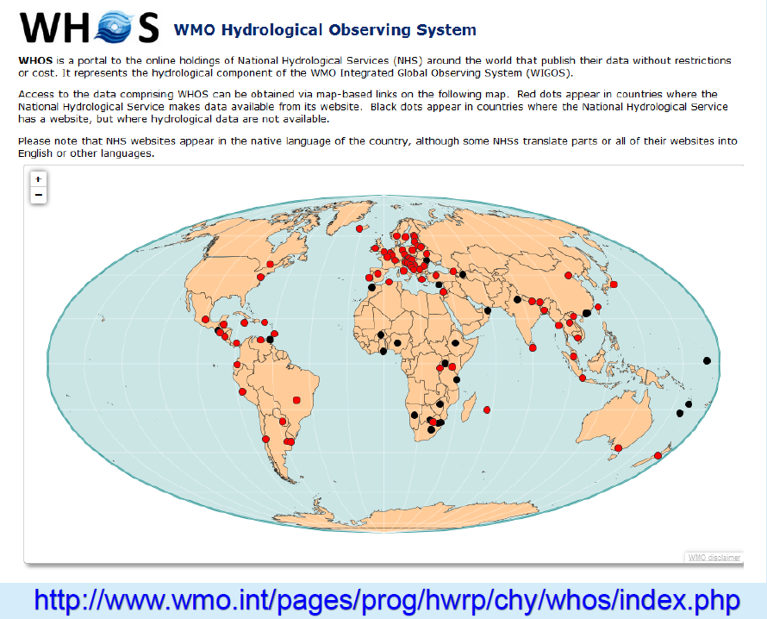
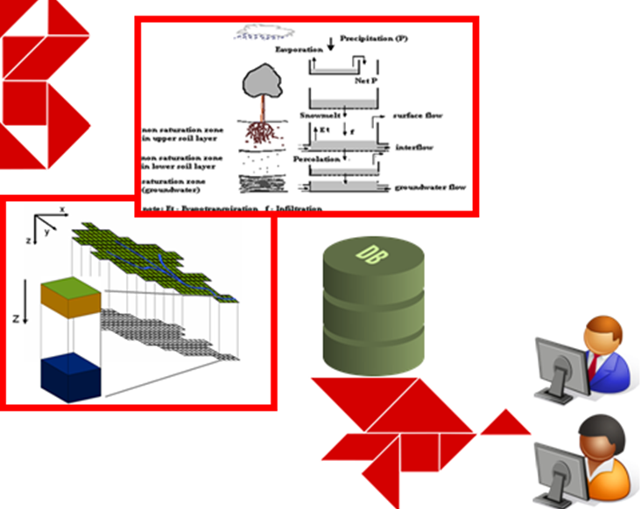
WMO Hydrological Observing System
Possible links to UNOOSA-S4Water Portal

Slide 10
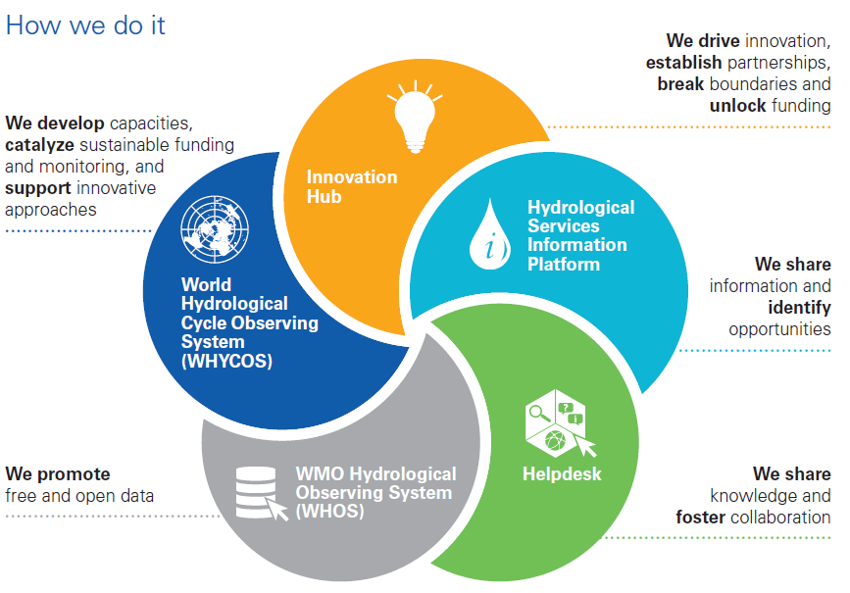
A new paradigm for Hydrometry

Slide 11
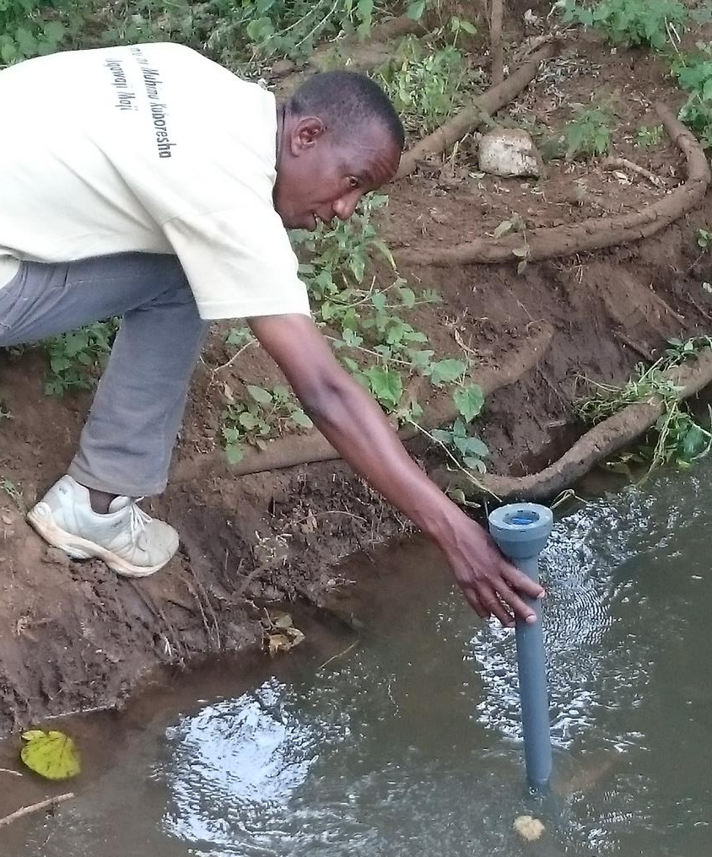
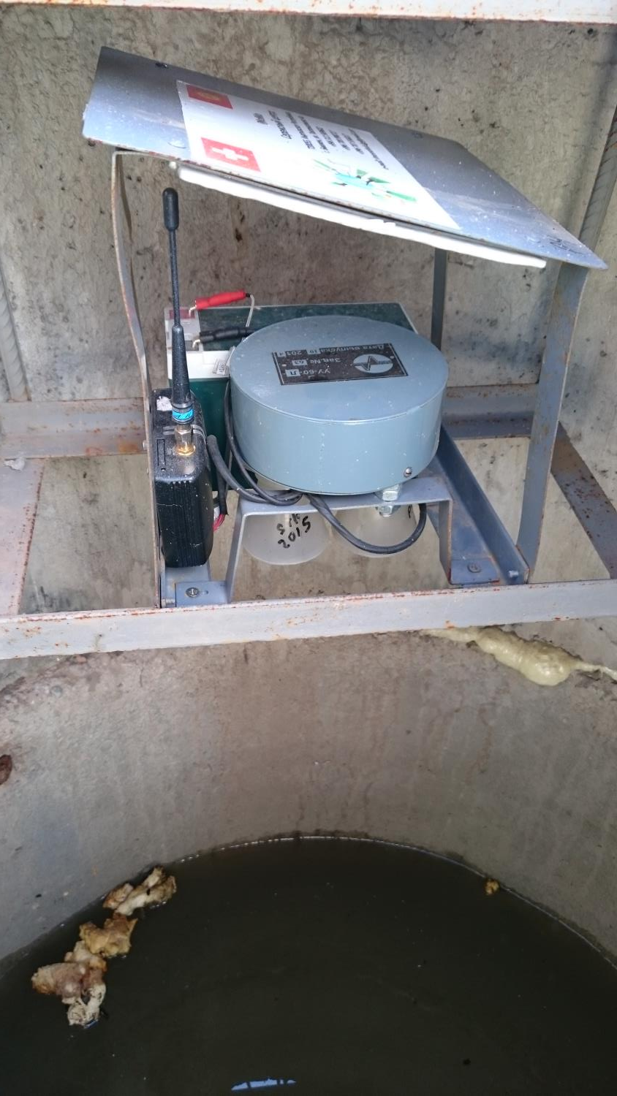
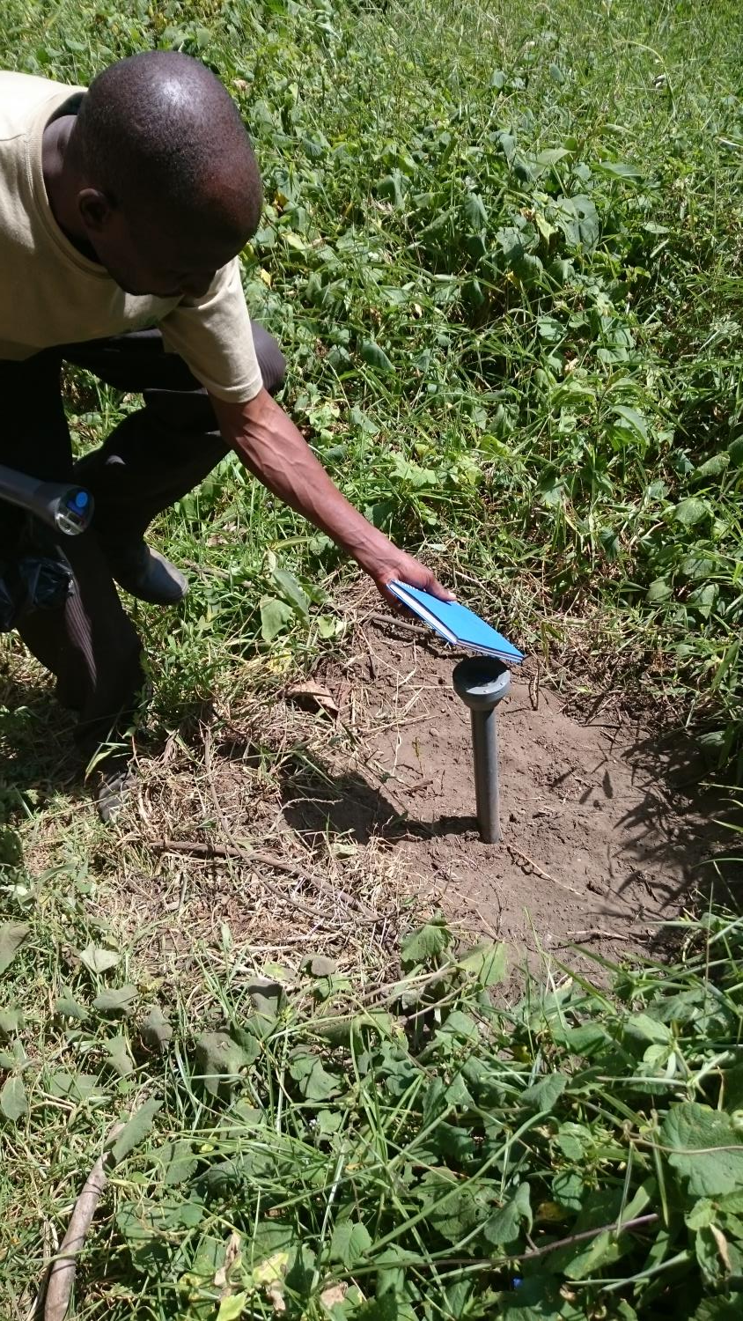
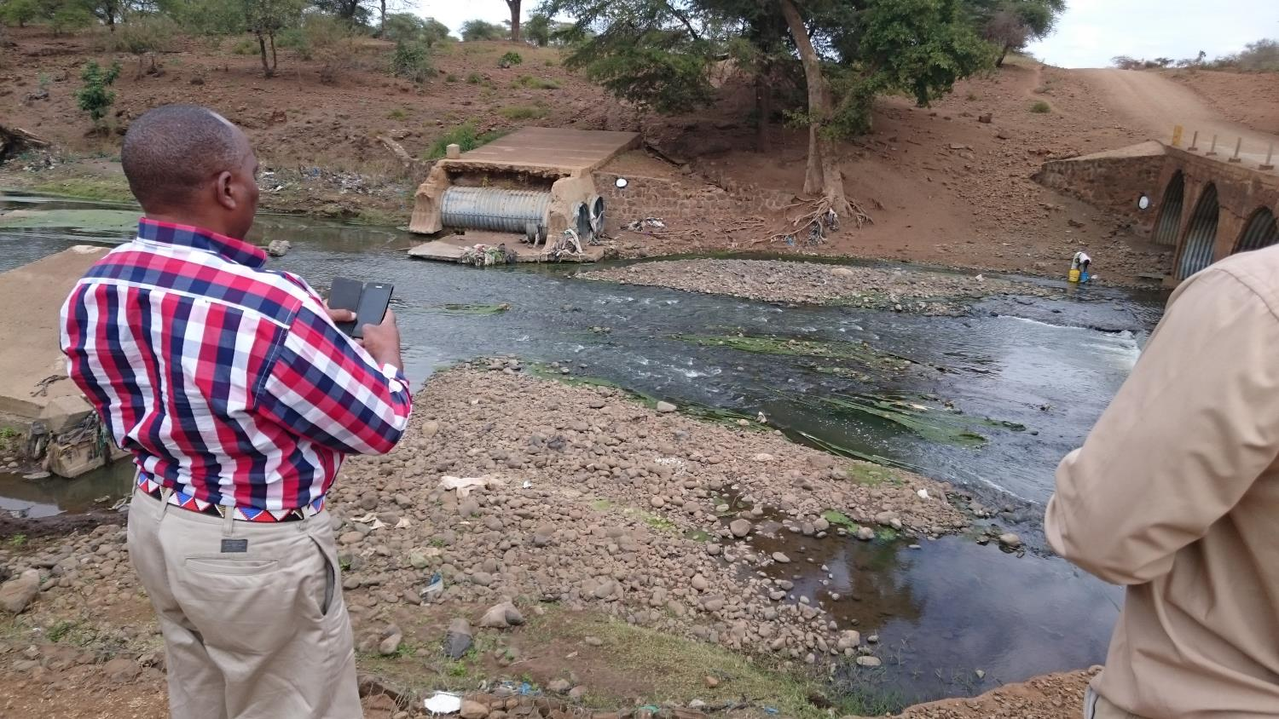
Innovative measurement
Imomo

Slide 12
A flagship under construction: HydroSOS
NEEDS
NEEDS

Slide 13
What does HydroSOS provide?
What data/models does HydroSOS use?
Notes:
The intent of the System is to provide estimates of current status of water resources relative to some ‘expected‘ or ‘normal’ condition for the location and time of year and an outlook indicating how the resource status may change over a period to 3 months in the future.
The information will be provided at a range of spatial scales including global, regional, national and local (river basin) scales. This should be provided in a system capable of ‘drill down/up’ across the spatial scales.
The status and outlook will be determined using observed data or from model outputs using meteorological models to drive hydrological models, particularly in areas where observations are scarce.
All metrics, data and information will be presented within an appropriate framework of uncertainty assessment. The system will provide the capability of blending or “turning on and off” the observed and modelled data in calculating the status metrics.
Pilot sites will serve as case studies to demonstrate the applicability of the methods used for the status and outlook components
Processed data from NMHSs and downscaled data from global models will be used for the models

Slide 14
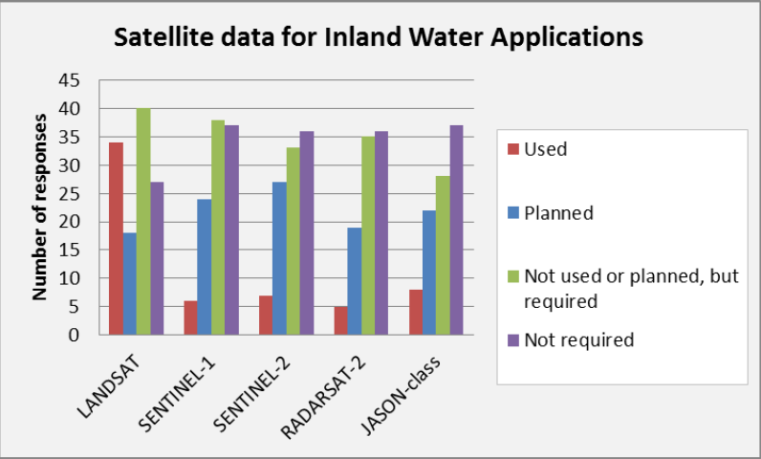
WMO user survey 2017 Satellite data for inland water-related applications

Slide 15
© ECMWF February 27, 2018, Christel Prudhomme

Slide 16
Hydroconference.wmo.int

Slide 17
Conclusions
Water is a complex system: no good decision without good information: data are central
All data sources must be combined
In situ, citizen science, remote sensing
Data quality and inter-comparizon!
WMO paves the way to innovative water monitoring (HydroHub) and to information on possible water related problems (HydroSOS)
Cooperation a key!
Key words we like: impact, efficiency and sustainability

Slide 18
Thank you
Merci

