Slide 1
The CNES Programme & EWVs
CEOS – Fresh Water from Space- Delft 13-15 Nov. 2018
Philippe Maisongrande
Programme Manager for land and hydrology – CNES
Notes:
A contribution to a structuerd activity around water ad agencies + remember mam

Slide 2
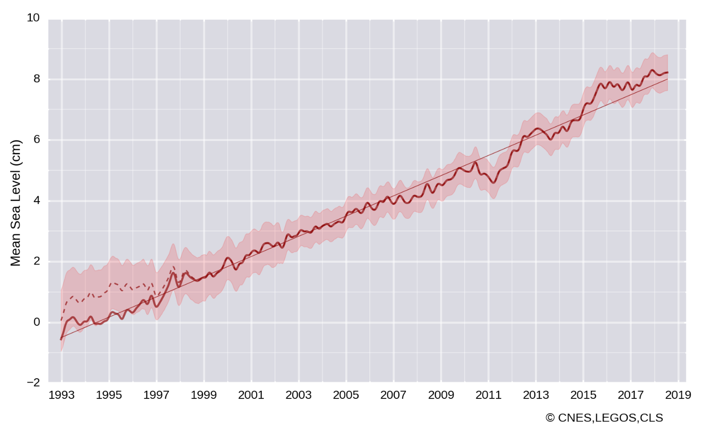
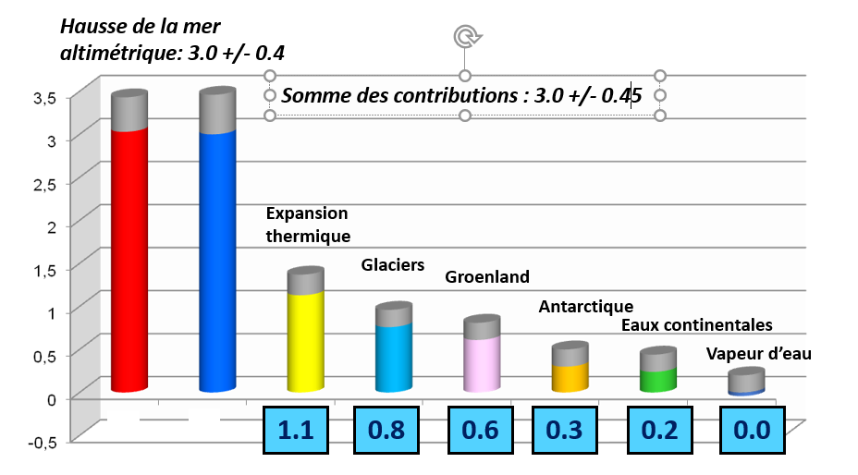
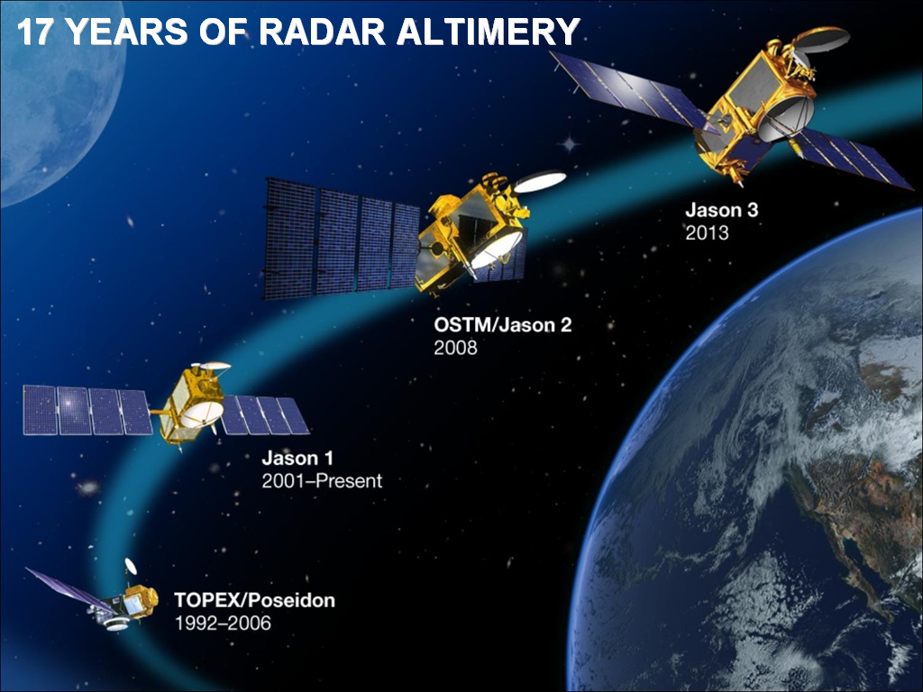
The Global Water Cycle
Sea level rise (an ECV)
3mm/year (+/-0.4)
Contributions to SLR

Slide 3
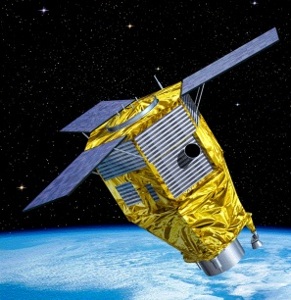
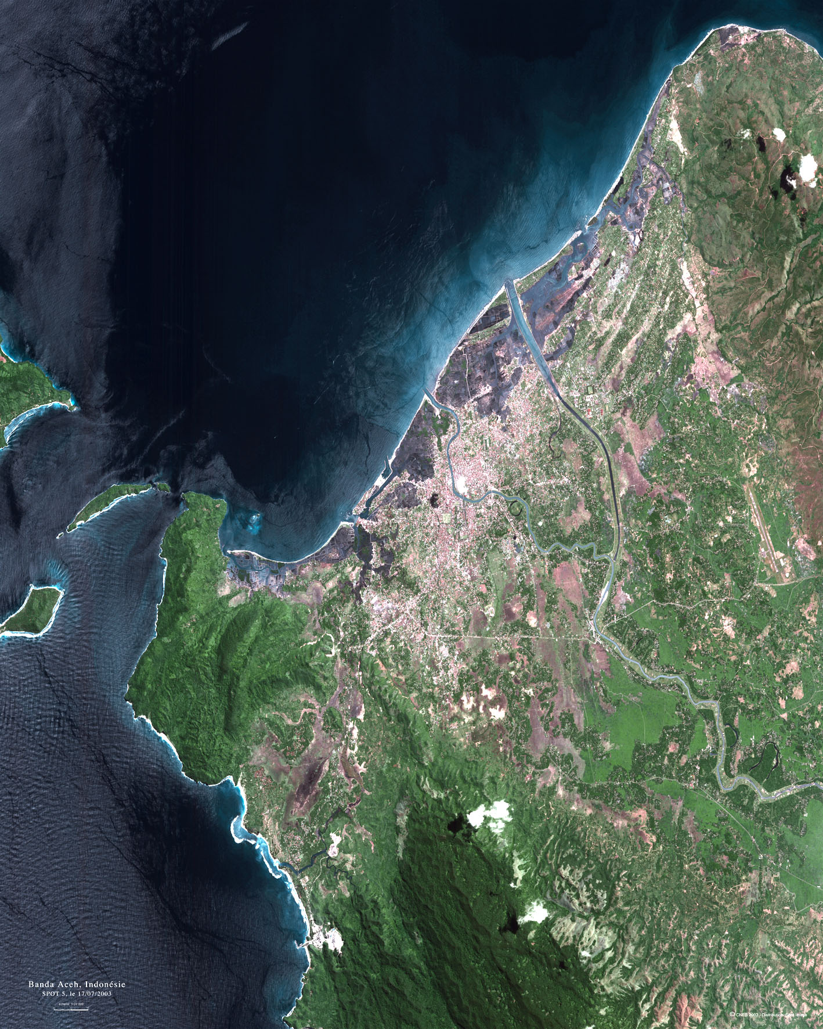
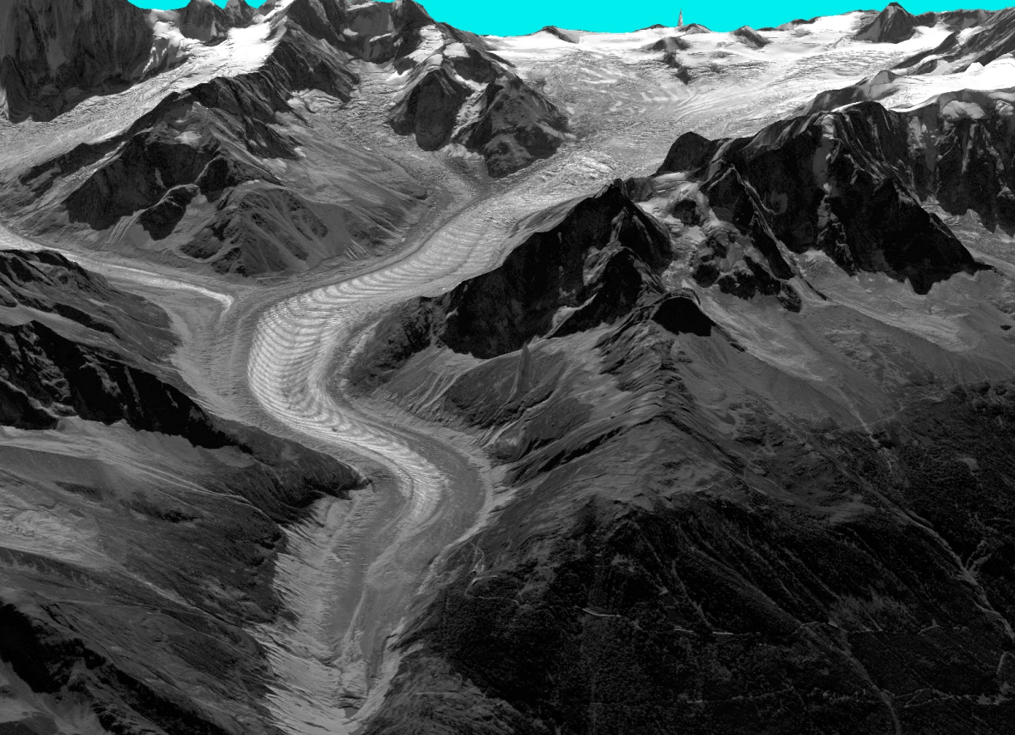
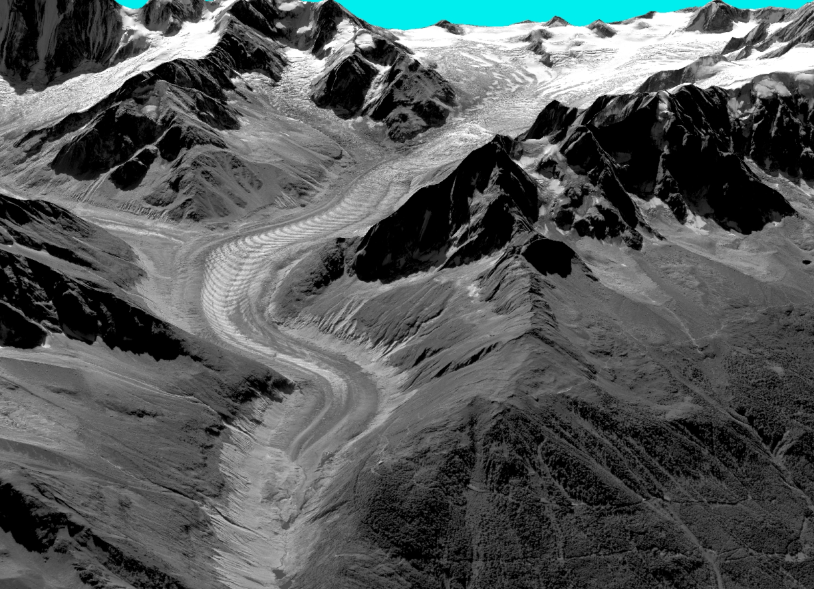

PLEIADES 1A / 1B
Launch date: December 17, 2011 / December 2, 2012
Nominal end of the mission: December 2018 / December 2019
  Mission objectives: Cartography, land use, risk, agriculture and forestry, civil planning and mapping, digital terrain models, defence, Snow & Ice: ice sheet topography
PLEIADES 1A / 1B main innovations:
Provision of an optical high-resolution panchromatic and multispectral imagery with high quality product standards.
Global coverage and a daily observation accessibility to any point on Earth
Service provision of a panchromatic image with a merged multispectral image orthorectified • Provision of stereo imagery and mosaic imagery
2012
CEOS – Fresh Water from Space - Delft 13-15 Nov. 2018

Slide 4
PLEIADES 1A / 1B
Launch date: December 17, 2011 / December 2, 2012
Nominal end of the mission: December 2018 / December 2019
  Mission objectives: Cartography, land use, risk, agriculture and forestry, civil planning and mapping, digital terrain models, defence, Snow & Ice: ice sheet topography
PLEIADES 1A / 1B main innovations:
Provision of an optical high-resolution panchromatic and multispectral imagery with high quality product standards.
Global coverage and a daily observation accessibility to any point on Earth
Service provision of a panchromatic image with a merged multispectral image orthorectified • Provision of stereo imagery and mosaic imagery
2003
CEOS – Fresh Water from Space - Delft 13-15 Nov. 2018

Slide 5
Global scale water cycle
Sea level rise 3mm/year (+/-0.4)
an ECV

Slide 6
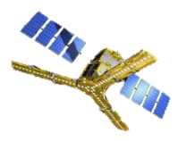
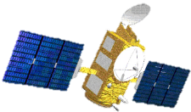
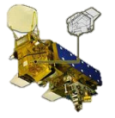
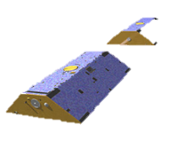
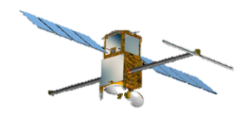
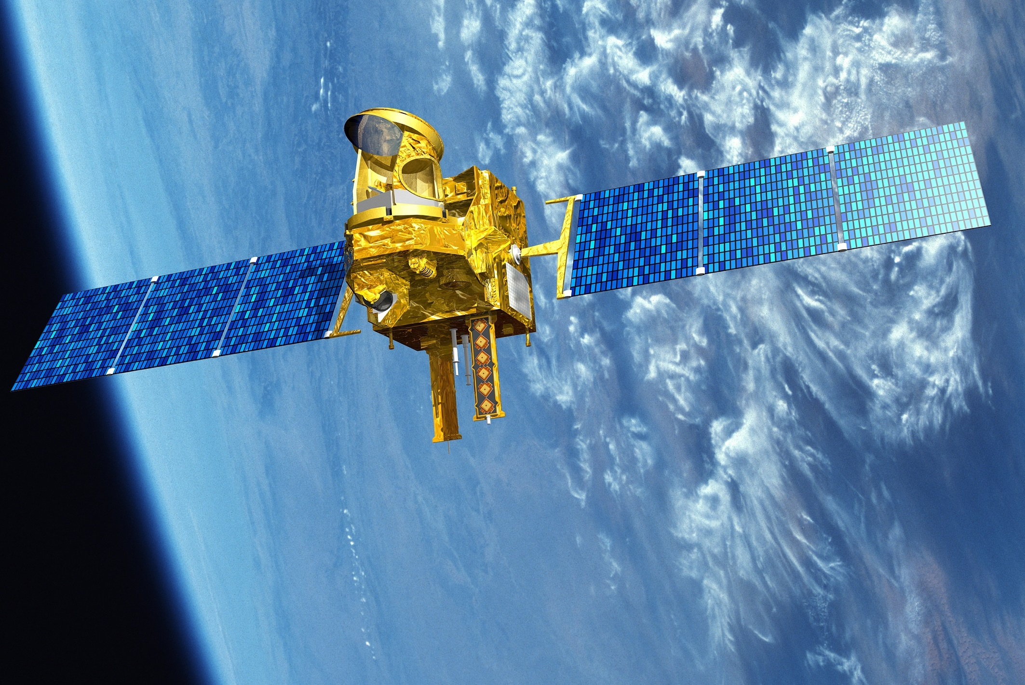
Regional water equation ant its sat measurements (EWV)
Ground water
Various resolution (xy,t,z) and accuracies
Various levels of proximity with EWV
Involving various levels of modelling
SMOS, SMAP,
AMSR-E, SSMI
Jason, S3
Saral Altika
SWOT, S1
TRMM, GPM,
Megha-Tropiques
oct
2011-?
Jason, S3
Saral Altika
SWOT
2021
CERES, S2
AIRS, MODIS
Landsat, TIR?
GRACE, GRACE-FO
CEOS – Fresh Water from Space - Delft 13-15 Nov. 2018

Slide 7
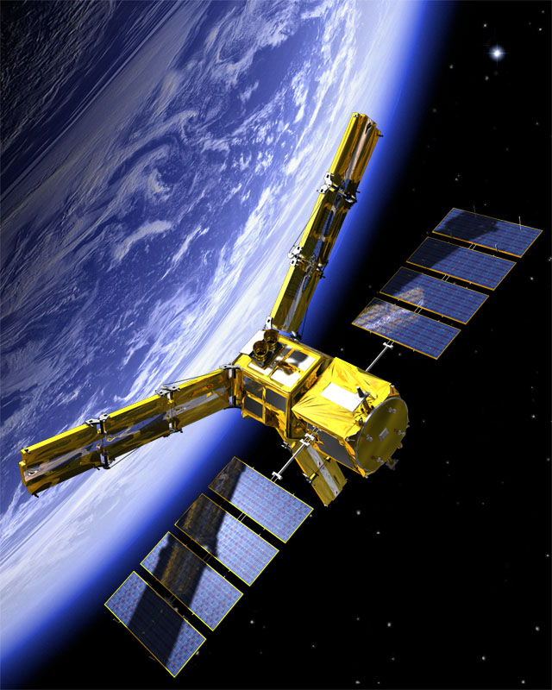
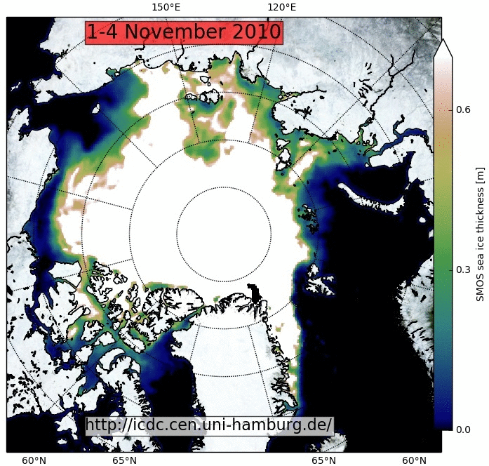
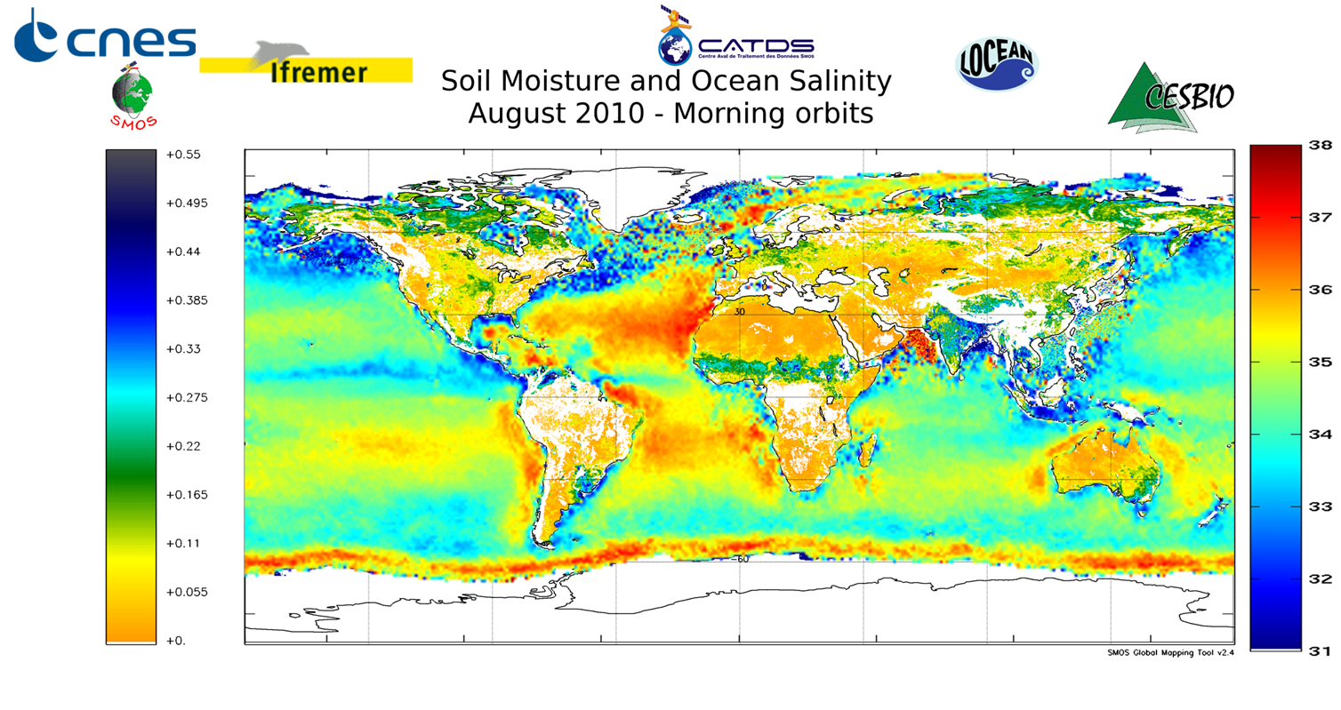
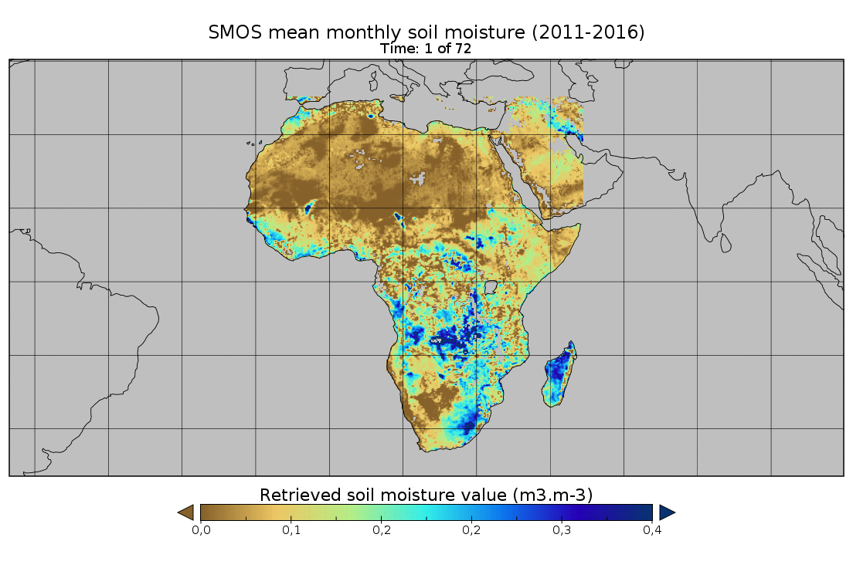
SMOS
Launch date: November 2 2009
Nominal end of the mission: Nov 2014 extended to 2021 (at least- all éléments in perfect shape)
Mission objectives: monitoring water cycle through soil moisture and sea surface salinity measurements
  Climate: water cycle trends and extreme events (droughts and floods) rainfall estimates,
  Agriculture: irrigation, water stress, yield estimates, phytosanitary attacks,
  Oceans: General circulation, Hurricane tracking and monitoring, very high wind speeds, rainfall amounts,
  Cryosphere, thin sea ice monitoring, snow liquid water content, snow density, Ice sheld internal temperature, Freeze thaw,
SMOS main innovations:
First ever L band interferometer in space
    First direct measurements of sea salinity and soil moisture operationally from space
  Global 3 day revisit (6 am and 6 pm)
  L band Brightness temeprature Multi angular acquisitions (first time)
  Downscaled to 1 km over land

Slide 8
Regional water equation ant its sat measurements
Ground water
Various resolution (xy,t,z) and accuracies
Various levels of proximity with EWV
Involving various levels of modelling
SMOS, SMAP,
AMSR-E, SSMI
Jason, S3
Saral Altika
SWOT, S1
TRMM, GPM,
Megha-Tropiques
Oct
2011-?
Jason, S3
Saral Altika
SWOT
2021
CERES, S2
AIRS, MODIS
Landsat, TIR?
GRACE, GRACE-FO
CEOS – Fresh Water from Space - Delft 13-15 Nov. 2018

Slide 9
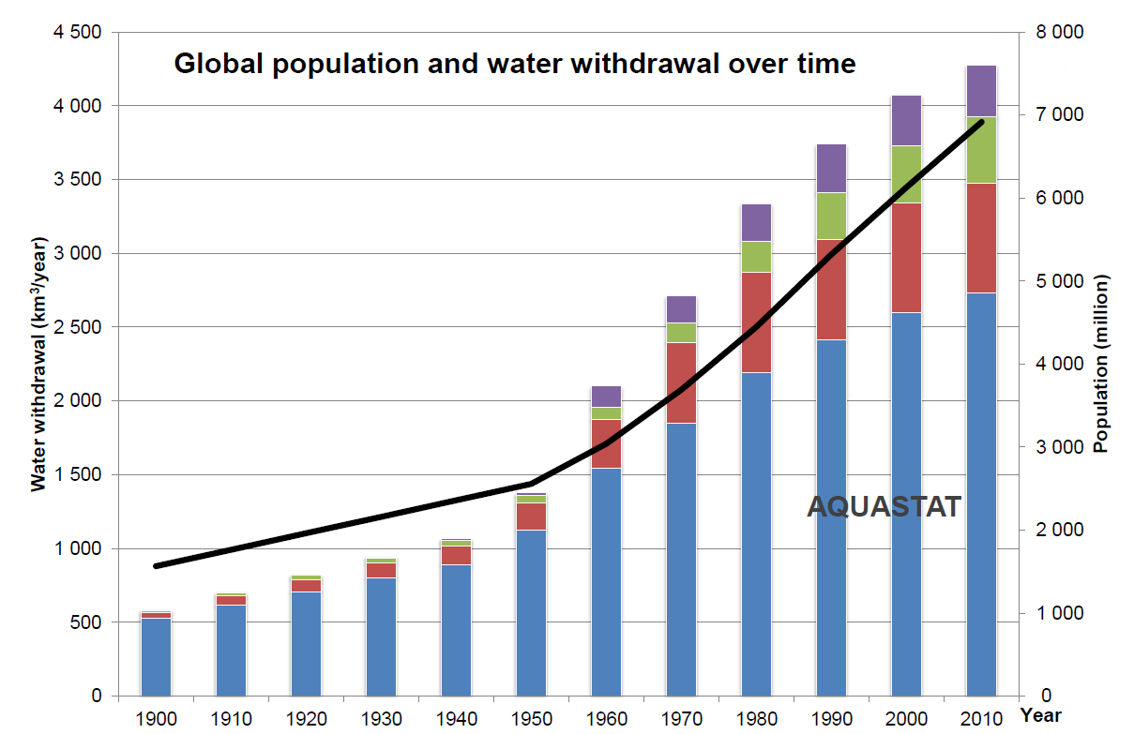
Global population and water withdrawal for irrigation
FAO AQUASTAT Dec. 2015
Artif. lakes Evapo.
Municipal
Industry
Agriculture
70%
From 2017 to 2050
Agri-production should increase by 60%
+77 % in developing countries (+ 24 % in developed)
CEOS – Fresh Water from Space - Delft 13-15 Nov. 2018

Slide 10
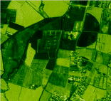
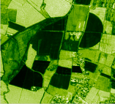
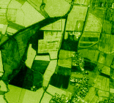
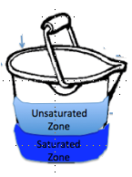
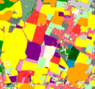
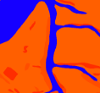
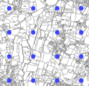
Crop water requirement
Reflectance Images
Water Stress
Land Use Maps
NEP & AET
Soil texture
Maps
Rg, Ta, P
CO₂ & Water fluxes
Meteo T, H, wind,
8 km
Biomass Production, Yield, irrigation
CEOS – Fresh Water from Space - Delft 13-15 Nov. 2018

Slide 11

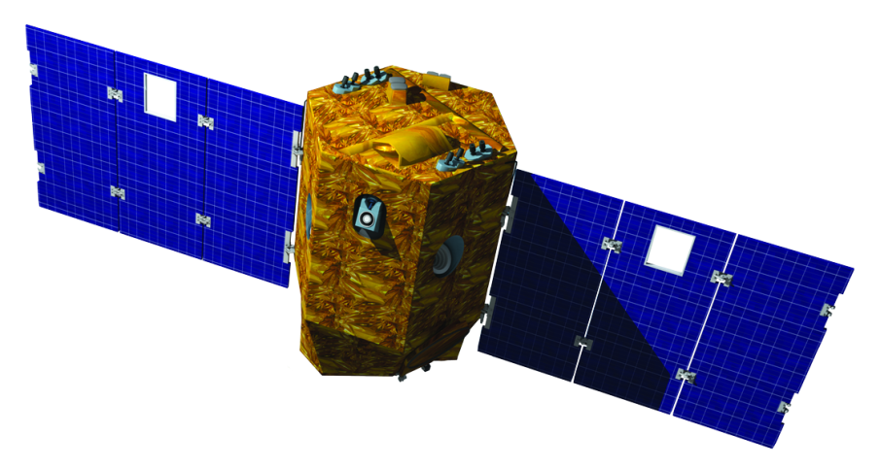
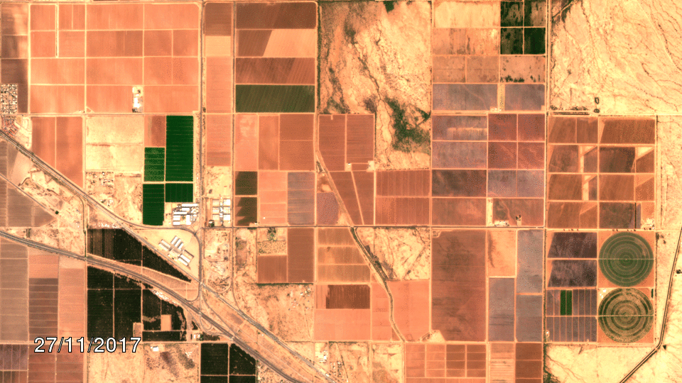
Venµs scientific mission
Mission objectives:
Science of water and carbon processes over land, modelling and data assimilation
  Climate: land surface models for climate scenarios (change, impacts, mitigation)
  Agriculture: crop yield, water balance and nutrient imputs modelling for precision farming and agroecological transition
  Demonstration of future EO mission
Launch date: August 1st, 2017
Nominal end of the mission: mid 2021
Venµs main innovations:
  2-days revisit over 110 sites for 2,5 years
  Constant viewing angle & local time
  5 and 10 m resolutions
  12 optical bands camera, from blue to near-infrared
  Stereoscopic imaging
  Advanced preprocessing
Data available via www.theia-land.fr

Slide 12
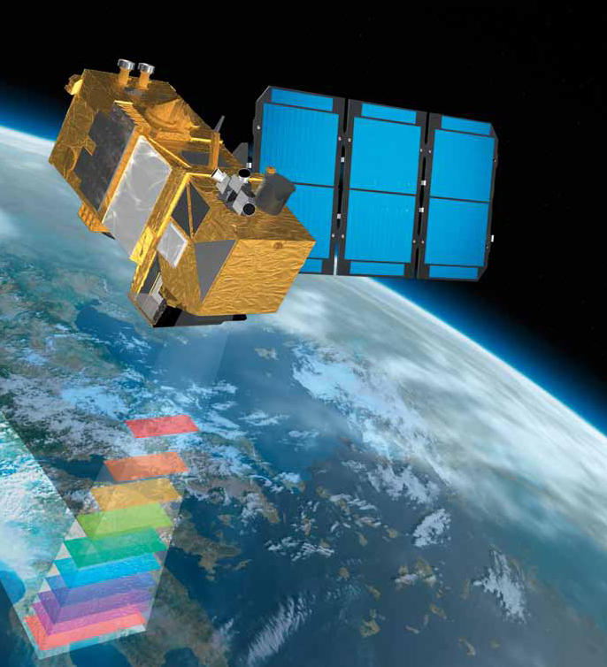
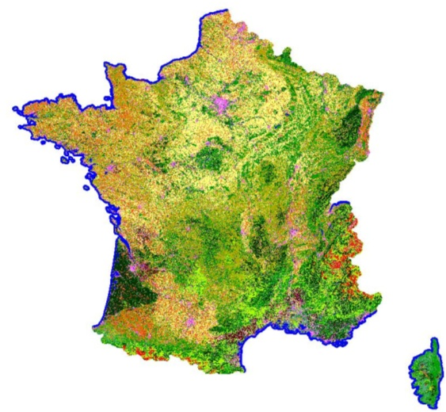

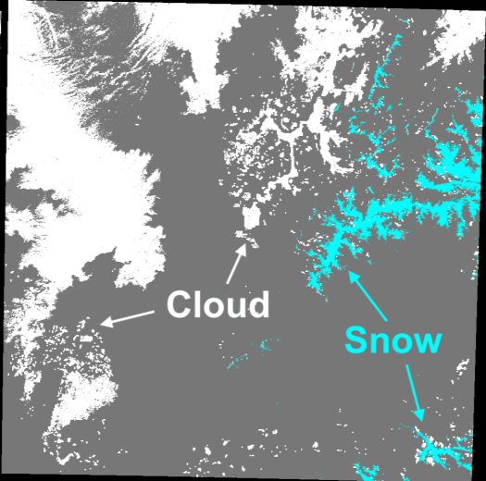
Sentinel 2
Launch date: Sentinel-2A on 23 June 2015; Sentinel-2B on 7 March 2017
Mission objectives:
Monitoring land cover and land use changes
Monitoring land, biosphere phenology, coastal and inland waters
  Risk and disaster mapping
  Agriculture: monitoring and modelling for food security, precision farming and agroecological transition
  Science of water and carbon processes over land, modelling and data assimilation
Sentinel 2 main innovations:
  Global 5-days revisit over land
  Constant viewing angle & local time
  Starts at 10 m resolution
  13 optical bands camera, from blue to shortwave-infrared
  Long term program
  Free and open data policy
Snow cover @20m
@5 days
Data available via www.theia-land.fr
Land cover 2016 @20m

Slide 13
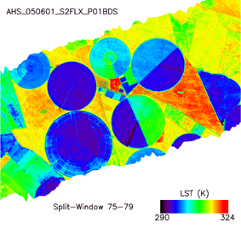
Crop water requirement
Reflectance Images
Temprerature images as drivers of water stress
Land Use Maps
NEP & AET
Soil texture
Maps
Rg, Ta, P
CO₂ & Water fluxes
Meteo T, H, wind,
8 km
Biomass Production, Yield, irrigation

Slide 14
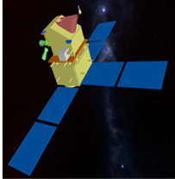


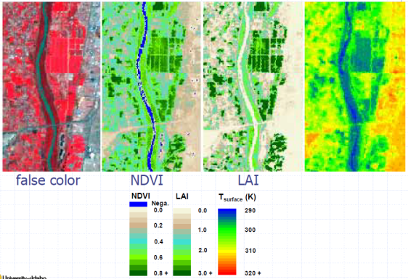
Trishna scientific mission
Mission objectives:
Ecosystem stress and water use (design driver)
Coastal and inland waters (design driver)
Urban, Cryosphere, Atmosphere,Solid Earth
Launch date: ~2025
Nominal end of the mission: TBD
Trishna main innovations:
  8&3-day revisit, global coverage
  Overpass time : ~13:00 LST
  Spatial resolution: 57 m (nadir)
  4 thermal channels + 6 optical bands camera, from blue-vis- NIR, SWIR
Tsurface
CEOS – Fresh Water from Space - Delft 13-15 Nov. 2018

Slide 15
Regional water equation ant its sat measurements
Ground water
Various resolution (xy,t,z) and accuracies
Various levels of proximity with EWV
Involving various levels of modelling
SMOS, SMAP,
AMSR-E, SSMI
Jason, S3
Saral Altika
SWOT, S1
TRMM, GPM,
Megha-Tropiques
oct
2011-?
Jason, S3
Saral Altika
SWOT
2021
CERES, S2
AIRS, MODIS
Landsat, TIR?
GRACE, GRACE-FO

Slide 16
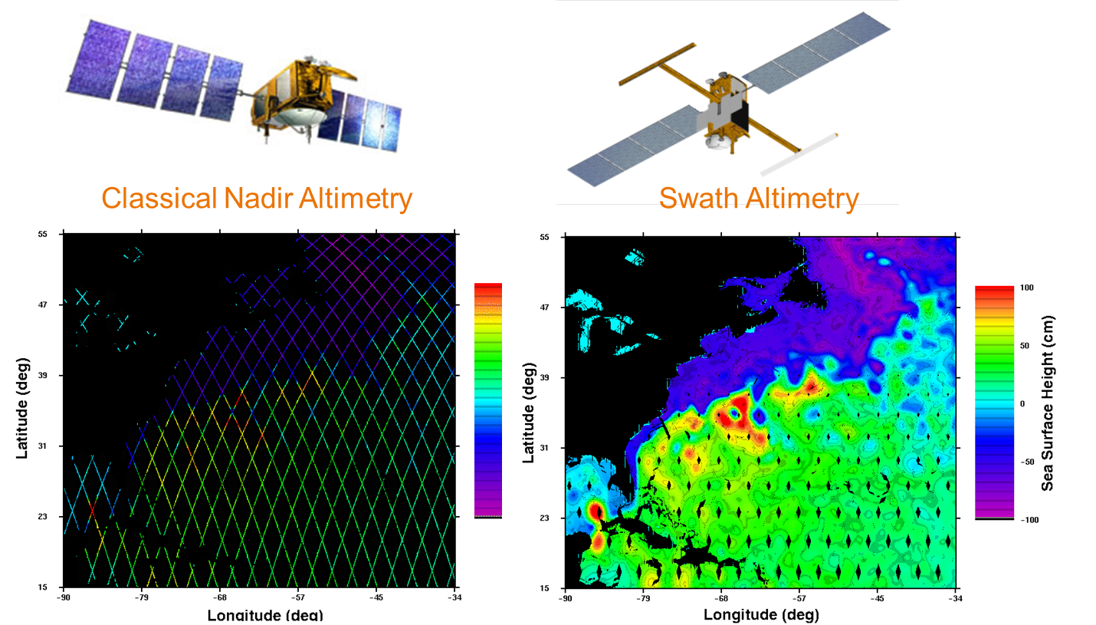
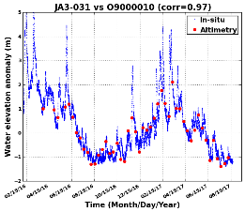
SWOT (Swath Altimetry in 2021) versus Classical altimetry
Garonne RIVER
1m
SWOT (revisit 21d)
Jason3 (revisit 10d)
A need for
more frequent observations

Slide 17
« Hydro satellites »
No S2 equivalent in TIR => TRISHNA
No SMOS continuity =>SMOS HR
Notes:
Selon logique organisationnationale

Slide 18
Requirements in summary
  time continuity, resolution and revisiting capacity
  Complementarity S2 /S1 (increase revisiting capacity)
  Water stress assessment IRT Mission, revisite <3 days, 50m (Trishna)
  Continuity soil moisture at improved resolution (SMOS-HR(10km))
  Continuity & Higher resolution in water levels (SWOT+along track)
  Digital Elevation Model, SurfaceEM at very high Resol. (pleaides like)
  Higher pixel resolution for Sentinel-NG 1&2 or other
  Hyperspectral / Superspectral?
By 2025
from
2025
To
2030
CNES prospective workshop in 2019
Toulouse Space Show – 26/06/2018

Slide 19

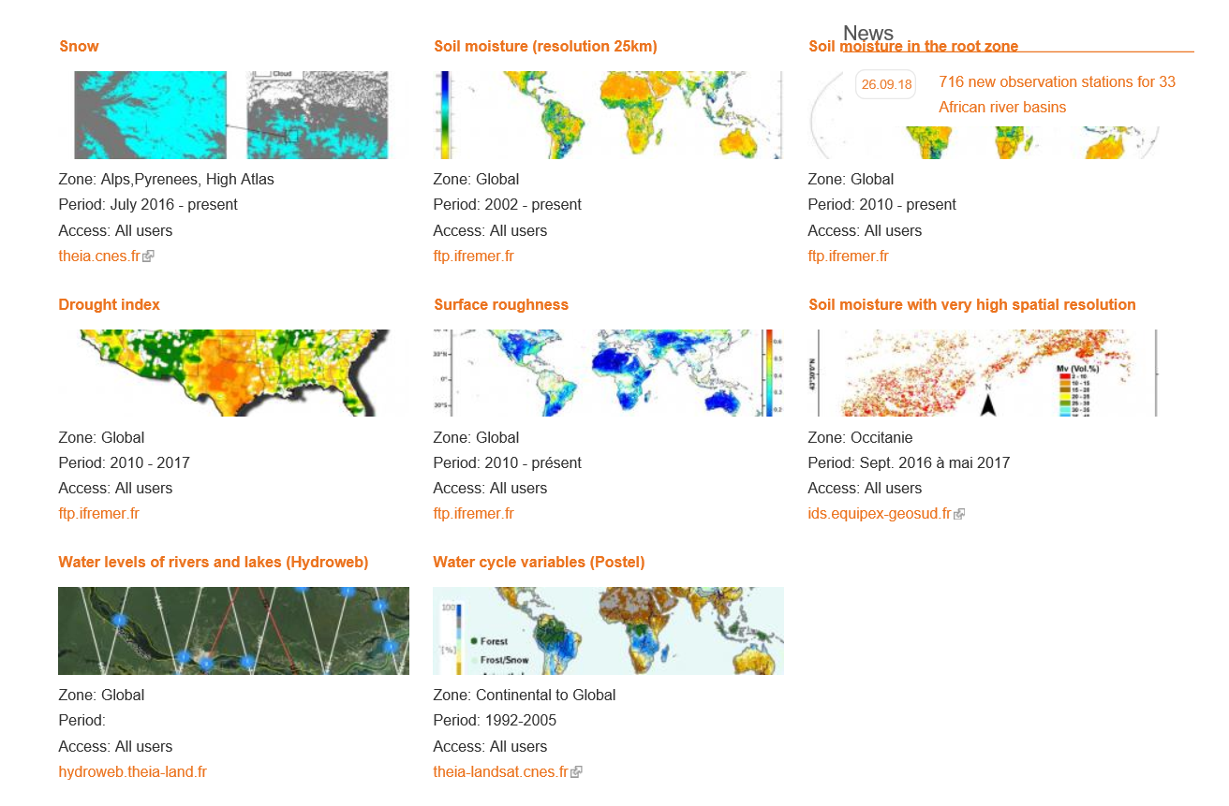









  Theia the french thematic platform for continental surfaces
    Infrastructures for Data ans Services (IDS) : CNES, GEOSUD, IGN
    More than 20 Scientific Expertise Centers (SEC)
    Regional network coordination between SEC and stakeholder
http://www.theia-land.fr/
Soil moisture SEC
Soil moisture with very high spatial resolution SEC
Colours of the continental waters SEC
Digital soil mapping SEC
Evapotranspiration SEC
Irrigated surfaces SEC
Land water bodies SEC
Land water quality
Snow-covered surface and snow altitude SEC
Water levels of lakes and rivers SEC (Hydroweb)
Notes:
Proximité mesure EWV

Slide 20
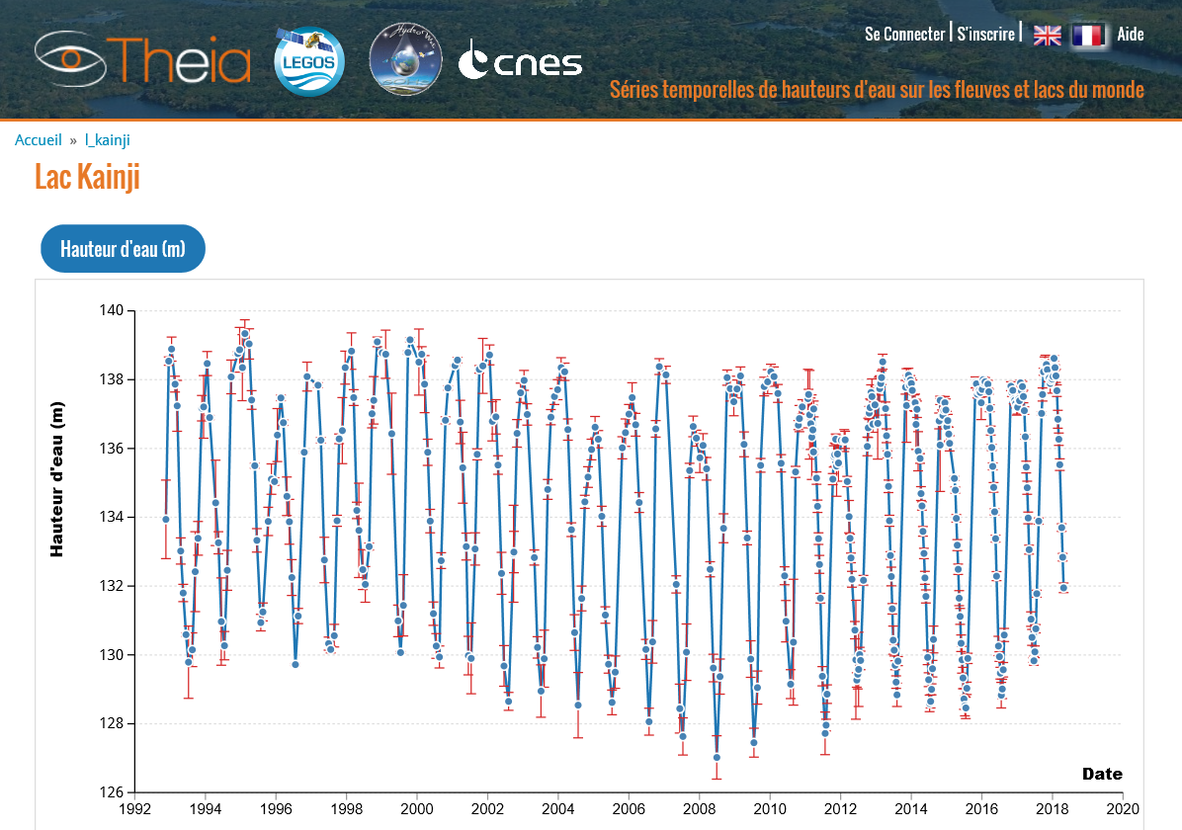
  Theia the french thematic platform for continental surfaces
    3 Infrastructures for Data ans Services (IDS) : CNES, GEOSUD, IGN
    More than 20 Scientific Expertise Centers (SEC)
    7 Animations Régionales Théia (ART) fédérées en réseau
Soil moisture SEC
Soil moisture with very high spatial resolution SEC
Colours of the continental waters SEC
Digital soil mapping SEC
Evapotranspiration SEC
Irrigated surfaces SEC
Land water bodies SEC
Land water quality
Snow-covered surface and snow altitude SEC
Water levels of lakes and rivers SEC (Hydroweb)
http://www.theia-land.fr/
Notes:
Proximité mesure EWV

Slide 21
Additional remarks
EWV are available on test Regions of interest through the French Theia land data center http://www.theia-land.fr/
These EWV should be available soon on a broader scale with other data (DEM, meteo, …) in a Water Database built up in the frame of the SWOT preparatory programme => modelling facilitation
Theai is also becoming part of a National Research Infrastructure gathering 4 thematic platforms (oceans, atmo, cont. Surfaces, solid Earth)
=> articulation between in situ / models / satellite data.
Toulouse Space Show – 26/06/2018
Notes:
Conclusions besides distributio
Models involvment

Slide 22
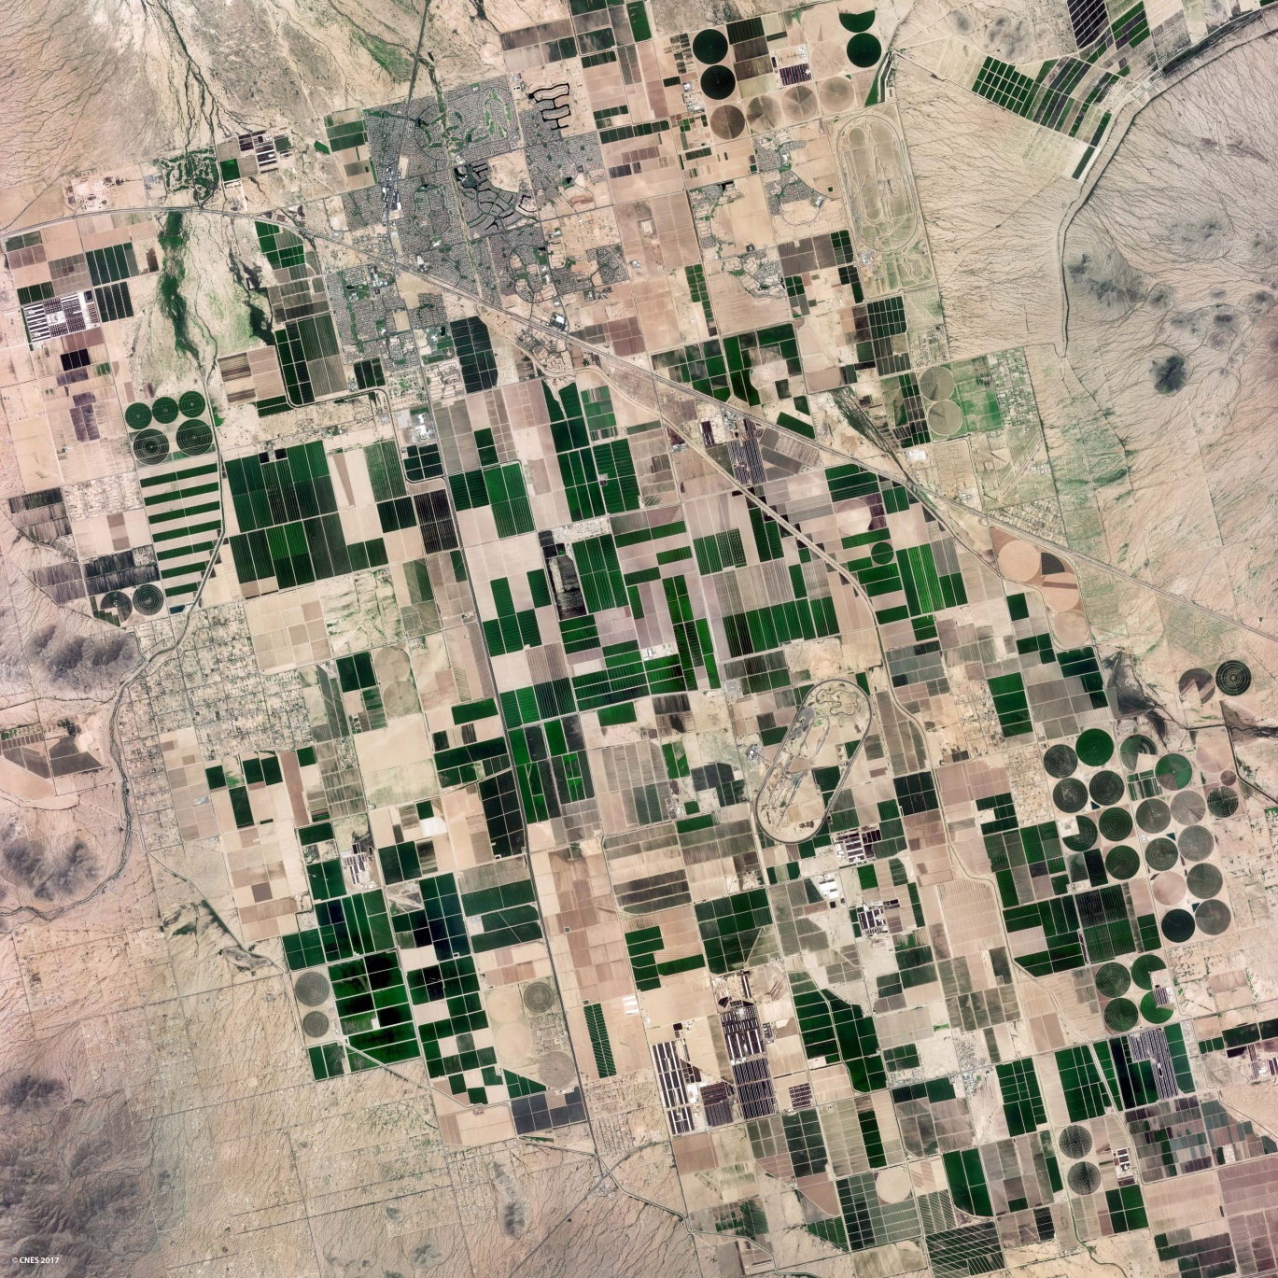

Thank you
Toulouse Space Show – 26/06/2018

Slide 23
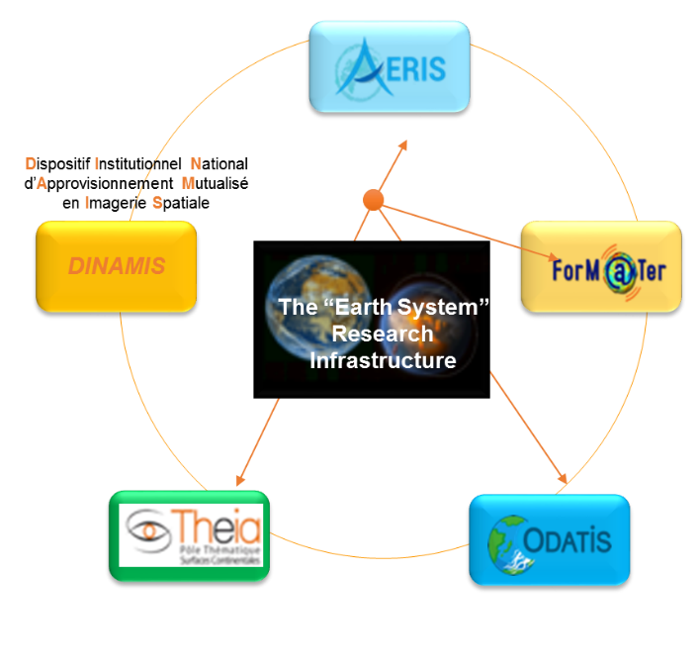
“Earth System” Research Infrastructure
Integrated “Earth System” studies
  Four data and service hubs: AERIS, Form@Ter, THEIA and ODATIS.
  Promote integrated and interdisciplinary research
  Implement the new National Institutional Scheme for Pooling the Supply of Space Imagery (DINAMIS), develop shared access and support users.
  Multi-source, multi-sensor data enabling multi-scale spatial, spectral and temporal uses
  Combining satellite-based, in situ and modelling data
  Interdisciplinarity
The mission of the Earth System infrastructure is:
  to serve the scientific communities, public authorities and innovation stakeholders.
  to develop European and international partnerships.
  To facilitate in situ and satellite data complementarity
  34 research institutions partnering
  CNES main contributor

Slide 24
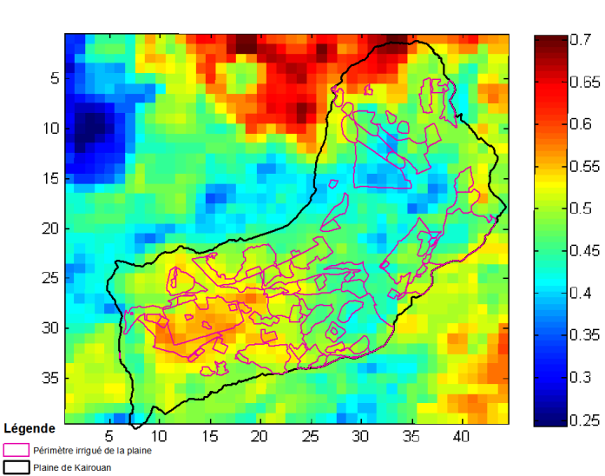
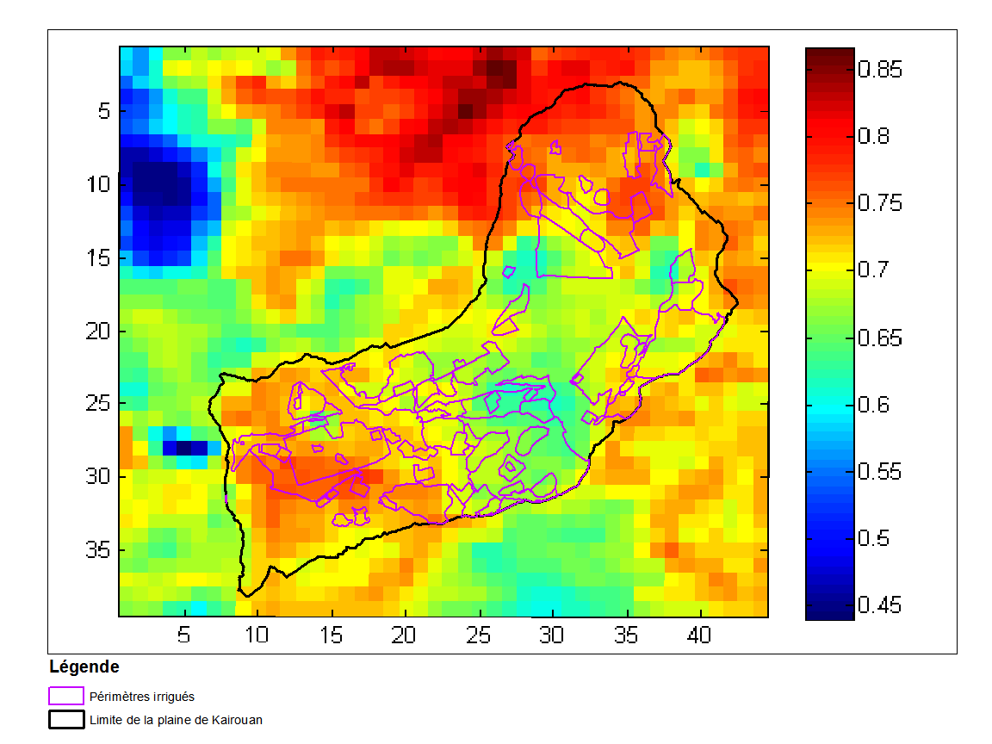
Crop water Stress with MODIS Thermal IR
Water stress 22/03/ 2013
Water stress 15/07/2013
(Kairouan region -Tunisia)
Courtesy G. Boulet (CESBIO)
CEOS – Fresh Water from Space - Delft 13-15 Nov. 2018

Slide 25
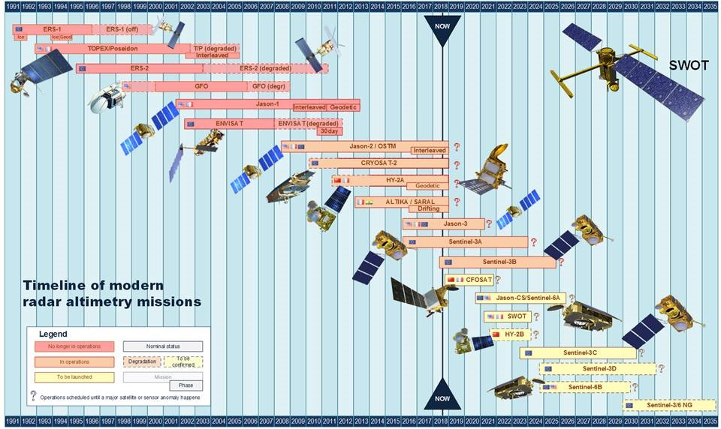
Current and future altimetry missions
Water quantity : water elevation
Continuity guaranteed after 2030
  Long times series
Current main issues in hydrology
  Number of rivers and lakes detected by altimeters and accuracy of water height:
  Improvements with Jason 3 and Sentinel 3 (Open Loop mode and fully focused SAR)
  SWOT : global coverage, accurate measurements
  Revisit time for an operational use :
    10d. for Jason series,
    27d. for Sentinel 3,
    21d. for SWOT.
Sentinel 3a virtual stations

Slide 26
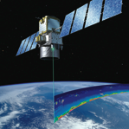
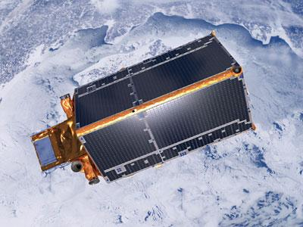
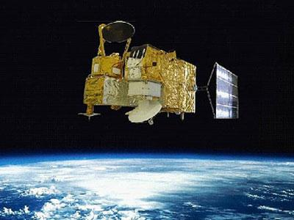
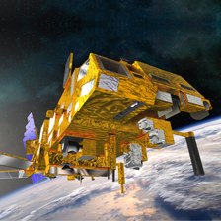


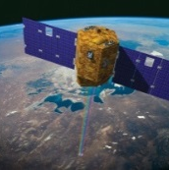
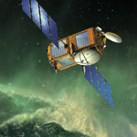
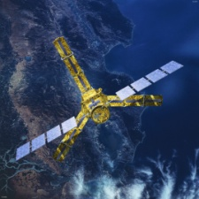
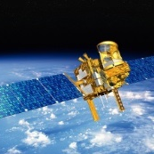




Franco-European program context
Calipso
Cryosat-2
Hy-2A
Iasi2/MetopB
Swarm
Jason 3
Venμs
2006 | 2007 | 2008 | 2009 | 2010 | 2011 | 2012 | 2013 | 2014 | 2015 | 2016 | 2017
Iasi1/MetopA
Jason 2
Smos
Megha-Tropiques
Saral-AltiKa
Sentinel-2A
Sentinel-3A
Sentinel-2B

Slide 27









Franco-European program context
Iasi 3/MetopC
Sentinel-3B
Jason-CS/Sentinel-6
Microcarb
Biomass
Merlin
2018 | 2019 | 2020 | 2021 | 2022 | 2023 | 2024
Strateole-2
CFOSAT
SWOT
IASI-NG1/3MI
Metop SG A

Slide 28









VENµS delivers high quality products
Registration, cloud mask, cloud shadow mask, atmospheric correction
4 08 2006 10 08 2006 13 08 2006 19 08 2006
Level 1:
Top of the Atmosphere reflectances calibrated & geocoded
Level 2:
Single date surface reflectances after cloud masking and atmospheric correction
Methods developed by CESBIO since 2007
Using Formosat-2
Now operational for Sentinel-2, Landsat and VENµS (MAJA software)
Level 3:
10 days time composite of level 2

