Slide 1

GEOGLOWS and EWVs
George J. Huffman / NASA Goddard Space Flight Center
CEOS Water From Space workshop, 13-15 November 2018, Delft, The Netherlands

Slide 2
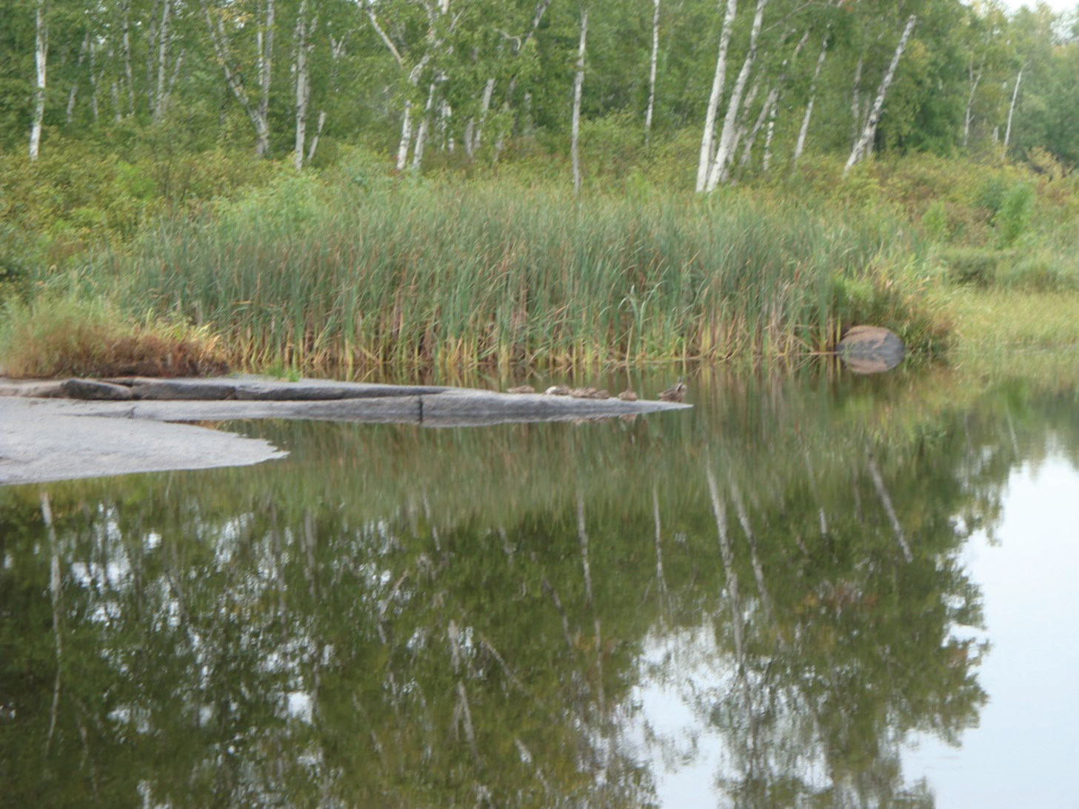
GEOGLOWS
GEO Global Water Sustainability
GEO initiative
• as of 2016
• to connect the demands for sound and timely environmental information
• to the supply of data and information about the Earth’s water system
• and to explore the science needed to achieve global water sustainability
Meet the information needs of policy drivers such as
• the Sustainable Development Goals,
• the Paris Agreement on Climate Change,
• the Sendai Framework for Disaster Risk Reduction, and
• the Aichi Targets of the Convention on Biodiversity
Advocate for
• broad, open data policies
• the right to access information
Engage water-sensitive communities
CEOS WFS, 13-15 November 2018
Delft, The Netherlands

Slide 3
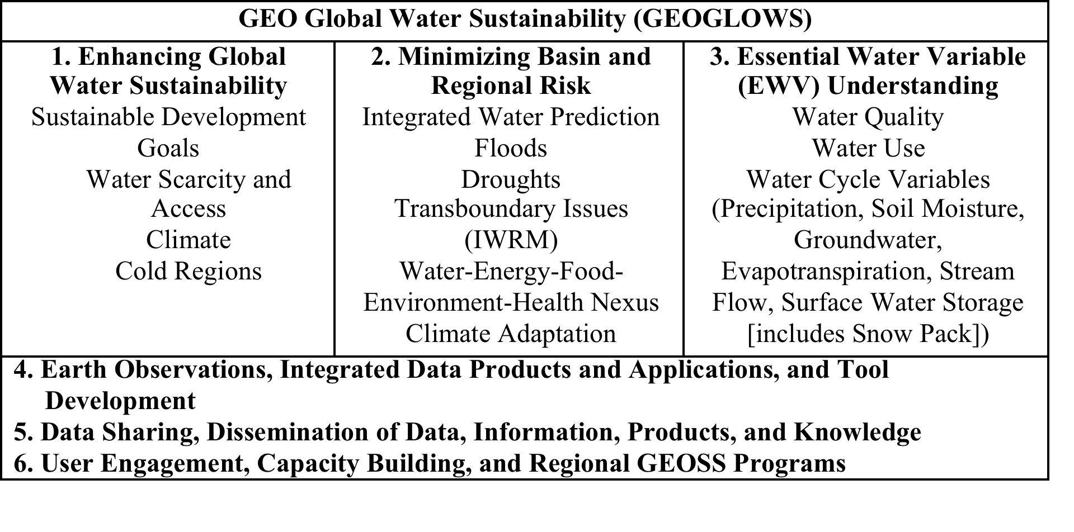
GEOGLOWS Thematic Structure
CEOS WFS, 13-15 November 2018
Delft, The Netherlands

Slide 4








Support for SBAs and SDGs
Links to SBAs and initiatives
EWVs are important and sometimes critical information inputs for
• Biodiversity
• Agricultural and Forestry monitoring
• Disaster Risk Management
• Climate Resilience
• Renewable Energy
Contributions to SDGs
• water data plays an essential role in achieving targets and calculating indicators for 11 of the 17 SDGs,
• SDG 6 (Water) is considered an important basis for defining Water Quality EWVs.
• Countries require EWVs in order to make timely interventions to achieve the SDGs.
CEOS WFS, 13-15 November 2018
Delft, The Netherlands

Slide 5
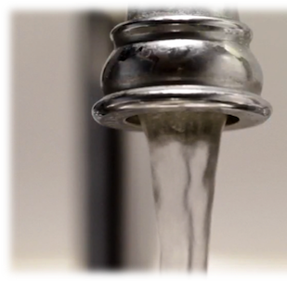
GEOGLOWS Approach to EWVs
Methodology
• the EWV status will be established through user and expert group surveys
• non-traditional data sources will be explored by engagement with citizen science and data groups
• observational system continuity and open data access will be pursued via white papers and advocacy to agencies
Project Governance Structure
• WG members will take lead responsibility in specific areas
Challenges and Issues
• the proper organizational structure of the water cycle and water quality EWVs is still under discussion
• the diverse breadth of EWVs requires a wide range of experts to address the very different technical and application issues that each EWV poses
• sensors and algorithms are needed that focus on fresh water quality, vs marine/coastal
CEOS WFS, 13-15 November 2018
Delft, The Netherlands

Slide 6
Selecting EWVs
Revisit user requirements across the range of EWVs
• considerable work is done, but need to expand to non-English-speaking groups
• quantity (water cycle) and quality EWVs are at different stages of development
• water quality requires consolidating a list of users and needs
• interacting with AquaWatch, GEO-BON, GEO-Wetlands
• CEOS Feasibility Study of an Aquatic Ecosystem Earth Observing System presents a detailed study of potential satellite observations for inland and coastal waters
• water quality requires a number of unique problem-specific criteria beyond the general criteria that will apply to all EWVs
• in-situ (and lab analysis) data are expected to play a significant role in determining the options for delivering water quality EWVs
Once the essential variables are identified, we need to analyze
• space/time/accuracy needs
• what criteria the various observing systems already meet or could meet for various thresholds for data services
• already initiated for quantitative EWVs
CEOS WFS, 13-15 November 2018
Delft, The Netherlands

Slide 7
Guidelines for EWVs
• Standards and best practices: The study should identify process guidelines for defining EWVs.
• Source: EWVs can be measured, modeled, or a proxy. The most acceptable ways of providing an EWV will be identified in this analysis.
• Redundancy: Select the variable that is easier to acquire even if it is not perfect.
• Hierarchy: The more direct and less prescriptive an EWV is, the more likely it will be to accept a variety of different measurement sources and methods.
• Attributes: A single variable can have a variety of sub-variables (aka attributes), which will be explicated in the definition process.
• Stages of approval: An EWV will be "conditional" until it is demonstrated in the field to actually work, with the target status of “sufficient consensus”.
• Updates: The EWV list will be updated periodically.
• Distribution: Open data distribution is key, starting with existing data portals, and considering more broad-based solutions, such as GEOSS links to other systems (e.g., WIGOS).
CEOS WFS, 13-15 November 2018
Delft, The Netherlands

Slide 8
Current Status of EWV List
CEOS WFS, 13-15 November 2018
Delft, The Netherlands

Slide 9

EWVs and ECVs
Differences and synergies
Compared to ECVs, EWVs need
• higher space and time resolution
• more frequent reporting
• relaxed accuracy requirements
• shorter time delays in making the information available (latency)
• stronger ties to short-term predictions
Synergies
• argue for support of observational networks and free access
• strengthen the case for international data centers
• support the development of data sets for areas where in-situ data are not adequate
• mutual review on a regular basis
CEOS WFS, 13-15 November 2018
Delft, The Netherlands

Slide 10
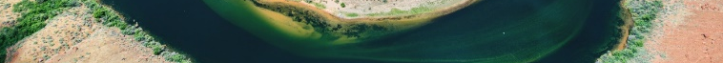
Key ongoing activities of GEOGLOWS (1/2)
As approved in the update to the 2017-2019 GEO Work Programme:
• coordinate identifying a priority list of initial EWVs
• with consistent criteria;
• organize an EWV Workshop in Europe, early February 2019;
• redact the “white paper” on EWVs for presentation to the GEO Plenary and Ministerial in 2019,
• including a plan for coordinating the definition of EWVs in support of the SDGs, Sendai, and other priority policies
CEOS WFS, 13-15 November 2018
Delft, The Netherlands

Slide 11
Key ongoing activities of GEOGLOWS (2/2)
And then
• submit an EWV implementation plan by the 2020 GEO Plenary;
• submit a plan for system development and governance facilitating consistent access to
• EWVs estimates and related processing tools
• at preferred resolutions
• by the 2021 GEO Plenary
CEOS WFS, 13-15 November 2018
Delft, The Netherlands

Slide 12
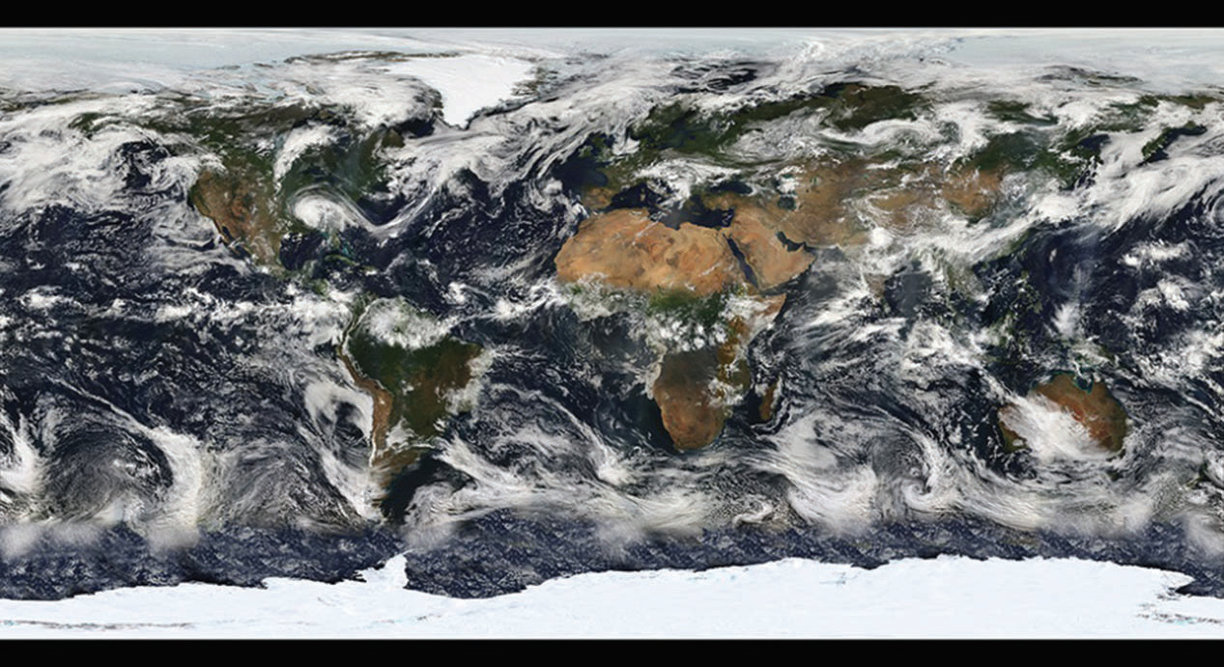
Thank You
george.j.huffman@nasa.gov
CEOS WFS, 13-15 November 2018
Delft, The Netherlands

