Slide 1
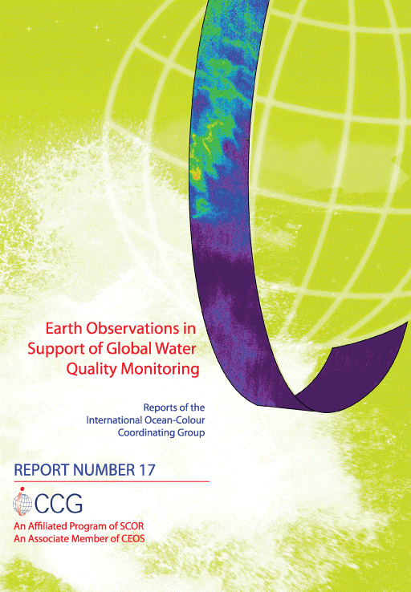
There are ( a lot of ) terrestrial, ocean and atmospheric EO sensors….. but none specifically for where ~60% of global population lives and ~60 Trillion U$ of GDP is produced……….
(non-ocean) Aquatic Ecosystems:
From Gap to Feasibility to Strategy
http://ioccg.org/what-we-do/ioccg-publications/ioccg-reports/
http://ceos.org/about-ceos/publications-2/

Slide 2
Scope of the Feasibility Study for an
Aquatic Ecosystem Earth Observing Sensor
One of the GEO Water Strategy recommendations (2015) to CEOS was : a feasibility assessment to determine the benefits and technological difficulties of designing a hyperspectral satellite mission focused on inland water quality measurements:
The GEO AquaWatch community proposed to extend the scope to: (i) a dedicated imaging spectrometer or (ii) augmenting designs of planned spaceborne sensors for terrestrial and ocean colour, to allow improved inland, near coastal waters, benthic and shallow water bathymetry applications.
CEOS agencies also requested : augmenting designs of spaceborne sensors for terrestrial and ocean colour applications as a cost-effective pathway to addressing the same science and societal benefit applications
Focus is on a global mapping mission

Slide 3
Scope of the Feasibility Study for an
Aquatic Ecosystem Earth Observing Sensor
One of the GEO Water Strategy recommendations (2015) to CEOS was : a feasibility assessment to determine the benefits and technological difficulties of designing a hyperspectral satellite mission focused on inland water quality measurements:
The GEO AquaWatch community proposed to extend the scope to: (i) a dedicated imaging spectrometer or (ii) augmenting designs of planned spaceborne sensors for terrestrial and ocean colour, to allow improved inland, near coastal waters, benthic and shallow water bathymetry applications.
CEOS agencies also requested : augmenting designs of spaceborne sensors for terrestrial and ocean colour applications as a cost-effective pathway to addressing the same science and societal benefit applications
Focus is on a global mapping mission

Slide 4
Scope of the Feasibility Study for an
Aquatic Ecosystem
Earth Observing System
One of the GEO Water Strategy recommendations (2015) to CEOS was : a feasibility assessment to determine the benefits and technological difficulties of designing a hyperspectral satellite mission focused on inland water quality measurements:
The GEO AquaWatch community proposed to extend the scope to: (i) a dedicated imaging spectrometer or (ii) augmenting designs of planned spaceborne sensors for terrestrial and ocean colour, to allow improved inland, near coastal waters, benthic and shallow water bathymetry applications.
CEOS agencies also requested : augmenting designs of spaceborne sensors for terrestrial and ocean colour applications as a cost-effective pathway to addressing the same science and societal benefit applications
Focus is on a global mapping mission

Slide 5
The CEOS Teams that
wrote or supported the report
Leads: CSIRO - Arnold Dekker; Coordinator: DLR - Nicole Pinnel
Members:
CNES Marie-Jose Lefevre & Xavier Briottet (France)
DLR Peter Gege, Harald Krawczyk, Bingfried Pflug, Birgit Gerasch (Germany)
EOMAP Thomas Heege (Germany)
CNR Federica Braga, Claudia Giardino & Vittorio Brando (Italy)
NASA Kevin Turpie & Nima Pahlevan (USA)
CSA Martin Bergeron & Maycira Costa (Canada)
USGS Thomas Cecere (USA)
WaterInsight Steef Peters (Netherlands)
TNO Andy Court (Netherlands)
CSIRO Hannelie Botha & Antonio Robles-Kelly (Australia)
Supporting sponsors:
(NSO) Mark Loos & Joost Carpaaij (Netherlands)
(EC) Astrid-Christine Koch & Catharina Bamps (European Commission)

Slide 6
Table of Contents:
Feasibility Study for an Aquatic Ecosystem Earth Observation System
Strategic direction for studying inland waters, coastal waters, benthos and shallow water bathymetry
Science and Applications Traceability Matrix and resulting sensor requirements
Instrument, platform and mission design considerations
Aquatic ecosystem Earth observation enabling activities
Summary, conclusions, recommendations
References
Appendix A: The science and applications traceability matrix
Appendix B: The forward bio-optical and atmospheric simulations
Available from: http://ceos.org/about-ceos/publications-2/

Slide 7
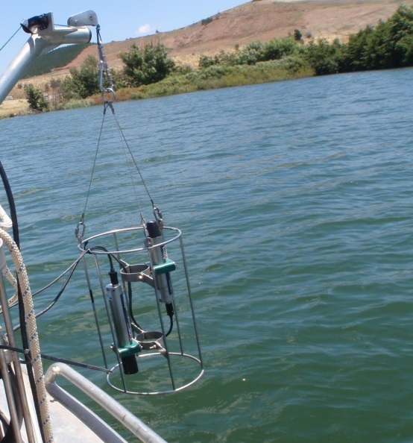
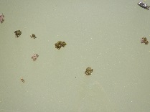

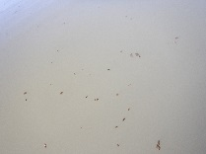
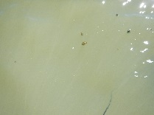
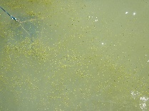
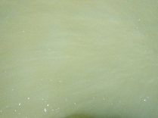
Inland waters not so simple: many different land-water boundaries; lakes at ~ - 408 to ~ + 6390 m altitude
Reflectance

Slide 8
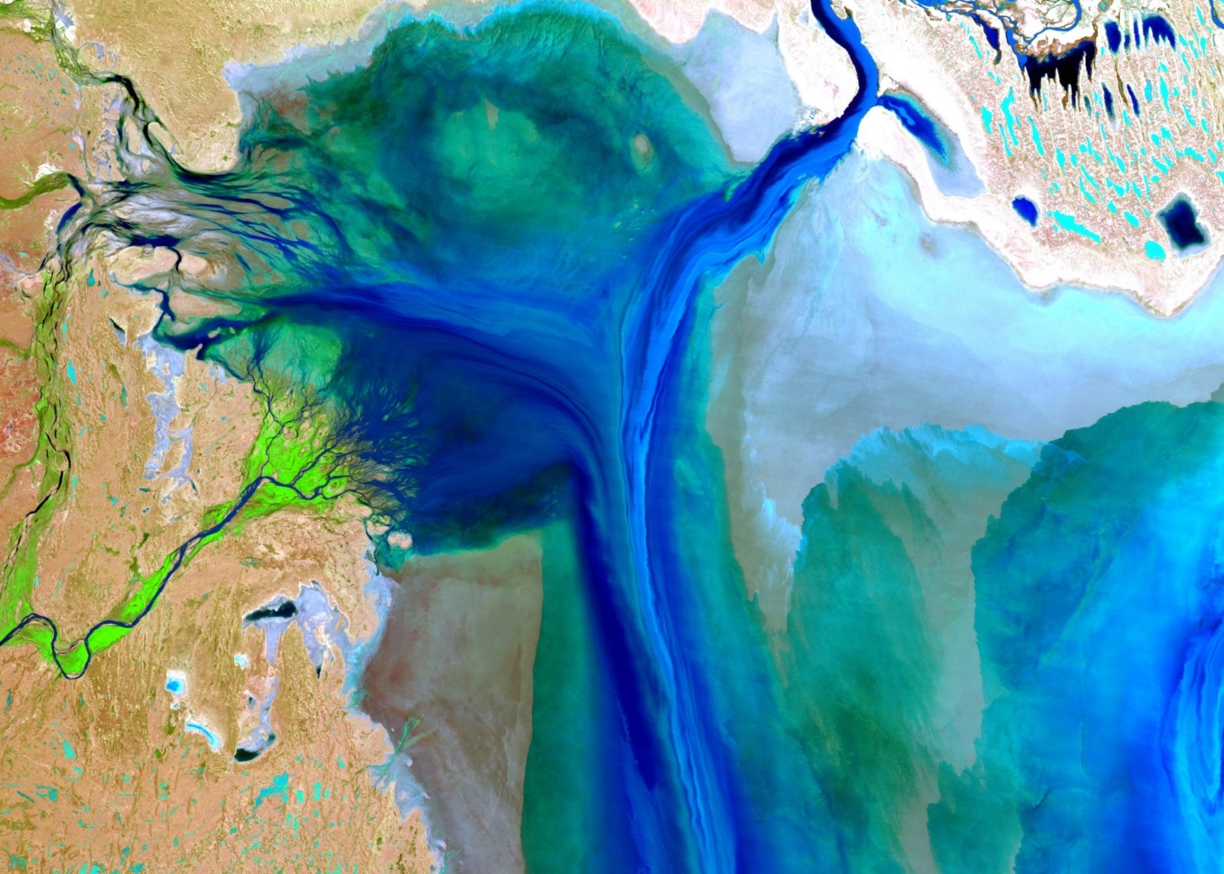
Salt lakes- not so simple
(Lake Eyre- Australia after floods)
Landsat image courtesy of USGS and GeoScience Australia

Slide 9
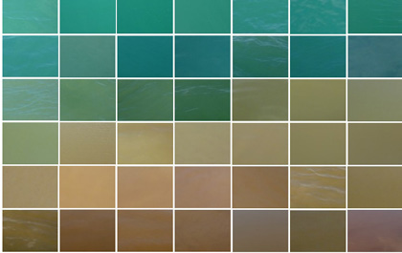
The colour of coastal waters
images courtesy of CSIRO D. Blondeau-Patissier & T. Schroeder

Slide 10
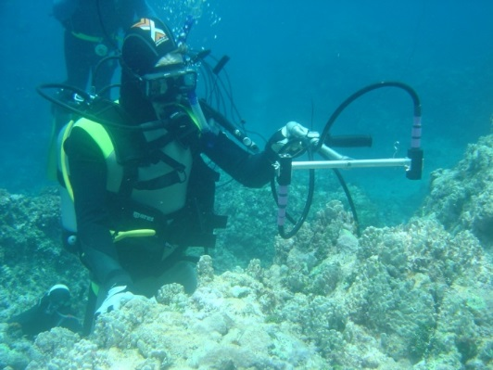
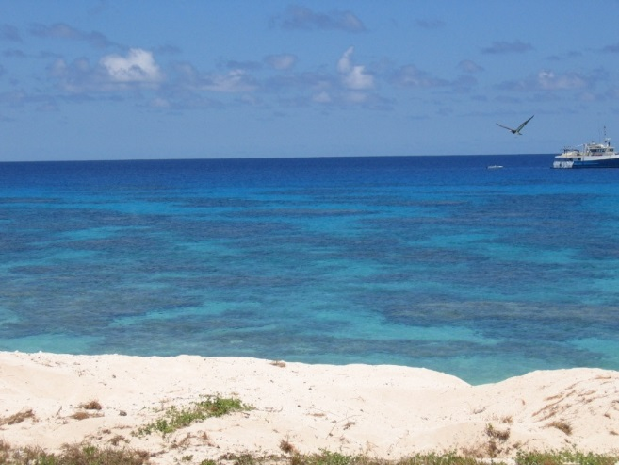
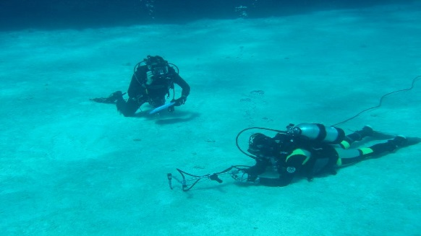
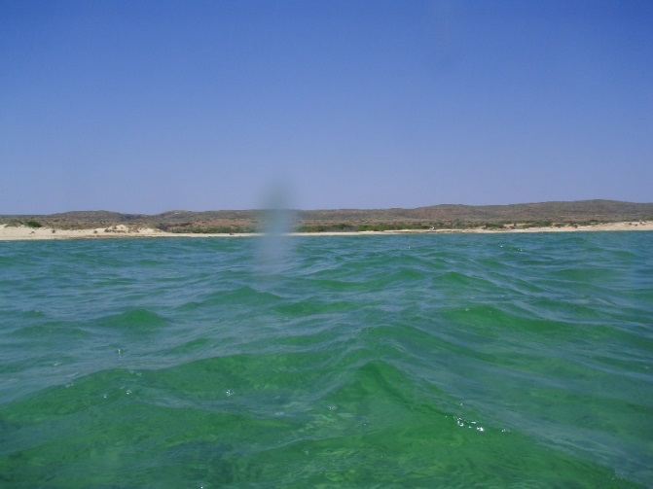
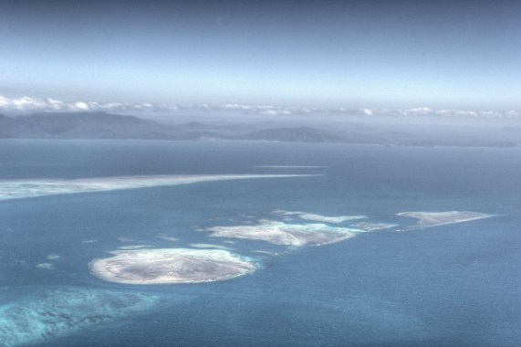
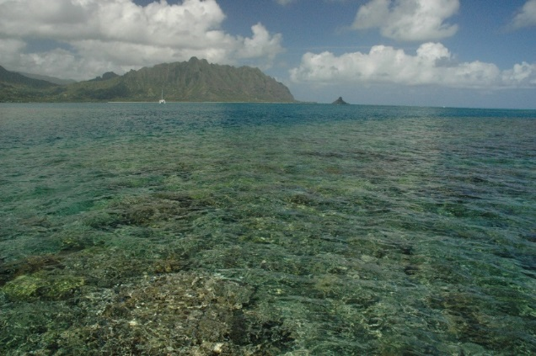
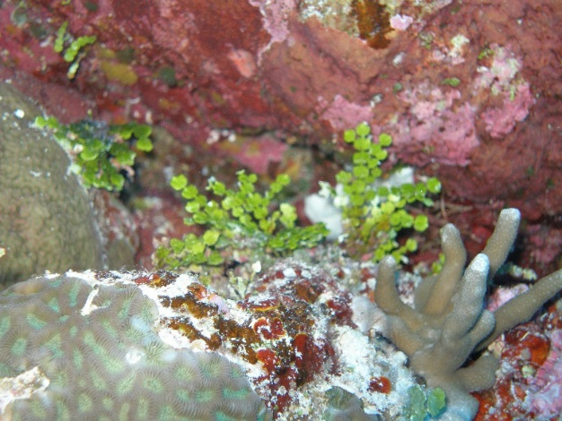
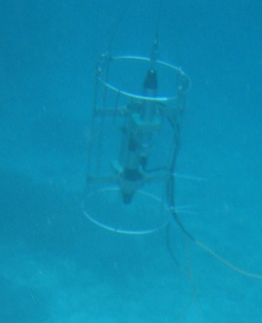
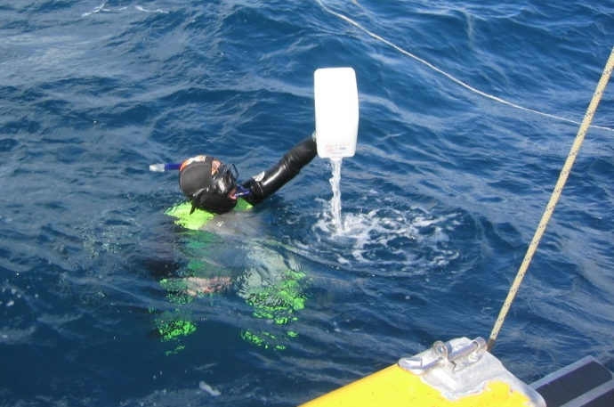
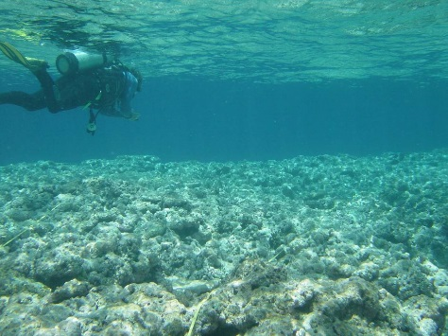
Coral reefs: not so simple:
Examples of coral reef habitat and sampling
In situ substrate reflectance measurements (RAMSES)
images courtesy of CSIRO Aquatic Earth Observation -Oceans & Atmosphere

Slide 11
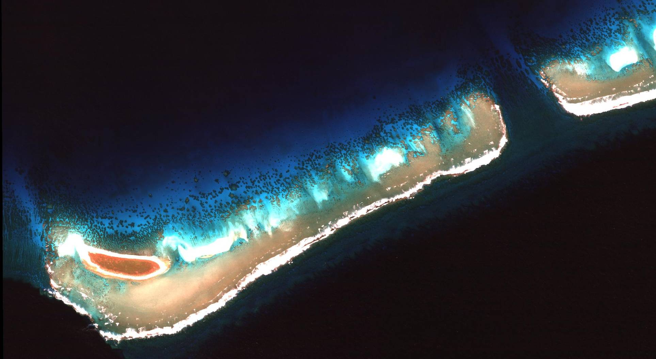
images courtesy of CSIRO Aquatic Earth Observation -Oceans & Atmosphere

Slide 12
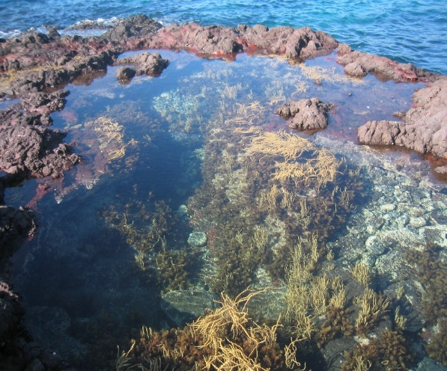
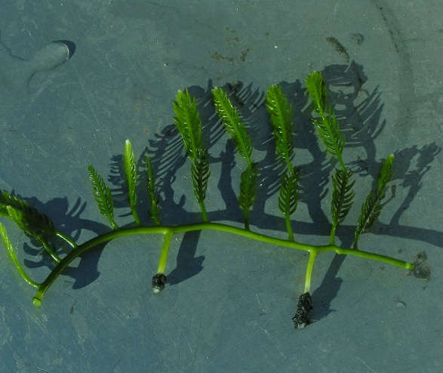
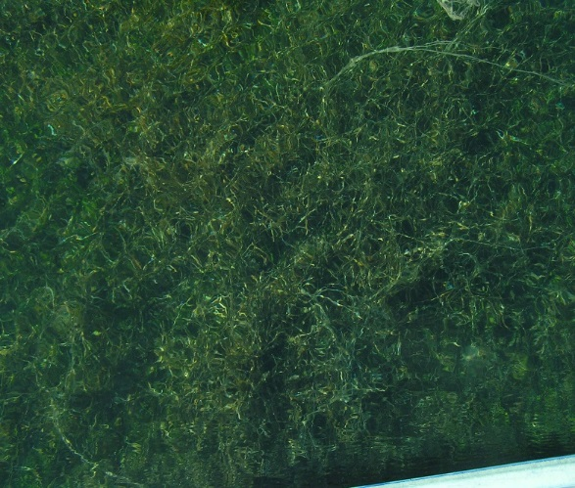
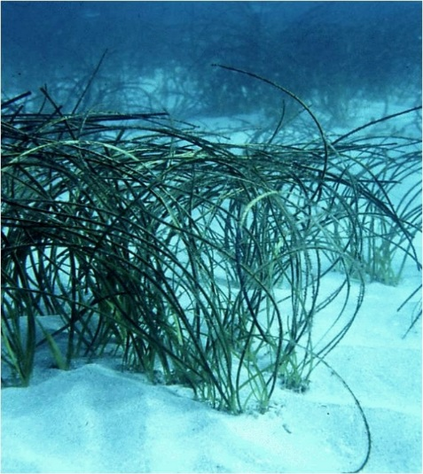
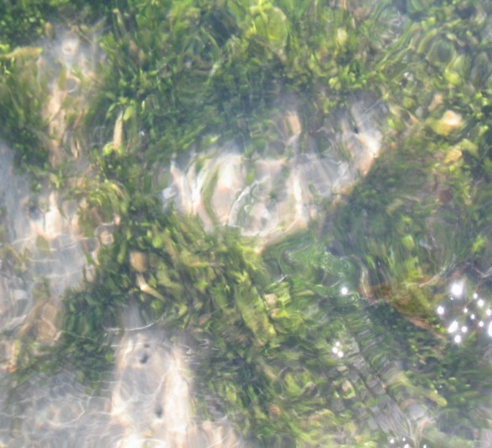
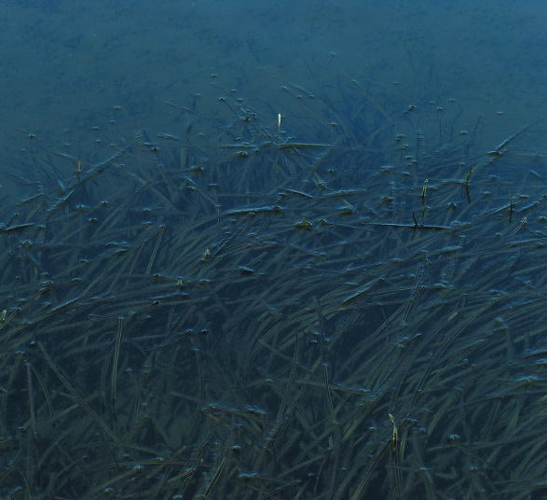
Seagrass and intertidal: not so simple:
images courtesy of CSIRO Aquatic Earth Observation -Oceans & Atmosphere

Slide 13
End User Requirements : highly variable for temporal and spatial resolution
Within hours such as algal blooms, flood events with associated influxes of high nutrient, high coloured dissolved organic matter and suspended sediment loads into reservoirs, estuaries or coastal seas or with tidal or wind driven events.
Within days such as pollution events, dredging effects etc.
Within weeks such as coral bleaching events (Healthy coloured coral -> bleached coral -> dead coral or recovered coral).
Seasonally to yearly to longer term such as successions of phytoplankton functional types or emergence, florescence and decay of macrophytes.
Across spatial scales of Lake Victoria, Baikal, Titicaca, Great lakes to rivers, farm dams, creeks, wetlands.

Slide 14
From science and applications requirements to design specifications for an EO sensor
Measurement requirement (B= Baseline, T=Threshold)
Levels/ranges of the desired aquatic ecosystem variable (e.g. concentration, spatial cover etc.)
Temporal resolution
Spatial resolution
Spectral resolution
Radiometric resolution
Geolocational accuracy
Sunglint avoidance
Polarisation sensitivity

Slide 15
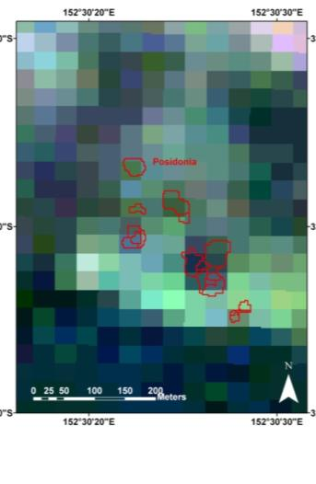
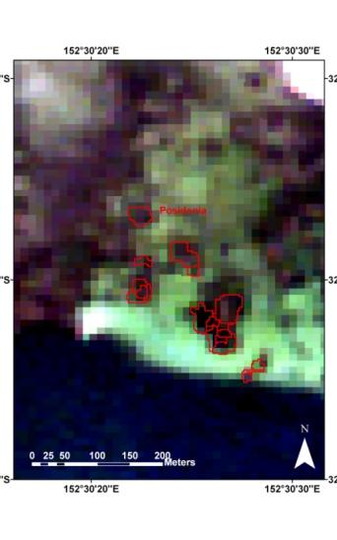
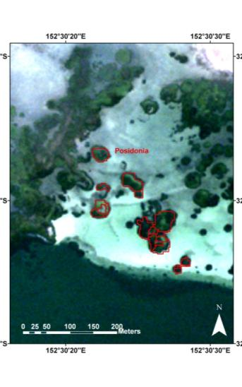
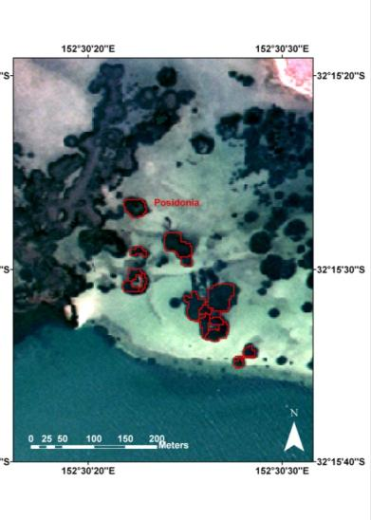
Effects of spatial resolution on feature discrimination:
Question: which most suitable for a global mapping mission?
(Example is Posidonia seagrass beds under a 1 m of water in coastal lagoon)
Low cost
Coarse detail
Higher cost
Fine detail
QuickBird-2
20 September 2008
WorldView-2
10 August 2010
Landsat TM5
20 September 2008
ALOS
5 January 2007
Spatial resolution: | 30m | 10m | 2.6m | 1.6m
Spectral Bands: | 4 VIS/NIR, 2 SWIR, 1 ThIR | 4 VIS/NIR | 4 VIS/NIR | 8 VIS/NIR
Notes:
Individual management requirements to determine optimal information needed for decision-making purposes whilst minimizing costs.
Mention red outlines posidonia beds

Slide 16
Spatial resolution for inland waters
is a key driver for specifications
Table 6.2.
Ground sampling distance requirements showing resolvable size class and total cumulative number and area coverage of the world’s lakes (based on assumptions using Verpoorter et al. (2014) dataset). (Courtesy E.L. Hestir & Mark Matthews)
Size Class | Required GSD* | % Total Area | Total number
≥ 10 km² | 1054 m | 44 | 25,976
≥ 1 km² | 333 m | 60 | 353,552
≥ 0.1 km² | 105 m | 80 | 4,123,552
≥ 0.01 km² | 33 m | 90 | 27,523,552
≥ 0.002 km² | 15 m | 100 | 117,423,552
*Calculated using a box of 3 x 3 pixels sufficient to resolve the specified lake size
Focus of current and future OC sensors
Focus of this study

Slide 17
Ground sampling distance requirements showing the resolvable river width class and cumulative number of total river reaches of the world’s rivers from Pavelsky et al. (2012) dataset.
Focus of current and future OC sensors
Focus of this study

Slide 18
Summary spectral bands & resolution from:
(i) multiple types of simulations, (2) spectral pigment features ( from phytoplankton, macrophytes and other benthos), and algorithm requirements

Slide 19
Recommended spectral bands for atmospheric correction purposes as well as Non Algal Particulate matter concentration estimation.

Slide 20
Temporal resolution requirements
Within hours such as algal blooms, flood events with associated influxes of high nutrient, high coloured dissolved organic matter and suspended sediment loads into reservoirs, estuaries or coastal seas or with tidal or wind driven events.
Within days such as pollution events, dredging effects etc.
Within weeks such as coral bleaching events (Healthy coloured coral -> bleached coral -> dead coral or recovered coral).
Seasonally to yearly to longer term such as successions of phytoplankton functional types or emergence, florescence and decay of macrophytes.
For bathymetry: decadal to immediate for navigation

Slide 21
Finer spatial resolution = less photons
Finer spectral resolution = less photons
Less photons means reduced radiometric resolution=> less depth intervals
Finer spatial resolution = lower radiometric resolution= less depth penetration but improved identification of smaller benthic features and less water column concentration composition discrimination
Coarser spatial resolution = higher radiometric resolution=deeper depth penetration but reduced identification of smaller benthic features and improved water column concentration composition discrimination.
Finer spectral resolution=> higher depth penetration although counteracted by lower radiometric resolution=> lower depth penetration but improved benthic cover and water column concentration composition discrimination.
Coarser spectral resolution=> higher radiometric resolution => better depth penetration but counteracted by less depth penetration due to broader spectral bands and less detailed benthic cover and water column concentration composition discrimination
e.g. Worldview-3 : high spatial , coarse spectral (~50 nm wide bands)=> medium radiometric resolution

Slide 22
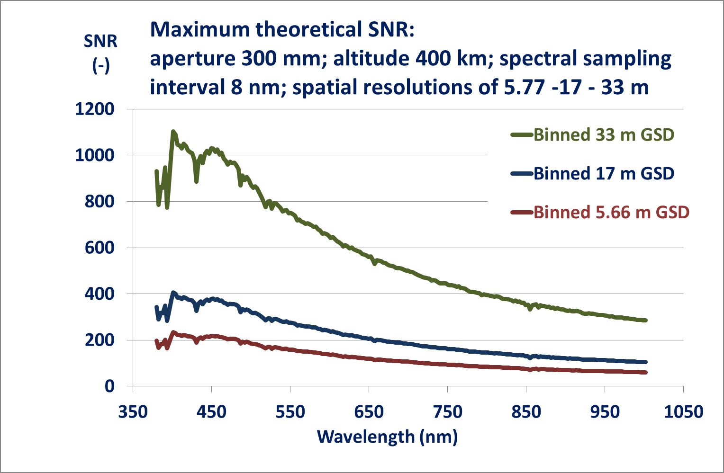
Trade-off Resolutions
Higher spatial resolution = lower radiometric resolution=less depth penetration

Slide 23
CEOS Report : “Feasibility Study for an Aquatic
Ecosystem Earth Observation System:
Summary Baseline and Threshold
Spectral and spatial resolution are the core sensor priorities
Spectral-
  ~27 bands in the 380-780 nm wavelength range for retrieving the aquatic ecosystem variables
  ~15 spectral bands between 360-380 nm and 780-1400 nm for removing atmospheric and air-water interface effects.
  These requirements are very close to defining an imaging spectrometer with spectral bands between 360 and 1000 nm (suitable for Si based detectors), possibly augmented by a SWIR imaging spectrometer.
Spatial-
  ~17 m pixels resolves ~25% of river reaches globally
  ~33 m pixels resolves the vast majority of water bodies (lakes, reservoirs, lagoons, estuaries etc.) large than 0.2 ha
  Still maintains radiometric sensitivity
Radiometric resolution and range and temporal resolution need to be as high as is technologically and financially possible.
A high temporal resolution could be obtained by a constellation of Earth observing sensors e.g. in a various low earth orbits augmented by high spatial resolution geostationary sensors.

Slide 24
CEOS Report : “Feasibility Study for an Aquatic
Ecosystem Earth Observation System:
Summary Lowest Cost Option
A cost-effective alternative solution of obtaining improved data over aquatic ecosystems could be to augment near future planned Earth observing sensors to make them significantly more useful for aquatic ecosystem Earth observation.
Two spectral bands (one between ~615-625 nm and one between ~670-680 nm) would greatly enhance the capability of these terrestrial focused sensors to determine two important aspects of water quality and benthic composition in inland and coastal waters respectively:
cyanobacterial (or blue-green algal) concentration and
overall abundance of algae via the main photosynthesis pigment of chlorophyll-a.

Slide 25
CEOS Report : “Feasibility Study for an Aquatic
Ecosystem Earth Observation System: Summary
What other non-aquatic applications would benefit from a sensor with these specifications???
Agriculture?
Forestry?
Vegetation ( e.g. invasive species, anomalies, stress)
Minerals?
Soils?
Urban?
Mining and mine site rehabilitation?
…..
…..
Increased overlap with non-aquatic applications would increase possibility of the proposed EO sensor system being funded.
! Feedback welcome!

Slide 26
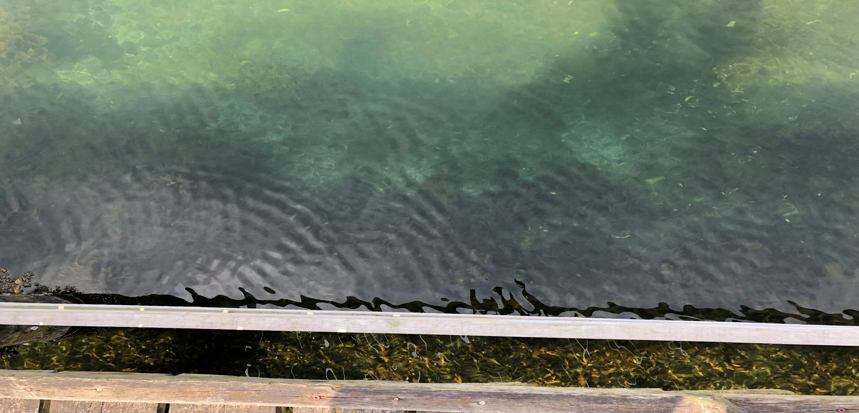
Feasible? YES
How to turn into a CEOS adopted strategy…..this workshop!!
Please Provide Feedback! & See Poster
Dr Arnold G Dekker
Director: SatDek Pty Ltd
“Satellite-based Discovery of Environmental Knowledge”
M: +61 41 941 1338 arnoldgdekker@gmail.com
Honorary Science Fellow : CSIRO O&A
Honorary Professor : Australian National University
Adjunct Professor : University of Queensland

