Slide 1

Satellite Soil Moisture
Yann Kerr, Rajat Bindlish
Contributions from: SMOS, SMAP teams

Slide 2

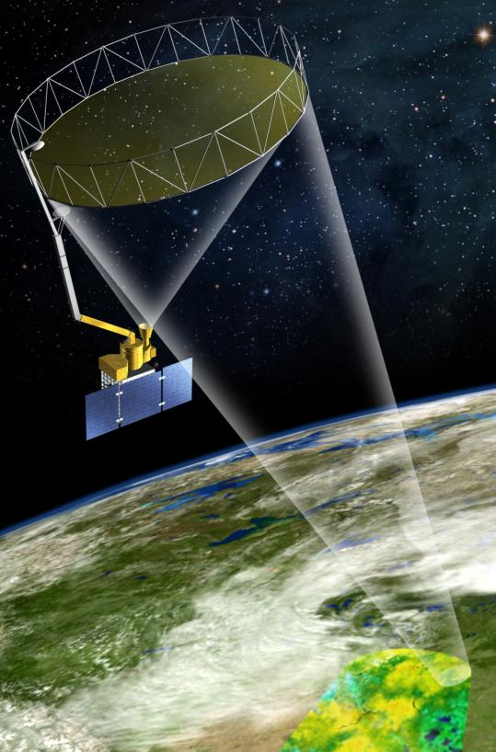
Soil Moisture
Objective of a Soil Moisture mission is to provide high-resolution and frequent-revisit global maps of soil moisture.
Understand processes that link the terrestrial water, energy and carbon cycles
Estimate global water and energy fluxes at the land surface
Quantify net carbon flux in boreal landscapes
Enhance weather, flood and drought prediction
Other applications such as agricultural productivity and human health
Nominal Requirements: 9 km resolution, 3 day global coverage with an accuracy of 0.04 m³/m³
SMOS (ESA) was launched in 2009; SMAP (NASA) was launched in 2015.

Slide 3
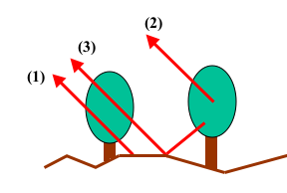
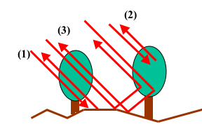
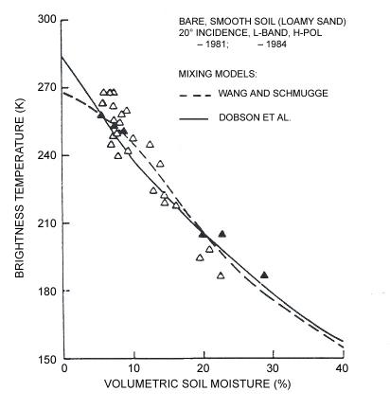
Measurement Approach (Physical Basis)
Emission
Backscatter
(Emission)
(Backscatter)
Equations for p = H, V (radiometer) and pq = VV, HH, HV (radar)
Contributions include three terms: soil, vegetation, and soil-vegetation interaction
Soil moisture is the dominant contributor to the signal
L is the vegetation attenuation factor, exp(-τ_{o} / cosθ)
Retrievals invert these equations to obtain soil moisture, with corrections for vegetation, roughness and surface temperature
[Jackson and O’Neill, IEEE TGARS, GE-25, 1987.]
Radiometer provides a greater sensitivity to Soil moisture than Radar observations

Slide 4
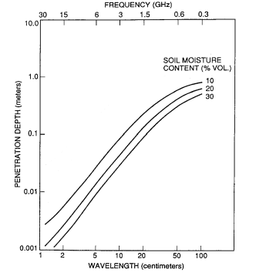
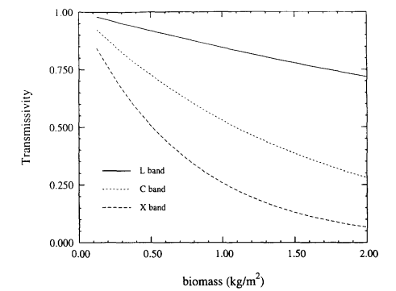
Microwave Soil Moisture Sensing
CMIS
AMSR
6.0 GHz
L-Band
1.4 GHz
SSM/I
19 GHz
1.4 GHz
6.0 GHz
d =
λ
4 π n”
10.0 GHz
λ = Wavelength
N” = Im {Refractive Index}
Power Attenuates as e^{-z/d}
Effective sensing depth decreases with increasing measurement frequency
Vegetation attenuation increases with increasing measurement frequency
L-band provides significant improvements in soil moisture sensing capability over previous missions (e.g. AMSR-E at C-band)

Slide 5

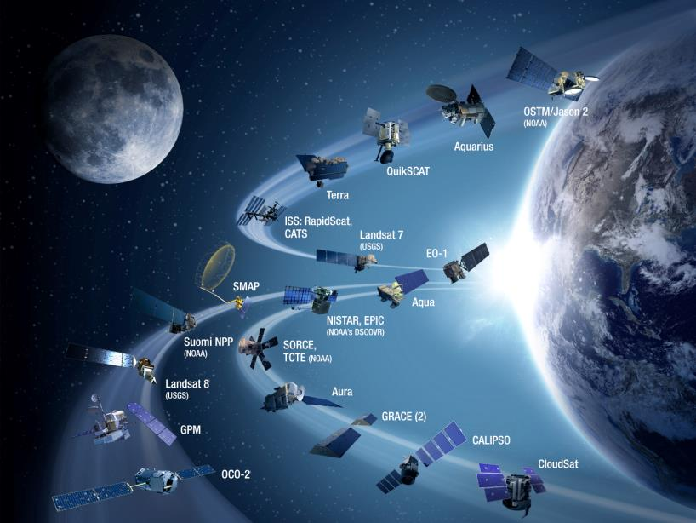
NASA Earth Observing Satellite Fleet
International Satellites
SMOS (ESA)
ASCAT (ESA)
GCOM-W (JAXA)
Future Satellites
AMSR3
NISAR
Courtesy of the Goddard Visualization Lab

Slide 6
Satellite Soil Moisture Data Characteristics
 | Mission Duration | SM Spatial Coverage¹ | Temporal Revisit | Orbit | Product Resolution
AMSR-E | 2002-2011 | Global land | 2-3 days | (1:30 pm asc / 1:30 am desc) | 25 km
GCOM-W (AMSR2) | 2012-Present | Global land | 2-3 days | (1:30 pm asc / 1:30 am desc) | 25 km
WindSat (DoD) | 2004-? | Global land | 2-3 days | Sun synch (6:00 am asc/ 6:00 desc) | 25 km
ASCAT | 2009-Present | Global land | 2-3 days | Sun synch (9:30pm asc / 9:30am desc) | 12.5 km/25 km
SMOS | 2009-Present | Global land | 2-3 days | Sun-synch (6am asc / 6pm desc) | 25 km
Aquarius | 2011-2015 | Global land | 8 days | Sun-synch (6pm asc / 6 am desc) | 100 km
SMAP | 2015-Present | Global land | 2-3 days | Sun-synch (6am desc / 6pm asc) | 3 km/9 km/36 km
SAOCOM | 2018-? | Argentina Pampas | ? | ? | 1 km
NISAR | 2021/2022-? | Global | 12 days | 6 am /6 pm | 200 m
C, X-band Passive
C-band Active
L-band Passive
L-band Active

Slide 7
AMSR Soil Moisture
AMSR-E was the first satellite mission to develop a soil moisture product
AMSR-E provided invaluable environmental data products (precipitation, cloud water, soil moisture, snow, sea ice) from 2002 to 2011
AMSR2 was launched by JAXA in July 2012 and provides an opportunity to extend this data record
AMSR2 products are invaluable for a more complete understanding of the climate system and provide a long term data record
AMSR-E and AMSR2 are both part of NASA’s A-train satellites
Goal Accuracy: 0.06 m³/m³ for regions with vegetation water contents (VWC) < 2 kg/m², 0.10 m³/m³ for VWC 2-5 kg/m².

Slide 8
The SMOS Mission
SMOS is the second Earth Explorer opportunity mission (1st round)
An ESA/CNES/CDTI project
Selected in 1999, initiated in 2000
Launched in November 2009
A new technique (2D interferometry) to provide global measurements from space of key variables (SSS and SM) for the first time.
SMOS : 2010-Present
Need for soil moisture and sea surface salinity fields
Only passive L band suitable
Real aperture systems currently not adequate (antenna size) ==>Synthetic antenna

Slide 9
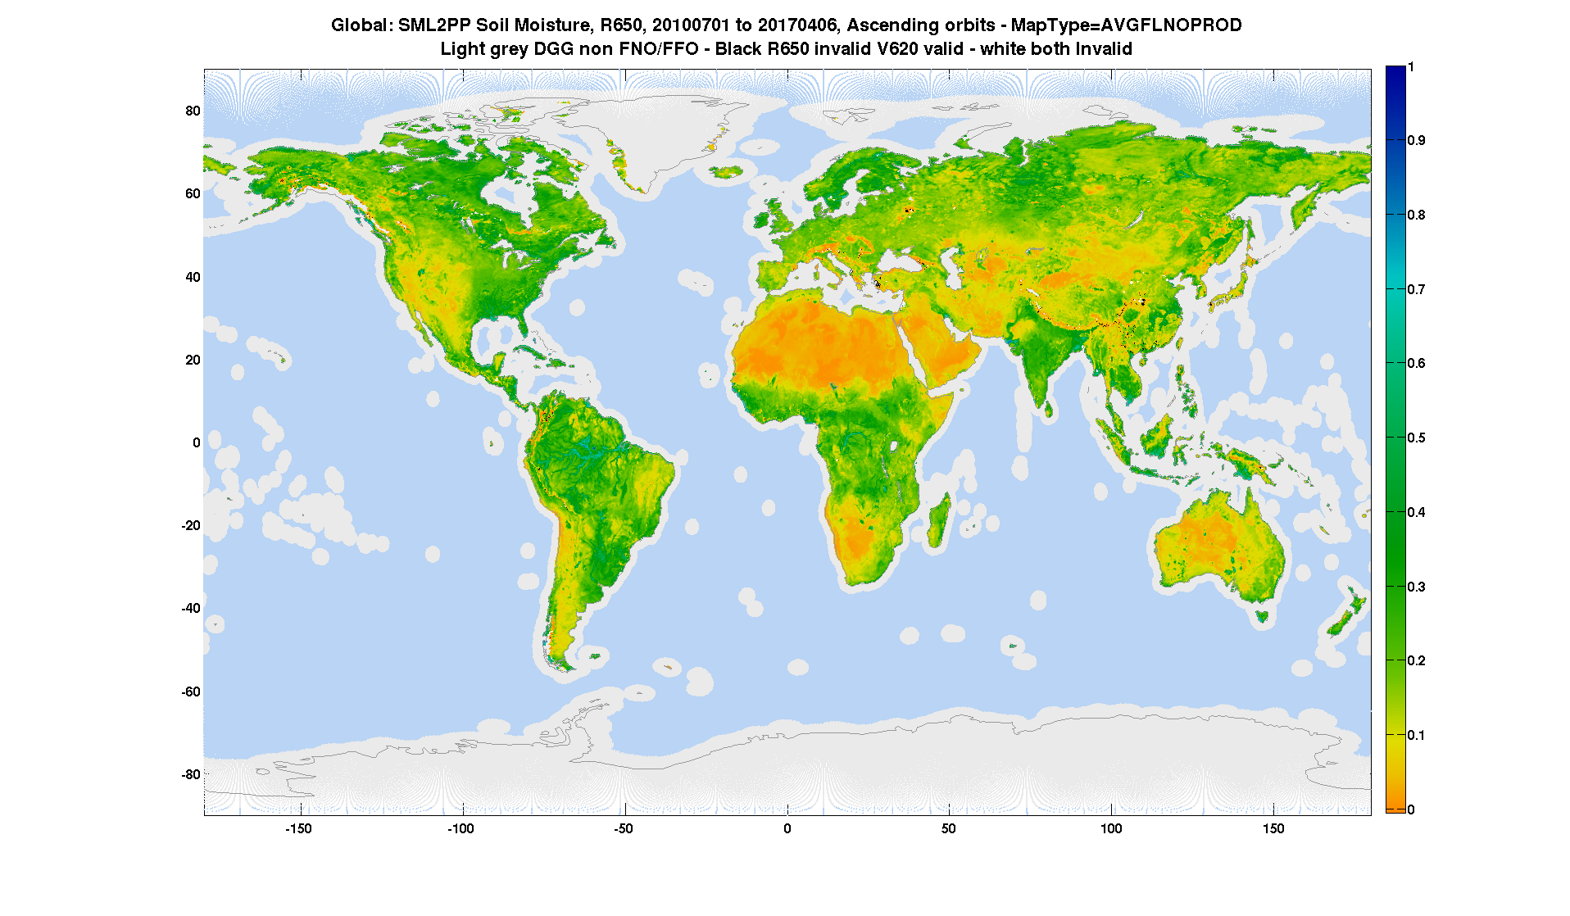
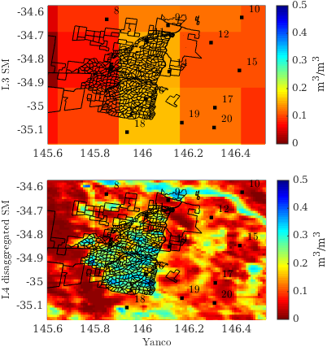
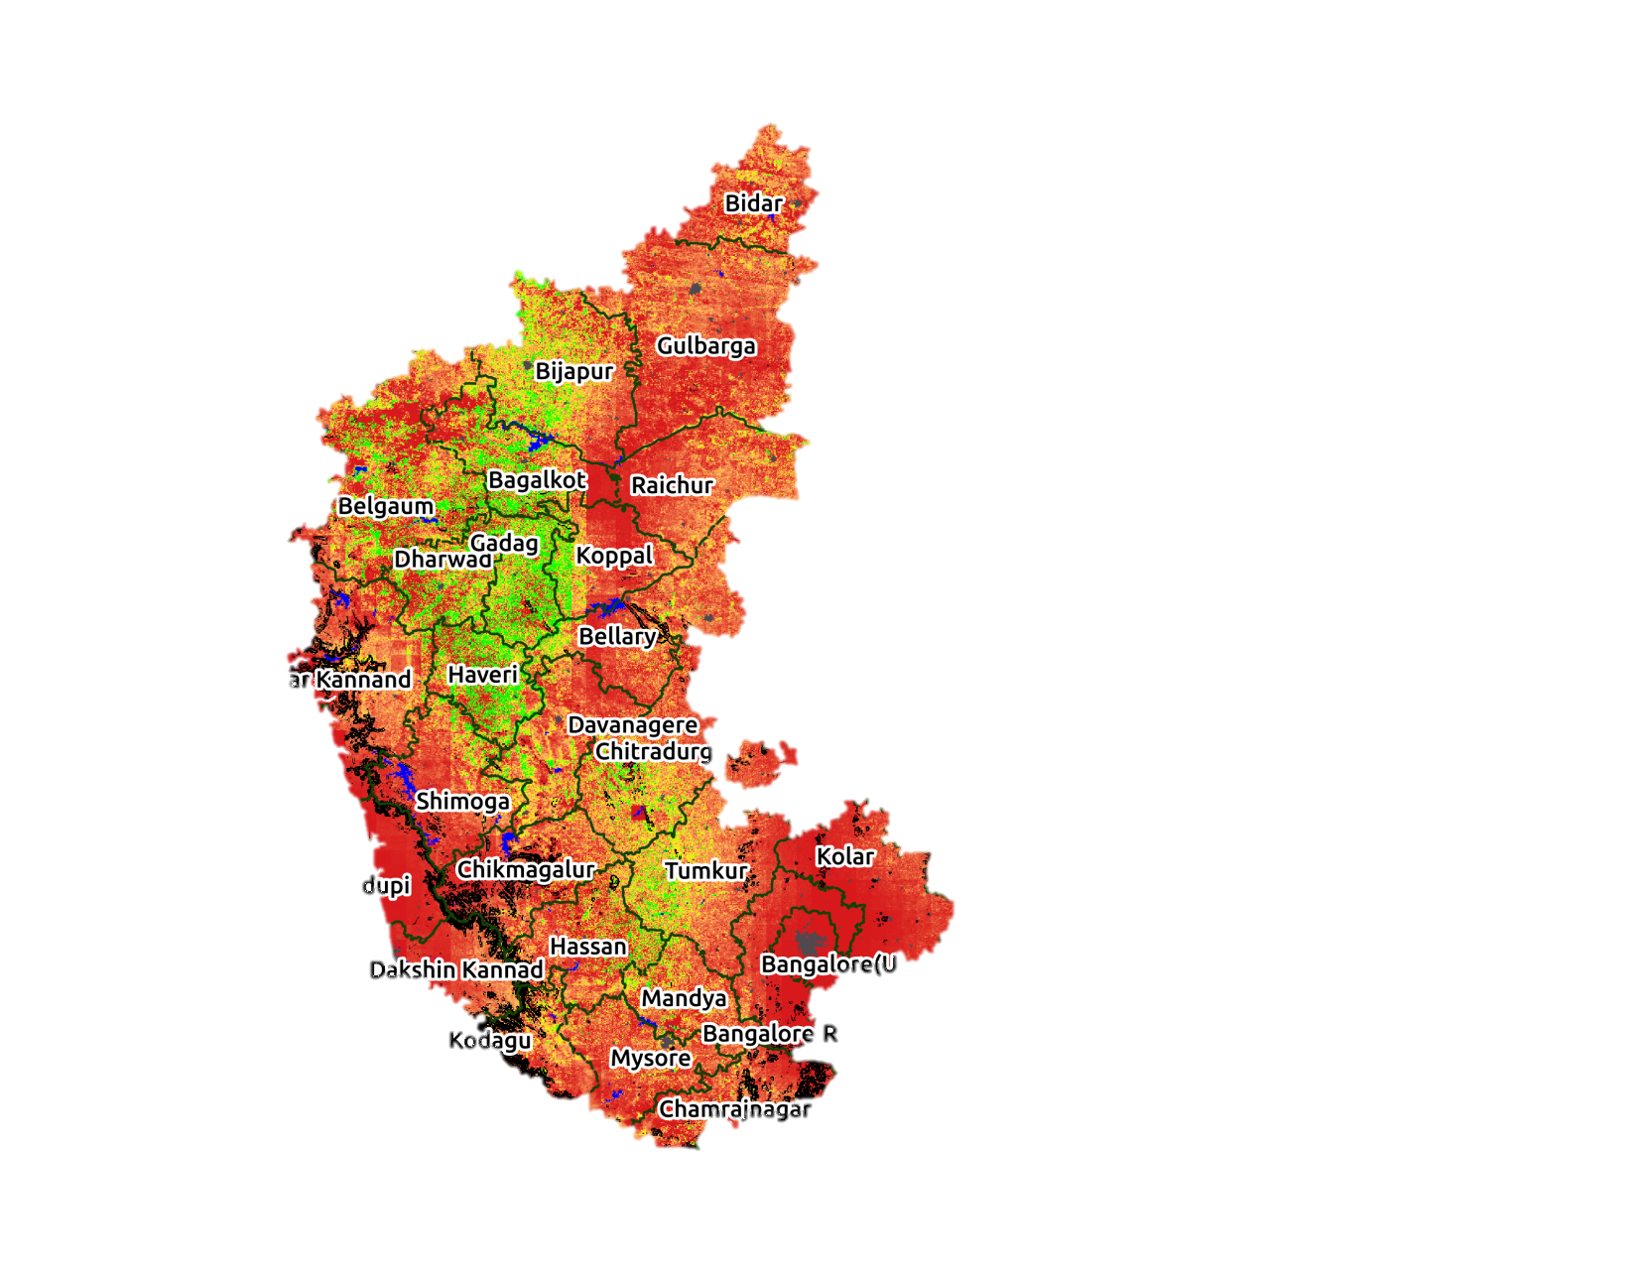
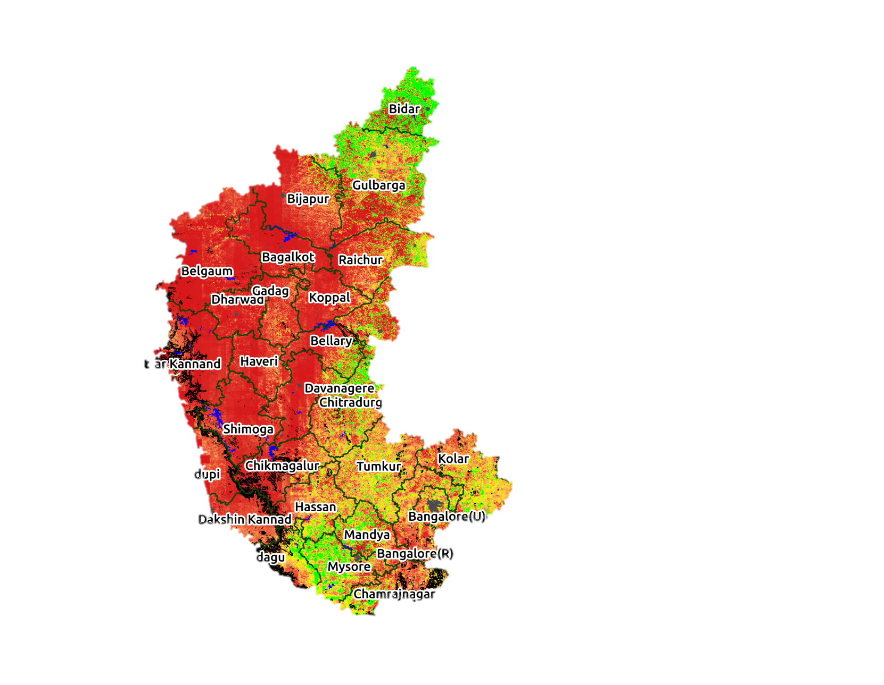
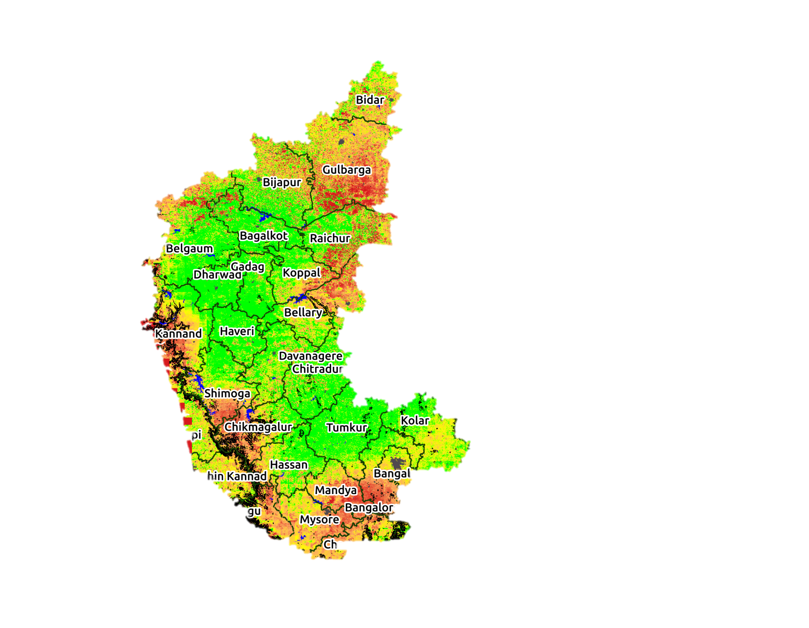
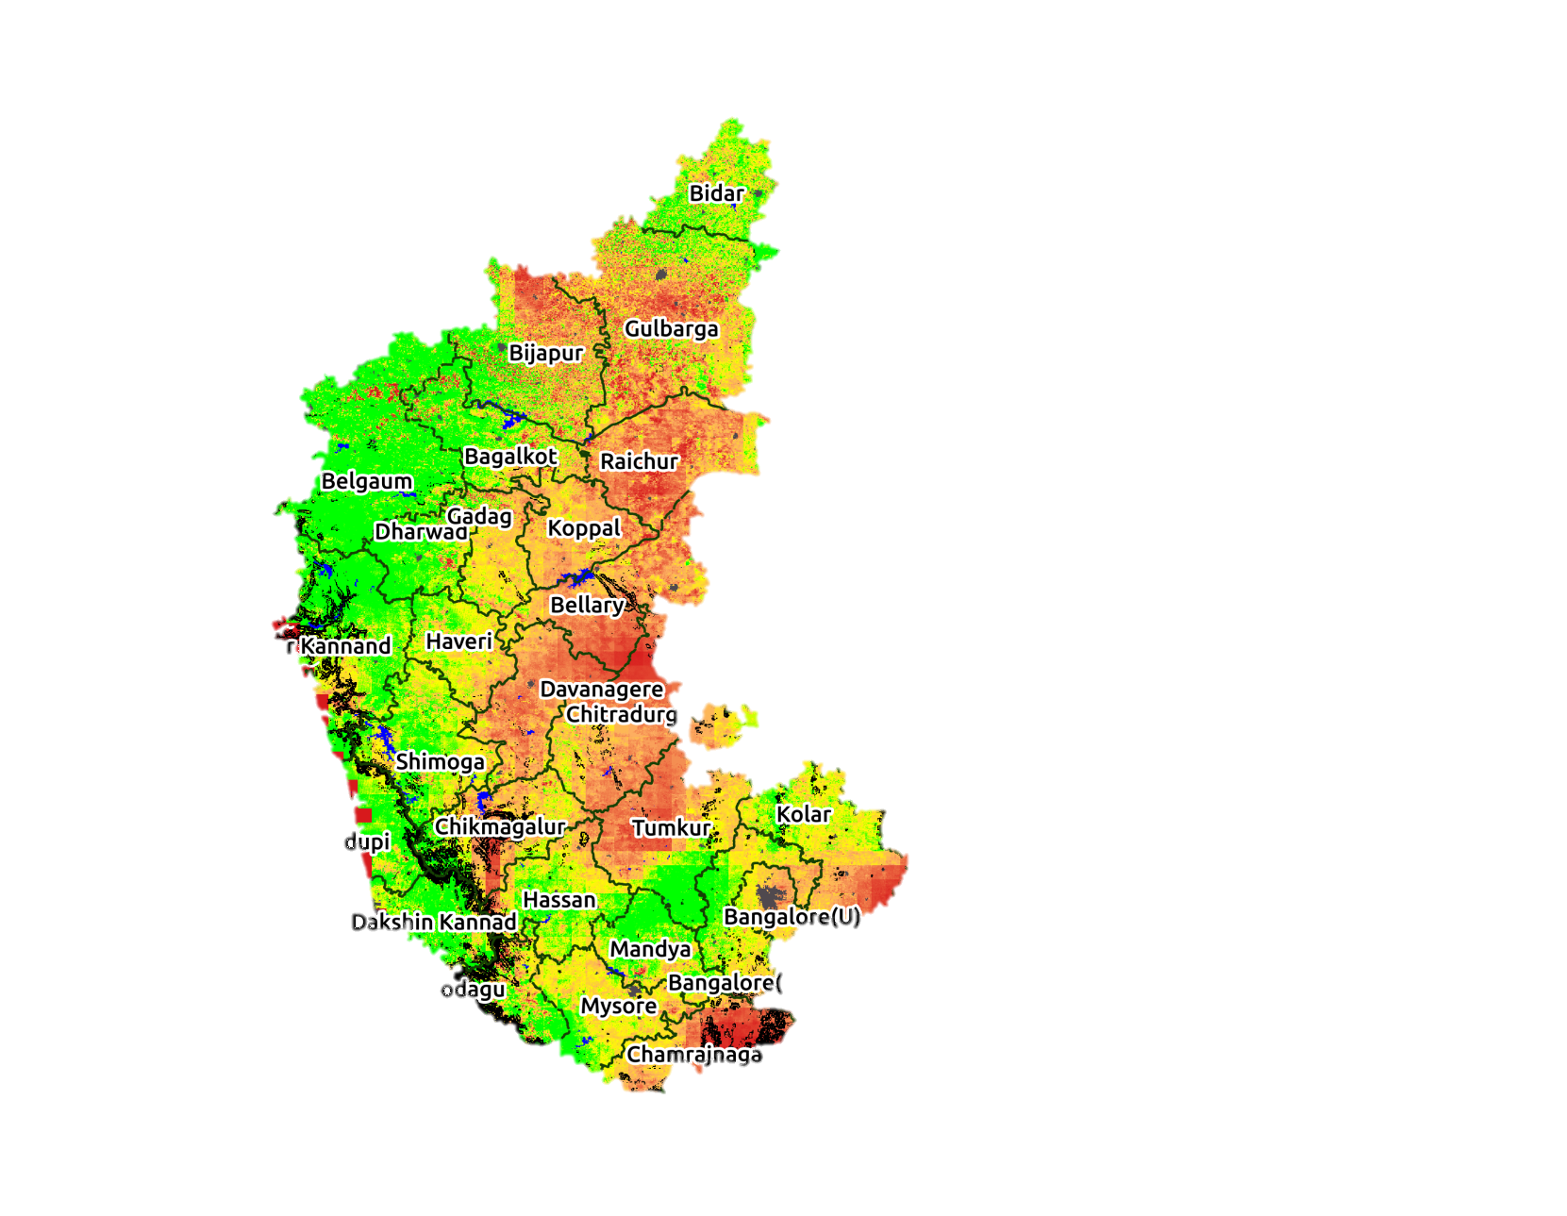
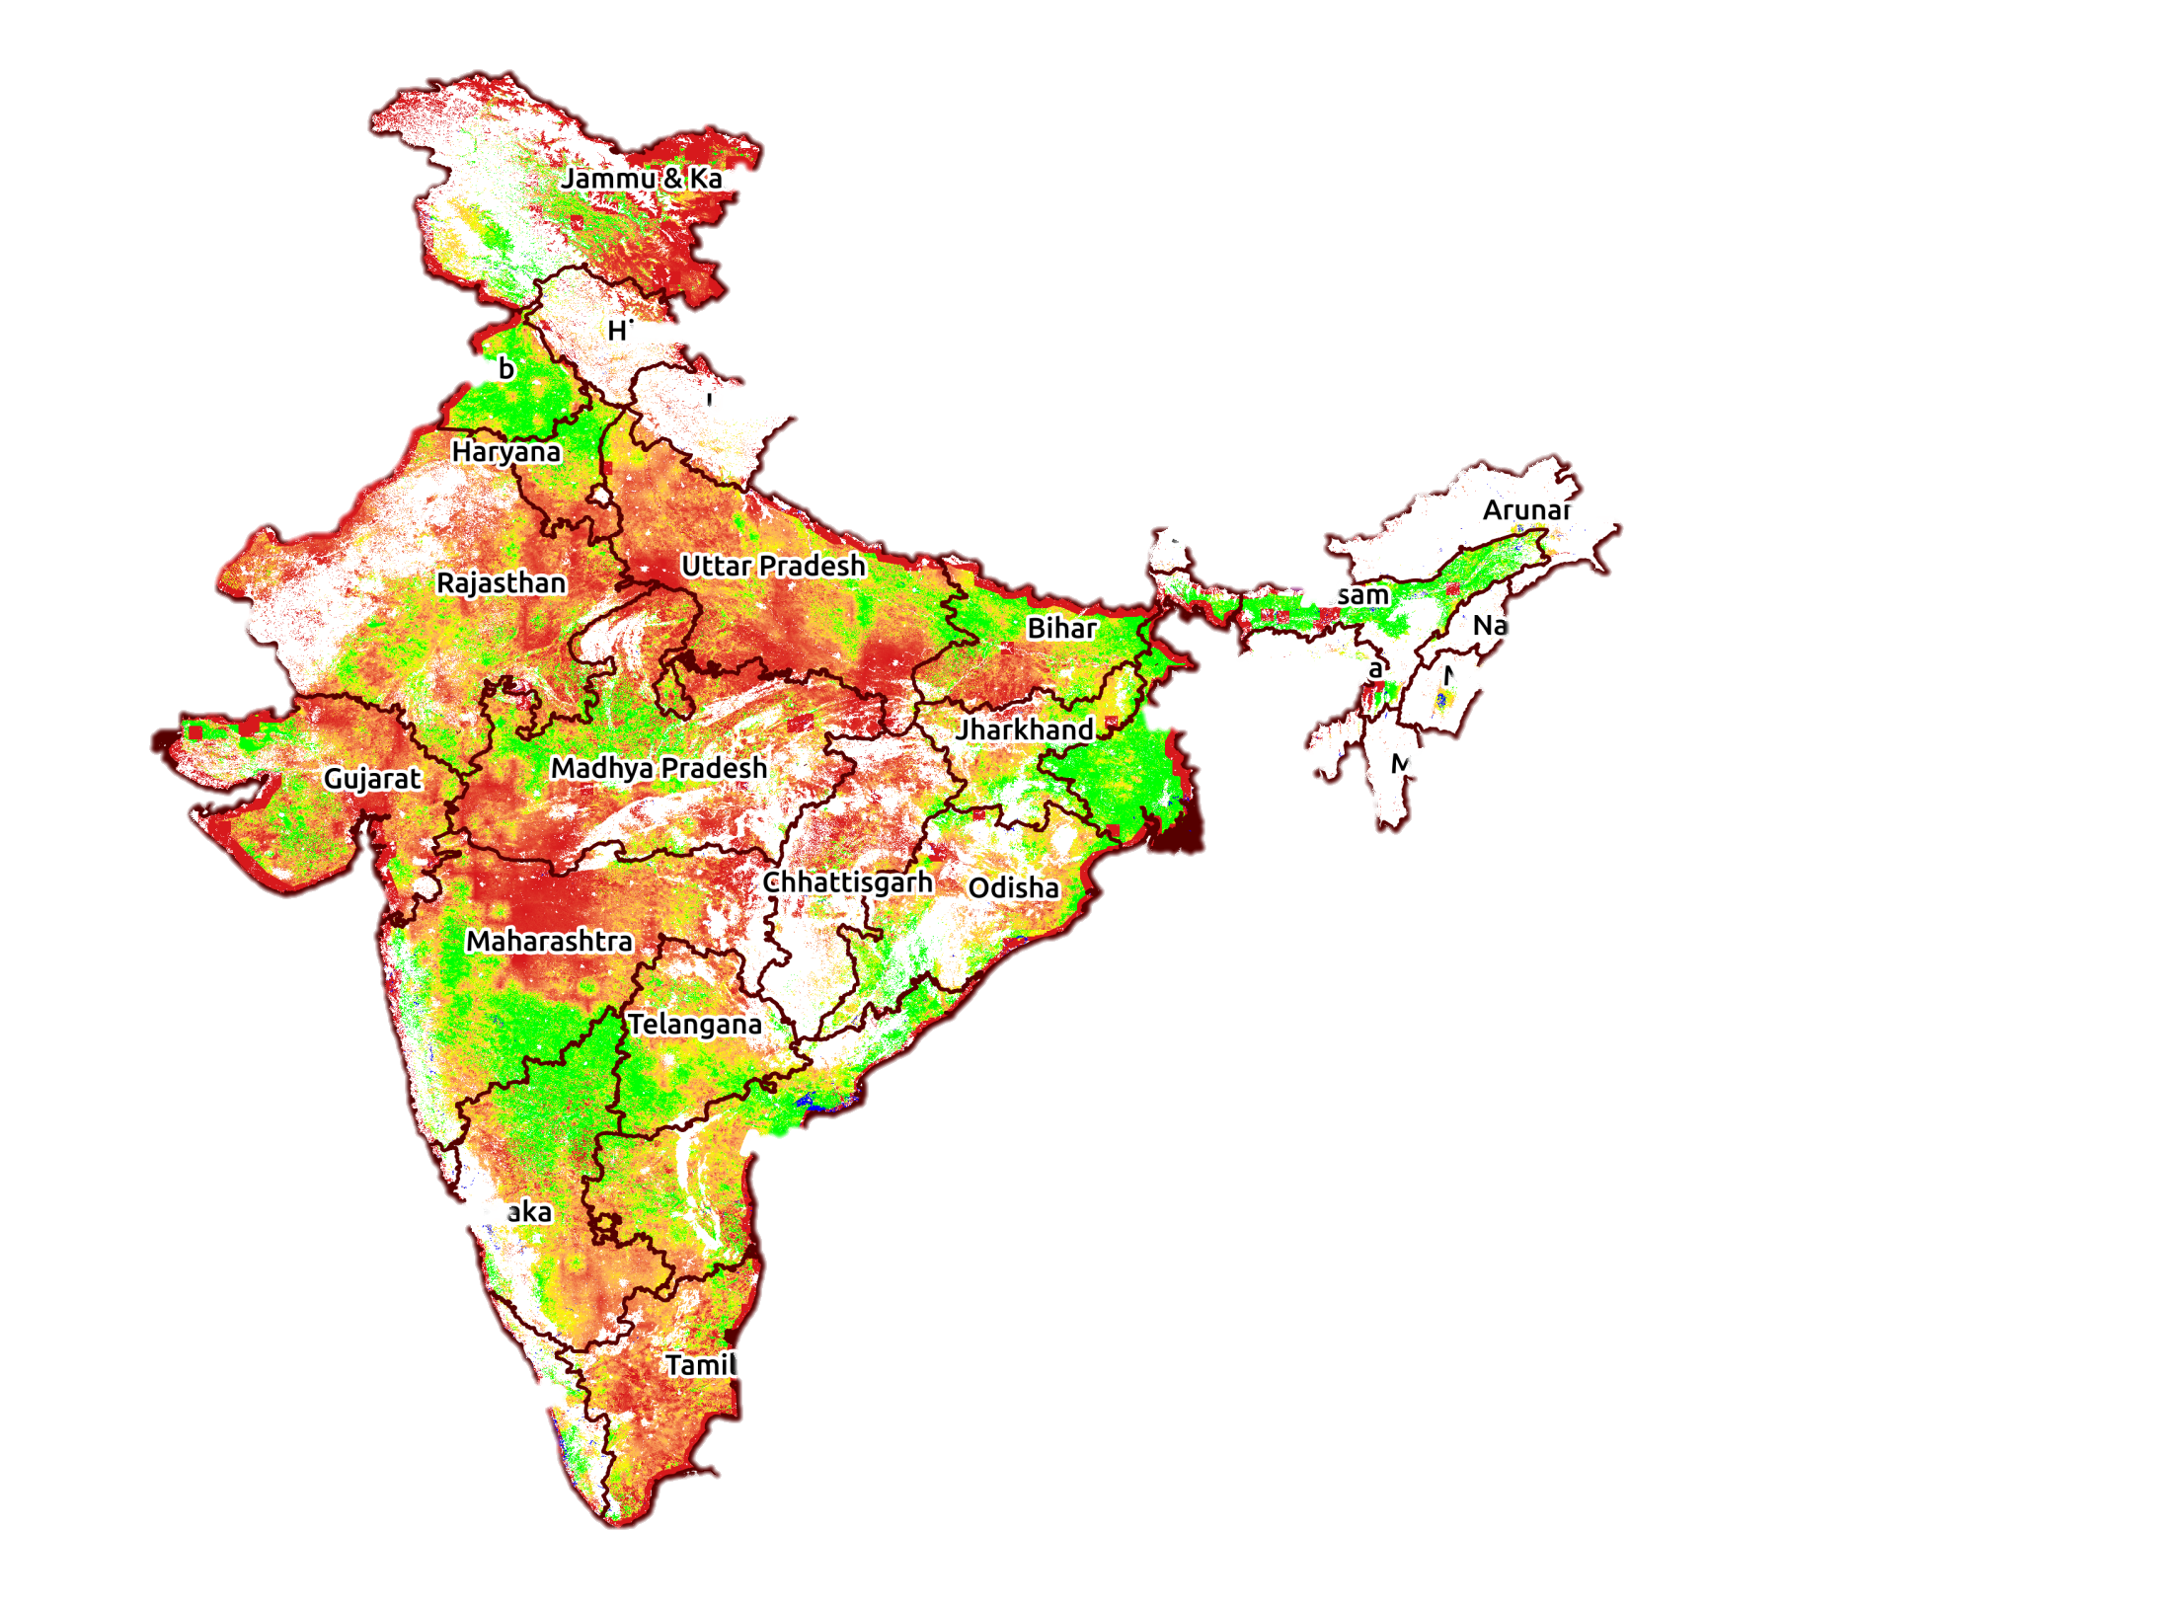
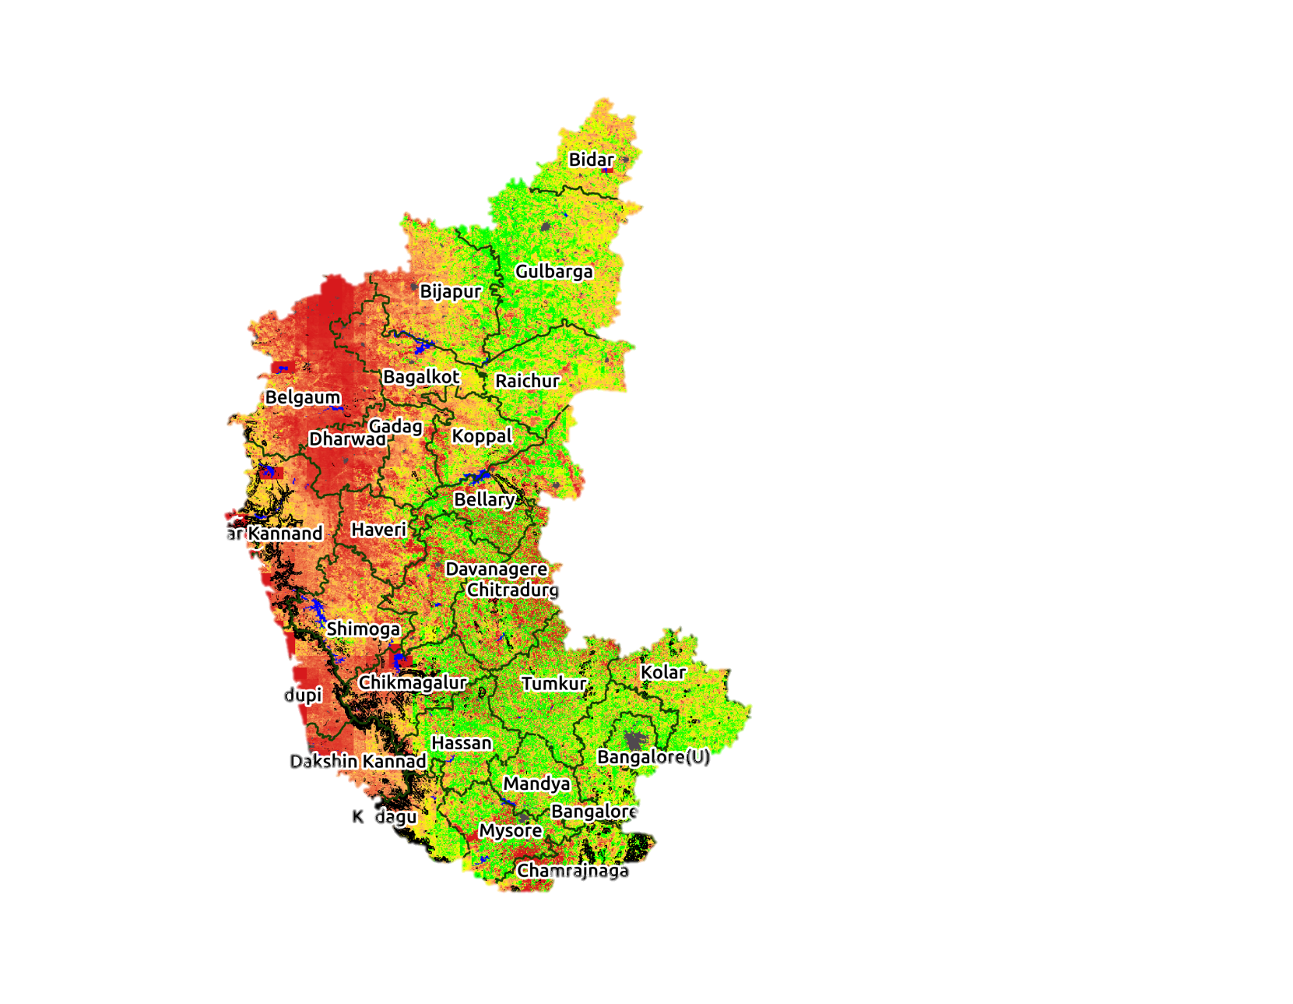
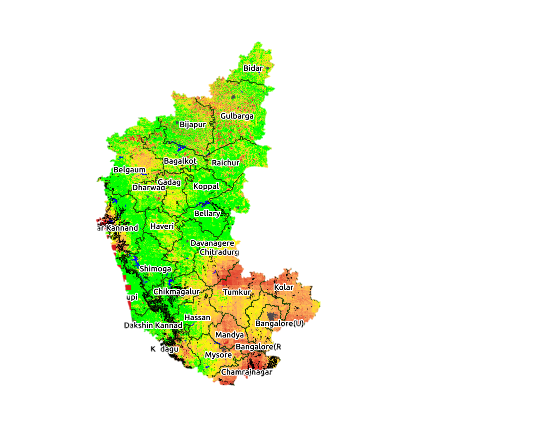
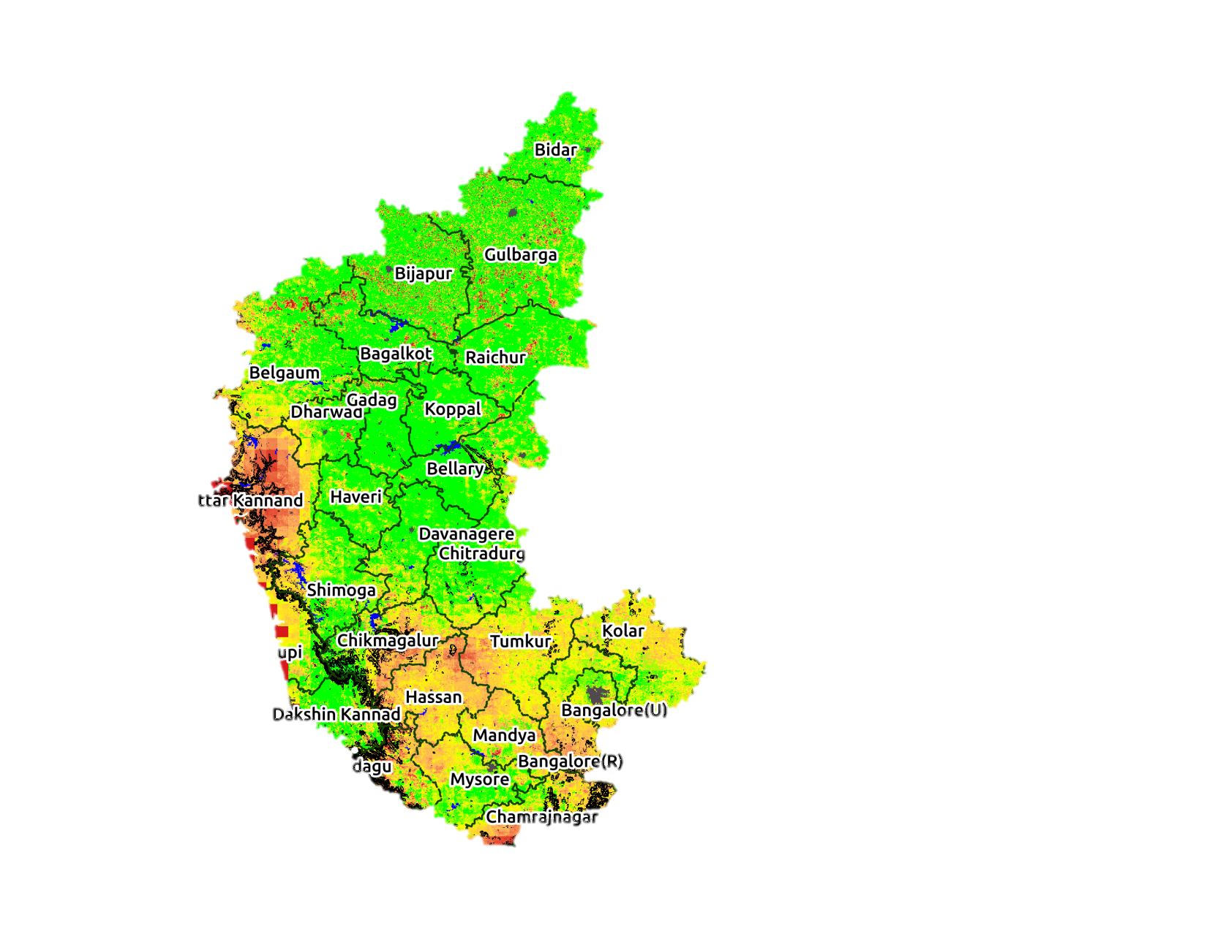
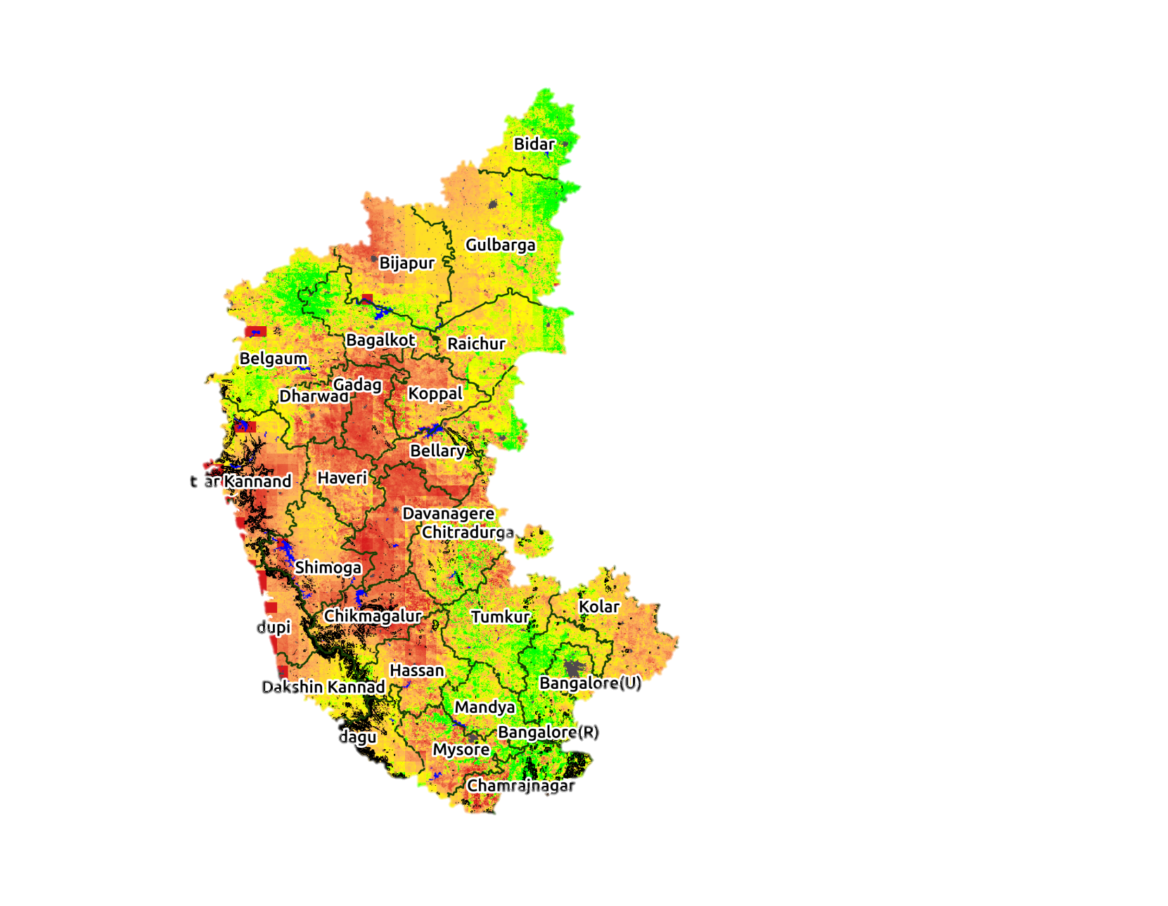
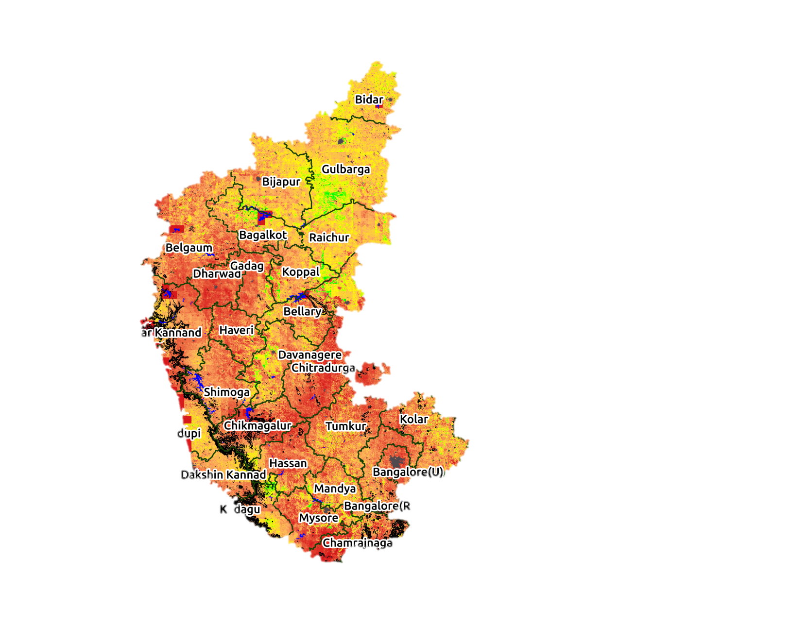
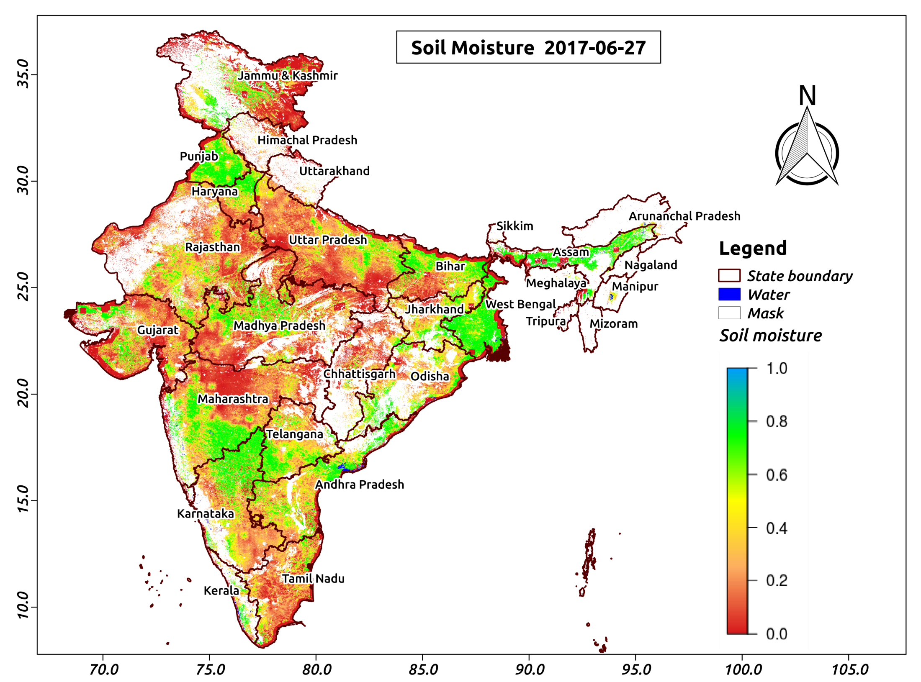

Sub-kilometric soil moisture (SMOS+ S3 or SMOS+S1 -500m)
April 2016
May 2016
June 2016
July 2016
Aug. 2016
Oct. 2016
Nov. 2016
Dec. 2016
Sept. 2016
Molero et al
www.aapahinnovations.com
Almost 9 years of SMOS soil moisture data

Slide 10
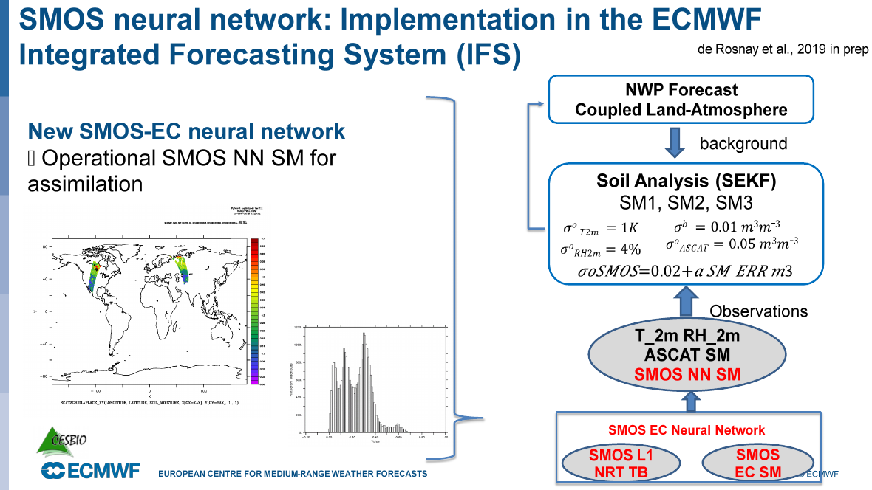
Status of the NRT SM data assimilation
In addition to the DA-NRT SM processing chain, the actual DA has been implemented at ECMWF

Slide 11
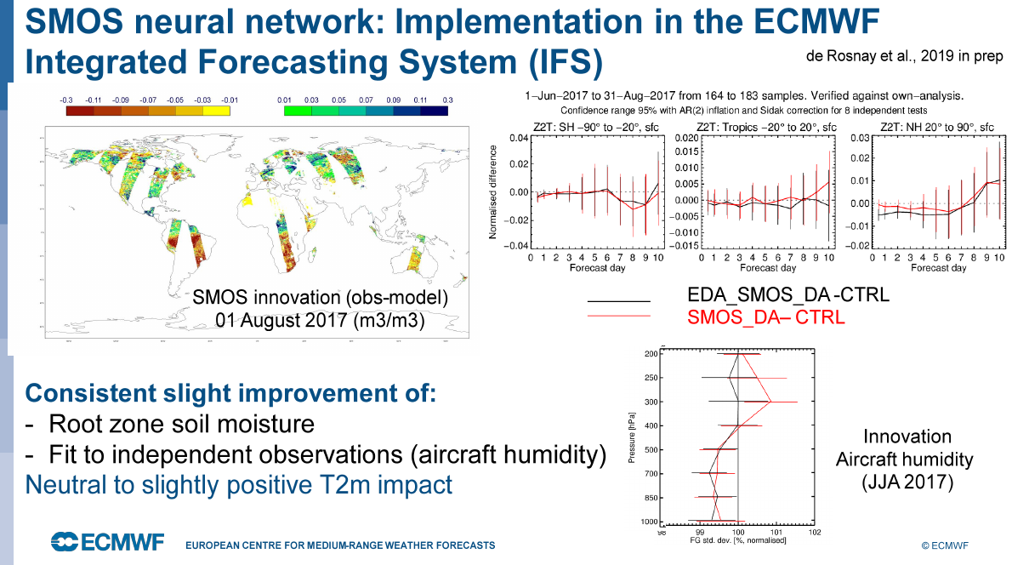
Status of the NRT SM data assimilation
The first evaluations are very promising !

Slide 12





GPM Rainfall estimates improved with SMOS
T. Pellarin, C. Roman, F. Gibon, Y. Kerr
worsening
ΔRMSE
Improvement
Improvement
ΔR²
worsening

Slide 13

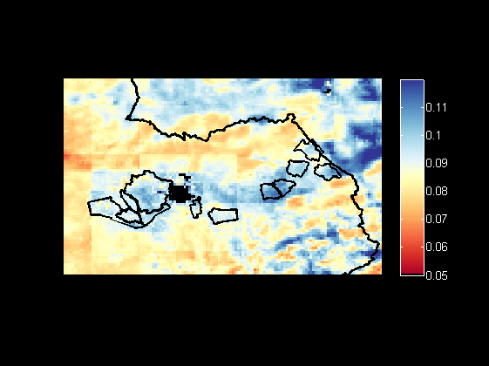
J. Malbeteau
Soil moisture – Irrigated area
Root zone Soil moisture (average of 145 days)
m³/m³
80 km
130km
Marrakesh
Irrigated area
Irrigated areas are visible

Slide 14
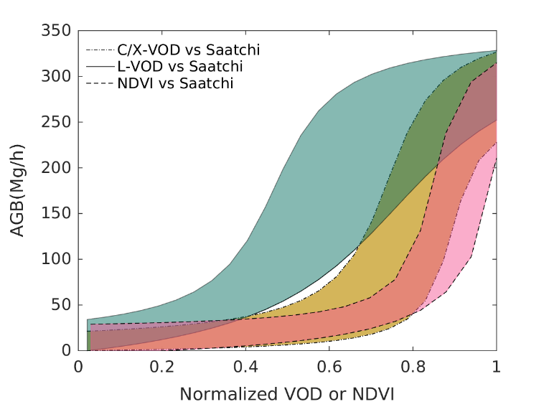
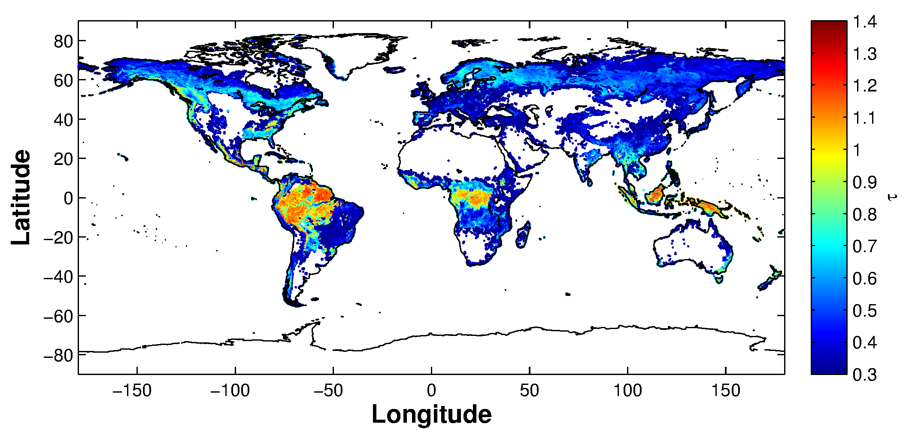
Vegetation Optical Depth
Rationale
  Use angular information to retrieve both soil moisture and vegetation opacity (unique product!) → no equivalent
    AMSR multi-frequency but lowest implies saturation around 150 t/ha
    NDVI saturates even earlier
Results
  Once Soil moisture validated more attention devoted to L-VOD
    Short term variations related to vegetation water content (low vegetation)
    Long term variations (forest) associated to biomass and / or tree height
    Excellent results for both
    No saturation below 350 T/ha → unique ➔ 2 Nature papers in 2018
Next steps
  Validate soil moisture retrievals underneath forested canopies
    Sodankylä, BIOMASS campaigns
  Study Biomass disaggregation using SAR (S1, Biomass, NISAR)
    Go down to higher resolution

Slide 15
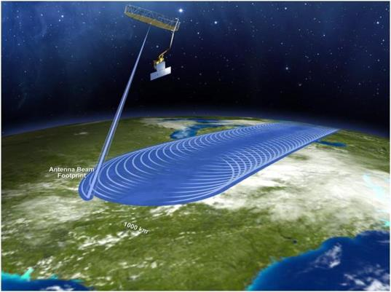
SMAP Overview
SMAP objective is to provide high-resolution and frequent-revisit global mappings of soil moisture and landscape freeze/thaw state
SMAP Instrument Configuration
Radar
Frequency: 1.26 GHz
Polarizations: VV, HH, HV
Resolution: 3 km
Relative Accuracy: 1.0 dB (HH and VV), 1.5 dB (HV)
Radiometer
Frequency: 1.41 GHz
Polarizations: H, V, 3rd & 4th Stokes
Resolution: 40 km
Relative Accuracy: 1.3 K
Shared Antenna
6-m diameter deployable mesh antenna
Conical scan at 14.6 rpm
Constant incidence angle: 40 degrees
1000 km-wide swath
Swath and orbit enable 2-3 day global revisit
Orbit
Sun-synchronous, 6 am/pm orbit, 685 km altitude
Radar Anomaly
350 km
350 km
Launch: Jan. 31, 2015 from Vandenberg Air Force Base in California onboard a Delta II.
Radar - High spatial resolution (1-3 km) but more sensitive to surface roughness and vegetation
Radiometer - High accuracy (less influenced by roughness and vegetation) but coarser resolution (40 km)
Notes:
How are the measurements obtained? SMAP uses two microwave sensors both operating at L-band. The reason microwave is used is because it is sensitive to soil moisture and freeze/thaw conditions and also because it can image the surface of the Earth regardless of day/night conditions or most weather conditions. L-band in particular has greater sensitivity to soil moisture than other frequencies.
The radar, which is the active system (and the A in SMAP) operates at 1.21 GHz and is gridded to a 3 km resolution. The radiometer is the passive system (and the P in SMAP) and operates at 1.41 GHz and is gridded to a 36 km resolution. Both sensors share an antenna that is 6 meters in diameter. The antenna rotates 14.6 revolutions/minute and creates a swath of 1000km wide on the ground. The orbit is polar sun synchronous at 685 km altitude with a 6am/6pm equatorial crossing allowing for a 2-3 day global revisit because of its swath to swath overlap. There is an 8-day exact orbit revisit. The mission is designed to operate for a minimum of three years however it is expected to last much longer than that (most NASA satellites have exceeded their design life by many years).
SMAP was launched into space on a Delta II rocket on Jan. 31, 2015 from Vandenberg Air Force Base in California. The uniqueness of SMAP is that it will provide soil moisture measurements by combining data from the radar and the radiometer to produce a 9 km soil moisture product that covers the globe every 2-3 days.

Slide 16
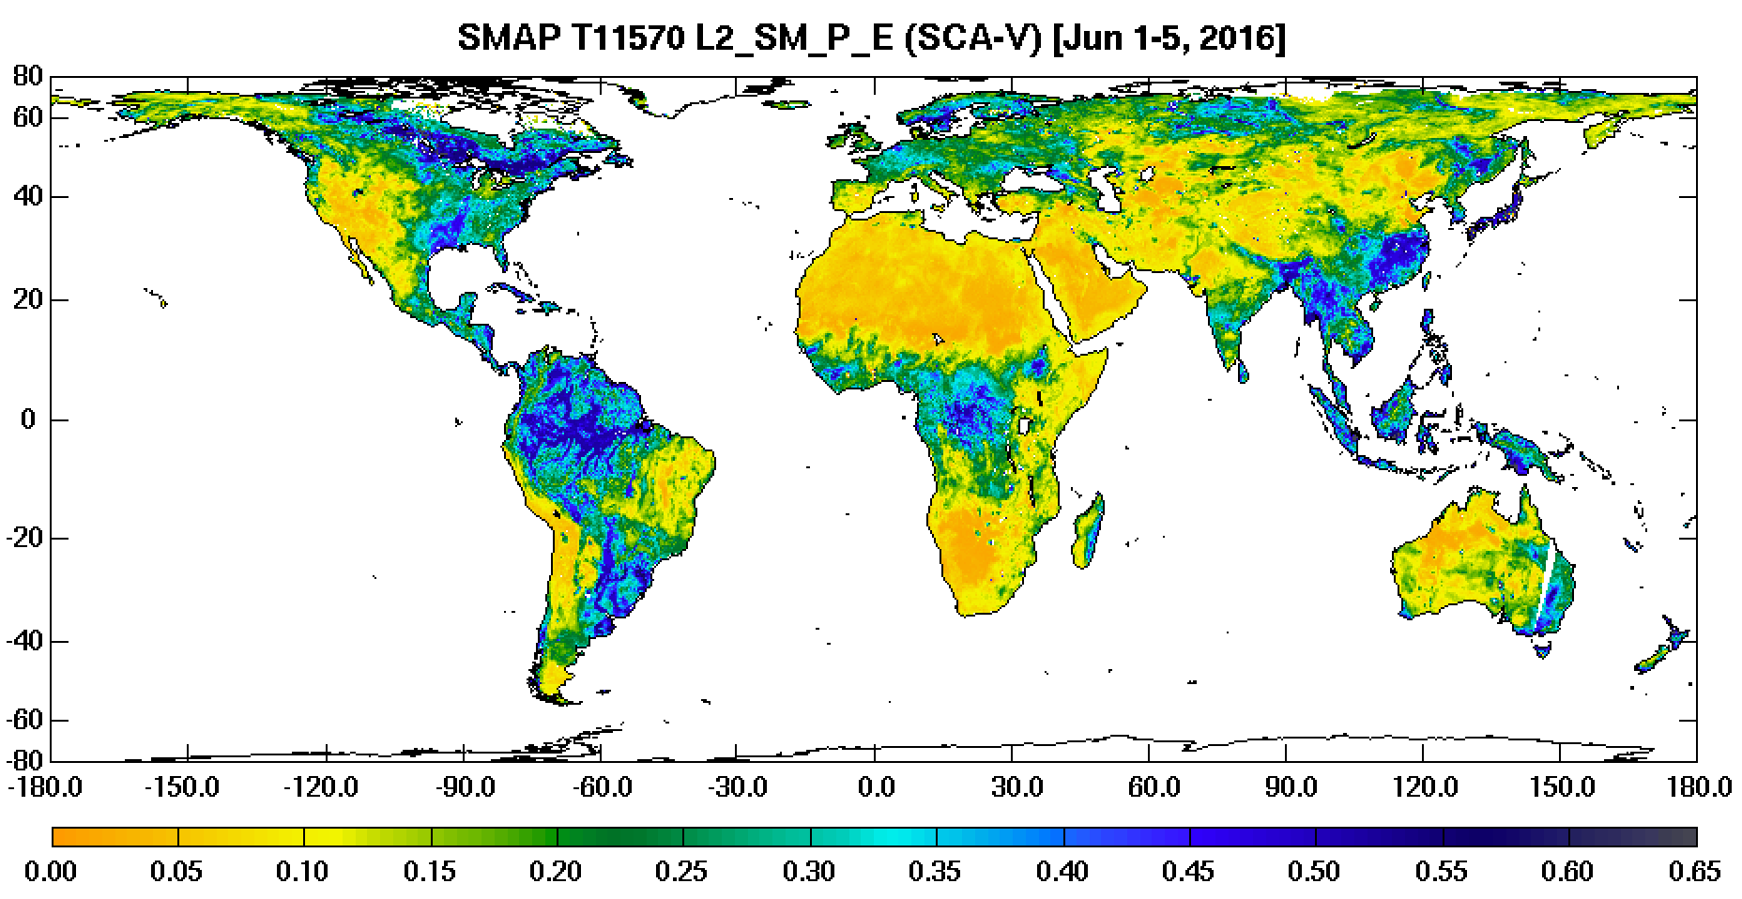
SMAP Radiometer Soil Moisture
SMAP T15570 L2_SM_P_E (SCA-V) [Jun 1-5, 2016]
The regions that are expected to be very dry (i.e., the Sahara desert) and wet (i.e., the Amazon Basin) reflect the expected levels of retrieved soil moisture.

Slide 17
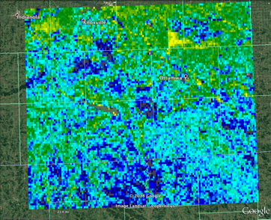
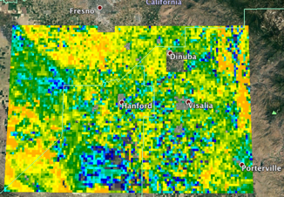
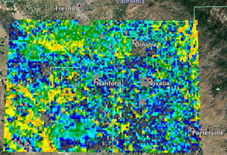
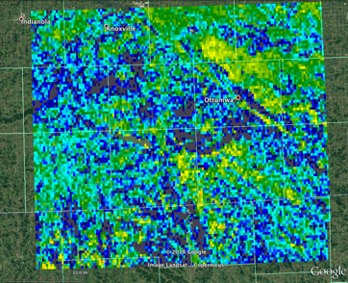
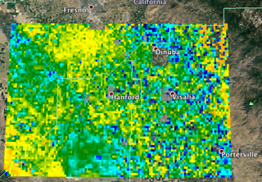
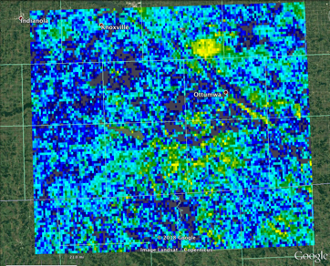
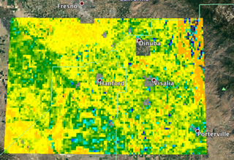
High Resolution
SMAP-Sentinel Soil Moisture Product
Southeast Iowa
San Joaquin Valley, California
02/08/2018
03/04/2018
The time series over two different regions clearly demonstrate how the L2_SM_SP product captures the evolution (wetting and drying) of soil moisture at fine resolution.
04/11/2018
04/08/2018
04/22/2018
05/02/2018
05/05/2018
Narendra Das (JPL)

Slide 18
SMAP Level-4 Soil Moisture Product
Surface and root-zone soil moisture
Reichle et al.

Slide 19
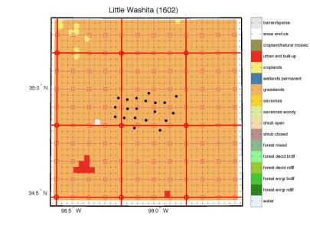
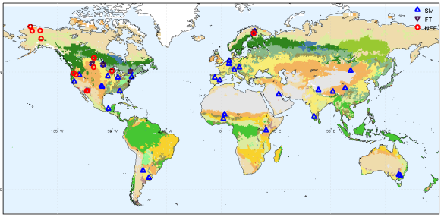
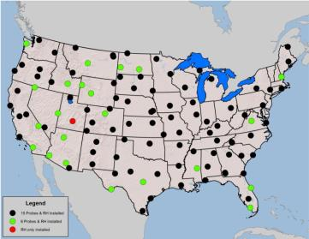
Soil Moisture Cal/Val Approach
Primary calibration and validation approach is utilization of dense in situ soil moisture measurements (multiple soil moisture measurement within the 3-km to 36-km SMAP footprint)
Supplemental approach will utilize large-scale sparse networks (one measurement within footprint), and global remote sensing and model-based soil moisture data products
Dense network
(core site)
100 km
100 km
NOAA USCRN
Global distribution of core validation sites

Slide 20
SMAP Soil Moisture Assessment
CVS | ubRMSE (m³/m³) |  |  | Bias (m³/m³) |  |  | RMSE (m³/m³) |  |  | R
 | SCA-H | SCA-V | DCA | SCA-H | SCA-V | DCA | SCA-H | SCA-V | DCA | SCA-H | SCA-V | DCA
AM SMAP L2SMP_E Average V2 (2018) | 0.046 | 0.038 | 0.049 | -0.029 | -0.001 | 0.039 | 0.062 | 0.047 | 0.072 | 0.780 | 0.814 | 0.728
PM SMAP L2SMP_E Average V2 (2018) | 0.045 | 0.036 | 0.047 | -0.024 | -0.002 | 0.031 | 0.061 | 0.045 | 0.066 | 0.780 | 0.818 | 0.712
Sparse Network | ubRMSD (m3/m3) |  | Bias (m3/m3) |  | RMSD (m3/m3) |  | R |  | N
 | SCA-V | SMOS | SCA-V | SMOS | SCA-V | SMOS | SCA-V | SMOS
AM SMAP L2SMP_E Average V2 (2018) | 0.045 | 0.068 | 0.003 | -0.043 | 0.065 | 0.099 | 0.668 | 0.511 | 399
PM SMAP L2SMP_E Average V2 (2018) | 0.046 | 0.067 | 0.008 | -0.039 | 0.067 | 0.097 | 0.635 | 0.497 | 399
Average is based upon all sets of observations, not the average of the land cover category.
Sparse results are similar to CVS results and verify the assessments
L-band radiometer-only soil moisture products meet the 0.04 m3/m3 accuracy requirement
SMAP soil moisture estimates outperform other satellite soil moisture products
AM and PM retrieval assessment is consistent

Slide 21
Summary Statistics for AMSR2 Soil Moisture
 | JAXA |  |  |  | SCA |  |  |  | LPRM
 | ubRMSE (m³/m³) | Bias (m³/m³) | RMSE (m³/m³) | R | ubRMSE (m³/m³) | Bias (m³/m³) | RMSE (m³/m³) | R | ubRMSE (m³/m³) | Bias (m³/m³) | RMSE (m³/m³) | R
Avg. AMSR2 All | 0.059 | -0.089 | 0.111 | 0.502 | 0.055 | -0.047 | 0.080 | 0.569 | 0.088 | 0.100 | 0.137 | 0.601
AMSR2 (VWC < 2 kg/m2) | 0.049 | -0.068 | 0.085 | 0.533 | 0.048 | -0.035 | 0.069 | 0.593 | 0.083 | 0.077 | 0.115 | 0.655
SMAP | - | - | - | - | 0.038 | -0.001 | 0.047 | 0.820 | - | - | - | -
Not much difference between A and D for a specific AMSR2 algorithm
Each AMSR soil moisture product has different performance assessment (compared to in situ observations)
AMSR2 meet the higher ubRMSE accuracy mission goal (0.06 m3/m3)
LPRM has high bias but good correlation
The one metric to note is the much improved correlation.
Expected improvement due to lower observation frequency

Slide 22
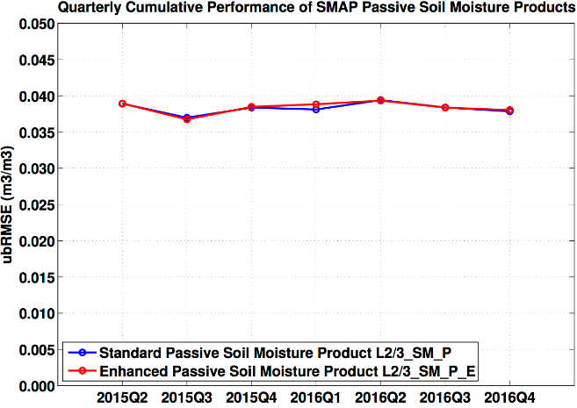
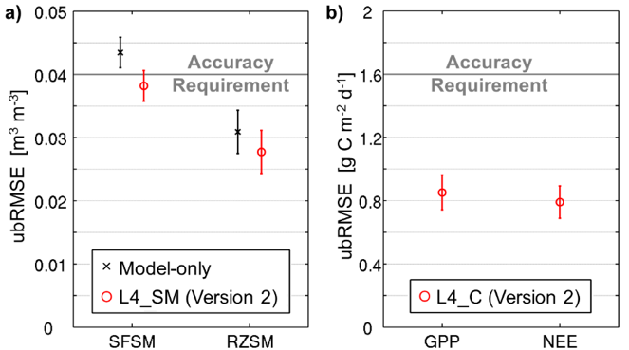
L2-4 SMAP Product Performance
(Left) Cumulative unbiased RMSE (ubRMSE) of L2SMP and L2SMPE (6:00 AM overpasses) soil moisture and (Right) Performance of Level 4 Version 2 products vs. in situ measurements: (a) Unbiased RMSE (ubRMSE) of surface soil moisture (SFSM) and root zone soil moisture (RZSM) for L4_SM and model-only estimates. The latter do not benefit from the assimilation of SMAP observations. (b) ubRMSE of GPP and NEE for L4_C. Metrics qre computed at core site in situ measurements at 9 km resolution using 3-hourly data for soil moisture and daily data for carbon fluxes for April 2015 to November 2016. Error bars indicate 95% confidence intervals.

Slide 23
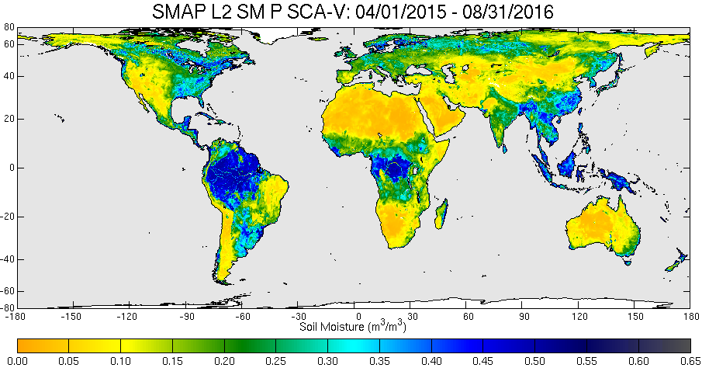
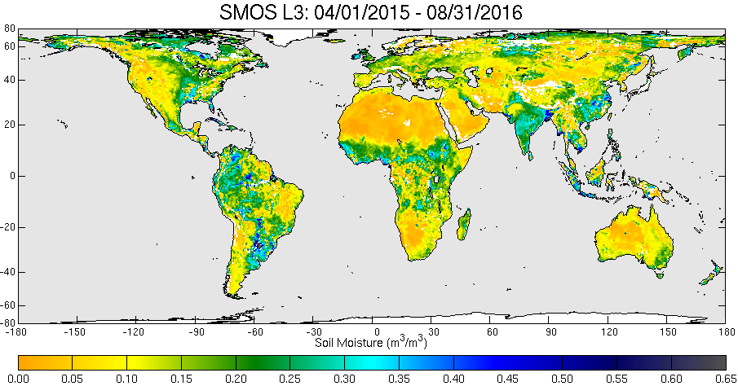
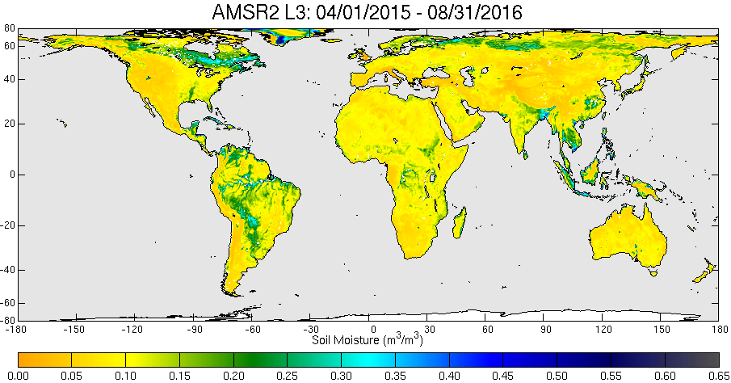
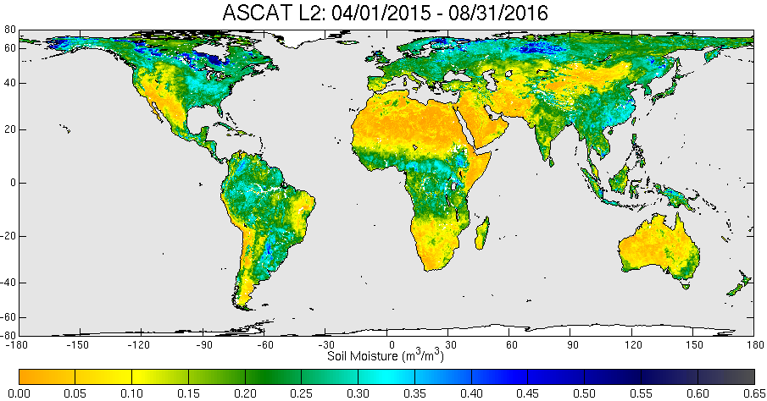
Global L2SMP inter-comparison
(SMAP, SMOS, AMSR2, ASCAT)

Slide 24
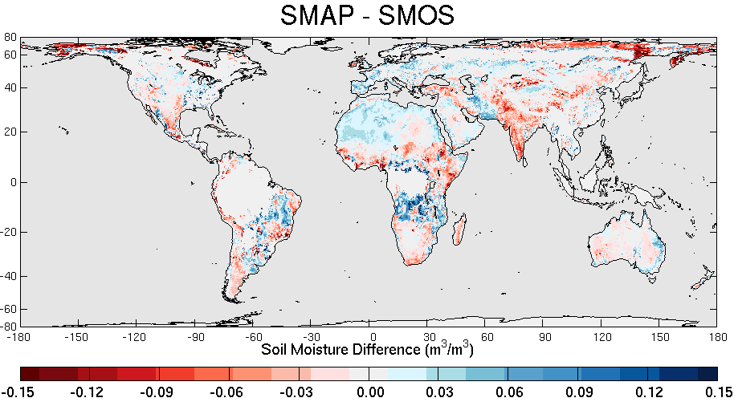
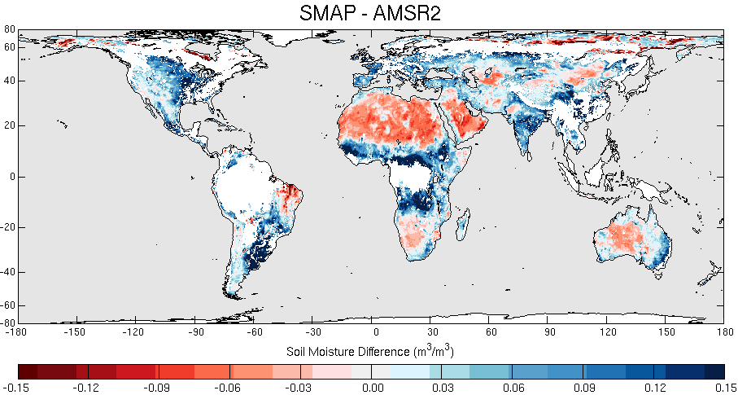
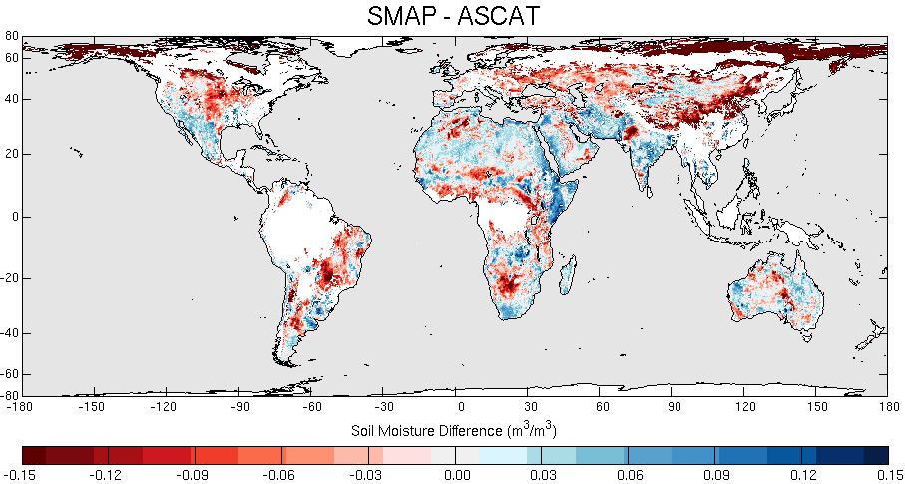
Global L2SMP inter-comparison
(Bias wrt SMAP)
SMAP and SMOS have low bias over most of the globe
SMAP and AMSR2 have greater biases (SMAP- drier over arid areas, wetter over other biomes)
SMAP and ASCAT have higher bias (ASCAT is wetter than SMAP over most domains)

Slide 25
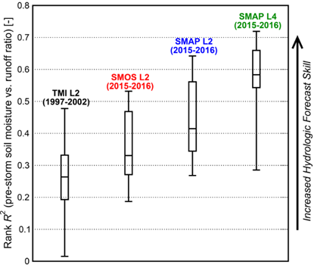
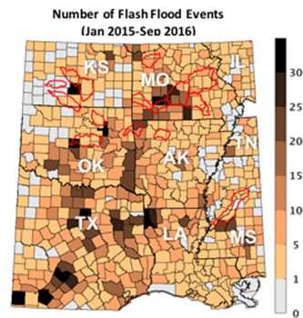
Land Surface Response to Storm Events
Application Example
(Left) Skill of forecasting the land surface response to rainfall for satellite-based soil moisture products. Skill is measured as the rank coefficient of determination (R²) between pre-storm soil moisture and subsequent storm-scale runoff ratio (i.e., total runoff divided by total rainfall) sampled across 16 basins. The SMAP Level 2 and Level 4 soil moisture products have the highest skill. Relatively lower values for the Tropical Rainfall Measurement Mission Microwave Imager (TMI) and Soil Moisture Ocean Salinity (SMOS) missions reflect skill obtained from earlier sensors. (Right) Boundaries (in red) of the 16 medium-scale (10³–10⁴ km²) basins and total number of flash-flood events during January 2015–September 2016 in the south-central U.S.
Wade Crow (USDA)

Slide 26
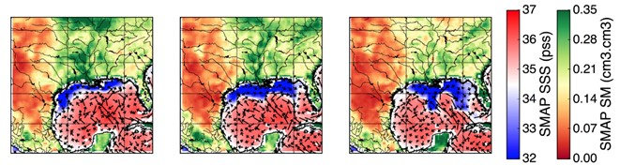
Water Cycles Linkages between Land & Ocean
Application Example
SMAP observed an unusual horseshoe-shaped plume of freshwater (dark blue) in the Gulf of Mexico after Texas flooding in May 2015. Louisiana is above the center of the plume, with Florida on the right and the Texas coastline at upper left (Fournier et al. 2016).

Slide 27
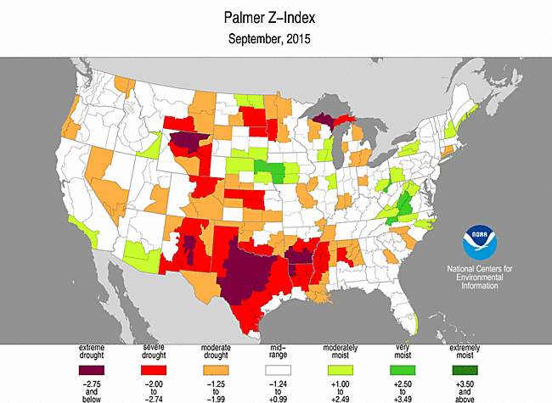


Mapping Drought
Application Example
SMAP Drought Index (September 2015)
Source: Vue , Mista and Entekhabi
SMAP Soil Moisture Change
(August-November 2016)
Available to Weekly Drought Monitor authors
Source: N. Das (JPL)

Slide 28
Summary
AMSR2 is healthy and providing good soil moisture estimates over areas with low vegetation.
Plans for AMSR3 are currently being developed.
SMOS and SMAP successfully demonstrated the ability to estimate soil moisture
  Use of low frequency for secondary applications was also demonstrated (Ocean Salinity, Freeze/thaw, Sea Ice, Ocean surface Winds)
SMOS is healthy and is performing well. SMOS is impacted by RFI.
SMAP radiometer is in good health. SMAP radiometer-only soil moisture products meet the level 1 accuracy requirement
L-band radiometer soil moisture products meet the accuracy requirement of 0.04 m3/m3 and significantly outperform the soil moisture products from other platforms
Unfortunately, no current plans for a future L-band mission
  Cost of the mission due to the large aperture
  Takes a long time to develop a satellite mission
Surface soil moisture and root zone soil moisture were identified as important variables but were not recommended in the ESAS2017.
Need for higher resolution soil moisture (field scale)

Slide 29
Thank you

Slide 30


Ocean Salinity
Ocean circulation
  Salinity + temperature determine density
Global water cycle:
  Salinity reflects balance between precipitation and evaporation
Changes in salinity reflect manifestations of climate change
  Freshening due to ice melt in Arctic
  Change in balance between Atlantic and Pacific
  Changes in coastal salinity due to increased run off from increased precipitation
Nominal Requirements:
  Open Ocean: 0.1 psu; 100 km; monthly revisit

Slide 31


Ocean Surface Winds
SMOS and SMAP radiometers have been able to measure ocean surface winds up to 65 m/s without being affected by rain
Effective in intense tropical cyclones
L-band not affected by rain or clouds
L-band emissivity does not appear to saturate with wind speed
Superior to all other ocean surface wind remote sensing at w>30 m/s
3 major hurricanes seen by SMOS in Fall 2015 over the Pacific

Slide 32


Sea Ice
Sea Ice thickness using L-band observations
  L-band not affected by rain or clouds
  L-band brightness temperatures useful to estimate sea ice thickness up to ~0.5 m
  Complementary observations to altimeter observations that have problems with thin sea ice
Monitoring melt water from sea ice and ice sheets during summer.
  Summer melt of sea ice and ice sheets can cause fresh water lenses
Ice thickness retrieval error for CryoSat-2 and SMOS.

Slide 33





SMOS Soil Freeze/Thaw product
Daily information on soil freeze/thaw state
Based on SMOS L3 brightness temperatures
Spatial resolution: 25x25km (EASE grid)
Three levels: ”frozen”, ”partially frozen”, ”thaw”
Current dataset: 2010 – 2017 => operational product under implementation
Soil state maps on
1st October,
1st November and
1st December 2014
Soil freezing in Siberia (left), and a 5-day cumulative air temperature sum (ECWMF) an example for October 2015
K. Rautiainen

