Slide 1
Context and state of play of the Copernicus anthropogenic CO₂ emissions initiative
CEOS workshop
Ispra, 18 June2018
Bernard Pinty ⁽¹⁾
Greet Janssens-Maenhout ⁽²⁾, Mark Dowell ⁽²⁾, H. Zunker ⁽¹⁾
with contributions from ESA, ECMWF & EUMETSAT
and many experts ⁽³⁾
⁽¹⁾ EC DG-GROW, Copernicus unit I.2, Brussels, Belgium
⁽²⁾ EC JRC, Directorate for Sustainable resources, unit D.6, Ispra, Italy
⁽³⁾ Major national & international institutions

Slide 2
Current political Context and Challenges
UNFCCC Parties agreed for an "enhanced transparency framework" to be implemented bottom-up through national inventory reports (Paris Agreement, 2015) and complemented by a global CO₂ Monitoring and verification support capacity to fill in gaps of data.
The global CO₂ budget needs to provide input to the 5-yearly global stocktake exercise starting from 2023 established under the Paris Agreement.
Analysis at local/regional level may help countries in evaluating the effectiveness of their CO₂ emission reduction strategies and possibly in defining revised Nationally Determined Contributions of the UNFCCC Parties.
Need to provide independent evidence on and verification of nationally reported anthropogenic CO2 emissions and help assessing the uncertainties and gaps associated with the emission inventories.

Slide 3
Boundary conditions
Emphasis on systems: inventories, space-borne and in-situ observations, data assimilation framework, inversion system, transport models, decision support system
Emphasis on operational intent – from the outset
Fundamentally underpinned by strong user requirements based on international commitments and corresponding EU Policy implementation
Fundamental added value of international engagement on multiple aspects of system implementation/development

Slide 4
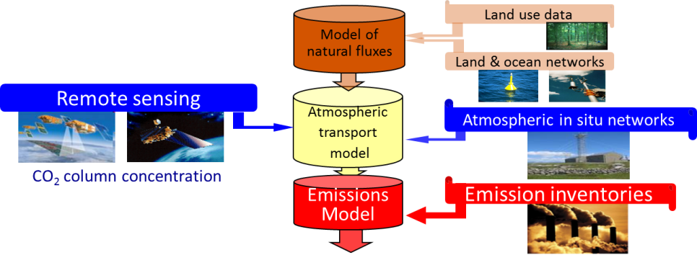
Expansion of the Copernicus Programme: CO₂ Report –November 2015
Expansion of the Copernicus Programme: CO₂ Report –November 2015
CO₂ Task Force A
CO₂ Task Force B
Towards a European Operational Observing System to Monitor Fossil CO₂ Emissions
2015
The crux of the matter is about increasing significantly the density of high quality relevant observations

Slide 5
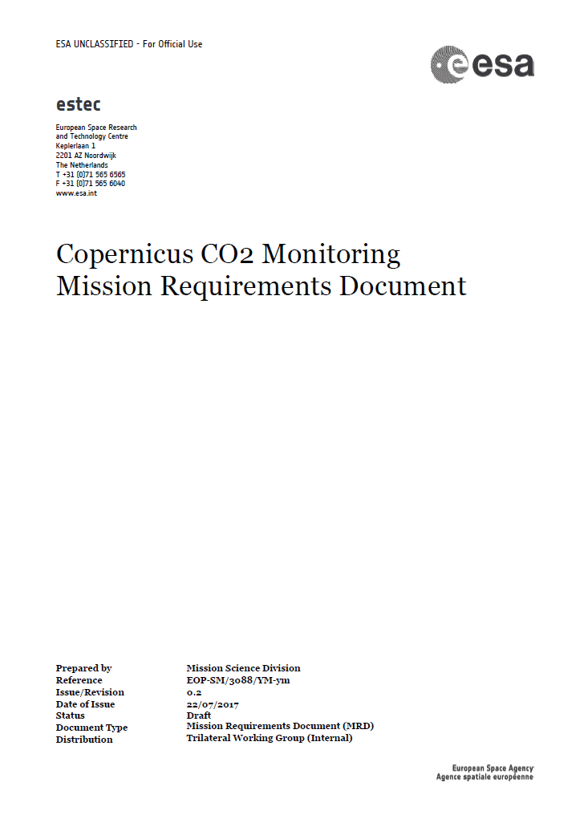
Objectives and Requirements from the Space Component: Task Force A
XCO₂ precision: 0.5 – 0.7 ppm
Systematic bias < 0.5 ppm
Spatial resolution about 4 km²
Continuously sampled swath width > 200 km
Revisit around 3 days (poleward of 40 deg)
A constellation of N satellites (N about 3 to 4)
Orbit equator crossing time 11:00 – 12:00 hrs
    *
    Radiometric uncertainty < 3%
    Relative radiometric accuracy < 0.5%
Band | Spectral range [nm] | Spectral resolution [nm] | SNR at reference radiance
NIR | 747–773 | 0.1 | 400 - 600
SWIR-1 | 1590–1675 | 0.3 | 300 - 500
SWIR-2 | 1925–2095 | 0.55 | 200 - 400

Slide 6
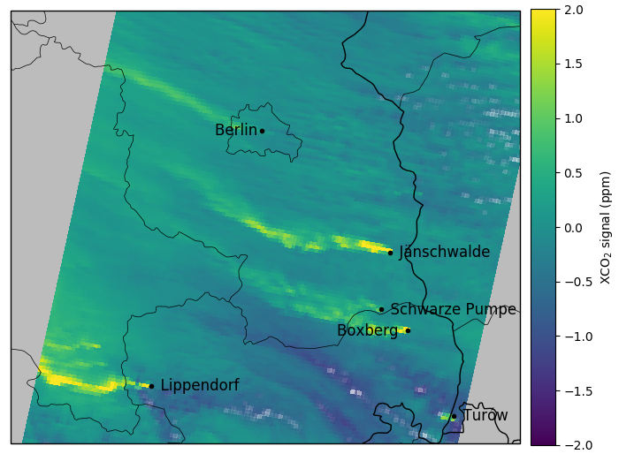
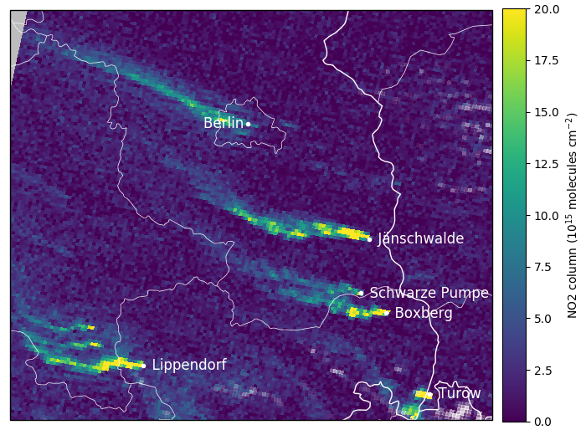
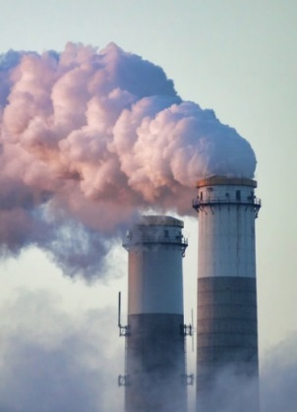
Consolidating Requirements: Main Open Points
Complementary NO₂ and/or CO observations for attribution of anthropogenic emission sources → Y/N?
Complementary aerosol/cloud observations for light path correction → Y/N?
Temporal/spatial coverage → how many satellites?
CO₂
NO₂
Plumes

Slide 7
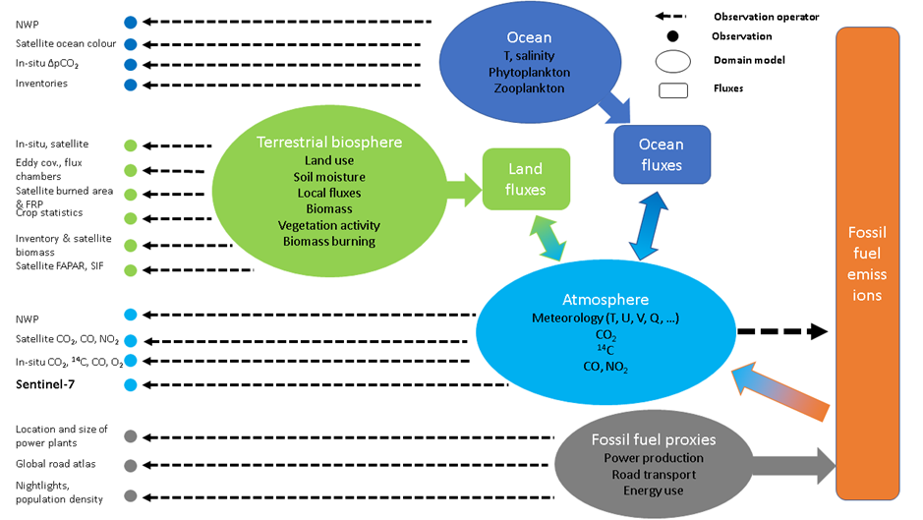
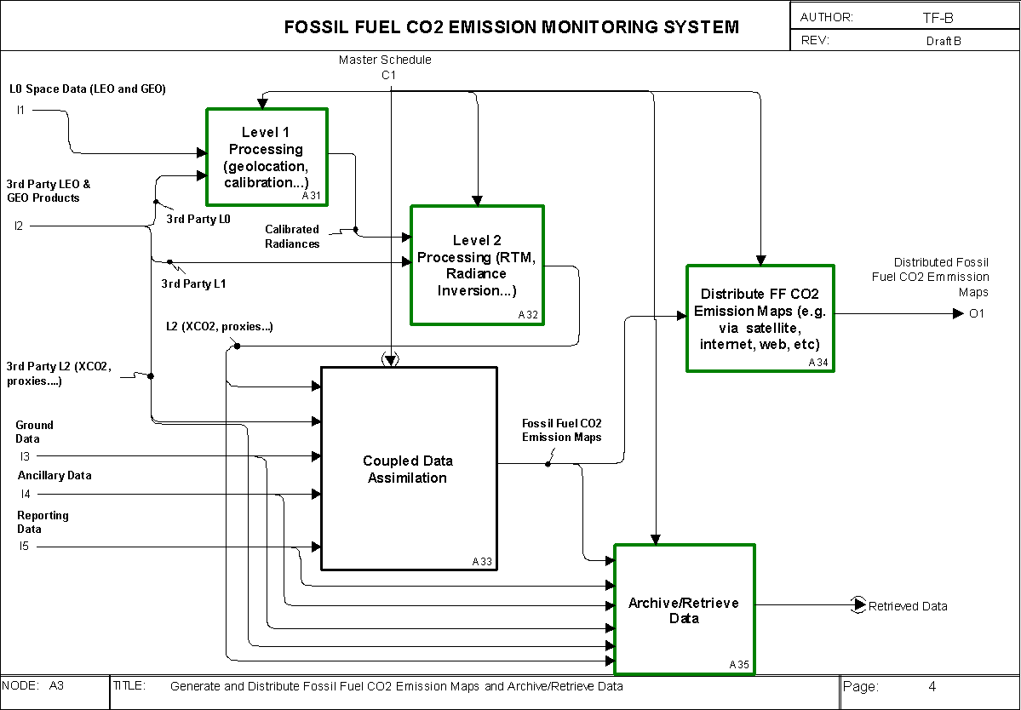
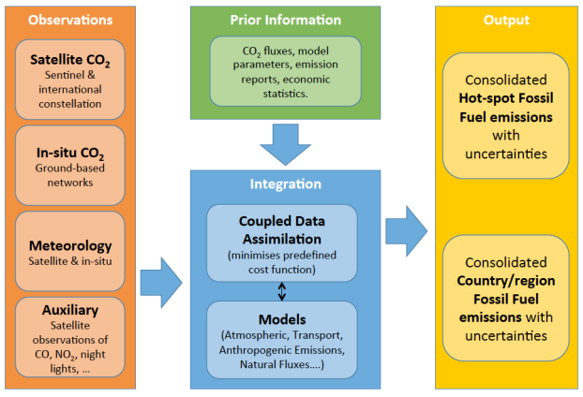

Functional Architecture – An integrated system approach: Task Force B
An Operational Anthropogenic CO₂ Emissions
Monitoring & Verification Support Capacity
2017

Slide 8
Way Forward for the CO2 Task Force: 3 dedicated working groups
Reviewing inputs from system simulations to assess the system performance.
Apportionment of requirements between system elements.
Identifying critical issues affecting the system design.
Engage stakeholders on the further adjustment of the requirements, including the functionality needed for decision-making – basis for decision support system.
Outlining options for the physical realisation of the functional architecture, including conducting a survey of existing capabilities, need for developments, re-use.
Make initial assessment of options of governance arrangement for a system.
Implementation planning .
Provide a detailed assessment of activities and infrastructure requirements for in-situ observations (taking advantage of current EU investments and international partnerships)
Provide a overview of a strategy for calibration and validation of the system and it’s implications on the observing component
1
2
3

Slide 9

Towards an anthropogenic CO₂ Monitoring & Verification Support Capacity
Global Stock
Take 1
using inventories of 2026
CO₂ Task Force & ESA MAG
Global Stock
Take 2
2017
2019
2021
2023
2025
2027
2028
2029
system capacity built up
operation
MRD
#1
MRD
#2
MRD
#3
Launch target for
Copernicus S-7
constellation
ESA support studies
H2020 space call
H2020 Coordination & support Action: CHE
H2020: VERIFY

Slide 10
SOCAT
ICOS
……
Operational
Anthropogenic CO2/GHG Emission
Monitoring and Verification Support Capacity
IG3IS (WMO)
In-situ Observations
FLUXNET
TCCON
GEO Carbon & GHG (GEO)
Major Coordinating frameworks & initiatives
TANSAT & 2nd gen (CMA)
OCO-2 (NASA)
GOSAT (JAXA)
MicroCarb (CNES)
Copernicus – supporting missions
Copernicus expansion
Sentinel- 7
dedicated LEO
constellation
(first launch 2025- fully operational 2030)
GCOS
Satellite observations
CEOS & CGMS
LEO Missions
Global GEO Ring

Slide 11
Thank you
CEOS workshop
Ispra, 18 June2018

