Slide 1

GEO Carbon, In-situ coordination & GEO Paris Agreement Workshop
Workshop on EC CEOS Priority on GHG Monitoring, Ispra
18, June 2018, André Obregón, GEO Secretariat

Slide 2


Slide 3







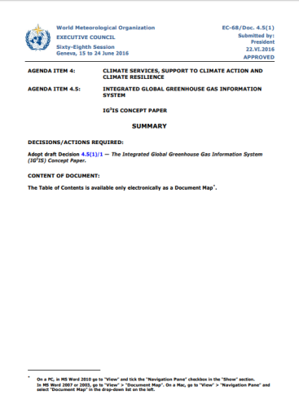
GEO-C
History
  2010 GEO Carbon Community of Practice
  Follow-up strategies

Slide 4

GEO-C
Mission
  Integrating carbon cycle observations across ocean, land and atmosphere
  Coherence & Consistency

Slide 5

The need for integration
Pinty et al., 2018

Slide 6
















From observations to decisions
SBSTA
Observations Services Knowledge Decisions
1
2
3
4
Identifying observational gaps
Improve data harmonization
Improve inter-operability
Improve data accessibility
Data Citation
Cross-sectoral engagement
Sustainability
Elaborated products
and services

Slide 7


GEO-C
Governance
Steering Committee
preparatory phase Coordinators
Secretariat
Jouni Heiskanen (ICOS, Host)
Antonio Bombelli (CMCC) Nobuko Saigusa (NIES)
Implementation/
Tasks

Slide 8
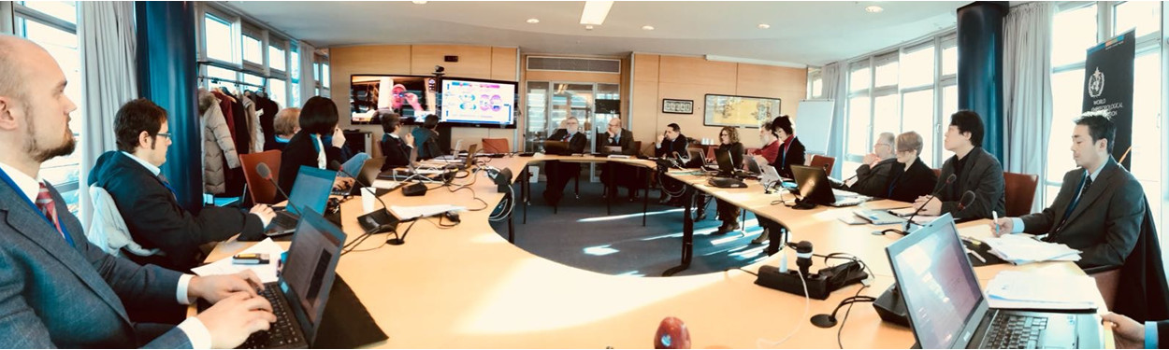
Steering Committee
First Meeting 2 Feb 2018, Geneva
Participants: Han Dolman (Netherlands) [Chair], Werner Kutsch (ICOS) [Vive-Chair], Hiroyuki Muraoka (Japan) [Vice-Chair], Pascal Lecomte (CEOS), Mauro Facchini, Mark Dowell (EC), Carolin Richter, Simon Eggleston (GCOS), Phil DeCola (IG3IS), Kiyoto Tanabe (IPCC TFI), Joanna Post (UNFCCC), Deon Terblanche (WMO)
unable to attend: Pep Canadell (GCP), Bob Scholes (South Africa),

Slide 9
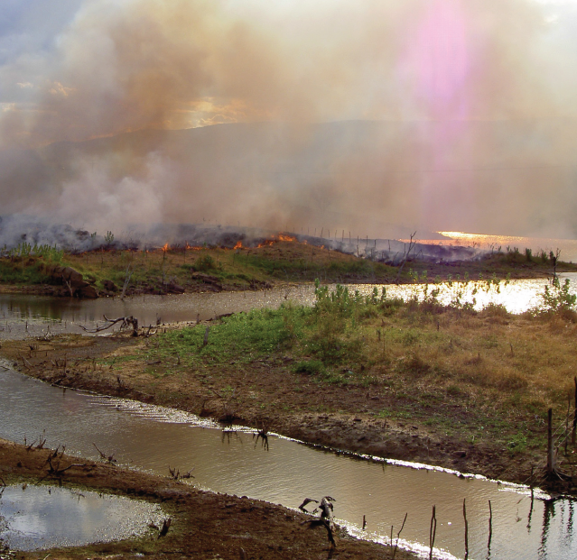
Role of GEO-C
in collaboration with all actors
Objectives 1/2
Provide a global forum for formal and informal discussions;
Map the carbon observation and modelling landscape;
Identify observational and modelling requirements to define requirements for an integrated global carbon monitoring system;
Identify existing gaps in modelling and observation

Slide 10
Role of GEO-C
in collaboration with all actors
Objectives 2/2
Improve policy science interface, with the aim to produce rapid feedback in both directions;
Establish common terminology;
Agree on joint roadmap to reach goals;
Explore cross-boundary opportunities between science and society

Slide 11
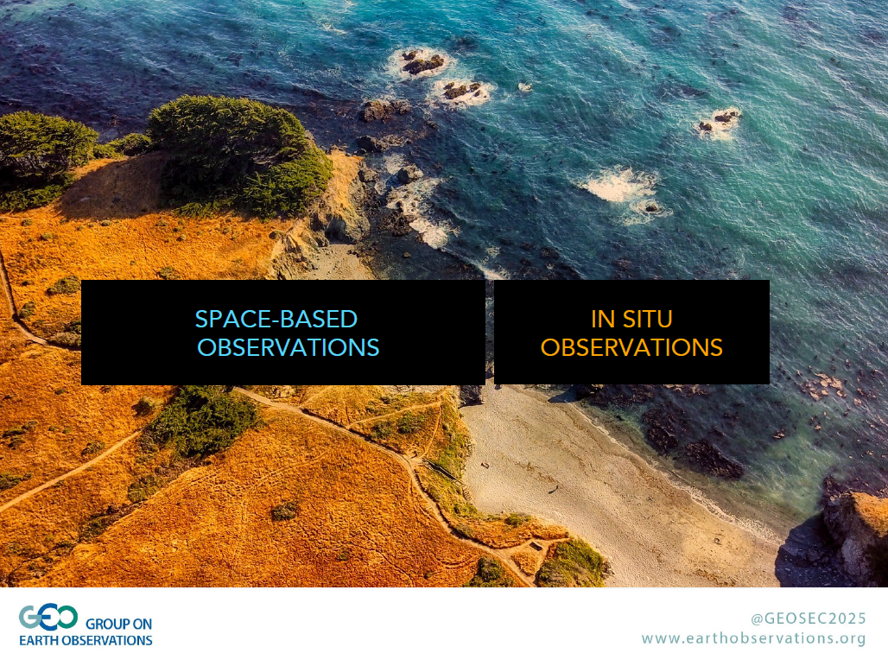





?

Slide 12











ATMOSPHERE
OCEAN
LAND
IN SITU OBSERVATIONS
...others

Slide 13
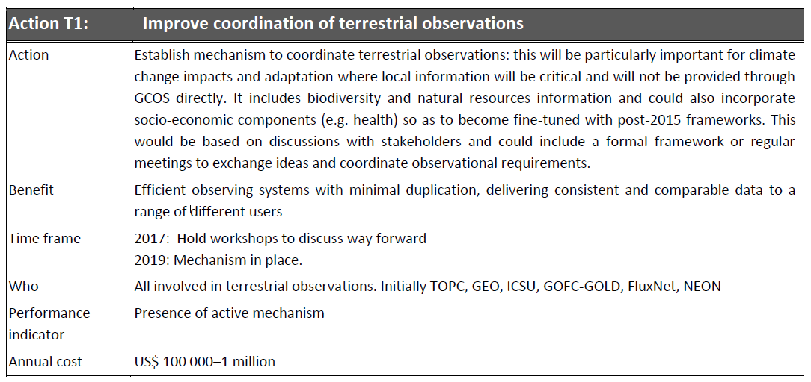
Implementation Plan
Coordination needs

Slide 14


Strategy Session
Addressing the gap in coordination of terrestrial observations
Frascati, 13 March 2017
Organisers:
Participants:
CEOS, CMCC, EC-JRC, ESA, GOFC-GOLD, ISCC, UNEP
Coordination for terrestrial observations is missing…
… Across systems, MEAs, disciplines, institutions…
How can coordination be added?

Slide 15
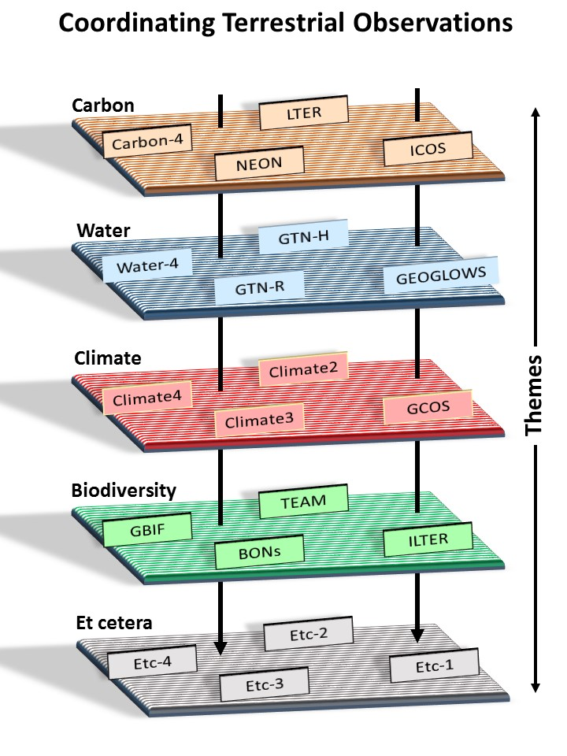
Strategy Session
Outcomes
Recognition of the limited coordination within and in particular across themes
Identification of coordination benefits: shared sites/databases, fill gaps, eliminate overlaps, coordinate methods/protocols, harmonize standards, increase interoperability etc.
Recommendation to hold a workshop bringing together network coordinators and operators

Slide 16
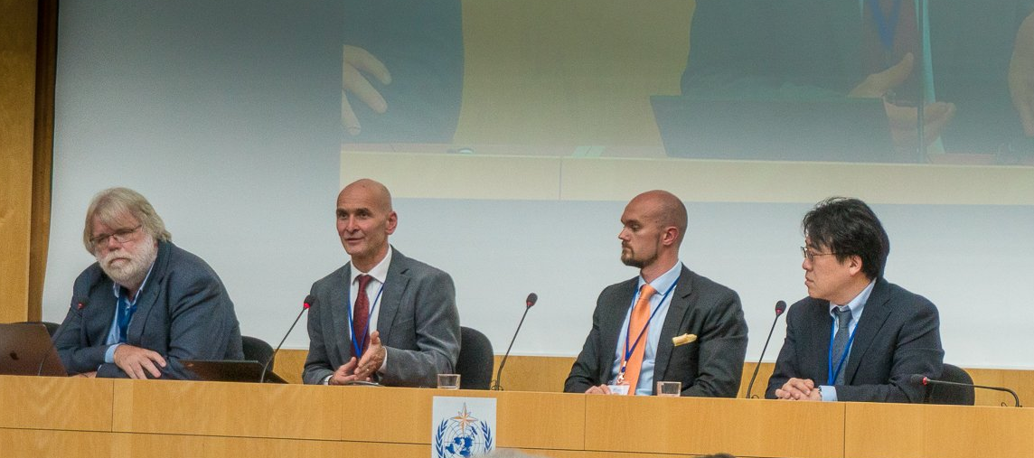
Coordinating Terrestrial In-situ Observations
GEO Symposium 2018: Session 3
Focus on climatological and environmental observations
Michael Mirtl
(ILTER)
Jouni Heiskanen
(ICOS, ENVRIplus)
Simon Eggleston
(GCOS)
Hiroyuki Muraoka
(AP-BON, JaLTER

Slide 17
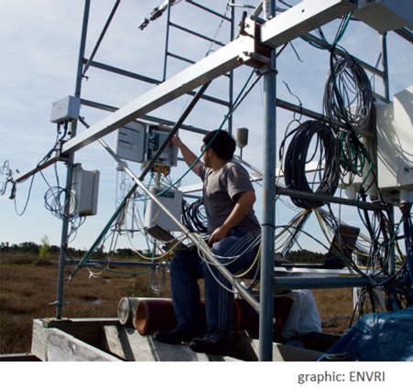
Coordinating Terrestrial In-situ Observations
GEO Symposium 2018: Session 3
Key messages
The terrestrial domain is perceived to be the least coordinated area and provides opportunities for GEO.
GCOS has identified this area in their Implementation Plan which can guide the GEO community.
Need to resource in situ task.
Need to liaise with network coordinators and operators.

Slide 18

&
GEO Climate Workshop:
„Earth Observations for the Paris Agreement“

Slide 19

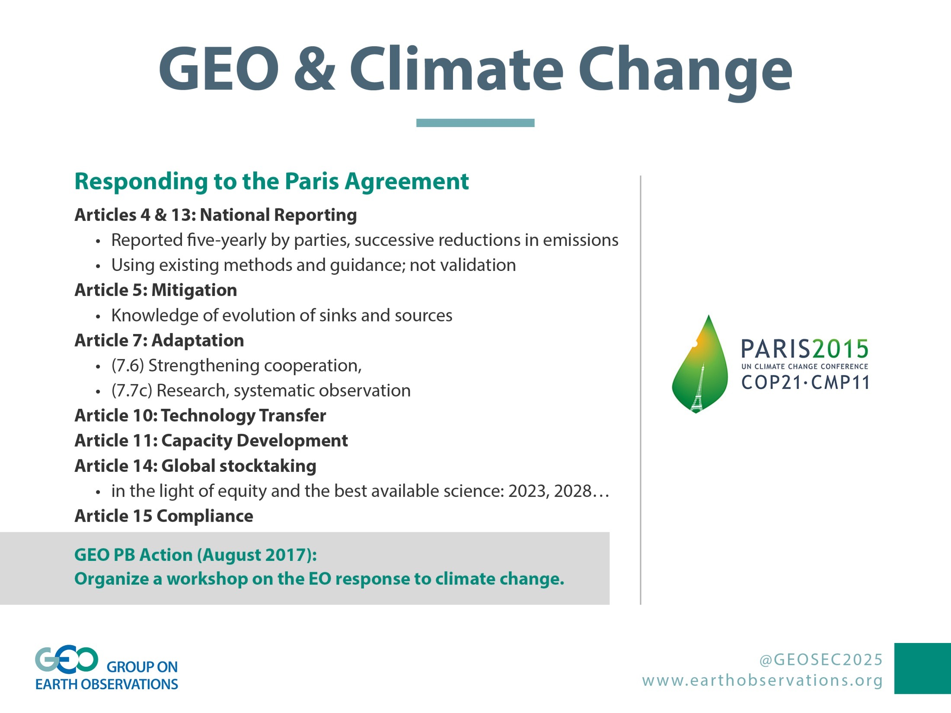

Climate Change
Responding to the Paris Agreement
Article 4 and Article 13 – National Reporting
Reported five-yearly by parties, successive reductions in emissions
Using existing methods and guidance; not validation
Article 5 Mitigation
Knowledge of evolution of sinks and sources
Article 7 Adaptation
(7.6) Strengthening cooperation,
(7.7c) Research, systematic observation
Article 10 Technology Transfer
& Article 11 Capacity Development
Article 14 Global stocktaking
in the light of equity and the best available science: 2023, 2028…
Article 15 Compliance
GEO PB Action (Aug 2017):
Organise a workshop on the EO response to the Paris Agreement
GCOS and others

Slide 20
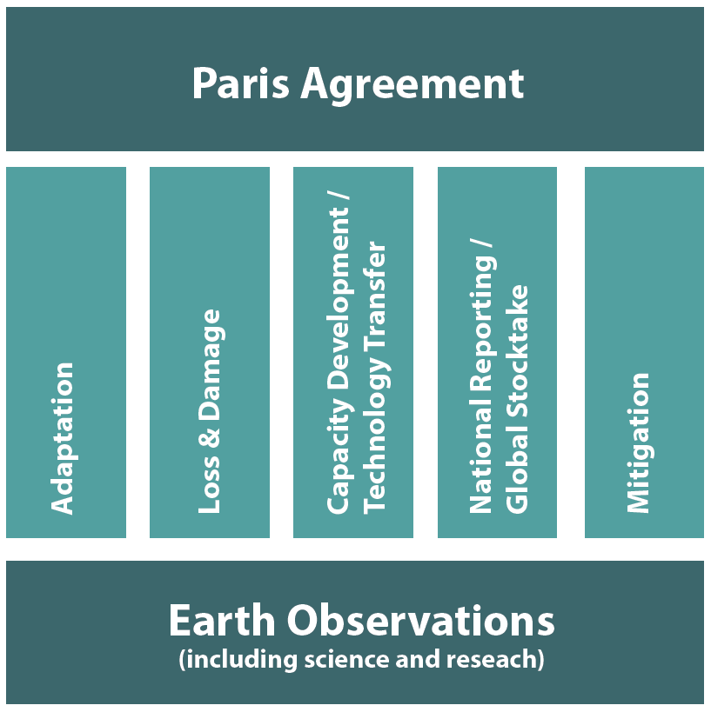
Paris Agreement
Pillars for Earth Observations
GEO Programme Board Subgroup 1

Slide 21
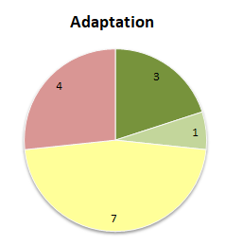
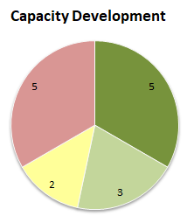
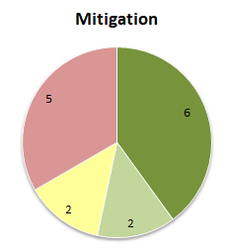
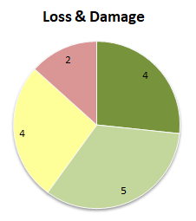
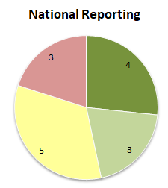
GEO Contribution to Pillars
Preliminary results from mapping exercise

Slide 22
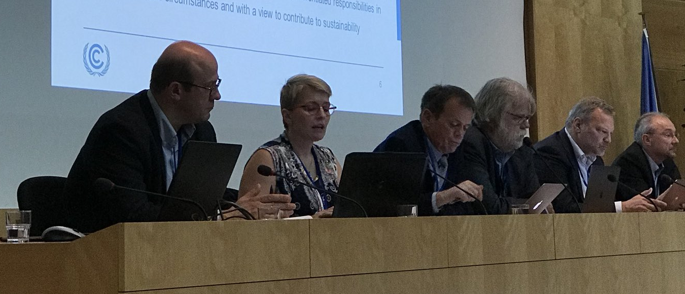
GEO Symposium: Climate Session
Speakers
Speakers: Joanna Post (UNFCCC), Abdalah Mokssit (IPCC), Simon Eggleston (GCOS), Lars Peter Riihshojgaard (WMO), Joerg Schulz (CEOS/CGMS), Michel Rixen (WCRP), Michael Sideris (IUGG)
Moderator: Mark Dowell (EC)

Slide 23
GEO Symposium: Climate Session
Opportunities for GEO articulated by Speakers
          Identify needs, gaps and support access to data (sustained observations, early warning)
          Support actions on mitigation, adaptation and loss and damage
          Work towards integrated approach with SDGs, Sendai Framework and other Rio Conventions
          Engage with national stakeholders (e.g. in National Adaptation Planning)
          Support IPCC processes: 2019 Refinement of 2006 IPCC Guidelines on National GHG Inventories; Sixth Assessment Cycle
          Respond to actions in the GCOS Implementation Plan
          Enhance use of climate data records for a variety of application areas

Slide 24
GEO Climate Workshop
Key Points from Discussion
1
PROGRAMMATIC GAPS (beyond GEO)
Advocacy at high national level; Data provision beyond met domain; High-res data; Climate impact measurements; Products for Exposure and Vulnerability; Raising awareness among national delegates; Timeliness of carbon-related data; Data rescue
2
MISSED OPPORTUNTIES (internal to GEO)
Joint advocacy for data sharing; Data access to WMO in situ data; Using OSCAR database and ECV Inventory; Data integration; Risk assessments; Supplementary guidance to adaptation

Slide 25
GEO Climate Workshop
Key Points from Discussion
3
COORDINATION (internal to GEO)
Developing Case Studies and Pilots; Increase cooperation across activities; Cross-cutting climate coordination mechanism needed
4
PARTNERSHIPS (external)
Avoid duplication; Build interfaces with UNFCCC Constituted Bodies; Build on documents made available by Parties; Hold regional workshops with stakeholders

Slide 26
GEO Climate Workshop
Recommendations to GEO Programme Board
Establish a coordination mechanism for climate across the GEO Work Programme
Develop Pilots for dedicated tasks within the existing activities e.g. on adaptation
Mid-term target: GEO to formulate supplementary guidance report to NAP process on the use and potential of EO

Slide 27



