Slide 1

UNFCCC/IPCC Engagement Efforts
Committee on Earth Observation Satellites
Osamu Ochiai, Akiko Suzuki
Japan Aerospace Exploration Agency (JAXA)
CEOS GHG Workshop
EC/JRC, Ispra, Italy
18th and 19th June 2018

Slide 2





“Road to IPCC Guidelines”
Support coordination with IPCC
IPCC Guidelines
（to be refined in 2019）
Methodology document
Satellite-based GHG Data
Develop methodology document to support for national statistician to use GHG data for the accuracy of the greenhouse gases inventory.
Provide high accurate data set and documents (ATBD)
Calibrations and validation for quality control
CEOS
Provide and share GHG data
Space Agencies
Ministry of Environment/NIES
Ministry of Education, Sports, Culture, Science and Technology
JAXA
GOSAT/
GOSAT-2(*)
NASA
OCO-2
GeoCarb
ESA
Sentinel-5p,
FLEX
CNES
IASI, MicroCarb, MERLIN
DLR
MERLIN
CMA
TanSat
*GOSAT/GOSAT-2 are joint projects by Ministry of Environment, NIES and JAXA .

Slide 3
Summary of Progress
“Road to IPCC Guidelines”
Support coordination with IPCC
IPCC Guidelines
（to be refined in 2019）
Engagement with International Bodies
CEOS Review
Methodology document
Satellite-based GHG Data
Develop methodology document to support for national statistician to use GHG data for the accuracy of the greenhouse gases inventory.
Provide high accurate data set and documents (ATBD)
Calibrations and validation for quality control
MOE/NIES “Methodology Document”
WGCV
CEOS
AC-VC
Quality Control and Accuracy of GHG Data
Provide and share GHG data
Space Agencies
Ministry of Environment/NIES
Ministry of Education, Sports, Culture, Science and Technology
JAXA
GOSAT/
GOSAT-2(*)
NASA
OCO-2
GeoCarb
ESA
Sentinel-5p,
FLEX
CNES
IASI, MicroCarb, MERLIN
DLR
MERLIN
CMA
TanSat
Engagement with Space Agencies
*GOSAT/GOSAT-2 are joint projects by Ministry of Environment, NIES and JAXA .

Slide 4
Activity Report in 2017
October 2016
  CEOS approved “UNFCCC/IPCC Engagement” in its GHG Initiative.
April 2017 to March 2018
  JAXA initiated the proposed enhancement of engagement
  Shared the goal with space agencies and international organizations (GEO, WMO, CGMS).
  Shared the goal: to be defined satellite data as a tool to support accuracy of national GHG emissions in IPCC Guidelines for GHG Inventories.
  Shared the technical and scientific advancements of satellite monitoring at UNFCCC/COP23.
  JAXA/NIES concluded GHG agreements with ESA, CNES and DLR.
  NIES developed GHG guidebook and CEOS reviewed the draft.
  JAXA, in support of CEOS Chair and AC-VC, submitted expert comments to the first order draft (FOD) of IPCC guidelines.
Completed
Completed

Slide 5
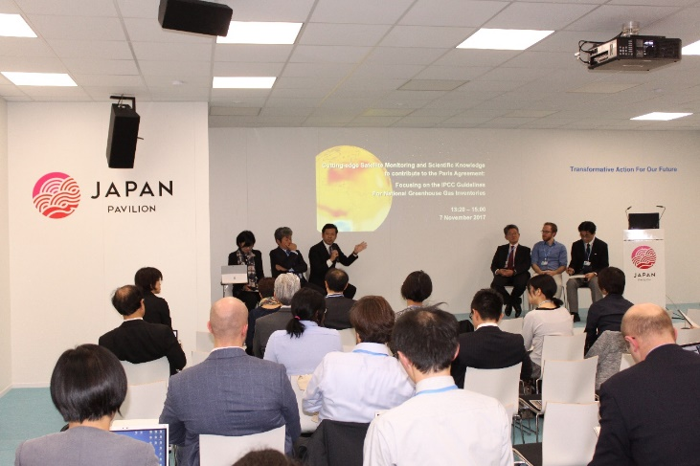
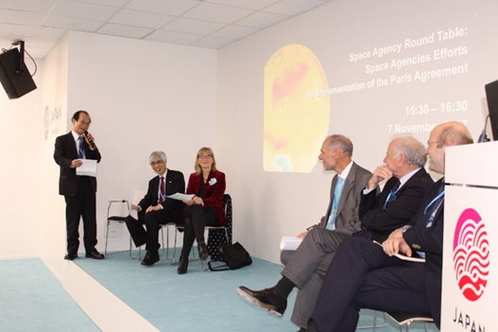


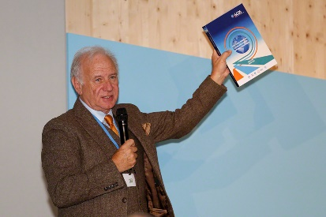

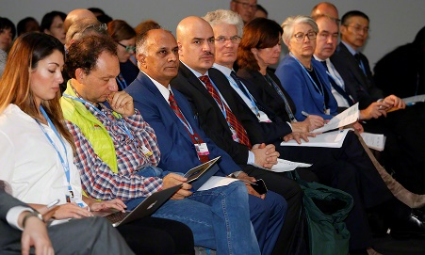
Side events at COP23
❖ “Cutting-edge Satellite Monitoring & Scientific Knowledge to contribute to the Paris Agreement: Focusing on the IPCC Guidelines for National Greenhouse Gas Inventories”
(hosted by MOE, NIES, MEXT, JWA, JAXA on November 7)
❖ “Space Agency Round Table: Space Agencies Efforts for Implementation of Paris Agreement”
(hosted by JAXA on November 7)
❖ “Integrated observations for mitigation and adaptation & Practical support to Parties”
(hosted by GEO, GECOS, RESTEC/JAXA on November 8)
© IISD Reporting Service
© IISD
Reporting Service
© IISD Reporting Service
© IISD Reporting Service

Slide 6

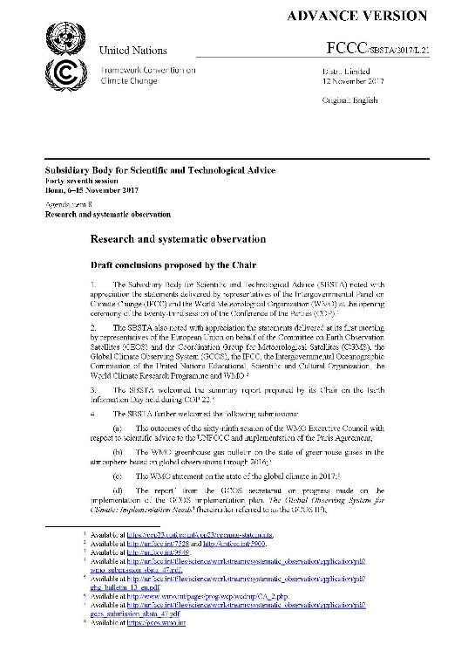
Key Notes at side events, COP-23
  SBSTA Chair recognized in his conclusion, “.....the increasing capability to systematically monitor greenhouse gas concentrations and emissions, through in situ as well as satellite observations, and its relevance in support of the Paris Agreement”.
  IPCC/TFI Chair noted during the official side event that chapters in relation with satellite observation was expected to be updated due to technical advancements of observation since 2006.

Slide 7
Expert comments to the draft of IPCC Guidelines
❖ Expert Review on First Order Draft (FOD) of 2019 Refinement to the 2006 IPCC Guidelines for National Greenhouse Gas Inventories (December 4, 2017 – February 11, 2018)
JAXA submitted comments:
  A series of GHG monitoring satellites on orbit in operation.
  Their observations and the result data available openly and freely.
  Continuity of future GHG satellite missions in next decade.
  Importance of high quality GHG information integrated with ground based measurements and models in supporting a monitoring and verification system for NDCs and stocktaking, and CEOS and CGMS started activity to define an optimum constellation of satellites to meet requirements of such a monitoring and verification system.
  Further engagement of partnerships/collaboration: CEOS/CGMS for the space component aspects; GEO/WMO on the broader framework; GCOS, UNFCCC and IPCC in better defining the role for space-based observation in the inventory guidelines process.
Notes:
The first order draft of 2019 IPCC Guidelines

Slide 8
Activities in 2018-2019
April 2018 to March 2019
  Continue Cal/Val to enhance reliability of data
  Literature cut-off date in June, and the second order draft (SOD) of IPCC Guidelines in July to September
  ⇒ Relevant papers should be issued before the cut-off date, and CEOS should submit expert comments to SOD.
  UNFCCC/COP24@Katwice in December
  ⇒ Intensify engagement for the final review (governmental review) of IPCC Guidelines (space agencies, international organizations, governments, research institutes and public sector）
  IPCC Plenary in Japan in May
  ⇒ Adoption of the refined IPCC Guidelines!
◄ We are here!

Slide 9
Timeline for Guidelines Refinement
29 – 31 Aug 2016 @Minsk | Scoping Group meeting
17 – 20 Oct 2016 @Bangkok | IPCC decision on outline
Feb 2017 | Decision on selection of Authors
7 – 14 Jul 2017 @Bilbao | First Lead Author Meeting (LAM1)
25 – 28 Sep 2017 @Victoria Falls | Second Lead Author Meeting (LAM2)
4 Dec 2017 - 11 Feb 2018 | First Order Draft (FOD) Expert Review
10 - 13 Apr 2018 @Cairns | Third Lead Author Meeting (LAM3)
June 25 2018 | Literature Cut-off
2 July - 9 Sep 2018 | Second Order Draft (SOD) Government & Expert Review
4w of Oct 2018 | Forth Lead Author Meeting (LAM4)
14 Jan – 10 Mar 2019 | Final Government Distribution (FGD) Government Review
May 2019 @Japan | IPCC adoption/acceptance
Issue AC-VC White Paper
before the cut-off date
Submit Expert
Comments

Slide 10


Beyond Refinement of IPCC Guidelines
Future
The Paris Agreement
Monitoring, Mitigation, Adaptation
Model
In-Situ
Space-based GHG Observation
2019
Refinement of IPCC Guidelines
Now
Notes:
JAXA activities will focus on contributing to Space-based GHG observation
and GFOI

