Slide 1

Highlights from the 14th
International Workshop on Greenhouse Gas
Measurements from Space
IWGGMS-14
Toronto, Canada
May 8-10, 2018
Ray Nassar (Environment and Climate Change Canada)
CEOS Chair Priority Workshop on GHGs
European Commission, Joint Research Centre, Ispra, Italy, June 18, 2018

Slide 2
IWGGMS Objective & History
1 – Tokyo, Japan, April 2004
2 – Pasadena, USA, March 2005
3 – Tsukuba, Japan, May 2006
4 – Paris, France, June 2007
5 – Pasadena, USA, June 2008
6 – Kyoto, Japan, January 2010
7 – Edinburgh, UK, May 2011
8 – Pasadena, USA, June 2012
9 – Yokohama, Japan, June 2013
10 – Noordwijk, The Netherlands, May 2014
11 – Pasadena, USA, June 2015
12 – Kyoto, Japan, June 2016
13 – Helsinki, Finland, June 2017
14 – Toronto, Canada, May 2018
Exchange information on the state of the art in remote sensing of CO₂, CH₄, and other greenhouse gases, and foster international collaboration, focusing on:
  Existing and on-going missions
  Retrievals and validation
  Use of the data for flux/source estimation
  Future missions
186 Registered Participants,
51 Talks, 90 Posters in 2018
https://iwggms14.physics.utoronto.ca/presentation-archive/

Slide 3
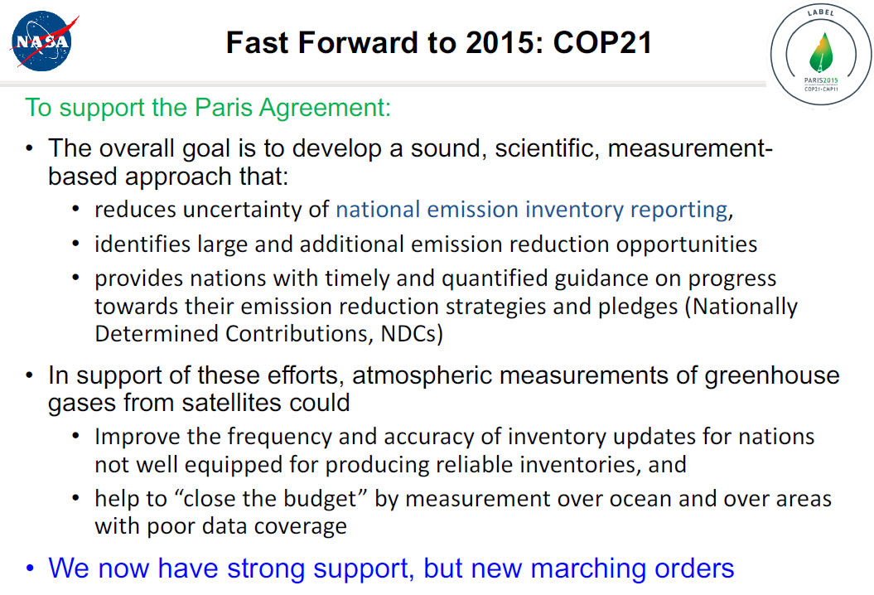
Precision, Accuracy, Resolution, and Coverage:
A few insights from GOSAT and OCO-2
David Crisp, Annmarie Eldering, Christopher W. O'Dell
GOSAT and OCO-2 have met their precision and accuracy requirements and helped us to understand what we need for the next generation of missions.

Slide 4
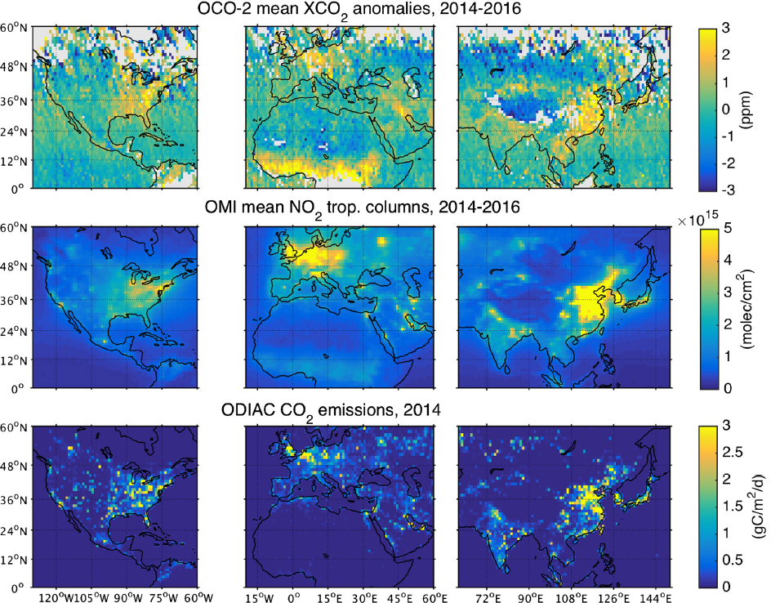
Global XCO₂ anomalies as seen by OCO-2
Janne Hakkarainen, Iolanda Ialongo, Shamil Maksyutov and David Crisp
Hakkarainen et al. (2016, GRL) demonstrated that XCO₂ enhancements in OCO-2 data could be traced to either fossil fuel use or biomass burning
More recently extending their method to look at finer time scales

Slide 5
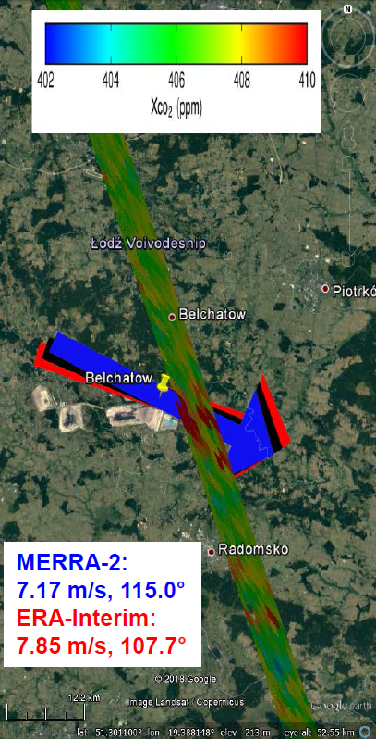

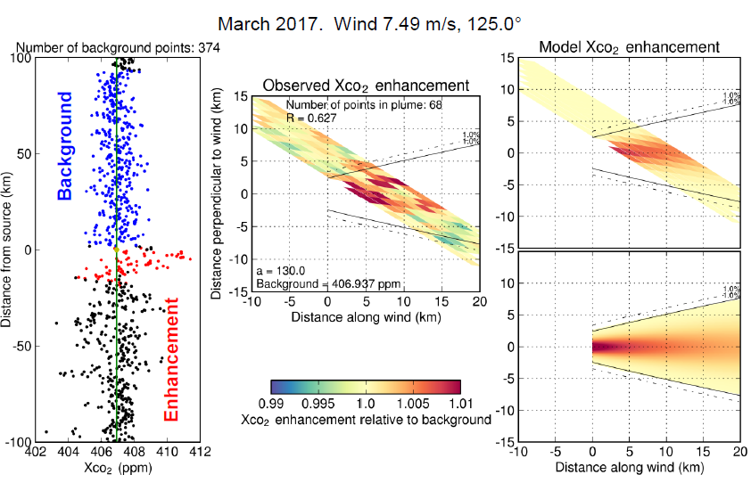
Advances in Quantifying Power Plant CO₂ Emissions from Space
Ray Nassar, Cameron MacDonald, Tim G. Hill, Chris McLinden, Debra Wunch, Dylan B.A. Jones, and David Crisp
Nassar et al. (2017, GRL) was first quantification of CO₂ emissions from individual power plants from space
OCO-2 versions 7 & 8 show good consistency, but small improvements with use of v8
New OCO-2 close flyby of Europe’s largest power plant is promising, but likely has topography-related bias requiring a correction during processing (v9)
Also described new statistical studies on US EPA data to try to quantify number of overpasses needed for accurate annual emission quantification

Slide 6
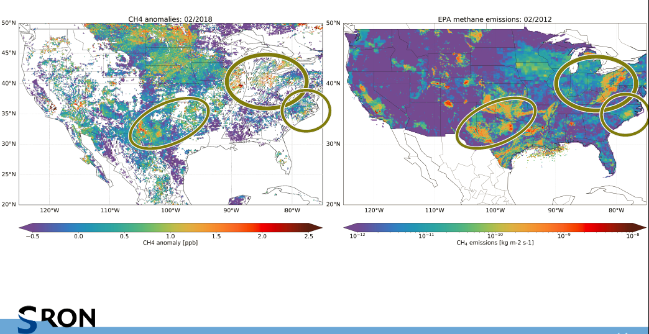
First methane retrievals and hotspot identification with TROPOMI
Haili Hu, Jochen Landgraf, Sudhanshu Pandey, Rob Detmers, Tobias Borsdorff, Joost aan de Brugh, Andre Butz, Ilse Aben, Sander Houweling, Coleen Roehl, Laura Iraci, Paul Wennberg, Otto Hasekamp
TROPOMI-GOSAT CH₄ comparisons suggest similar quality data
XCH₄ anomaly over the US shows clear evidence for CH₄ enhancement due to anthropogenic and wetland emissions

Slide 7
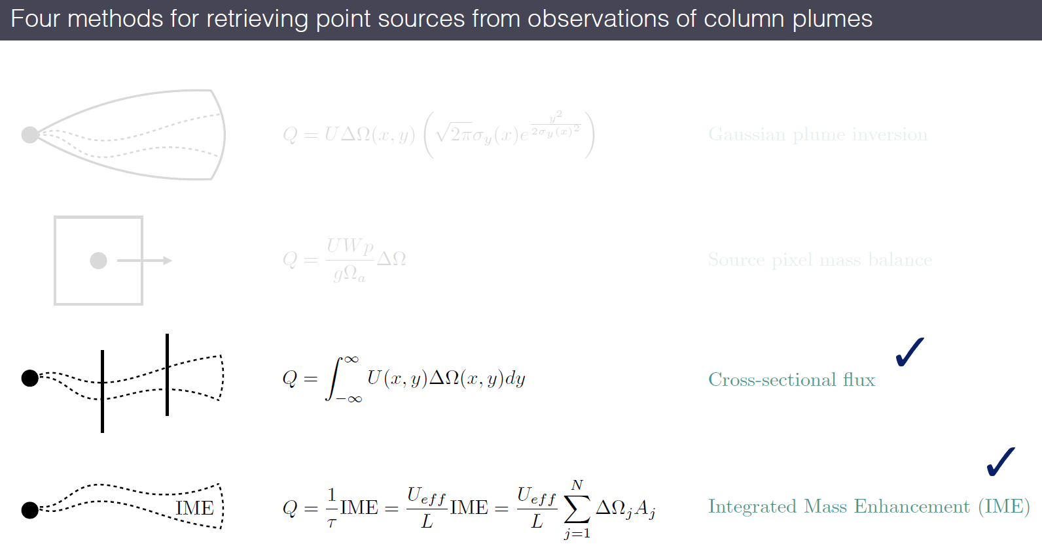
Quantifying methane point sources from fine-scale (GHGSat) satellite observation of atmospheric plumes
Daniel Varon, Daniel J. Jacob, Jason McKeever, Dylan Jervis, Berke O. A. Durak, Yan Xia, Yi Huang
Comparison of methods for retrieving point source emissions from column observations of plumes reveals the strengths and weaknesses of different methods
CO₂ and CH₄ may require different approaches due to typical scales: Power plant (CO₂) vs. leaks in infrastructure (CH₄)

Slide 8


GHGSat Inc. is a commercial Canadian entity that launched a 15 kg satellite with a Fabry-Perot Spectrometer in 2016 and plan to launch follow-on missions to establish a constellation. GHGSat-D images CH₄ and CO₂ columns at ~30x30 m², but precision is ~7.5% for CH₄ and ~30% for CO₂ (Durak et al. 2017, IWGGMS talk)
Bluefield is a US company with similar (although more ambitious plans) for a constellation of ~20 microsatellites using gas correlation spectrometers for high spatial resolution CH₄ observations

Slide 9
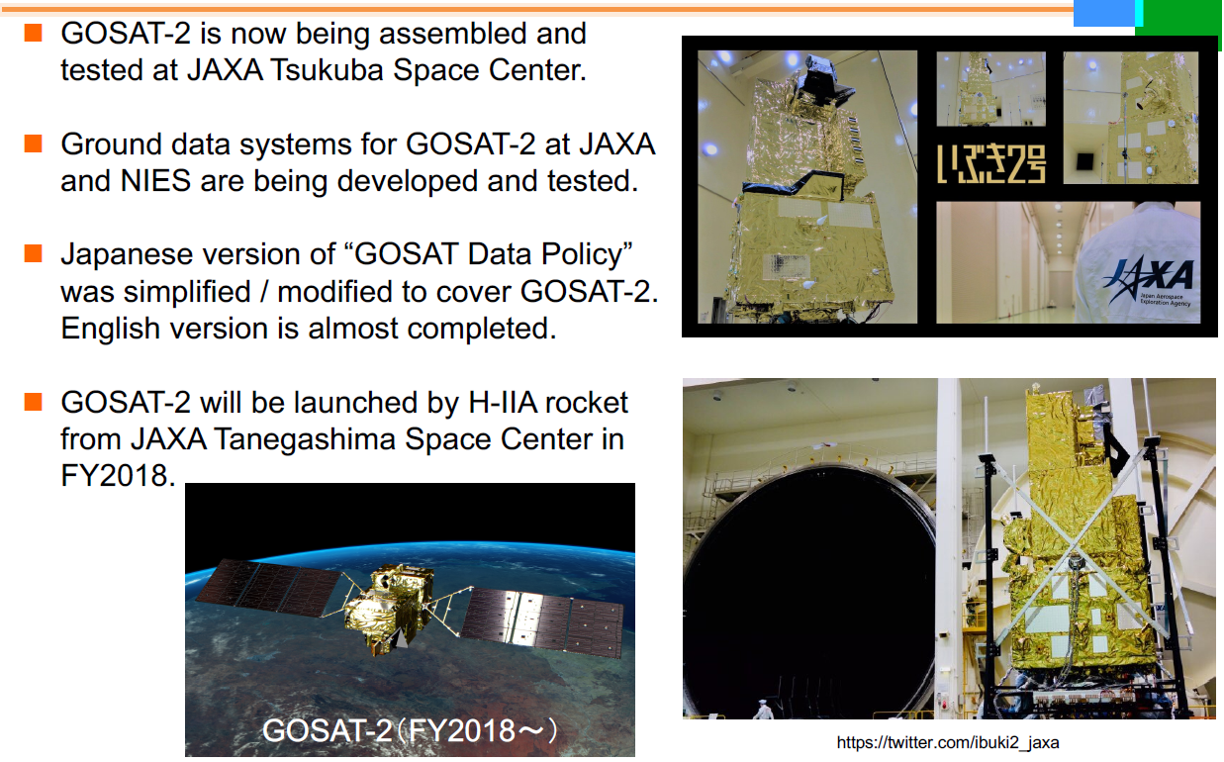
Recent Progress of GOSAT Project and Preparation for GOSAT-2
Tsuneo Matsunaga, Akihide Kamei, Shamil Maksyutov, Isamu Morino, Makaoto Saito, Hibiki Noda, Hirofumi Oyama, Fumie Kawazoe, Yukio Terao, and Osamu Uchino

Slide 10
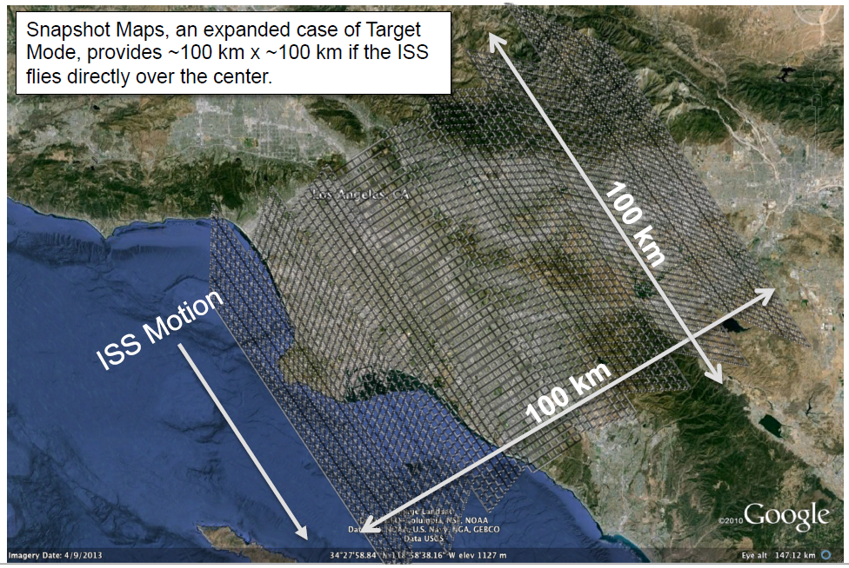

OCO-3: Science Objectives and Instrument Performance
Annmarie Eldering and the OCO-3 team including: Chris O’Dell, Tommy Taylor, Ryan Pavlick, Thomas Kurosu, Greg Osterman, Brendan Fisher, Rob Rosenberg, Richard Lee, Peter Lawson, Lars Chapsky, Shanshan Yu, Matt Bennett, Muthu Jengenathan, Gary Spiers, Ralph Basilio
Launch to ISS planned for Feb 2019 - SpaceX
More focus on anthropogenic using target and snapshot capabilities

Slide 11
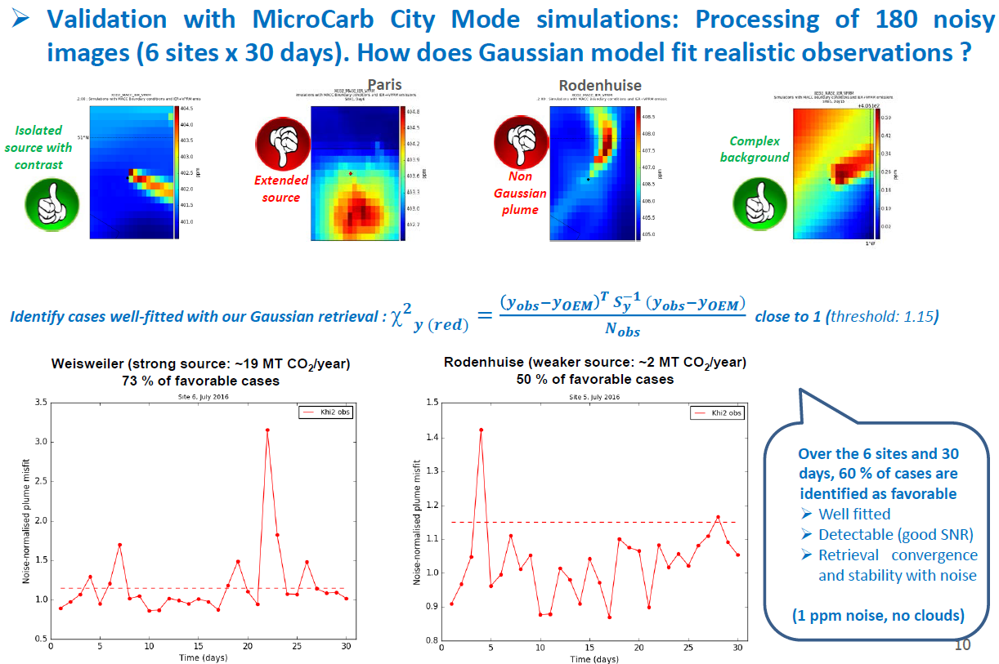
Plume detection and characterization from XCO₂ imagery: methodology and expected uncertainties on derived point source fluxes
Claude Camy-Peret, Pascal Prunet, François-Marie Bréon, Grégoire Broquet, Diego Santaren
Studies to inform decisions for MicroCarb city mode
Gaussian plume assumption can be reasonable for isolated sources but not for emissions from an urban area
also: An updated status of MicroCarb Project
Francois Buisson, Didier Pradines, Arnaud Varinois, Véronique Pascal, Pascal Prieur, Denis Jouglet

Slide 12



Anthropogenic CO₂ Monitoring Mission
State of play of the European Anthropogenic CO₂ Monitoring Mission
Yasjka Meijer, M.R. Drinkwater, J.-L. Bezy, A. Loescher, B. Sierk, B. Pinty, H. Zunker with contributions from many experts
The European Anthropogenic CO₂ Monitoring Mission: Instrument spectral sizing and the supporting aerosol instrument
Jochen Landgraf, Joost aan de Brugh, Lianghai Wu, Stephanie Rusli, Hein van Heck, Rob Detmers, Haili Hu, Otto Hasekamp, Andre Butz, Michael Buchwitz, Heinrich Bovensmann, Hartmut Bösch, Yasjka Meijer, Armin Löscher, Bernd Sierk
The European Anthropogenic CO₂ Monitoring Mission: Instrument requirements for space-borne measurement of greenhouse gas point sources (poster)
Bernd Sierk, Jochen Landgraf, Joost aan de Brugh, Michael Buchwitz, André Butz, Hartmut Bösch, Yasjka Meijer, Armin Löscher, Jean-Loup Bézy

Slide 13
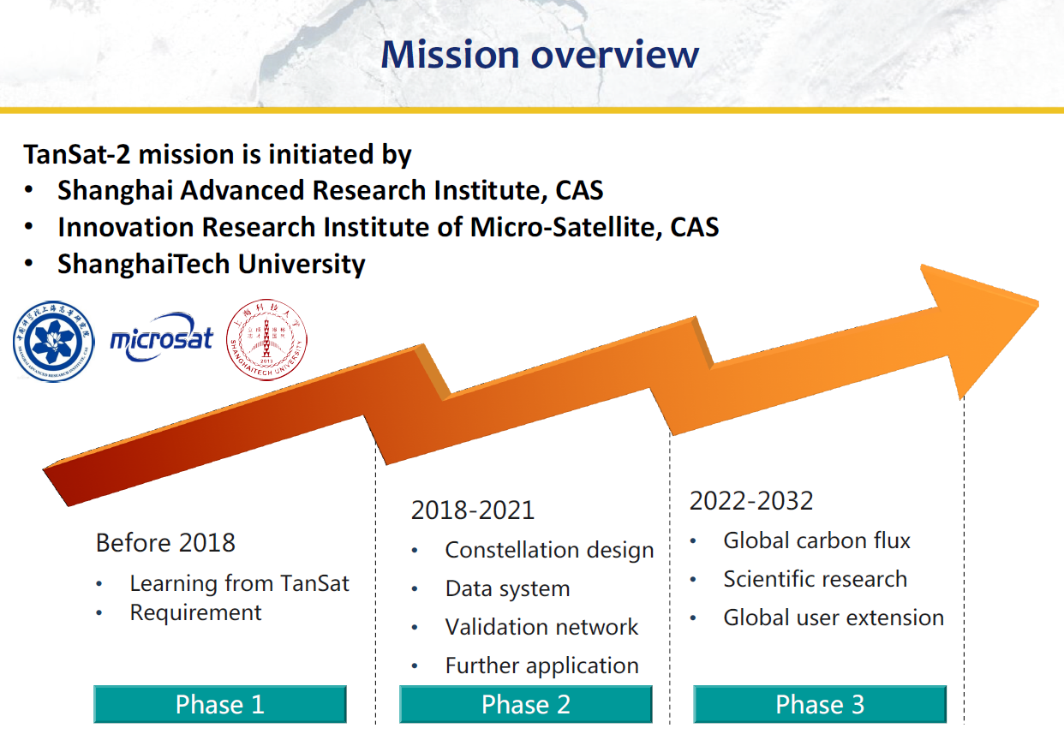
The next generation of Chinese greenhouse gas monitoring satellite mission: TanSat-2
Dongxu Yang, Yi Liu, Maohua Wang, Zengshan Yin, Zhaonan Cai, Lin Qiu, Longfei Tian and the TanSat-2 team
4-6 LEO satellites
> 100 km swaths
CO₂, CH₄, CO, O₃, NO₂, SO₂ at ~2x2 km²
Cloud & aerosol < 0.5 km

Slide 14
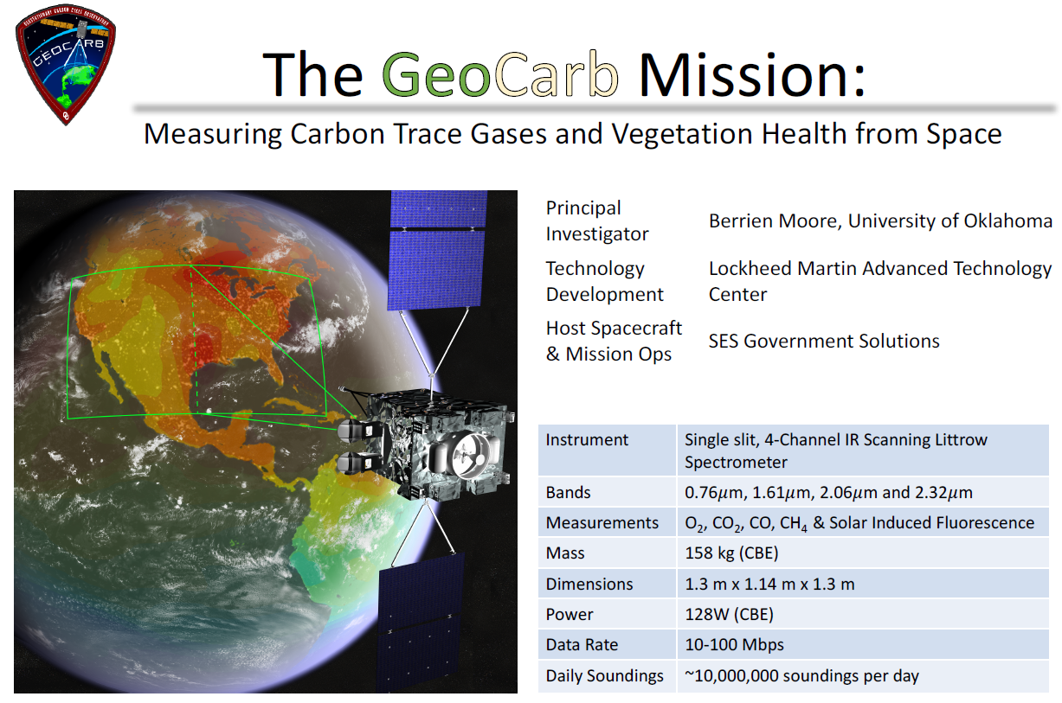
GeoCarb: Mission Status Update
Berrien Moore, Sean Crowell, Eric Burgh, Chris O’Dell, Greg McGarragh, Susan Kulawik, Cathy Chou, Brett Allard, Steve Merrihew, Dean Read, Shelly Finley, David Crisp, Annmarie Eldering, James Lemen, David Schimel and many others
Launch and Orbit Raising Jun 2022 - Mar 2023

Slide 15
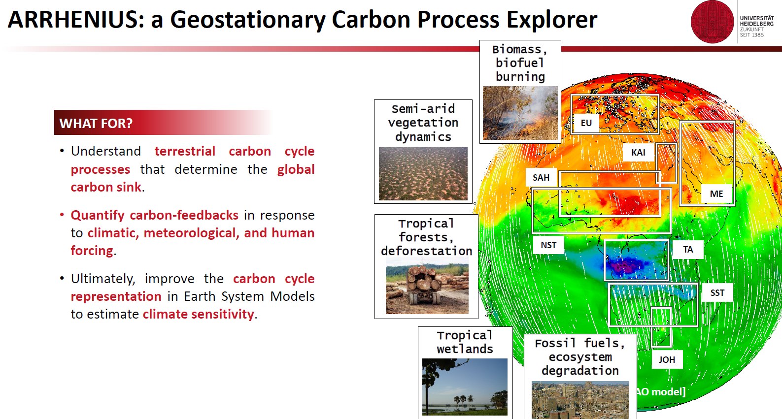
ARRHENIUS
A. Butz, P. Palmer, H. Bösch, Phillipe Bousquet, H. Bovensmann, D. Brunner, L. Bugliaro, D. Crisp, S. Crowell, J. Cuesta, B. Dils, E. Gloor, S. Houweling, J. Landgraf, J. Marshall, C. Miller, R. Nassar, J. Orphal, G. van der Werf
for Africa, Europe and the Middle East
Candidate for ESA’s EE-10, target launch late 2020s
Process-emphasis, diurnal cycle coverage with flexible and intelligent pointing for cloud avoidance

Slide 16
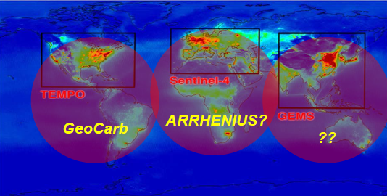
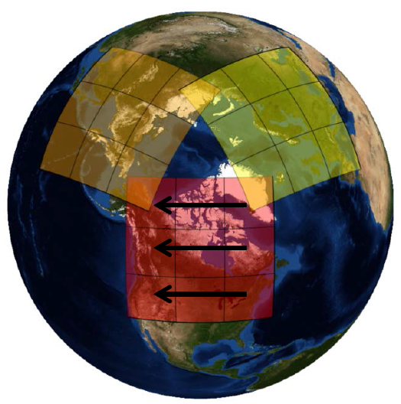

AIM-North: The Atmospheric Imaging Mission for Northern Regions
R. Nassar, C. McLinden, C. Sioris, J. Mendonca, L. Garand, S. Polavarapu, Y. Rochon, F. Kolonjari, A. Trichtchenko, C. Boisvenue, M. Johnson, C. Adams, G. Drolet, K. Walker, T. McElroy, D. Wunch, K. Strong, N. O’Neill, D.B.A Jones, R.V. Martin, Z. Vaziri, G. Singh, C. MacDonald, F. Grandmont, L. Moreau, J. Tamminen, C. Miller, W. Simpson
A LEO & GEO constellation for GHGs (or air quality) would leave a gap in diurnal sampling of high latitudes.
A highly elliptical orbit (HEO) mission could fill this gap and overlap with GEO coverage for intercalibration.
CO₂, CH₄, CO, SIF, O₃, NO₂, BrO, HCHO, SO₂ …
3x3 km² every ~90 minutes of daylight over land
Now in Phase 0, with potential launch in late 2020s

Slide 17
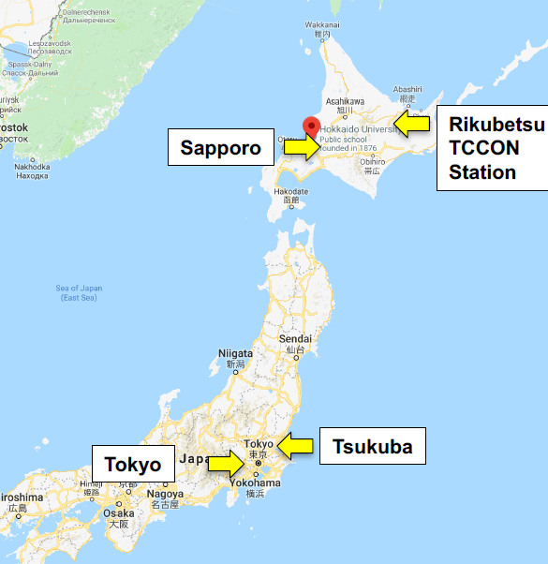

IWGGMS-15
Shortly after launch of GOSAT-2
Hokkaido University, Sapporo, Hokkaido, Japan
3 days during the week of June 3-7, 2019
Expect > 200 participants

