Slide 1

2018 European Commission CEOS Chair GHG Priority Workshop
Committee on Earth Observation Satellites
Mark Dowell
mark.dowell@ec.europa.eu

Slide 2
CEOS Chair 2018 GHG Priority
Specific Chair Initiative : Laying the foundation for an international CO2 and GHG monitoring system
Three specific activities are foreseen for advancing this effort in 2017-2018:
Facilitate the completion and follow-on activities of the AC-VC whitepaper on defining an optimum constellation for CO2 and GHG monitoring, including the joint competences of CEOS and CGMS, and in the general framework of the continued implementation of the CEOS Carbon Strategy
Advance the relationship with CGMS for an operationally implemented and sustained observation capability. Consider establishing a formal working relationship between CEOS and CGMS as with the successful ongoing relationship on Systematic Observations of ECVs in support of UNFCCC.
Place the space segment in the broader context of a fully sustained system for CO2 monitoring. Individual CEOS Agencies have counterparts in their individual countries/regions who have responsibility for Inventories, the required modelling, in-situ infrastructure and the ground segment elements.

Slide 3
CEOS Chair Workshop - GHG
On “placing the space segment in the broader context of a fully sustained system for CO2 monitoring”
The EC proposes to organise a dedicated discussion workshop:
Bringing together these different stakeholders to define best practices and synergies
Exploring possibilities for common approaches to some of the system development.
This would also require the strong engagement of CGMS as well as CEOS Associate members such as the WMO.
June 18-19th European Commission – JRC , Ispra (IT)
9 CEOS Agencies confirmed attendance 2-4 people each, 3 CEOS Associates – around 40 attendees in total

Slide 4
General comments
Workshop organised from a CEOS – Space Agency point-of-view
Emphasis of workshop is on extracting and documenting best practices on interactions between CEOS Agencies/Associates, and counterparts working on modelling, in-situ and inventory,
Identify open issues and have some specific recommendations on efforts that CEOS Agencies could target in the future.
This should build open the existing recent efforts both within CEOS (i.e. the AC-VC Whitepaper on GHG Constellation) and efforts lead by other international efforts (e.g. WMO/IG3IS, GEO-C, GCOS, UNFCCC/SBSTA, IPCC-TFI)

Slide 5
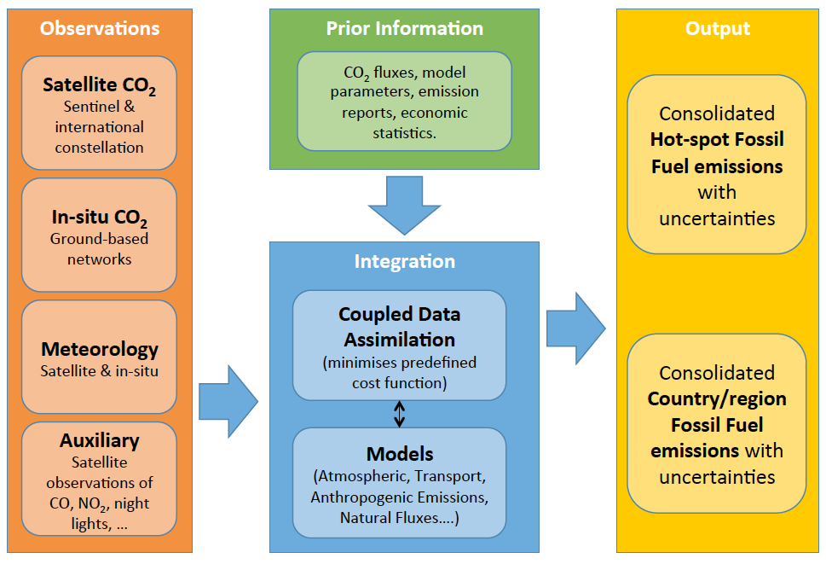
Overview of the Core Elements of the Copernicus CO₂ Emission Monitoring & Verification Support capacity

Slide 6
Action in GCOS IP 2016
GCOS-200
“Specifically CEOS and CGMS will undertake, over the next few years, dedicated preparatory work in a coordinated international context…:
The definition of an architecture of space component elements to address the requirements of a CO₂ and GHG monitoring system , … This will provide a global holistic perspective both from the point of view of existing and planned space segment assets as well and that for an optimum global constellation.
The documentation of best practices on the relationships between individual space agencies and their counterparts working on the modelling aspects, the inventories and in-situ data provision, …
The further consolidation of partnerships and collaborations between the relevant international entities including: the relationship between CEOS and CGMS on the space component aspects, the partnership with the WMO and GEO on the broader framework, … and finally the relationships with GCOS itself, UNFCCC and IPCC TFI process in better defining the role for space-based observation in the inventory guideline process.”

Slide 7
COP-23/SBSTA-47
Considerable support in the RSO negotiations from Japan and EU delegations
Especially for Conclusions 9 & 12

Slide 8
CEOS Chair GHG Workshop
Monday 18th June
Tuesday 19th June
Introduction & Objectives
Review of Previous Day
International Programmes:
WMO, GCOS, GEO
Break out Groups:
Space-Modelling,
Space-In-situ,
Space-Inventory
AM
AM
Ongoing Activities:
AC-VC Whitepaper, Inversion Modelling Workshop, IPCC TFI, Copernicus…
Agencies Perspectives:
CNES, CSA, CMA, DLR, NOAA, NASA,
JAXA, EU (EC, ESA, EUM), UKSA
Reports from Breakout Groups
PM
PM
Consolidation of Recommend-
ations and Identified
Best Practices
General & Crosscutting Aspects: discussion on issues such as terminology
System defn., needs and requirements
Conclusion and Follow-up

Slide 9
Guidelines:
2018 European Commission CEOS Chair GHG Priority Workshop
Committee on Earth Observation Satellites
Mark Dowell
mark.dowell@ec.europa.eu

Slide 10
Agency Perspectives
  Presentations from individual agencies on their perspective on working with different communities (modelling, insitu, inventory) wrt GHG monitoring and analysis
  Presentations should (also) address:
    Agency programmatic state-of-play on GHG missions and plans
    Ongoing activities with modelling community
    Ongoing activities with In-situ community
    Any existing dialogue with Inventory community
    Engagement/Involvement at international level (bilateral/multilateral)
    Target/focus of any relevant research funding

Slide 11
Crosscutting issues and Best Practices
Questions/issues to address (not exhaustive):
  Terminology/Scope: different "levels" of acceptable terminology, monitoring capability, support capacity for verification, verification capacity, validations versus verification. Is there a common denominator that can be acceptable in international/multilateral discussions?
  Sources and view on needs and requirements: can we agree on common needs/requirements for system output and sources of observational requirements (e.g. GCOS)?
  High-level view on System Architecture: can we agree on a common representation of System Architecture?
  Identify critical elements sustainability of space segment contribution to operational system (operational vs. research satellites)
  Centralised repository of QC'ed data: is there a need for a common (centralised) facility for maintaining QC'ed dat from the constellation
  Moderator: M. Dowell Rapporteur: R. Husband

Slide 12
Breakout: Space - Modelling
Questions/issues to address (not exhaustive):
OSSE experiments: requirements, prioritisation, "division of labour"
Generic issues on joint assimilation of satellite and in-situ observations
Issues relating distinguishing natural and anthropogenic signal
Dependency on transport models, mitigating impact of uncertainty
Requirement of ancillary data (satellite): natural carbon cycle land-ocean, SIF, weather, night-lights. Common datasets ?.
Moderator R. Engelen Rapporteur – R. Husband.

Slide 13
Breakout: Space - Insitu
Questions/issues to address (not exhaustive):
Access to in-situ data on operational timescales: can/should space agencies "invest" in this?
Prioritize in-situ cal/val for GHG (virtual) Constellation
Centralised repository of QC'ed data: is there a need for a common (centralised) facility for maintaining QC'ed data from the constellation (contd from Crosscutting)
Additional in-situ requirements from system, harmonisation activities? Is the way they are current provided fit-for-purpose.
(Additional?) Needs for international standards – e.g. WMO, ISO
  Moderator: David Crisp Rapporteur: Matt Steventon

Slide 14
Breakout: Space - Inventory
Questions/issues to address (not exhaustive):
Interactions with the inventory community - what has been successful what hasn't?
Links between CEOS agencies – national inventory agencies and UNFCCC, have we made all appropriate links e.g. IPCC-TFI, SBSTA/RSO
Are there developments or plans for Decision Support Systems where we can foresee joint efforts? Role for CEOS Agencies?
Is there a need for standards/formats in how inventory information is used to establish priors for the systems?
Should CEOS push/promote the need for harmonsised gridded inventory dataset? (e.g.EDGAR)?
Moderator: G. Maenhout/Hugo DvD Rapporteur: G. Maenhout/Hugo DvD

Slide 15
Cross-cutting issues:
2018 European Commission CEOS Chair GHG Priority Workshop
Committee on Earth Observation Satellites
Mark Dowell
mark.dowell@ec.europa.eu

Slide 16
Crosscutting issues and Best Practices
Questions/issues to address (not exhaustive):
  Terminology/Scope: different "levels" of acceptable terminology, monitoring capability, support capacity for verification, verification capacity, validations versus verification. Is there a common denominator that can be acceptable in international/multilateral discussions?
  Sources and view on needs and requirements: can we agree on common needs/requirements for system output and sources of observational requirements (e.g. GCOS)?
  High-level view on System Architecture: can we agree on a common representation of System Architecture?
  Identify critical elements sustainability of space segment contribution to operational system (operational vs. research satellites)
  Centralised repository of QC'ed data: is there a need for a common (centralised) facility for maintaining QC'ed dat from the constellation
  Moderator: M. Dowell Rapporteur: R. Husband

Slide 17
Terminology/Scope
“Support of National Inventory Preparation”
“An Operational Anthropogenic CO2 Emissions Monitoring & Verification Support Capacity”
“USE OF SATELLITE GREENHOUSE GASES OBSERVATION DATA FOR VERIFICATION OF GREENHOUSE GASES EMISSION INVENTORIES”

Slide 18
Overview of the Core Elements of the Copernicus CO₂ Emission Monitoring & Verification Support capacity

