Slide 1
ESA activities in measuring GHGs
Yasjka Meijer for ESA
18 June 2018

Slide 2
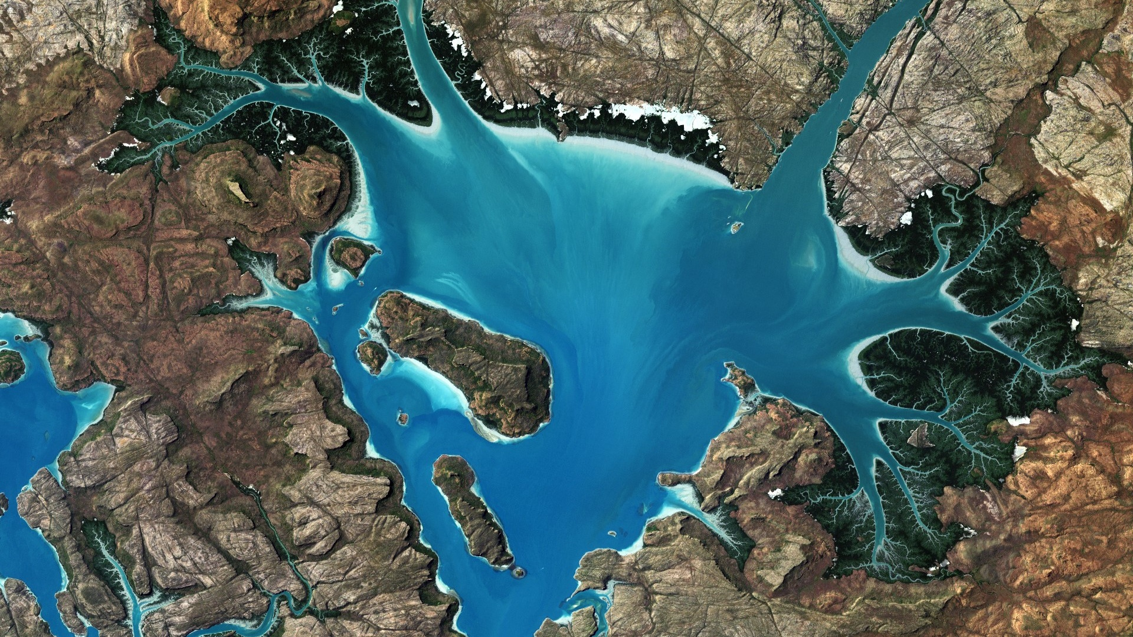
Copernicus Space Component

Slide 3
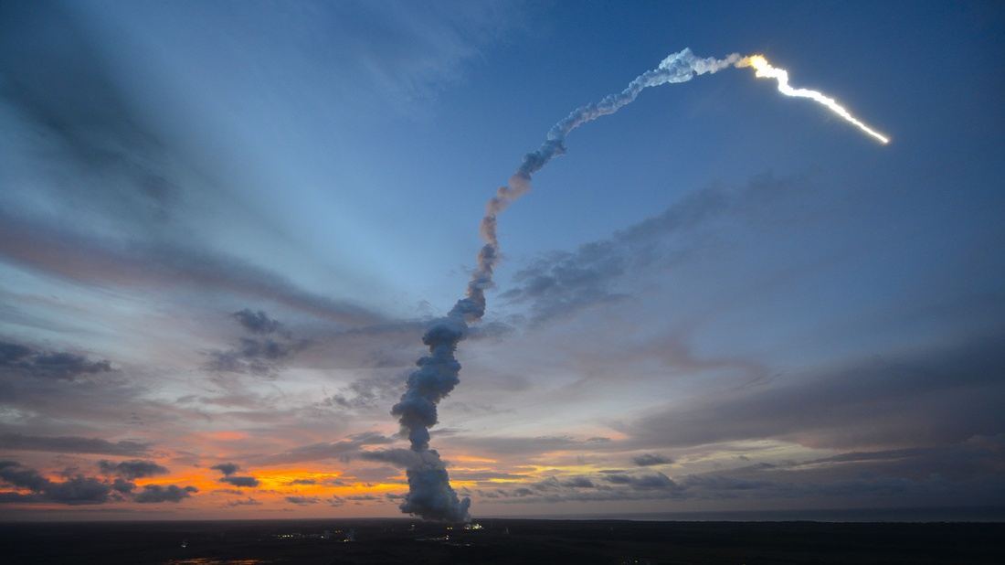



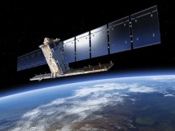
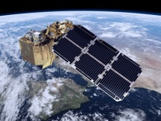
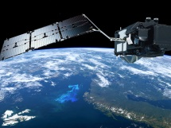
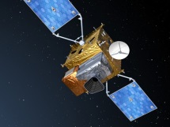
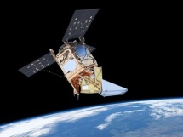
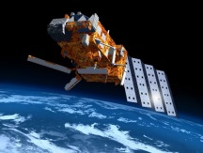
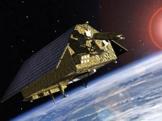

Copernicus Sentinel missions
S-1
S-2
S-3
S-4
S-5P
S-5
S-6
Radar
High Resolution Optical
Medium Resolution Optical & Altimetry
Atmospheric Chemistry (GEO)
Atmospheric Chemistry (LEO)
Atmospheric Chemistry (LEO)
Altimetry
A
3 Apr. 2014
A
23 Jun. 2015
A
16 Feb. 2016
A
2021
A
13 Oct. 2017
A
2021
A
2020
B
25 Apr. 2016
B
6 Mar. 2017
B
25 Apr. 2018
B
2027
B
2027
B
2025
Notes:
Note S-1 – S-3 are series of satellites to provide operational continuity in monitoring the components of the Earth‘s system over time – through 2030 and beyond.

Slide 4
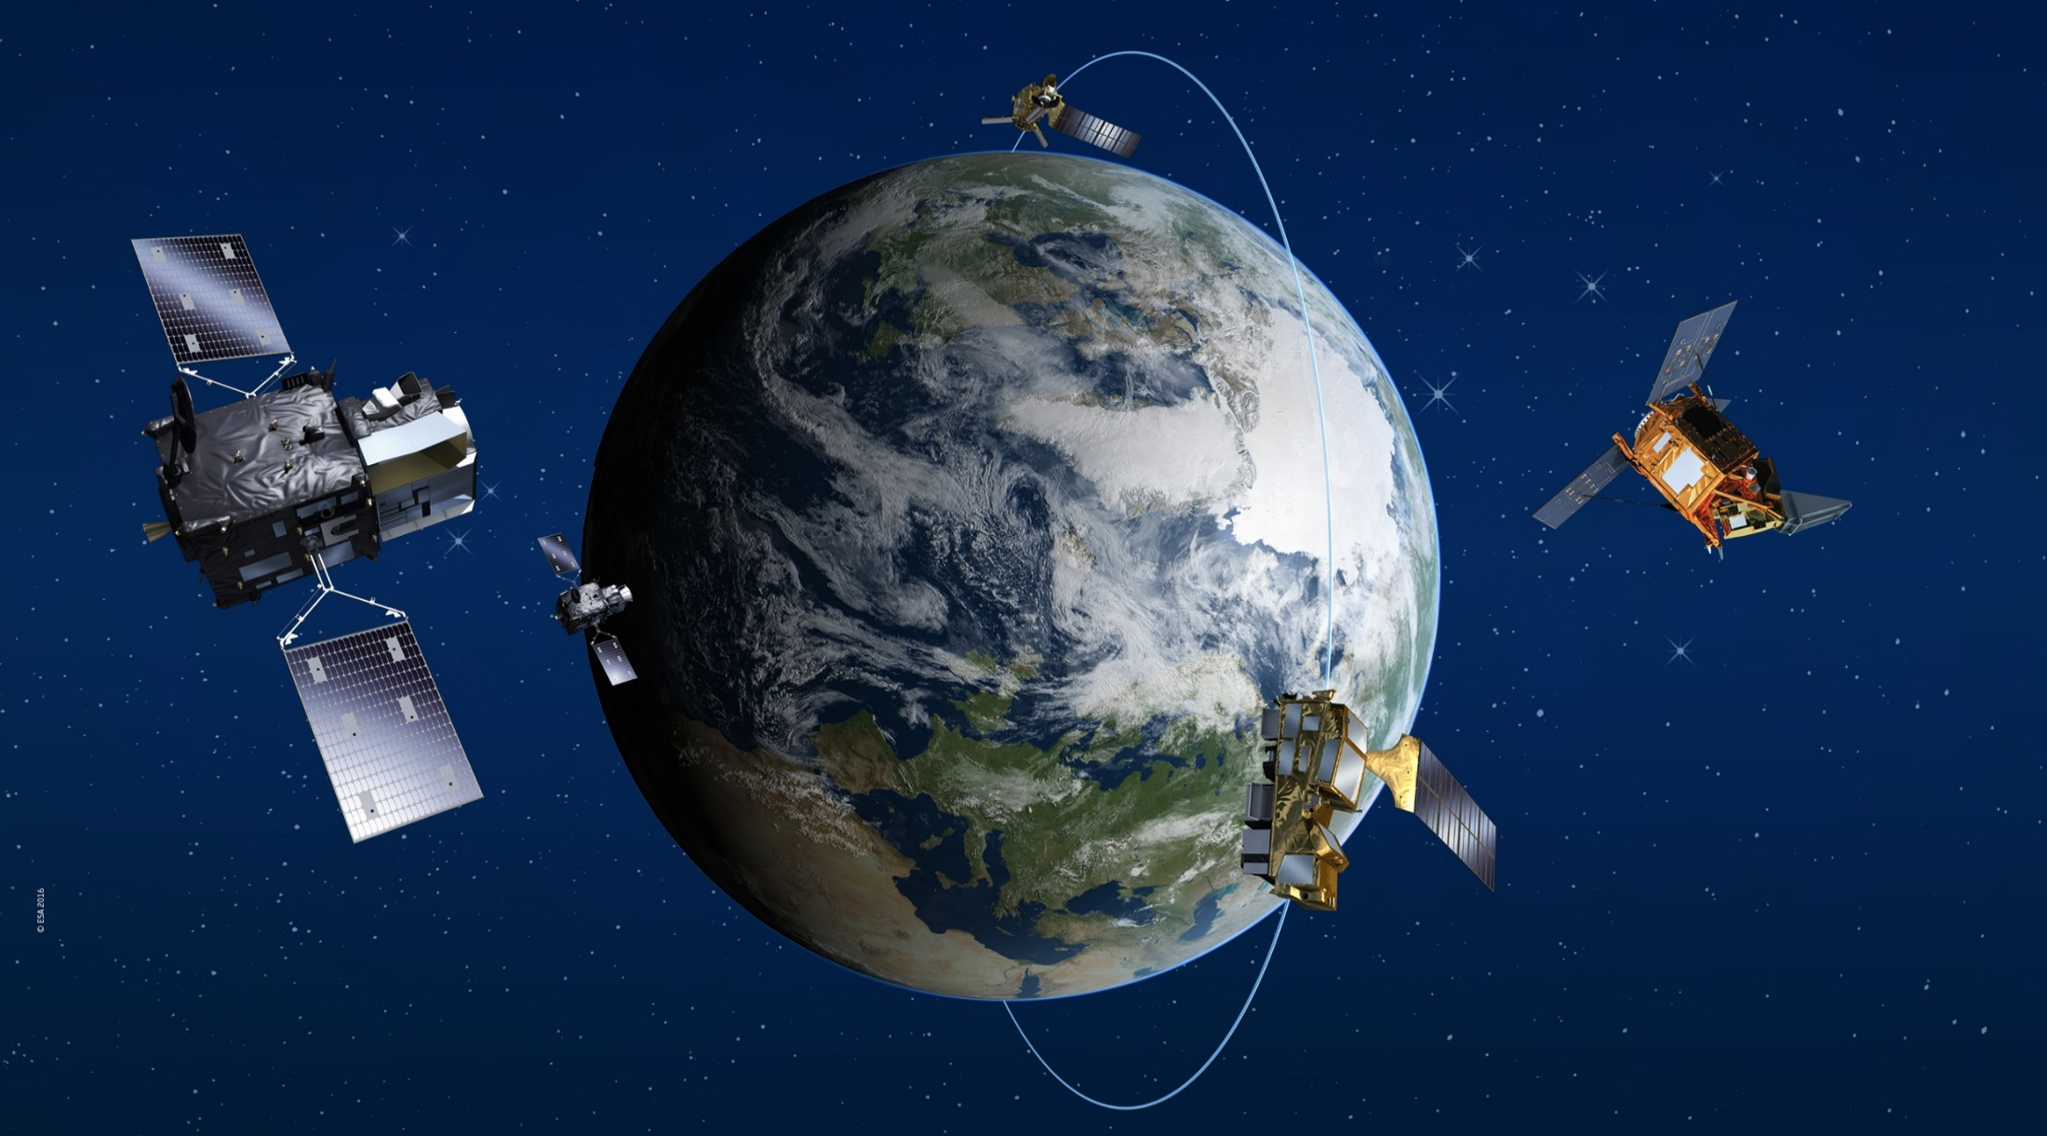




The Atmospheric Sentinels
Sentinel-4
Hosted on MTG-S
Sentinel-5 Precursor
Sentinel-5
Hosted on EPS-SG
Sentinel CO₂ Mission (Phase A)
Notes:
“EUMETSAT” deleted, as funded 1/3 though ESA MS, to be kept neutral

Slide 5
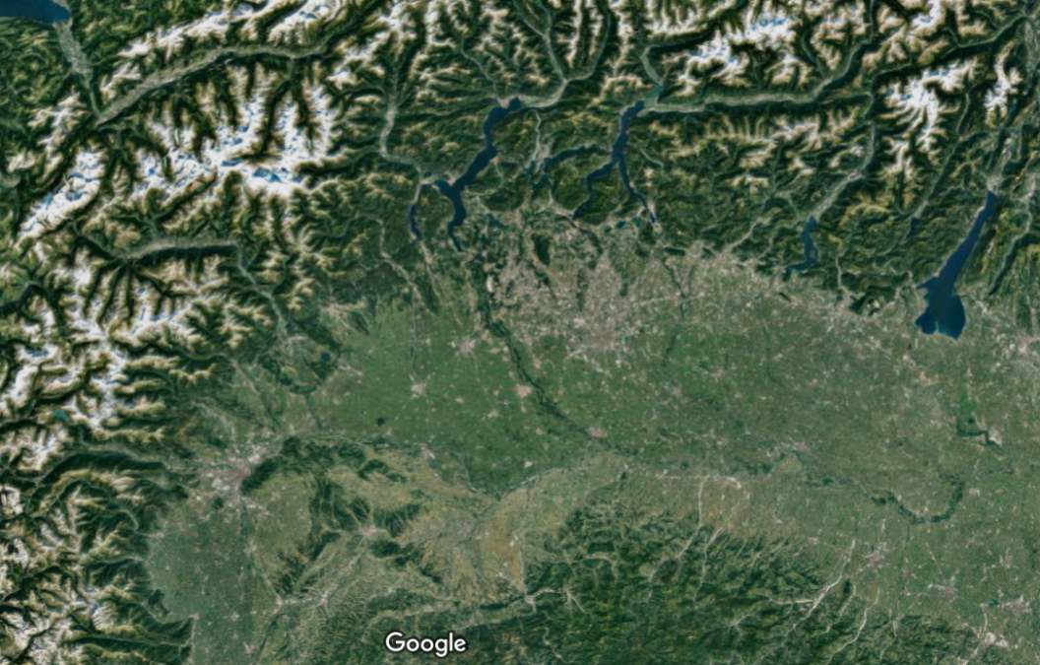
Sentinel-5p: Improved Spatial Resolution
SCIAMACHY
S5P/TROPOMI
OMI
GOME-2
GOME
Po valley, Italy (Google)
S-5P vs SCIAMACHY, GOME-2, OMI:
Smaller pixels: 3.5x7 km² and 7x7 km²
Larger swath-width (2600 km) → daily global coverage
~1.5 million spatial samples/orbit

Slide 6
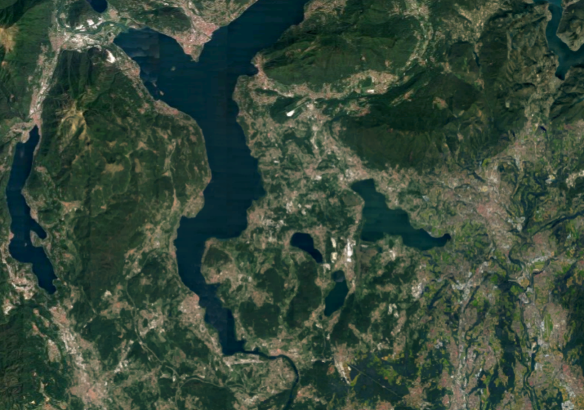
Sentinel-5p: Improved Spatial Resolution
S5P/TROPOMI
Pixel
7 km
3.5 km
Ispra and Lago Maggiore (Google)
S-5P vs SCIAMACHY, GOME-2, OMI:
Smaller pixels: 3.5x7 km² and 7x7 km²
Larger swath-width (2600 km) → daily global coverage
~1.5 million spatial samples/orbit
Notes:
Beijing Airport

Slide 7

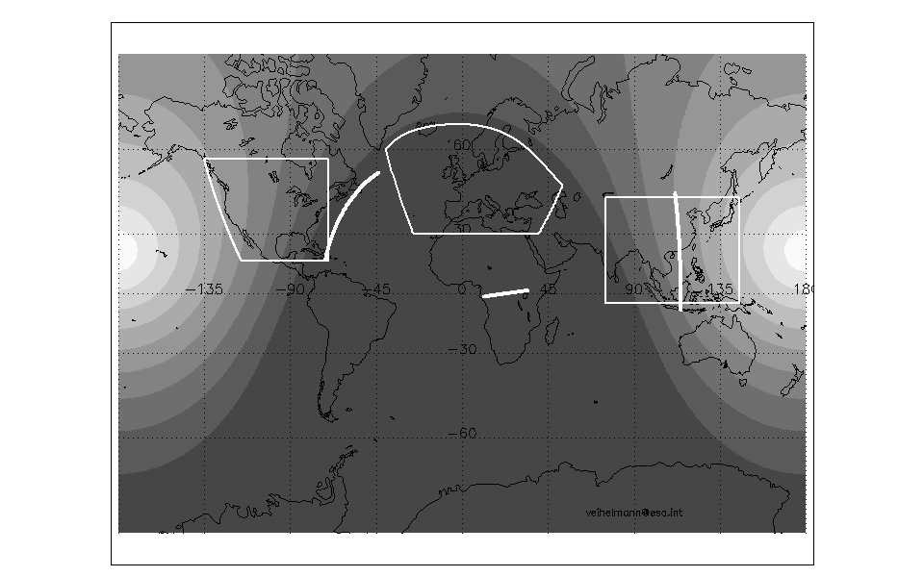
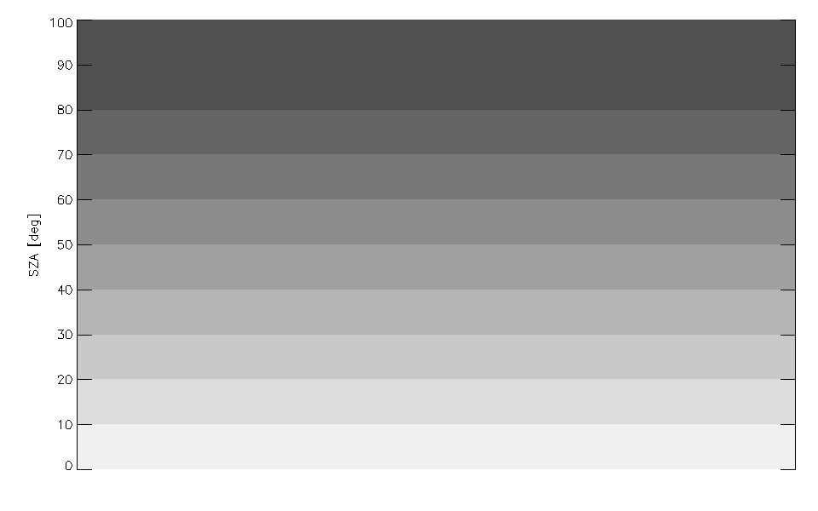

Sentinel GHG & Its Related Products
Sentinel-5 Precursor:
From 2017 – on-going
Sentinel-5 on MetOp-SG (EUM):
Launch readiness in 2021
Product | Spatial | Temporal
CH₄ | 7 x 7 km² | Daily revisit
CO | ” ” | ” ”
NO₂ | 3.5x7 km² | ” ”
Vegetation SIF | ” ” | ” ”
Product | Spatial | Temporal
CH₄ | 7x7 km² | Daily revisit
CO | ” ” | ” ”
NO₂ | ” ” | ” ”
Vegetation SIF | ” ” | ” ”
Sentinel-4 on MTG-S (EUM):
Launch readiness in 2022
CEOS
Virtual
Constellation
Product | Spatial | Temporal
NO₂ | 8x8 km² | Hourly Europe
Vegetation SIF | ” ” | ” ”
TEMPO
Sentinel-4
GEMS
Solar zenith angle [°]
Sentinel-5P

Slide 8
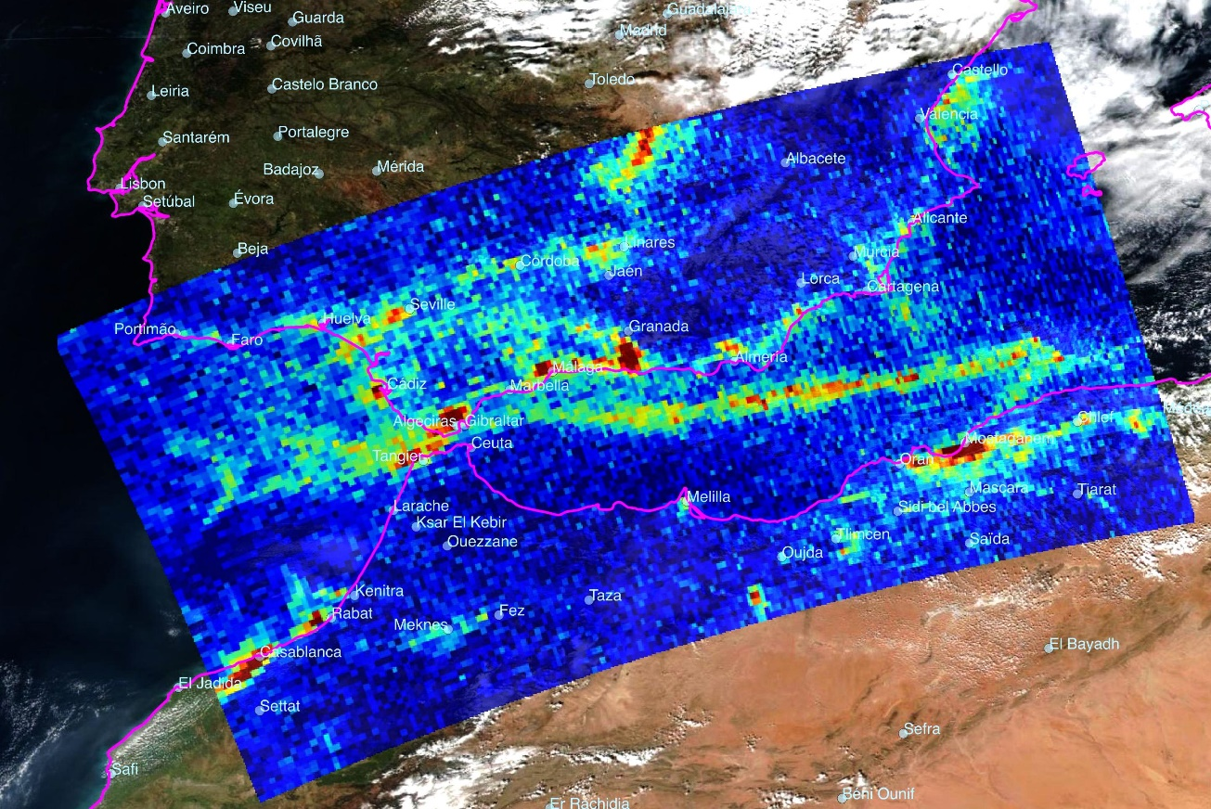
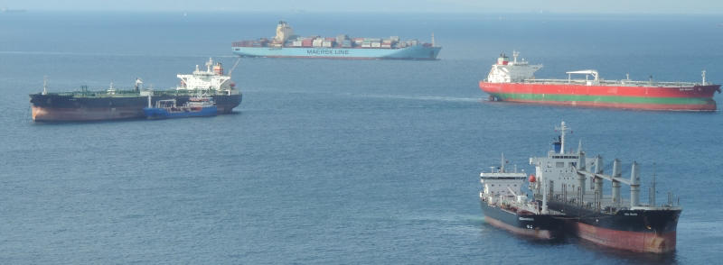
Sentinel-5P: Nitrogen Dioxide NO₂ Ship Tracks
Strait of Gibraltar
on 20 Feb. 2018
(KNMI/NSO/ESA)
Notes:
Highlight Shiptracks

Slide 9
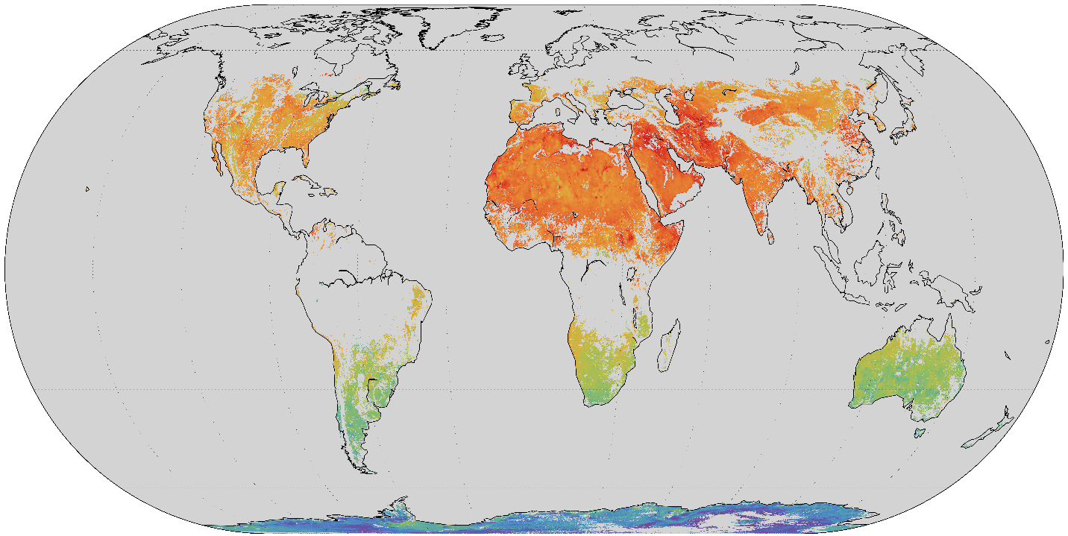
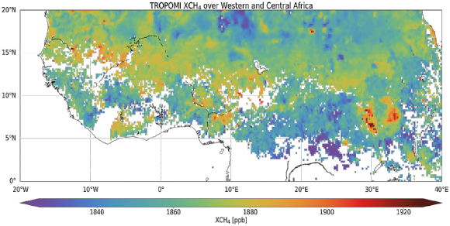

Sentinel-5P: Methane Preliminary Results
Nov/Dec 2017
CH₄ anomalies in Africa from biomass burning & wetland emissions
No glint processing to date
Planned data release in October

Slide 10
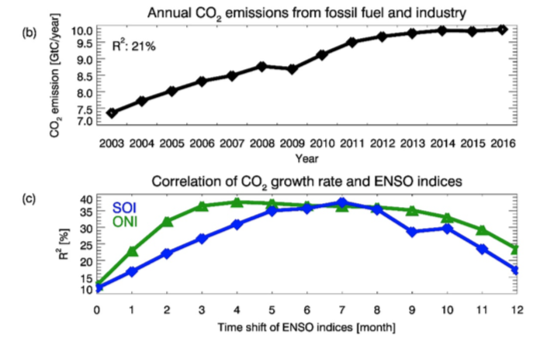
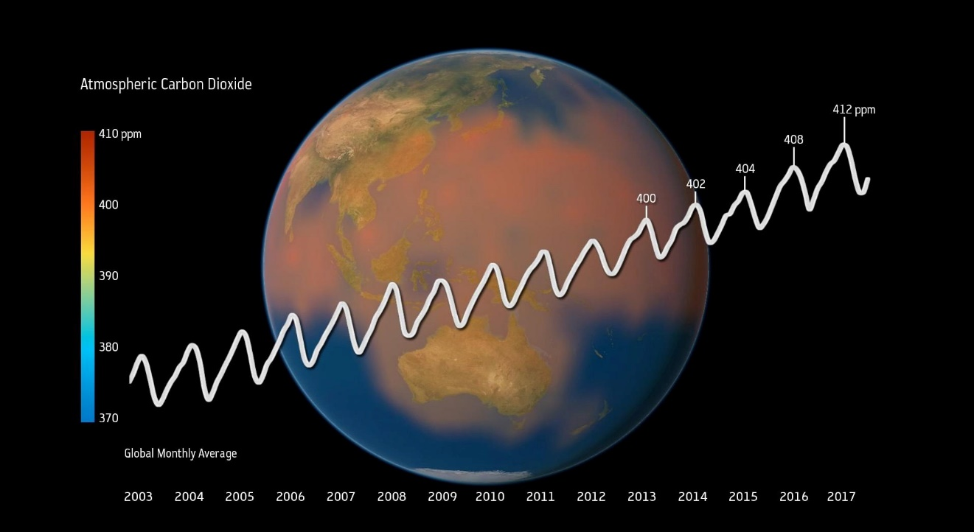
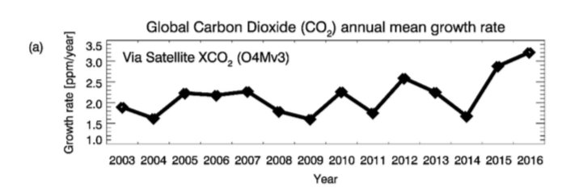
GHG-CCI: Satellite observation of CO₂ growth rates
+9%
in just 15 years time
© ESA CCI / Planetary Visions, 21 Feb. 2018
Michael Buchwitz1, Maximilian Reuter1, Oliver Schneising1, Stefan Noël1, Bettina Gier1,2, Heinrich 5 Bovensmann1, John P. Burrows1, Hartmut Boesch3,4, Jasdeep Anand3,4, Robert J. Parker3,4, Peter Somkuti3,4, Rob G. Detmers5, Otto P. Hasekamp5.
Computation and analysis of atmospheric carbon dioxide annual mean growth rates from satellite observations during 2003-2016
Notes:
Computation and analysis of atmospheric carbon dioxide annual mean growth rates from satellite observations during 2003-2016
This study estimate by how much the impact of ENSO (El Niño Southern Oscillation) dominates the impact of fossil fuel burning related emissions in explaining the variance of the atmospheric CO2 growth rate.
In this study, we analyze a new satellite XCO2 data set covering 14 years (2003-2016), this new data set confirms record large growth rates around 3 ppm/year in 2015 and 2016, which are attributed to the 2015/2016 El Niño.
Anthropogenic emissions of CO2, primarily from fossil fuel combustion, have increased the atmospheric CO2 mixing ratios at the surface by more than 40% since pre-industrial times
On average less than half of the emitted CO2 remains in the atmosphere but this “airborne fraction” varies substantially from year to year : years having higher temperatures during the vegetation growing season are
associated with larger growth rates in atmospheric CO2 at northern mid-latitudes.
The time series for the three latitude bands shown in have very similar slopes but differ in the amplitude of the seasonal cycle, which reflects the latitudinal dependence of uptake and release of atmospheric CO2 by the terrestrial biosphere
The searchers conclude that the human emissions explain 27% of the variance of the growth rate and that ENSO,as quantified by the
25 SOI, explains 41%
This analysis shows that the ENSO impact on CO2 growth rate variations dominates over that of human emissions throughout the period 2003-2016
Twitter post suggestion
“The GHG XCO2 data reveals suprising result on the correlation between El Nino southern Oscillation (ENSO) and atmospheric CO2 growth rate “

Slide 11
CSC Expansion

Slide 12
High Priority Candidate Missions (HPCMs)
Anthropogenic CO₂ | Monitoring Anthropogenic CO₂ Emissions in support of GHG Monitoring and Verification
High Spatial/Temporal Res. Land Surface Temperature | Monitoring Emissivity and Evapotranspiration to support Agricultural productivity and Water Resource Management
Polar Ice & Snow Topography | Land & Sea Ice Thickness Change (incl. sea, river and lake level) in support of C3S and CMEMS
Passive Microwave Imaging | Sea Ice Concentration and Sea Surface Temp. (others incl. soil moisture and Snow Water Equivalent) in support of operational ice/marine services and EU Arctic Policy
Hyperspectral Imaging | Agriculture/food security, forestry, raw materials, soil properties and biodiversity (others incl. water quality)
L-band SAR | Forestry, Natural Hazards, Crop type & Precision Farming, Sea ice type, ice motion (others incl. soil moisture and InSAR water extraction)

Slide 13

Candidate Copernicus Expansion Mission
End-to-end System requirements to monitor CO₂
Detection of emitting hot spots such as megacities or power plants.
Monitoring the hot spot emissions to assess emission reductions/increase of the activities.
Assessing emission changes against local reduction targets to monitor impacts of the NDCs.
Assessing the national emissions and changes in 5-year time steps to estimate the global stock take.
km &
daily scales
Accuracy
Space & Time
200-400 t/year
Notes:
The CO2 monitoring and verification system follows as modus operandus the following 4 steps "1) detection of hot spot, 2) quantification of hot spot emission and monitoring this over time, 3) assessing the sum of the changes of the hot spot emissions belonging to a given country (allowing to follow implemented measures on the largely emitting facilities), 4) monitoring the change in emission pattern to identify potential shifts or new hot spots and evaluate the trend of the country emissions (most challenging). While the first step requires high resolution to resolve the hot spot emissions (km, daily), the last step requires large coverage and no longer high spatial and temporal resolution. On the contrary, the accuracy needed to measure the changes in emissions are becoming more demanding for step 3 and 4 when covering all emissions for an entire country, which is not only composed of hot spots. To measure the emission changes of a European country (in average only 1% relative change per year, mounting to an averaged 10% change over 5 year), the system needs to distinguish a few hunderd ton of CO2 emissions per year for the gridcells/pixels composing the country.
200 tons per yr for the grid cell area of 0.1degx0.1deg corresponds to a change of 1% of the total inventory of Belgium, which is the expected change of the Belgian inventory over 5 yr.
Added IASAI prototype CO2… advantage is that it is based on IASI which is the L1 reference instrument for IR L1.

Slide 14
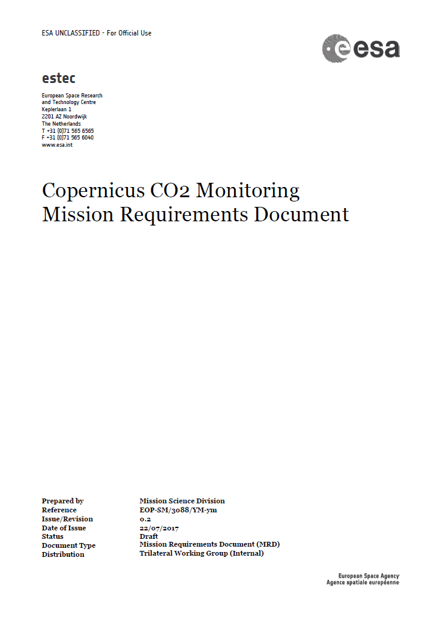
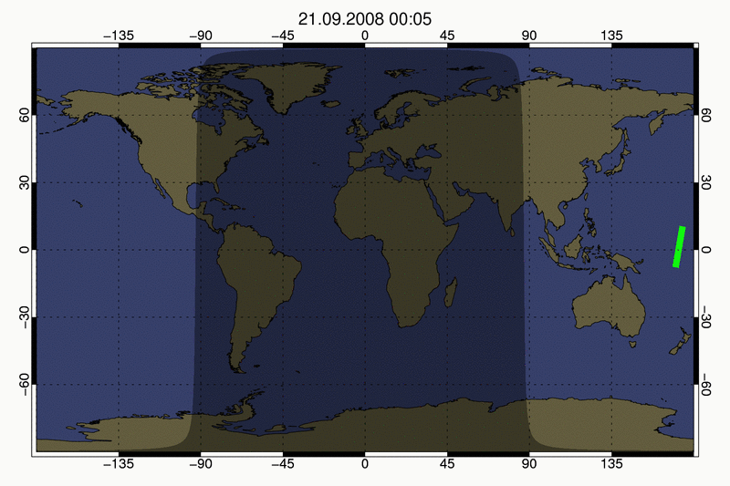
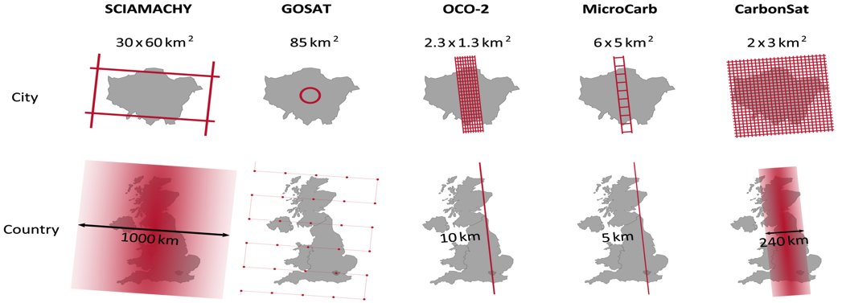
CO₂ Monitoring – Space Segment Requirements 1/2
Mission requirements for XCO₂:
Spatial resolution 4 km²
Revisit around 2–3 days (poleward of 40 deg)
XCO₂ precision: 0.5 – 0.7 ppm
Systematic bias < 0.5 ppm
MRD
OCO-2 &
TanSat
CO2M
2x2 km²

Slide 15
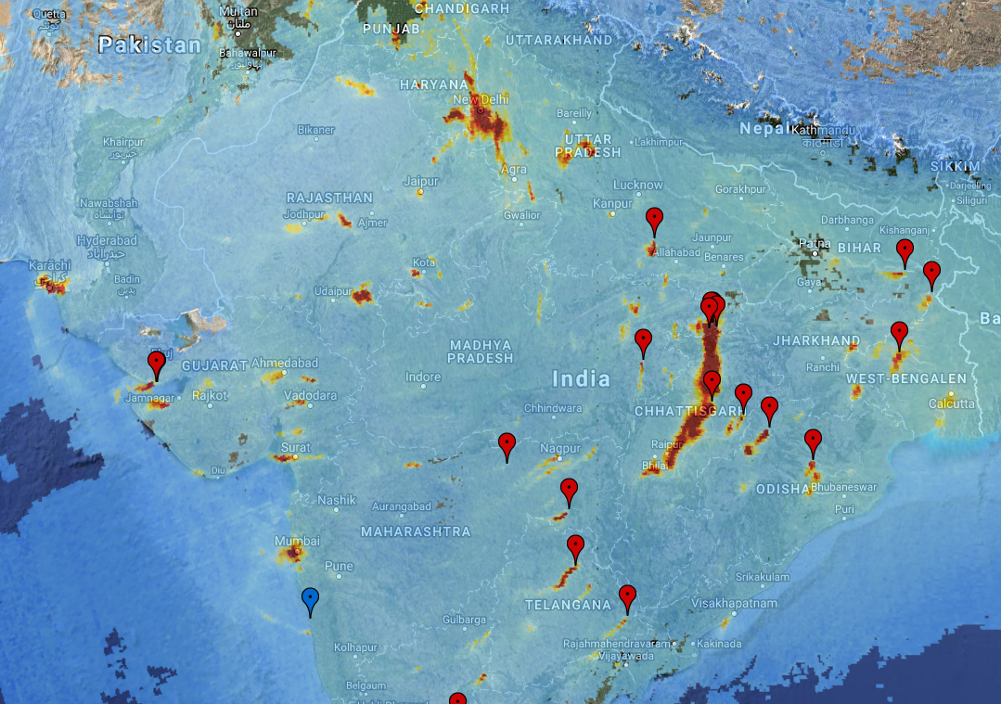
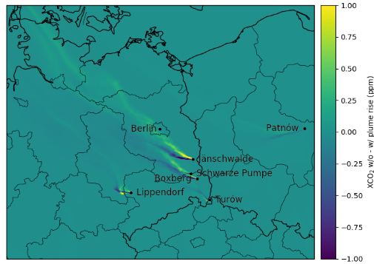
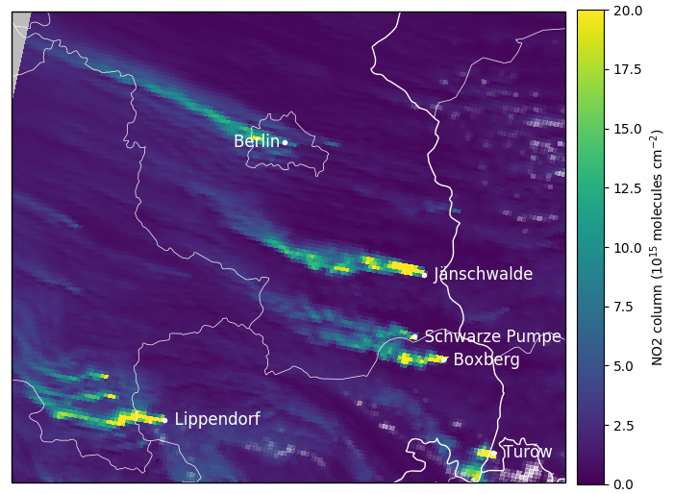
CO₂ Monitoring – Space Segment Requirements 2/2
Auxiliary data:
NO₂ plumes for CO₂ plume location, height,
and to select best wind field for inversion
→ more & better CO₂ emission estimates
Spatial resolution 4 km² (as for CO₂)
NO₂ precision: 1–2·10¹⁵ molec/cm²
Multi-angle polarimeter for light path correction
Cloud imaging
MRD
India (Tropomi) Locations of power plants
Credits: WUR, KNMI
Simulated plume rise of XCO₂
Credits: EMPA
Simulated NO₂ plumes
Credits: EMPA

Slide 16
Sentinel GHG & Its Related Products (candidate)
CO₂ Monitoring Mission :
Objective is start in 2025
Product | Spatial | Temporal
CO₂ | 4 km² | 2–3 day revisit
CH₄ | 4 km² | 2–3 day revisit
NO₂ | 4 km² | 2–3 day revisit
Vegetation SIF | 4 km² | 2–3 day revisit
CEOS Virtual Constellation options for CO2M:
Add CO₂ imagers in constellation → Increase coverage
Add CO₂ lidar in constellation → calibrate imagers
Contribute with in-situ
Contribute with radiometric calibration
Exploit data

Slide 17
Thank you

