Slide 1
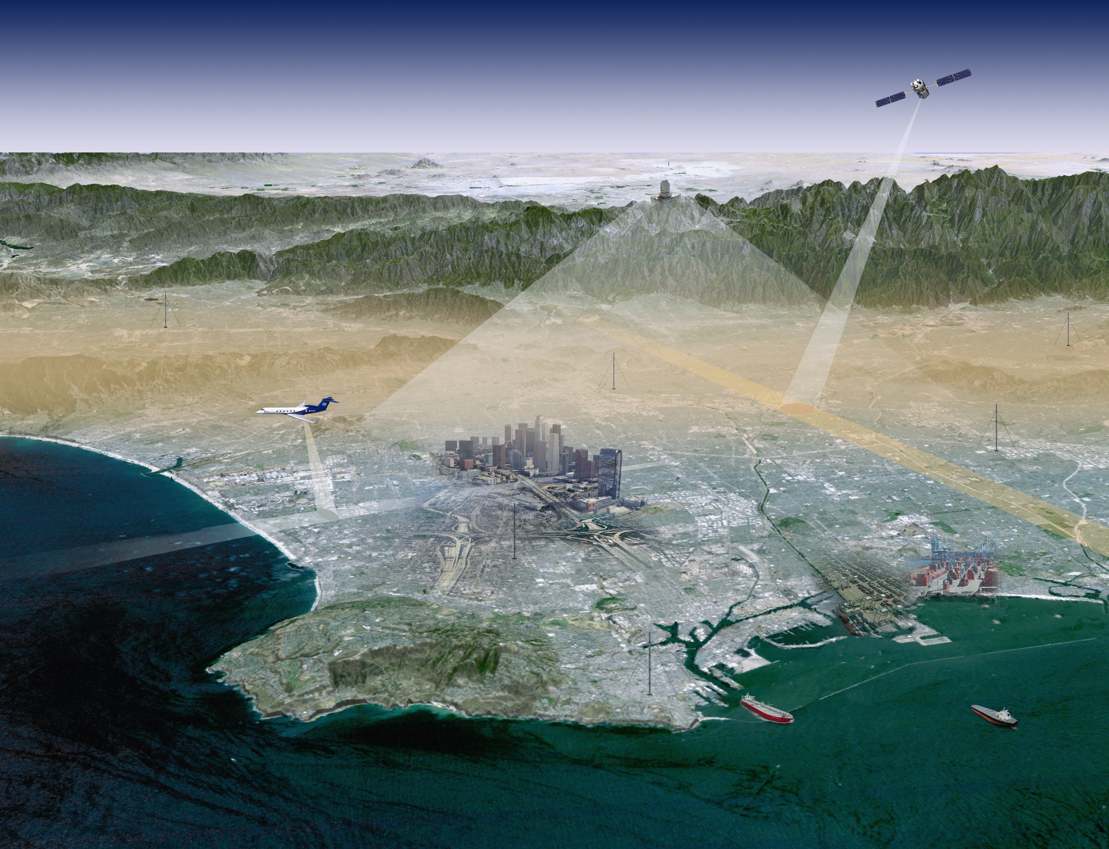


Integrated Global GHG Information System (iG³IS):
(Systematic Services)
You can manage what you measure
EC CEOS GHG Monitoring Priorities Workshop
Phil DeCola
Sigma Space
University of Maryland
Oksana Tarasova
WMO GAW
Felix Vogel, E&CC Canada Dominik Brunner, EMPA
Riley Duren, NASA JPL Daniel Zavala, EDF Philippe Ciais, LSCE CEA
Shamil Maksyutov
NIES Japan
IG³IS Science Team

Slide 2
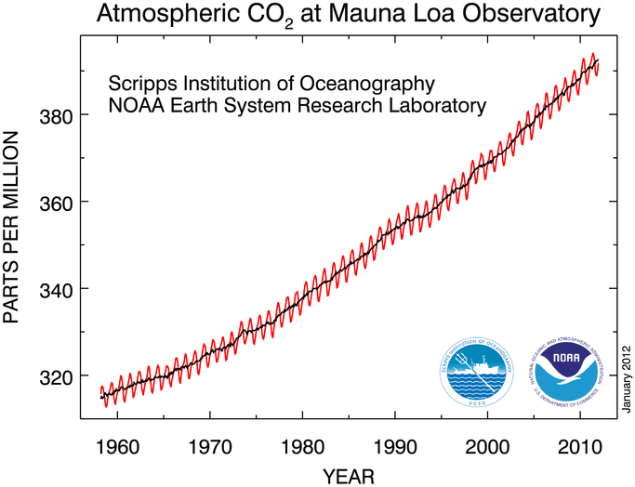
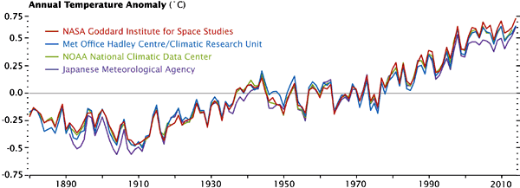
The bedrock of the UNFCCC process is made from the high-precision, long-term, science-based (or evidence-based) info; data records like the “Keeling curve” and the global average temperature records

Slide 3


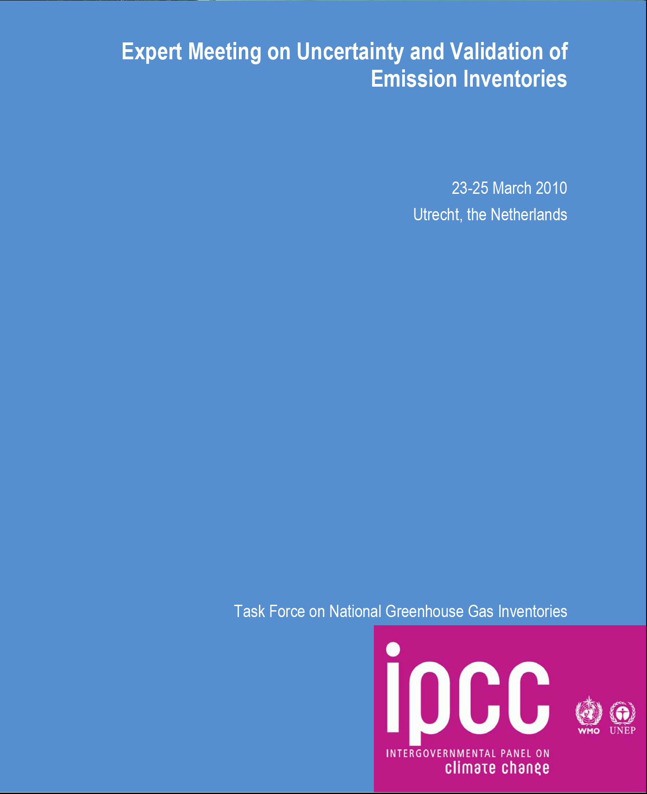
Atmospheric Science View on GHG monitoring circa 2010: atmospheric “top-down” versus inventory “bottom-up”
Can atmospheric measurements and models
“verify” inventories?
Notes:
In 2010, the United States’ National Research Council, Committee on Methods for Estimating Greenhouse Gas Emissions and the Group on Earth Observations (GEO) each separately studied and reported on the state of carbon cycle research, observations and models and their ability to validate and improve the accuracy of self-reported emission inventories based on fossil fuel usage and land use activities. All three studies concluded that by enhancing our in situ and remote-sensing observations and atmospheric transport and data assimilation modeling capabilities, a necessary GHG information system could be achieved in the coming decade, which could serve the needs of policies and actions to reduce GHG emissions.

Slide 4

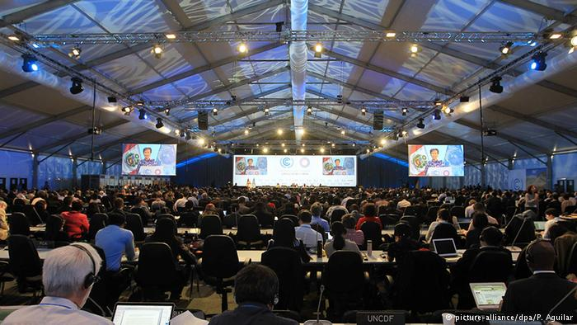
UNFCCC Process and GHG Monitoring:
Moving away from “Top-Down versus Bottom-Up” Paradigm
Then (2009)
Now (2016)
Binding Multi-national Treaty Commitments
“we will verify your reported emissions”
Nationally Determined Contributions
“we will help you improve your data”
A grand top-down GHG Information System
Advocates: Science Community!!!
Federation of focused monitoring systems
Advocates: WMO (191 countries),UNEP,
Cities (eg, C40), NGOs, Industry (eg, Oil Companies)
Notes:
Evolution of policy process and today we are saying that we’ll help you improve data
Instead of top down approach envisioned in reports in 2010 still a notion in some of scientific community to have enough obs and model skill to constrain fluxes on a regional scale globally; while may be a future capability it’s quite far off still. Just as treaty moved on (brought 191 countries on policy front in Lima and Paris, IGIS goal is to start where we have skill, move to where there are users ready to partner with us
IG3IS will be working with country, sub-national, private sector and NGO partners to combine atmospheric observations and models with improved bottom up activity data (and emission factors) from the “bottom up” to 1) provide nations and subnational actors lower-latency, higher-fidelity trend data in support of the Paris Agreement’s desire to revisit the progress of countries’ INDCs and support of subnational emission reduction efforts to revisit INDCs 2) reduce inventory uncertainty (such as UK country reporting efforts to be mentioned later), and 3) inform new additional mitigation action. Like methane from the oil and gas supply chain

Slide 5

Integrated Global GHG Information System:
IG³IS Principles
Combine (unified approach) atmospheric measurements with socioeconomic inventory data to better quantify and attribute greenhouse gas emissions.
Success-criteria are that the information guides additional and valuable emission-reduction actions.
Stakeholders are entrained from the beginning to ensure that information products meet user priorities and deliver on the foreseen value proposition.
IG³IS will serve as an international coordinating mechanism and establish and propagate consistent methods and standards (BIPM/GAW partnership).
IG³IS must mature in concert with evolution of policy and technology.
Notes:
5

Slide 6
IG³IS Implementation:
Products and Objectives
Activities
Pilot projects to build user-base and improve skill,
Document good-practice implementation guidelines
Objectives
Inform national inventory reporting by making use of atmospheric measurements for all countries
GHG monitoring in large urban source areas (megacities)
Detection and quantifying large unknown industrial CH₄ emissions
Timely and quantified trend assessment in support of countries’ NDC tracking and “Global Stocktaking” (TBD)
Crosscutting Activities
Stimulate high-priority Research and Development
Inverse Modeling benchmarking, testbed and intercomparison

Slide 7
IG³IS early achievements
IPCC TFI guidelines/guidance provide broad international calculation methods (2006):
  Inventory protocols for transparent, documented, consistent over time, complete, comparable, assessed for uncertainties, subject to quality control and quality assurance, and efficient in the use of resources
IPCC TFI 2019 Refinement to 2006 Guidelines– will improve guidance to countries
  Will include assessment of methods for using atmospheric measurements & analyses to improve inventory estimates and certainties.
  Establish link with WMO/IG³IS effort to propagate methods and standards to both developed and developing countries.

Slide 8
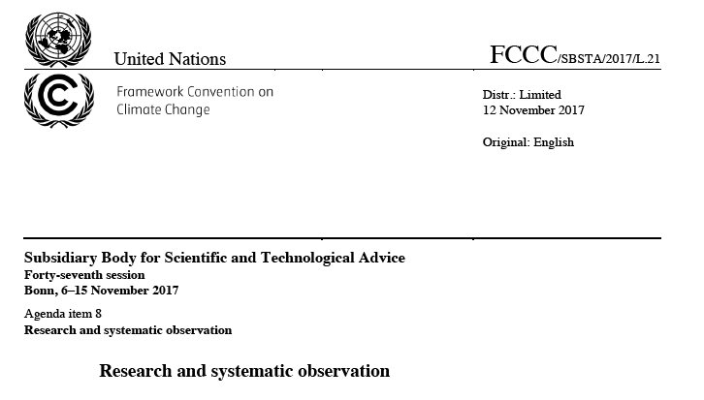


Slide 11
Summary
“Translation Science”
Promote and build confidence today that science-based information services need to be part of the solutions:
  Define the detailed good-practice guidelines for each objective area
  Develop near term pilot projects for each objective area
  Actively entrain users, partners and sponsors through all stages of development (GCF, GEF, WB, National and subnational governments, others)
  Coordinate with intergovernmental partners: UNFCCC, IPCC, EC, GCOS, GFCS, GEO, WCRP, others

Slide 12
IG³IS Implementation:
Products and Objectives
Products
Pilot projects to build user-base and improve skill,
Document good-practice implementation guidelines
Objectives
Support of Paris Agreement:
Support for Improved national inventory reporting by making use of atmospheric measurements for all countries
Timely and quantified trend assessment in support of countries’ NDC tracking and “Global Stocktaking” (TBD)
Key sub-national efforts and new mitigation opportunities:
GHG monitoring in large urban source areas (megacities)
Detection and quantifying large unknown CH₄ emissions

Slide 13
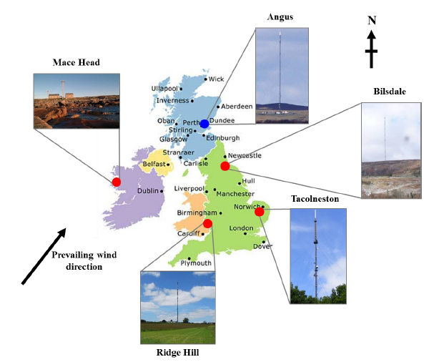
UK Measurement Network in support of national inventory reporting

Slide 14
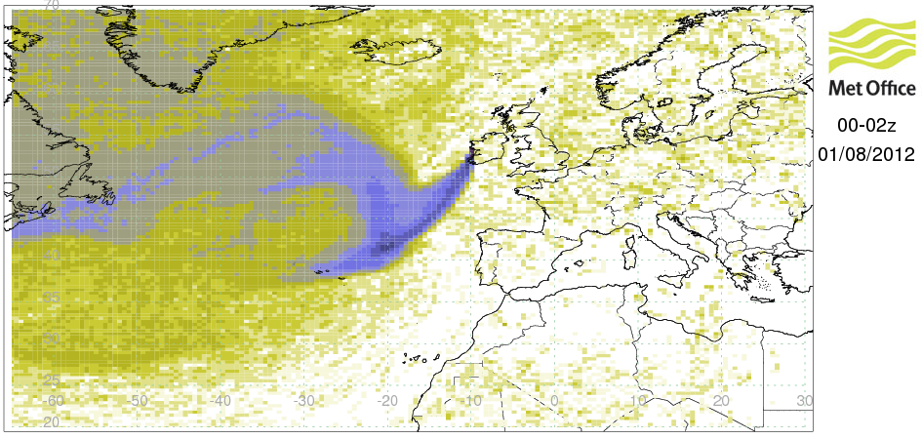
UK Met Office Modelling and Analysis
Mace Head air history maps are generated for each 2-hour period between 1989 and 2015
Use the NAME transport model driven by 3-D meteorology to understand the recent (3-4 weeks) history of the air arriving at measurement stations
Two stage process:
  Estimate long-term Northern Hemisphere baseline concentrations using Mace Head observations.
  Estimate regional emissions through inversion modelling (InTEM).

Slide 15
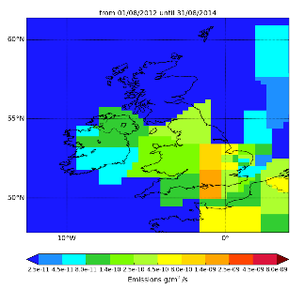
Example from UK report to UNFCCC: HFC-134a
Significant mismatch throughout the entire time-series of emissions, approximately inversion is 50% lower than inventory.
Investigated the refrigeration model used by inventory compilers, key variables to be re-considered by BEIS (formerly DECC):
  Refill rate
  Uptake rate

Slide 16
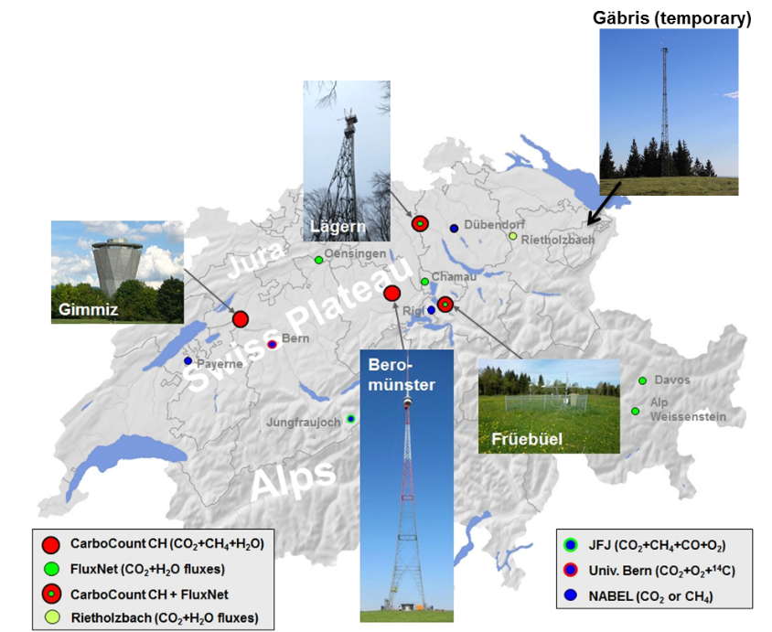
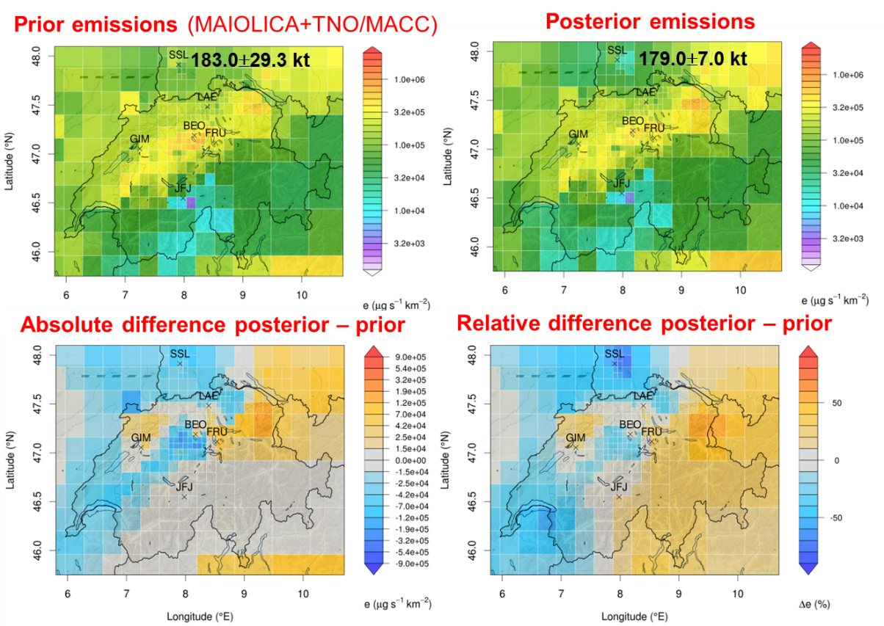
IG³IS good practice example from Switzerland
CH₄ emissions in Switzerland 2013
Henne, S.,D Brunner et al.,2016 : Validation of the Swiss methane emission inventory by atmospheric observations and inverse modelling, Atmos. Chem. Phys., 16, 3683–3710, www.atmos-chem-phys.net/16/3683/2016/
New GHG measurement network established
(project CarboCount-CH)

Slide 17
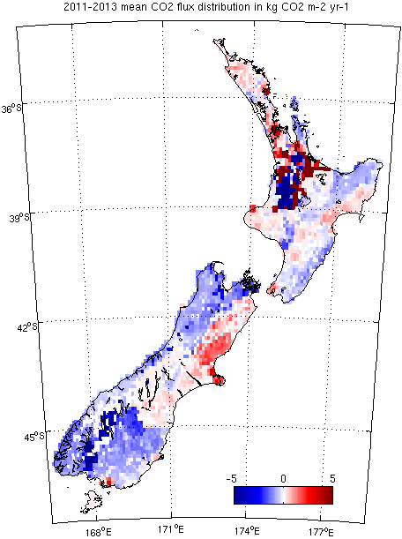
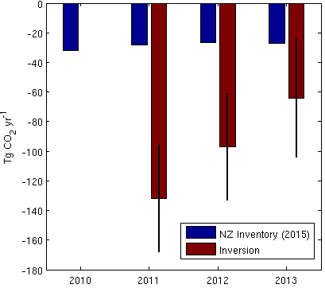
CO₂ inversion for New Zealand
indicates larger land carbon uptake than expected
Inverse model analysis of atmospheric measurements indicates that the terrestrial biosphere in New Zealand is a much stronger net annual CO₂ sink:
98 TgCO₂ yr⁻¹ versus 27 TgCO₂ yr⁻¹ reported for 2011–2013.
  Collaboration of atmospheric scientists and inventory builders to refine both approaches and provide best estimates of land carbon exchange.
Atmospheric CO2 observations and models suggest strong carbon uptake by forests in New Zealand
Steinkamp et al, Atmos. Chem. Phys., 17, 47–76, 2017, doi:10.5194/acp-17-47-2017
CO₂ inversion for New Zealand indicates larger land carbon uptake than expected
Inverse model analysis of atmospheric measurements indicates that the terrestrial biosphere in New Zealand is a much stronger net annual CO₂ sink and removed
  98 TgCO₂ yr⁻¹ from the atmosphere on average during 2011–2013. This sink is much larger than the reported 27 TgCO₂ yr⁻¹ in the national inventory for the same time period.
  Ongoing collaboration of atmospheric scientists and inventory builders work to refine both approaches and provide best estimates of land carbon exchange.

Slide 18
IG³IS Implementation:
Products and Objectives
Products
Pilot projects to build user-base and improve skill,
Document good-practice implementation guidelines
Objectives
Support of Paris Agreement:
Improved national inventory reporting by making use of atmospheric measurements for all countries
Timely and quantified trend assessment in support of countries’ NDC tracking and “Global Stocktaking” (TBD)
Key sub-national efforts and new mitigation opportunities:
GHG monitoring in large urban source areas (megacities)
Detection and quantifying large unknown CH₄ emissions

Slide 19
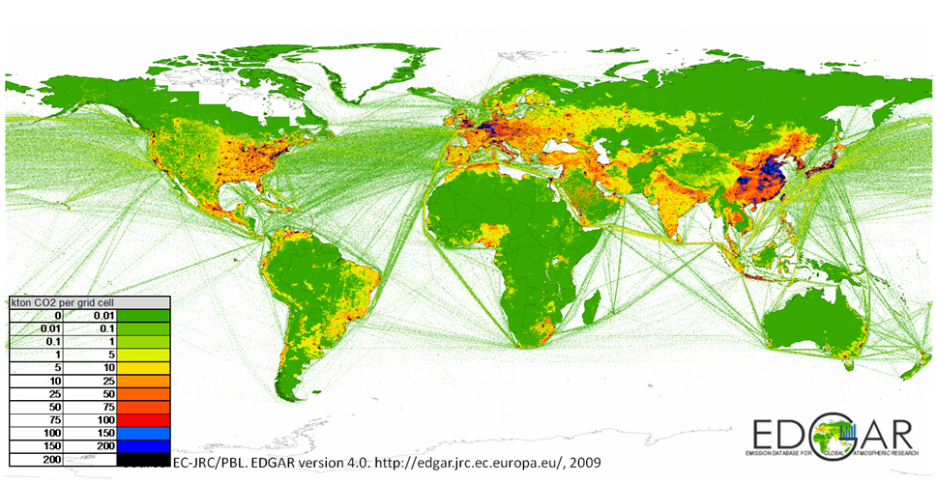
Relevance: cities matter
Cities account for roughly two-thirds of energy-related greenhouse gas (GHG) emissions
The Lima–Paris Action Agenda of the Paris Agreement has formalized a role for “non-state actors” including cities

Slide 20
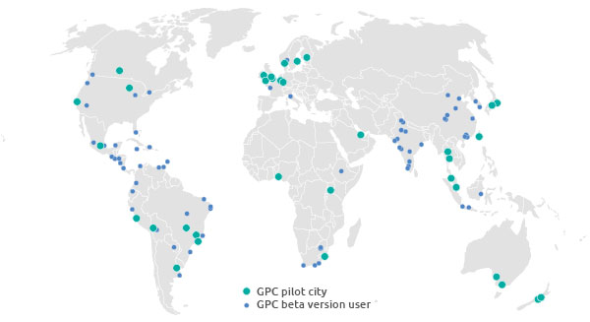








Why care about GHGs in cities?
Cities are active stakeholders and have ambitious reduction targets and mitigation efforts

Slide 21
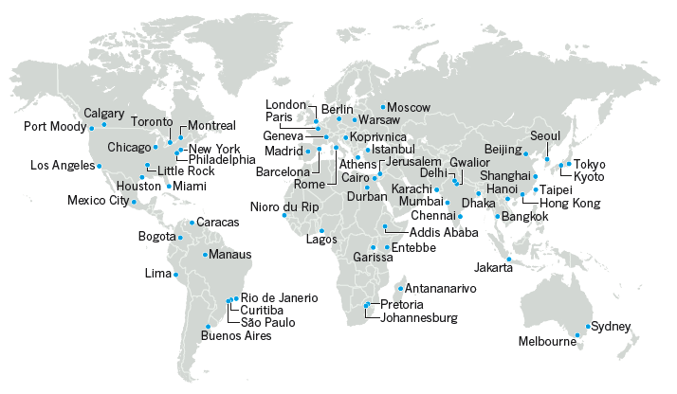
Urgency: cities are changing rapidly
http://www.c40cities.org
Both with Stabilization
  Green LA Plan (2007)
    35% (vs 1990) by 2030
  Paris Climate Plan (2007)
    25% (vs 2004) by 2020
and Growth
  Global urbanization will double by 2050
  Explosive growth in developing megacities
  population >4%/year
  emissions >10%/year

Slide 22
IG³IS City-Scale Objective
Carbon emissions from cities and their support systems represent the single largest human contribution to climate change.
IG³IS city-scale objective provides a strategy, methodology and roadmap for an international framework to assess directly the carbon emission trends of the world’s cities.
http://megacities.jpl.nasa.gov
Notes:
Megacities observing system for Los Angeles
In-situ sensors located around the LA basin provide continuous, high accuracy measurements of greenhouse gas (GHG) mixing ratios of CO2, CH4, and CO. A remote-sensing instrument on Mt. Wilson provides multiple scans per day of the basin to measure slant-column mixing ratios. Another remote-sensing instrument at Caltech provides continuous daytime measurements of column mixing ratios. Aircraft and mobile laboratories provide infrequent but intensive measurements of mixing ratios. Satellites are beginning to provide remote-sensing measurements of LA. Other instruments (not shown) measure winds and boundary layer height.

Slide 23
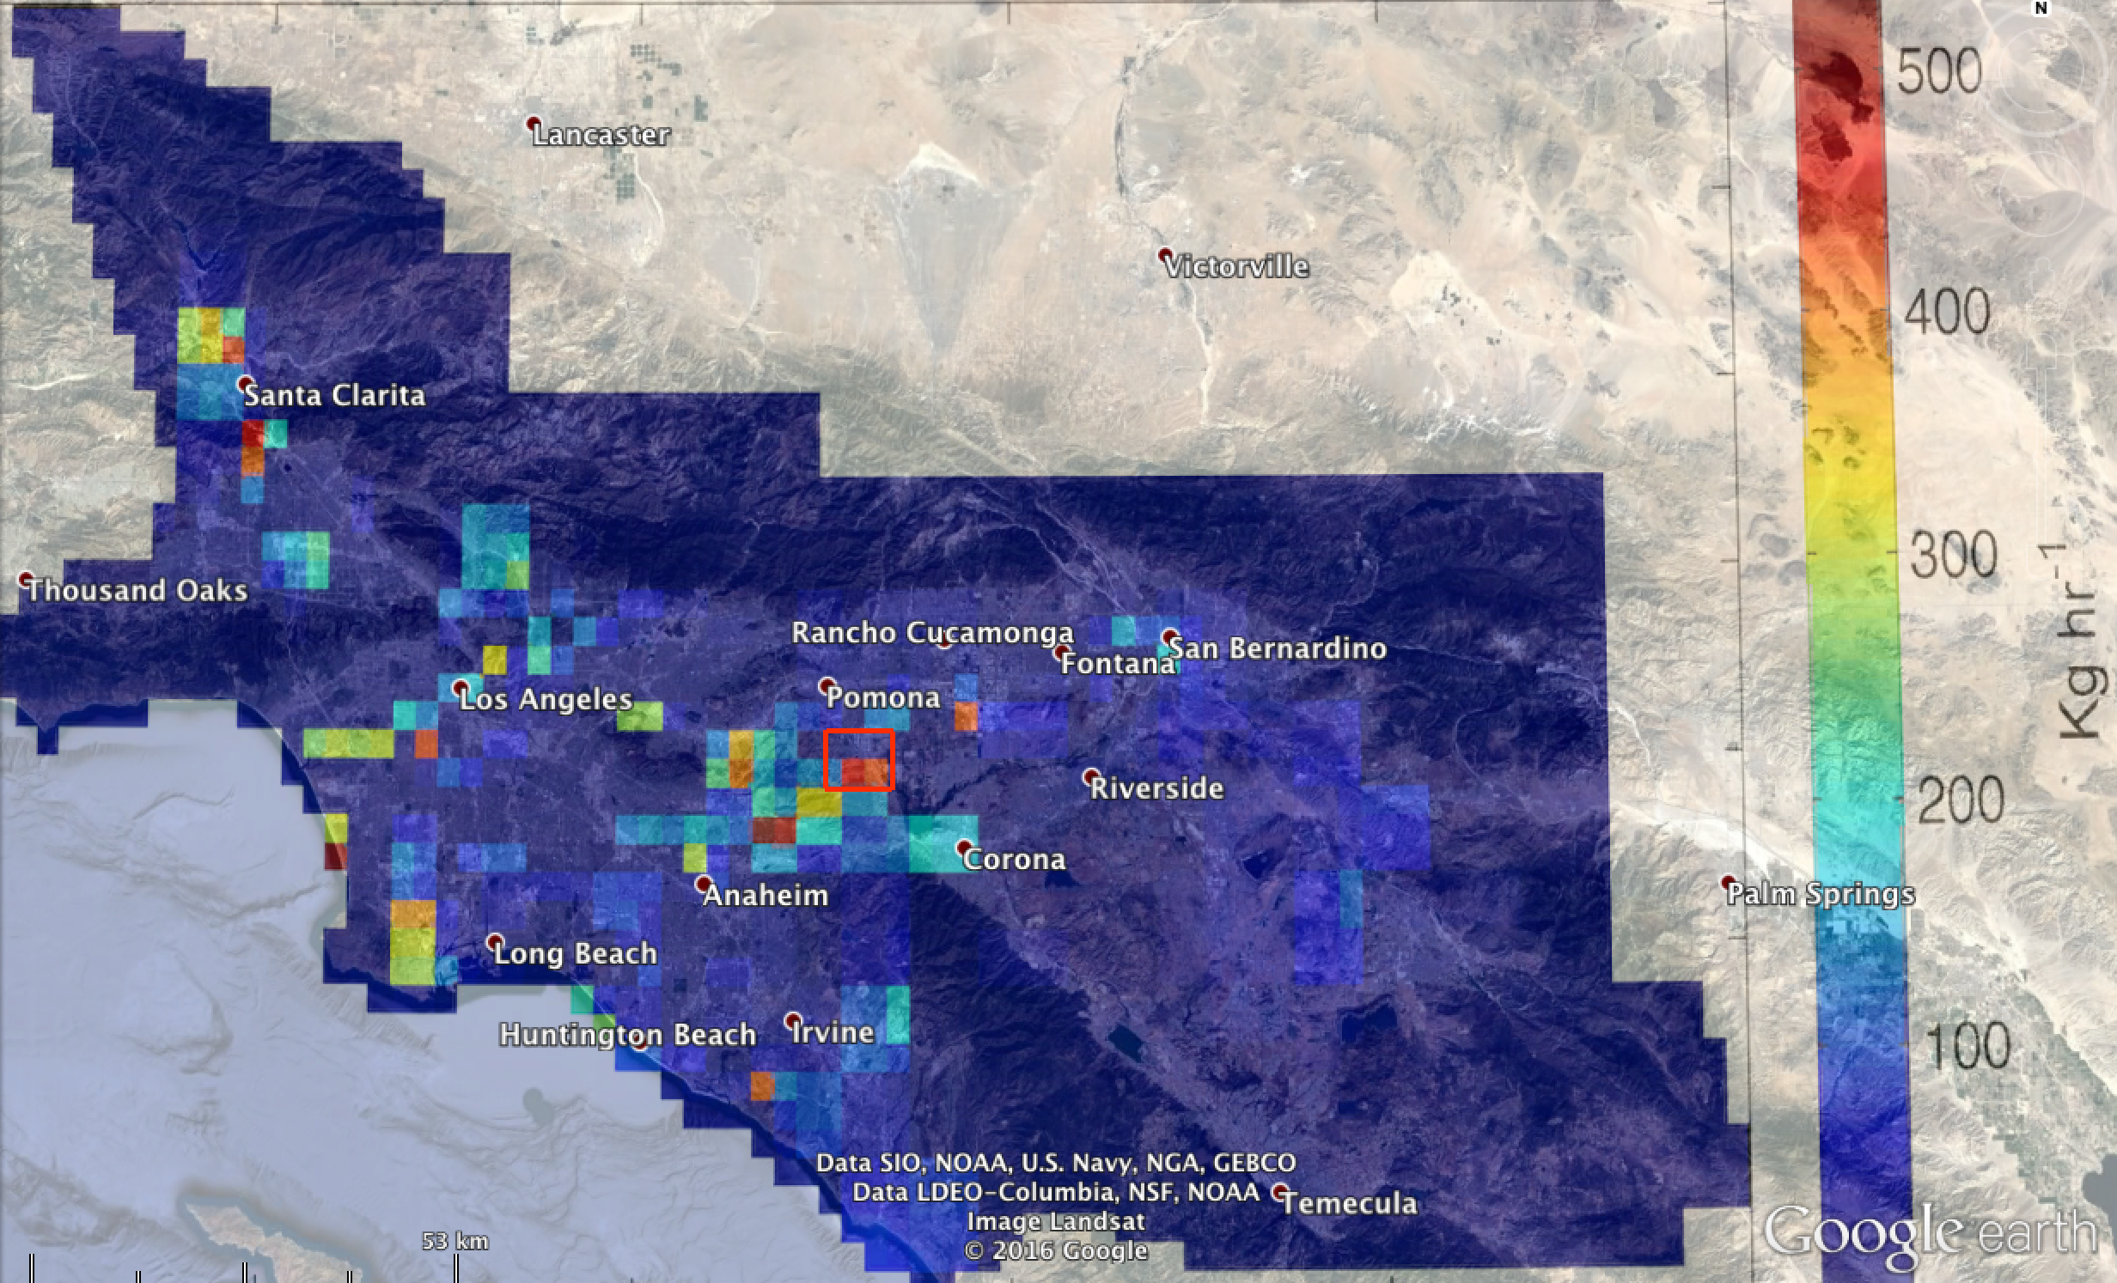
Los Angeles inverse model of 12 tower measurements shows
methane hot spots at known & a large unknown source

Slide 24
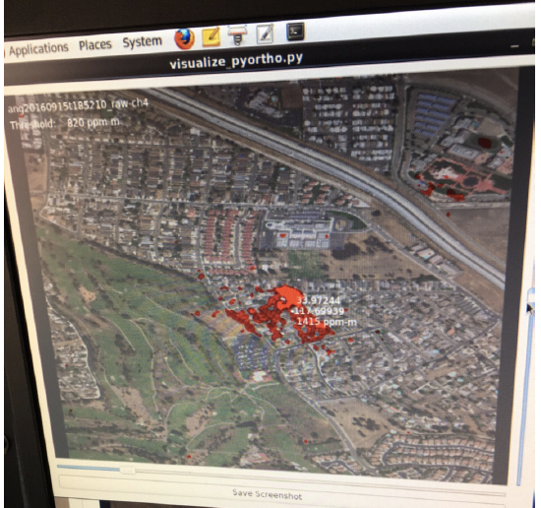
Airborne imaging spectrometer sees methane plume
confirming large leak from distribution system

Slide 25
IG³IS Implementation:
Products and Objectives
Products
Pilot projects to build user-base and improve skill,
Document good-practice implementation guidelines
Objectives
Support of Paris Agreement:
Improved national inventory reporting by making use of atmospheric measurements for all countries
Timely and quantified trend assessment in support of countries’ NDC tracking and “Global Stocktaking” (TBD)
Key sub-national efforts and new mitigation opportunities:
GHG monitoring in large urban source areas (megacities)
Detection and quantifying large unknown CH₄ emissions

Slide 26

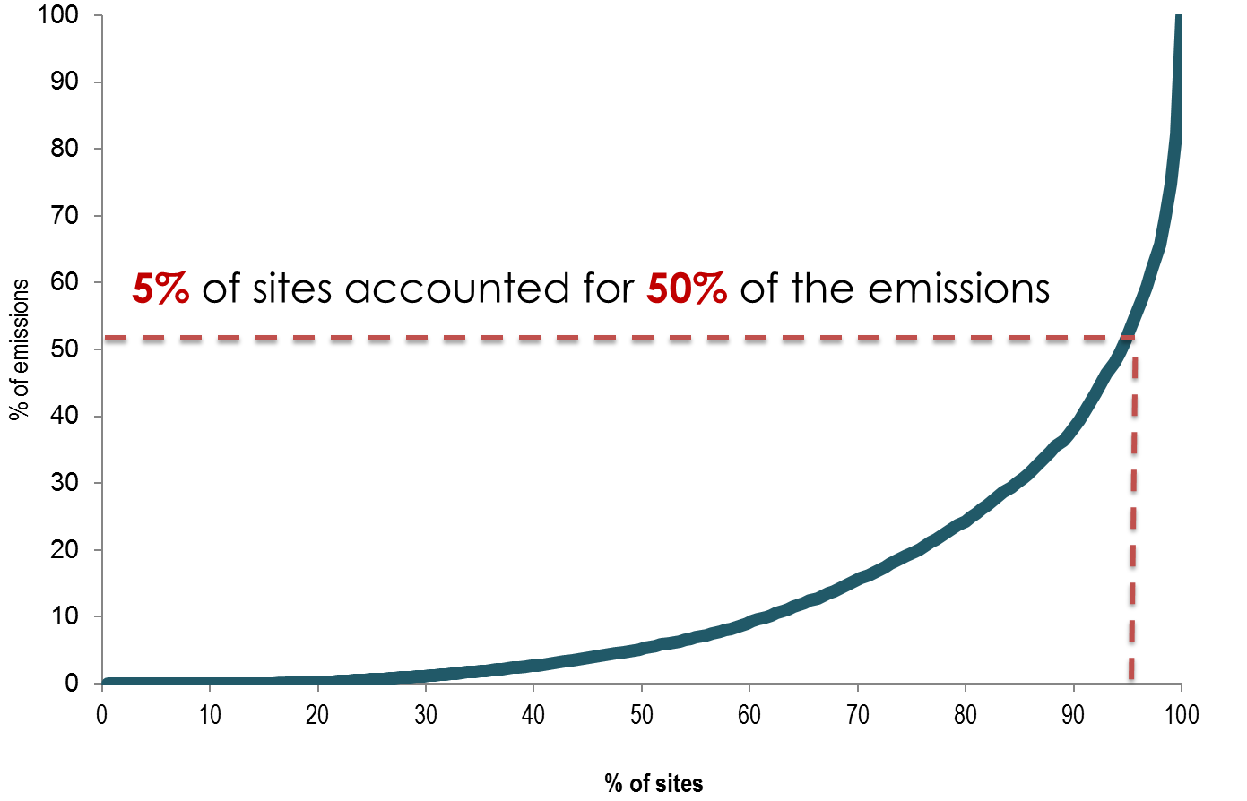
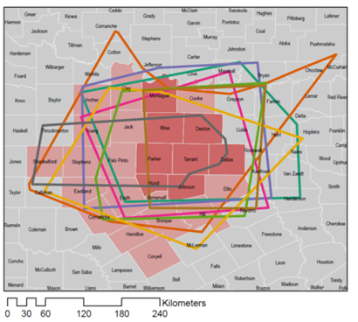
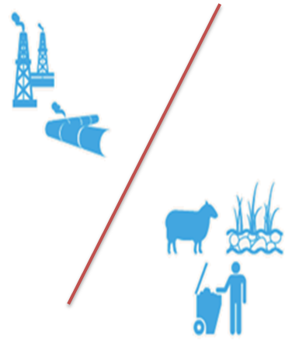
Objective 3: Detect and Quantify
Industrial and Agricultural
Methane Emissions
Multiple flights
Attribution techniques

Slide 27
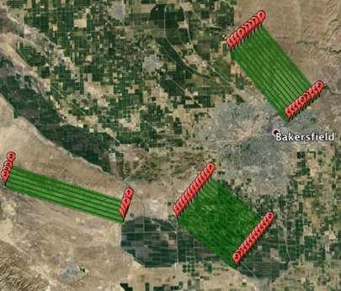
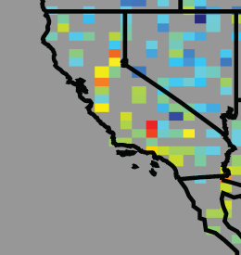
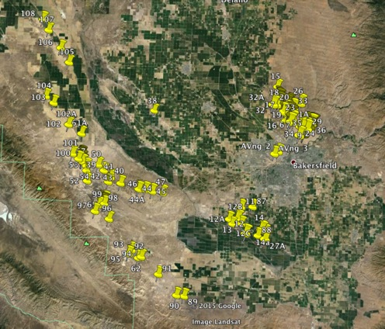
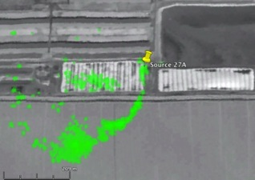
Tiered strategy for monitoring methane leaks in the US
Tier 1: Satelite detects hotspot region
Tier2 (Blue boxes):
Aircraft spectrometers estimates local fluxes & attributes source sectors
Kern River oil field
Turner et al 2015
Elk Hills oil field
Taft dairies
500 km
Oil fields
50 km
Enhanced
Activity Data
Tier 3: Plume Imaging aircraft map point sources
Dairies
Tier 4 (not shown):
Surface observations
Pixel size 1.5m
500 m
Notes:
A tiered strategy for monitoring methane leaks in the US. An EIA map illustrates onshore oil and gas production in key regions of the contiguous United States (CONUS). Red boxes indicate the focus of Tier 1: persistent monitoring for large leaks by a methane-imaging satellite in low-Earth orbit and ultimately geostationary orbit - enveloping key elements of the domestic oil and gas supply chain: well-heads, processing/ storage facilities, and distribution and consumption in urban areas. Other key methane sectors (e.g., major livestock areas and landfills) are also covered – ensuring proper source attribution. Methane leaks that significantly exceed EPA predictions are automatically detected, located within 500 meters, and communicated to facility operators within 3-15 days of onset. The inset offers a close-up of dense oil (orange) and gas (blue) wells with an overlay illustrating the size of satellite pixels. Tier 2 would apply targeted follow-up in selected areas with plume- imaging aircraft to pin-point locations and provide spatial maps of leaks. Tier 3: a national network of methane instruments on 15 tall towers (dark green triangles existing NOAA network; light green triangles indicate notional network expansion) would estimate the atmospheric methane budget of the CONUS every month, with a spatial resolution of about 50 km.
As the measurement methods that were validated in the the Barnett research are applied in other regions across the U.S. – and the world – they will provide a much clearer picture of the state of oil and gas methane emissions, and how to best address them.
Satellite data cannot be as accurate as ground-based estimates, but from space, global consistency is achievable

Slide 28
IG³IS Implementation:
Products and Objectives
Products
Pilot projects to build user-base and improve skill,
Document good-practice implementation guidelines
Objectives
Support of Paris Agreement:
Improved national inventory reporting by making use of atmospheric measurements for all countries
Timely and quantified trend assessment in support of countries’ NDC tracking and “Global Stocktaking” (TBD)
Key sub-national efforts and new mitigation opportunities:
GHG monitoring in large urban source areas (megacities)
Detection and quantifying large unknown CH₄ emissions

Slide 29

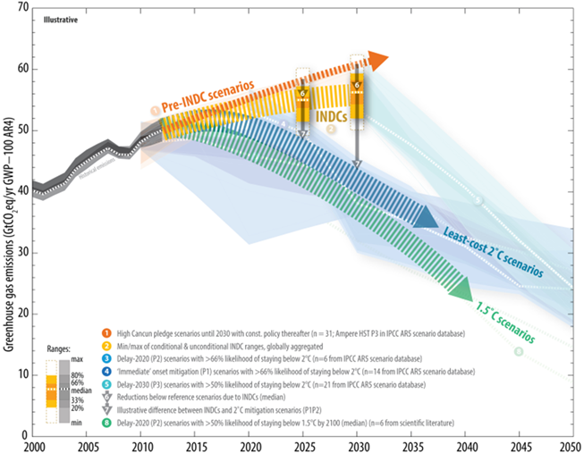
Objective 4: IG³IS in Support of the Global Stock Take
IPCC Special Report

Slide 30

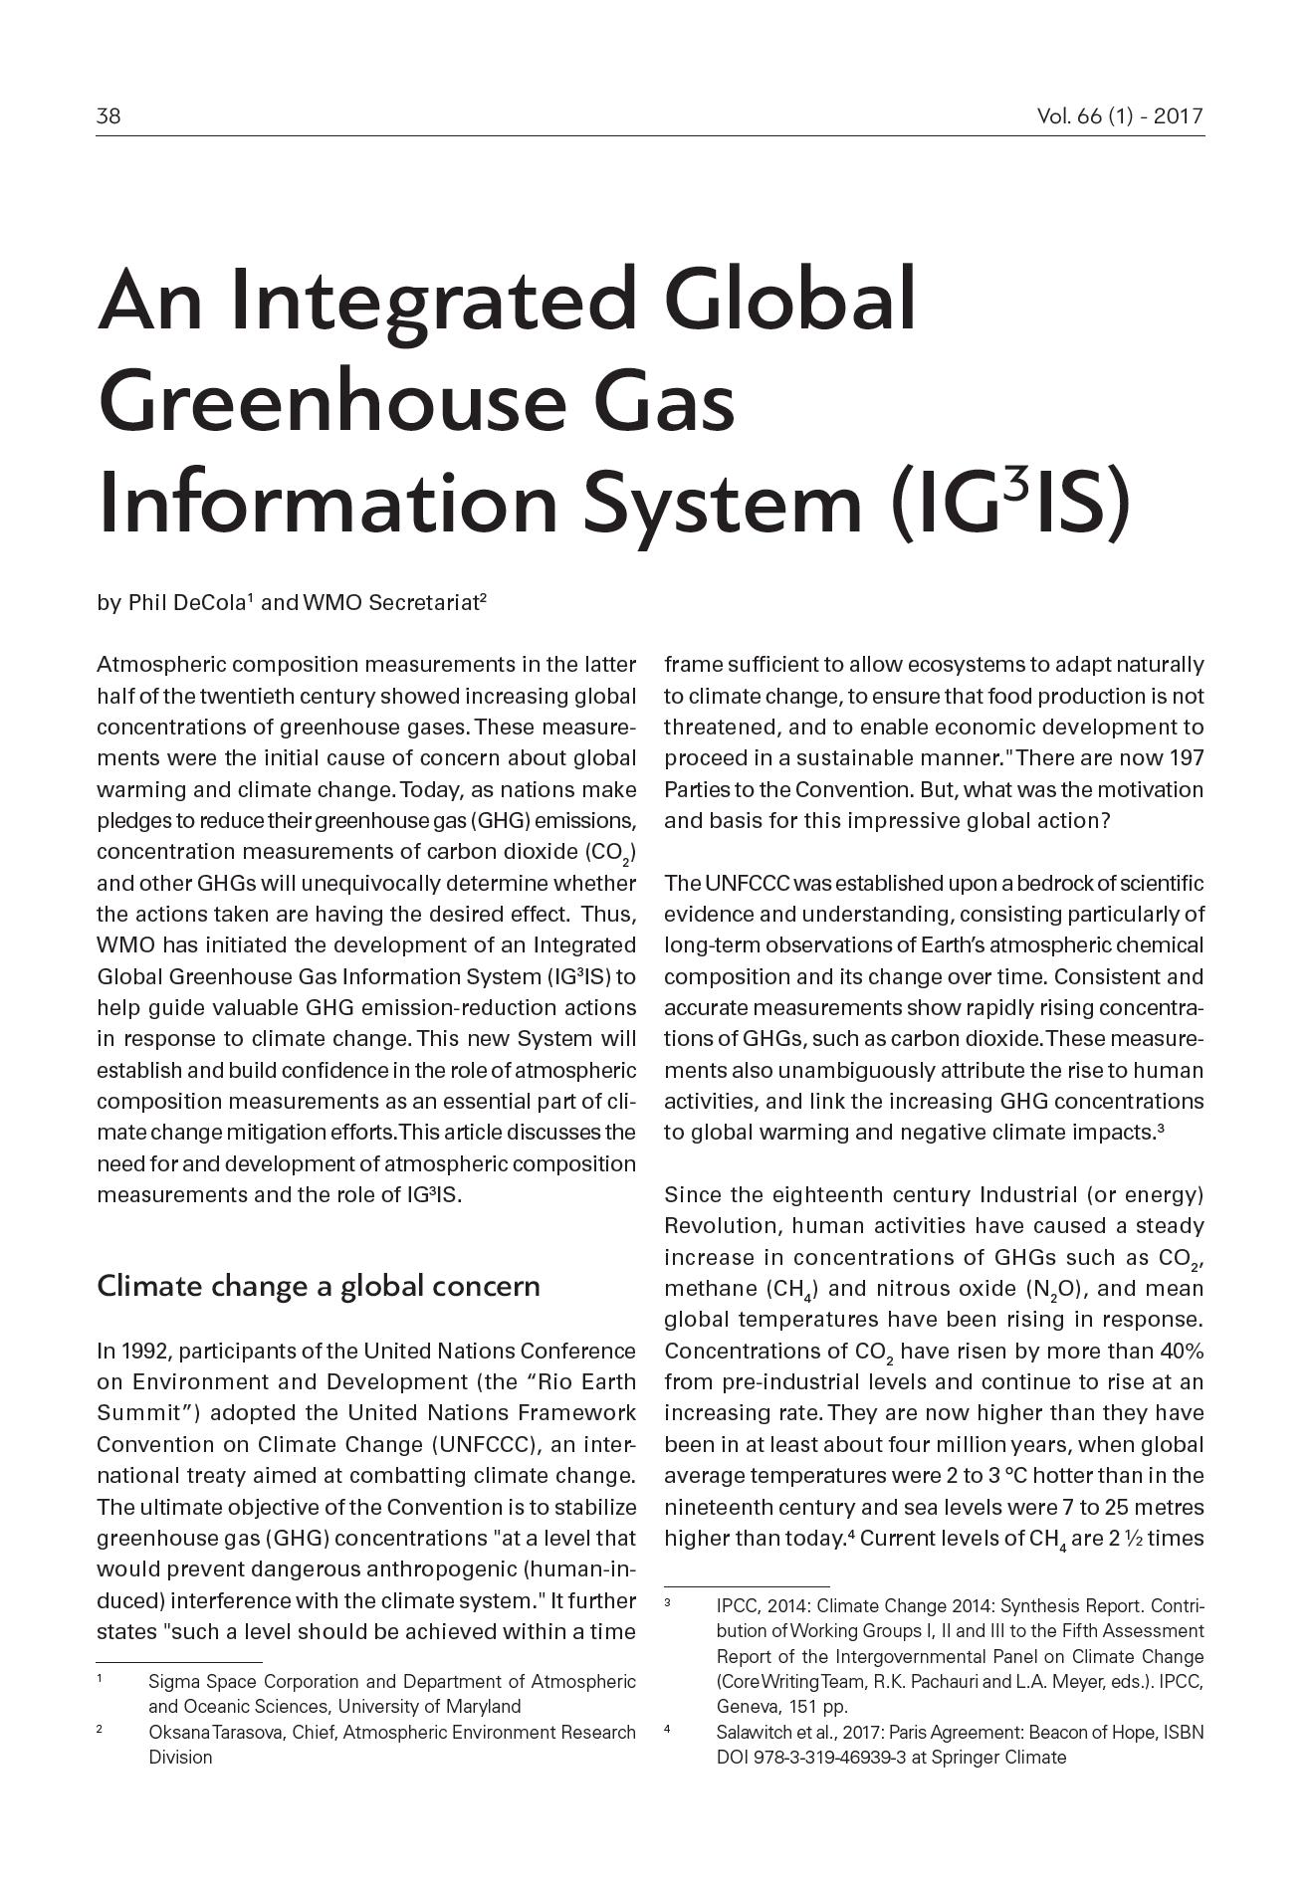
https://public.wmo.int/en/resources/bulletin

