Slide 1
German Aerospace Center – Space Administration
Workshop “Interfaces between CEOS agencies and the GHG Monitoring”
Joint Research Centre, European Commission
June 18th, 2018
Albrecht von Bargen (DLR Space Administration)
Julia Marshall (MPI for Bio-Geochemistry)
Christian Plaß-Dülmer (DWD)

Slide 2
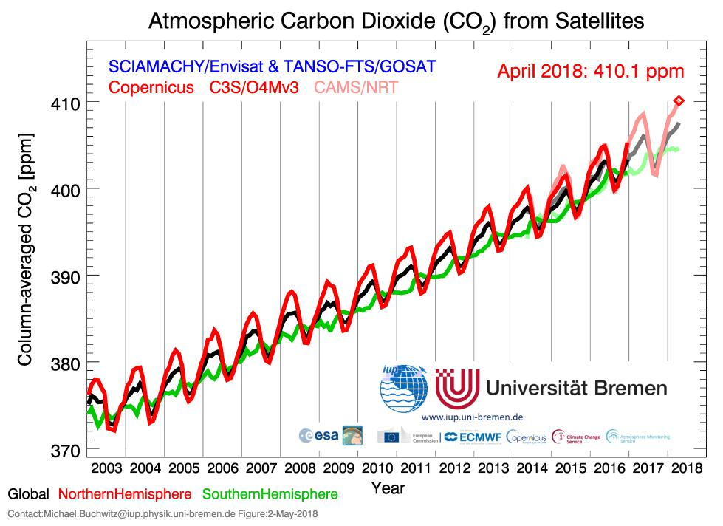
German Space Programme Heritage
SCIAMACHY on-board ESA’s ENVISAT (DLR / NSO / BIRA)
Launched in 2002 and successfully operated until 2012
Main focus on atmospheric constituents (ozone hole)
Included channels to sense Greenhouse Gases
First demonstrator observing Greenhouse Gases from space
National Mission Study (CarbonMon)
Passive remote sensing (spectrometry) of CO₂ and Methane
Active remote sensing (lidar) of Methane
Understanding the sources / sinks and fluxes on regional and local scale
ESA Earth Explorer 8 candidate CarbonSAT
Common French and German cabinet decision (2010)
Bi-national mission to understand the climate changes

Slide 3
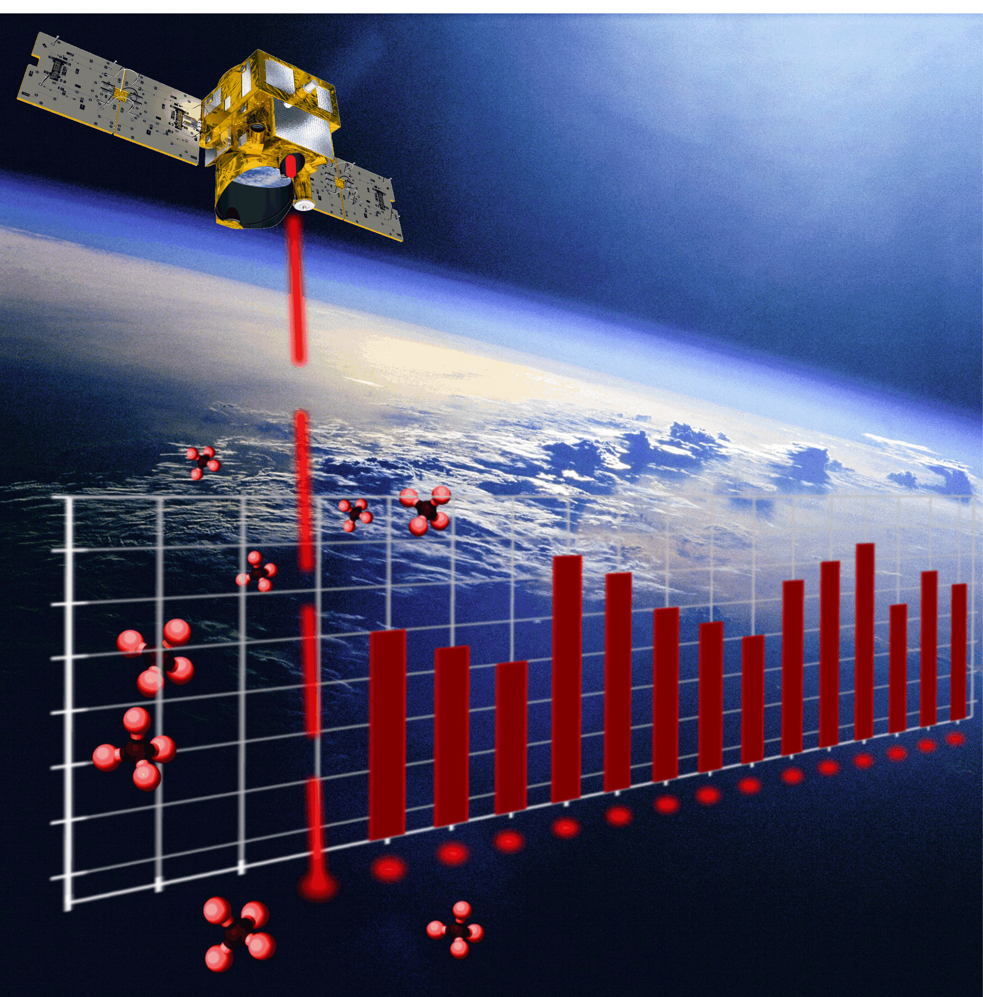
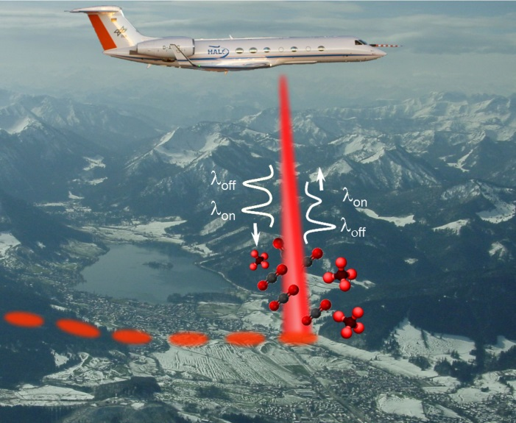
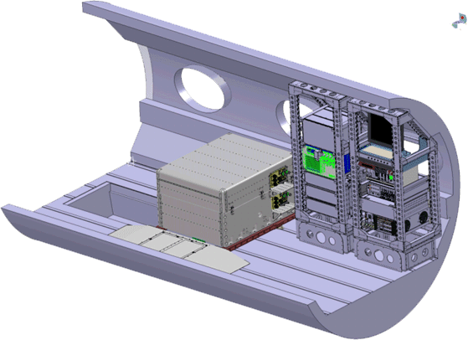
MERLIN aims at improving our knowledge of the Global Methane Cycle and of the processes which govern the exchange of methane between biosphere and atmosphere
Primary mission objective
High accurate space-borne measurements of the spatial and temporal variability of atmospheric CH₄ for determination of Methane fluxes (emissions) on the Earth surface
Secondary mission objective
Surface properties & vegetation
Contribution to cloud / aerosol data base
Launch in 2023 / life time of around 3 years
Major milestone: successful airborne demonstrator flight in 2015
CHARM-F on HALO 2015
© DLR IPA

Slide 4
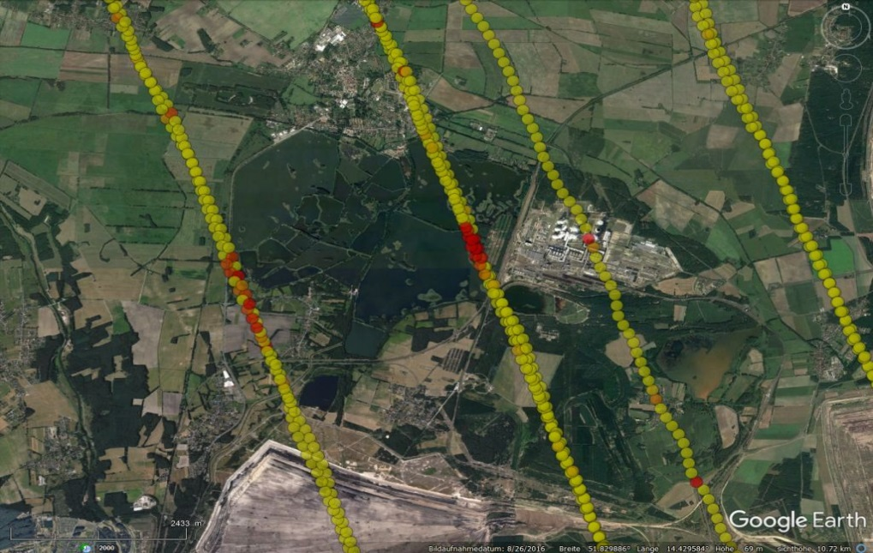
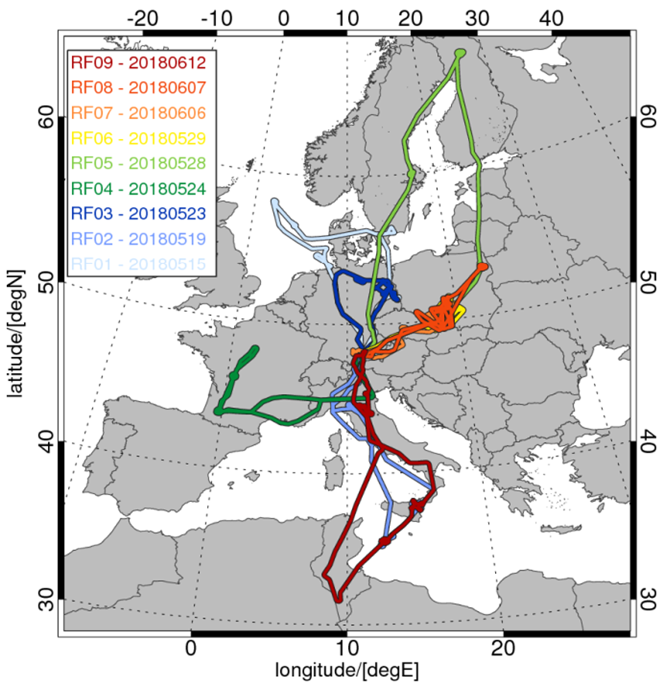
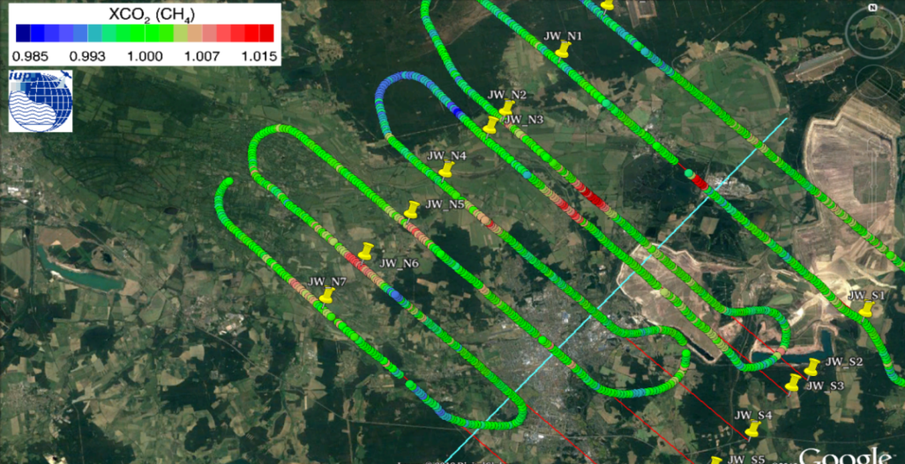
COMET: An airborne mission to simultaneously measure CO₂ and CH₄ using lidar, passive remote sensing and in-situ techniques
First measurement of CO₂ emissions from large power plants (Jänschwalde, DE,
~25 Mt CO₂/yr) by co-located airborne passive (MAMAP) & active (CHARM-F) remote sensing instruments
Quicklook result: CHARM-F on the HALO aircraft
Quicklook result: MAMAP on the Cessna aircraft

Slide 5
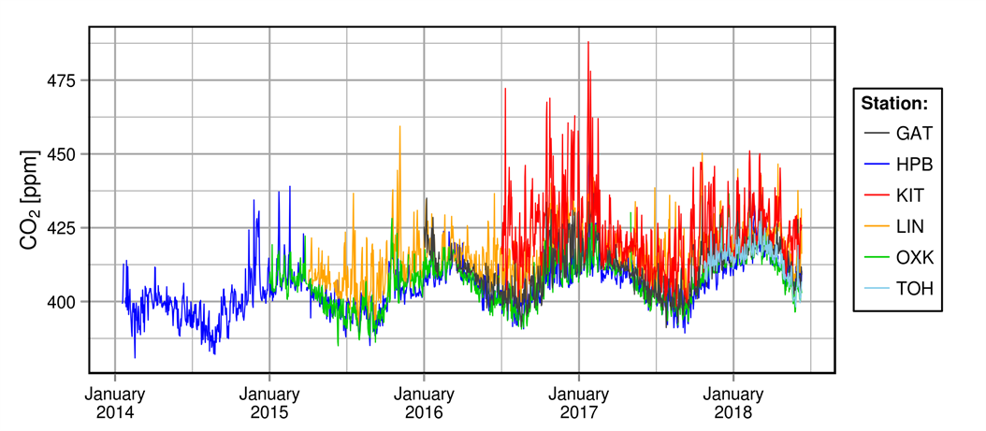
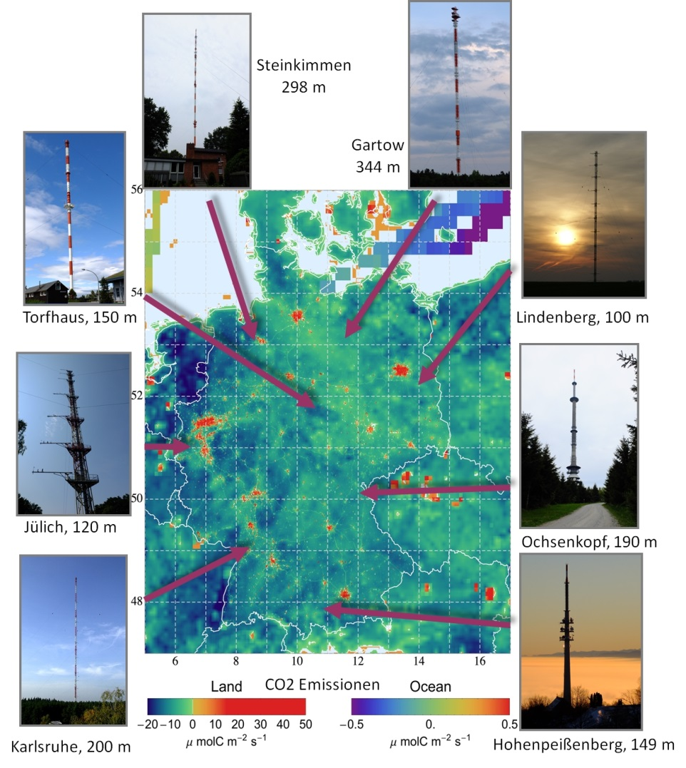
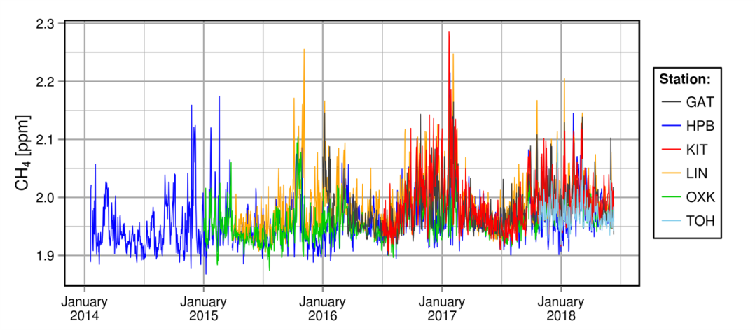
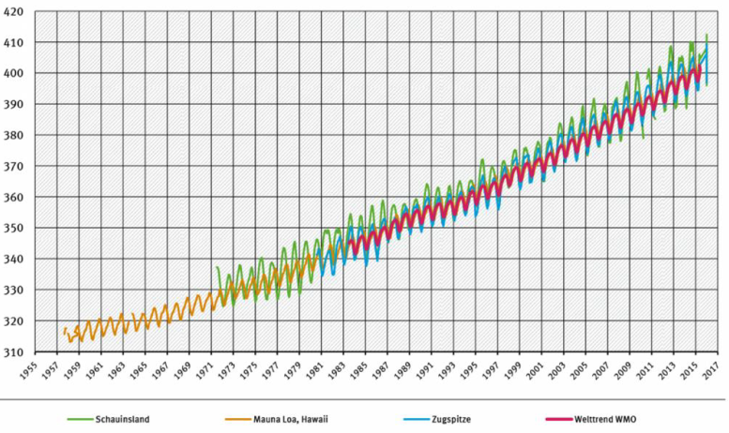
German Greenhouse Gas in-situ measurements
CO₂
Schauinsland
Zugspitze
UBA +
IUP Heidelberg

Slide 6
GHG Monitoring and Inventory Community
Policy in Germany is driven by classical approach of the inventory compilation (regulations)
Lead in Germany by the Umweltbundesamt (Federal Office for the Environment) by coordinating the input from the state-level offices
Input generation based on the EU ETS regulations and on the 2006 IPCC guidelines
Reported emissions as input
As announced during a national Copernicus user workshop in 2017, the Umweltbundesamt is studying approaches including observation data.
At the DWD Climate Workshop 2017, an agreement to go for top-down emissions from atmospheric observations (ICOS) and inverse modelling (STILT) was made with first NIR addition in 2019
Further intention in Germany: include satellite (Sentinel-5P, GOSAT, OCO-2) and in-situ data + inverse modelling Eulerian NWF model (ICON-ART, ensemble, filter), a national consortium is forming coordinated by DWD

Slide 7
DLR Policy on Greenhouse Gas Remote Sensing
German Space Programme reflects the high and sustained commitment of Germany
National level (Mission and data exploitation)
Coherent R&D on GHG measurements from space
Concepts of integration of current & future missions (TanDEM, EnMAP, MERLIN) incl. in-situ & modelling
Supporting mission success by on-ground Cal/Val activities & coordinating German user community
European level
EC COPERNICUS programme including services, e.g. Sentinel-4, Sentinel-5, and Sentinel-NG
ESA Earth Observation programme
EUMETSAT programme
International level
Bilateral efforts (mission implementations, agreements etc.)
Multilateral coordination of space agencies’ activities (CEOS) and support to GEO initiatives
Inclusion of space-based measurements in international efforts for the evaluation of GHGs

Slide 8
Acknowledgements
COMET Campaign Team: Andreas Fix et al.
Gerhard Ehret (DLR)
University of Bremen: Heinrich Bovensmann

