Slide 1

CEOS AC-VC Whitepaper
Committee on Earth Observation Satellites
David Crisp, NASA/JPL
CEOS Chair Priority Workshop on GHG Monitoring
European Commission Joint Research Centre,
Ispra, Italy
18-19 June 2018
Copyright 2018 California Institute of Technology. Government sponsorship acknowledged.

Slide 2
AC-VC White Paper
Chapters
Contributions from participants at the CEOS SIT and CEOS AC-VC meetings were incorporated into the White Paper structure:
Executive Summary
Introduction
Using atmospheric GHG measurements to improve inventories
Space-based GHG measurement capabilities and near term plans
Lessons Learned from SCIAMACHY, GOSAT and OCO-2
Integrating GHG Satellites into Operational Constellations
Towards an operational constellation measuring anthropogenic CO₂ emissions
The Transition from Science to Operations
Conclusions

Slide 3
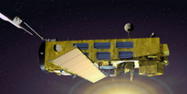
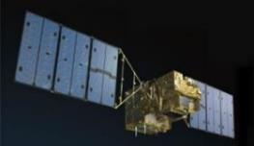
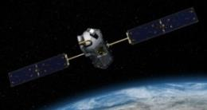
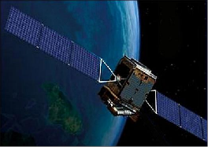
Past and Present GHG Satellites
SCIAMACHY (2002-2012) – First sensor to measure O₂, CO₂, and CH₄ using reflected NIR/SWIR sunlight
  Regional-scale maps of X_{CO2} and X_{CH4} over continents
GOSAT (2009 …) – First Japanese GHG satellite
  FTS optimized for high spectral resolution over broad spectral range, yielding CO₂, CH₄, and chlorophyll fluorescence (SIF)
OCO-2 (2014 …) – First NASA satellite to measure O₂ and CO₂ with high sensitivity, resolution, and coverage
  High resolution imaging grating spectrometer small (< 3 km²) footprint and rapid sampling (10⁶ samples/day)
TanSat (2016 …) - First Chinese GHG satellite
  Imaging grating spectrometer for O₂ and CO₂ bands and cloud & aerosol Imager
  In-orbit checkout formally complete in August 2017

Slide 4
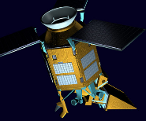
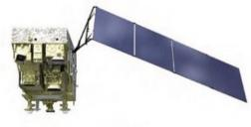
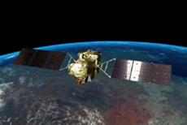

The Next Generation
Feng Yun 3D (2017) – Chinese GHG satellite on an operational meteorological bus
  GAS FTS for O₂, CO₂, CH₄, CO, N₂O, H₂O
Sentinel 5p (2017) - Copernicus pre-operational Satellite
  TROPOMI measures O₂, CH₄ (1%), CO (10%), NO₂, SIF
  Imaging at 7 km x 7 km resolution, daily global coverage
Gaofen 5 (2018) - 2nd Chinese GHG Satellite
  Spatial heterodyne spectrometer for O₂, CO₂, and CH₄
GOSAT-2 (2018) – Japanese 2nd generation satellite
  CO as well as CO₂, CH₄, with improved precision (0.125%), and active pointing to increase number of cloud free observation
OCO-3 (2019) – NASA OCO-2 spare instrument, on ISS
  First CO₂ sensor to fly in a low inclination, precessing orbit
In orbit Checkout

Slide 5
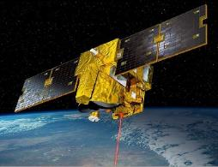
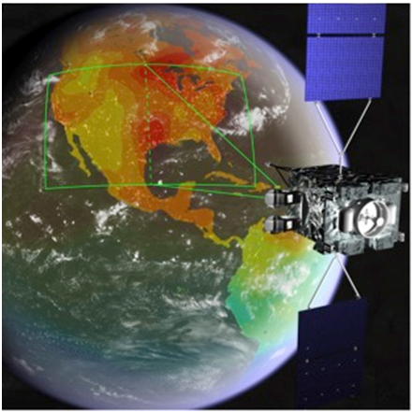
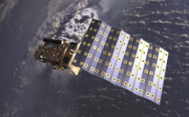
Future GHG Satellites (2)
CNES/UK MicroCarb (2021+) – compact, high sensitivity
  Imaging grating spectrometer for O₂ A, O₂ ¹Δ_{g}, and CO₂
  ~1/2 of the size, mass of OCO-2, with 4.5 km x 9 km footprints
CNES/DLR MERLIN (2021+) - First CH₄ LIDAR (IPDA)
  Precise (1-2%) X_{CH4} retrievals for studies of wetland emissions, inter-hemispheric gradients and continental scale annual CH₄ budgets
NASA GeoCarb (2022*) – First GEO GHG satellite
  Imaging spectrometer for X_{CO2}, X_{CH4}, X_{CO} and SIF
  Stationed above ~85° W to view North/South America
Sentinel 5A,5B,5C (2022) - Copernicus operational services for air quality and CH4
  Daily global maps of XCO and XCH4 at < 8 km x 8 km
“ Pre-Decisional Information -- For Planning and Discussion Purposes Only

Slide 6
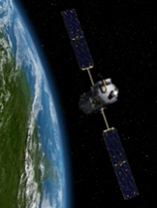
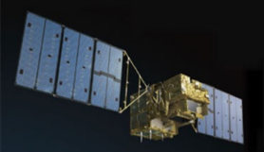
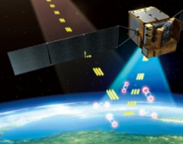

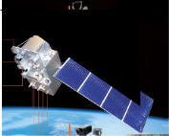

GHG Mission Timeline
A broad range of GHG missions will be flown over the next decade.
Most are “science” missions, designed to identify optimal methods for measuring CO₂ and CH₄, not “operational” missions designed to deliver policy relevant GHG products focused on anthropogenic emissions

Slide 7
GCOS CO₂ and CH₄ Requirements.
The CO₂ and CH₄ measurement requirements in the 2011 update for the Global Climate Observing System (GCOS) Systematic Observation Requirements for Satellite-Based Data Products for Climate (GCOS, 2011) and GCOS 2016 Implementation Plan (GCOS, 2016) were adopted as targets for a future GHG constellation.
Variable / Parameter | Horizontal Resolution | Vertical Resolution | Temporal Resolution | Accuracy | Stability/ Decade* | Stability/ Decade**
Tropospheric CO₂ column | 5-10km | N/A | 4 h | 1 ppm | 0.2 ppm | 1.5 ppm
Tropospheric CO₂ | 5-10 km | 5 km | 4 h | 1 ppm | 0.2 ppm | 1.5 ppm
Tropospheric CH₄ column | 5-10 km | N/A | 4 h | 10 ppb | 2 ppb | 7 ppb
Tropospheric CH₄ | 5-10 km | 5 km | 4 h | 10 ppb | 2 ppb | 0.7 ppb
Stratospheric CH₄ | 100-200 km | 2 km | Daily | 5% | 0.30% | 0.30%
* from GCOS 2011
** from GCOS 2016

Slide 8
Timely inputs to policy makers
Global Stock
Take 1
Global Stock
Take 2
Paris
Agreement
using inventories of 2026
using inventories of 2021
CO₂ Task Force
2015
2017
2021
2023
2026
2028
CO2 Follow-up Report
Initial system capacity built up
Mission Requirement Document
Launch target for
Copernicus S-7
constellation

Slide 9
A Candidate GHG Constellation Architecture
The accuracy, precision, resolution, and coverage requirements could be achieved with a constellation that incorporates
A constellation of 3 (or more) satellites in LEO with
  A broad (> 200) km swath with a mean footprint size < 4 km²
  A single sounding random error near 0.5 ppm, and vanishing small regional scale bias (< 0.1 ppm) over > 80% of the sunlit hemisphere
  One (or more) satellites carrying ancillary sensors (CO, NO₂, CO₂ and/or CH₄ Lidar)
A constellation with 3 (or more) GEO satellites
  Monitor diurnally varying processes (e.g. rush hours, diurnal variations in the biosphere)
  Stationed over Europe/Africa, North/South America, and East Asia
This constellation could be augmented with one or more HEO satellites to monitor carbon cycle changes in the high arctic

Slide 10
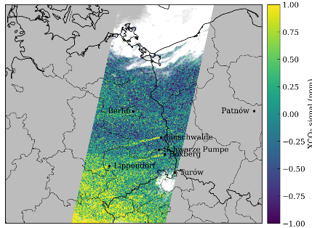
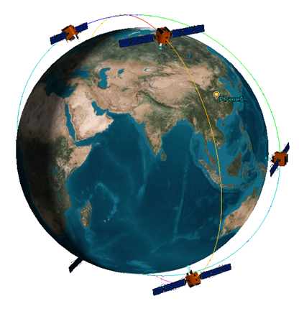
Future LEO GHG Constellations in the Planning Stages
X_{CO2} (σ= 0.5 ppm)
Copernicus CO₂ Sentinel (2025+)
  3 or 4 LEO satellites in an operational GHG constellation
  Primary instruments measure O₂ (0.76 μm A-band), CO₂ (1.61 and 2.06 μm), CH4 (1.67 μm) and NO₂ (0.450 μm) at a spatial resolution of 2 km x 2 km along a 200-300 km swath
  A dedicated cloud/aerosol instrument is also under consideration
TanSat-2 Constellation
  6 satellites, with 3 flying in morning sun-synchronous orbits and 3 flying in afternoon sun-synchronous orbits
  primary GHG instrument on each satellite with measure CO₂ (1.61 and 2.06 µm), CH₄ and CO (2.3 µm) as well as the O₂ A-band (0.76 µm) across a 100-km cross-track swath
TanSat Constellation

Slide 11
Merging Science and Operations
Because of the unprecedented requirements for precision and accuracy, the space based elements of the an operational GHG constellation architecture must be accompanied by
  Rigorous pre-launch and on-orbit measurement calibration and product validation methods that evolve to meet emerging needs
  Continuous refinements in remote sensing retrieval and flux inversion modeling methods that improve the products over time
CEOS could play an essential role in coordinating these activities among its partner agencies
Any operational architecture will also have to address
  orbit and mission coordination, data distribution, data exchange, and data format requirements
  Training and capacity building and public outreach will be needed to fully exploit the value of the space based GHG measurements
CEOS should collaborate with CGMS and other operational organizations to foster the development of these capabilities

