Slide 1
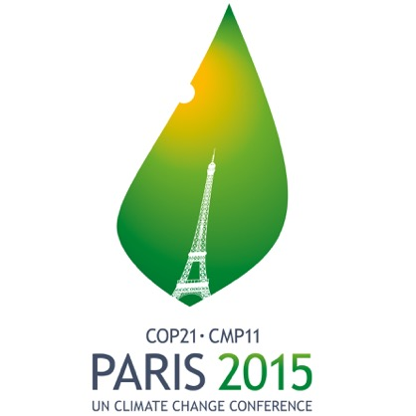
GCOS, The Paris Agreement and Carbon
Stephen Briggs, Chair GCOS Committee &
Simon Eggleston, GCOS Secretariat
Workshop on EC CEOS Priority
on GHG Monitoring
JRC Ispra, 18-19th June 2018

Slide 2
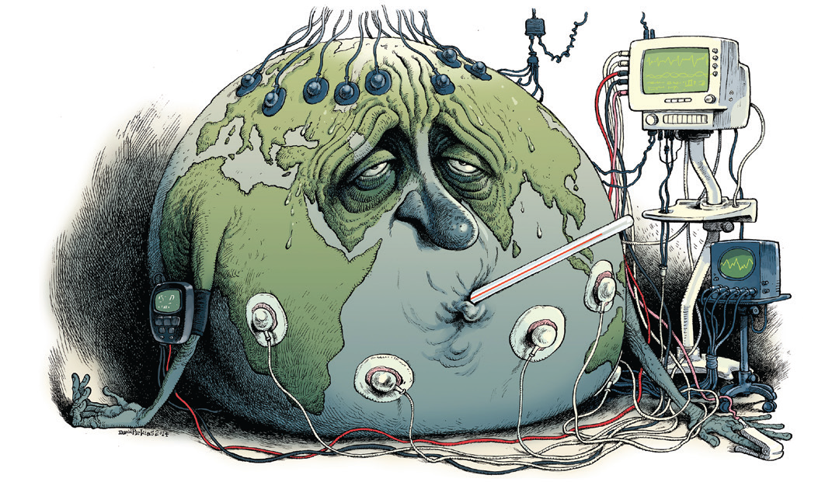
The importance of observations………
Credit: Victor & Kennel, Nature Climate Change, 2014.

Slide 3
GCOS
Vision
a world where users have free access to the climate-related information they need
Aim
to ensure the availability and quality of observations necessary to monitor, understand and predict the global climate system so that communities and nations can live successfully with climate variability and change
What is needed?
ECV Requirements Implementation Plans, Principles and Guidelines (1)
Support to observations
implementation plans, Regional workshops and plans, capacity development, (2)
Observations
NMHSs, Space Agencies, Other networks and research organisations
Where are we now?
adequacy of ECV observations and evaluation of improvements
(1)
Networks contributing to global climate observations should be:
Free and Open
Transparent
Accurate
Useful
Timely
Use best available science
Advocate (3) Coordinate (4) and Communicate (5)
GCOS Sponsors:

Slide 4
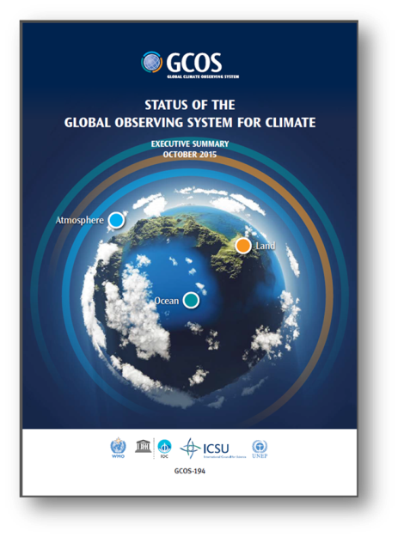
GCOS Reports and Plans
Adaptation & Mitigation
I
Water, Energy and Carbon cycles
II
Status
2015
New Plan
2016
Additional Essential Climate Variables
III
Emphasis on more help for networks in developing countries
IV
Notes:
The GCOS programme has duly delivered a status report, on how well we are doing in global observing systems, and we have submitted it to SBSTA last year in Paris. This year, we have provided you with a new plan on how to enhance and improve our existing observing systems.
New in our plan is that it looks into how to provide observations needed for adaptation and mitigation and it discusses what is needed to close the global cycles for water, energy and carbon. We have added a few new ECVs and we have put more emphasis on help for networks in developing countries.
3rd plan
And the news here is that…we are supporting adaptation&mitigation and ensuring that the cycles are being supported
Emphasis on the need to support developing countries and their observing networks
The Status Report which we have been delivered to COP21 in Paris last year showed that there has been improvement in the adequacy of the existing observing networks since 2010, but for the next decade we have to look into
1. Adaptation & Mitigation
2. Water, Energy and Carbon cycles
3. Additional Essential Climate Variables
4. Emphasis on more help for networks in developing countries

Slide 5
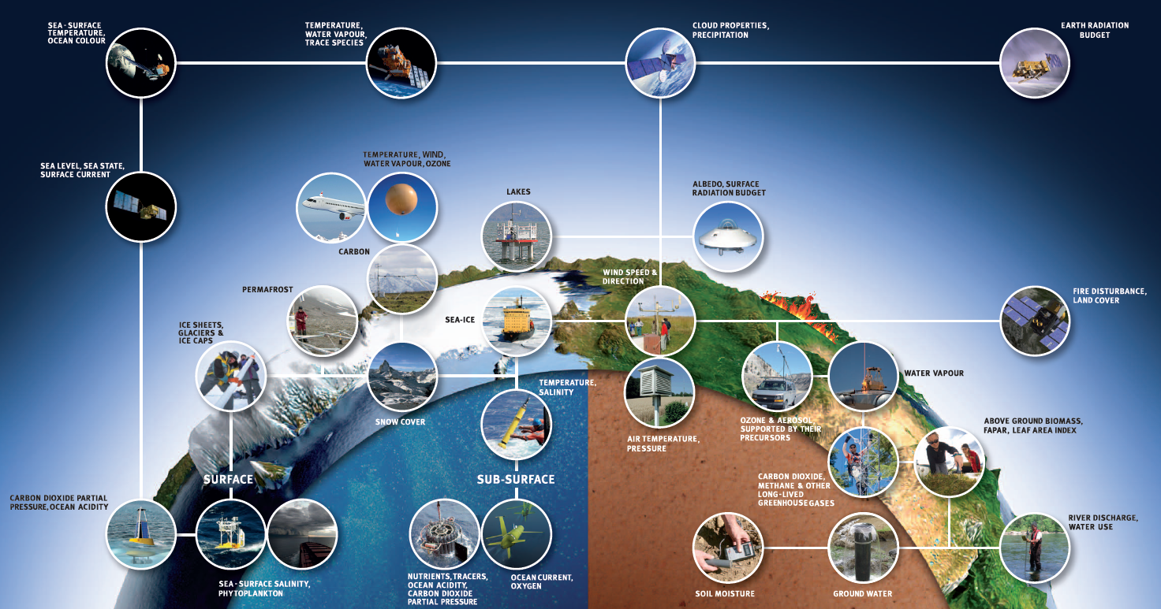
GCOS Essential Climate Variables

Slide 6
Climate Indicators
Global Indicators
Indicators under development
Temperature and Energy
Atmospheric Composition
Ocean
Cryosphere
Biosphere
Supplementary Indicators
Surface Temperature
Atmospheric CO₂
Ocean Acidification
Glacier Mass Balance
Ocean Heat
Sea Level
Arctic and Antarctic Sea Ice
Water
Heat Waves
Heavy Precipitation
Ecosystem change
Droughts
Methane
Top of atmosphere energy balance
N₂O
Snow extent
Halocarbon GHG

Slide 7
Mean Temperature
Ocean Acidity
Atmospheric CO₂
Glacier Mass
Balance
Global mean temperature anomalies, with respect to the 1850–1900 baseline, for the five global datasets (Source: UK Met Office Hadley Centre)
Trends in surface (< 50 m) ocean carbonate chemistry calculated from observations obtained at the Hawaii Ocean Timeseries (HOT) Program in the North Pacific over
1988–2015. Seawater pH (black points, primary y-axis) and carbonate ion concentration (green points, secondary y-axis). Ocean chemistry data were obtained from the Hawaii Ocean Timeseries Data Organization & Graphical System (HOT-DOGS). (Source: US National Oceanic and Atmospheric Administration (NOAA), Jewett and Romanou, 2017)
Globally averaged mole fraction (measure of concentration), from1984 to 2016, of CO2 in
parts per million (left), CH4 in parts per billion (middle) and N2O in parts per billion (right). The red line is the monthly mean mole fraction with the seasonal variations removed; the blue dots and line depict the monthly averages. (Source: WMO Global Atmosphere Watch)
Mean cumulative mass balance of all reported glaciers (blue line) and the reference glaciers (red line). SOURCE: world glacier monitoring service http://wgms.ch/
Ocean Heat Content
Sea Ice Extent
Sea Level
Change
Arctic
Antarctic
Global ocean heat content change (x 1022 J) for the 0–700 metre layer: three-monthly means (red), and annual (black) and 5-year (blue) running means, from the US National Oceanic and Atmospheric Administration (NOAA) dataset. (Source: prepared by WMO using data from NOAA National Centers for Environmental Information)
Global mean sea-level time series (with seasonal cycle removed), January 1993–January 2018, from satellite altimetry multi-missions. Data from AVISO
(Source: Collecte- Localisation-Satellite (CLS) – Laboratoire d’Etudes en Géophysique et Océanographie Spatiales (LEGOS))
September sea-ice extent for the Arctic, and (right) September sea-ice extent for the Antarctic. Percentage of long-term average of the reference period 1981–2010 (Source: prepared by WMO using data from the US National Snow and Ice Data Center)

Slide 8
The UNFCCC and GCOS
UNFCCC
Global Carbon Budget
Sea Level Rise, etc
Adaptation and Mitigation Workstreams
NAPs, NDCs
Loss & Damage
…
Observe
WMO
GCOS
CEOS
Research
WCRP
IAMC
Future Earth
PROVIA
Assess Knowledge
IPCC
AR6,
SR1.5, SROCC,
SRCCL, SCFR
SBSTA
Research
Systematic Observations
COP/CMA Global Stocktake
Assess collective progress on implementation of Paris Agreement
Assess adequacy of agreed warming limit
Climate Services
GFCS
WCSP
Temperature, and other critical climate parameters for Adaptation & Other Services.
ECV Inventory, Indicators, IG³IS
GCOS Implementation Plan
Regional Workshops
WMO State of the Environment
Feedback on needs and adequacy of information

Slide 9
Art 4
Art 5
Art 7
Art 8
Art 9
Art 10
Art 11
Art 12
Art 13
Art 14
NDCs
FINANCE
MITIGATION
TECH TRANSFER
COMMUNICATIONS
GLOBAL STOCKTAKE
LOSS & DAMAGE, EWS,..
CAPACITY BUILDING
ADAPTATION, EWS, RSO…
REPORTING/TRANSPARENCY
Art 7 (7c)
*Paris Agreement Article 7 (7c): Strengthening scientific knowledge on climate, including research, systemic observation of the climate system and early warning systems.
Notes:
COP-21: Paris Agreement Article 7 (7c)
Strengthening scientific knowledge on climate, including research, systematic observation of the climate
system and early warning systems, in a manner that informs climate services and supports decision- making
Developing the Transparency Framework (the need to promote transparency, accuracy, completeness, consistency, and comparability, and environmental integrity)
Short Keys:
Art. 4. Nationally Determined Contribution
Art. 5. Mitigation (REDD+)
Art. 7. Adaptation & Early Warning Systems. Systematic Observations, Adaption planning
Art. 8. Loss and damage: Early warning systems, emergency preparedness, slow onset events etc.
Art. 9 Provide finance Art. 10 Technology Transfer
Art. 11 Capacity Development
Art. 12. Improve Public Communications
Art. 13: para. 7 & 8. Reporting and transparency framework Art. 14 Global Stocktake

Slide 10
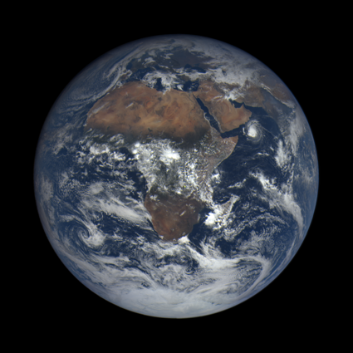
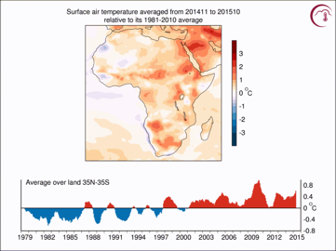
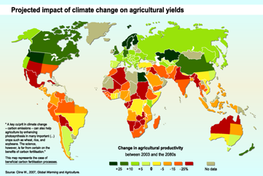
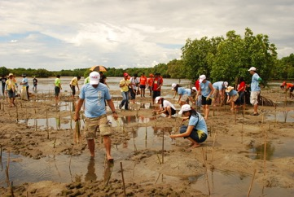
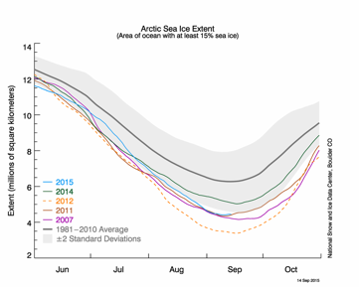
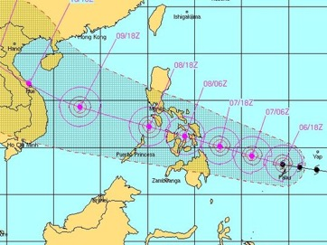
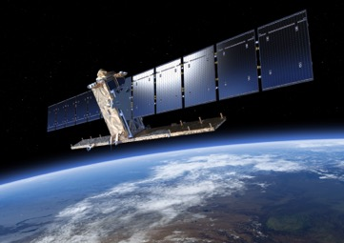
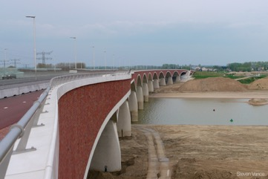
From observations to decisions
Sensing
Observation of the Earth System
Data Records
Preparation of Climate Data records
Archiving,
Reanalysis,
Production of long datasets
Delivery of Services
Delivery of targeted information for specific applications or to inform decisions
Decision Making and Implementation
Implement actions based on the information

Slide 11
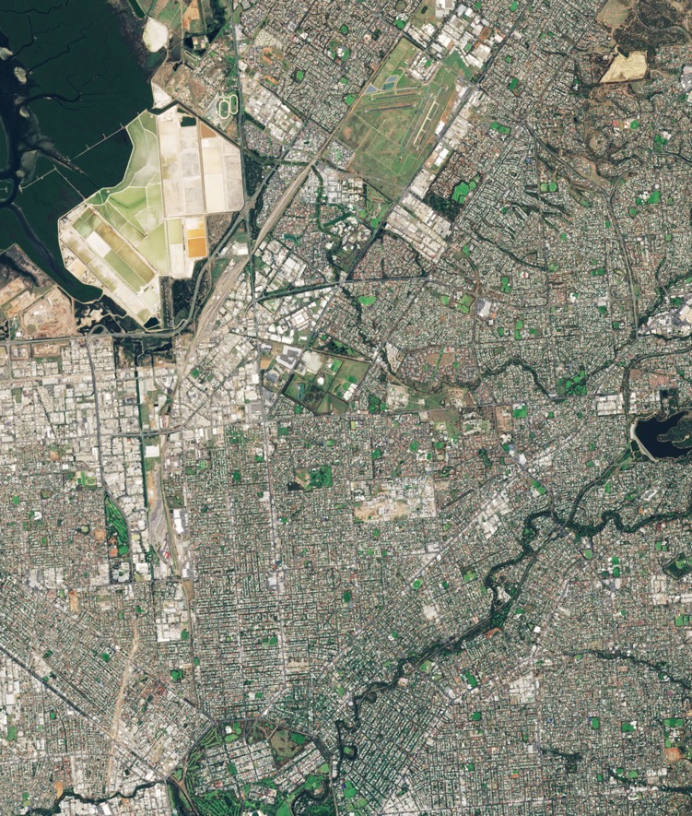
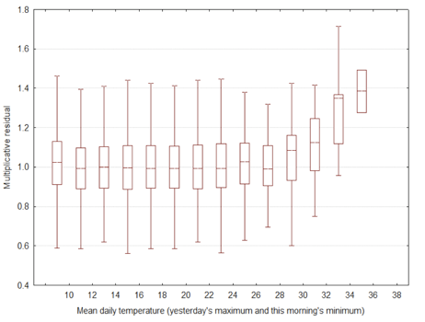
Example of potential remote observation of implementation of adaption actions
Expected Mortality leads to Actions to cool Cities
Overall impact of these actions can be monitored remotely
Adelaide. SOURCE: modified Copernicus Sentinel data (2017), processed by ESA, CC BY-SA 3.0 IGO

Slide 12
Precipitation, Cloud Properties, Water Vapour Surface Temperature
Ocean Acidification
Carbon Dioxide, Methane
Deforestation
Mitigation
Ecosystem Loss
Sea Level Rise
Fisheries
Water
Carbon
Sea Surface & Subsurface Salinity, Sea Level, Sea Surface Temperature
Soil Moisture, River Discharge, Lakes, Groundwater, Cryosphere, Water use
Inorganic Carbon
Soil Carbon, Above-ground Biomass, Fire, GHG Fluxes
GCOS aims to improve monitoring of Global Climate Cycles
Coral Bleaching
Agriculture
Human Health
Floods
Droughts
Water Resources
Storms
Radiation Budgets, Temperature Wind speed & direction
Systemic Risks
Security
Slow Economic Development
Energy
Ocean Surface Heat Flux, Sea Surface & Subsurface Temperature,
Albedo, Latent and Sensible Heat fluxes, Land Surface Temperature
Temperature
Heat waves

Slide 13
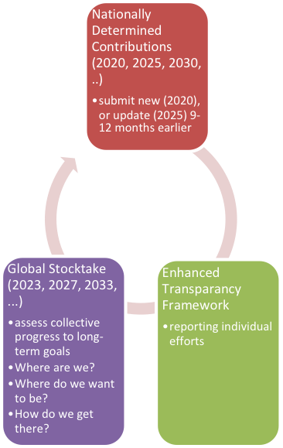
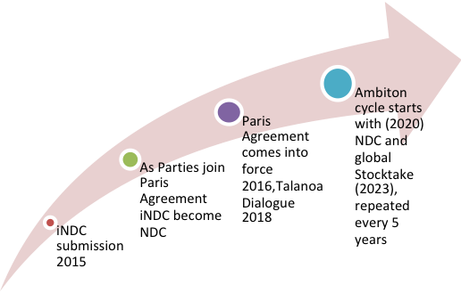
The road to the Global Stocktake
Ambition Cycle
Every 5 years

Slide 14
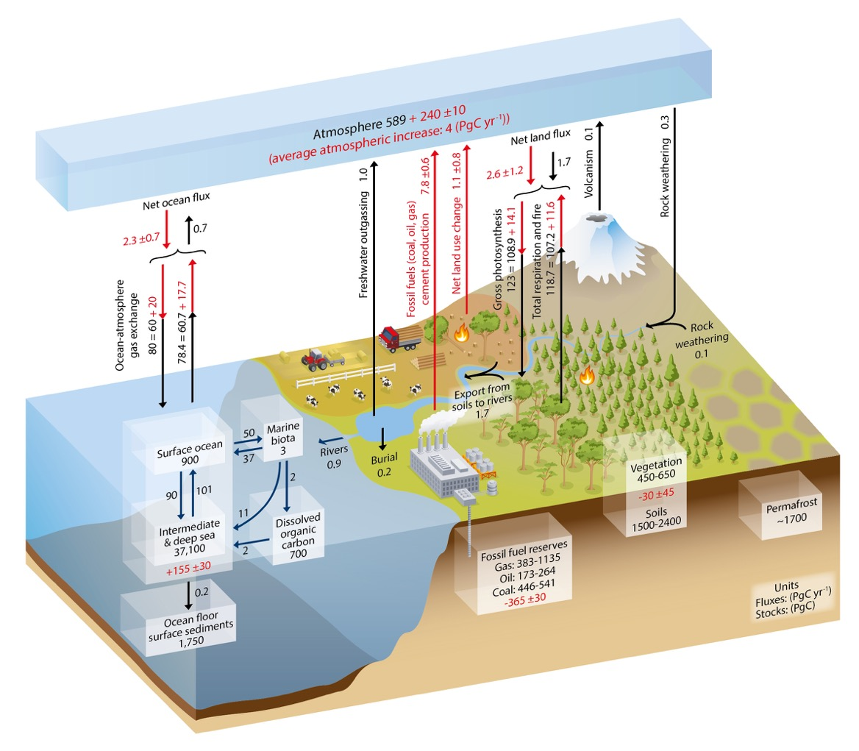
Global Carbon Cycle: selected improvements
What is needed to improve monitoring of the global carbon cycle?
The GCOS implementation plan identifies several actions that support the improvement in the observation of the carbon cycle and some are highlighted here.
These will be implemented by a wide range of organisations such as WMO, IOC, GOOS, GTN-P, Satellite agencies and national metrological, hydrological and forest agencies.
GCOS, through its science panels, will review progress on these actions and advocate for improvements.
Following a public review, the GCOS science panels produced requirements for the observation of all ECV products in terms of resolution and measurement uncertainty. These requirements will be reviewed and updated for an update of the implementation plan in 2021/2022. To initiate this update, GCOS will be asking for public comments and suggestions later this year.
Land Use Change
Atmospheric concentrations
Fire
Biosphere
Anthropogenic Emissions
Ocean Carbonate System
SOURCE: IPCC AR5, IPCC 2013
Permafrost
Coastal Areas
River Discharge
Ocean carbonate system
Increase the number of sites leading to improved information on seasonal and longer variability with a better regional resolution.
Soil Carbon
Cooperate with soil carbon exercises to produce accurate global maps. Flux measurements at 5-year intervals to supplement long-term experiments.

Slide 15
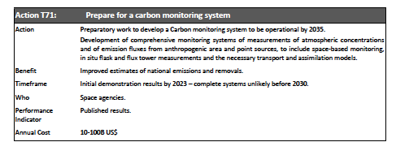
GCOS IP Action T71

Slide 16
Observing the carbon cycle
Globally we understand and can quantify the carbon cycle
There is a budget imbalance but this is small over several years but with larger year-to-year variability
Regional estimates of CO₂ can be made and compared with emission inventory estimates – in general these agree fairly well
More observations are needed to support national emission estimates
Estimates for fuel combustion and industry good – more uncertainties around land use change and agriculture.
Uncertainties are much larger for Methane (and N₂O)
Emission estimates are made following the IPCC guidelines but these have large uncertainties for diffuse sources
Leaks depend on age, maintenance, regulation and oversight etc.
IPCC emission factors are averages so give better results for larger areas
It is difficult to split land-based emissions (e.g. wetlands) into anthropogenic and non-anthropogenic
Observations of individual forests for mitigation can be good, but these are not made on a global scale

Slide 17
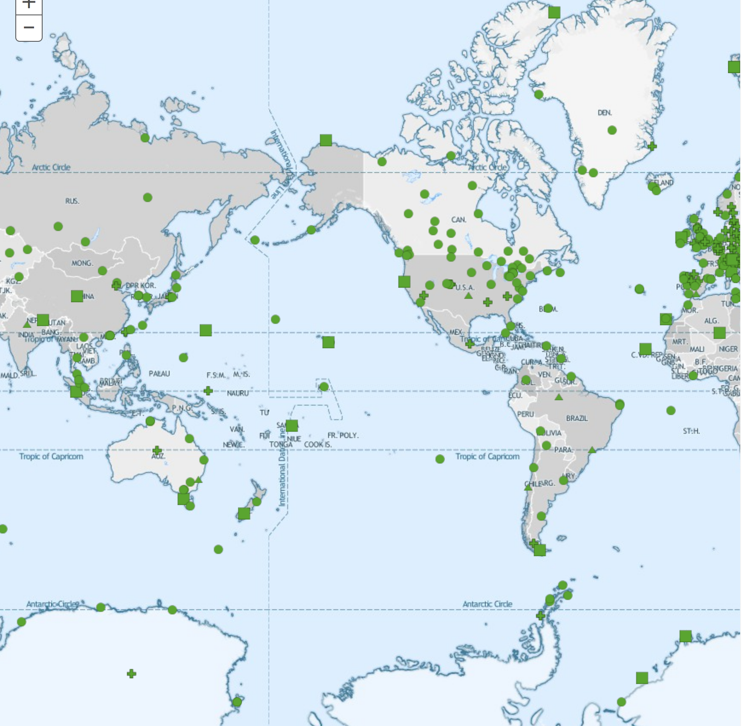
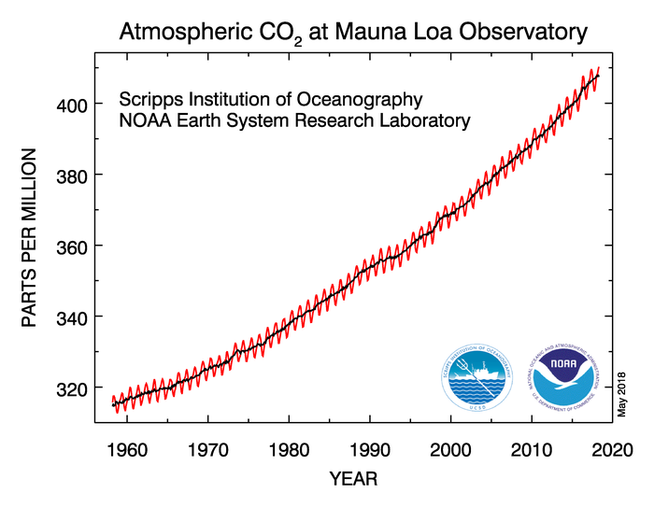
Atmospheric CO₂
Measurements coordinated by WMO’s Global Atmosphere Watch, GAW
Globally, trends, growth rate and variability well understood
More measurement needed to assess national source strengths and support national emission inventories (IG3IS)

Slide 18
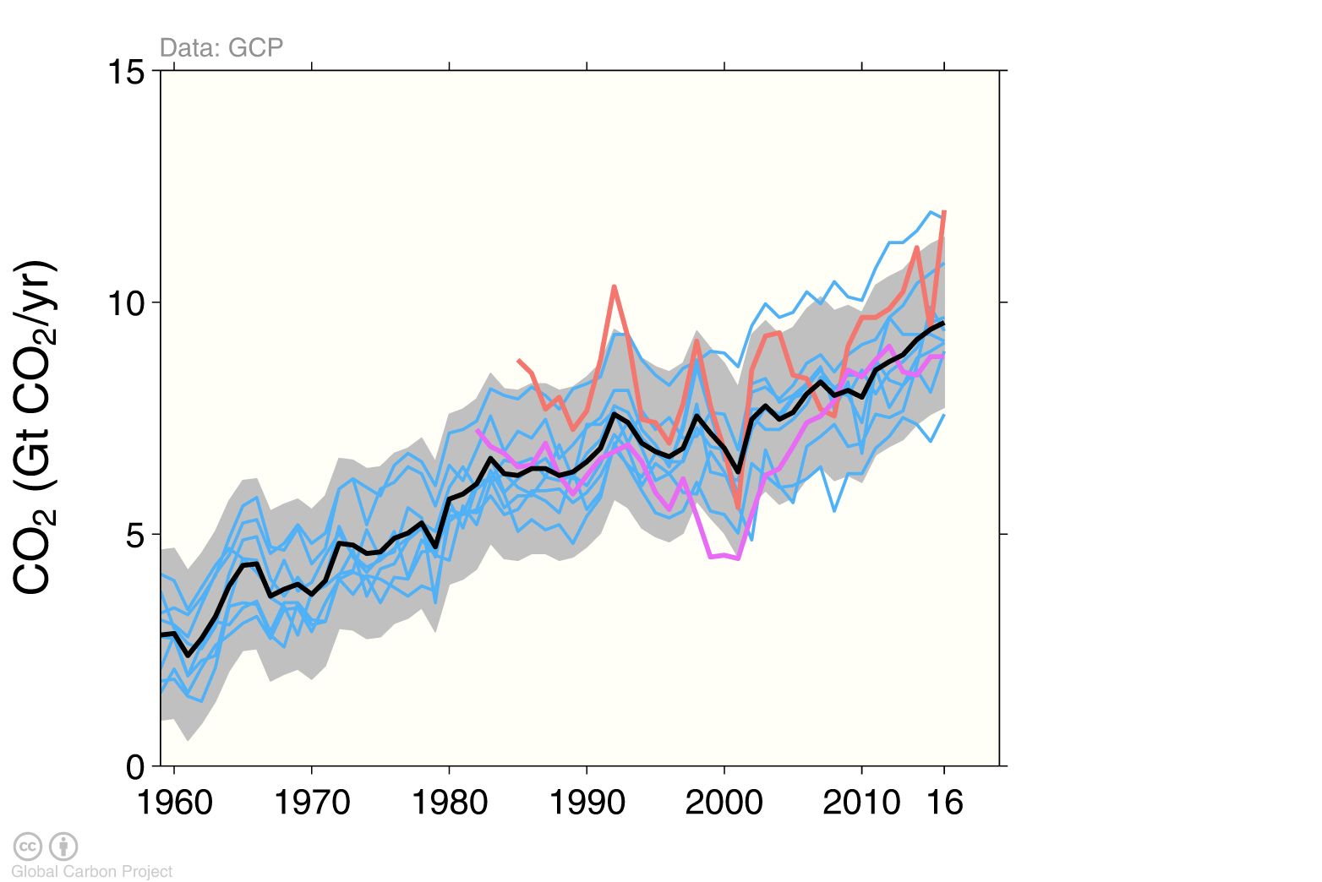
Global Carbon Project - Ocean Carbon
The ocean carbon sink continues to increase: 8.7±2 GtCO2/yr for 2007–2016 and 9.6±2 GtCO2/yr in 2016
Significant differences between observation based products but consistent with range of models
individual ocean models
Global Carbon Project carbon budget
pCO₂-based flux products
ISource: SOCATv5; Bakker et al 2016; Le Quéré et al 2017; Global Carbon Budget 2017 Individual estimates from: Aumont and Bopp (2006); Buitenhuis et al. (2010); Doney et al. (2009); Hauck et al. (2016); Ilyina et al. (2013); Landschützer et al. (2016); Law et al. (2017); ; Rödenbeck et al. (2014). Séférian et al. (2013); Schwinger et al. (2016). Full references provided in Le Quéré et al. (2017).

Slide 19
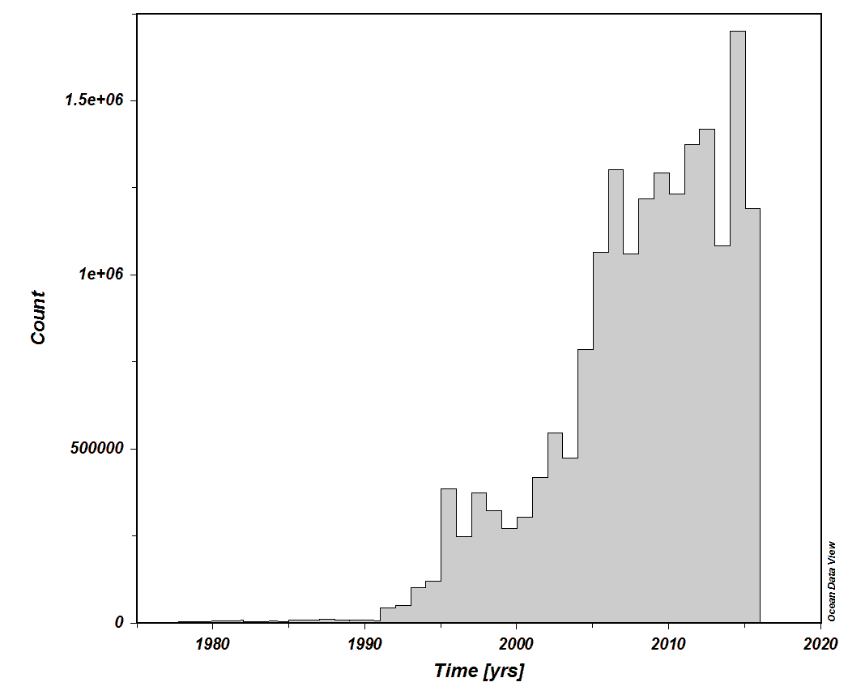
Ocean Observations
Main sources of uncertainty in C sink (GCP):
Variability on ocean circulation
Global, particularly the southern ocean, Semi-decadal to decadal
Anthropogenic changes in nutrient supply
Global, Multi-decadal trend
River discharge carbon not included
Future improvements aimed at
Reversing decline in measurements form ships
More measurements from buoys, drifters etc.

Slide 20
Land: Main sources of uncertainty (GCP)
Land-use change emissions (mainly observations)
Land Sink (mainly process understanding)
Land-cover and land-use change statistics
Continuous, Global, particularly tropics
Sub-grid scale transitions
Annual, global
Wood and crop harvest
Annual, SE Asia
Peat burning
Multi-decadal trend, global
Loss of additional sink capacity
Multi-decadal trend, global
Strength of CO₂ fertilisation
Multi-decadal, global
Response to variability in temperature and rainfall
Annual, global
Nutrient limitation and supply
Multi-decadal trend, global
Response to diffuse radiation
Annual, global

Slide 21
Land observations
Increasing temporal and spatial resolution of satellite data
Often used for mitigation e.g. REDD+
30m resolution and more than once a year
Combining radar and optical observations
Ground-based data needed for validation and calibration to biomass and Carbon
Often not scaled up to give regional picture
Land and forest degradation can be more difficult to track
Inventories reported to UNFCCC report only “anthropogenic emissions and removals”
Anthropogenic is defined here as occurring on managed land so is not the same as biogenic

Slide 22
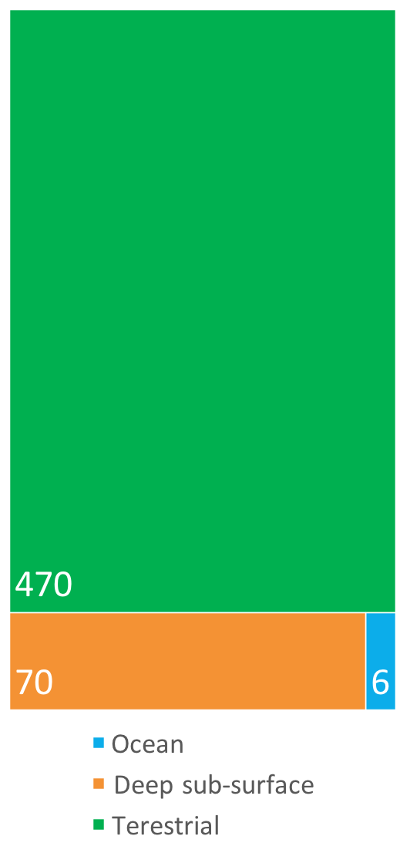
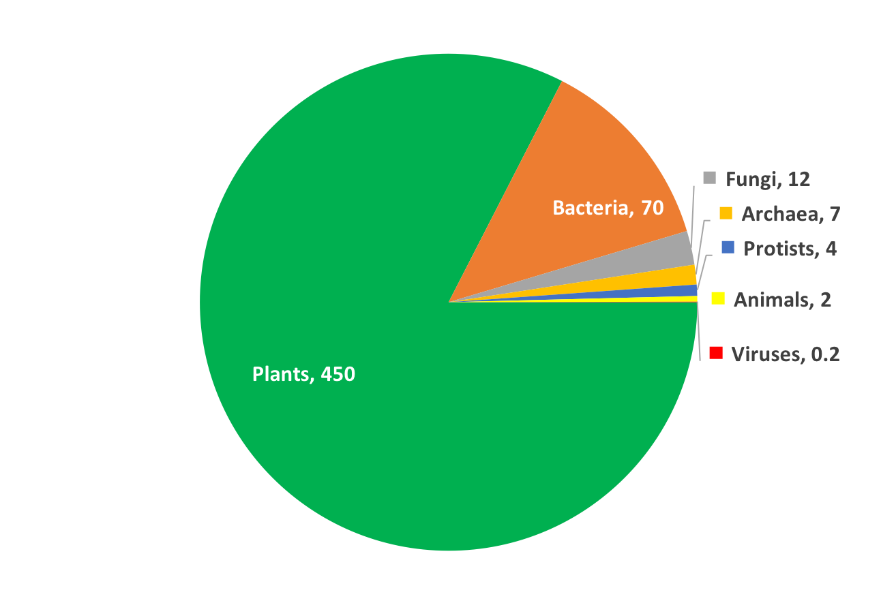
Carbon held in biomass
82% of carbon in biomass is in plants
86% 0f carbon in biomass is terrestrial
SOURCE: The biomass distribution on Earth, Yinon M. Bar-On, Rob Phillips, and Ron Milo, PNAS May 21, 2018. https://doi.org/10.1073/pnas.1711842115

Slide 23
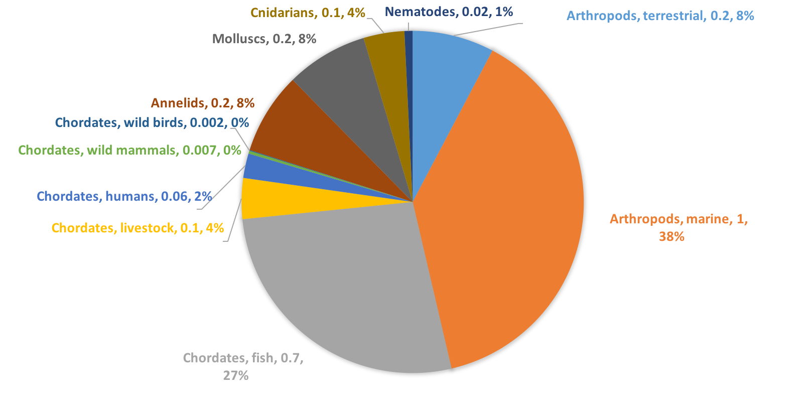
Carbon held in animals
Animals account for only 0.4% of carbon in all biomass
SOURCE: The biomass distribution on Earth, Yinon M. Bar-On, Rob Phillips, and Ron Milo, PNAS May 21, 2018. https://doi.org/10.1073/pnas.1711842115

Slide 24
Global Fossil fuel and industry emissions by country
Emissions from OECD countries are about the same as in 1990 Emissions from non-OECD countries have increased rapidly in the last decade
Source: CDIAC; Le Quéré et al 2017; Global Carbon Budget 2017

Slide 25
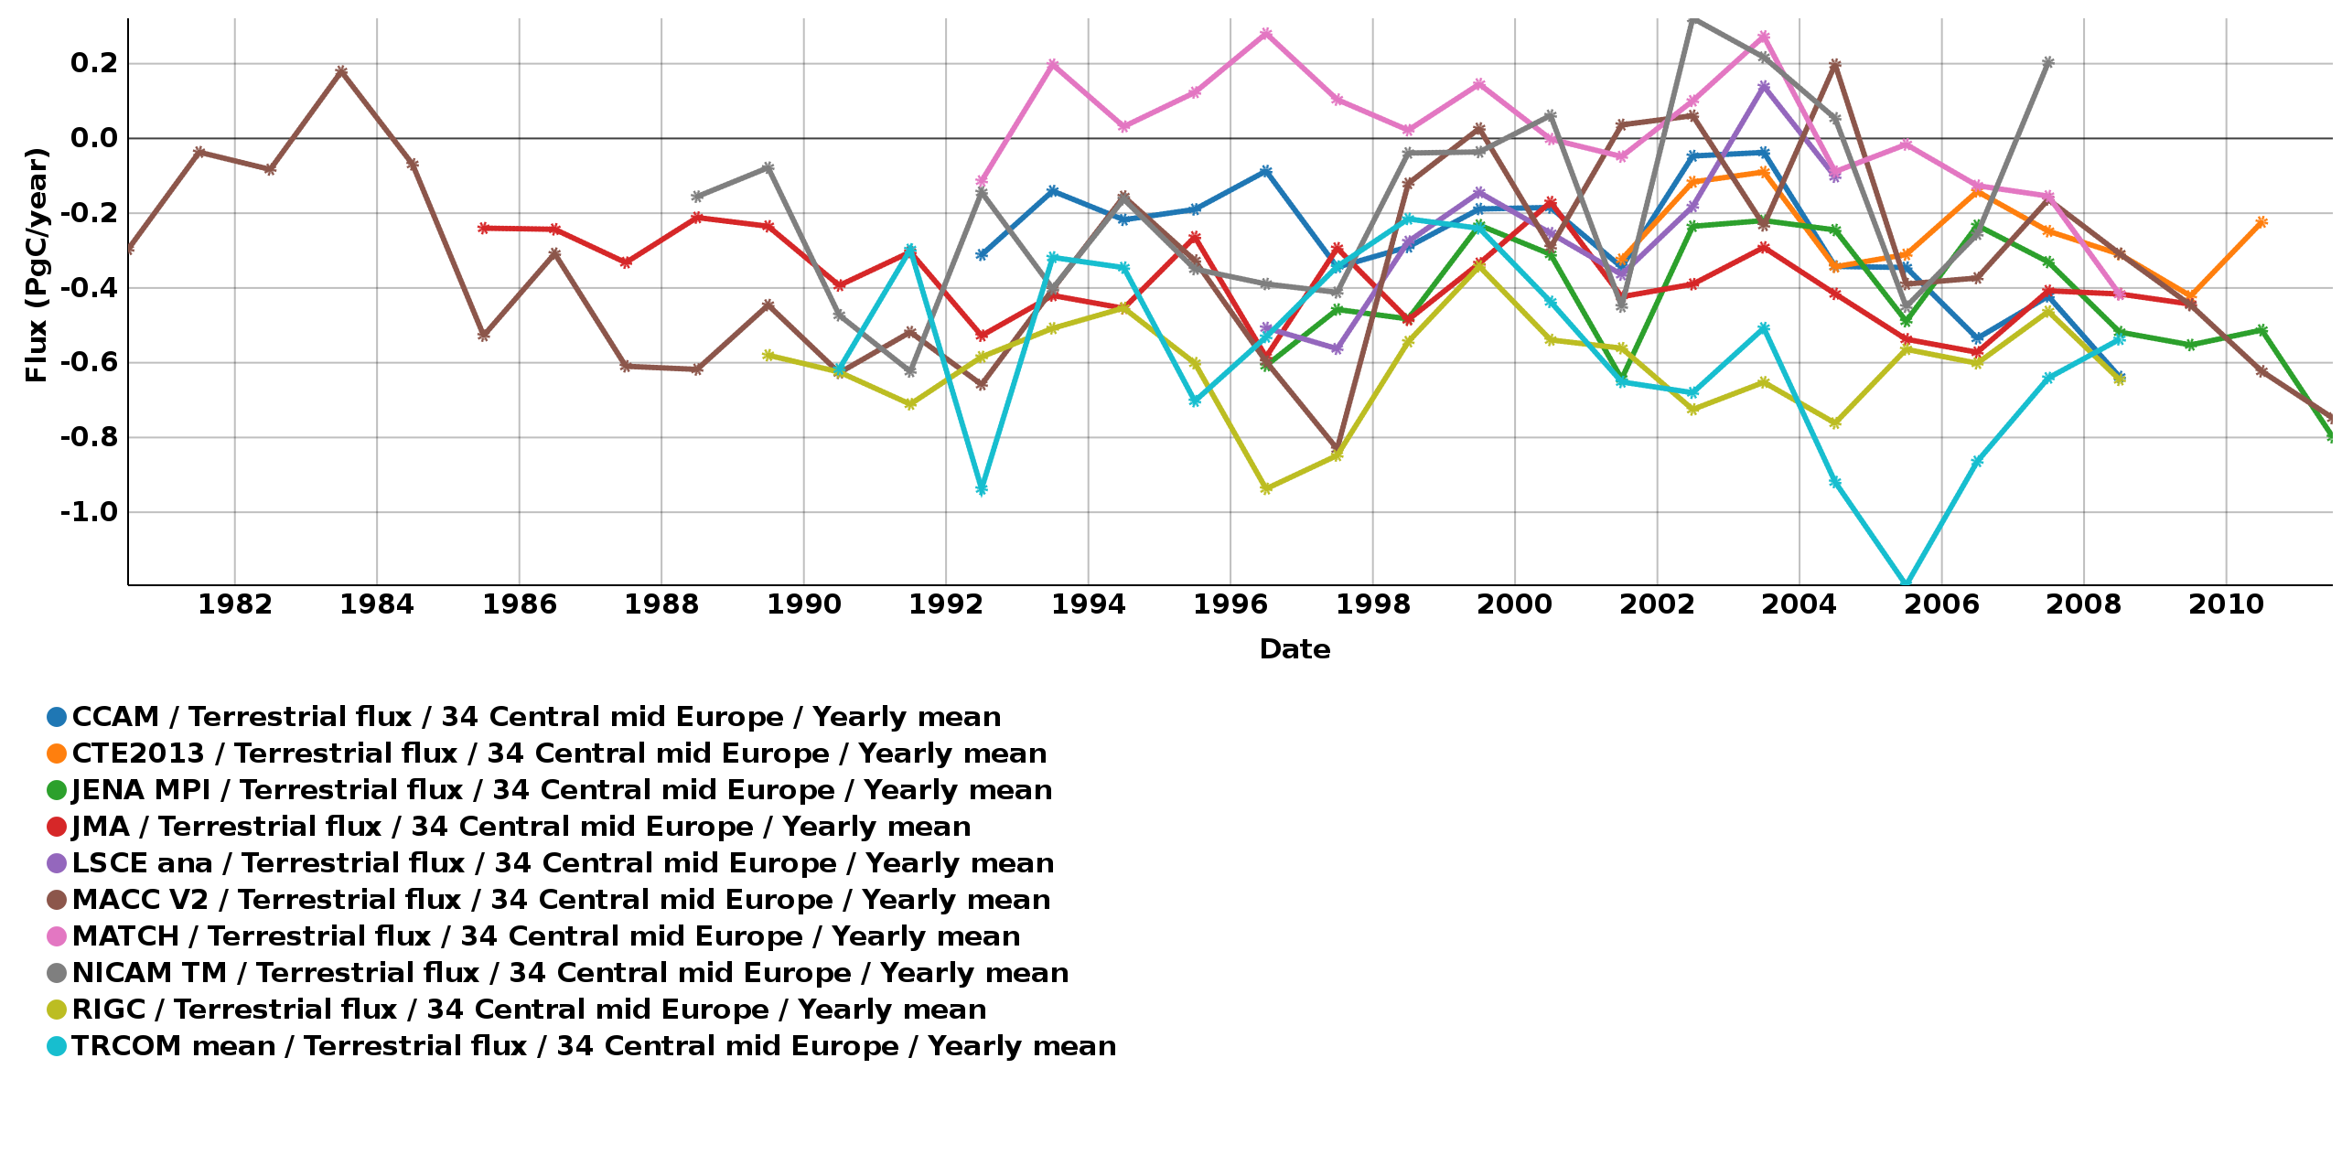
Inversions
Countries report their emissions to the UNFCCC using guidelines written by the IPCC and based, mainly, on socio-economic data, measured fuel consumption and carbon and energy contents.
It is possible to use inversion of atmospheric composition data to estimate source strengths: Some national examples exist
This would provide needed checks and guidance for inventory compilers and add credibility to their results.
A comprehensive plan to improve observations is needed to fulfil this promise
Inventories provide a lot of detailed needed for planning mitigation and inversion can give needed checks in the overall outcomes
Inversions for central-mid Europe

Slide 26
Thank you

