Slide 1
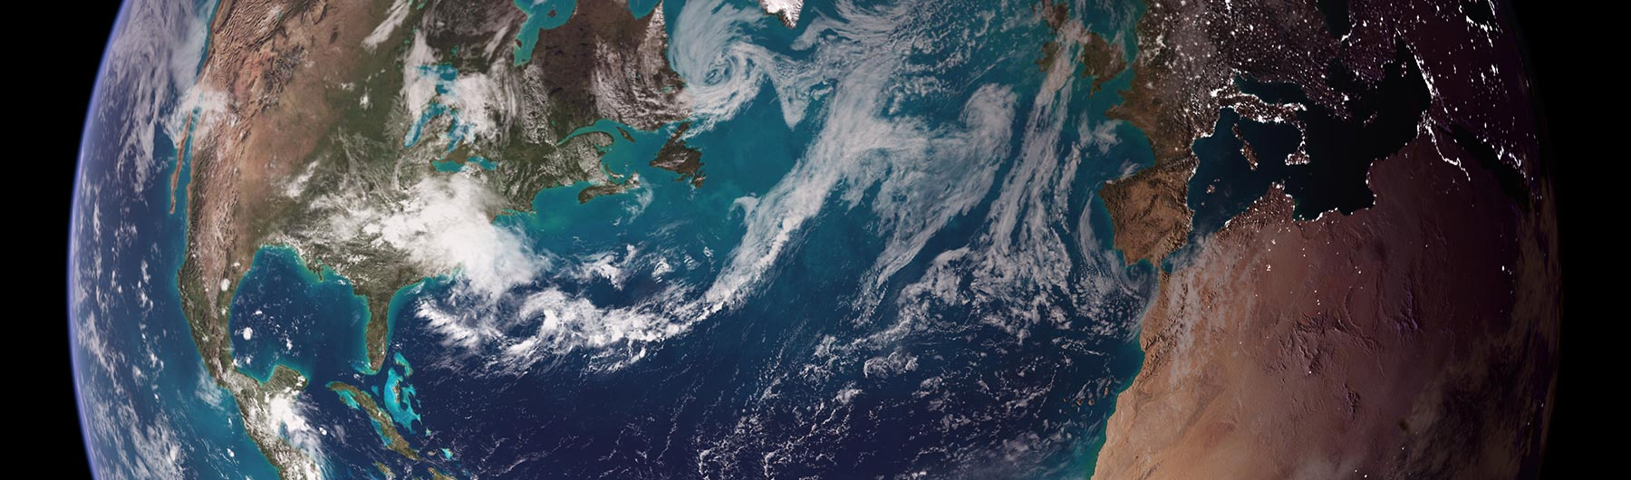

CEOS Priority Workshop on GHG Monitoring: Interfaces Between CEOS Agencies and the GHG Monitoring System
Alisa Young and Chris Barnet
Ispra, Italy
June 18-19 2018

Slide 2
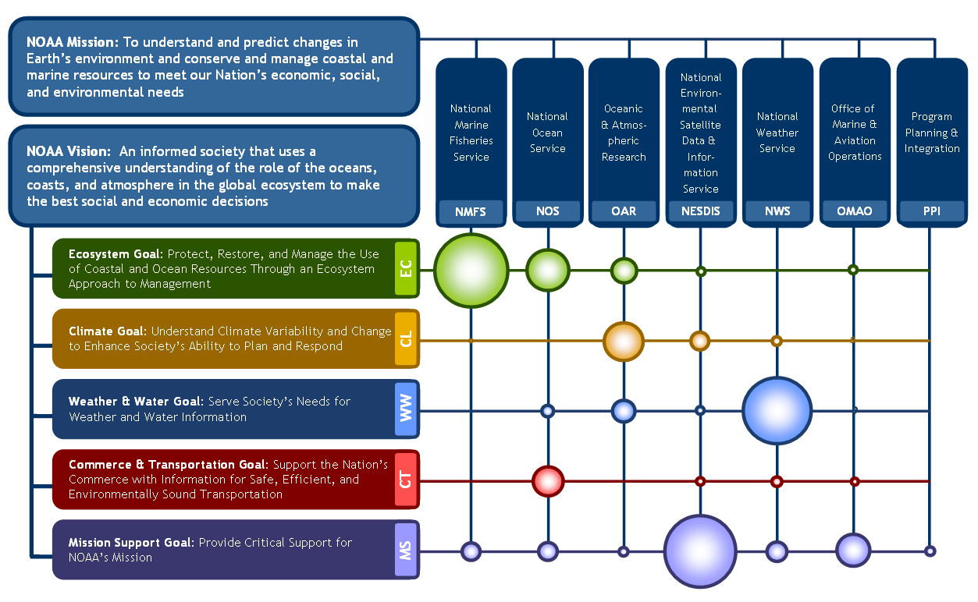
NOAA Line Office Priorities
Notes:
Notes:
The size of the circles given is the illustration are relational and demonstrative of line office and mission focus versus scaled accurately to show the proportional budget or manpower investment in each goal (notably NESDIS funding is half of NOAA overall & double NMFS). The schematic shows the degree to which various line offices prioritize and/or carry out particular goals as it relates to the ecosystem, weather, and water, climate, etc and is helpful in guiding the direction of the agency perspectives on sustained observations/sampling of atmospheric constituents and GHG Monitoring which could be effectively considered a climate goal.
Although observing, modeling, and engaging with users/stakeholders are shared enterprise services/goals. We’ll focus on the capabilities provided from OAR and NESDIS
NWS has climate prediction center as an example of the small part of its mission area that is focused on Climate (ENSO for example)

Slide 3
Office Oceanic and Atmospheric Research (OAR)
Global Monitoring of Atmospheric Constituents:
Measures climate forcing agents in the atmosphere at 269 sites around the world for up to 40 different chemicals.
GHG Reference Network of air sampling sites has 55 active sites that precisely measure CO₂, methane (CH₄), nitrous oxide (N₂O), sulfur hexafluoride (SF₆), carbon monoxide (CO), and hydrogen (H₂).
Monitoring includes, In-situ observations, at surface, on towers, buoys, via aircraft, etc.
Notes:
Top Image: NOAA Global Cooperative Air Sampling Network Used to Determine the AGGI. Red dots are weekly flask sampling sites and blue circles are continuous measurement sites.
Bottom Left Image: Flask air samples in ESRL/GMD Lab
Bottom Right Image: Image during flight for ESRL/GMD Aircraft Program
ERSL/GMD global CO2 372 ppm in 2002, 402 ppm in 2016, 30 pppm/372 ~= 8% increase
Within NOAA, OAR serves a unique role. NOAA’S other line offices specialize in operational services: managing environmental data, providing information on ocean environments, delivering weather forecasts, and warnings, and acting as stewards of living marine resources and habitats. OAR, on the other hand, specializes in improving these capabilities, and improving our understanding of the Earth system across these mission areas. OAR's position is at the intersection of NOAA’s science and service missions and the broader research community enables it to lead a research agenda and forge partnerships that advance understanding and prediction of the Earth System to enhance society's ability to make effective decisions.
OAR Climate R&D Questions:
What is the state of the climate system and how is it evolving?
What causes climate variability and change on global and regional scales?
What improvements in global and regional climate predictions are possible?
How can NOAA bet inform and support the Nation’s efforts to adapt to the impacts of climate variability and change?

Slide 4
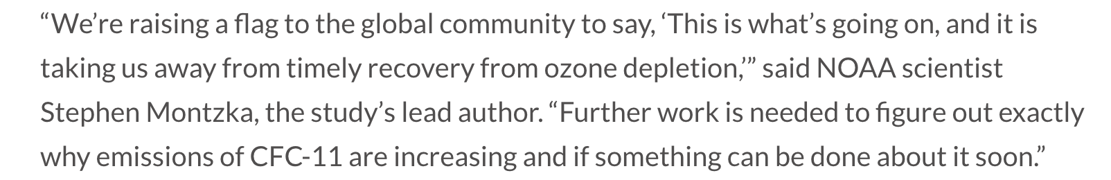
Office Oceanic and Atmospheric Research (OAR)
Global Monitoring of Atmospheric Constituents:
Other Societal Services:
Independent verification of emissions reductions
NOAA Annual GHG Index (AGGI)
Carbon Tracker (Modeling)
North American Carbon Program
Satellite Cal/Val
GHG Research
“An unexpected and persistent increase in global emissions of ozone-depleting CFC-11” – Lead Author, Stephen Montzka
Notes:
Top Image: NOAA Global Cooperative Air Sampling Network Used to Determine the AGGI. Red dots are weekly flask sampling sites and blue circles are continuous measurement sites.
Bottom Left Image: Flask air samples in ESRL/GMD Lab
Bottom Right Image: Image during flight for ESRL/GMD Aircraft Program
ERSL/GMD global CO2 372 ppm in 2002, 402 ppm in 2016, 30 pppm/372 ~= 8% increase
Within NOAA, OAR serves a unique role. NOAA’S other line offices specialize in operational services: managing environmental data, providing information on ocean environments, delivering weather forecasts, and warnings, and acting as stewards of living marine resources and habitats. OAR, on the other hand, specializes in improving these capabilities, and improving our understanding of the Earth system across these mission areas. OAR's position is at the intersection of NOAA’s science and service missions and the broader research community enables it to lead a research agenda and forge partnerships that advance understanding and prediction of the Earth System to enhance society's ability to make effective decisions.
OAR Climate R&D Questions:
What is the state of the climate system and how is it evolving?
What causes climate variability and change on global and regional scales?
What improvements in global and regional climate predictions are possible?
How can NOAA bet inform and support the Nation’s efforts to adapt to the impacts of climate variability and change?

Slide 5
NESDIS
Primary function is to support other NOAA LO.
Core Capabilities are for real-time regional weather imagery and global near real-time soundings.
Observations of Global Atmospheric Composition have not been a high-level priority.
However, we do have some capabilities for global GHG monitoring
Objectives are ranked by importance of improvement above threshold level as defined by the NSOSA, a pathfinder study for steering NESDIS into new cost effective business approaches that offers more agility for launching new technologies in space.

Slide 6
CO2 Retrievals from Space:
Thermal Hyperspectral Sounder Capabilities
We have 5 operational thermal sounder suites at this time
There are numerous differences in these sounding suites
  Instruments are different
    Spectra resolution, sampling and noise
    Spatial sampling
    Degradation over time
  Algorithm differences
    Training datasets are different
      9:30/1:30 orbits co-location w/in-situ is different
  Resultant product differences
    Sensitivity to meteorology (e.g., clouds at 9:30 vs 1:30 am/pm) or climate (e.g., 8% increase in CO₂, 2002-2017)
Satellite | Instruments | Overpass | Launch dates
Aqua | AIRS, AMSU | 1:30 | 2002
Metop-A, -B | IASI, AMSU, MHS | 9:30 | 2005, 2012, …
S-NPP, NOAA-20 | CrIS, ATMS | 1:30 | 2011, 2017, …
GHG Monitoring was not the primary design criteria of the modern satellite sounding suite
Notes:
ERSL/GMD global CO2 372 ppm in 2002, 402 ppm in 2016, 30 pppm/372 ~= 8% increase
Could be induced by algorithm
Operational in 2009 for Metop-A and 2012 for S-NPP, 2014 for Metop-B
e.g., operational constraints prohibit a common training of T(p) and q(p) regression
..or.. meteorology at 9:30 is different than 1:30
9:30 T & clouds are closer to diurnal average, 1:30 max extremes
Marine stratocumulus tend to be more filled-in at 9:30 am
Oceans are cloudier at 9:30 am, Land is ~20% cloudier at 1:30 pm
..or.. due to instrument differences
4 FOV IASI CCR’s have lower contrast than 9 FOV CCR’s
IASI spectral resolution, spatial sampling, NEDN
ATMS spatial and spectral sampling is better than AMSU/MHS
..or.. due to poor validation datasets
Aliasing between over-pass time and synoptic model or RAOB launch time
1:30 am/pm overpass tends to select Europe/Hawaii 0,12Z
9:30 am/pm overpass tends to select mid-Atlantic, Japan, and Australia 0,12Z
A common RAOB dataset doesn’t help
Forcing Metop and S-NPP to use same RAOBS forces a systematic 4 hour time of day difference

Slide 7
CO2 Retrievals from Space (Cont.)
Two versions of our retrieval algorithm:
NOAA-Unique Combined Atmospheric Processing System (NUCAPS)
  Model-independent system (except surface pressure).
  Real-time processing via direct broadcast.
  Each algorithm became operational ~1 year after launch.
Community Long-term Infrared Microwave Coupled Atmospheric Product System (CLIMCAPS)
  Uses Merra-2 for T(p), q(p), and O3(p) a-priori.
    Less sensitive to instrument and sampling differences.
  Full error propagation (partition a-priori and measurement errors).
  Hind-sight re-processing (~1 month latency).

Slide 8
Together these two algorithms can meet the needs of three communities
WEATHER
Extreme events
Risk - Commercial (Air Traffic, Energy)
COMPOSITION
Monitor GHG’s
Air Quality
CLIMATE
Processes
Feedbacks
Long-term trends

Slide 9
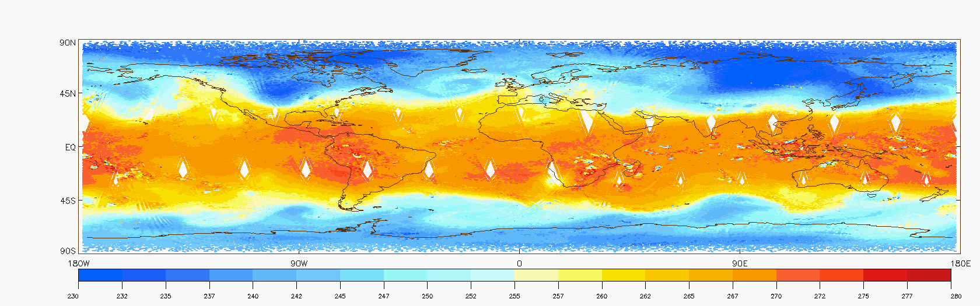
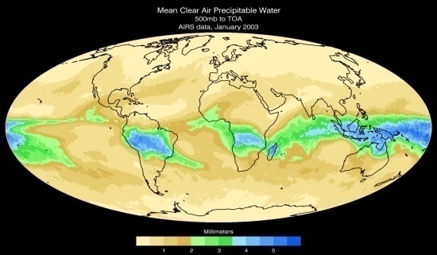
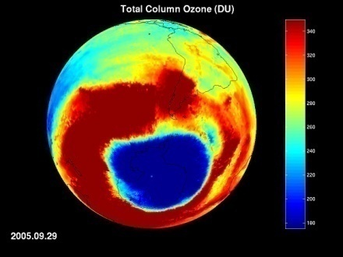
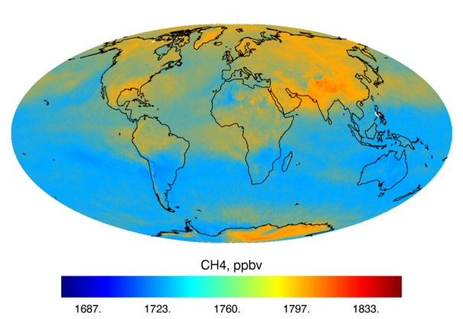
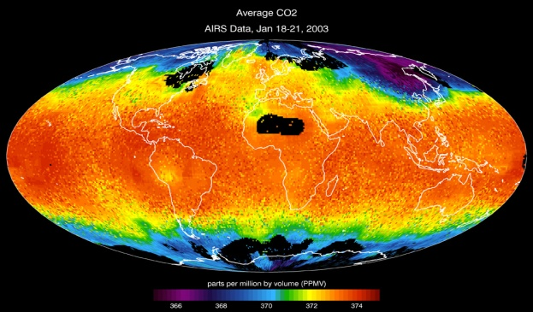
Operational and experimental retrieval products
Retrieval Product | Spectral Region(s) Used (cm⁻¹)
Cloud Clearing Parameters (4 linear parameters) | 660 – 750 2200 – 2400
Cloud fraction and Cloud Top Pressure and Temperature | 660 - 750
Surface temperature (LST, SST), emissivity and solar reflectivity | 800 – 950, 1210 – 1230, 2400 – 2550
~10 to 1000 hPa Temperature, T(p) (Note: also use 57 GHz microwave) | 660 - 750 2200 – 2400
~200 to 1000 hPa Water Vapor, q(p) (Note: also use 20, 35, 89, 183 GHz) | 780 – 1090 1200 – 1750
Lower stratosphere Ozone | 990 – 1070
Mid-tropospheric Carbon Monoxide, CO(p) | 2155 – 2220
Mid-troposphere Methane, CH₄(p) | 1220 - 1350
Mid-troposphere Carbon Dioxide, CO₂(p) | 660 – 760, 980, 2200 - 2400
Lower-stratosphere Nitrous Oxide, N₂O(p) | 1290 - 1300 2190 - 2240
Mid-troposphere Nitric Acid, HNO₃(p) | 760 - 1320
Volcanic mid-tropospheric Sulfur Dioxide, SO₂(p) | 1343 - 1383
500 hPa Temperature
500 hPa Water Vapor
(January 5th 2014 Polar Vortex Anomaly)
Ozone
Methane
Carbon Dioxide

Slide 10
Areas of our current sounding research
With NUCAPS we are developing the weather and air quality applications (uses both 9:30 and 1:30 orbits).
  Air traffic safety.
  Pre-convective forecasting
  Wildfire management and air quality.
  Hurricane forecasting.
  Ozone recovery.
With CLIMCAPS we are developing a long-term (2002-2040’s and beyond) climate record for Aqua/AIRS and S-NPP/JPSS CrIS
  We incorporated the NASA climate re-analysis as a prior.
  Support scientific research in process studies.
  Support scientific research in climate and composition.
  Study how to build and document the best long-term record.
Also exploring future LEO and GEO instrument concepts for weather, air quality, and climate.

Slide 11
Example Field Campaign Support:
Summer 2019: FIREX
Experiment: Intensive study of western North American fires
Science goal: understand the influence of fire on regional and global environments
  Explore New Applications: use of NUCAPS trace gas products in Wildfire Management and Pollution Transport.
What we provide:
  Low latency NUCAPS operational and CLIMCAPS research products (e.g., CO and averaging kernels).
  New web-based visualization capability of NUCAPS trace gas products
What we get:
  Feedback from experts on the value of retrievals in smoke (source) identification, long-range transport, fire weather applications.
  In-situ data products to validated NUCAPS products.
  Ability to routinely visualize trace gas products as means of monitoring air quality, an ability that does not exist anywhere at present.
https://www.star.nesdis.noaa.gov/jpss/documents/meetings/2016/JPSS_CPO/JPSS_CPO_AC4_REPORT.pdf
https://www.esrl.noaa.gov/csd/projects/firex/
Notes:
https://www.star.nesdis.noaa.gov/jpss/documents/meetings/2016/JPSS_CPO/JPSS_CPO_AC4_REPORT.pdf

Slide 12
Questions?

