Slide 1

The Committee on Earth Observation Satellites (CEOS)
The 3-Year CEOS Work Plan
January 2015
Viewing Earth
Serving Society

Slide 2
About the CEOS 3-Year Work Plan
The Work Plan is the vehicle that translates expressions of commitment from CEOS Agencies into EXPECTED OUTCOMES.
Its contents reflect the ongoing and emerging priorities of CEOS, as characterized by internal decision making & external commitments.
Focused on improved Earth observation system coordination and enhanced data access for key global programs.
First 3-Year Work Plan released in June 2014 covering 2014-16.
3-Year timespan enables more strategic approaches, efficient resource utilisation, maintain momentum, clarity for stakeholders.
Notes:
2
Established in 1984 at the request of the Economic Summit of Industrialized Nations Working Group (G7), as the international forum for Earth observing space agencies. CEOS contributes the space component of the Global Earth Observation System of Systems (GEOSS) and supports key stakeholders with a wide range of Earth observation data, products, and expertise. Focal point for international coordination of space-related Earth Observation (EO) activities; Optimize benefits through cooperation of members in mission planning and in development of compatible data products, formats, services, applications, and policies.

Slide 3
About the CEOS 3-Year Work Plan
Defines objectives and deliverables with associated timescales and assigned responsibilities.
Provide sound and shared basis for measuring our progress in a multiannual perspective.
Updated annually by the CEO under the guidance of the CEOS Chair, and in consultation with:
  The CEOS Strategic Implementation Team Chair
  CEOS Secretariat
  CEOS Working Groups
  Virtual Constellations
  Ad Hoc Teams
  The CEOS membership at large
  CEOS’s external stakeholders
Consistent with & supporting of other CEOS guiding documents.
Notes:
3
Established in 1984 at the request of the Economic Summit of Industrialized Nations Working Group (G7), as the international forum for Earth observing space agencies. CEOS contributes the space component of the Global Earth Observation System of Systems (GEOSS) and supports key stakeholders with a wide range of Earth observation data, products, and expertise. Focal point for international coordination of space-related Earth Observation (EO) activities; Optimize benefits through cooperation of members in mission planning and in development of compatible data products, formats, services, applications, and policies.

Slide 4



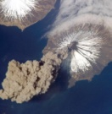




Work Plan - Expected Outcomes
The main outcomes are described for the following thematic areas:
  Climate Monitoring, Research, and Services
  Carbon Observations, Including Forested Regions
  Observations for Agriculture
  Observations for Disasters
  Capacity Building, Data Access, Availability and
  Quality
  Advancement of the CEOS Virtual Constellations
  Support to Other Key Stakeholder Initiatives
  Outreach to Key Stakeholders
  Organizational Issues
Currently being updated to cover 2015-2017
Eighty (80) Objectives/Deliverables for 2014-2016

Slide 5
Current Priorities
CEOS 2014-2016 Work Plan: 3 Jun 2014
CEOS Agencies will continue to enhance their cooperation to respond effectively to Earth observation users’ needs by achieving integration across the full range of Earth observations, by closing important observational gaps, and by promoting the sharing of CEOS Agency data, and improving access to and use of such data.
CEOS will support more effective societal decision making in the areas of climate monitoring and research; carbon observations, including observations to support the effective monitoring and management of the world’s forested regions; food security; disaster risk management; biodiversity; capacity building; and data availability and access.
CEOS Working Groups and Virtual Constellations will expand their technical and scientific coordination to support these priorities, and improve the overall level of complementarity and compatibility of their Earth observation and data management systems for societal benefit.
CEOS will consider other requests from external stakeholders and determine what, if any, support is possible and appropriate. CEOS will also continue its outreach and communications efforts.
As it executes these activities, CEOS will operate in accordance with the guidance provided in the CEOS Governance and Processes document regarding the organization’s structure, processes, and stakeholder relations.

Slide 6
Current Objectives (1 of 5)
CEOS 2014-2016 Work Plan: 3 Jun 2014
Climate Monitoring, Research, and Services (CMRS)
Coordinate development of Climate Data Records (CDRs) and related datasets addressing Essential Climate Variables (ECVs) established by the Global Climate Observing System (GCOS).
Continue cooperation with GEO, GCOS, the World Meteorological Organization (WMO), and the CGMS in the development of a space-based system to support climate information and adaptation.
Nine (9) MRS Objectives/Deliverables for 2014-2016
Carbon Observations, Including Forested Regions (CARB)
Coordinate space-based observations to support the effective monitoring and management of the world’s forested regions to support any future international climate agreement and support the Space Data Component of the GEO Global Forest Observations Initiative (GFOI).
Publish the CEOS Strategy for Carbon Observations from Space and determine how CEOS can best implement the strategy.
Seven (7) CARB Objectives/Deliverables for 2014-2016

Slide 7
Current Objectives (2 of 5)
CEOS 2014-2016 Work Plan: 3 Jun 2014
Observations for Agriculture (AGRI)
Develop and implement a data acquisition strategy to provide satellite observations that will facilitate the monitoring of agricultural production in support of the GEO Global Agricultural Monitoring (GEOGLAM) initiative.
Continue support to the Joint Experiments on Crop Assessment and Monitoring (JECAM) initiative.
Two (2) AGRI Objectives/Deliverables for 2014-2016
Observations for Disasters (DIS)
  Strengthen support to the disaster management community through the sustained coordination of disaster-related activities undertaken by CEOS Agencies.
  Ensure that the importance of Earth observations from space is emphasized at the UN 2015 World Conference on Disaster Risk Reduction and in the post-Hyogo Framework for Actions (HFA2).
  Continue support to the Geohazards Supersites and Natural Laboratories (GSNL) Initiative.
  Six (6) DIS Objectives/Deliverables for 2014-2016

Slide 8
Current Objectives (3 of 5)
CEOS 2014-2016 Work Plan: 3 Jun 2014
Capacity Building, Data Access, Availability, and Quality (CB, DATA, CV)
  Advance of CEOS Data Democracy activities.
  Continue to support the development and operationalization of the GEOSS Common Infrastructure (GCI) and its CEOS-related elements.
  Coordinate the development of suitable methodologies for the on-ground characterization of satellite-based EO sensors, the calibration of EO missions, and the validation of satellite-based Level 1 and Level 2 products.
  Continue the cooperation with other CEOS elements in supporting the generation of well-calibrated and validated data records.
  Continue cooperation with GEO, Global Space-based Inter-calibration System (GSICS), and WMO and ground-based networks in the provision of high quality EO data products.
  Six (6) CB Objectives/Deliverables for 2014-2016
  Two (2) DATA Objectives/Deliverables for 2014-2016
  Twelve (12) CV Objectives/Deliverables for 2014-2016

Slide 9
Current Objectives (4 of 5)
CEOS 2014-2016 Work Plan: 3 Jun 2014
Advancement of the CEOS Virtual Constellations (VC)
  Characterize the Virtual Constellations in the context of both the development of the space segment for GEOSS and of the multitude of outcomes and deliverables that CEOS seeks to provide for GEO and other users and frameworks.
  Nineteen (19) VC Objectives/Deliverables for 2014-2016
CEOS Support to Further Key Stakeholder Initiatives (BP, BON, WAT, POL
Continue CEOS contributions and maintain leadership role in the GEO Blue Planet Task.
Further develop CEOS contributions to meet biodiversity observation requirements.
Continue dialogue on potential CEOS contributions to Integrated Water Cycle products and services.
  Continue dialogue on enhanced CEOS-level coordination to support improved research and monitoring of the Earth’s Polar Regions.
  One (1) each BP, WAT, and POL Objective/Deliverable for 2014-2016
  Three (3) BON Objectives/Deliverables for 2014-2016

Slide 10
Current Objectives (5 of 5)
CEOS 2014-2016 Work Plan: 3 Jun 2014
Outreach to Key Stakeholders (OUT)
Engage, attend, be strategically involved (where appropriate), report on CEOS achievements, and present at key meetings.
Maintain and annually update CEOS online services such as the CEOS website and Missions, Instruments and Measurements (MIM) database.
  Publish the CEOS Newsletter.
Six (6) OUT Objectives/Deliverables for 2014-2016
Organizational Issues (ORG)
Develop additional detailed guidance documents as proposed by the CEOS Self-Study Implementation Initiative (CSSII).
Six (6) ORG Objectives/Deliverables for 2014-2016

Slide 11
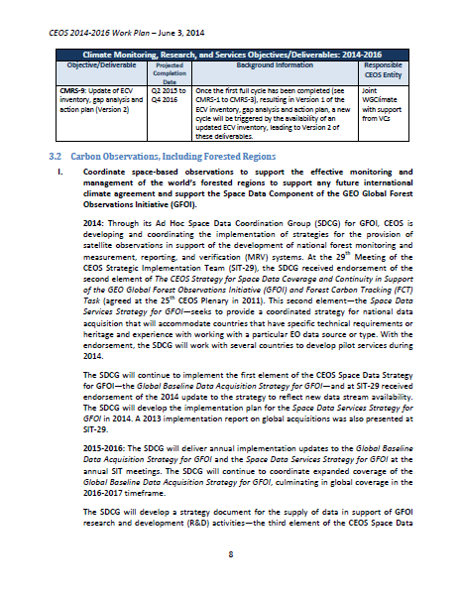
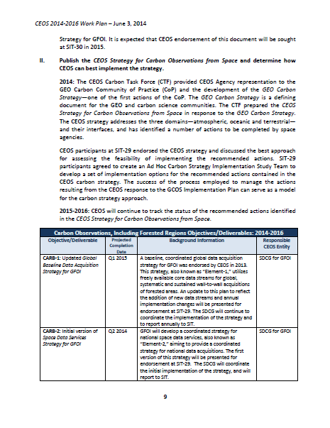
Inside the Work Plan
Notes:
11
Established in 1984 at the request of the Economic Summit of Industrialized Nations Working Group (G7), as the international forum for Earth observing space agencies. CEOS contributes the space component of the Global Earth Observation System of Systems (GEOSS) and supports key stakeholders with a wide range of Earth observation data, products, and expertise. Focal point for international coordination of space-related Earth Observation (EO) activities; Optimize benefits through cooperation of members in mission planning and in development of compatible data products, formats, services, applications, and policies.

Slide 12
One year (sort of) in …
36 Objectives/Deliverables projected to be completed in 2014:
  4 Climate Monitoring, Research, and Services (CMRS-X)
  4 Carbon Observations, Including Forested Regions (CARB-X)
  1 Observations for Agriculture (AGRI-X)
  5 Observations for Disasters (DIS-X)
  6 Capacity Building, Data Access, Availability & Quality (DATA-X, CV-X)
  4 Advancement of the CEOS Virtual Constellations (VC-X)
  2 Support to Other Key Stakeholder Initiatives (BON-X, POL-X)
  4 Outreach to Key Stakeholders (OUT-X)
  5 Organizational Issues (ORG-X)
Around 90% completed.
An effective way of communicating and tracking activity.
To be supported by ‘on line’ action tracking shortly.
Notes:
12
Established in 1984 at the request of the Economic Summit of Industrialized Nations Working Group (G7), as the international forum for Earth observing space agencies. CEOS contributes the space component of the Global Earth Observation System of Systems (GEOSS) and supports key stakeholders with a wide range of Earth observation data, products, and expertise. Focal point for international coordination of space-related Earth Observation (EO) activities; Optimize benefits through cooperation of members in mission planning and in development of compatible data products, formats, services, applications, and policies.

Slide 13
Update progress
Development of the 2015-2017 Work Plan underway.
‘Version 0’ completed and circulated to CEOS Entities (including CEOS SEC, i.e. GEO). Version 0:
  Reflects what occurred in 2014
  Reflects CEOS Chair priorities
  Reflects Tromso Statement
Initial input from CEOS Entities due NOW
  Changes to current content
  Forward plan to covert the ‘new year’ : 2017
Pre-v1 to be circulated in February for final comments. Then:
  Incorporate and reconcile final CEOS entity and CEOS SEC comments.
  Share the Final Draft Work Plan with the CEOS Principals for virtual endorsement in accordance with CEOS Governance and Processes.
  PUBLISH!!
Notes:
13
Established in 1984 at the request of the Economic Summit of Industrialized Nations Working Group (G7), as the international forum for Earth observing space agencies. CEOS contributes the space component of the Global Earth Observation System of Systems (GEOSS) and supports key stakeholders with a wide range of Earth observation data, products, and expertise. Focal point for international coordination of space-related Earth Observation (EO) activities; Optimize benefits through cooperation of members in mission planning and in development of compatible data products, formats, services, applications, and policies.

Slide 14
Thank You

