Slide 1
GEO CEOS meeting --GEO Cold Regions

Slide 2
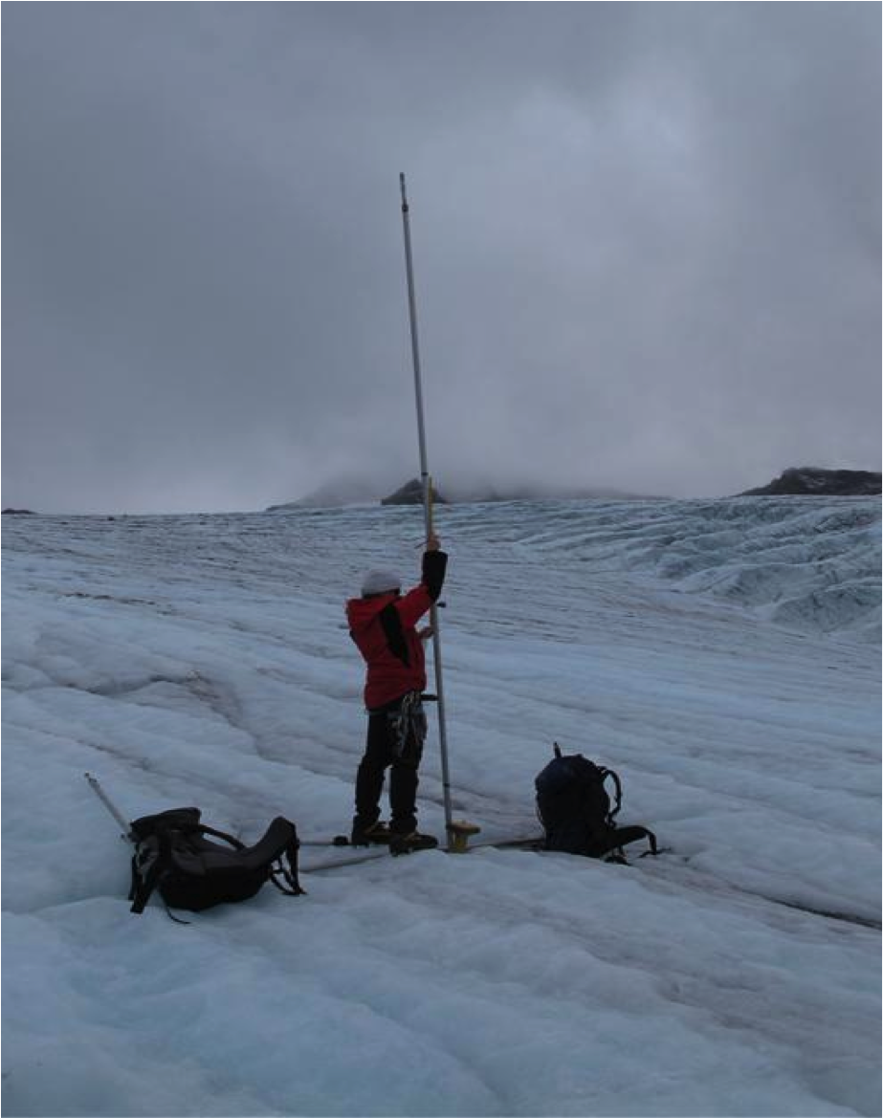
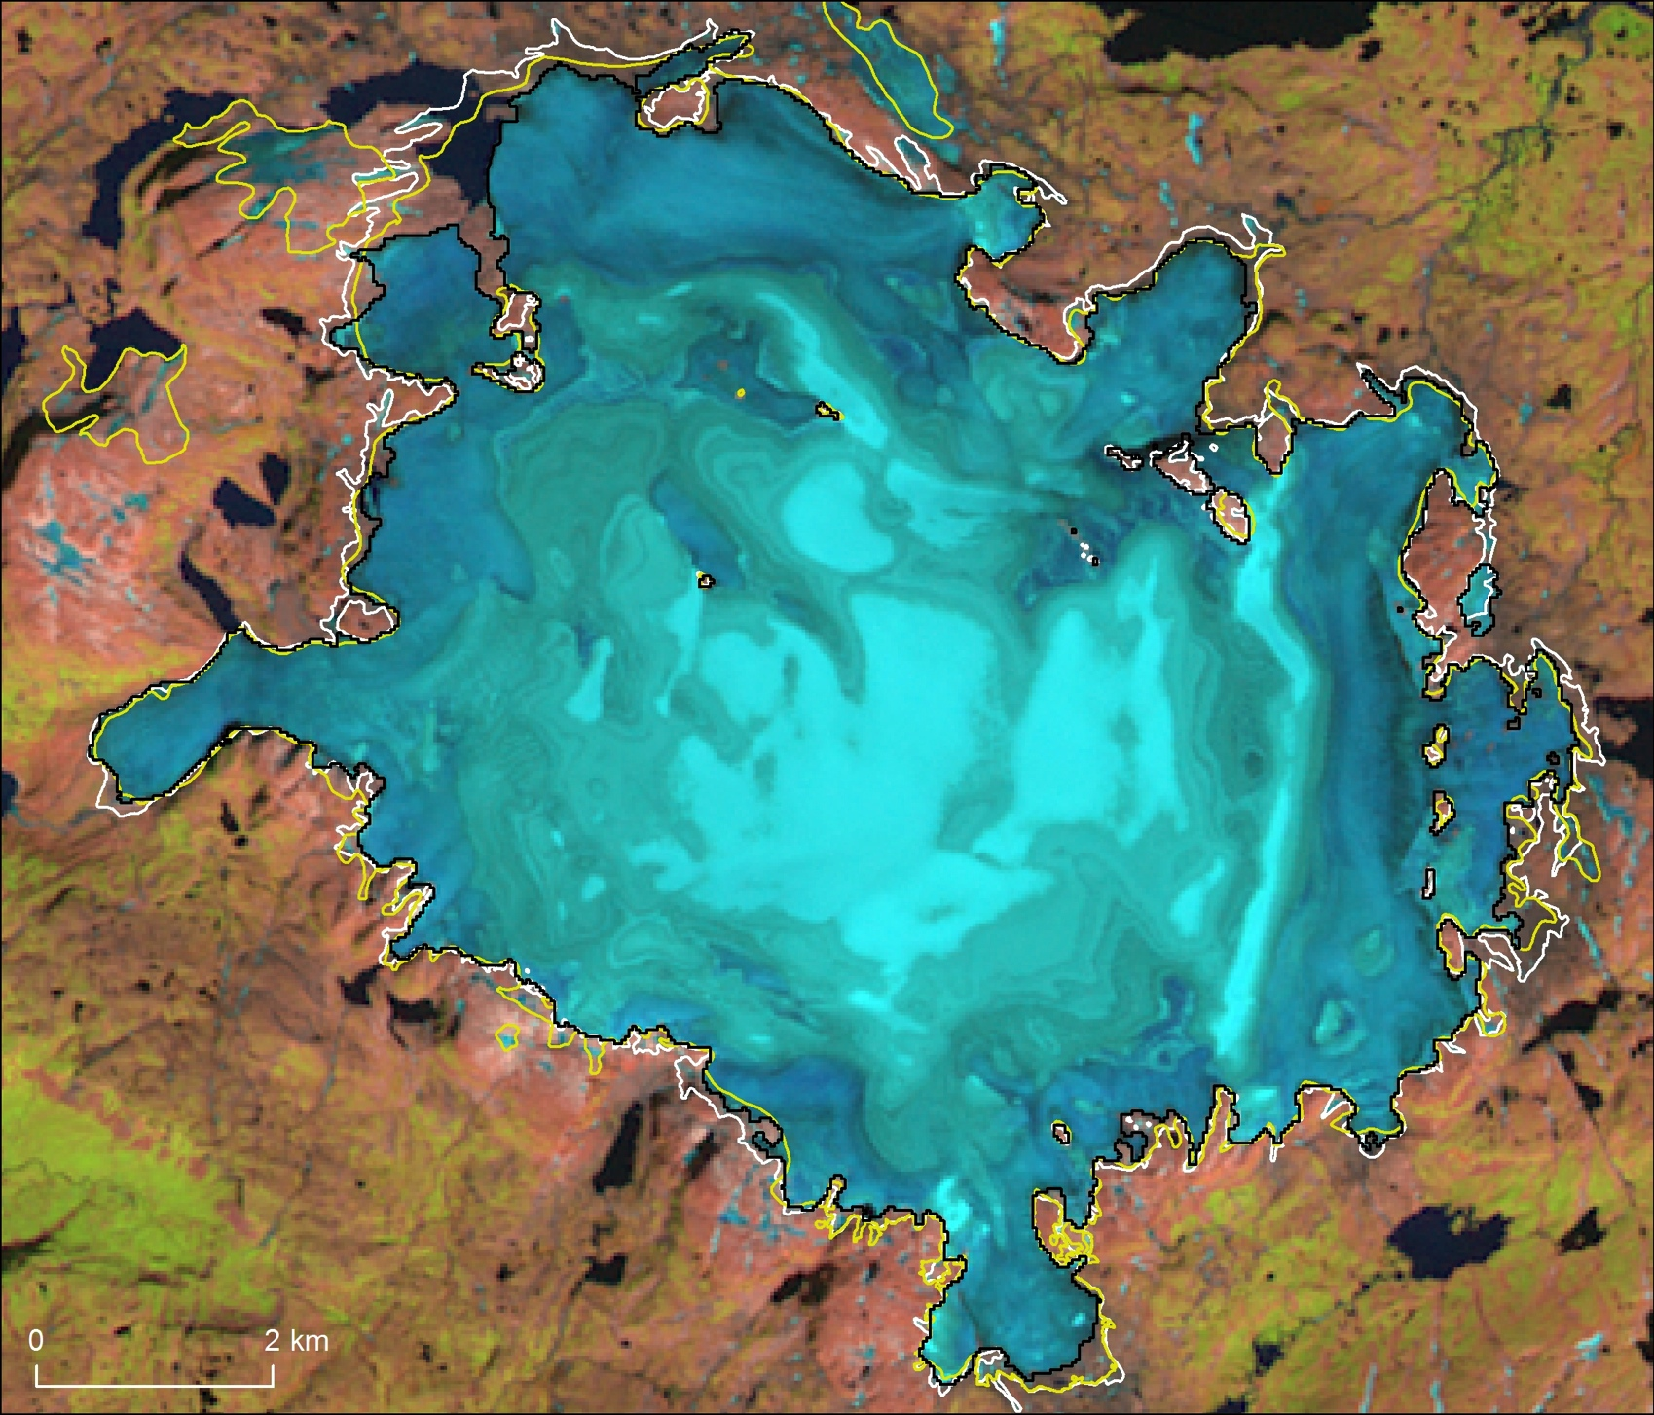
Aim of GEO Cold Regions
Easy access to cold regions observations and environmental information products by users across the globe
Strengthen synergies among the activities of the Environmental, Climate and Cryospheric communities across poles and mountain Cold Regions
Offer a global interface for existing programs, allowing them to reach communities outside their own membership domains and create synergies among different activities/programs
CryoClim

Slide 3
Expectations 2015 (excerpt)
(Meta) data exchange between archives, data sharing system, data catalogue
Provinding essential climate variable sea ice based on satellite passive microvawe and radar altimeter
Build the sustaining arctic observing networks (SAON)
Links between information portals
Permafrost monitoring through DInSAR
CryoClim

Slide 4
GEO Cold Regions participation
Countries
Canada
China
Finland
Germany
India
Italy
Japan
Netherlands
Norway
Spain
Sweden
Switzerland
United Kingdom
United States
Organisations/Projects
CAFF CBMP: Conservation of Arctic Flora and Fauna - Circumpolar Biodiversity Monitoring Program
CCIN: Canadian Cryospheric Information Network – Polar Data Catalogue
CliC: Climate and Cryosphere
CryoClim Cryosphere Climate Monitoring Service
ICIMOD: International Centre for Integrated Mountain Development
INTERACT: International Network for Terrestrial Research and Monitoring in the Arctic
PEEX: Pan-Eurasian Experiment
SAON: Sustaining Arctic Observing Network
SIOS: Svalbard Integrated Earth Observing System
SwissEx: Swiss Experiment Platform
TPE: Third Pole Environment
WMO GCW: Global Cryosphere Watch

Slide 5
GEO Cold Regions Conclusions
The GEO Cold Regions may offer a global interface for existing programs, allowing them to reach communities outside their own membership domains and create synergies among different activities/programs.
Developing a GEO Cold Regions Community Portal to GEOSS should be considered. The portal would expand the outreach of, and maximize synergies among, thematically wide GEO activities and thematically deep participant activities, thereby exploiting their complementary roles.

Slide 6
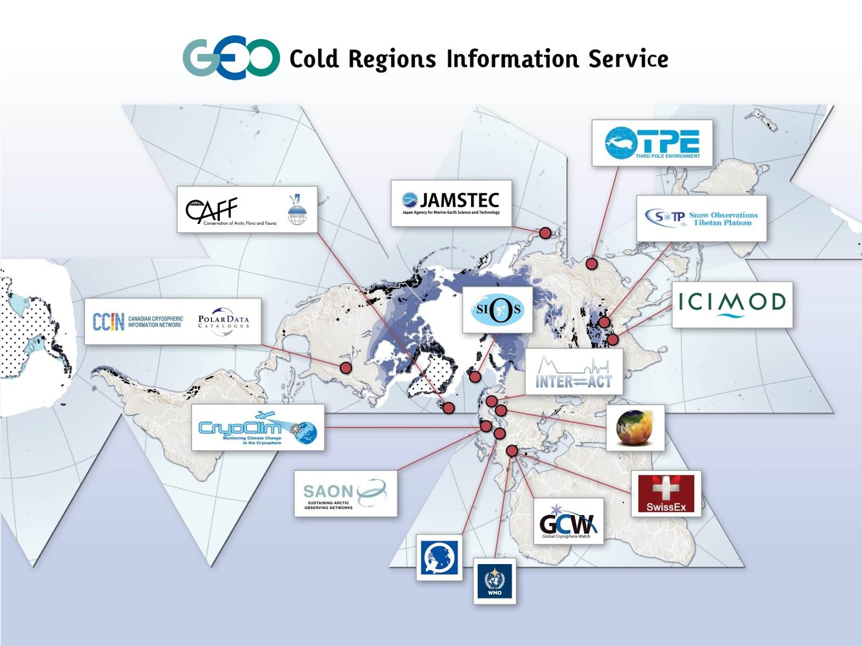
A Arctic focus

Slide 7
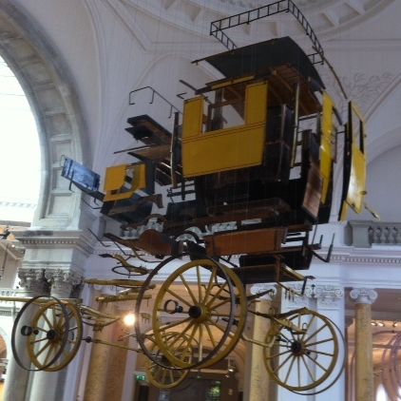
Last conclusions
Let’s put the pieces together!

