Slide 1


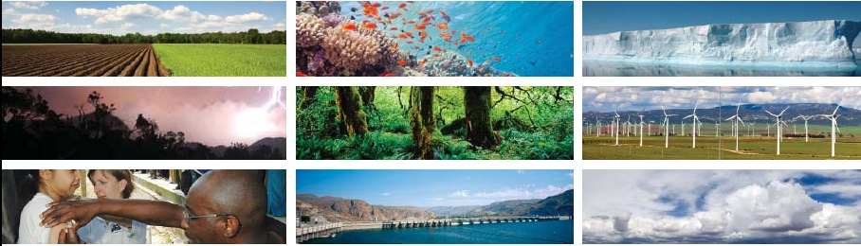
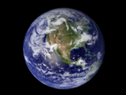

Unleashing the
Power of Where
UN Headquarters • 22 April 2015
How Geographic Information Contributes to Achieving the SDGs
Lawrence Friedl
NASA Earth Science

Slide 2


Social
Environmental
Economic
“Everything happens somewhere.”
- Nancy Tosta

Slide 3
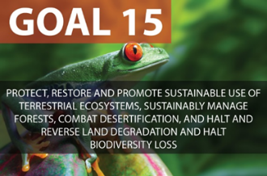

Forest Cover from Earth-observing
Environmental Satellites
Target 15.1:
By 2020 ensure conservation, restoration and sustainable use of terrestrial and inland freshwater ecosystems and their services, in particular forests, wetlands, mountains and drylands …
Target 15.2:
By 2020, promote the implementation of sustainable management of all types of forests, halt deforestation, restore degraded forests, and increase afforestation and reforestation by x% globally.
Vegetation in greens
Soils in mauves
Credit: Matthew C. Hansen, Univ. Maryland, et al. Image for 2000.
Notes:
Credit:
Matt Hansen, Peter Potapov, Rebecca Moore, Matt Hancher, Svetlana Turubanova, Alexandra Tyukavina, Dave Thau, Steve Stehman, Scott Goetz, Tom Loveland, Anil Kommareddy, Alexey Egorov, Louise Chini, Chris Justice and John Townshend
Organizations and Sponsors:
Univ. of Maryland-College Park, NASA, USAID, USGS, Google, Gordon and Betty Moore Foundation

Slide 4
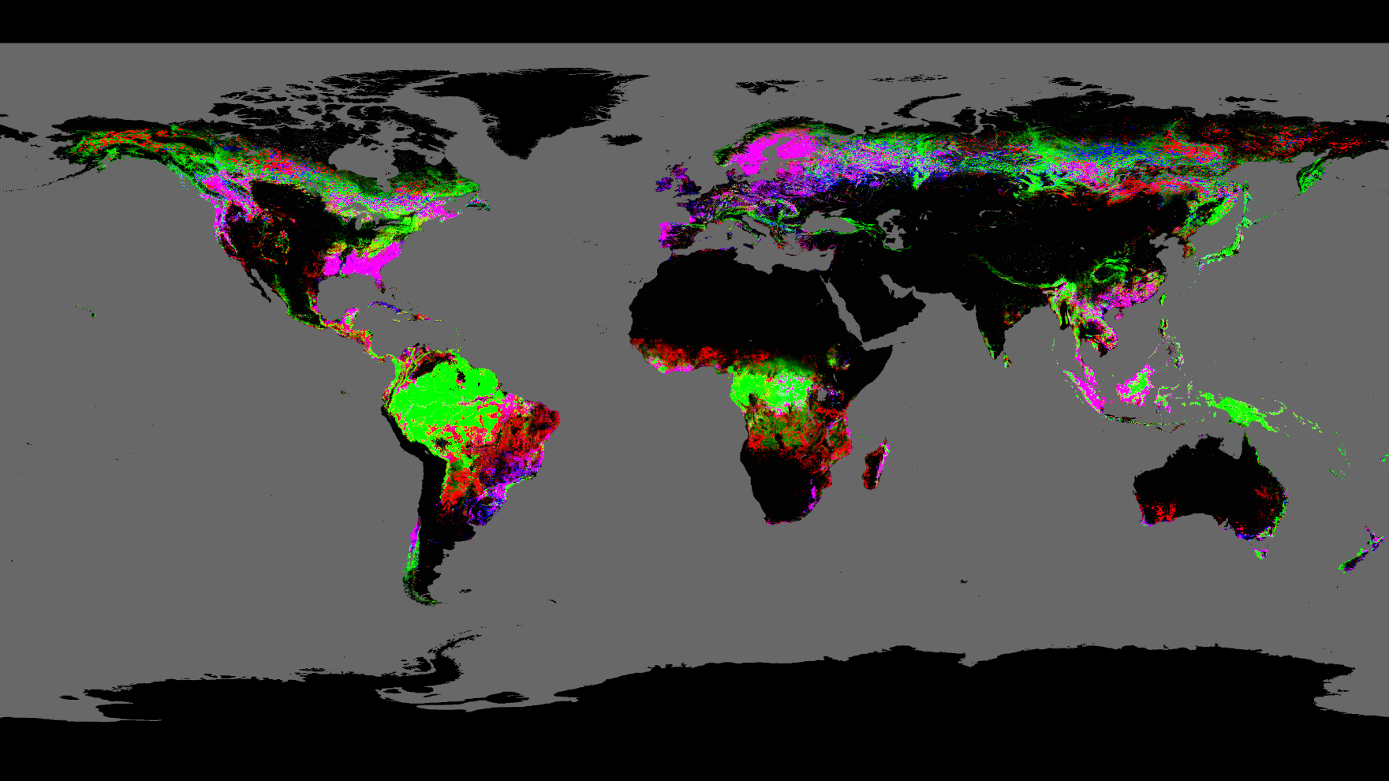
Tree cover extent and forest loss and gain
2000 to 2013
Target 15.1:
By 2020 ensure conservation, restoration and sustainable use of terrestrial and inland freshwater ecosystems and their services, in particular forests, wetlands, mountains and drylands …
Target 15.2:
By 2020, promote the implementation of sustainable management of all types of forests, halt deforestation, restore degraded forests, and increase afforestation and reforestation by x% globally.
Credit: Matthew C. Hansen, Univ. Maryland, et al.
Notes:
Credit:
Matt Hansen, Peter Potapov, Rebecca Moore, Matt Hancher, Svetlana Turubanova, Alexandra Tyukavina, Dave Thau, Steve Stehman, Scott Goetz, Tom Loveland, Anil Kommareddy, Alexey Egorov, Louise Chini, Chris Justice and John Townshend
Organizations and Sponsors:
Univ. of Maryland-College Park, NASA, USAID, USGS, Google, Gordon and Betty Moore Foundation

Slide 5
Cote d’Ivoire/Liberia
Landsat 5-4-3
2000 best pixel composite
Credit: Matthew C. Hansen,
Univ. Maryland, et al.
Vegetation in greens
Soils in mauves
Notes:
Credit:
Matt Hansen, Peter Potapov, Rebecca Moore, Matt Hancher, Svetlana Turubanova, Alexandra Tyukavina, Dave Thau, Steve Stehman, Scott Goetz, Tom Loveland, Anil Kommareddy, Alexey Egorov, Louise Chini, Chris Justice and John Townshend
Organizations and Sponsors:
Univ. of Maryland-College Park, NASA, USAID, USGS, Google, Gordon and Betty Moore Foundation

Slide 6
Cote d’Ivoire/Liberia
2000 to 2013 tree cover extent
and forest loss and gain
Credit: Matthew C. Hansen,
Univ. Maryland, et al.
Notes:
Credit:
Matt Hansen, Peter Potapov, Rebecca Moore, Matt Hancher, Svetlana Turubanova, Alexandra Tyukavina, Dave Thau, Steve Stehman, Scott Goetz, Tom Loveland, Anil Kommareddy, Alexey Egorov, Louise Chini, Chris Justice and John Townshend
Organizations and Sponsors:
Univ. of Maryland-College Park, NASA, USAID, USGS, Google, Gordon and Betty Moore Foundation

Slide 7
White = all protected areas.
2000 to 2013 tree cover extent
and forest loss and gain
Cote d’Ivoire/Liberia
Credit: Matthew C. Hansen,
Univ. Maryland, et al.
Notes:
Credit:
Matt Hansen, Peter Potapov, Rebecca Moore, Matt Hancher, Svetlana Turubanova, Alexandra Tyukavina, Dave Thau, Steve Stehman, Scott Goetz, Tom Loveland, Anil Kommareddy, Alexey Egorov, Louise Chini, Chris Justice and John Townshend
Organizations and Sponsors:
Univ. of Maryland-College Park, NASA, USAID, USGS, Google, Gordon and Betty Moore Foundation

Slide 8
Cote d’Ivoire/Liberia
White = all protected areas.
Forest loss mapped by year.
Credit: Matthew C. Hansen,
Univ. Maryland, et al.
Notes:
Credit:
Matt Hansen, Peter Potapov, Rebecca Moore, Matt Hancher, Svetlana Turubanova, Alexandra Tyukavina, Dave Thau, Steve Stehman, Scott Goetz, Tom Loveland, Anil Kommareddy, Alexey Egorov, Louise Chini, Chris Justice and John Townshend
Organizations and Sponsors:
Univ. of Maryland-College Park, NASA, USAID, USGS, Google, Gordon and Betty Moore Foundation

Slide 9

Global annual forest cover loss
Credit: Matthew C. Hansen, Univ. Maryland, et al.
Notes:
Credit:
Matt Hansen, Peter Potapov, Rebecca Moore, Matt Hancher, Svetlana Turubanova, Alexandra Tyukavina, Dave Thau, Steve Stehman, Scott Goetz, Tom Loveland, Anil Kommareddy, Alexey Egorov, Louise Chini, Chris Justice and John Townshend
Organizations and Sponsors:
Univ. of Maryland-College Park, NASA, USAID, USGS, Google, Gordon and Betty Moore Foundation

Slide 10

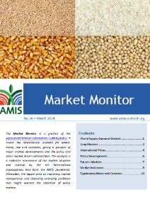
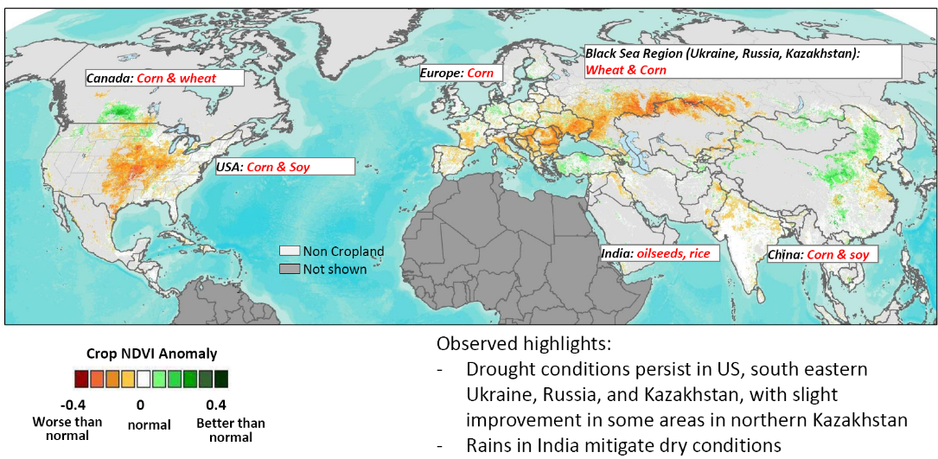



Global observations routinely provide early insights on anomalies in crop condition and aid food supply and production forecasts.
The Agricultural Market Information System includes monthly crop health estimates in the Market Monitor.
Target 2.4:
By 2030 ensure sustainable food production systems and implement resilient agricultural practices that increase productivity and production …
Target 2.c:
Adopt measures to ensure the proper functioning of food commodity markets and their derivatives, and facilitate timely access to market information, including on food reserves, in order to help limit extreme food price volatility.
Northern Hemisphere: August 2012 Crop Conditions
Crop NDVI Anomalies from 2000-2013 average (13.Aug.2012)
Notes:
Credit:
GEOGLAM, Group on Earth Observations, Committee on Earth Observing Satellites
Chris Justice, Inbal Becker-Reshef, and Alyssa Whitcraft. University of Maryland
Michel Deshayes, GEO Secretariat
Note: GEOGLAM involves numerous countries and GEO participating organizations.

Slide 11
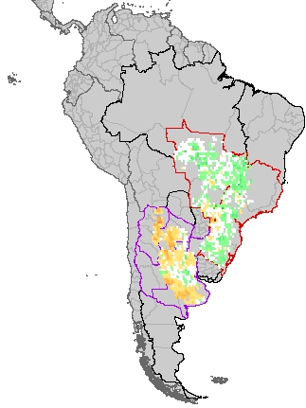
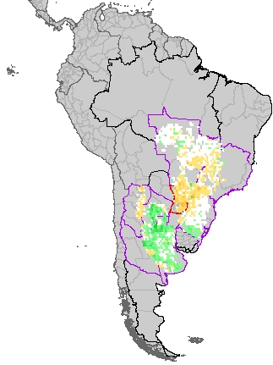
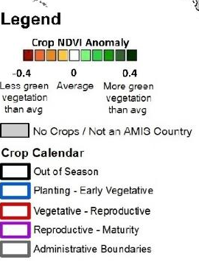

Global observations routinely provide early insights on anomalies in crop condition and aid food supply and production forecasts.
The Agricultural Market Information System includes monthly crop health estimates in the Market Monitor.
Target 2.4:
By 2030 ensure sustainable food production systems and implement resilient agricultural practices that increase productivity and production …
Target 2.c:
Adopt measures to ensure the proper functioning of food commodity markets and their derivatives, and facilitate timely access to market information, including on food reserves, in order to help limit extreme food price volatility.
Soybeans
1/31/2014
2/28/2014
Crop NDVI Anomalies from 2000-2013 average
Notes:
Credit:
GEOGLAM, Group on Earth Observations, Committee on Earth Observing Satellites
Chris Justice, Inbal Becker-Reshef, and Alyssa Whitcraft. University of Maryland
Michel Deshayes, GEO Secretariat
Note: GEOGLAM involves numerous countries and GEO participating organizations.

Slide 12

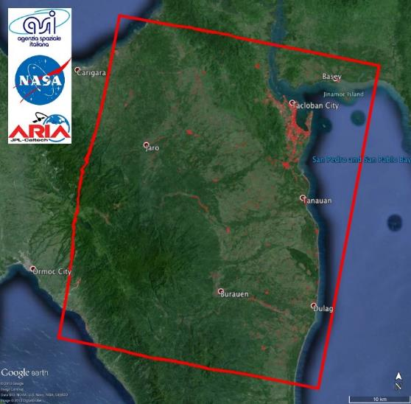
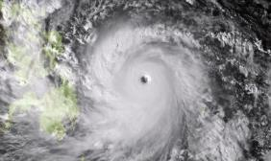
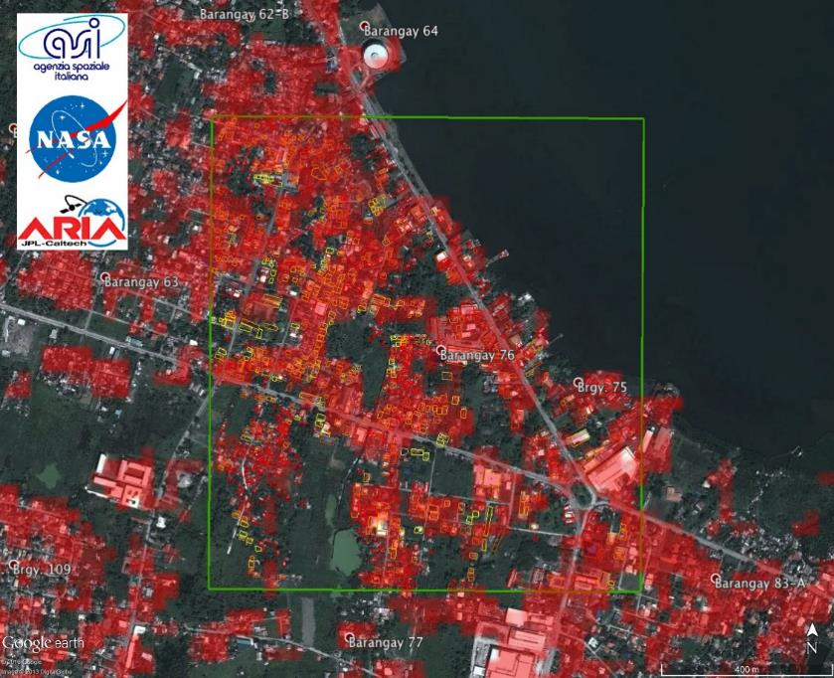

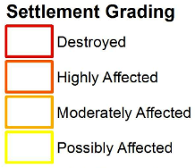
Super Typhoon Haiyan
Damage in Tacloban, Philippines
December 2013
Target 11.5:
By 2030 significantly reduce the number of deaths and the number of affected people and decrease by [x] per cent the economic losses relative to GDP caused by disasters, including water-related disasters, with the focus on protecting the poor and people in vulnerable situations.
Imaged with COSMO-SkyMed radar satellite constellation
Proposed Indicator 2:
Number of housing units damaged and destroyed [by disasters]
Notes:
COSMO-SkyMed © ASI (acquired on 2013/08/15, 2013/08/19, 2013/11/11)
Damage grade polygons derived by Copernicus Emergency Management Service from visual interpretation of pre-event (Pleiades © CNES 2013/04/07) and post-event (GeoEye-1 © Digitalglobe 2013/11/10) optical images
Google Earth
Credit:
> Sang-Ho Yun, Susan Owen, Frank Webb, Hook Hua, Bob Crippen
Jet Propulsion Laboratory, California Institute of Technology
> Pietro Milillo
School of Engineering, University of Basilicata
> Giovanni Milillo, Alessandro Coletta
Italian Space Agency (ASI)

Slide 13
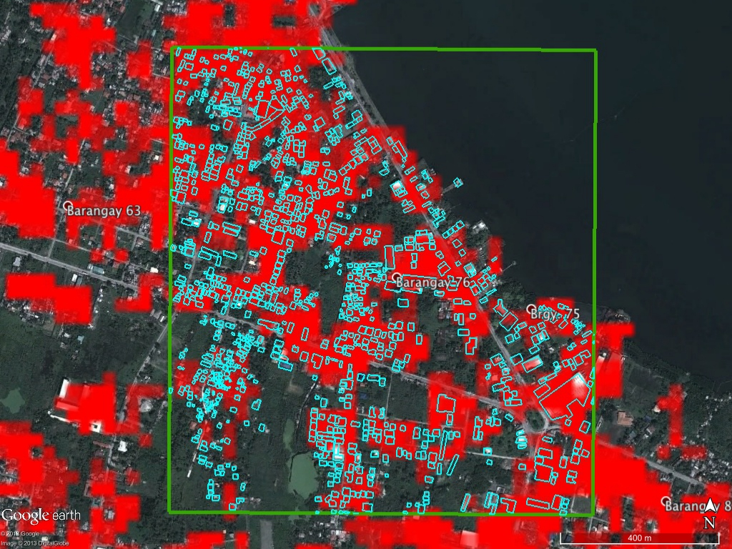


Settlement Grading
Possibly Affected
- Destroyed
Degree of Change
0
1
Notes:
COSMO-SkyMed © ASI (acquired on 2013/08/15, 2013/08/19, 2013/11/11)
Damage grade polygons derived by Copernicus Emergency Management Service from visual interpretation of pre-event (Pleiades © CNES 2013/04/07) and post-event (GeoEye-1 © Digitalglobe 2013/11/10) optical images
Google Earth
Credit:
> Sang-Ho Yun, Susan Owen, Frank Webb, Hook Hua, Bob Crippen
Jet Propulsion Laboratory, California Institute of Technology
> Pietro Milillo
School of Engineering, University of Basilicata
> Giovanni Milillo, Alessandro Coletta
Italian Space Agency (ASI)

Slide 14
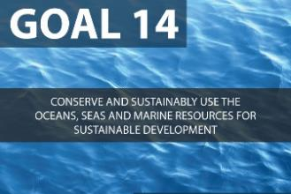
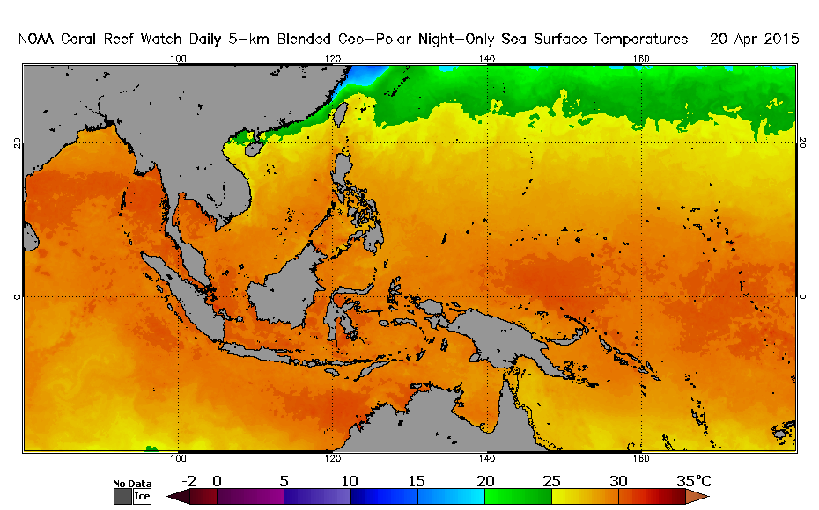
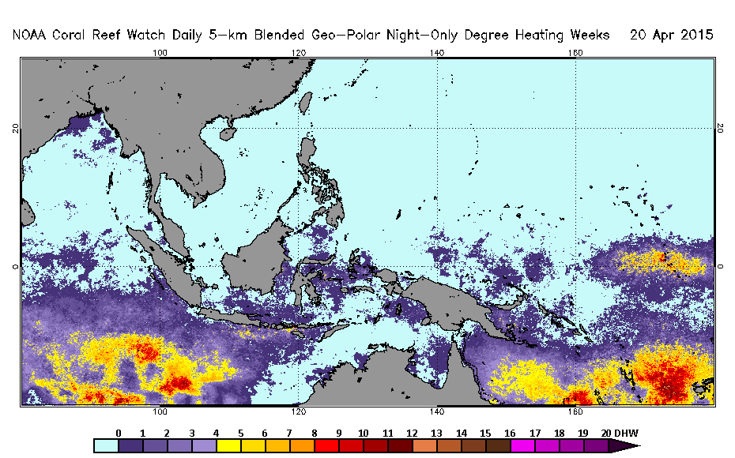
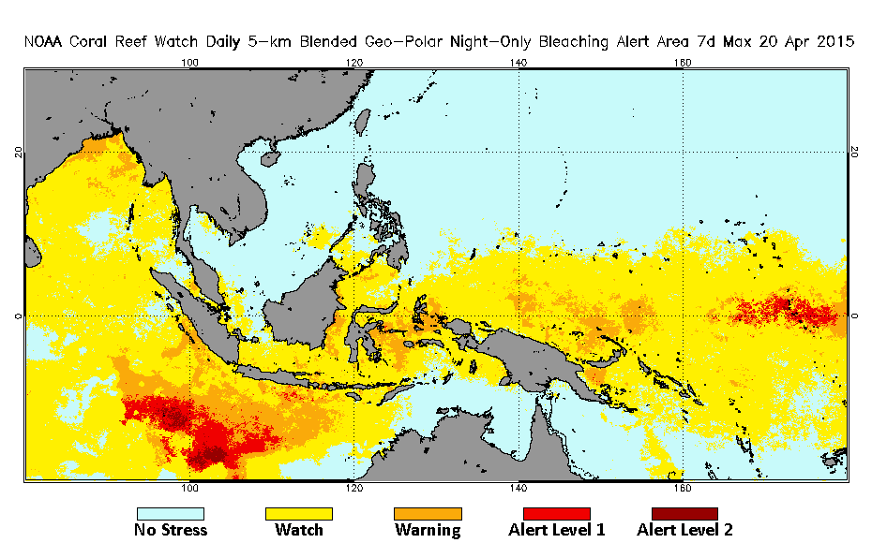
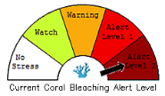
Coral Reef Watch
Ecosystem-Based Management of
Tropical Coral Reef Environments
Target 14.2:
By 2020, sustainably manage and protect marine and coastal ecosystems to avoid significant adverse impacts, including by strengthening their resilience, and take action for their restoration, to achieve healthy and productive oceans
Target 14.3:
Minimize and address the impacts of ocean acidification, including through enhanced scientific cooperation at all levels
Sea Surface Temperature
Degree Heating Weeks
Bleaching Alert
Source: NOAA/NESDIS
http://coralreefwatch.noaa.gov/satellite/bleaching5km/index.php
Notes:
Credit: Frank Muller-Karger (carib@usf.edu) and Mark Eakin (mark.eakin@noaa.gov)
Source: US Department of Commerce / NOAA / NESDIS / STAR / Coral Reef Watch
Images acquired through http://coralreefwatch.noaa.gov/satellite/bleaching5km/index.php

Slide 15

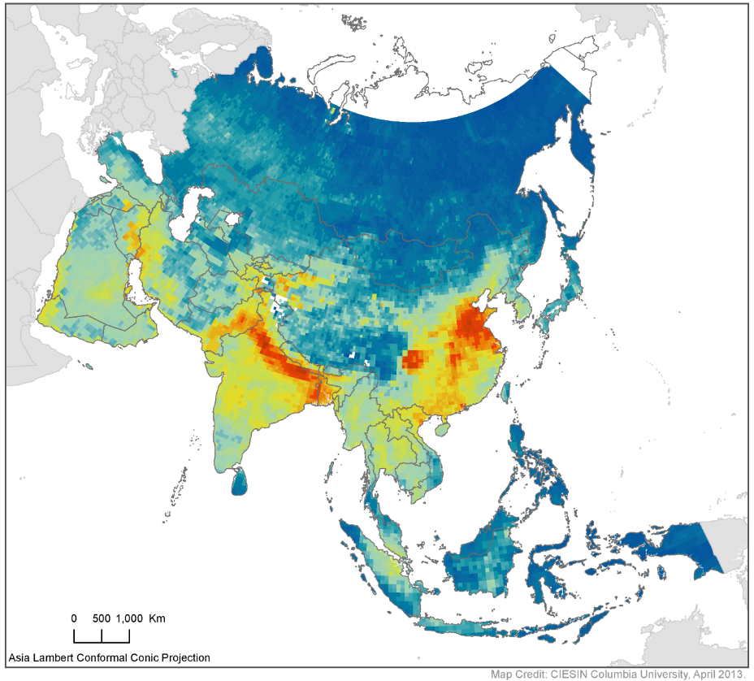

Air Quality: Particulate Matter
Based on Measurements from
Space-based Sensors
Target 3.9:
By 2030 substantially reduce the number of deaths and illnesses from hazardous chemicals and air, water, and soil pollution and contamination
Target 11.6:
Reduce the adverse per capita environmental impact of cities, including by paying special attention to air quality, municipal and other waste mngmnt.
Global Annual Average PM2.5 Grids, 2010
Source:
CIESIN
Notes:
Source / Credit: Center for International Earth Science Information Network (CIESIN) at the Earth Institute, Columbia University
Image from materials published by SEDAC / CIESIN / Columbia
http://sedac.ciesin.columbia.edu/data/set/sdei-global-annual-avg-pm2-5-2001-2010
Citations
Battelle Memorial Institute, and Center for International Earth Science Information Network - CIESIN - Columbia University. 2013. Global Annual Average PM2.5 Grids from MODIS and MISR Aerosol Optical Depth (AOD). Palisades, NY: NASA Socioeconomic Data and Applications Center (SEDAC).http://dx.doi.org/10.7927/H4H41PB4. Accessed 21 April 2015.
de Sherbinin, A., M. Levy, E. Zell, S. Weber, and M. Jaiteh. 2014. Using Satellite Data to Develop Environmental Indicators. Environmental Research Letters 9 (8): 084013. http://dx.doi.org/10.1088/1748-9326/9/8/084013.

Slide 16

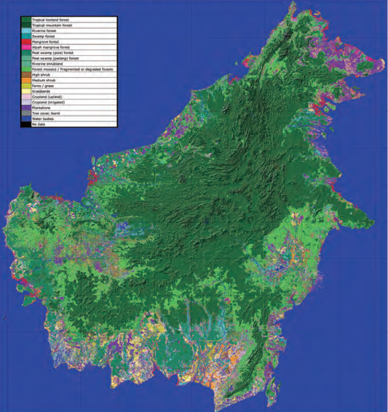
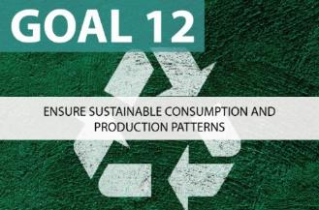
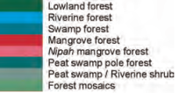
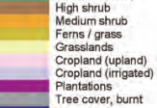
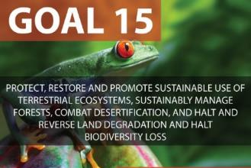

Land Use and Land Cover Mapping
Borneo Island
Forest and land cover map featuring 18 classes
Source: JAXA EORC; CEOS EO Handbook. ALOS PALSAR image, 2007.
Notes:
Images for slide provided by JAXA EORC (Japan Aerospace Exploration Agency, Earth Observation Research Center)
Image acquired from ALOS PALSAR (Phased Array type L-band Synthetic Aperture Radar); acquired in 2007
Map available through CEOS Earth Observations Handbook produced by CEOS and ESA.
http://www.eohandbook.com/eohb2014/case_studies_global_forest_observations_for_carbon_tracking.html
and
http://www.eohandbook.com/eohb2014/images/part_2_images/5.3_image_05_large.jpg

Slide 17
SDG Goals and Geospatial Data
Goal 2 | Hunger and Food Security
Crop yield estimates, soil characteristics, crop water productivity, irrigation
Goal 3 | Health and
Well-being
Health facility maps
Goal 4 | Education
Goal 6 | Water and Sanitation
School facility maps
Goal 9 | Access to Infrastructure
Water resources
Roads, Public transportation
Goal 1 | End Poverty
Proposed indicator on losses from natural disasters
Poverty maps
Nutritional status maps
Disease incidence and risk maps
Literacy and educational achievement maps
Water and sanitation access maps
Mobility maps
Facilities inventories
Source: Center for International Earth Science Information Network
Notes:
Source / Credit: Center for International Earth Science Information Network (CIESIN) at the Earth Institute, Columbia University

Slide 18
SDG Goals and Geospatial Data
Goal 11 | Cities
Goal 14 | Marine and coastal ecosystems
Coastal/Marine protected areas
Goal 15 | Terrestrial ecosystems
Land cover, land degradation, bio-diversity
Goal 16 | Peaceful and inclusive societies
Maps of political violence
Access to public green space
Substandard housing maps
Goal 12 | Sustainable Consumption
Goal 13 | Combating Climate Change
CO₂ emissions
Exposure to extreme storms and droughts
Harmful algal blooms
Eutrophication
Protected areas
Refugee and IDP movement
Energy productivity maps
Pollution maps
Crime maps
Source: Center for International Earth Science Information Network
Notes:
Source / Credit: Center for International Earth Science Information Network (CIESIN) at the Earth Institute, Columbia University

Slide 19
Unleashing the
Power of Where
UN Headquarters • 22 April 2015
Thank You

Slide 20
Unleashing the
Power of Where
UN Headquarters • 22 April 2015
Lawrence Friedl
NASA Headquarters
Washington, DC
1.202.358.7200
NASA Earth Science
Applied Sciences Program
http://AppliedSciences.NASA.gov

Slide 21
Unleashing the
Power of Where
UN Headquarters • 22 April 2015
Backup Materials

Slide 22
Geospatial Data Prominent within Sustainable Development Monitoring Framework
Development planning and SDG outcomes can be visualized with maps.
Mapping SDG related data will improve planning, evaluation and communication of the results.
Technological innovations are increasing our measuring abilities and cost-reductions are making it feasible.
The SDGs arrive at a prime convergence moment for seizing the power of spatial data and information.
Source: Center for International Earth Science Information Network
Notes:
Source / Credit: Center for International Earth Science Information Network (CIESIN) at the Earth Institute, Columbia University

Slide 23
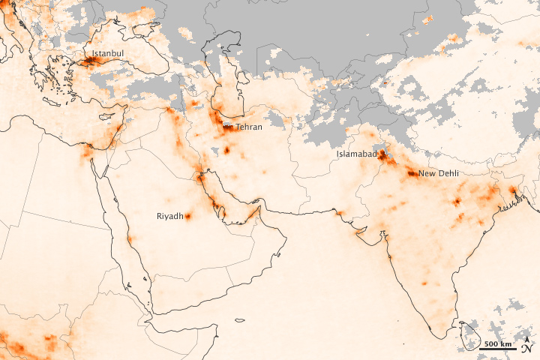
Concentrations of NO2 for Jan. 1-8, 2013
Data from Ozone Monitoring Instrument on Aura satellite
Target 3.9:
By 2030 substantially reduce the number of deaths and illnesses from hazardous chemicals and air, water, and soil pollution and contamination
Target 11.6:
Reduce the adverse per capita environmental impact of cities, including by paying special attention to air quality, municipal and other waste mngmnt.
Shades of orange reflect the relative abundance of NO₂.
Grays show areas without usable data (e.g., cloud cover)
Source: NASA Earth Observatory
Notes:
Source / Credit:
http://earthobservatory.nasa.gov/IOTD/view.php?id=80200

Slide 24
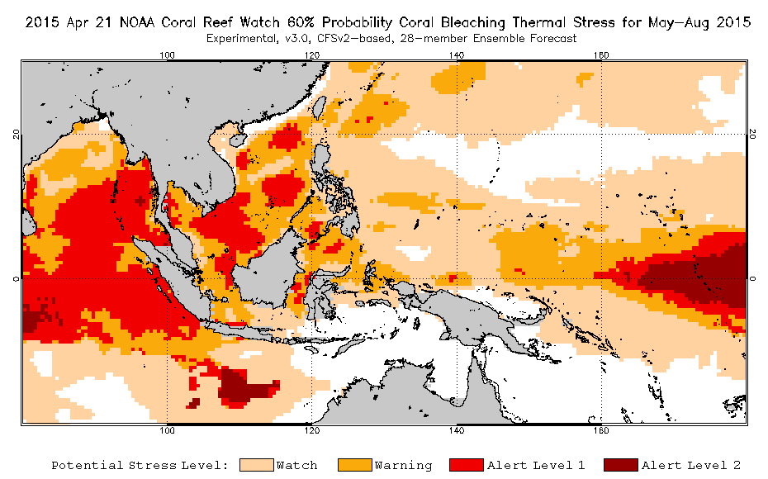
Coral Reef Watch
Ecosystem-Based Management of
Tropical Coral Reef Environments
Target 14.2:
By 2020, sustainably manage and protect marine and coastal ecosystems to avoid significant adverse impacts, including by strengthening their resilience, and take action for their restoration, to achieve healthy and productive oceans
Target 14.3:
Minimize and address the impacts of ocean acidification, including through enhanced scientific cooperation at all levels
Source: NOAA/NESDIS
http://coralreefwatch.noaa.gov/satellite/bleaching5km/index.php
Notes:
Credit: Frank Muller-Karger (carib@usf.edu) and Mark Eakin (mark.eakin@noaa.gov)
Source: US Department of Commerce / NOAA / NESDIS / STAR / Coral Reef Watch
Images acquired through http://coralreefwatch.noaa.gov/satellite/bleaching5km/index.php

