Slide 1
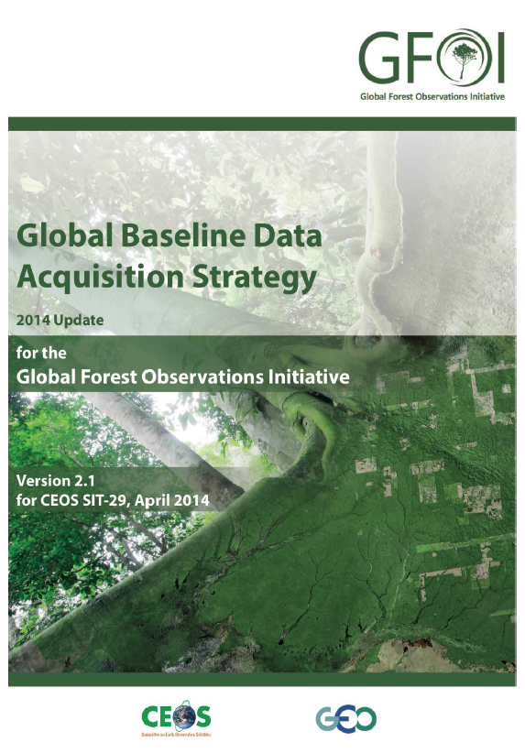
Deforestation
Satellite Data for Forest Management & UN-REDD Objectives
The CEOS Ad Hoc Space Data Coordination Group for the Global Forest Observations Initiative (SDCG for GFOI) coordinates sustained space-based observations for forest management.
Data Services pilots improve data access & analysis capabilities for developing nations. CEOS collaborates with FAO and SilvaCarbon to test data services and build country capacity.

Slide 2
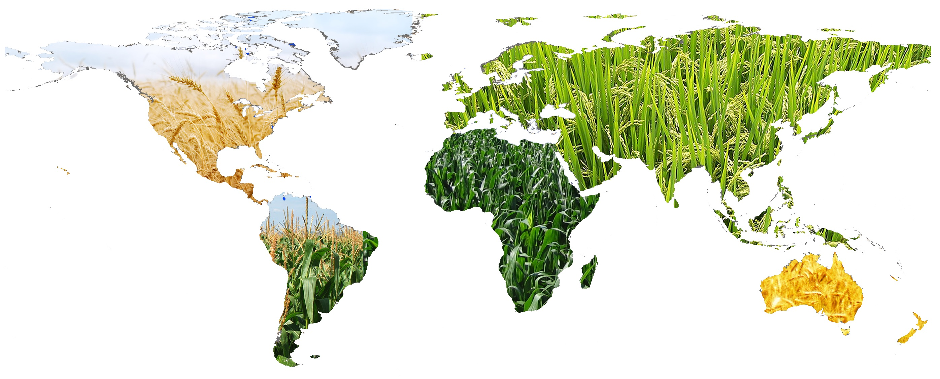
Food Security
Satellite Data Contribute to Food Security & UN-FAO Objectives
The CEOS Ad-Hoc Working Group on GEOGLAM (Group on Earth Observations Global Agriculture Monitoring initiative) focuses on providing coordinated and sustained space-based observations for agriculture management.

Slide 3
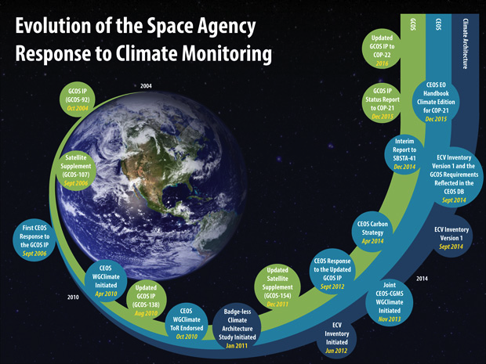
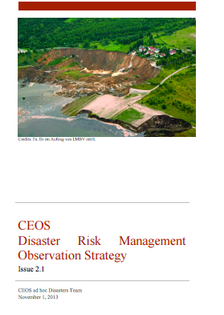
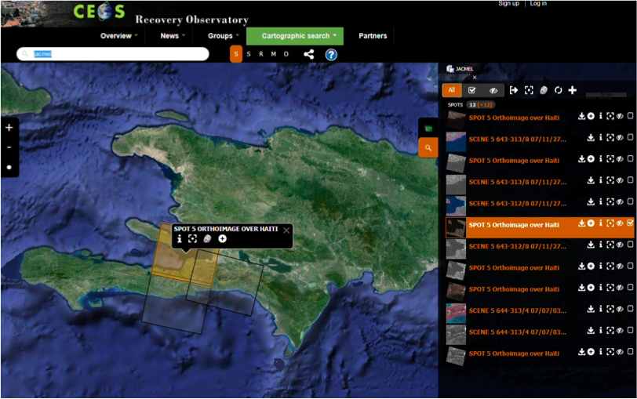
Disaster Response
Satellite Data for Disaster Management & UNISDR Objectives
Designing a Disaster Risk Management Observation Strategy for space-based flood, earthquake, & volcano measurements
Recovery Observatory: A concerted effort to make data freely available to users for ongoing recovery efforts long after disaster strikes
Pilots help affected communities access and use flood, seismic, & volcano data.
CEOS Agencies improve the coordination of satellite observations for disaster management.

Slide 4
Climate Change
Satellite Data for Climate Science & UNFCCC Objectives
Putting together an Essential Climate Variable (ECV) Inventory to facilitate gap assessments & improve international coordination
From publishing the CEOS Response to GCOS (2006) to publishing a set of Strategic Actions designed to improve the international coordination & measurement of carbon from space (2015)
CEOS Agencies collaborate to improve climate monitoring & Climate Data Record availability.

Slide 5
21 New Satellites!
CEOS Agencies Launch 21 New Satellites in 2 Years
CEOS Agencies launched 17 new satellites since the 2014 GEO Ministerial Summit; 4 more before 2016! Data Applications Include:
Atmospheric Composition
CO₂ Sources & Sinks
Global Precipitation & Evaporation
Heliogeophysics
Land Surface Imaging & Topography
Meteorology
Ocean Monitoring & Topography
Ocean Surface Winds
Soil Moisture
CEOS Agencies currently operate 135 satellite missions with a wide range of data applications!

Slide 6
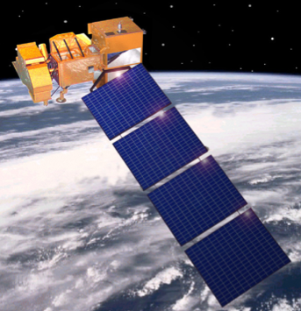
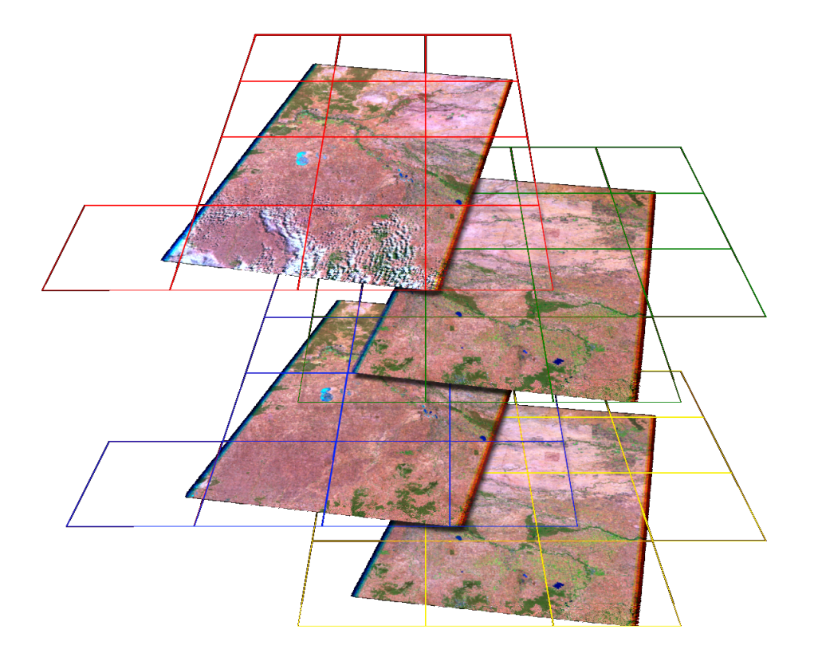
Data Cubes
A Flexible Data Architecture for Large Datasets Supporting Diverse Applications
Satellite
Mission
Key Features of the CEOS Data Cube Architecture
Open Source — Free and open to any user
Flexible deployment — Local, Data Hub, or Computing Cloud
Multiple data layers (optical and radar) in one system made up of pixels extracted from scenes
Flexible grid projections for spatial consistency and data interoperabilty
Computationally efficient “Big Data” approaches
User interface for common analyses (cloud-free mosaics, change detection)
Support for infinite applications
Successfully implemented in Australia
Pilot projects in Kenya and Colombia
Processed Data Products
Data Cube
User Interface

Slide 7
New Open Datasets
New Open Data Releases: SRTM, ALOS-PALSAR, SPOT-5
Shuttle Radar Topography Mission (SRTM)
CEOS organized several capacity building/training workshops to expand the use of this data for national applications in Kenya, South Africa, and Mexico, reaching 63 people from 23 countries.
Global 30-m Digital Elevation Model (DEM)
Advanced Land Observing Satellite (ALOS)
Phased Array L-band Synthetic Aperture Radar (PALSAR)
CEOS will use these mosaics in several Data Cube projects to support forestry and agriculture initiatives in Kenya and Colombia.
Global 25-m annual mosaics, 2007-2010
Satellite for Observation of Earth (SPOT-5)
All data older than five years are now open and available. CEOS will use SPOT-5 data to support its R&D contributions to the GFOI & GEOGLAM Flagships.
Global 2.5 to 20-m high resolution optical

Slide 8
21 New Satellites!
Mission Name | Space Agency or Country Lead | Launch | Primary Applications
GPM | JAXA,NASA | 2/27/14 | Global precipitation and evaporation
Sentinel-1A | ESA | 3/4/14 | Land and ocean monitoring
DMSP-F19 | NOAA | 4/3/14 | Global cloud cover
ALOS-2 | JAXA | 5/24/14 | Land monitoring
OCO-2 | NASA | 7/2/14 | Carbon Dioxide sources and sinks
Meteor-M-N2 | Russia | 7/8/14 | Land monitoring, heliogeophysics.
GAOFEN-2 (GF-2) | China | 8/19/14 | Land monitoring
RapidScat-ISS | NASA | 9/20/14 | Ocean surface wind speed and direction
Himawari-8 | JAXA | 10/7/14 | Meteorology
CBERS-4 | INPE | 12/7/14 | Land monitoring
Resurs-P2 | Russia | 12/26/14 | Land monitoring, topography
FY-2G | China | 12/31/14 | Meteorology
CATS-ISS | NASA | 1/10/15 | Atmospheric pollution, dust, smoke, and aerosols
SMAP | NASA | 1/31/15 | Soil Moisture, Freeze-thaw state
KOMPSAT-3A | Astrium,DLR,KARI | 3/25/15 | Land monitoring, topography
Sentinel-2A | ESA, EC | 6/23/15 | Land Surface Monitoring
MSG-4 (Meteosat-11) | EUMETSAT | 7/15/15 | Meteorology
Sentinel-3A | ESA, EC | Future 2015 | Land and ocean monitoring
Jason-3 | NASA, CNES, EUMETSAT, NOAA | Future 2015 | Sea surface topography
ElectroL2 | Russia | Future 2015 | Land monitoring, climatology, heliogeophysics
Resurs-P3 | Russia | Future 2015 | Land monitoring, topography

