Slide 1

2015 Activities of Committee on Earth Observation Satellites
Viewing Earth
Serving Society
Presented by Chu Ishida,
On behalf of CEOS Chair,
Mr.Shizuo Yamamoto, JAXA
66h International Astronautical Congress 2015 B.1.1

Slide 2
What is CEOS
Established in 1984 under auspices of G-7 Economic Summit of Industrialized Nations
  Focal point for international coordination of space-related Earth Observation (EO) activities
  Optimize benefits through cooperation of members in mission planning and in development of compatible data products, formats, services, applications, and policies
Operates through best efforts of Members and Associates via voluntary contributions
31 Members (Space Agencies), 24 Associates (UN Agencies, Phase A programs or supporting ground facility programs)
As the space component of the Global Earth Observation System of Systems (GEOSS), CEOS is implementing high priority actions in support of Group on Earth Observation (GEO) Tasks
Notes:
Phase A: Preliminary Analysis
The Project creates a preliminary design and project plan as a proof of concept specifying what to build, when to launch, the course the spacecraft is to take, what is to be done during cruise, when the spacecraft will reach the target, and what operations will be carried out. The preliminary plan also addresses build-versus-buy decisions, what spacecraft instruments are needed, where system tests will be performed, who performs mission operations, what ground data system capabilities are required, and who the experimenters are. Generally speaking, publication of the preliminary plan with costing data marks the completion of Phase A: Preliminary Analysis.”

Slide 3
Mission and Objectives
Mission
CEOS ensures international coordination of civil space-based Earth observation programs and promotes exchange of data to optimize societal benefit and inform decision making for securing a prosperous and sustainable future for humankind.
Three Primary Objectives
To optimize the benefits of space-based Earth observation through cooperation of CEOS Agencies in mission planning and in the development of compatible data products, formats, services, applications and policies.
To aid both CEOS Agencies and the international community by, among other things, serving as the focal point for international coordination of space-based Earth observation activities, including the Group on Earth Observations and entities related to global change.
To exchange policy and technical information to encourage complementarity and compatibility among space-based Earth observation systems currently in service or development, and the data received from them, as well as address issues of common interest across the spectrum of Earth observation satellite missions.

Slide 4
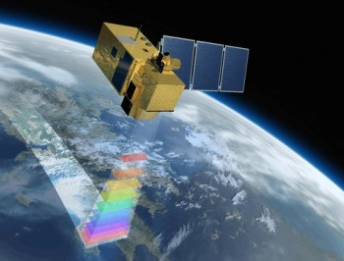

55 Agencies operating 135 satellites
5 CEOS Agency launches so far in 2015:
  CATS-ISS (NASA)
  SMAP (NASA)
  KOMPSAT-3A (Astrium, DLR, KARI)
  Sentinel-2A (ESA, EC)
  Meteosat-11 (EUMETSAT)
Upcoming launches
  Sentinel-3ª (ESA, EC)
  Jason-3 (NASA)
  Ingenio (CDTI)
  SAOCOM-1ª (CONAE)
  Electro-L2 (ROSHYDROMET,ROSKOSMOS)
  Resurs-P3 (ROSHYDROMET,ROSKOSMOS)
  … And more.

Slide 5
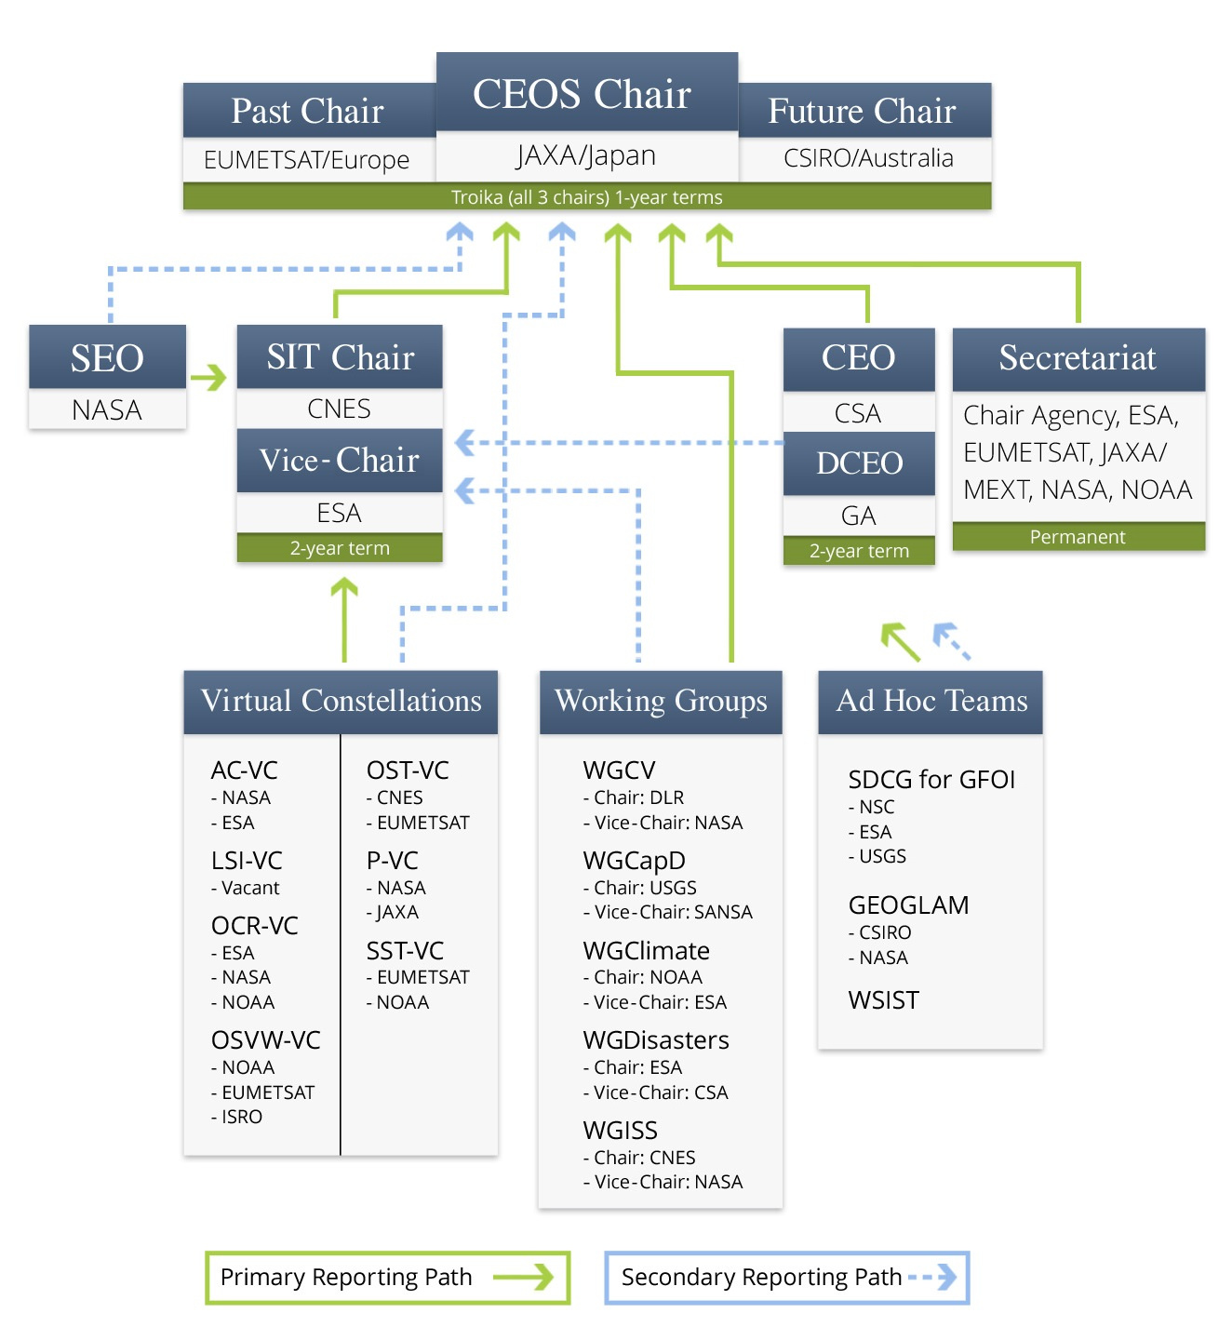
Notes:
The five main implementation mechanisms available to CEOS to undertake the work required on individual actions in support of GEOSS space segment targets are: CEOS Strategic Implementation Team, CEOS Secretariat, Five Standing Working Groups, CEOS Virtual Constellations, and Ad Hoc Teams.
5 CEOS Working Groups
Working Group on Capacity Building and Data Democracy (WGCapD): to develop a strategy for future CEOS activities in education and training, particularly in developing countries.
Working Group on Calibration & Validation (WGCV): to ensure long-term confidence in the accuracy and quality of Earth observation data and products.
Working Group on Information Systems & Services (WGISS): to stimulate, coordinate, and monitor the development of the systems and services which manage and supply the data and information from participating agencies’ missions.
Working Group on Climate (WGClimate): to provide guidance to CEOS regarding climate-related activities in support of various international organizations
Working Group on Disasters (WGDisasters): to coordinate CEOS activities to support the disaster management community
The CEOS Secretariat is chaired by the current CEOS host agency in support of the Plenary. In addition, to ensure the expeditious conduct of business, the past and the forthcoming CEOS chair are included in the CEOS Secretariat. The Secretariat prepares and distributes the minutes for the Plenary meetings, serves as a point-of-contact for external organizations interacting with CEOS, maintains and updates the CEOS database on space and ground segment activities, produces other periodic publications such as the CEOS Newsletter and Annual Report, ensures communications among members between meetings, reports at each Plenary session on its activities and the status of action items from previous Plenary meetings and perform other tasks as assigned by the CEOS Plenary.

Slide 6
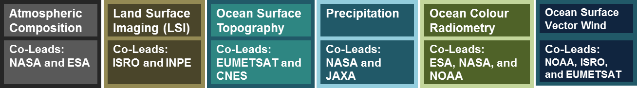
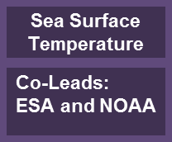
CEOS Virtual Constellations
Demonstrate the value of collaborative partnerships in addressing key observational gaps and bridging multiple GEO Societal Benefit Areas while maintaining the independence of individual contributions
Focus dialogue from “all topics/all agencies” to small, specialized groups
Guidance for design and development of future systems to meet the broad spectrum of EO requirements
  Avoid duplication and overlap in EO efforts
  Close information gaps for GEO SBAs
  Establish and sustain global EO coverage and data availability
Re-focus underway
A Virtual Constellation is a set of space and ground segment capabilities operating together in a coordinated manner to meet a combined and common set of Earth observation requirements.
Notes:
CEOS Virtual Constellations are a means to better address space-based Earth observation needs on a global basis – without eroding the independence of individual agencies.
CEOS Virtual Constellations harmonize and maximize efforts among space agencies to deploy Earth observation (EO) missions as part of GEOSS, address emerging data gaps, avoid overlap among observing systems, and make maximum use of existing assets. A Virtual Constellation consists of multiple satellites, ground systems, and related data delivery systems mobilized in a coordinated manner for greater efficiency.

Slide 7
CEOS Working Groups
Working Group on Calibration and Validation (WGCV)
  To ensure long-term confidence in the accuracy and quality of Earth observation data and products
Working Group on Information Systems and Services (WGISS)
  To coordinate the development of systems and services which manage and supply the data and information from Member missions
Working Group on Capacity Building & Data Democracy (WGCapD)
  To increase the capacity of institutions in less developed countries for effective use of Earth observation data for the benefit of society and to achieve sustainable development
Working Group on Climate (WGClimate) Jointly led with CGMS
  To facilitate the use of Essential Climate Variable (ECV) time-series through coordination of Member Agencies’ initiatives and activities
Working Group on Disasters (WGDisasters)
  To increase the contribution of Earth Observation satellite to the various disaster risk management phases and raise the awareness on the benefits of using satellite Earth Observation in all phases of disasters.
Working Groups enhance technical cooperation among CEOS Agencies in specific topical areas with broad international benefit.
Notes:
Working Groups typically address topics such as calibration/validation, data portals, capacity building, and common data processing standards that area shared across a wide range of Earth observation domains. As a consequence, their activities are intimately connected with, and complementary to, the work of the Virtual Constellations and are often viewed as “cross-cutting” mechanisms within CEOS.

Slide 8
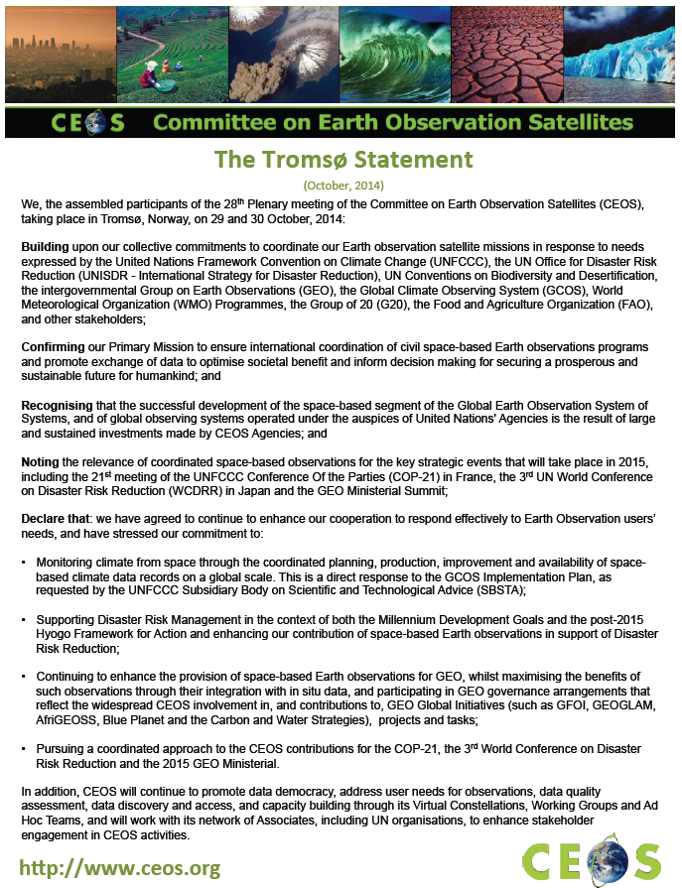
The Tromsø Statement, Oct 2014
CEOS Agencies will continue and enhance their cooperation to respond effectively to Earth observation users needs.
CEOS stresses its commitment to:
Monitoring climate from space through coordinating space-based climate data records on a global scale.
Supporting Disaster Risk Management in the context of both the Millennium Development Goals and the post-2015 Hyogo Framework for Action.
Enhancing the provision of space-based Earth observations for GEO, participating in GEO governance arrangements and contributing to, GEO Global Initiatives, projects and tasks.
Promoting data democracy, address user needs for observations, data quality assessment, data discovery and access, and capacity building.
A coordinated approach to the CEOS contributions for the COP-21, the 3rd World Conference on Disaster Risk Reduction and the 2015 GEO Ministerial.
CEOS will work with its network of Associates to enhance stakeholder engagement in its activities.

Slide 9
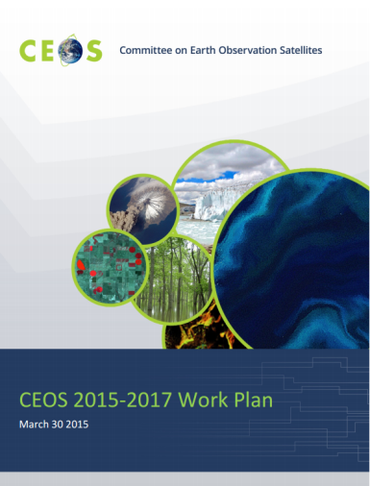
Ninety-three Deliverables for
2015-2017
Climate Monitoring, Research and Services
Coordinate development of Climate Data Records (CDRs) and related datasets addressing Essential Climate Variables (ECVs) established by the Global Climate Observing System (GCOS).
Continue cooperation with GEO, GCOS, the World Meteorological Organization (WMO), and the CGMS in the development of a space-based system to support climate change information and adaptation.
Carbon Observations, including Forested Regions
Coordinate space-based observations to support the effective monitoring and management of the world’s forested regions to support any future international climate agreement and support the Space Data Component of the GEO Global Forest Observations Initiative (GFOI).
Progress implementation of the CEOS Strategy for Carbon Observations from Space

Slide 10
Ninety-three Deliverables for
2015-2017
Observations for Agriculture
Develop and implement a data acquisition strategy to provide satellite observations that will facilitate the monitoring of agricultural production in support of the GEO Global Agricultural Monitoring (GEOGLAM) initiative.
Continue support to the GEOGLAM/AsiaRICE and the Joint Experiments on Crop Assessment and Monitoring (JECAM) initiative.
Observations for Disasters
Strengthen support to the disaster management community through the sustained coordination of disaster-related activities undertaken by CEOS Agencies.
Ensure that the importance of Earth observations from space is emphasized at the UN 2015 World Conference on Disaster Risk Reduction and in the post-2015 Framework for Actions (HFA2).
Continue support to the GEO Geohazards Supersites and Natural Laboratories Initiative.

Slide 11
Ninety-three Deliverables for
2015-2017
Observations for Water
Provide integrated CEOS input to the GEO Water Implementation Plan.
Capacity Building, Data Access, Availability and Quality
Advance CEOS Data Democracy activities.
Continue to support the development and operationalization of the GEOSS Common Infrastructure (GCI) and its CEOS-related elements.
Coordinate the development of suitable methodologies for the on-ground characterization of satellite-based EO sensors, the calibration of EO missions, and the validation of satellite-based Level 1 and Level 2 products.
Continue the cooperation with other CEOS elements in supporting the generation of well-calibrated and validated data records.
Continue cooperation with GEO, Global Space-based Inter-calibration System, and WMO and ground-based networks in the provision of high quality EO data products.
Maintain the Missions, Instruments and Measurements database as a key tool to enhance understanding of Earth observations from space missions and data. Coordinate development of Climate Data Records and related datasets addressing Essential Climate Variables established by the Global Climate Observing System.

Slide 12
Ninety-three Deliverables for
2015-2017
Advancement of the CEOS Virtual
Constellations
Characterize the Virtual Constellations in the context of both the development of the space segment for GEOSS and of the multitude of outcomes and deliverables that CEOS seeks to provide for GEO and other users and frameworks.
Support to Other Key Stakeholder Initiatives
Continue CEOS contributions and maintain leadership role in the GEO Blue Planet Task.
Further develop CEOS contributions to meet biodiversity observation requirements.
Continue dialogue on enhanced CEOS-level coordination to support improved research and monitoring of the Earth’s Polar Regions.

Slide 13
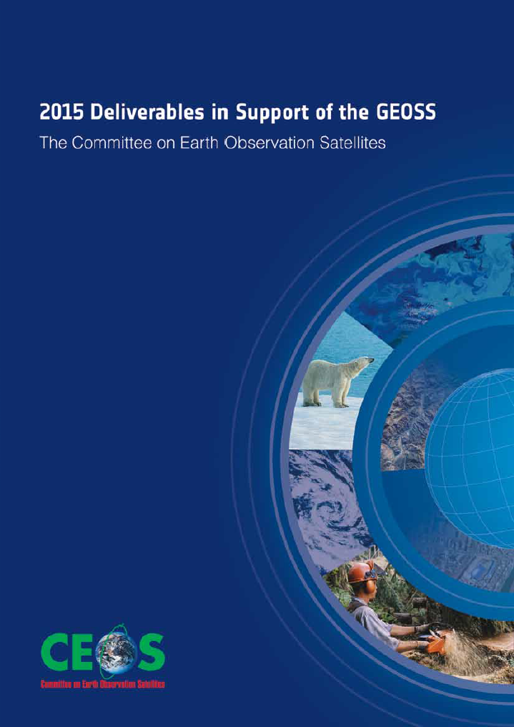
CEOS and the Group on Earth Observations (GEO)
CEOS is a GEO Participating Organization
The establishment of GEO in 2005 was a strong focus for coordination among the Earth observations community and provided additional impetus and direction for CEOS
CEOS is recognized as the space component of GEO, with responsibility for implementation of the space segment of the Global Earth Observation System of Systems (GEOSS)
  Integrate observing systems to benefit from the increased number and distribution of observations of any given event
  Minimize data gaps – toward a comprehensive, coordinated, and sustained GEOSS
CEOS has aligned much of its resources and capacity in support of GEO’s commitments to the international community, supporting a wide range of its activities.

Slide 14
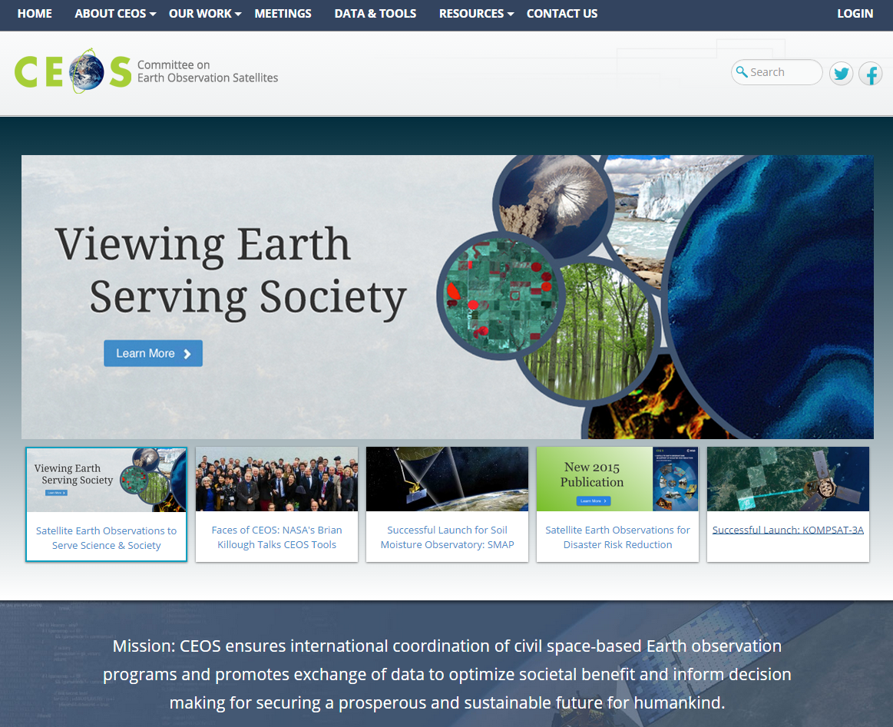
Our new website – ceos.org

Slide 15
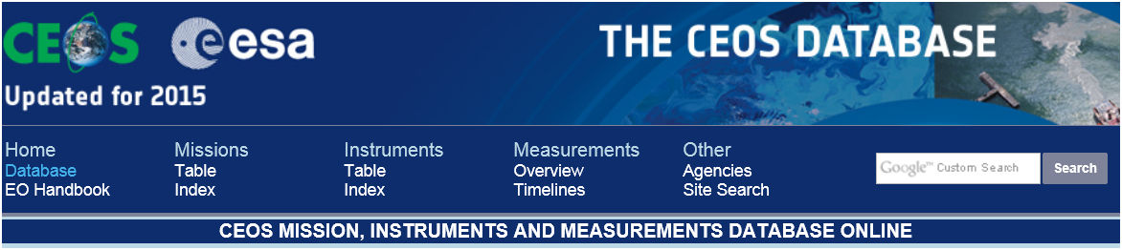
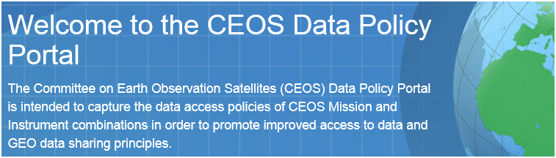

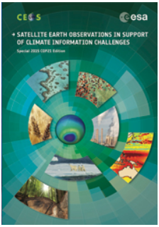
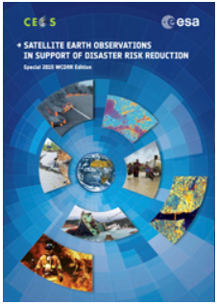
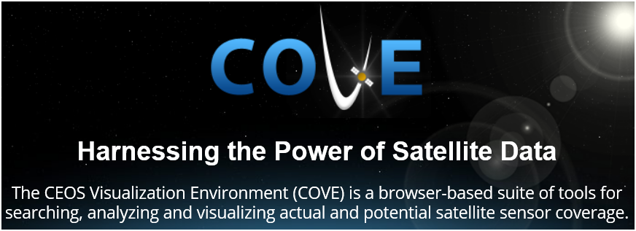
CEOS Tools and Resources
CEOS EO Handbook
Multimedia eBook and Pdf version
Special 2015 Editions
Assisting researchers in locating information on available datasets and services
COP21
3rd UN World Conference on Disaster Risk Reduction
Notes:
DATA Policy Portal: The CEOS Data Policy Portal captures the data access policies of all CEOS satellites and instruments in an effort to promote improved data access and data sharing principles.
The CEOS IDN is an international effort developed to assist researchers in locating information on available Earth science datasets and services.
The EO Handbook presents satellite EO capabilities and applications.
The Online Database details present and future satellites, instruments, and measurement capabilities.
The CEOS Visualization Environment (COVE) is a browser-based suite of tools for searching, analyzing and visualizing actual and potential satellite sensor coverage.

Slide 16
CEOS Members and Associates
MEMBERS
Agenzia Spaziale Italiana (ASI)
Canadian Space Agency (CSA)
Centre National d’Etudes Spatiales (CNES), France
Centro para Desarrollo Tecnólogico Industrial (CDTI), Spain
China Center for Resources Satellite Data and Applications (CRESDA)
Chinese Academy of Space Technology (CAST)
Comisión Nacional de Actividades Espaciales (CONAE), Argentina
Commonwealth Scientific & Industrial Research Organisation (CSIRO), Australia
Deutsches Zentrum fürLuft-und Raumfahrt (DLR), Germany
European Commission (EC)
European Organisation for the Exploitation of Meteorological Satellites
(EUMETSAT)
European Space Agency (ESA)
Geo-Informatics and Space Technology Development Agency (GISTDA), Thailand
Indian Space Research Organisation (ISRO)
Instituto Nacional de Pesquisas Espaciais (INPE), Brazil
Japan Aerospace Exploration Agency/Ministry of Education, Culture, Sports,
Science, and Technology (JAXA/MEXT)
Korea Aerospace Research Institute (KARI)
National Aeronautics and Space Administration (NASA), USA
National Oceanic and Atmospheric Administration (NOAA), USA
National Remote Sensing Center of China (NRSCC)
National Satellite Meteorological Center/Chinese Meteorological Administration
(NSMC/CMA)
National Space Agency of Ukraine (NKAU)
National Space Research Agency of Nigeria (NASRDA)
Netherlands Space Office (NSO)
Russian Federal Space Agency (ROSCOSMOS)
Russian Federal Service for Hydrometeorology and Environmental Monitoring
(ROSHYDROMET)
South African National Space Agency (SANSA)
Scientific and Technological Research Council of Turkey (TÜBITAK)
United Kingdom Space Agency (UKSA)
United States Geological Survey (USGS)
Vietnam Academy of Science and Technology (VAST)
ASSOCIATES
Belgian Federal Science Policy Office (BELSPO)
Canada Centre for Mapping & Earth Observation (CCMEO)
Crown Research Institute (CRI), New Zealand
Earth Systems Science Organisation (ESSO), India
South African Council for Scientific and Industrial Research
(CSIR)/Satellite Applications Centre (SAC)
Global Climate Observing System (GCOS)
Geoscience Australia
Global Geodetic Observing System (GGOS)
Global Ocean Observing System (GOOS)
Global Terrestrial Observing System (GTOS)
Intergovernmental Oceanographic Commission (IOC)
International Council for Science (ICSU)
International Geosphere-Biosphere Programme (IGBP)
International Ocean Colour Coordinating Group (IOCCG)
International Society of Photogrammetry and Remote Sensing (ISPRS)
Norwegian Space Centre (NSC)
Swedish National Space Board (SNSB)
United Nations Economic and Social Commission for Asia and the
Pacific (ESCAP)
United Nations Educational, Scientific and Cultural Organization (UNESCO)
United Nations Environment Programme (UNEP)
United Nations Food and Agriculture Organization (FAO)
United Nations Office for Outer Space Affairs (UNOOSA)
World Climate Research Programme (WCRP)
World Meteorological Organization (WMO)

