Slide 1

Introducing CEOS
Viewing Earth
Serving Society
May 2016

Slide 2
Background
Established in 1984 under auspices of G-7 Economic Summit of Industrialized Nations
  Focal point for international coordination of space-related Earth Observation (EO) activities
  Optimize benefits through cooperation of members in mission planning and in development of compatible data products, formats, services, applications, and policies
Operates through best efforts of Members and Associates via voluntary contributions
31 Members (Space Agencies), 28 Associates (UN Agencies, Phase A programs, other existing satellite coordination groups, scientific or governmental bodies that are international in nature, supporting ground facility programs)
As the “space arm” of the intergovernmental Group on Earth Observations, CEOS is implementing high priority actions to support delivery of societal benefit
Notes:
Phase A: Preliminary Analysis
The Project creates a preliminary design and project plan as a proof of concept specifying what to build, when to launch, the course the spacecraft is to take, what is to be done during cruise, when the spacecraft will reach the target, and what operations will be carried out. The preliminary plan also addresses build-versus-buy decisions, what spacecraft instruments are needed, where system tests will be performed, who performs mission operations, what ground data system capabilities are required, and who the experimenters are. Generally speaking, publication of the preliminary plan with costing data marks the completion of Phase A: Preliminary Analysis.”

Slide 3
Mission and Objectives
Mission
CEOS ensures international coordination of civil space-based Earth observation programs and promotes exchange of data to optimize societal benefit and inform decision making for securing a prosperous and sustainable future for humankind.
Three Primary Objectives
To optimize the benefits of space-based Earth observation through cooperation of CEOS Agencies in mission planning and in the development of compatible data products, formats, services, applications and policies.
To aid both CEOS Agencies and the international community by, among other things, serving as the focal point for international coordination of space-based Earth observation activities, including the Group on Earth Observations and entities related to global change.
To exchange policy and technical information to encourage complementarity and compatibility among space-based Earth observation systems currently in service or development, and the data received from them, as well as address issues of common interest across the spectrum of Earth observation satellite missions.

Slide 4
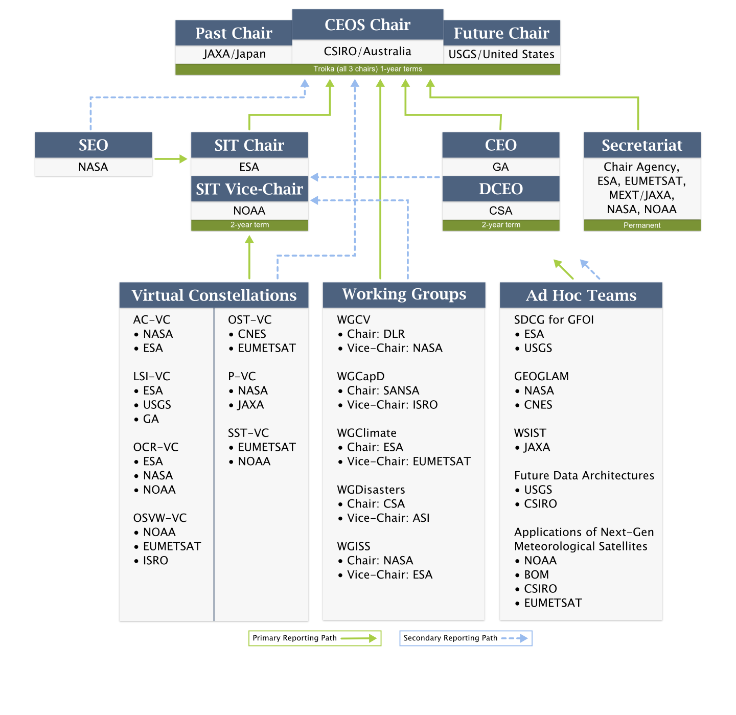
Organizational Structure
Notes:
The five main implementation mechanisms available to CEOS to undertake the work required on individual actions in support of GEOSS space segment targets are: CEOS Strategic Implementation Team, CEOS Secretariat, Five Standing Working Groups, CEOS Virtual Constellations, and Ad Hoc Teams.
5 CEOS Working Groups
Working Group on Capacity Building and Data Democracy (WGCapD): to develop a strategy for future CEOS activities in education and training, particularly in developing countries.
Working Group on Calibration & Validation (WGCV): to ensure long-term confidence in the accuracy and quality of Earth observation data and products.
Working Group on Information Systems & Services (WGISS): to stimulate, coordinate, and monitor the development of the systems and services which manage and supply the data and information from participating agencies’ missions.
Joint CEOS/CGMS Working Group on Climate (WGClimate): to provide guidance to CEOS, and to ensure coordination with the Coordination Group on Meteorological Satellites (CGMS), regarding climate-related activities in support of various international organizations
Working Group on Disasters (WGDisasters): to coordinate CEOS activities to support the disaster management community
The CEOS Secretariat is chaired by the current CEOS host agency in support of the Plenary. In addition, to ensure the expeditious conduct of business, the past and the forthcoming CEOS chair are included in the CEOS Secretariat. The Secretariat prepares and distributes the minutes for the Plenary meetings, serves as a point-of-contact for external organizations interacting with CEOS, maintains and updates the CEOS database on space and ground segment activities, produces other periodic publications such as the CEOS Newsletter and Annual Report, ensures communications among members between meetings, reports at each Plenary session on its activities and the status of action items from previous Plenary meetings and perform other tasks as assigned by the CEOS Plenary.
CEOS SEC is also supported by subject-matter ‘experts’ on topics such as oceans, carbon, biodiversity and polar issues.

Slide 5
Strategic Implementation Team (SIT)
Created in 1996 to advance the involvement of CEOS in the development of the Integrated Global Observing System (IGOS)
Plays a central role in coordination of existing and future missions of CEOS Agencies in support of GEO, GCOS, WMO, UNFCCC, etc.
Comprised of the Principals of CEOS Members and some Associates with the authority to commit Agency support to initiatives
SIT Chair Key Responsibilities:
  Lead CEOS interaction with GEO/GEOSS and strengthen linkages to GEO and implementing the space segment of GEOSS
  Oversee the activities of the CEOS Virtual Constellations
  Work to accomplish grater synergy between the research satellite and operational satellite communities
SIT provides strategic guidance on the direction, progress, and status of implementation activities in relation to the established priorities, commitments, and partnerships of the CEOS organization.

Slide 6
CEOS Virtual Constellations
Demonstrate the value of collaborative partnerships in addressing key observational gaps and bridging multiple GEO Societal Benefit Areas while maintaining the independence of individual contributions
Focus dialogue from “all topics/all agencies” to small, specialized groups
Guidance for design and development of future systems to meet the broad spectrum of EO requirements
  Avoid duplication and overlap in EO efforts
  Close information gaps for GEO SBAs
  Establish and sustain global EO coverage and data availability
Ocean Surface Topography
Land Surface
Imaging
Atmospheric
Composition
Ocean Surface
Vector Winds
Sea Surface
Temperature
Precipitation
Ocean Colour
Radiometry
Co-Leads:
CNES, EUMETSAT
Co-Leads:
USGS, ESA, GA
Co-Leads:
NASA, ESA
Co-Leads:
NOAA,
EUMETSAT
Co-Leads:
NOAA,
EUMETSAT
Co-Leads:
JAXA, NASA
Co-Leads:
ESA, NOAA,
NASA
A Virtual Constellation is a set of space and ground segment capabilities operating together in a coordinated manner to meet a combined and common set of Earth observation requirements.
Notes:
CEOS Virtual Constellations are a means to better address space-based Earth observation needs on a global basis – without eroding the independence of individual agencies.
CEOS Virtual Constellations harmonize and maximize efforts among space agencies to deploy Earth observation (EO) missions as part of GEOSS, address emerging data gaps, avoid overlap among observing systems, and make maximum use of existing assets. A Virtual Constellation consists of multiple satellites, ground systems, and related data delivery systems mobilized in a coordinated manner for greater efficiency.

Slide 7
CEOS Working Groups
Working Group on Calibration and Validation (WGCV)
  To ensure long-term confidence in the accuracy and quality of Earth observation data and products
Working Group on Information Systems and Services (WGISS)
  To coordinate the development of systems and services which manage and supply the data and information from Member missions
Working Group on Capacity Building & Data Democracy (WGCapD)
  To increase the capacity of institutions in less developed countries for effective use of Earth observation data for the benefit of society and to achieve sustainable development
Working Group on Climate (WGClimate) Jointly led with CGMS
  To facilitate the use of Essential Climate Variable (ECV) time-series through coordination of Member Agencies’ initiatives and activities
Working Group on Disasters (WGDisasters)
  To increase and strengthen the contribution of Earth Observation satellite to the various disaster risk management phases and raise the awareness on the benefits of using satellite Earth Observation in all phases of disasters.
Working Groups enhance technical cooperation among CEOS Agencies in specific topical areas with broad international benefit.
Notes:
Working Groups typically address topics such as calibration/validation, data portals, capacity building, and common data processing standards that area shared across a wide range of Earth observation domains. As a consequence, their activities are intimately connected with, and complementary to, the work of the Virtual Constellations and are often viewed as “cross-cutting” mechanisms within CEOS.

Slide 8

The Kyoto Statement
CEOS Agencies will continue and enhance their cooperation to respond effectively to Earth observation users needs.
CEOS stresses its commitment to:
Ensuring that climate observation requirements identified by the Global Climate Observing System (GCOS) – including implications arising from the COP-21 meeting in 2015 – are addressed.
Ensuring, in the context of the Sendai Framework for Disaster Risk Reduction 2015-2030, that CEOS Agency data are made available in support of disaster risk reduction and that CEOS continues engagement with UN agencies and authorities.
Ensuring that space-based Earth observations support the success of the next decade of the Group on Earth Observations (GEO), and that CEOS engagement in GEO governance and leadership is enhanced.
Proactively engage in global discussions on the critical challenges that face society, such as the achievement of the Global Goals for Sustainable Development.
CEOS will work with its network of Associates to enhance stakeholder engagement in its activities.

Slide 9
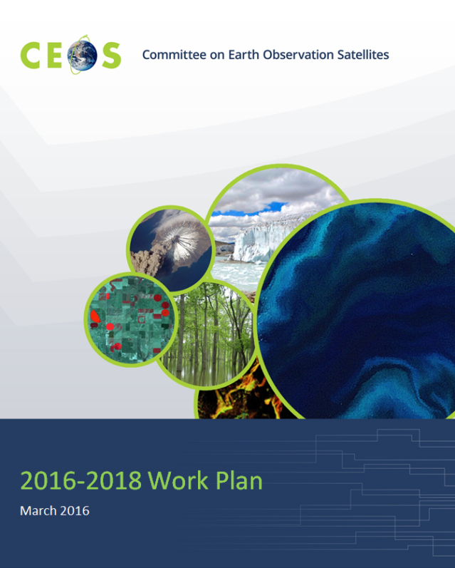
Work Plan – Expected Outcomes
The expected outcomes reflect the ongoing and emerging priorities of CEOS, as characterized by its internal decision making and external commitments. They are intended to focus on improved Earth observation (EO) systems coordination and enhanced data access for key global programs and initiatives.
The main outcomes are described for the following thematic areas:
  Climate Monitoring, Research, and Services
  Carbon Observations, Including Forested Regions
  Observations for Agriculture
  Observations for Disasters
  Observations for Water
  Capacity Building
  Data Access, Availability and Quality
  Advancement of the CEOS Virtual Constellations
  Support to Other Key Stakeholder Initiatives
  Outreach to Key Stakeholders
  Organizational Issues
Seventy-four (74) Objectives/Deliverables for 2016-2018

Slide 10
Current Objectives
Climate Monitoring, Research and Services
Continue cooperation with GEO, GCOS, WMO, and the CGMS in the development of a space-based system to support climate change information and adaptation.
Continued implementation of the Architecture for Climate Monitoring from Space
Continued strong engagement with UNFCCC/SBSTA and GCOS processes
8 Objectives/Deliverables for 2016-18
Carbon Observations, including Forested Regions
Coordinate space-based observations to support the effective monitoring and management of the world’s forested regions to support any future international climate agreement and support the Space Data Component of the GEO Global Forest Observations Initiative (GFOI).
Progress implementation of the CEOS Strategy for Carbon Observations from Space
7 Objectives/Deliverables for 2016-18.

Slide 11
Current Objectives
Observations for Agriculture
Develop and implement a data acquisition strategy to provide satellite observations that will facilitate the monitoring of agricultural production in support of the GEO Global Agricultural Monitoring (GEOGLAM) initiative.
Continue support to the Joint Experiments on Crop Assessment and Monitoring (JECAM) initiative.
2 Objectives/Deliverables for 2016-18.
Observations for Disasters
Strengthen support to the disaster management community through the sustained coordination of disaster-related activities undertaken by CEOS Agencies.
Support implementation of a coordinated approach, convened through the Group on Earth Observations, to implementation of priority recommendations in the Sendai Framework for Disaster Risk Reduction 2015-2030 (GEO-DARMA). [NEW]
Continue support to the GEO Geohazards Supersites and Natural Laboratories Initiative.
4 Objectives/Deliverables for 2016-18.

Slide 12
Current Objectives
Observations for Water
Implement the CEOS Strategy for Water Observations from Space. [NEW]
1 Objective/Deliverable for 2016-18.
Capacity Building, Data Access, Availability and Quality
Advance CEOS Data Democracy activities.
Explore potential for CEOS Agencies to leverage future data architectures to unlock the value of space Earth observations [2016 CEOS Chair Initiative!] [NEW]
Continue to support the development and operationalization of the GEOSS Common Infrastructure (GCI) and its CEOS-related elements.
Coordinate the development of suitable methodologies for the on-ground characterization of satellite-based EO sensors, the calibration of EO missions, and the validation of satellite-based Level 1 and Level 2 products.
Continue the cooperation with other CEOS elements in supporting the generation of well-calibrated and validated data records.
Continue cooperation with GEO, Global Space-based Inter-calibration System (GSICS), and WMO and ground-based networks in the provision of high quality EO data products.
Maintain the Missions, Instruments and Measurements (MIM) database as a key tool to enhance understanding of Earth observations from space missions and data.
22 Objectives/Deliverables for 2016-18.

Slide 13
Current Objectives
Advancement of the CEOS Virtual Constellations
Characterize the Virtual Constellations in the context of both the development of the space segment for GEOSS and of the multitude of outcomes and deliverables that CEOS seeks to provide for GEO and other users and frameworks.
19 Objectives/Deliverable for 2016-18.
Support to Other Key Stakeholder Initiatives
Continue CEOS contributions and maintain leadership role in the GEO Blue Planet Task.
Further develop CEOS contributions to meet biodiversity observation requirements.
Continue dialogue on enhanced CEOS-level coordination to support improved research and monitoring of the Earth’s Polar Regions.
Exploitation of data from next-generation geostationary satellites to support regional and global challenges [2016 CEOS Chair Initiative!] [NEW]
6 Objectives/Deliverables for 2016-18.

Slide 14
Current Objectives
Outreach to Key Stakeholders
Engage, attend, be strategically involved (where appropriate), report on CEOS achievements, and present at key meetings.
Maintain the CEOS Website and enhance currency and relevance of content.
Publish the CEOS Newsletter.
Highlight the value of Earth observations from space in delivering societal benefit.
Promote the use of satellite data in the 2030 Agenda for Sustainable Development. [NEW]
Promote the CEOS Data Cube infrastructure for improved utilization of the growing volume of satellite data. [NEW]
4 Objectives/Deliverables for 2016-18.
Organizational Issues
Updated and refreshed Terms of Reference for CEOS Working Groups
1 Objectives/Deliverable for 2016-18.

Slide 15
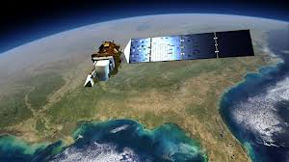
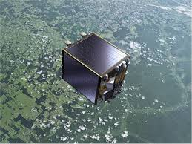
CEOS Agency Missions
CEOS Agencies currently operate 136 missions and ~400 instruments.
8 CEOS Agency launches Jan 15 – Mar 16:
  EC/ESA/EUMETSAT – Sentinel-2A, Sentinel-3A
  NASA – CATS-on-ISS
  NASA/CSA – SMAP
  NOAA/NASA – DSCOVR
  KARI – KOMPSAT-3A
  NRSCC – BJ-2
  EUMETSAT/ESA – Meteosat-11
  NASA/CNES/EUMETSAT/NOAA – JASON-3
Up to 35 planned for the rest of 2016!
  EC/ESA– Sentinel-1B, Sentinel-2B
  EC/ESA/NOSA - Sentinel-5P
  CONAE – SAOCOM-1A
  JAXA – GCOM-C
  CDTI – PAS
  ISRO – INSAT-3DR, RESOURCESAT-2A, SCATSAT
  ESA - ADM-Aeolus
  CAST – HY-2C, -3A
  NOAA – GOES-R
  ROSCOSMOS/ROSHYDROMET – 7 Units
  … And many more.

Slide 16

CEOS and the Group on Earth Observations (GEO)
CEOS is a GEO Participating Organization
GEO’s establishment in 2005 gave focus for the Earth observations community, including CEOS.
CEOS is the recognized “space arm of GEO”:
  Integrate observing systems to benefit from the increased number and distribution of observations of any given event
  Minimize data gaps – toward a comprehensive, coordinated, and sustained global system.
CEOS is a member of the GEO Programme Board and Observer at GEO Executive Committee.
CEOS is fully committed to supporting GEO make its second decade even more successful than its first.
CEOS has aligned much of its resources and capacity in support of GEO’s commitments to the international community, supporting a wide range of its activities.

Slide 17
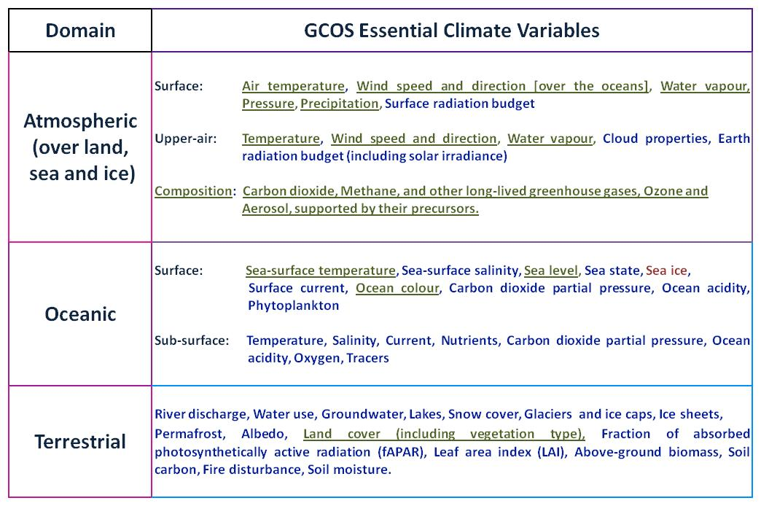
CEOS and the Global Climate Observing System (GCOS)
CEOS will actively participate in the development of the updated GCOS Implementation Plan and associated Satellite Supplement.
CEOS will then deliver an updated CEOS Response detailing how space agencies will work together to address GCOS requirements.
Observations being collected by current Virtual Constellations are underlined
Observations that could be collected by new Virtual Constellations are in red font
Notes:
ECVs are required to support the work of the UNFCCC and the IPCC and thereby GEO.
ECVs are technically and economically feasible for systematic observation.
These variables require international exchange to access both current and historical observations.
Currently, there are 48 ECVs as shown in the table (as detailed in the 2010 Update to the GCOS Implementation Plan).
Additional variables required for research purposes have not been included.

Slide 18





International Coordination Mechanisms
1972 Coordination Group for Meteorological Satellites (CGMS)
1984 Committee on Earth Observation Satellites (CEOS)
1986-1996 International Coordination Working Group (ICWG) of the Space Station Partners
1998-2008 Integrated Global Observing Strategy (IGOS)
2000 International Charter on Space and Major Disasters
2000 World Meteorological Organization Consultative Meetings on High-Level Policy on Satellite Matters
2003 Group on Earth Observations (GEO); established as an Intergovernmental GEO in 2005

Slide 19
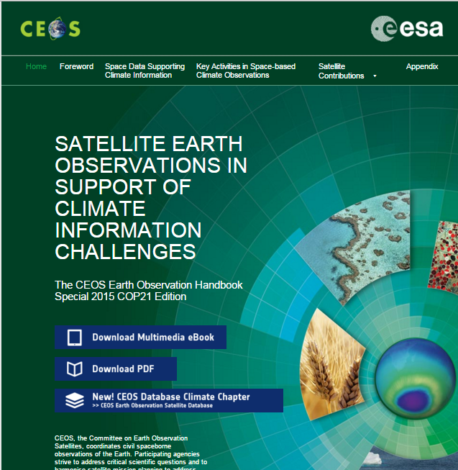
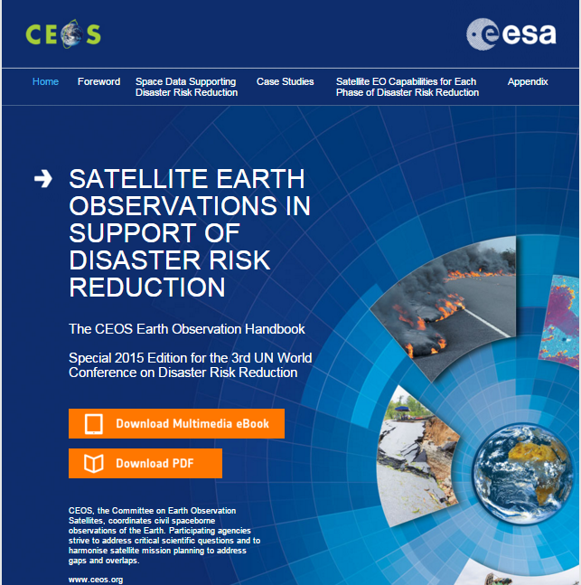
Publications
Multimedia
eBooks – NEW!
Access here
Access here
Highlighting the relevance and value of satellite
Earth observation to topics of global significance.

Slide 20
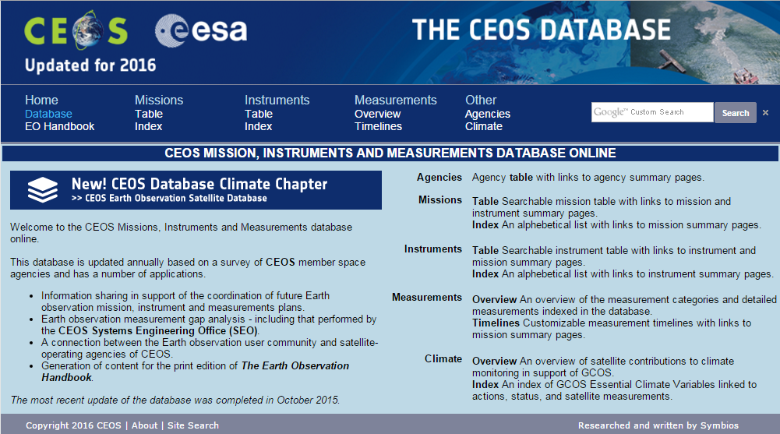
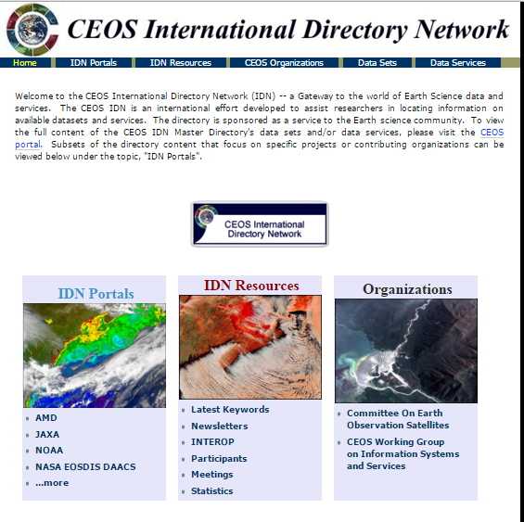
Online Resources
CEOS Database
The official source of information on
CEOS satellites and sensors
CEOS IDN
Connecting you to CEOS data
Access here
Access here

Slide 21
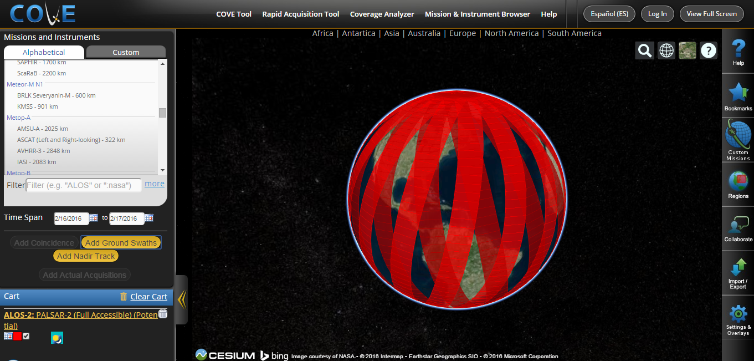
CEOS Coverage Analyzer
Past
What data have CEOS
satellites collected?
Present
What are they
acquiring now?
Future
What could
they collect?
Access here

Slide 22

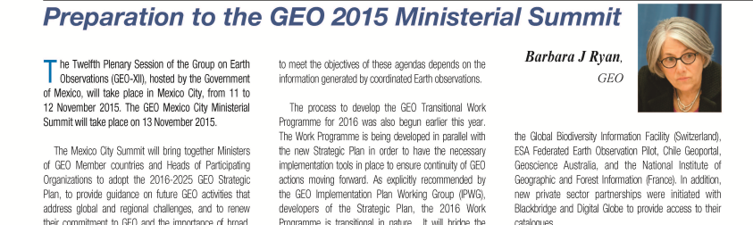
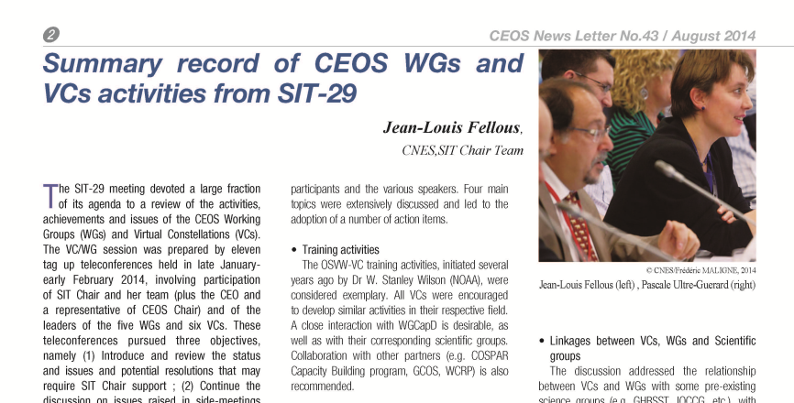
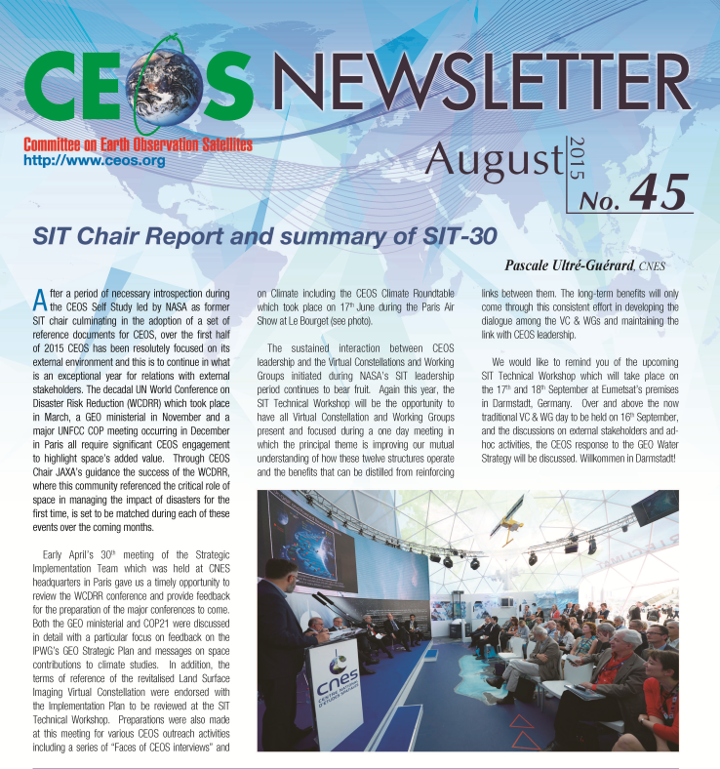
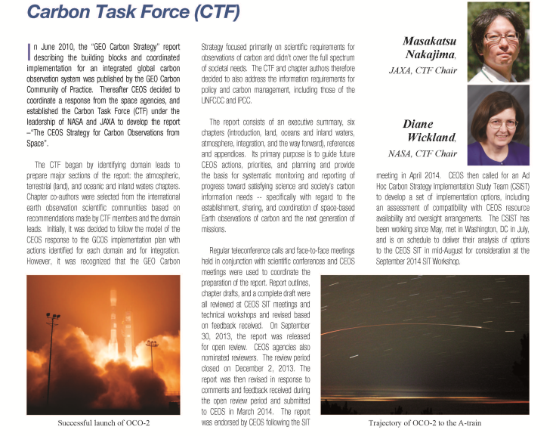
Publications
The semi-annual CEOS Newsletter provides
updates and summaries of CEOS work
throughout the year.

Slide 23
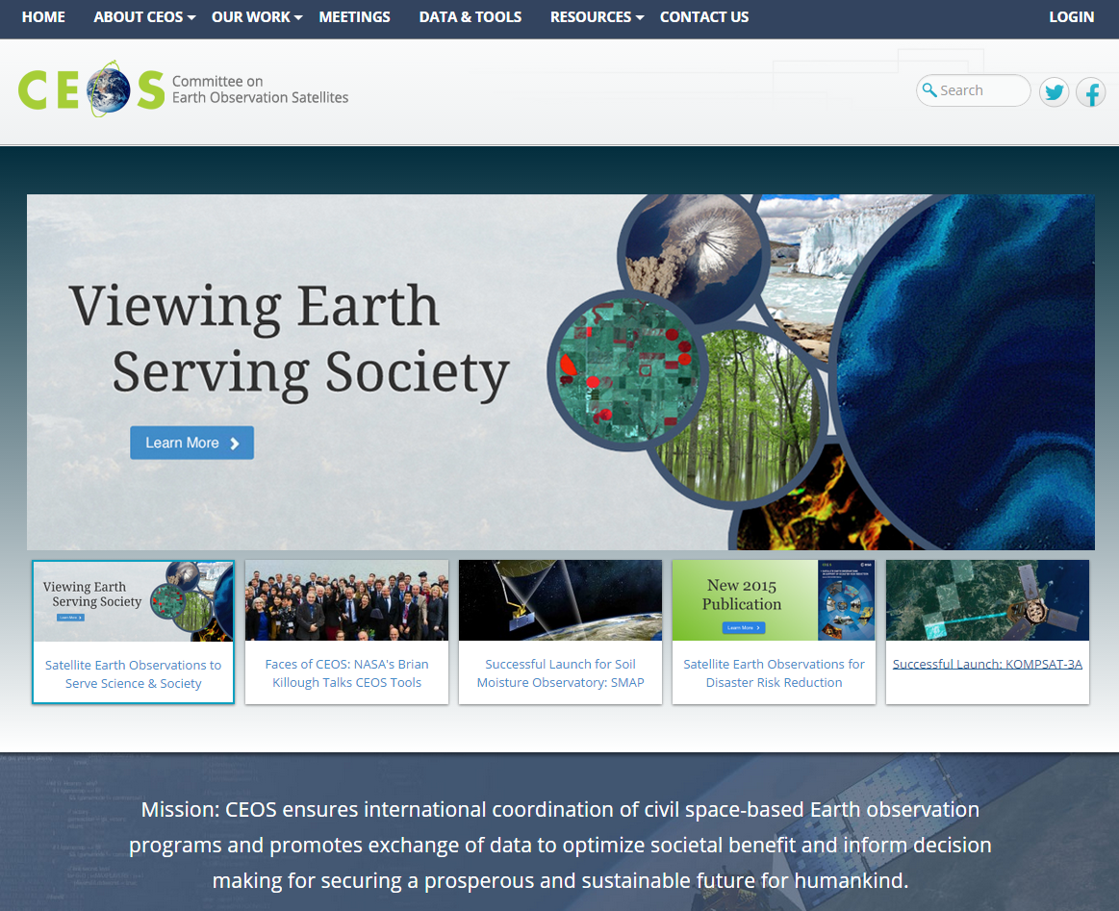
Our website – ceos.org
Access here

Slide 24
CEOS Members and Associates
MEMBERS
Agenzia Spaziale Italiana (ASI)
Canadian Space Agency (CSA)
Centre National d’Etudes Spatiales (CNES), France
Centro para Desarrollo Tecnólogico Industrial (CDTI), Spain
China Center for Resources Satellite Data and Applications (CRESDA)
Chinese Academy of Space Technology (CAST)
Comisión Nacional de Actividades Espaciales (CONAE), Argentina
Commonwealth Scientific & Industrial Research Organisation (CSIRO),
Australia
Deutsches Zentrum fürLuft-und Raumfahrt (DLR), Germany
European Commission (EC)
European Organisation for the Exploitation of Meteorological Satellites
(EUMETSAT)
European Space Agency (ESA)
Geo-Informatics and Space Technology Development Agency (GISTDA),
Thailand
Indian Space Research Organisation (ISRO)
Instituto Nacional de Pesquisas Espaciais (INPE), Brazil
Japan Aerospace Exploration Agency/Ministry of Education, Culture, Sports,
Science, and Technology (JAXA/MEXT)
Korea Aerospace Research Institute (KARI)
National Aeronautics and Space Administration (NASA), USA
National Oceanic and Atmospheric Administration (NOAA), USA
National Remote Sensing Center of China (NRSCC)
National Satellite Meteorological Center/Chinese Meteorological Administration
(NSMC/CMA)
National Space Agency of Ukraine (NKAU)
National Space Research Agency of Nigeria (NASRDA)
Netherlands Space Office (NSO)
Russian Federal Space Agency (ROSCOSMOS)
Russian Federal Service for Hydrometeorology and Environmental Monitoring
(ROSHYDROMET)
South African National Space Agency (SANSA)
Scientific and Technological Research Council of Turkey (TÜBITAK)
United Kingdom Space Agency (UKSA)
United States Geological Survey (USGS)
Vietnam Academy of Science and Technology (VAST)
ASSOCIATES
Australian Bureau of Meteorology (BOM)
Belgian Federal Science Policy Office (BELSPO)
Canada Centre for Mapping & Earth Observation (CCMEO)
Crown Research Institute (CRI), New Zealand
Earth Systems Science Organisation (ESSO), India
South African Council for Scientific and Industrial Research
(CSIR)/Satellite Applications Centre (SAC)
Gabonese Agency for Space Studies and Observations (AGEOS)
Global Climate Observing System (GCOS)
Geoscience Australia (GA)
Global Geodetic Observing System (GGOS)
Global Ocean Observing System (GOOS)
Global Terrestrial Observing System (GTOS)
Intergovernmental Oceanographic Commission (IOC)
International Council for Science (ICSU)
International Geosphere-Biosphere Programme (IGBP)
International Ocean Colour Coordinating Group (IOCCG)
International Society of Photogrammetry and Remote Sensing
(ISPRS)
Malaysian National Space Agency (ANGKASA)
Mexican Space Agency (AEM)
Norwegian Space Centre (NSC)
Swedish National Space Board (SNSB)
United Nations Economic and Social Commission for Asia and the
Pacific (ESCAP)
United Nations Educational, Scientific and Cultural Organization
(UNESCO)
United Nations Environment Programme (UNEP)
United Nations Food and Agriculture Organization (FAO)
United Nations Office for Outer Space Affairs (UNOOSA)
World Climate Research Programme (WCRP)
World Meteorological Organization (WMO)

Slide 25
CEOS Plenaries
Plenary | Year | Venue | Host |  | Plenary | Year | Venue | Host
1st | 1984 | Washington DC, USA | NOAA |  | 17th | 2003 | Colorado Springs, USA | NOAA
2nd | 1986 | Frascati, Italy | ESA |  | 18th | 2004 | Beijing, China | NRSCC
3rd | 1988 | Ottawa, Canada | CSA |  | 19th | 2005 | London, UK | BNSC
4th | 1990 | Sao Jose dos Campos, Brazil | INPE |  | 20th | 2006 | Buenos Aires, Argentina | CONAE
5th | 1991 | Washington DC, USA | NASA/NOAA |  | 21st | 2007 | Kona, Hawaii, USA | USGS
6th | 1992 | London, UK | BNSC |  | 22nd | 2008 | George, South Africa | CSIR
7th | 1993 | Tsukuba, Japan | MEXT/NASDA |  | 23rd | 2009 | Phuket, Thailand | GISTDA
8th | 1994 | Berlin, Germany | DARA |  | 24th | 2010 | Rio de Janeiro, Brazil | INPE
9th | 1995 | Montreal, Canada | CSA |  | 25th | 2011 | Lucca, Italy | ASI
10th | 1996 | Canberra, Australia | CSIRO |  | 26th | 2012 | Bangalore, India | ISRO
11th | 1997 | Toulouse, France | CNES |  | 27th | 2013 | Montreal, Canada | CSA
12th | 1998 | Bangalore, India | ISRO |  | 28th | 2014 | Trömso, Norway | EUMETSAT
13th | 1999 | Stockholm, Sweden | EUMETSAT |  | 29th | 2015 | Kyoto, Japan | JAXA
14th | 2000 | Rio de Janeiro, Brazil | INPE |  | 30th | 2016 | Brisbane, Australia | CSIRO
15th | 2001 | Kyoto, Japan | MEXT/NASDA |  | 31st | 2017 | Rapid City, United States | USGS
16th | 2002 | Frascati, Italy | ESA

Slide 26
Acronyms
SIT Strategic Implementation Team
CEO CEOS Executive Officer
SEO Systems Engineering Office
AC-VC Atmospheric Composition Virtual Constellation
LSI-VC Land Surface Imaging Virtual Constellation
OCR-VC Ocean Colour Radiometry Virtual Constellation
OST-VC Ocean Surface Topography Virtual Constellation
OSVW-VC Ocean Surface Vector Wind Virtual Constellation
P-VC Precipitation Virtual Constellation
SST-VC Sea Surface Temperature Virtual Constellation
WGCV Working Group on Calibration and Validation
WGCapD Working Group on Capacity Building and Data Democracy
WGClimate Working Group on Climate (joint CEOS and CGMS)
WGDisasters Working Group on Disasters
WGISS Working Group on Information Systems and Services
SDCG for GFOI Space Data Coordination Group for Global Forest Observation Initiative
GEOGLAM GEO Global Agricultural Monitoring

