Slide 1

Introducing CEOS
Viewing Earth
Serving Society
February, 2017

Slide 2

Background
Established under the auspices of the G-7 Economic Summit of Industrialized Nations (1984)
Operates through the best efforts & voluntary contributions of 31 Members (space agencies) & 24 Associates (UN Agencies, Phase A programs, or supporting ground facility programs)
Delivers on high priority objectives in support of the Group on Earth Observation (GEO) Tasks as the space component of the Global Earth Observation System of Systems (GEOSS)
Notes:
Phase A: Preliminary Analysis
The Project creates a preliminary design & project plan as a proof of concept specifying what to build, when to launch, the course the spacecraft is to take, what is to be done during cruise, when the spacecraft will reach the target, & what operations will be carried out. The preliminary plan also addresses build-versus-buy decisions, what spacecraft instruments are needed, where system tests will be performed, who performs mission operations, what ground data system capabilities are required, & who the experimenters are. Generally speaking, publication of the preliminary plan with costing data marks the completion of Phase A: Preliminary Analysis.”

Slide 3
Primary Objectives
Serve as a focal point for coordinating international satellite Earth Observation (EO) activities
Optimize EO benefits via cooperation on mission planning & the development of compatible data products, formats, services, applications, & policies
Exchange policy & technical information to encourage complementarity & compatibility among space-based EO systems & their data
Address issues of common interest across the spectrum of EO satellite missions

Slide 4
Organizational Structure
Notes:
The five main implementation mechanisms available to CEOS to undertake the work required on individual actions in support of GEOSS space segment targets are: CEOS Strategic Implementation Team, CEOS Secretariat, Five Standing Working Groups, CEOS Virtual Constellations, & Ad Hoc Teams.
5 CEOS Working Groups
Working Group on Capacity Building & Data Democracy (WGCapD): to develop a strategy for future CEOS activities in education & training, particularly in developing countries.
Working Group on Calibration & Validation (WGCV): to ensure long-term confidence in the accuracy & quality of Earth observation data & products.
Working Group on Information Systems & Services (WGISS): to stimulate, coordinate, & monitor the development of the systems & services which manage & supply the data & information from participating agencies’ missions.
Working Group on Climate (WGClimate): to provide guidance to CEOS regarding climate-related activities in support of various international organizations
Working Group on Disasters (WGDisasters): to coordinate CEOS activities to support the disaster management community
The CEOS Secretariat is chaired by the current CEOS host agency in support of the Plenary. In addition, to ensure the expeditious conduct of business, the past & the forthcoming CEOS chair are included in the CEOS Secretariat. The Secretariat prepares & distributes the minutes for the Plenary meetings, serves as a point-of-contact for external organizations interacting with CEOS, maintains & updates the CEOS database on space & ground segment activities, produces other periodic publications such as the CEOS Newsletter & Annual Report, ensures communications among members between meetings, reports at each Plenary session on its activities & the status of action items from previous Plenary meetings & perform other tasks as assigned by the CEOS Plenary.

Slide 5
Strategic Implementation Team
Created to advance CEOS involvement in developing the Integrated Global Observing System (1996)
Comprised primarily of CEOS Member Principals (& some CEOS Associate Principals with the authority to commit Agency support to initiatives)
Plays a central role in coordinating CEOS Agency missions in support of GEO, GCOS, WMO, UNFCCC, etc.
Provides strategic guidance & direction on the implementation of CEOS activities related to established priorities, commitments, & partnerships
Leads CEOS interactions with (& strengthens linkages to) GEO & the implementation of the space segment of GEOSS
Oversees CEOS Virtual Constellation activities
Works to improves research & operational satellite community synergies

Slide 6
Virtual Constellations
A set of space & ground segment capabilities operating in a coordinated manner to meet a combined/common set of EO requirements, aiming to:
Demonstrate the value of collaborative partnerships in addressing key observational gaps & bridge multiple GEO Societal Benefit Areas while maintaining the independence of individual contributions
Focus dialogue from “all topics, all agencies” to small, specialized groups
Provide guidance on the design & development of future systems to meet the broad spectrum of EO requirements:
  Avoiding duplication & overlap in EO efforts
  Closing information gaps for GEO SBAs
  Establishing & sustaining global EO coverage & data availability
Notes:
CEOS Virtual Constellations are a means to better address space-based Earth observation needs on a global basis – without eroding the independence of individual agencies.
CEOS Virtual Constellations harmonize & maximize efforts among space agencies to deploy Earth observation (EO) missions as part of GEOSS, address emerging data gaps, avoid overlap among observing systems, & make maximum use of existing assets. A Virtual Constellation consists of multiple satellites, ground systems, & related data delivery systems mobilized in a coordinated manner for greater efficiency.

Slide 7
Virtual Constellations
Current CEOS Virtual Constellations include:
Atmospheric Composition (AC-VC)
Land Surface Imaging (LSI-VC)
Ocean Colour Radiometry (OCR-VC)
Ocean Surface Topography (OST-VC)
Ocean Surface Vector Wind (OSVW-VC)
Precipitation (P-VC)
Sea Surface Temperature (SST-VC)
Notes:
CEOS Virtual Constellations are a means to better address space-based Earth observation needs on a global basis – without eroding the independence of individual agencies.
CEOS Virtual Constellations harmonize & maximize efforts among space agencies to deploy Earth observation (EO) missions as part of GEOSS, address emerging data gaps, avoid overlap among observing systems, & make maximum use of existing assets. A Virtual Constellation consists of multiple satellites, ground systems, & related data delivery systems mobilized in a coordinated manner for greater efficiency.

Slide 8
Working Groups
Working Group on Calibration & Validation | Ensure long-term confidence in the accuracy & quality of EO data & products
Working Group on Capacity Building & Data Democracy | Increase the capacity of institutions in less developed countries for effective use of EO data for the benefit of society & to achieve sustainable development
CEOS/CGMS Working Group on Climate | Facilitate the use of Essential Climate Variable time-series through coordination of Member initiatives & activities
Working Group on Disasters | Increase & strengthen the contribution of EO satellites to the various disaster risk management phases & raise the awareness on the benefits of using satellite EO in all phases of disasters.
Working Group on Information Systems & Services | Coordinate the development of systems & services that manage & supply the data & information from Member missions
Notes:
Working Groups typically address topics such as calibration/validation, data portals, capacity building, & common data processing standards that area shared across a wide range of Earth observation domains. As a consequence, their activities are intimately connected with, & complementary to, the work of the Virtual Constellations & are often viewed as “cross-cutting” mechanisms within CEOS.

Slide 9
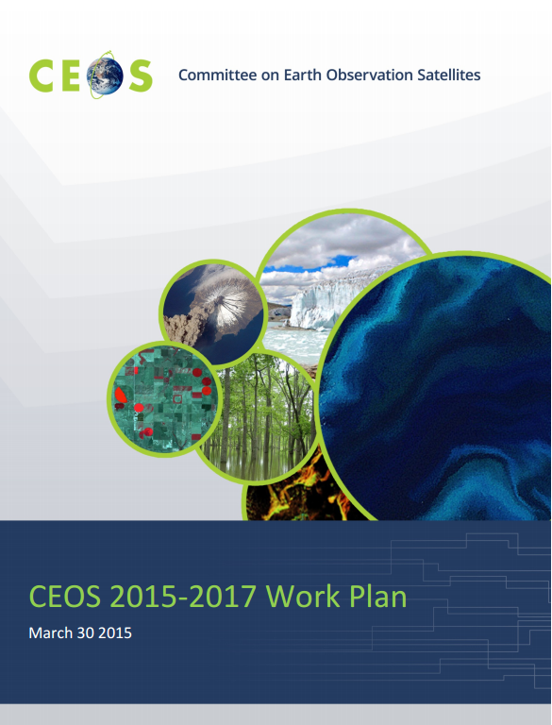
Work Plan – Expected Outcomes
The CEOS Work Plan Expected Outcomes reflect ongoing & emerging priorities as characterized by internal decision making & external commitments (focusing on improved EO systems coordination & enhanced data access for key global programs & initiatives) in the following thematic areas:
  Climate Monitoring, Research, & Services
  Carbon Observations, Including Forested Regions
  Observations for Agriculture
  Observations for Disasters
  Observations for Water
  Capacity Building, Data Access, Availability & Quality
  Advancement of the CEOS Virtual Constellations
  Support to Other Key Stakeholder Initiatives
  Outreach to Key Stakeholders
  Organizational Issues
  There are 93 Objectives/Deliverables for 2015-2017.

Slide 10
Current Objectives/Deliverables
2015-2017
Climate Monitoring, Research & Services (8)
Coordinate development of Climate Data Records (CDRs) & related datasets addressing Essential Climate Variables (ECVs) established by the Global Climate Observing System (GCOS).
Continue cooperation with GEO, GCOS, the World Meteorological Organization (WMO), & the CGMS in the development of a space-based system to support climate change information & adaptation.
Carbon Observations, including Forested Regions (4)
Coordinate space-based observations to support the effective monitoring & management of the world’s forested regions to support any future international climate agreement & support the Space Data Component of the GEO Global Forest Observations Initiative (GFOI).
Progress implementation of the CEOS Strategy for Carbon Observations from Space

Slide 11
Current Objectives/Deliverables
2015-2017
Observations for Agriculture (4)
Develop & implement a data acquisition strategy to provide satellite observations that will facilitate the monitoring of agricultural production in support of the GEO Global Agricultural Monitoring (GEOGLAM) initiative.
Continue support to the Joint Experiments on Crop Assessment & Monitoring (JECAM) initiative.
Observations for Disasters (8)
Strengthen support to the disaster management community through the sustained coordination of disaster-related activities undertaken by CEOS Agencies.
Ensure that the importance of Earth observations from space is emphasized at the UN 2015 World Conference on Disaster Risk Reduction & in the post-2015 Framework for Actions (HFA2).
Continue support to the GEO Geohazards Supersites & Natural Laboratories Initiative.

Slide 12
Current Objectives/Deliverables
2015-2017
Observations for Water (1)
Provide integrated CEOS input to the GEO Water Implementation Plan.
Capacity Building, Data Access, Availability, & Quality (28)
Advance CEOS Data Democracy activities.
Continue to support the development & operationalization of the GEOSS Common Infrastructure (GCI) & its CEOS-related elements.
Coordinate the development of suitable methodologies for the on-ground characterization of satellite-based EO sensors, the calibration of EO missions, & the validation of satellite-based Level 1 & Level 2 products.
Continue the cooperation with other CEOS elements in supporting the generation of well-calibrated & validated data records.
Continue cooperation with GEO, Global Space-based Inter-calibration System (GSICS), & WMO & ground-based networks in the provision of high quality EO data products.
Maintain the Missions, Instruments & Measurements (MIM) database as a key tool to enhance understanding of Earth observations from space missions & data.Coordinate development of Climate Data Records (CDRs) & related datasets addressing Essential Climate Variables (ECVs) established by the Global Climate Observing System (GCOS).

Slide 13
Current Objectives/Deliverables
2015-2017
Advancement of the CEOS Virtual Constellations (19)
Characterize the Virtual Constellations in the context of both the development of the space segment for GEOSS & of the multitude of outcomes & deliverables that CEOS seeks to provide for GEO & other users & frameworks.
Support to Other Key Stakeholder Initiatives (6)
Continue CEOS contributions & maintain leadership role in the GEO Blue Planet Task.
Further develop CEOS contributions to meet biodiversity observation requirements.
Continue dialogue on enhanced CEOS-level coordination to support improved research & monitoring of the Earth’s Polar Regions.

Slide 14
Current Objectives/Deliverables
2015-2017
Outreach to Key Stakeholders (4)
Engage, attend, be strategically involved (where appropriate), report on CEOS achievements, & present at key meetings.
Maintain the CEOS Website & enhance currency & relevance of content.
Publish the CEOS Newsletter.
Highlight the value of Earth observations from space in delivering societal benefit
Organizational Issues (3)
Updated & refreshed Terms of Reference for CEOS Working Groups

Slide 15
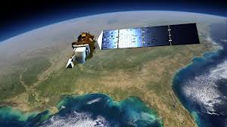
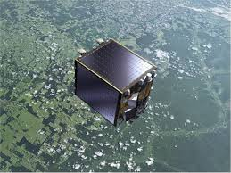
CEOS Agency Missions
60 CEOS Agencies currently operate 143 satellites.
NEEDS UPDATE: 10 CEOS Agency launches from 2014:
  ESA/EC – Sentinel-1A
  JAXA – ALOS-2
  JAXA/JMA – Himawari-8
  CAST/INPE – CBERS-4
  NASA – GPM, OCO-2
  ROSCOSMOS – Electro-L/N2, METEOR-M/N2, RESURS-P N2
  CMA – FY-2G
Up to 23 planned for 2015
  CONAE – SAOCOM-1A
  KARI – KOMPSAT-3A
  EC/ESA/EUMETSAT – Sentinel-2A, -3A, -1B, -3B, 5P
  ESA - ADM-Aeolus
  NASA – SMAP
  CMA – FY-2H, -3D, -4A
  CAST – HY-2C, -3A
  NASA/CNES/EUMETSAT/NOAA – JASON-3
  ISRO – INSAT-3DR
  … & more.

Slide 16

CEOS & the
Group on Earth Observations
The establishment of GEO in 2005 was a strong focus for coordination among the Earth observations community & provided additional impetus & direction for CEOS
CEOS is responsible for implementation of the space segment of the Global Earth Observation System of Systems (GEOSS). As the space component of GEO, CEOS:
  Integrates observing systems to benefit from the increased number & distribution of observations of any given event
  Minimizes data gaps for a more comprehensive, coordinated, & sustained GEOSS
CEOS is a GEO Participating Organization and supports a wide range of GEO activities.

Slide 17
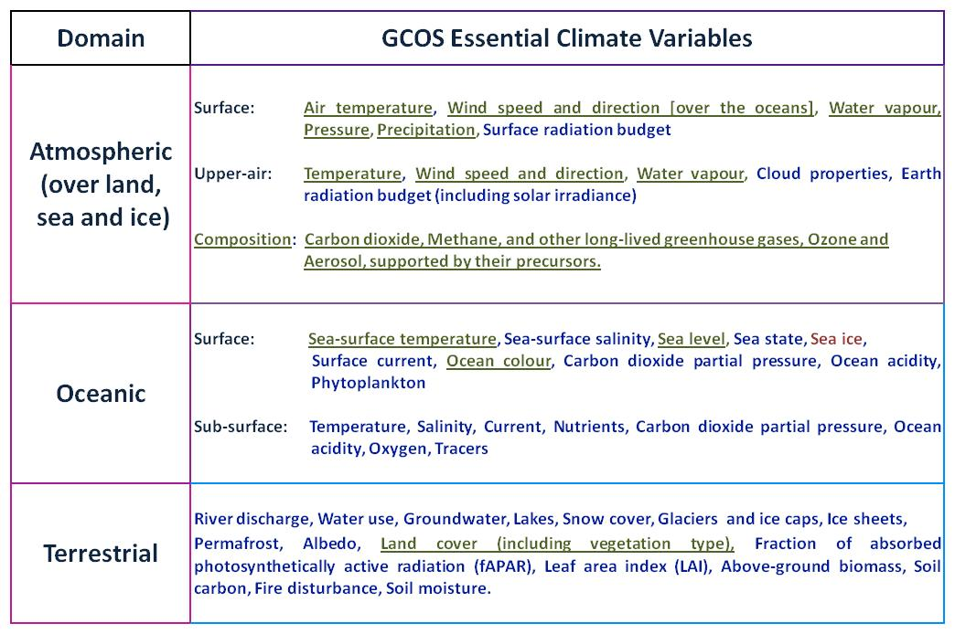
CEOS & the
Global Climate Observing System
Observations being collected by current Virtual Constellations are underlined
Observations that could be collected by new Virtual Constellations are in red font
Notes:
ECVs are required to support the work of the UNFCCC & the IPCC & thereby GEO.
ECVs are technically & economically feasible for systematic observation.
These variables require international exchange to access both current & historical observations.
Currently, there are 48 ECVs as shown in the table (as detailed in the 2010 Update to the GCOS Implementation Plan).
Additional variables required for research purposes have not been included.

Slide 18





International
Coordination Mechanisms
1972 Coordination Group for Meteorological Satellites (CGMS)
1984 Committee on Earth Observation Satellites (CEOS)
1986-1996 International Coordination Working Group (ICWG) of the Space Station Partners
1998-2008 Integrated Global Observing Strategy (IGOS)
2000 International Charter on Space & Major Disasters
2000 World Meteorological Organization Consultative Meetings on High-Level Policy on Satellite Matters
2003 Group on Earth Observations (GEO); established as an Intergovernmental GEO in 2005

Slide 19

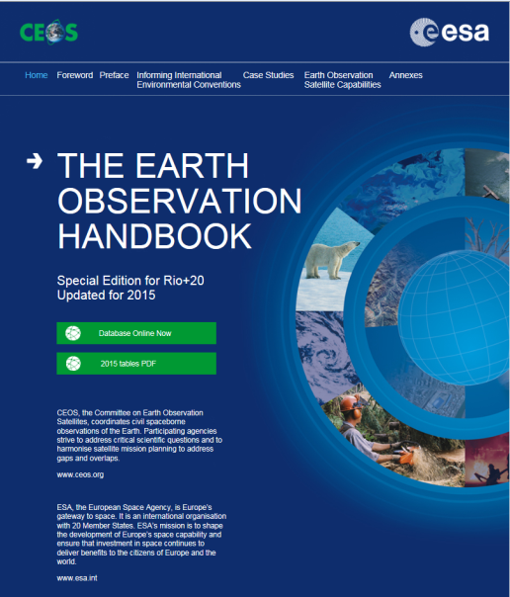

Publications

Slide 20
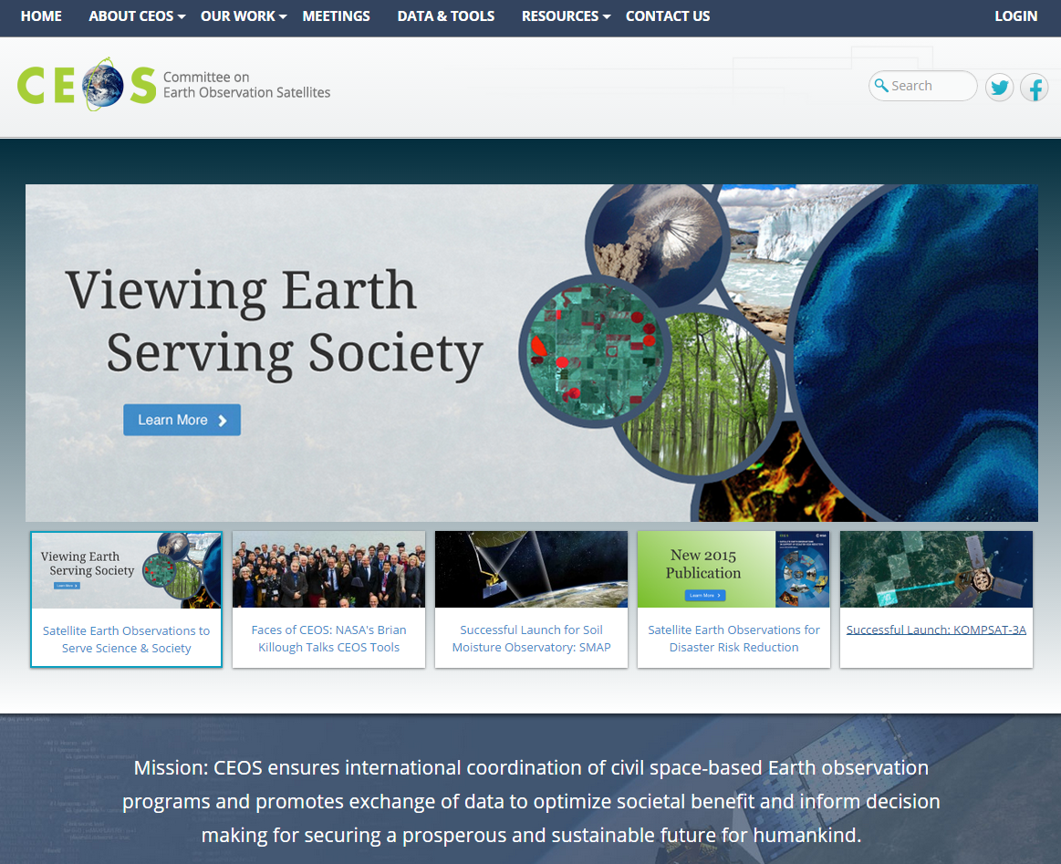
The CEOS Website

Slide 21
CEOS Members & Associates
MEMBERS
Agenzia Spaziale Italiana (ASI)
Canadian Space Agency (CSA)
Centre National d’Etudes Spatiales (CNES), France
Centro para Desarrollo Tecnólogico Industrial (CDTI), Spain
China Center for Resources Satellite Data & Applications (CRESDA)
Chinese Academy of Space Technology (CAST)
Comisión Nacional de Actividades Espaciales (CONAE), Argentina
Commonwealth Scientific & Industrial Research Organisation (CSIRO),
Australia
Deutsches Zentrum fürLuft-und Raumfahrt (DLR), Germany
European Commission (EC)
European Organisation for the Exploitation of Meteorological Satellites
(EUMETSAT)
European Space Agency (ESA)
Geo-Informatics & Space Technology Development Agency (GISTDA),
Thailand
Indian Space Research Organisation (ISRO)
Instituto Nacional de Pesquisas Espaciais (INPE), Brazil
Japan Aerospace Exploration Agency/Ministry of Education, Culture, Sports,
Science, & Technology (JAXA/MEXT)
Korea Aerospace Research Institute (KARI)
National Aeronautics & Space Administration (NASA), USA
National Oceanic & Atmospheric Administration (NOAA), USA
National Remote Sensing Center of China (NRSCC)
National Satellite Meteorological Center/Chinese Meteorological Administration
(NSMC/CMA)
National Space Agency of Ukraine (NKAU)
National Space Research Agency of Nigeria (NASRDA)
Netherlands Space Office (NSO)
Russian Federal Space Agency (ROSCOSMOS)
Russian Federal Service for Hydrometeorology & Environmental Monitoring
(ROSHYDROMET)
South African National Space Agency (SANSA)
Scientific & Technological Research Council of Turkey (TÜBITAK)
United Kingdom Space Agency (UKSA)
United States Geological Survey (USGS)
Vietnam Academy of Science & Technology (VAST)
ASSOCIATES
Belgian Federal Science Policy Office (BELSPO)
Canada Centre for Mapping & Earth Observation (CCMEO)
Crown Research Institute (CRI), New Zealand
Earth Systems Science Organisation (ESSO), India
South African Council for Scientific & Industrial Research
(CSIR)/Satellite Applications Centre (SAC)
Global Climate Observing System (GCOS)
Geoscience Australia
Global Geodetic Observing System (GGOS)
Global Ocean Observing System (GOOS)
Global Terrestrial Observing System (GTOS)
Intergovernmental Oceanographic Commission (IOC)
International Council for Science (ICSU)
International Geosphere-Biosphere Programme (IGBP)
International Ocean Colour Coordinating Group (IOCCG)
International Society of Photogrammetry & Remote Sensing
(ISPRS)
Norwegian Space Centre (NSC)
Swedish National Space Board (SNSB)
United Nations Economic & Social Commission for Asia & the
Pacific (ESCAP)
United Nations Educational, Scientific & Cultural Organization
(UNESCO)
United Nations Environment Programme (UNEP)
United Nations Food & Agriculture Organization (FAO)
United Nations Office for Outer Space Affairs (UNOOSA)
World Climate Research Programme (WCRP)
World Meteorological Organization (WMO)

Slide 22
CEOS Plenaries
Plenary | Year | Venue | Host |  | Plenary | Year | Venue | Host
1st | 1984 | Washington DC, USA | NOAA |  | 16th | 2002 | Frascati, Italy | ESA
2nd | 1986 | Frascati, Italy | ESA |  | 17th | 2003 | Colorado Springs, USA | NOAA
3rd | 1988 | Ottawa, Canada | CSA |  | 18th | 2004 | Beijing, China | NRSCC
4th | 1990 | Sao Jose dos Campos, Brazil | INPE |  | 19th | 2005 | London, UK | BNSC
5th | 1991 | Washington DC, USA | NASA/NOAA |  | 20th | 2006 | Buenos Aires, Argentina | CONAE
6th | 1992 | London, UK | BNSC |  | 21st | 2007 | Kona, Hawaii, USA | USGS
7th | 1993 | Tsukuba, Japan | MEXT/NASDA |  | 22nd | 2008 | George, South Africa | CSIR
8th | 1994 | Berlin, Germany | DARA |  | 23rd | 2009 | Phuket, Thailand | GISTDA
9th | 1995 | Montreal, Canada | CSA |  | 24th | 2010 | Rio de Janeiro, Brazil | INPE
10th | 1996 | Canberra, Australia | CSIRO |  | 25th | 2011 | Lucca, Italy | ASI
11th | 1997 | Toulouse, France | CNES |  | 26th | 2012 | Bangalore, India | ISRO
12th | 1998 | Bangalore, India | ISRO |  | 27th | 2013 | Montreal, Canada | CSA
13th | 1999 | Stockholm, Sweden | EUMETSAT |  | 28th | 2014 | Trömso, Norway | EUMETSAT
14th | 2000 | Rio de Janeiro, Brazil | INPE |  | 29th | 2015 | Kyoto, Japan | JAXA
15th | 2001 | Kyoto, Japan | MEXT/NASDA |  | 30th | 2016 | Brisbane, Australia | CSIRO

Slide 23
Acronyms
SIT Strategic Implementation Team
CEO CEOS Executive Officer
SEO Systems Engineering Office
AC-VC Atmospheric Composition Virtual Constellation
LSI-VC Land Surface Imaging Virtual Constellation
OCR-VC Ocean Colour Radiometry Virtual Constellation
OST-VC Ocean Surface Topography Virtual Constellation
OSVW-VC Ocean Surface Vector Wind Virtual Constellation
P-VC Precipitation Virtual Constellation
SST-VC Sea Surface Temperature Virtual Constellation
WGCV Working Group on Calibration & Validation
WGCapD Working Group on Capacity Building & Data Democracy
WGClimate Working Group on Climate (joint CEOS & CGMS)
WGDisasters Working Group on Disasters
WGISS Working Group on Information Systems & Services
SDCG for GFOI Space Data Coordination Group for Global Forest Observation Initiative
GEOGLAM GEO Global Agricultural Monitoring

Slide 24
Current Priorities
CEOS Agencies will continue to enhance their cooperation to respond effectively to Earth observation users’ needs by achieving integration across the full range of Earth observations, by closing important observational gaps, & by promoting the sharing of CEOS Agency data, & improving access to & use of such data.
CEOS will support more effective societal decision making in the areas of climate monitoring & research; carbon observations, including observations to support the effective monitoring & management of the world’s forested regions; food security; disaster risk management; biodiversity; capacity building; & data availability & access.
CEOS Working Groups & Virtual Constellations will expand their technical & scientific coordination to support these priorities, & improve the overall level of complementarity & compatibility of their Earth observation & data management systems for societal benefit.
CEOS will consider other requests from external stakeholders & determine what, if any, support is possible & appropriate. CEOS will also continue its outreach & communications efforts.
As it executes these activities, CEOS will operate in accordance with the guidance provided in the CEOS Governance & Processes document regarding the organization’s structure, processes, & stakeholder relations.

