Slide 1
Committee on
Earth
Observation
Satellites
Viewing Earth
    Serving Society
CEOS Leadership
January 2024

Slide 2

CEOS Chair
The CEOS Chair has the overarching responsibility for ensuring that guidance and strategic direction from CEOS Principals are reflected in CEOS's activities and collective priorities, and acts as the primary interface in representation of CEOS for external engagement.
The CEOS Chair is a senior space agency official and serves a one-year term. As codified in the CEOS Terms of Reference to promote leadership diversity, CEOS makes every effort to rotate the Chair responsibility amongst geographic regions (Americas, Europe/Africa, Asia/Pacific).
The CEOS Chair presides over the CEOS Secretariat (SEC), the CEOS Executive Officer (CEO), and the CEOS Working Groups.
The Chair also presides over the CEOS Troika, which consists of three entities: the 2024 CEOS Chair, the future 2025 CEOS Chair, and the past 2023 CEOS Chair. The Troika is a leadership mechanism that the CEOS Chair can use to discuss important strategic / politically sensitive topics. Other entities,
such as the SIT Chair, CEO, and SEO are sometimes invited to participate in Troika meetings at the discretion of the CEOS Chair.
2024 CEOS Chair
Éric Laliberté

Slide 3
2024 CEOS Chair Priorities
1
Exploring a Post-2024 Strategy for CEOS and Biodiversity
2
Increase Policy Footing and Linkages to the Biodiversity Community

Slide 4


CEOS Strategic Implementation Team (SIT)
The SIT Chair Agency serves a two-year term and formally reports to the CEOS Chair.
The SIT Chair’s main focus is strategic guidance and monitoring of the implementation of CEOS activities across the Working Groups (WGs), Virtual Constellations (VCs) and ad hoc Teams. The SIT Chair also coordinates the technical implementation of CEOS contributions to the Group on Earth Observations (GEO) Work Programme and represents CEOS on the GEO Programme Board and GEO Executive Committee.
The SIT Chair also facilitates structured debate on strategically significant issues during SIT Meetings. The annual SIT Meeting focuses on strategic discussion and is held in Q1/Q2; the SIT Technical Workshop has a resource management focus and is held in Q3 every year.
The SIT Chair oversees the VCs and the ARD Oversight Group.
2024-2025 SIT Vice-Chair
Takeshi Hirabayashi
2024-2025 SIT Vice-Chair
Karen St. Germain

Slide 5
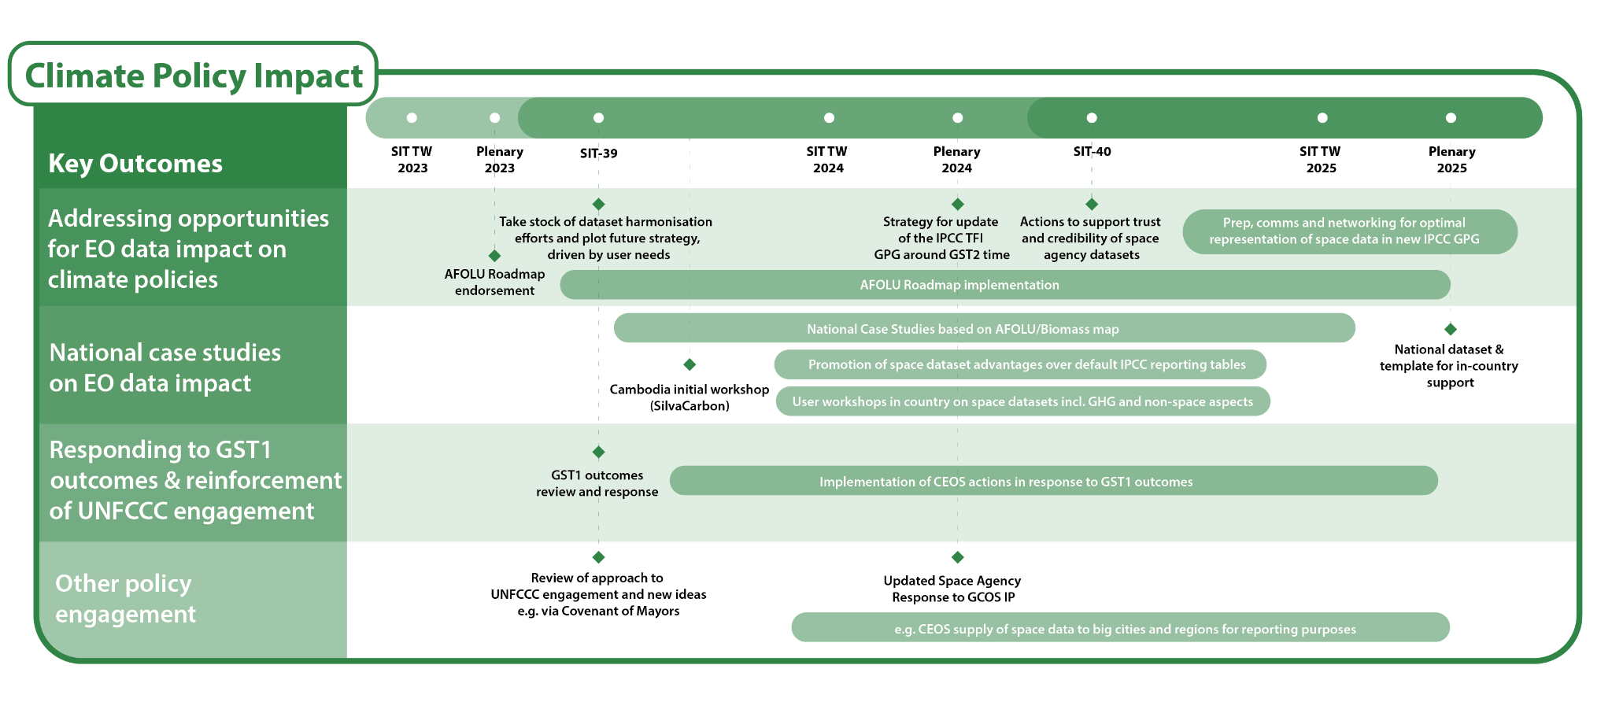
2024-2025 SIT Chair Objectives:
Climate Policy Impact
Notes:
UN Environmental Programme (UNEP) on 2 March 2021 officially announced the creation of the International Methane Emissions Observatory (IMEO).

Slide 6
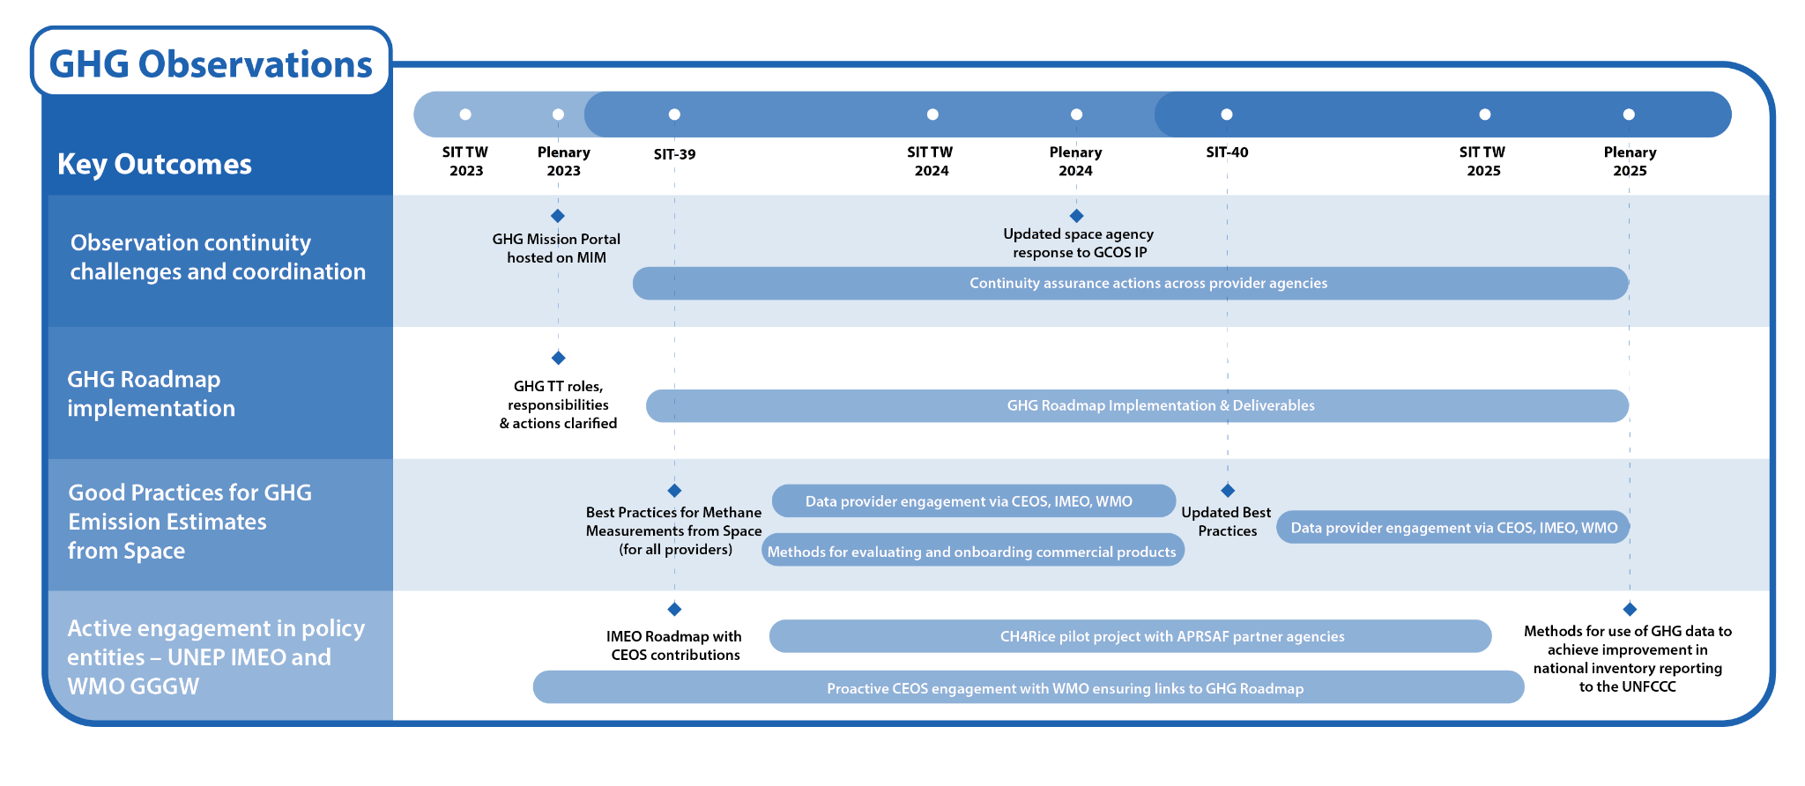
2024-2025 SIT Chair Objectives:
Greenhouse Gas Observations from Space
Notes:
UN Environmental Programme (UNEP) on 2 March 2021 officially announced the creation of the International Methane Emissions Observatory (IMEO).

Slide 7
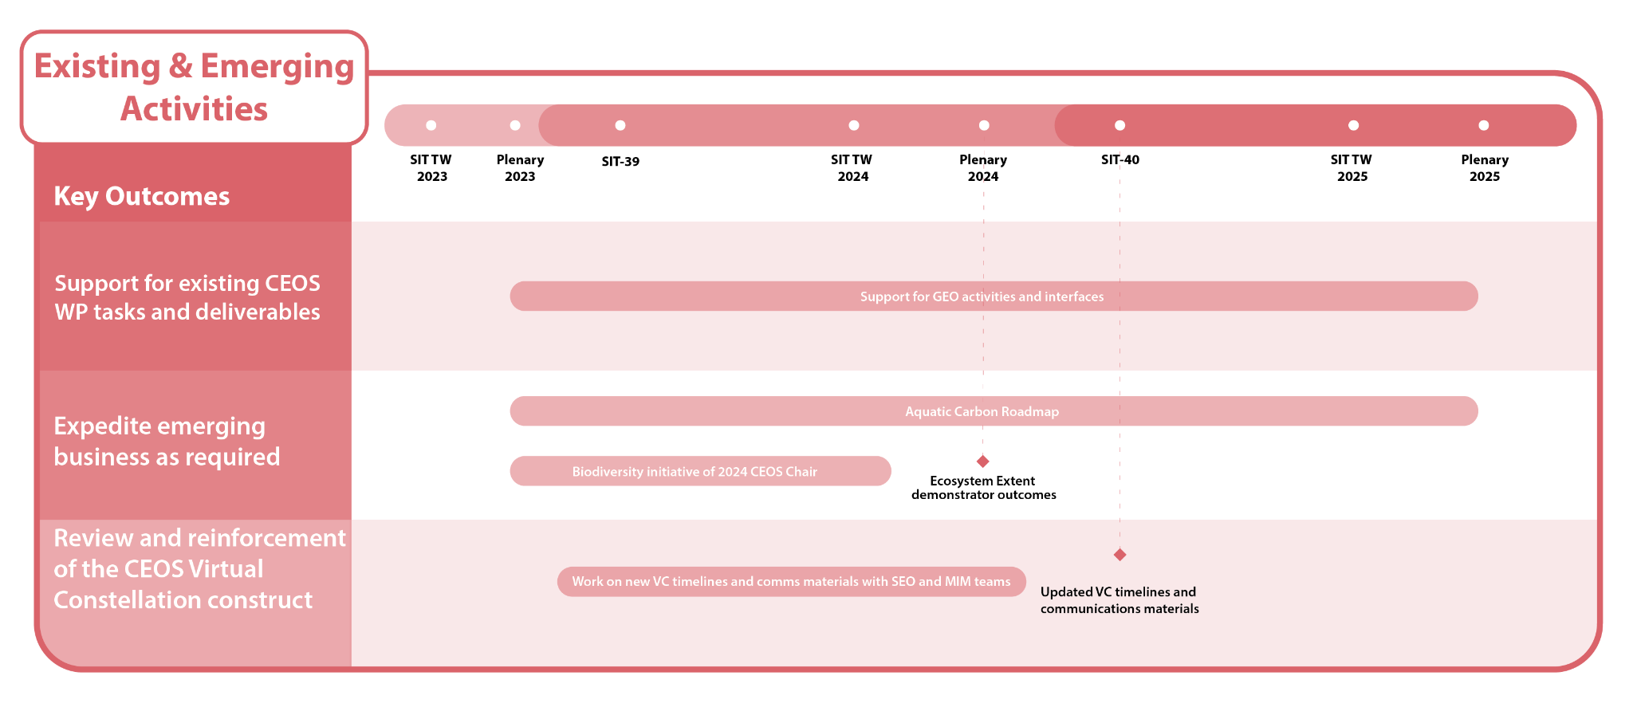
2024-2025 SIT Chair Objectives:
Existing and Emerging Activities
Notes:
UN Environmental Programme (UNEP) on 2 March 2021 officially announced the creation of the International Methane Emissions Observatory (IMEO).

Slide 8



CEOS Secretariat
The CEOS Secretariat (SEC) is chaired by the CEOS Chair and provides a forum for coordination between the three major meetings each year. The SEC is maintained by 5 permanent CEOS Agency Members (ESA, EUMETSAT, NASA, NOAA and MEXT/JAXA). In addition, the SIT Chair, SIT Vice-Chair, Working Group Chairs, CEOS Executive Officer (CEO), and CEOS Systems Engineering Office (SEO) are invited to participate in the SEC. Representatives from additional CEOS Agencies, including past and future CEOS Chairs, or other relevant organisations, may participate in the SEC at the invitation of the CEOS Chair.
The SEC coordinates internal and external CEOS activities and assists the CEOS Chair and SIT Chair in the formulation of CEOS position statements, the coordination of external meeting attendance, and the review of major meeting agendas, actions, and minutes.
SEC agencies voluntarily maintain the:
CEOS Systems Engineering Office (NASA),
CEOS Earth Observation Handbook (ESA), and the
CEOS Newsletter (JAXA).
The SEC is the monthly forum to coordinate on
stakeholder engagement.
CEOS Secretariat 2024
Permanent SEC members

Slide 9
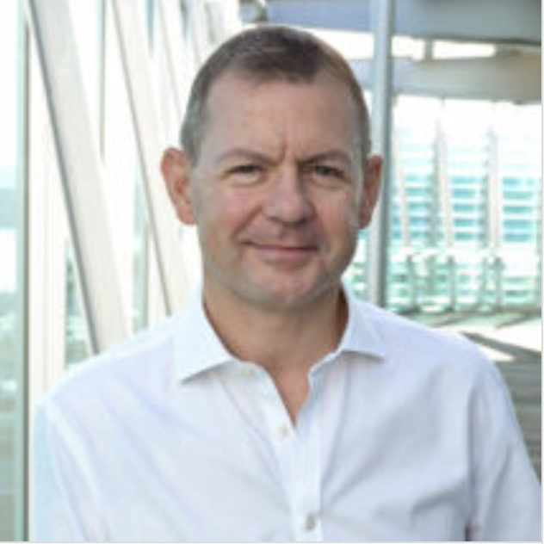
CEOS Executive Officer (CEO)
The CEOS Executive Officer (CEO) serves the entire organisation and acts with neutrality. The CEO reports to the CEOS Chair, but works closely with the SIT Chair, the SEC and across all CEOS entities. The CEO is the:
  Focal point on governance, resourcing and processes.
  Custodian of CEOS Governing Documents, including the CEOS Work Plan.
  Ensures information flow across all CEOS entities and advises CEOS leadership
  Contact point for all enquiries, handles membership and works with the SEO on communication and outreach.
              Point of Contact for all external stakeholders, both existing and new.
              CEOS interface to the Group on Earth Observations (GEO);
              supports coordination meetings and sits on the GEO Programme
              Board and Executive Committee.
              External interface with the official Agency contacts and represents
              CEOS at partner and stakeholder meetings as delegated by the
              CEOS Chair.
2024-2025 CEO
Steven
Ramage

Slide 10
CEOS Systems Engineering Office (SEO)
The CEOS Systems Engineering Office (SEO) provides systems engineering leadership to the Working Groups, Virtual Constellations, and other technical activities.
The SEO facilitates the use of systems engineering methodologies and tools to strengthen and improve CEOS collaboration and engages with external stakeholders on specific topical areas and initiatives.
The SEO formally reports to the SIT Chair but may consider requests for work from the CEOS Chair where resources allow.
The SEO leads the implantation of the SDG Coordination Group, which seeks to respond to selected UN Sustainable Development Goals.
SEO Director
David Borges

Slide 11
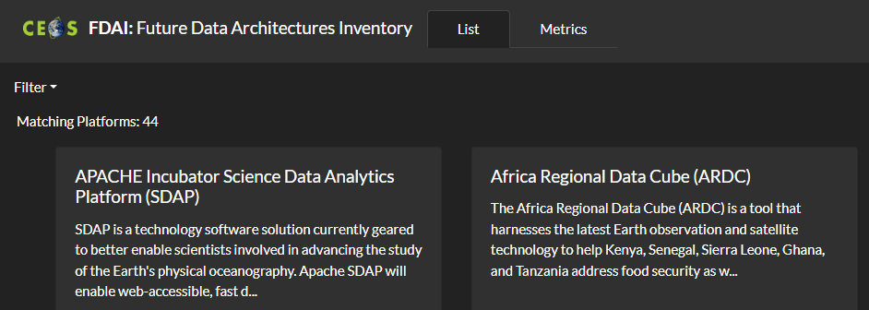
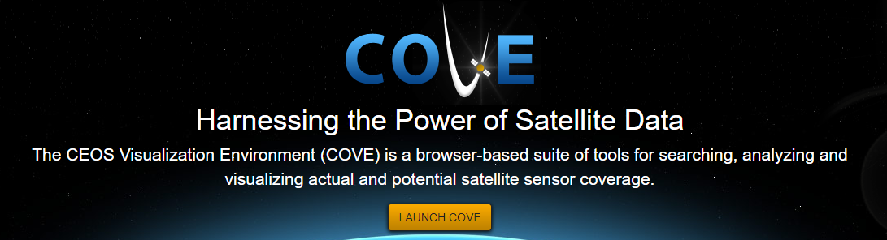
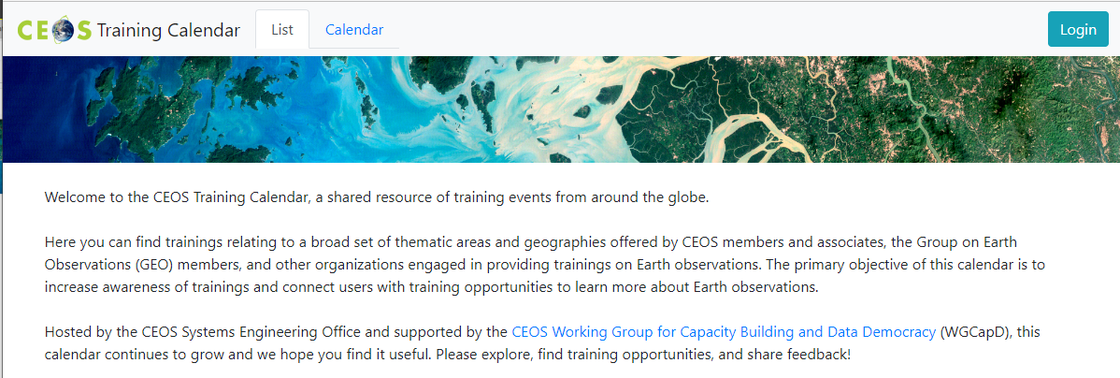
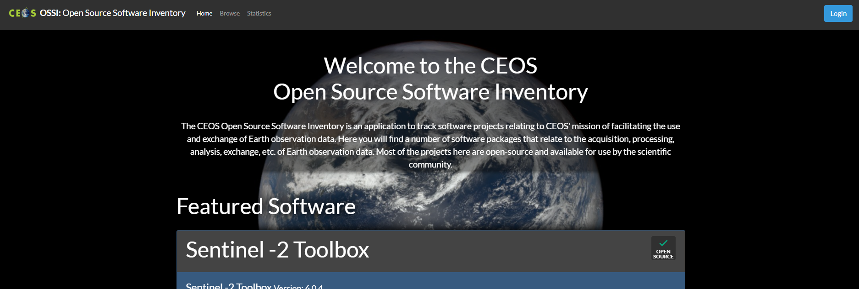
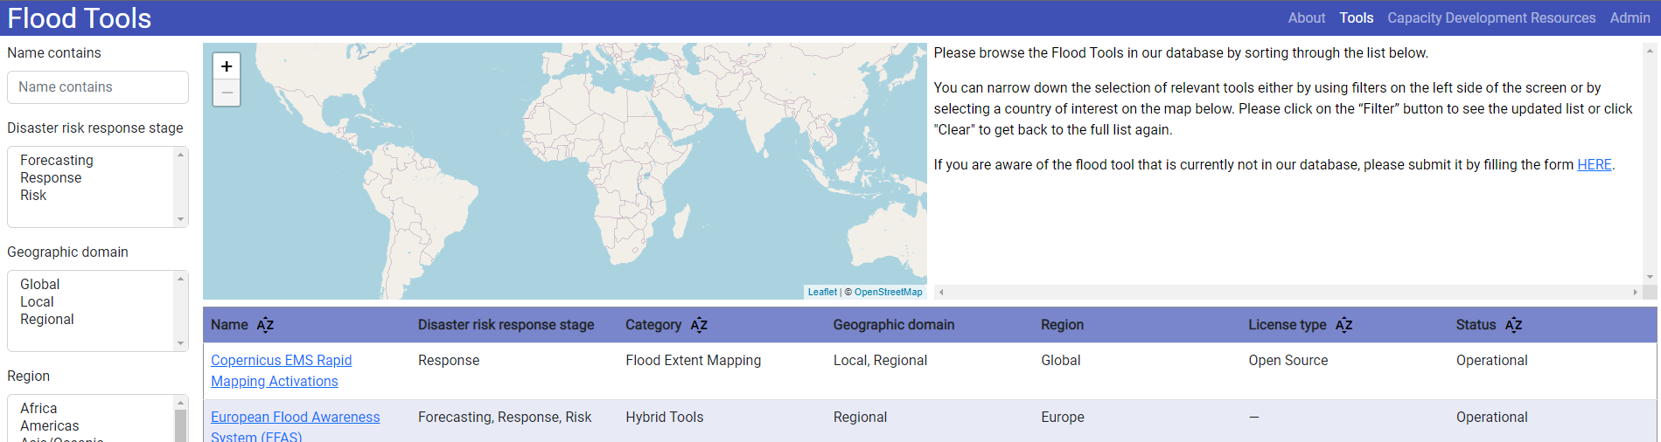
CEOS SEO Fundamentals
“Provide systems engineering leadership and support to CEOS through management and technical services and the development of tools and products that facilitate systems engineering solutions for societal benefit.”
  CEOS website infrastructure
  Deliverables Tracking Tool 2.0
  CEOS Visualization Environment (COVE)
  Open-Source Software Inventory
  Future Data Architectures Inventory
  Training Calendar
  EOTEC DevNet
  Open Data Cube (ODC)
  CEOS MIM Database Team support

Slide 12
Thank you!

