Slide 1
SESSION 5 Space Data Country Outreach and Delivery
SDCG-9: Frascati, 25-26 February, 2016

Slide 2
Mechanism to deliver data
FOREST MAPPING
SilvaCarbon is working directly with the countries and linking Universities
UMD and BU work with Colombia, Ecuador, Peru, Bangladesh, Vietnam
Upcoming UMD and BU work with Nepal, Thailand, and Laos
Delivery of data in hard drives packed by EROS to complement this work
FAO providing mapping guidance directly to the countries using SEPAL system
12 countries
Potential work with NASA CEOS using data cube
Prototype with Colombia and Kenya
Possibility of including UMD algoright in the data cube for countries working with SilvaCarbon
Others?
Countries creating their own NFMS with a combination of multiple methods

Slide 3
Guidelines for country presentations
What space-based data is being used for forest management purposes in your country? How is that data acquired, processed and managed in your country?
What is the scope of your data use? Are you using data for wall-to-wall maps, test sites, specific time periods?
What new space-based data is desired?
What are the challenges and issues with acquiring and making use of space-based data where GFOI and the CEOS Space Data Coordination Group (SDCG) can help?
Maximum of 5 slides

Slide 4
Background
Countries provided feedback to SDCG in spatial data acquisition plan starting in Pasadena 2012
Peru
Colombia
Ecuador
Mexico
Honduras
Alertas Tempranas (wall-to-wall) - Early Warning - | Resolucion Mediana - medium Resolution - | Resolucion Alta - High Resolution - for use in validation; 10% of country area (annual & free of clouds; ~same 10% each year) | DEM
SAR (Sentinel, TerraSAR, COSMO-SkyMed, ALOS 1y2) | Landsat 8 (co-registered) - wall-to-wall | RapidEye (5) - most important | SRTM - need 30m
MODIS (mantenimiento) | SAR - specific areas (C/X bands) | IKONOS (1) | TanDEM-X - need 5m
 | LISS III/IV | QuickBird (2) - 2nd most important
 |  | SPOT6 (3)
 |  | Worldview2 (1)
 |  | Nigersat II (1)
 |  | FORMOSAT (2) - 3rd most important
 |  | Additional needs: facilitate intepretation of medium resolution for training data development
THE FOLLOWING REQUIREMENTS ENABLE ROBUST PRODUCTS TO BE GENERATED

Slide 5
Countries provided feedback to SDCG in spatial data acquisition plan in FAO, Rome 2013
Tanzania
Uganda
DRC
Kenya
Zambia
Countries provided feedback to SDCG in spatial data acquisition plan in Oslo, Norway 2014
Nepal
Indonesia
Philippines
Bangladesh

Slide 6
Countries provided feedback to SDCG in spatial data acquisition plan Australia 2015
Cambodia
Kenya
Colombia
Discuss the possibility of reaching out to commercial providers for HR data
Database of HR data was provided to the group

Slide 7
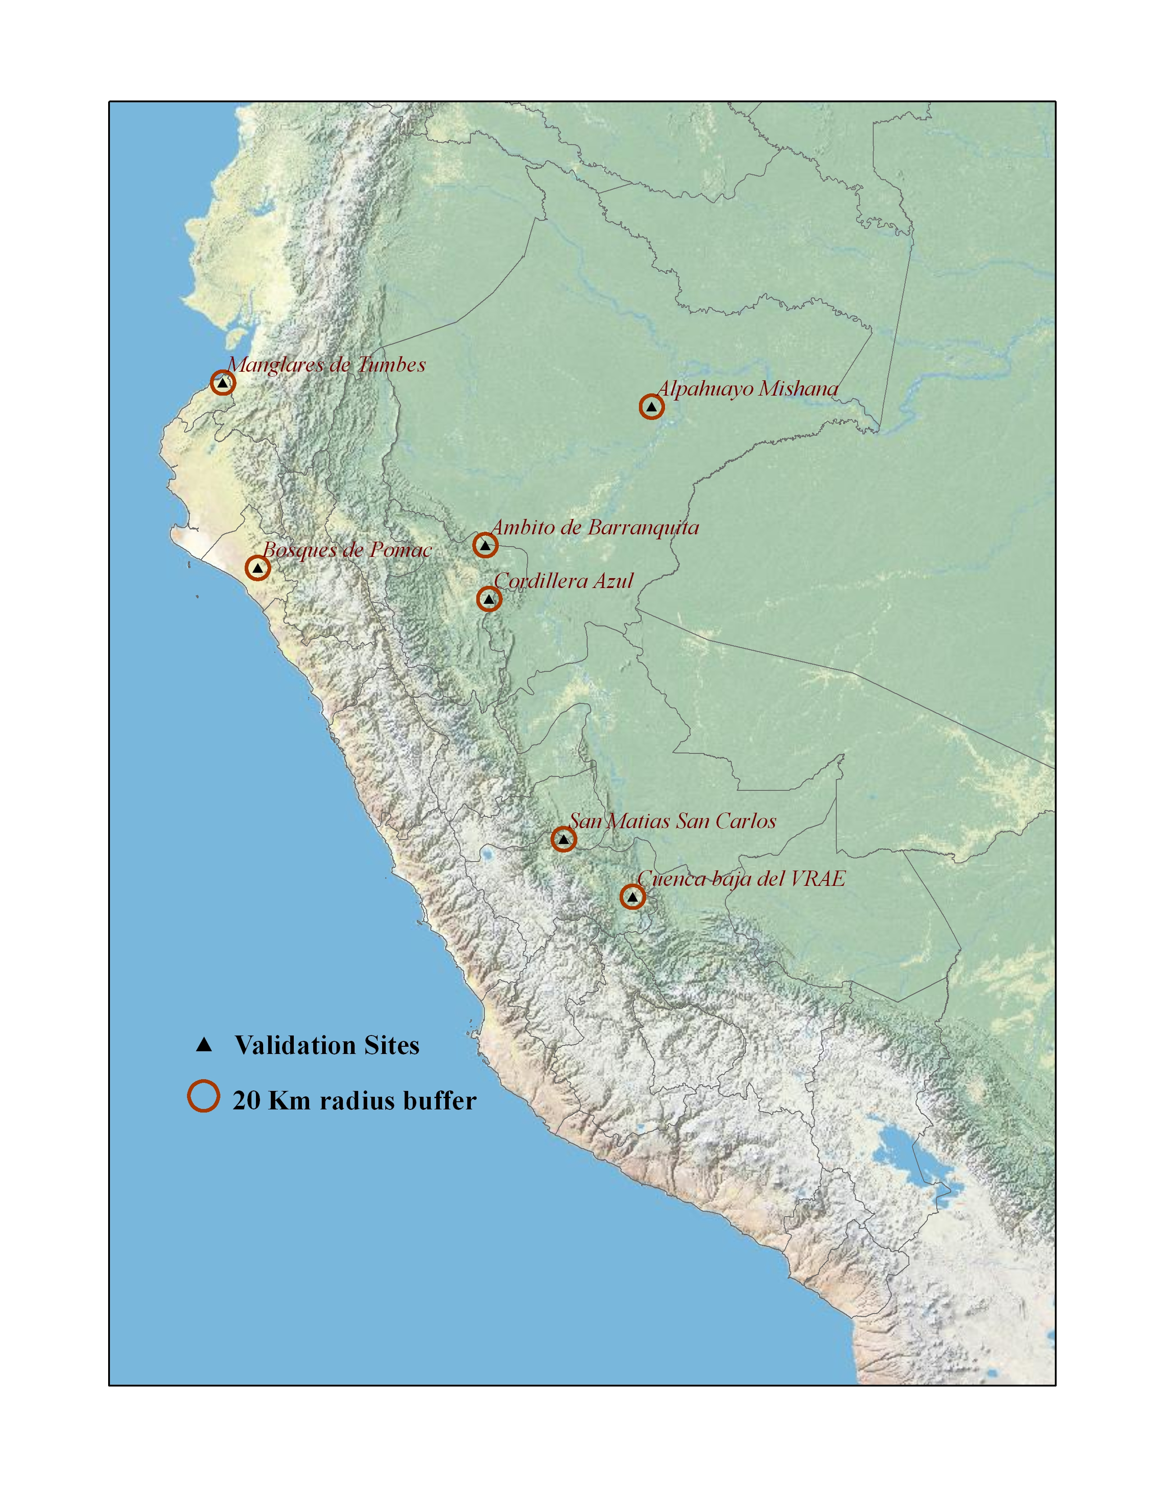
HR Sites collected
Sites information collected for 21 countries: Total 421

