Slide 1
GFOI Component Coordination and Country Engagement
SDCG-8, Session 10 Stephen Ward (Australia)
24 Sep 2015, Bonn

Slide 2
Component Coordination & Country Engagement
In order to achieve the broader GFOI goals, each partner organisation must be aware of the contribution of each component, and ensure that developing country programmes are able to engage.
This Component Coordination and Country Engagement planning is the responsibility of the GFOI Lead team and GFOI Office.
The SDCG is well placed to contribute information, services and expertise to this harmonisation goal.

Slide 3
CC & CE: SDCG WP outcomes
The SDCG 3 year Workplan includes 3 Outcomes related to country engagement.
Delivery of a coherent customer experience for GFOI countries
Space data support and services provided to all priority countries
Effective management of country interfaces

Slide 4
CC & CE: SDCG WP outcomes
Progress against each of these outcomes have been lead by GFOI Office, S Ward, G Dyke, S Wilson and the FAO
via efficient coordination among the GFOI Space Data component, the other GFOI components (i.e. MGD, Capacity Building, R&D), and the GFOI Office.
based on interactions by the GFOI Office, at regional workshops in coordination with FAO, SilvaCarbon, and others, and;
via the implementation and maintenance of a country relationship database, kept current on a regular basis.

Slide 5
CC & CE: SDCG WP tasks
Specific tasks to achieve these outcomes were planned to be completed during 2015 :
Develop a coordinated plan for the most efficient provision of GFOI deliverables to countries.
FAO and SilvaCarbon will help define the priority countries for GFOI support and deliverables
a) Development of simple Excel-based database -b) Establish modus operandi in collaboration with FAO, SilvaCarbon and GFOI Lead Team for country engagement.

Slide 6
CC & CE: Progress (2015)
Highlights from the progress on each of these tasks are:
All GFOI partners with capacity building programmes in developing countries have been able to provide access to the necessary space data.
The SDCG strategy included priorities for forested countries and is global in its outlook. This has largely superseded the need for the GFOI community to set individual target countries
The long standing relationship between CEOS agencies and the GFOI has resulted in the establishment of efficient mechanisms and innovative tools to access data.

Slide 7
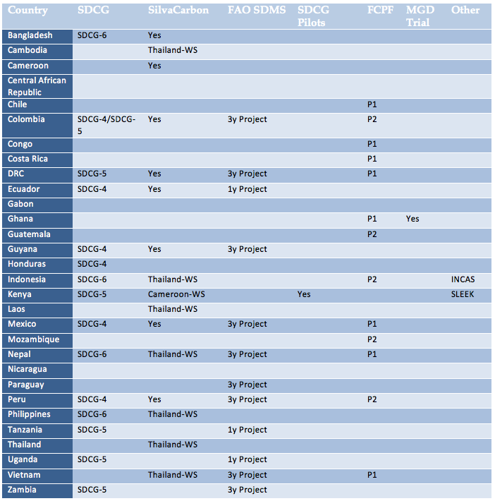
SDCG’s Priority country table

Slide 8
CC & CE: Progress (cont’d)
Developed a simple Excel-based database to ensure the GFOI office is able to maintain a high-level summary of all GFOI related activities into the future.
Arranging a technology transfer between Australia and the CEOS SEO, and developing a prototype Data Cube and a user interface to pilot in Kenya
Development of a GFOI Space Data Access Guide outlining practical steps that countries should take to access space data. The Guide should directly reference the advice provided by the MGD, and provide a concise and explicit data access information including product details, and data access contact information.

Slide 9
Space Data Portal
Equivalent and complementary to MGD portal
Tutorial resources
Access to all the tools: data policy portal, archive characterisation, COVE, CEOS MIM, links <-> MGD portal, links to the archives themselves,
SDCG Sec will Lead with resource contributions from NASA SEO
Space Data Access Guide will be one of the inputs – need a good format for that
Looking for ideas on content and structure – ACTION PLEASE

Slide 10
CC & CE: Opportunities - discuss
Ongoing need to understand country requirements for space data.
The MGD Portal is currently being tested at SilvaCarbon workshops, and will be a clear deliverable available as basis for country engagement with GFOI
Space Data Portal
New data management tools, including the current prototype of the Data Cube and user interface will be clear deliverables - available as basis for country engagement with GFOI
GFOI Plenary & Open Forum (Feb 2016) will be a large gathering of countries and stakeholders

