Slide 1
Element 3
Space Data Support to GFOI R&D
A. Rosenqvist, N. Fujimoto
SDCG-8 Session #8

Slide 2
GFOI R&D Coordination
SDCG Element-3
JAXA supporting the Element 3 plan coordination (Fujimoto/Rosenqvist)
GFOI R&D Component
Funding limbo for GFOI R&D Component resolved. GOFC-GOLD LC Office (@ U. Wageningen) assuming coordination role from October 2015, supported by ESA. Current funding until Dec 2016.
Contacts with GFOI research groups re-established. All groups (13) have confirmed continued interest.

Slide 3
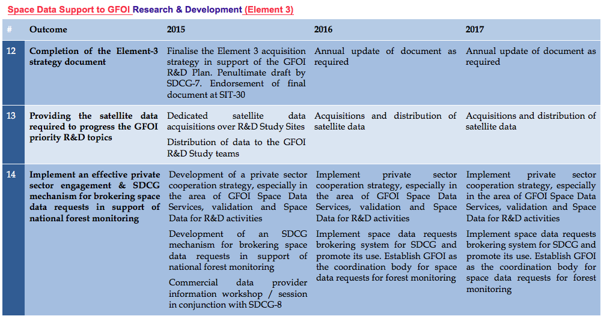
3-Year Work Plan

Slide 4
3-Year Work Plan
3 Year Work Plan Outcomes:
12) Completion of the Element-3 strategy document to be finalised prior to SIT-30 [Completed]
13) Providing the satellite data required to progress the GFOI priority R&D topics outlined in the GFOI R&D plan to pre-operational or operational status, in coordination with the R&D component, and in support of improvements to the MGD. [Ongoing]
14) Effective private sector engagement implemented in conjunction with an SDCG mechanism for brokering space data requests in support of national forest monitoring. [Ongoing]

Slide 5
Way forward / Actions

Slide 6
Way forward / Actions
Acquisitions and data distribution
GFOI R&C Component funding and new lead resolved
Confirmed continued interest from all current (13) GFOI research groups
Confirmed continued interest from SDCG agencies
Interest from commercial providers (next slide)
- we are ready to go!
Action:
SDCG Exec to assist agencies (e.g. through facilitating contacts with R&D groups etc.)
- to commence/resume acquisitions over R&D Study Sites
and commence/resume distribution of archive data to R&D groups
Clarify process

Slide 7
Way forward / Actions
Commercial data providers
Confirmed initial interest from providers to participate/contribute. Details and level of engagement to be hammered out
Actions:
SDCG Exec (together with G-G) to follow-up with direct contacts with BlackBridge/PL, GAF, and Airbus DS/France (Spot 6/7).
(DLR and CNES, remain PoC for TSX, TDX and Pléiades)
Discussion
2nd commercial provider meeting (in North America)?

Slide 8
Way forward / Actions
Accommodating GFOI R&D Component evolution
Under the coordination of GOFC-GOLD, the GFOI R&D Component will continue to progress during 2015/2016.
Action:
SDCG agencies, in collaboration with GOFC-GOLD, to agree on a mechanism (and boundary conditions) to accommodate new research groups and Study Sites.

Slide 9
Way forward / Actions
Coordinated Research Announcements:
Agencies interested in coordinating RAs (ASI, CSA, CNES, DLR) to agree on
(1) schedule for coordinated calls,
(2) Select R&D topics of common interest (e.g. sensor synergy),
(3) common preamble text
License agreements:
Separate agreements for each mission/agency?
Possibility for multi-agency MURF?
Actions?

