Slide 1

SEO Data Services Tools for GFOI
Brian Killough
CEOS Systems Engineering Office (SEO)
CEOS SDCG-7 Meeting
Sydney, Australia
March 4, 2015 (Day #3)

Slide 2

Agenda
COVE Tool
Coverage Analyzer Tool
Rapid Acquisition Tool
Landsat Archive Analyses
Data Services Projects
Data Services Demo

Slide 3
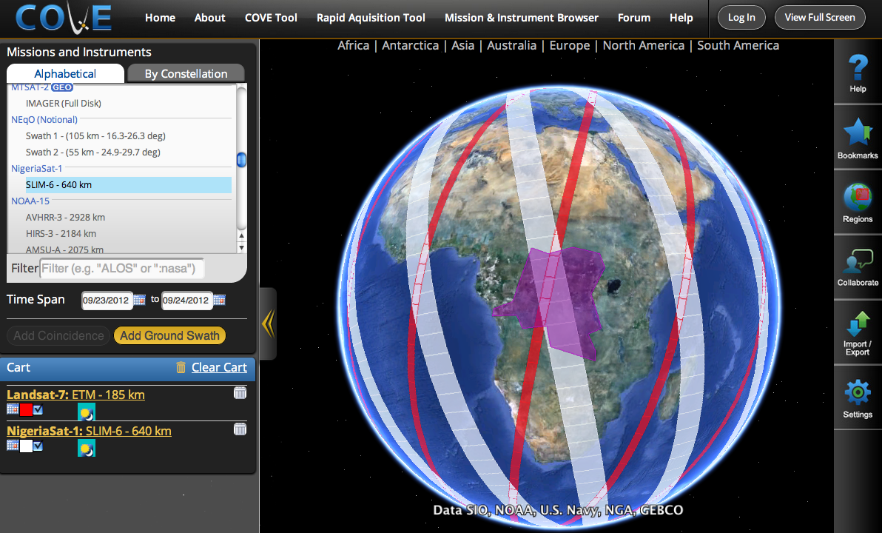
COVE Tool
www.ceos-cove.org
Free and Open browser-based tool using Google-Earth to display satellite coverage swaths and calculate coincidence scene locations.
Automated daily satellite position data from CelesTrak.
Saved bookmarks and states, Google-Earth KML and Shapefile compatibility, collaborative sessions.
Output: position, UTC time, viewing angles, solar angles, day/night, and EXCEL tables
Large mission database:
259 missions, 697 Mission-Instrument combinations
Did you know ....
There are 1235 Earth orbiting missions
There are 131 active CEOS satellites

Slide 4
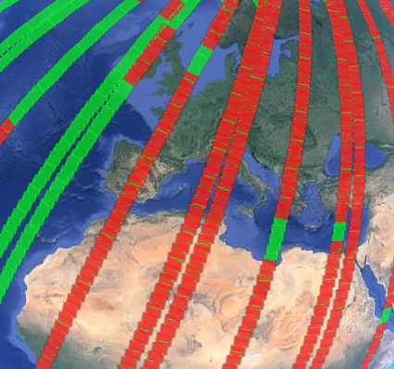
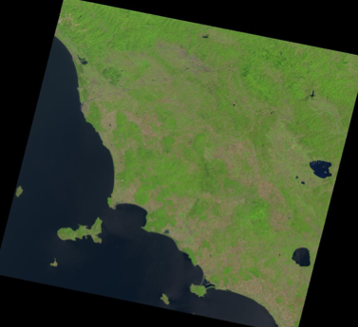
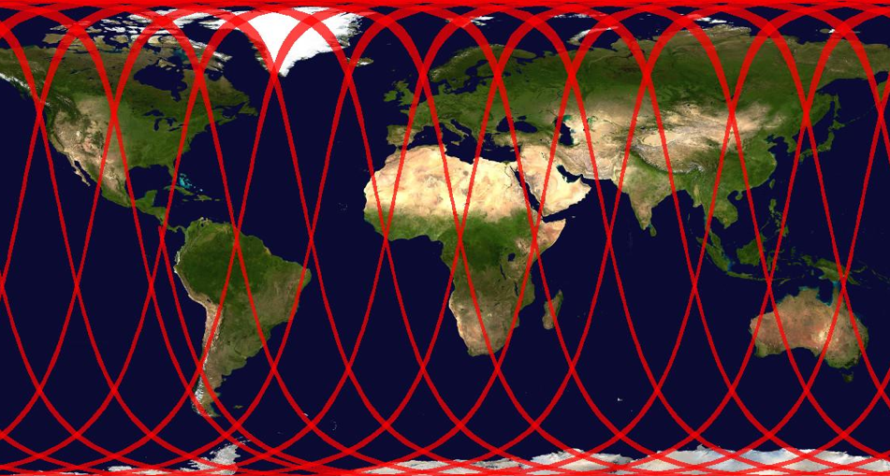
COVE Features
Data Overlays: Landsat WRS, Sentinel-2 tiles, ASTER DEM, GlobCover, MODIS LCC.
Future Overlays: Vegetation Phenology (NDVI peak month)
Data Archive Links:
Landsat 7/8, SPOT 1-6, Pleaides-1A/1B, Radarsat-2, ALOS-1
Future Data Archive Links:
Envisat, ERS-1/2, TerraSAR-X, RapidEye, Sentinel-1A/2A.
2D global output in JPEG format and KML output for Google Earth
Conversion to Spanish.
Landsat 8, Aug 1-3, 2013 over Europe
Green (potential), Red (actual)
Browse ... Northern Italy
2D global map of Radarsat-2 (W3 mode) on Aug 1, 2013

Slide 5
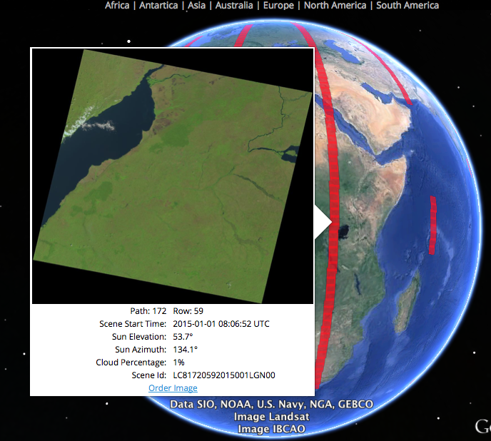
Landsat in COVE
January 1, 2015 over Uganda, Africa
Query tool allows the user to review metadata (Path, Row, Date/Time, Sun Angles, Cloud%, Landsat Scene ID.
Link to ORDER image is provided. User is directly linked to the USSG data ordering tool with the selected scene in the “cart”

Slide 6
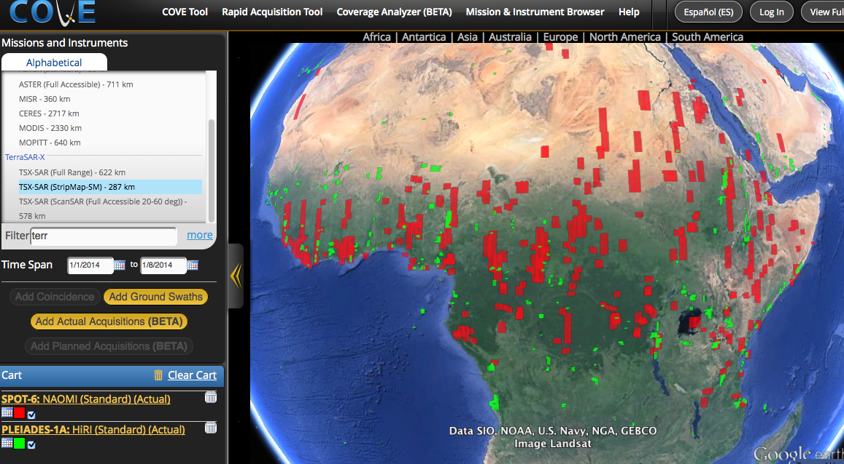
SPOT and Pleaides in COVE
January 1-8, 2014 over Africa

Slide 7
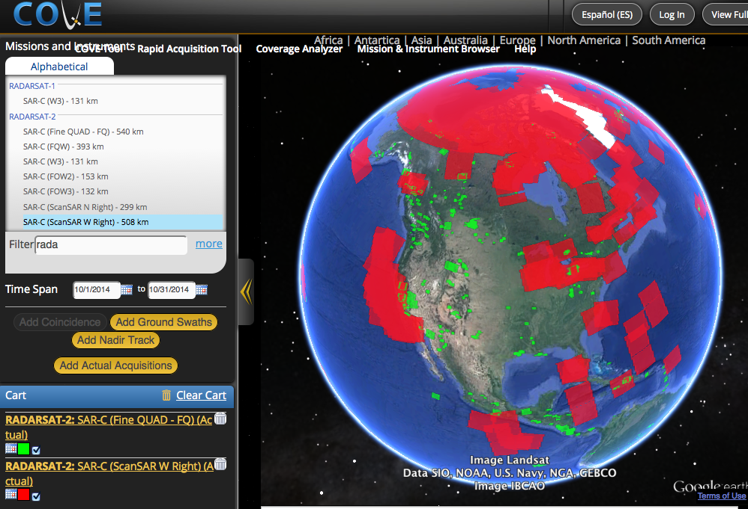
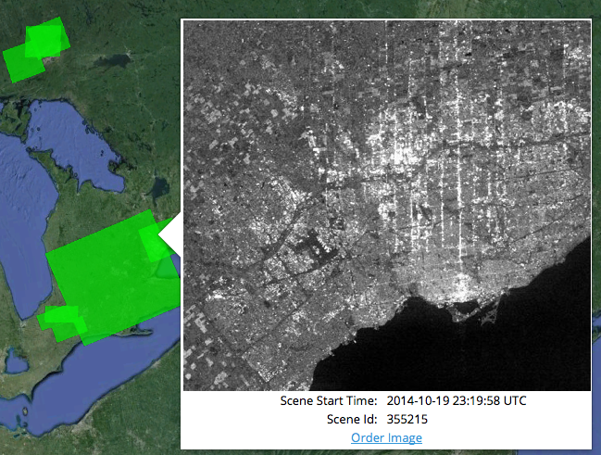
Radarsat-2 in COVE
Sample Browse Image
Scene: 355215
Date: 19-Oct-2014
Location: Toronto
October 2014
Fine QUAD mode (GREEN)
ScanSAR Wide (RED)

Slide 8
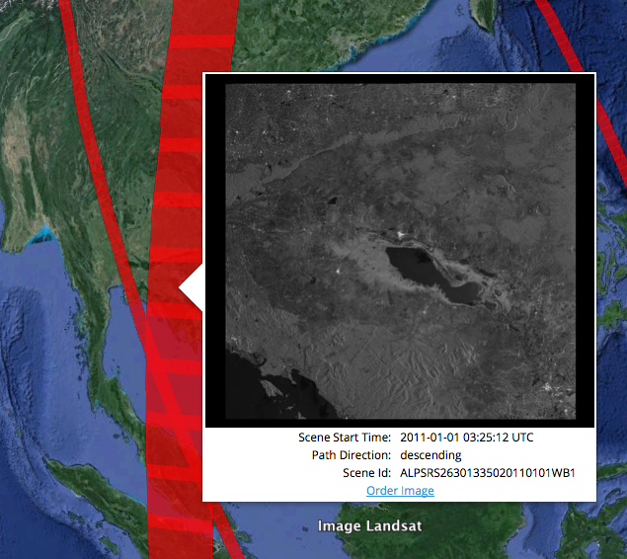
ALOS-1 in COVE
ALOS-1 recently added to COVE . Thanks to JAXA!
Mission Dates:
24-Jan-2006 to 22-Apr-2011.
Example: January 1, 2011 over Cambodia
Browse images available over some Asia regions.
Metadata includes Date/Time, Path, Scene ID, and a link to ORDER the data.

Slide 9
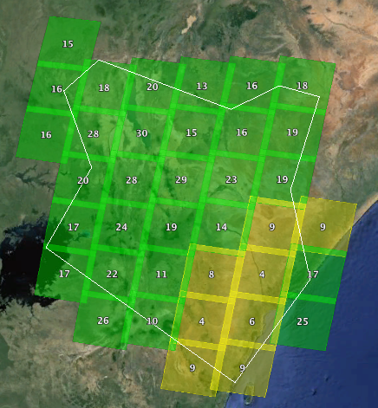
Coverage Analyzer
Count historic acquisitions over defined regions.
Cloud filtering and custom discritization possible.
Missions: Landsat-7/8, SPOT-5/6, Pleaides-1A/1B, Radarsat-2.
Output in Google Earth or Table format.
KML and CSV export.
Tool is used to create “Country Reports”
Landsat-7 and Landsat-8 over Kenya in 2014
Total Scenes <20% cloudy

Slide 10
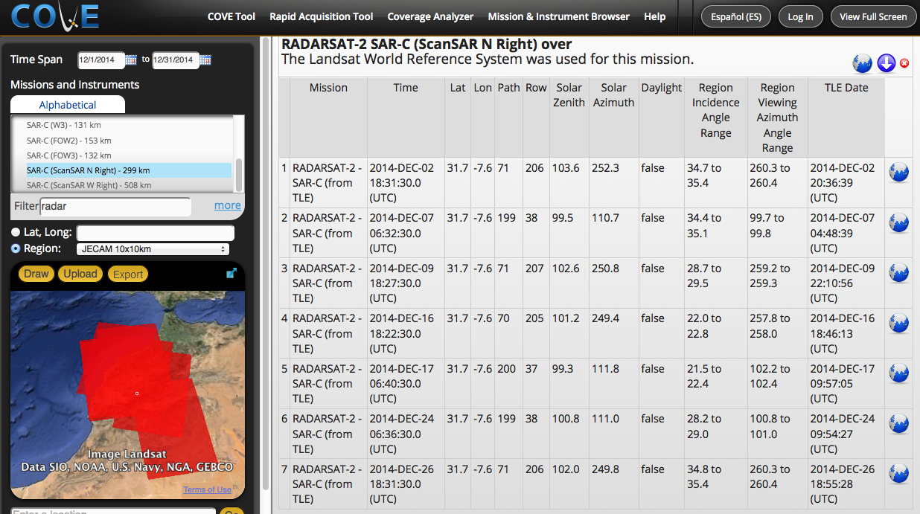
Rapid Acquisition Tool
Radarsat-2
ScanSAR Mode
Dec 2014
Morocco
JECAM Site
Overpasses
Calculates and tabulates potential acquisitions of defined regions (local to regional) for extended time periods (e.g. days to months).
Includes solar and viewing angles.

Slide 11
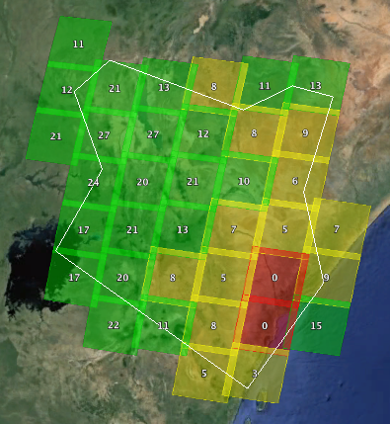
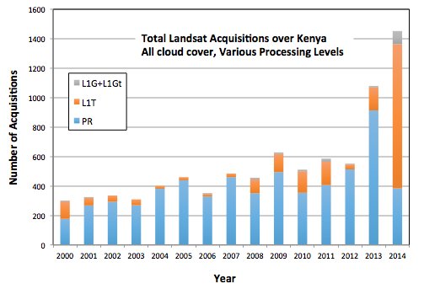
Landsat Archive Analyses
The SEO has completed detailed Landsat coverage analysis for 19 countries using the Coverage Analysis tool and some custom programming tools. Reports were delivered at several SDCG meetings and SilvaCarbon workshops.
Reports for Kenya, Colombia and Cambodia are delivered here ... SDCG-7.

Slide 12

Why Data Services?
Many countries lack the knowledge and infrastructure to access and use space-based data.
Countries have expressed a desire for support from CEOS by providing: search and discovery tools, cloud-based storage and processing capabilities, and training and capacity building.
The SEO is working on two initiatives to demonstrate a data services model ... GFOI (Forests) and GEOGLAM (Agriculture).
It is expected that these data services pilot projects will provide a foundation for future operational systems that will be funded and managed by GFOI, GEOGLAM and individual countries.
CEOS has a keen interest in this activity since it promotes the use and benefit of satellite data from CEOS Agencies.

Slide 13
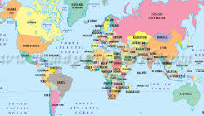





Data Services Vision
Query
COUNTRY
Data
Services
Results
Space
Data
Guidance
Request
GFOI Computing Cloud
or Local Country Computer
Online
MGD
Data Services
Request
Deploy Tools
Training
Request
Open Source
Data Management Tools:
Scene-based or Data Cube
Analysis
Request
CEOS Systems Engineering
Office (SEO)

Slide 14

Data Services Vision
Countries will perform their own scene-based data search and discovery and then download processed thematic data products.
Countries will perform their own analyses and coverage assessments using the COVE tool.
CEOS will provide training for systems engineering tools and Data Services.
Countries that desire an in-country Space Data Management System (SDMS) will be provided with a modular data services solution. These data services will utilize cloud-based storage and computing.
CEOS will fund limited data services prototypes for short durations (~1 year), but will require funding from stakeholders (e.g., GFOI) for long-term operations.
CEOS will continue to develop new tools (e.g., Data Cubes), add enhancements to existing data services (e.g., automated data processing and download), and provide updated training, as needed.

Slide 15
Data Services
Framework
Examples
SDMS Framework
Loaded Data
Landsat Archive
AWS
Federated Database
Sentinel Archive
AWS
Remote Data Sources
User Provided Data
Custom Data Sources
AWS
Processing Library
Tool Integration Framework
AWS
Processing
Tools & Libraries
Web-based API
(GEE, etc.)
AWS
Modular Component Framework
AWS
Custom Tools
Component Modules
Visualization Components
Security
Framework
AWS
Job Manager
Security Modules
Data Browser
Platform Notes:
AWS FIle Storage and Cloud-based Processing
Built on the Spring Framework
Tool Integration: JavaScript front-end, Back-end uses custom Java-wrapping of tools and web services

Slide 16
Data Services
Modular Architecture
Modular Component Framework
Data Browser Module
JavaScript Processing Module
Data Management Module
…
Metadata and Browse Images
Future
Folders and Projects
Tool Integration Framework
Wrapper
Wrapper
Mission-specific Processing Tools
GDAL
Wrapper
Wrapper
Wrapper
Google Earth Engine
DataCube
FAO OpenForis Toolset
Future
Future
Wrapper
R Processing Language

Slide 17
Data Services Projects
GFOI | GEOGLAM | Pilot Project Name | Status | Key Participants | Countries | Datasets | Processing Tools
 | X | Asia-RICE Pilot | Delivered June 1, 2014 | SEO, JAXA | Indonesia | Radarsat-2 35 scenes (210GB) | INAHOR (from JAXA)
X |  | FAO Pilot for UN-REDD | Delivered Nov. 5, 2014 | SEO, FAO, Norway | Ecuador, Tanzania, Uganda, Guyana | Landsat-7 2013 only (16TB) | Open Foris Geospatial Toolkit (from FAO)
X |  | Colombia DEM Pilot | Delivered Dec. 3, 2014 | SEO, DLR | Colombia | TanDEM-X 24 Tiles (15GB) | Local (TBD)
X |  | Kenya Pilot | Alpha Release: Mar 2015 Beta Release: Sept 2015 | SEO, Symbios, Clinton Foundation, SLEEK Program | Kenya | Landsat-7/8 (from 2013/2014), 66 scenes (128GB) | Open Foris, Earth Engine
 | X | JECAM SAR Pilot | Release 1: Apr 2015 Release 2: Aug 2015 | JECAM Team | 8 sites: Ukraine, Belgium, Argentina, Canada, China | Radarsat-2, Landsat, Sentinel-1 | SAR Processing Tools (from JECAM)

Slide 18

Module-based Systems
SDMS features are available “a la carte”
  Component modules operate independently
Balances complexity and functionality
Provides extensible platform for future development
FUTURE
FAO SDMS
Colombia SDMS
Kenya SDMS
AWS Storage / Processing
AWS Storage / Processing
AWS Storage / Processing
Terminal Interface
Terminal Interface
Javascript Interface
Data Browser
Data Browser
FAO OpenForis Toolset
Data Management
FAO OpenForis Toolset
Data Cube Interface

Slide 19
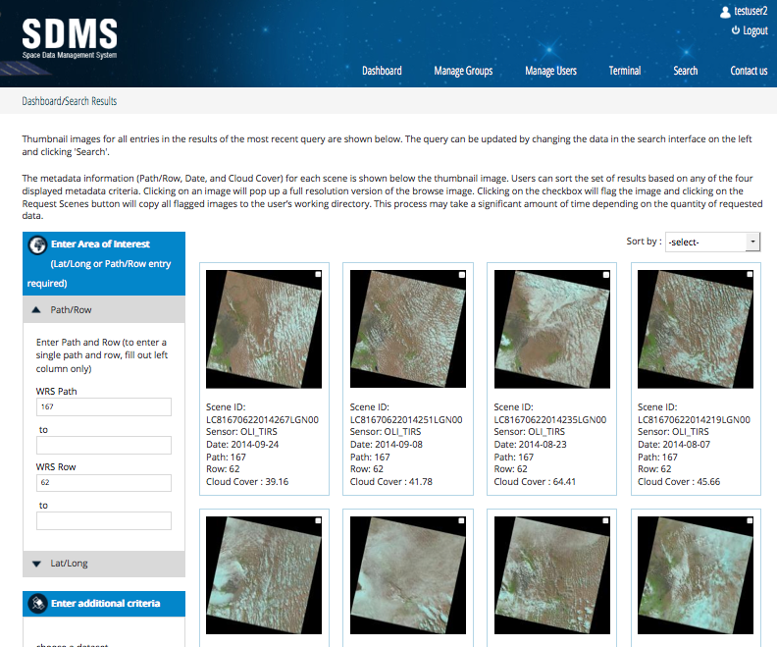
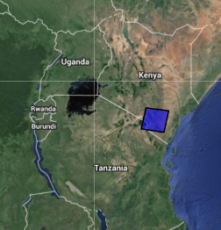
FAO Project
  File Manager / Dashboard
  User and Group Control
  Terminal Line Editor for OpenForis toolset operations
  Search tool for Landsat archive searches and data download
  Example: Landsat-8, Kenya
  Path/Row: 167/62
  Dates: 01-01-14 to 10-31-14
  Results: 16 scenes acquired.
  2 scenes <20% cloud cover.
Initial deployment to 4 countries in early 2015. Expanded deployment to 14 countries through 2018.
19

Slide 20
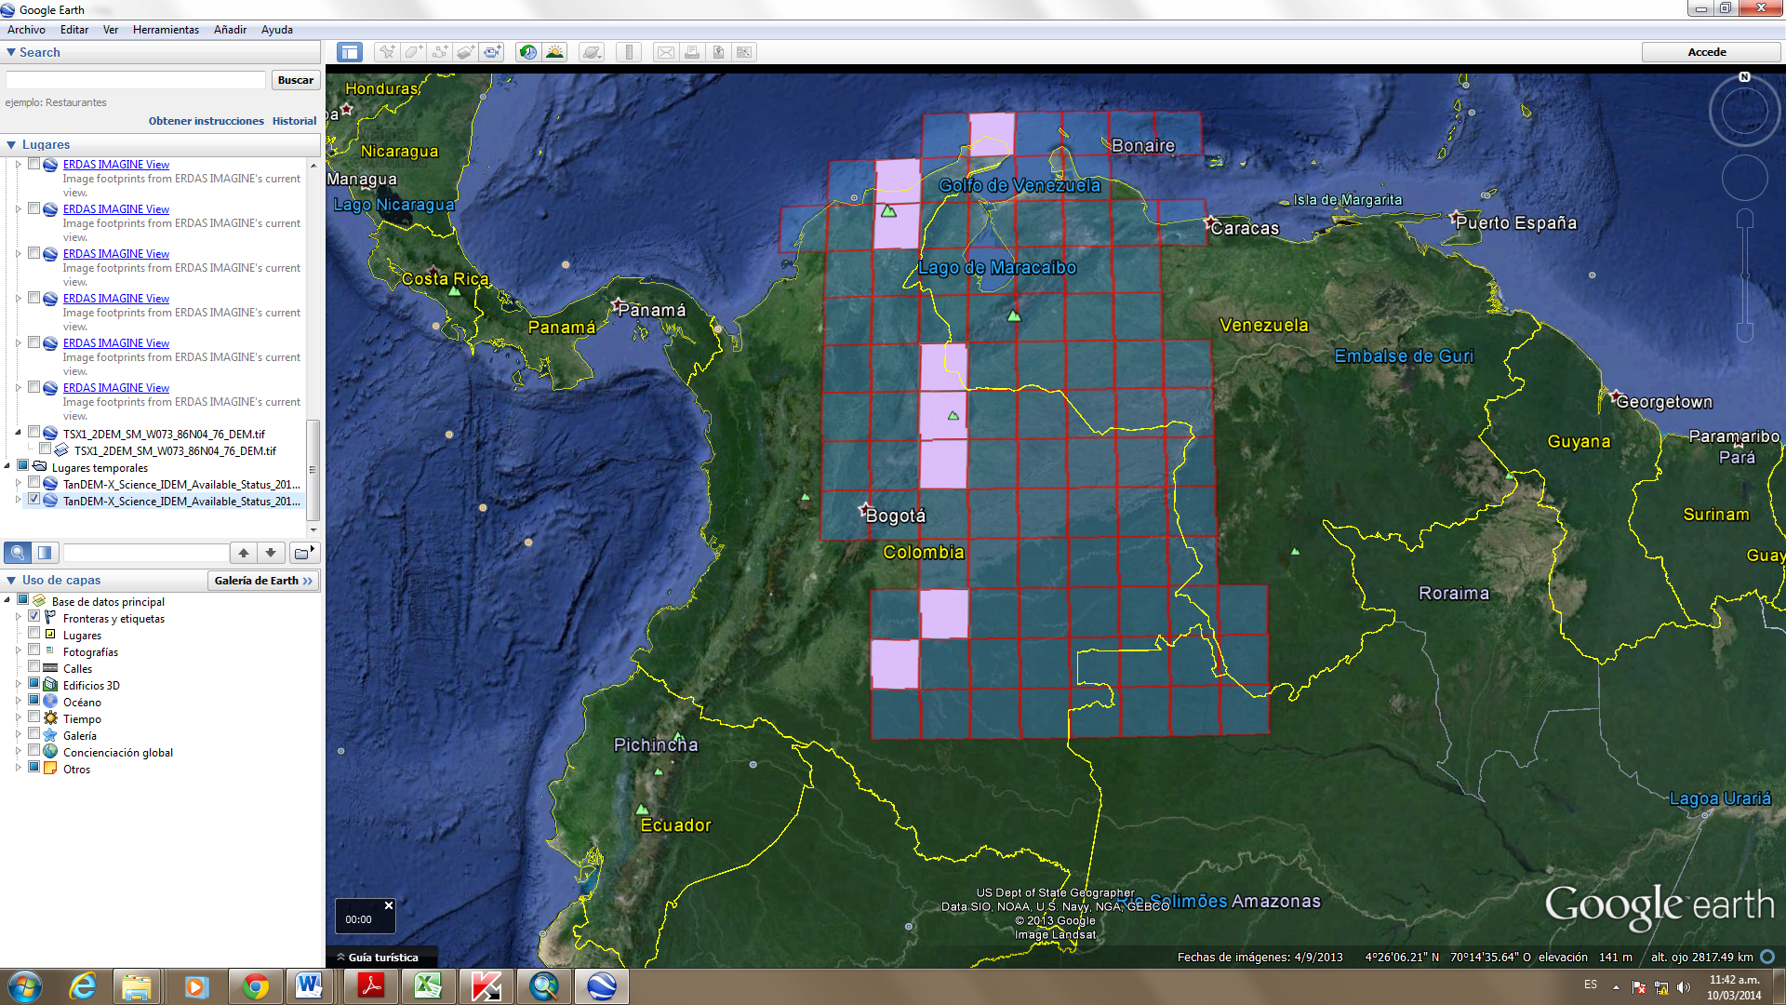
Colombia DEM Project
Working directly with Sylvia Wilson (USGS, SilvaCarbon), Edersson Cabrera Montenegro (Colombia) and Gustavo Galindo Garcia (Colombia).
March 2014 – SEO develops a proposal to DLR for TanDEM-X datasets over Colombia. Accepted in June 2014.
December 3, 2014 – SEO delivers Data Services tool to Colombia including downloaded datasets.
Dedicated storage and secure access to datasets in 8 regions over Colombia (see figure). Each tile location will provide 3 DEM resolutions ...
12-meter, 30-meter, and 90-meter.
Amazon Web Services cloud storage and processing capability to allow local users to test local data processing tools.
Feedback on performance expected in early 2015.

Slide 21
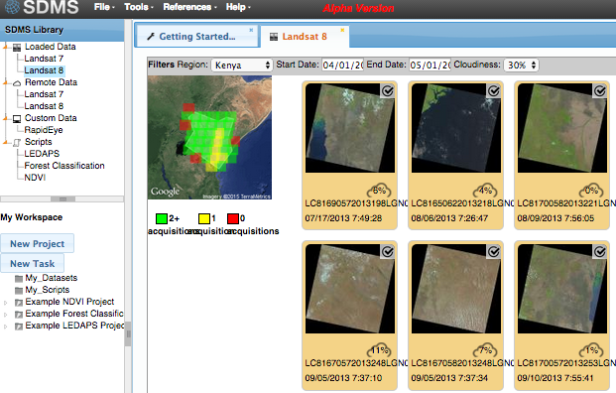
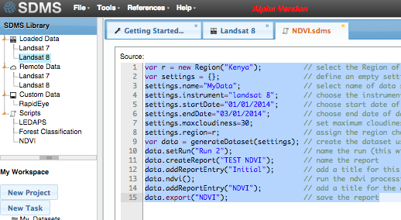
Kenya Project
The Kenya Data Services project will develop an advanced system for in-country testing to support forest reporting to UNFCCC. Two deliveries (Alpha and Beta versions in March and Sept 2015).
Working closely with the Australian Government, Clinton Foundation (SLEEK project).
Amazon cloud-based storage and processing system, Data Management System (local data, remote data, scripts, projects), Landsat scene selection, download and browse image viewing, web-based programming (Javascript), OpenForis processing, Earth Engine analyses (via an API), sample classification and cloud-filtering algorithms.
DEMO

Slide 22

CEOS Website: http://www.ceos.org
COVE Tool: http://www.ceos-cove.org
SDMS (Alpha Version): http://www.ceos-sdms.org
The End

