Slide 1
Introduction GFOI R&D Component Planning Session
Alex Held (CSIRO)
Ake Roseqvist (soloEO), Anthea Mitchell (UNSW)
GFOI Components meetings
Sydney, Australia, March 2-6, 2015

Slide 2
GFOI R&D Element (i.e. the “Continuous Improvement” activity of GFOI )
Key Functions:
Provide material input to updates of the GFOI MGD, taking into account:
New data/model integration & analysis methods and sensors (e.g. S-1, S-2, ESA Biomass, EnMAP, SAOCOM, etc…)
Requests for help by countries to adapt new methods & sensors to unique national needs & circumstances (“leaf-frogging” conventional approaches).
Liaise with SDCG to coordinate acquisitions and provisions of both “core” and “non-core” satellite data (“Element-3”), as needed by GFOI countries, and for specialized applications development & R&D research groups
Liaise with GFOI Capacity Building Element, to support in-country R&D and customised operational implementations, specialized data acquisitions (when requested by GFOI partners)
Provide a link between GFOI and wider forest monitoring R&D community (e.g. under GOFC-GOLD, K&C, etc.)

Slide 3
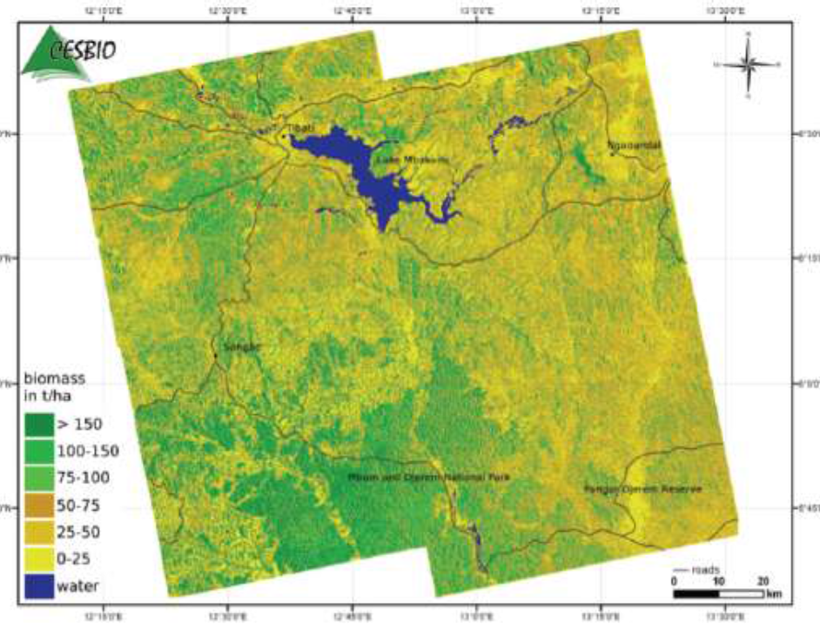
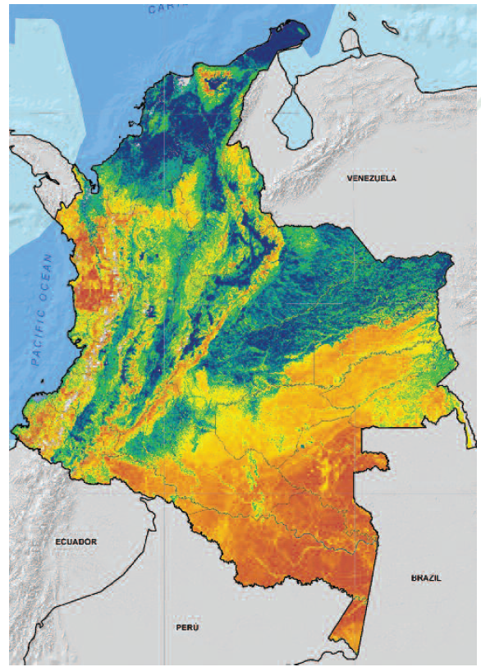
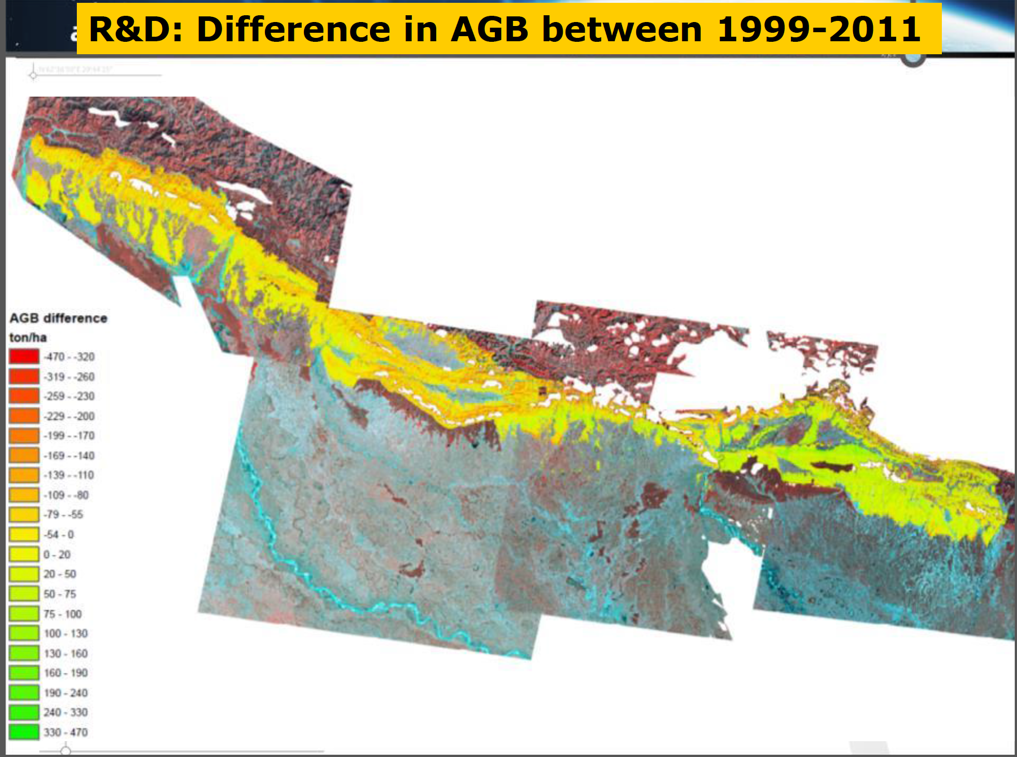
Cameroon
Nepal
Colombia

Slide 4
Key Achievements (2013-14)
Review of Priority Research & Development Topics (Dec. 2013)
Peer-reviewed (200+ experts, country reps., stake holders, GFOI/FCT leads invited)
Identification of R&D topics of priority for GFOI to progress towards operational status
Technical Expert Workshops (Woods Hole, Wageningen, Brisbane, Mexico (?)
Identify “low-hanging fruit”, pre-operational methodologies that require minimal R&D for application as part of NFMS
Landscaping study (July, 2014)
Mapping of priority R&D topics vs. interests of potential research and partner organisations
Identification of possible funding sources
MGD component interactions
Support to the definition of the MGD Forest Information products (MGD, Table 6)
Authoring of MGD chapter on radar applications (MGD, section 3.2.4)
Co-drafting of summary note for GFOI Leads meeting (Oct. 2014) on MGD and R&D priority research

Slide 5
Issues for Discussion
Sustainability, membership & funding of GFOI R&D Element (from 2015)
Potential closer structural & functional alignment with GOFC-GOLD
Process for use of R&D Expert workshop reports and “maturing” R&D methods to be used for update of the MGD
There are several promising methods & datasets which could be considered for documentation now (e.g. around sensor interoperability, forest degradation and biomass sensing).
How best to support countries that wish to “leap forward” with new technologies and methods, beyond what is currently covered in the MGD
Linking R&D and CB more closely
Donor engagement

Slide 6
This Session:
Details on Activities: Ake Rosenqvist
Tentative “Maturing” methods for inclusion into MGD2:
Satellite Sensor interoperability (some Optical – SAR examples)
Use of airborne/ground lidar to compliment forest inventory
Mapping Degradation “hotspots” (non-quantitative)
Data integration for more direct biomass mapping (the “Australian” example)
Discussion and Q&A

