Slide 1
The ICF Hectares Indicator
A UK application of Earth Observation for donor funded REDD+ type activities
Richard Tipper
Ecometrica

Slide 2
ICF Hectares Indicator
Background
The International Climate Fund (ICF) = UK’s commitment to support climate adaptation, low carbon growth and tackle deforestation , under UNFCCC
£2.9 billion ODA expenditure planned from 2011 to 2015
Approx 20% on forests , diverse projects
Involves DECC, DEFRA, DFID bilateral and multilateral channels
Strong emphasis on evidence-based actions, Monitoring, Evaluation and Learning (MEL) and value for money

Slide 3
ICF Hectares Indicator
All forest related ICF programmes are required to report the hectares of forest loss and degradation avoided
Why Use Indicators?
Are we achieving successful outcomes (not just outputs)?
Are we learning what works, where?
Are we delivering efficiently?
Are we focused on the right things?
(Not to claim direct credit for UK ODA inputs; not yet linked to payment for results; Not explicitly linked to GFOI or national MRV)

Slide 4
ICF Hectares Indicator
Outputs v Outcomes
Clinics built, vaccines administered, nurses trained
Farmers trained, protected areas strengthened?
Mortality reduced, health improved, poverty reduced
Forest s conserved, ecosystems restored
If we don’t monitor outcomes we cannot know whether our intervention has succeeded.

Slide 5
Methodology Challenges
Reference Methods Review document available
Too Complex? v Too Simple?
Carbon Project Standards or detailed economic modelling:
Difficult and time consuming
Inconsistencies between countries
National Level statistics:
No sub-national detail or evidence
Infrequent
Questionable in some countries

Slide 6
ICF Hectares Indicator
4 Step Method, being tested in Nepal, Ghana and Brazil
1
Determine relevant areas
Use “theory of change”, logframes and other information to define the types of forest covered by project.
2
Categorize and Map Risk
Find best available data to map Accessible, Cultivable / Extractable, Unprotected (ACEU) forest areas.
3
Monitor forest loss (and damage)
Overlay forest loss data from GFW. Assess accuracy of GFW.
4
Analysis
Calculate “hectares avoided loss” ([expected loss – observed loss] in each risk category)

Slide 7
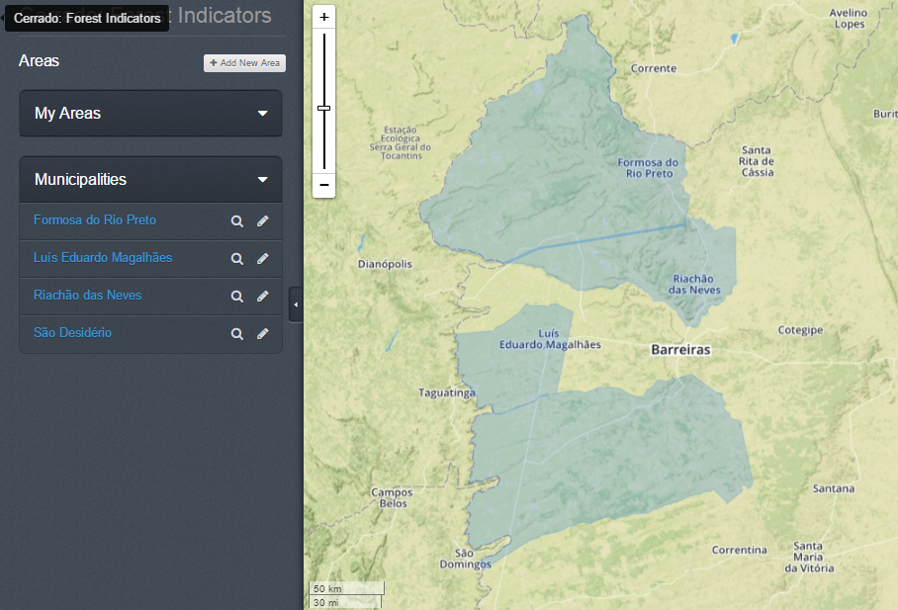
Area delineation
1
Delineate the relevant forest and non-forest areas
Brazil: Municipalities
Nepal: Community forests
Ghana: All high forest
Forest definitions vary
Municipal boundaries
ESA GlobCover
JAXA
Hansen et al
Modis VCF
National maps

Slide 8
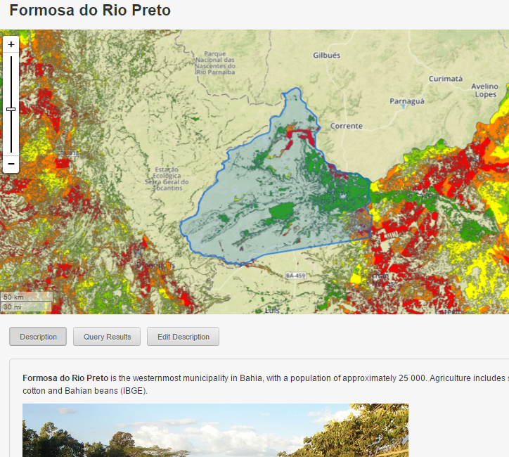
Risk Mapping
2
Develop risk maps
Cerrado loss is driven mainly by agricultural expansion. We have made an initial map using the following possible risk factors.
Proximity to roads
Proximity to previous loss
Not-PPA or LR
Rainfall >1000 mm
Flat topography

Slide 9
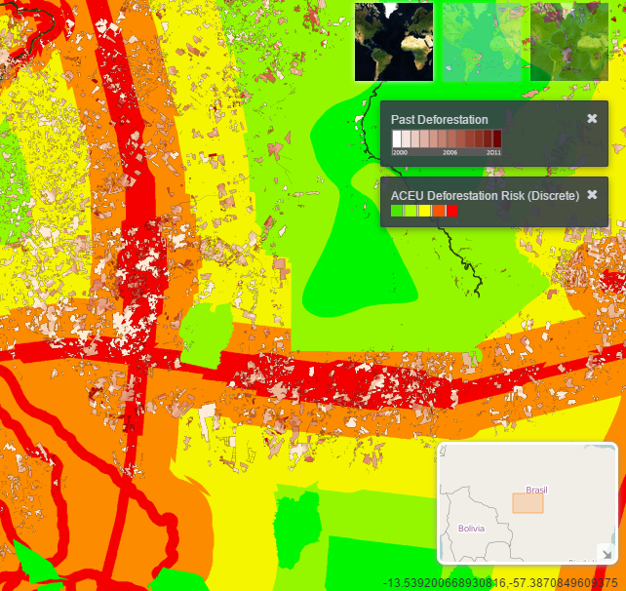
Risk Categories
Risk factors grouped into:
Accessibility
Cultivability / Extractable
Unprotected – Protected
Are used to classify areas into 5 categories of expected loss and damage within 20 years, in absence of intervention:
Category % area loss
V. High >80%
High 60-80%
Med 40-60%
Low 20-40%
V. Low <20%
Example from Amazonia, based on work by Soares-Filho B. S.A., Nepstad, D., Curran, L., Voll, E., Cerqueira,G., Garcia, R. A., Ramos, C. A., Mcdonald, A., Lefebvre, P., Schlesinger, P. (2006). Modelling conservation in the Amazon basin. Nature, London, v. 440, pp. 520-523. Past Deforestation overlay = PRODES

Slide 10
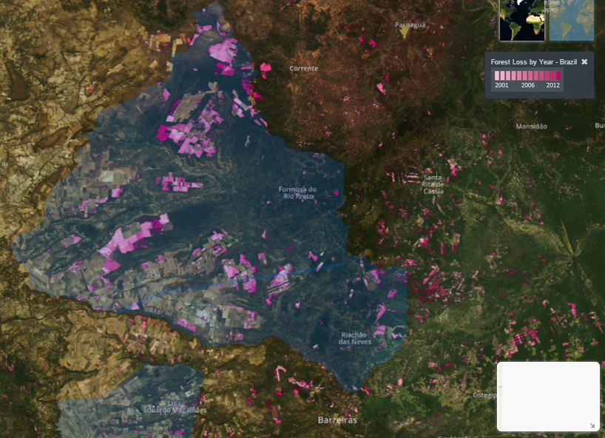
Accuracy assessment of forest loss products
3
Set-up forest loss monitoring process
Testing of Global Forest Watch – UMD forest loss data in progress
GFW – UMD data uploaded
Test areas defined
Draft test Protocol written
SPOT & RapidEye Images
Tests completed

Slide 11
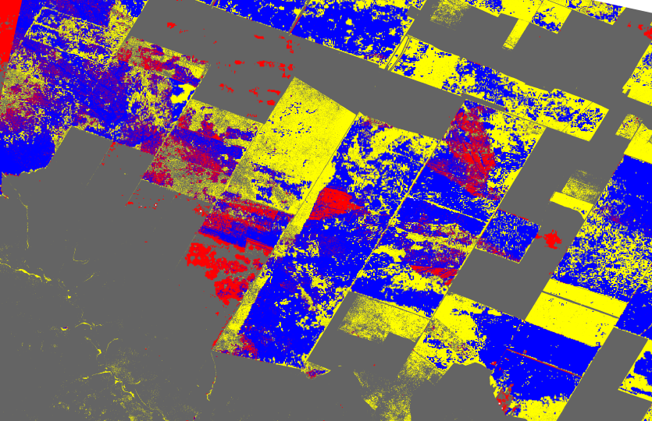
Results of accuracy assessment
3
Set-up forest loss monitoring process
Testing of Global Forest Watch – UMD forest loss data preliminary results from Bahia between 2003 - 2013
Red = false forest loss detected
Yellow = forest loss missed
Blue = correct forest loss detection
Grey = correct forest intact

Slide 12
Lessons Learned
Definition of forest and deforestation has a big impact on the area numbers
Risk mapping can work at multiple scales (unlike broad %) for setting transparent reference levels
Data stewardship is a major issue for all countries, especially less advanced
University of Maryland – GFW forest loss data has serious limitations in fragmented / low forests
A protocol for assessing and reporting accuracy of change detection products is needed

Slide 13
Other points
REDD+ is developing in a multi-faceted way as a result of different donor approaches and country situations
Forest change monitoring is required for needs-based funding as well as results-based funding
Durable capacity development goes beyond providing guidance and training
We successfully applied a cloud based spatial data sharing, querying tool

Slide 14
Future Plans
Further development of Change Detection Protocol and supporting data, results, test areas (initially Brazil and Mexico)
Regional and National Cloud based EO Data Labs:
cost-effective stewardship of data assets
query data without downloading
automated ingestion of products
controlled sharing through multiple applications
Promote ICF collaboration with GFOI

