Slide 1
Clinton Foundation

Slide 2
Key Messages
MRV Systems need to deliver more than emissions estimation – they must help governments deal with issues that matter to them
Development of MRV Systems need to start with the ‘why’ and ‘what’

Slide 3
What is SLEEK?
A system for estimating emissions and removals from the land sector that meets all reporting requirements
It is a complete system
Not just models and data
Include administrative processes, reporting processes, analysis and inputs to policy
It’s also supporting Kenya’s domestic agenda

Slide 4
Why are we doing SLEEK?

Slide 5
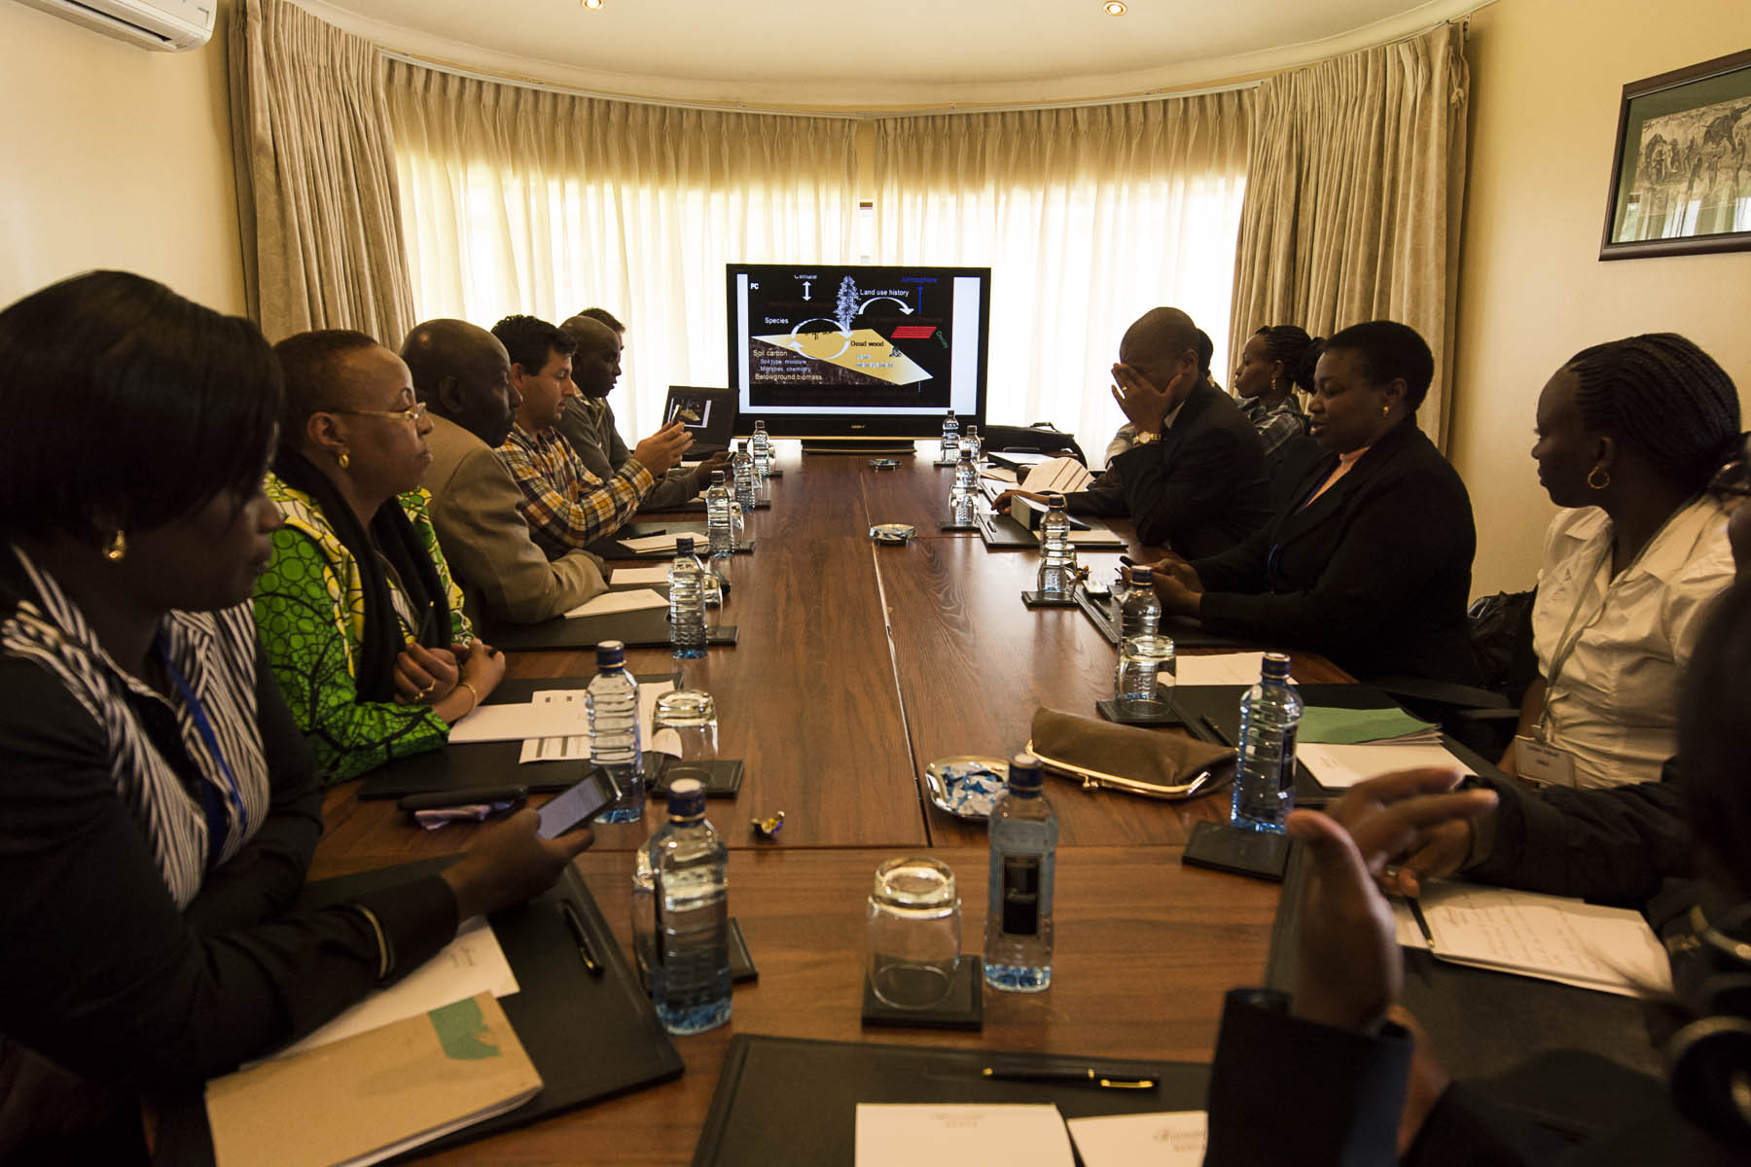
How did SLEEK come about?
Notes:
System design should not begin with a technical discussion
What are the government’s requirements? – international reporting, national information requirements/national policy requirements
What are the market requirements?
Follow mandates

Slide 6
What are the components of SLEEK?
Daily weather data and scenarios
Crop, forest and plant growth curves and information about management regimes
Land Cover maps showing change over time
Assessments of the level of carbon stored in soils and models for tracking change over time
Assessments and models of the drivers of Land Use Change

Slide 7
What are the key challenges in developing an MRV system?

Slide 8
Data is fragmented, disorganised and incomplete

Slide 9
Climate change competes with a range of pressing issues
Quality education
Unemployment
Gender inclusiveness
Safe water
Climate Change
Conflict
Infrastructure provision
Agricultural development
Political stability
Maternal & child health
HIV
Refugee pressure

Slide 10
MRV systems are complex to build

Slide 11
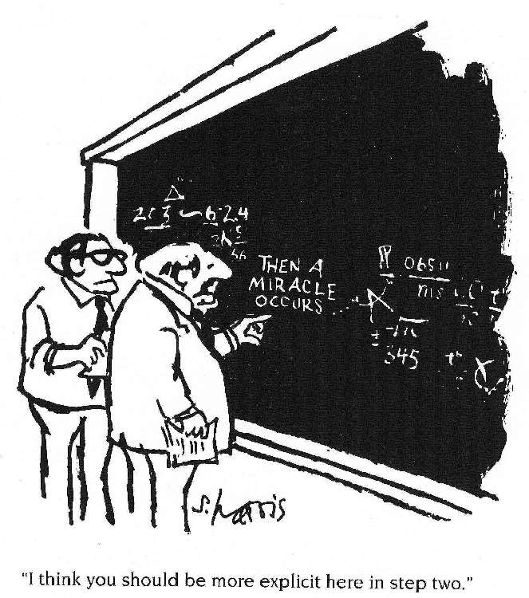
Institutional Arrangements are Key

Slide 12
Misguided Approach to MRV
Not starting with the why and what
Immediate conclusion jumping based on what people are interested in, e.g.
Need x plots
Then argue if circular, square etc
Need x remote sensing data
Because it is already there or
Because it is the latest thing
Lack of focus on national system needs
Retrofitting required

Slide 13
So what lessons should we consider in building sustainable MRV systems in developing countries?

Slide 14
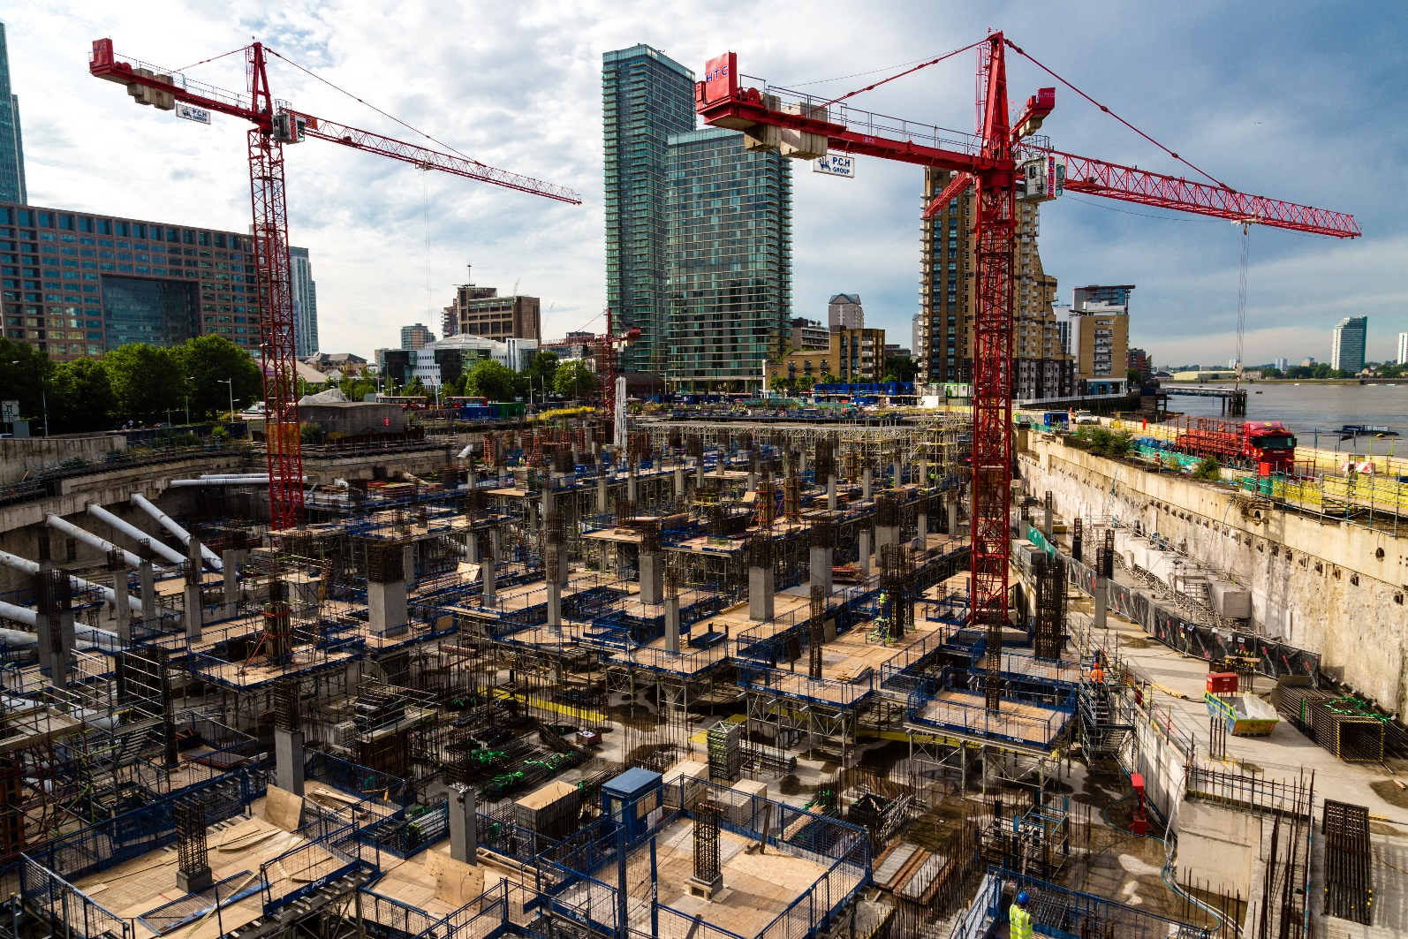
Step 1: build strong foundations within the country

Slide 15
Step 2: identify the data that’s in the country and fill the gaps

Slide 16
Step 3: reduce the costs by making the calculator generic

Slide 17
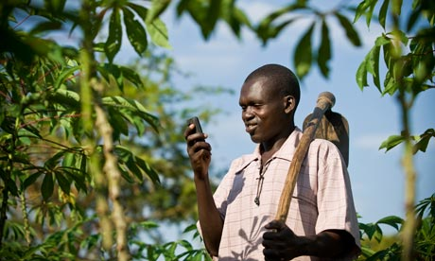
Step 4: improve the return on investment and foster political will for continued data by harnessing the data to meet development challenges

Slide 18
If the international community wants MRV systems in developing countries they need to be built in a way that supports broad development priorities

Slide 19
Examples of apps that SLEEK could support in Kenya
Monitoring progress towards 10% forest cover
Improving crop choice for farmers
REDD+ tool
Weather index based insurance
Prioritization of development interventions

Slide 20
Today’s take home message MRV development needs to start with the ‘why’ – and to be sustainable, it must be more than just carbon

