Slide 1


Slide 2
Clinton Foundation
Convening: businesses, governments, NGOs and individuals
Health: access to care, drugs, and wellness
Climate change: Help communities and nations mitigate and adapt
Economic opportunity: Create opportunities for growth
Women and girls: New opportunities
Childhood obesity: Education and reduction

Slide 3
Clinton Climate Initiative

Slide 4
Clinton Climate Initiative
The CCI strategy is based on a non-prescriptive, interactive engagement that stresses listening and stakeholder engagement.
Process: to understand the complexity of a technical-political-cultural-economic system, then find what works and replicate it
Leverage: CCI leverages its convening power, project and stakeholder management skills, and the resources of the Clinton Foundation to design and implement sustainable solutions
Flexibility: Every country and every community has unique features and will require unique solutions. CCI brings a flexible and scalable approach with measurable impacts

Slide 5
Clinton Climate Initiative
Launched in 2006 to implement solutions to climate change
Ecosystems and Livelihoods: Bring information-based management to preserve and restore forests and landscapes
Cities: Improve energy efficiency of 63 cities around the world, building retrofits and waste management
Clean Energy: Increase access to clean energy technology and deploy it at government, corporate, and homeowner levels.
Islands: Help 20 island nations reduce use of diesel fuel and adopt renewable energy

Slide 6
CCI Ecosystems and Livelihoods Program
Natural Resource Management: Helping communities and nations develop the policies and technical capacity for integrated and sustainable resource management, tailoring activities to specific needs as identified
REDD+: Working in the context of REDD+ to identify opportunities for funding based on implementation of MRV systems, and providing technical support and advice
Global Restoration and the Bonn Challenge: Working globally to raise awareness and nationally with pilot programs on restoration for building resilient landscapes for climate mitigation, water, and food security

Slide 7
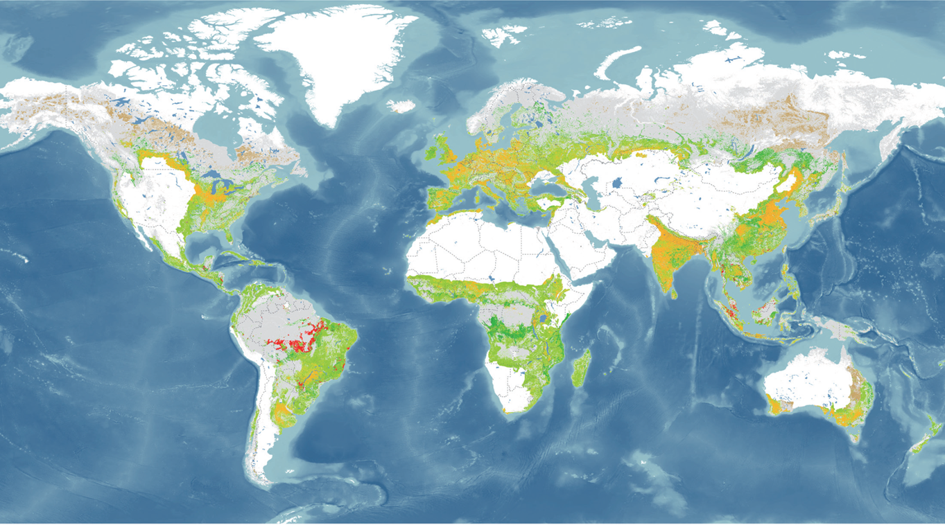
The Bonn Challenge
Restoring 150 million ha of degraded land by 2020 has been increased by the New York Declaration in September 2014 which adds an additional 200 million ha by 2030.
Notes:
Forest and Landscape Restoration Opportunities
Dark green: Wide-scale restoration
Light green: Mosaic restoration
Orange: cropland on former forest
Brown: remote and hard to restore
Gray: existing forest
Other Areas
Croplands on former fo

Slide 8
CCI Ecosystems and Livelihoods Program
Natural Resource Management: Helping the Government of Kenya develop a System for Land-based Emissions Estimation in Kenya (SLEEK) to meet a broad set of needs, supported by the Government of Australia
Restoration I: Working in Kenya and Ethiopia with WRI to catalyze large-scale landscape restoration through mapping, demonstration projects, and innovative investment models
Restoration II: Working in India, Colombia, and Vietnam with IUCN to pilot restoration initiatives to protect watersheds, habitats, and food security. Restoration I and II supported by the Government of Germany
Awareness and Commitment: Raising awareness of the importance of REDD+ and restoration as part of climate mitigation, water and food security.

Slide 9
Clinton Climate Initiative and GFOI
Early history: CCI and Australian Government worked together to support early development of GFOI thorough the concept plan that was accepted by the GEO Plenary in 2011 as a way to mobilize satellite providers and methodology experts
Link with GFOI: CCI’s work in South America (Guyana), East Africa (Kenya and Tanzania), and Indonesia has been supported by GFOI to help ensure availability of satellite and ground observations, to provide methods and guidance documentation, and to help with capacity building for information systems.

Slide 10
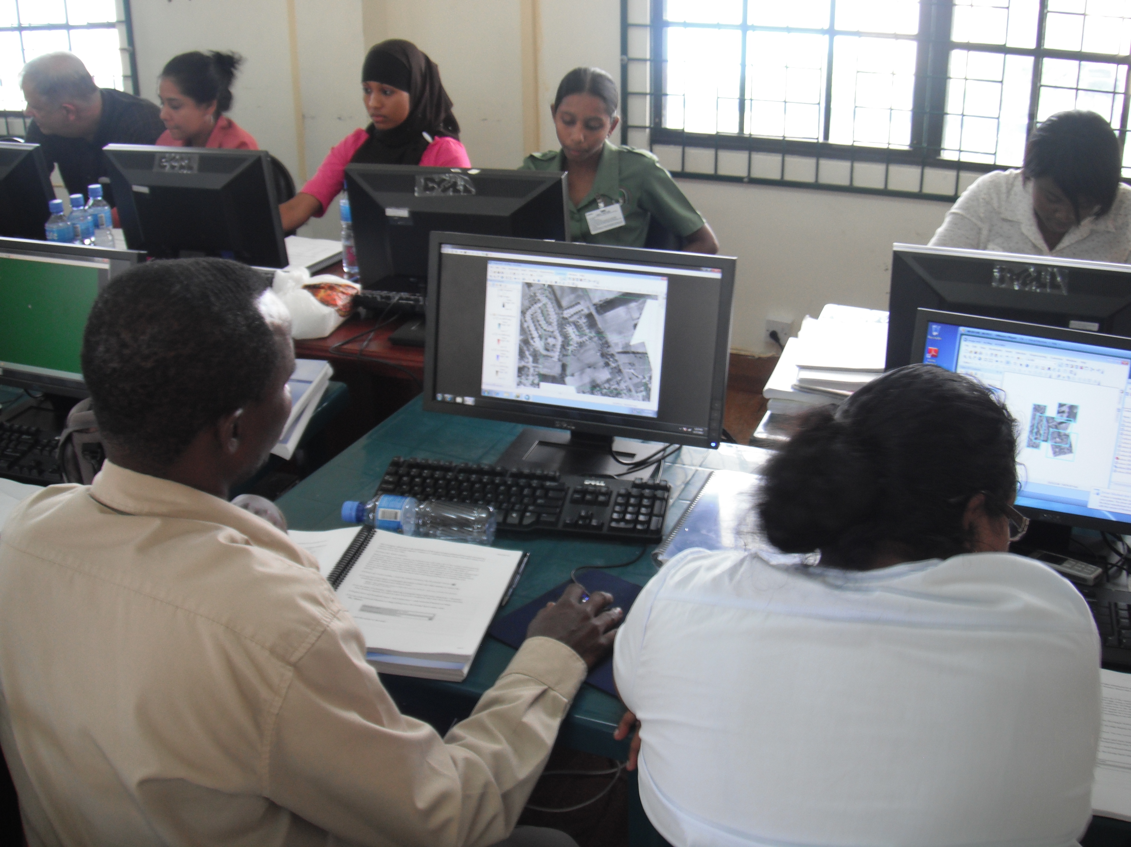
Clinton Climate Initiative
GIS Training in Guyana

Slide 11
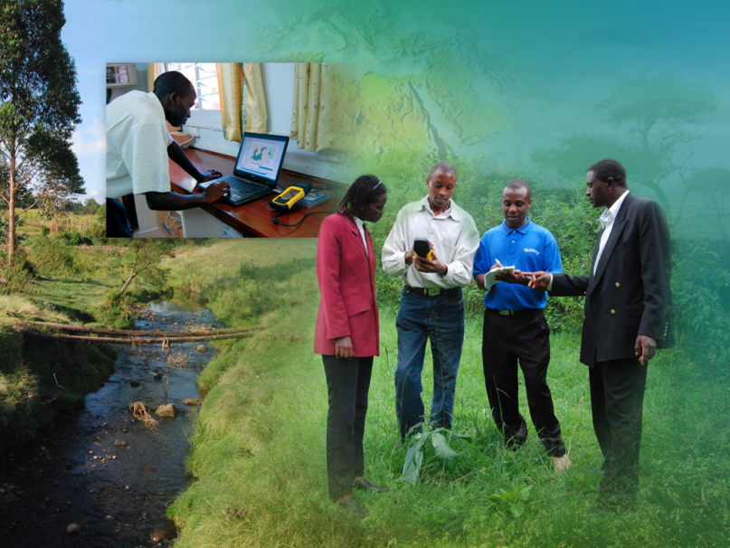
Clinton Climate Initiative
Data Access in Kenya

Slide 12
CCI and GFOI
CCI requirements: Data, methodology, and training from GFOI that are relevant to the successful implementation of information-based management.
Partners: CCI works with a small staff and many partners – technology providers, international, national, and local NGOs, the private sector, and individuals. Always looking for new partners to help countries meet national and international needs.
Examples: Current program partners include the World Resources Institute, International Union for the Conservation of Nature, The Nature Conservancy, the Green Belt Movement and many other national and local NGOs. Funding partners have included the Government of Australia, Germany, Norway and the Rockefeller Foundation.

Slide 13
Clinton Climate Initiative and GFOI
Bonn Challenge: of restoring 150 million ha of degraded land by 2020 has been increased by the New York Declaration in September 2014 which adds an additional 200 million ha by 2030.
Commitments need tools: Many countries have committed large areas for restoration, but need help in implementing. Setting the enabling conditions and supporting financial ambition to achieve landscape restoration at scale is critical.
Role for GEO and GFOI and partners: Providing the data and tools that countries need to restore environmental function to degraded land and to help show how these commitments can contribute to REDD+ and Intended Nationally Determined Contributions to the UNFCCC

Slide 14
Clinton Climate Initiative and GFOI
GFOI for Funding: CCI exploring new steady and long term sources of financing for restoration and conservation activities. Each of these will require data (data cubes), methodology, and training.
Payment for Ecosystem Services Model I: Pool philanthropic and Corporate Social Responsibility funds spent by extractive industries to support large-scale restoration of African landscapes. Data focused on restoration will help make the case.
Payment for Ecosystem Services Model II: Pool funds spend by pharmaceutical and cosmetic companies to protect large tracts of biodiversity-rich forest land. Data focused on biodiversity is key.

Slide 15
GFOI Role
Methodology and Tool development: has moved rapidly with more sophisticated tools now available
Capacity for use of tools: But in many countries the capacity to use these tools is not developing at the same rate
Expanded training: GFOI and its partners might consider an expanded training program (extended expert visits) for both technical groups and policy/decision makers
Preparing for reporting to UNFCCC: Such a program could help countries with both technical reporting and policy issues such as INDCs

Slide 16
Clinton Climate Initiative and GFOI
REDD+: GFOI a key partner with UN-REDD, FAO, UNDP, UNEP, and other actors in the REDD+ framework especially with MRV development.
Bonn Challenge: Setting the enabling conditions and supporting financial ambition to achieve landscape restoration at scale is critical.
Natural resource management: Lessons learned and country interest in broader resource management, example is the SLEEK model and possible expansion to other countries
Role for GFOI: With their partners, providing the data, tools, and methodologies and expanded training that countries need to meet national and international commitments

