Slide 1
Space Data Coordination Component
Eugene Fosnight on behalf of SDCG Exec
Sydney, 2nd March 2015

Slide 2
Space Data Coordination Component
The Space Data Component is well established in support of GFOI Space Data needs:
Baseline global acquisition strategy
Space Data Services
Data supply in support of GFOI R&D Component
With the SDCG Exec the Space Data Component is well managed and resourced;

Slide 3
Background global acquisitions
Global annual coverages by 2016 of the world’s forested areas - inclusion of GFOI requirements in the basic observation scenarios of the core data streams
This year, expanding global baseline coverage to 78 countries
GFOI Participating Countries, UN-REDD National Programme and Partner Countries, WB-FCPF Participating and Partner Countries, CD-REDD Project Countries (BMU)
Coverage by Landsat and Sentinel-1 for 2015
GFOI influenced increase in Landsat daily acquisitions to 725 scenes
Sentinel-1 ramp-up observation scenario is on-going: 3-month rolling archive started from 4 October 2014

Slide 4
Baseline Global Observation Scenario
 | 2015 | 2016 | 2017
Global annual coverages by 2016 of the world’s forested areas | Building to a total of 67 countries | Global annual coverages of the world’s forested areas using data from a suite of core mission sensors | Multiple global annual coverages of the world’s forested areas by several core mission sensors
Efficient and effective global flows of data | Complete global data flow study. | Implement processes and tools for efficient and effective global flows of data. Engage Sentinel-2A mission planners during the ramp-up phase | Efficient and effective global flows of data for development of GFOI standard products
Global coverage with consistent information products | Identify Space Agency and expert partner information product initiatives relevant to GFOI and MGD | Integrate flows of information products as they become available | Inclusion of GFOI requirements in agency data-related initiatives

Slide 5
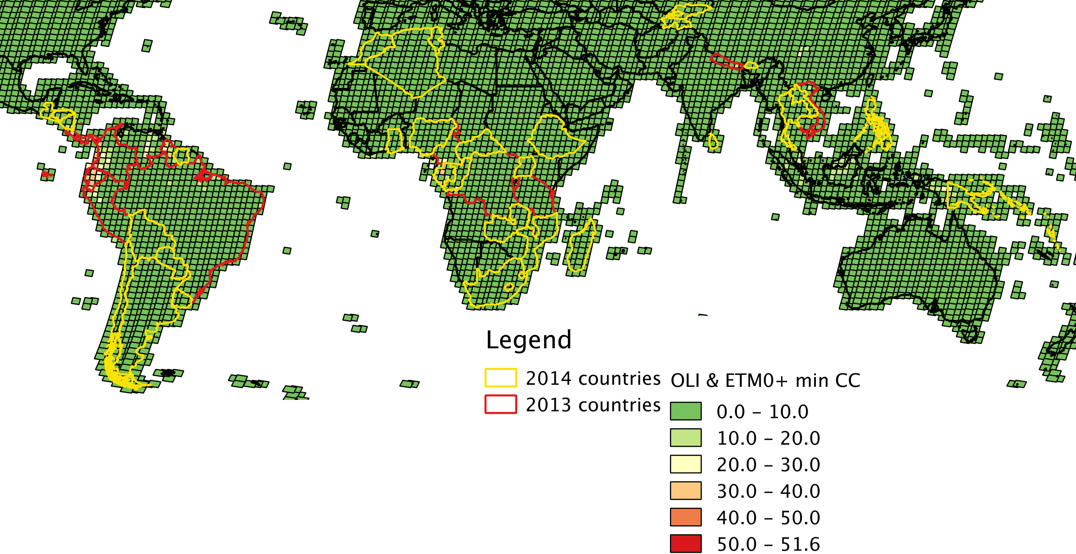
Landsat 7 & 8 combined

Slide 6
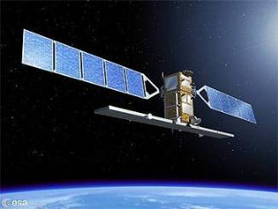
Sentinel-1
Sentinel-1 - in the full operational configuration of two satellites - will be a workhorse for forest monitoring:
with high repetition rates and independence from cloud coverage to provide early warning on forest disturbances
in synergy with optical sensors to ensure monitoring of heavily cloud covered areas.
with frequent coverage to estimate biomass in low carbon forests (e.g. in the boreal zone).
Sentinel-1A data are available since 3 October 2014 on a rolling archive at https://scihub.esa.int
http://sentinel.esa.int
Notes:
6

Slide 7
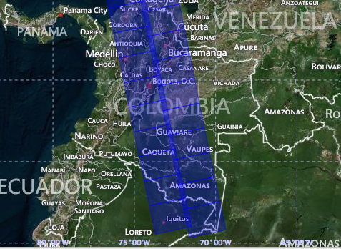
Sentinel-1 for GFOI
Several GFOI priority areas have been acquired during the Sentinel-1 ramp-up phase (overall / dual-pol scenes):
Colombia: 521 / 21
Ecuador: 236 / 0
Peru: 574 / 5
Tanzania: 452 / 61
Kenya: 269 / 34
Uganda: 211 / 30
Cameroon: 19 / 11
DRC: 198 / 36
Cambodia: 44 / 30
Viet-Nam: 253 / 99
Sumatra: 379 / 150

Slide 8
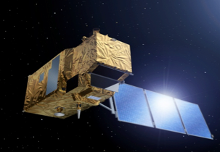
Sentinel-2
Sentinel-2 will fulfill key requirements for forest monitoring and will be a major workhorse for REDD+ with:
high repetition rates to acquire large data coverage in short time periods, which will lead to improved consistency, accuracy, timeliness and thematic detail of forest maps for e.g NFI, GHG, illegal logging
high spatial resolution to assess also forest stands with low canopy closure and map small disturbances of forests and forest degradation (MMU < 1 ha)
high spectral resolution with dedicated bands (red–edge) to discriminate between forest and spectrally similar vegetation types
Launch window: May – July 2015
Notes:
8

Slide 9
Space Data Services
Archive characterisation – 19 national reports now prepared with the 3 countries at SDCG-7 added
Data Discovery - COVE Coverage Analyzer now includes Landsat 7/8, SPOT 1-6, Pleaides-1A/1B, Radarsat-2, ALOS-1. We are working on adding Envisat, ERS-1/2, TerraSAR-X, RapidEye, and Sentinel-1A/2A in 2015. Aim is a “one-stop” location to perform coverage assessments and “discover” datasets
Data Assembly/delivery – USGS moving away from media delivery (Kenya was supplied), looking at analysis ready data close to its source with less demand on bandwidth. Global Data Flows analysis proposed in collaboration with main suppliers.

Slide 10
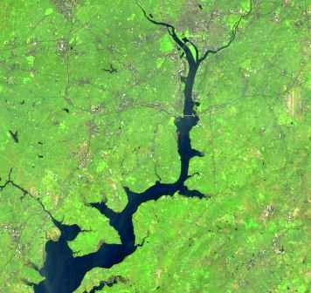
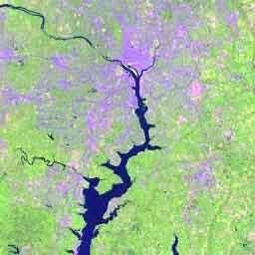
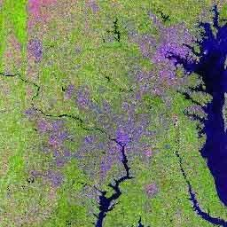
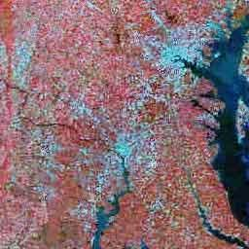
U.S. Landsat Archive Overview
OLI-TIRS: Landsat 8
385,345 scenes
average scene size 1813 MB
ETM+: Landsat 7
1,858,501 scenes
average scene size 487 MB
TM: Landsat 4 & Landsat 5
1,988,982 scenes
average scene size 263 MB
MSS: Landsat 1 through 5
1,299,626 scenes
average scene size 32 MB
Total:
5,532,454 scenes
All average scenes sizes are for uncompressed data
Notes:
The end result is a vast archive of Landsat acquisitions covering 4 decades.
The 41 year Landsat archive contains over 5 million scenes covering an astounding 171 Billion squ. km.

Slide 11
Space Data Services
SDMS Pilot Projects – FAO/Norway pilot concluded Nov, Colombia pilot (DEM) concluded Dec. ➔ FAO/Norway SDMS implementation project in 2015
Advanced prototype underway for Kenya (alpha version released). Collaboration with SERVIR for hosting at RCMRD.
Data cube application being pursued as priority – meeting next week with GA in Canberra
Model national system – Australia proposing that Kenya can be the test case for application of MGD and space data deliverables end to end

Slide 12
R&D Data Supply
Substantial effort invested in defining a strategy for support to the GFOI R&D activities including the contributing data streams such as from Canada, Italy, Germany, Japan, France
Await confirmation of solid governance, clear leadership and adequate resourcing of the R&D component. The R&D data supply document is ready to send to CEOS Principals.

Slide 13
3 Year Vision – outcomes to highlight ...
SDCG’s Space Data Services, alongside the GFOI Methods and Guidance, will be mainstreamed within the REDD+ activities of the major sponsors and in-country programs of FAO, World Bank, and others;
Incorporation of GFOI Space Data Services and Methods and Guidance in one or more operational national MRV programmes;
Effective and professional engagement of the most relevant countries, based on the priorities of FAO and World Bank, and leveraging the activities of SilvaCarbon – resulting in wide-spread awareness of GFOI products and services among these countries;
Implementation of a strategy for acquisition and provision of satellite data in support of GFOI R&D activities;

Slide 14
… and questions these raise
How GFOI is working with FAO and World Bank as GFOI leads to establish mechanisms for promotion and delivery of GFOI deliverables in country.
Clear need for an overall country engagement strategy of GFOI with an agreed shortlist and schedule of priority countries for trialling end-to-end GFOI deliverables including contributions from all Components. SDCG has been pioneering country contact (the “Country Days”) and support with the Capacity Building Component (SilvaCarbon), but needs structure and inclusion of the MGD component to ensure an integrated approach.
SDCG has a plan ready for support to the R&D component, but due to lack of governance, leadership and resourcing for the R&D component its future is not clear.
The need for an open and cooperative approach to the various SDMS projects (FAO/Norway, ESA TEP, …) to ensure maximum overall benefit.

