Slide 1
Global Forest Observations Initiative Methods and Guidance V2.0 and Portal
Dr Carly Green – MGD Component Manager
GFOI Sydney Component Meetings – 2 - 6th March, Sydney, Australia

Slide 2
Outline
MGD 2014 and beyond
Feedback from in-country use
MGD Portal Prototype
Notes:
1m

Slide 3
MGD 2014 and beyond
Notes:
1m

Slide 4
Methods and Guidance Document
Audience Aim and Objectives
Aimed at technical implementers, negotiators and those responsible for REDD-plus nationally
Provides operational link between IPCC methods and all REDD+ activities identified by UNFCCC
Aims to assists in the selection of the most appropriate technical solutions consistent with UNFCCC Warsaw Framework on REDD+
Notes:
1m

Slide 5
Methods and Guidance Document
GFOI Aims and Objectives
Documents the GFOI perspective on operational methods and guidance on REDD+
Including available/operational data sources and processing approaches
Guiding principles in the development of MRV systems
Guides GFOI components in the implementation of activities
linking capacity building & training from all partners to countries asking for GFOI support
tool for identifying, advertising and filling knowledge gaps (e.g. priority research areas)
Notes:
1m

Slide 6
Methods and Guidance Document
Activities completed in 2014
In country use and feedback
Development of training materials and decision support tools
Clarifying text on complementarity between GFOC-GOLD / MGD / FCMC manual
Checklists for countries to assess guidance / data and capacity needs
Use of global forest cover and change datasets in REDD+ Measuring, Reporting and Verifying
Forest Reference Emissions Levels
Biodiversity Monitoring
Design of the MGD online portal
Translation into Spanish and French
Publication of brochures and two short videos
Notes:
1m

Slide 7
Methods and Guidance Document
Take home messages for 2014
The MGD is useful but needs to be more usable to facilitate country engagement
Co-ordination between GFOI pillars needs to be improved particularly in regard to linkages between the MGD / data / tools / capacity building
Increasing hands on decision support and training tools with clear linkages to the MGD will enhance/increase its use
Notes:
1m

Slide 8
Methods and Guidance Document
Outcomes from Sydney Meeting
A GFOI partner plan for country engagement and feedback
MGD 2.0 structure and new material outline
Finalize features / support and development schedule for the online portal
Notes:
1m

Slide 9
Feedback from in-country use
Notes:
1m

Slide 10
In country use - Ghana
Ghana formally commenced design of its MRV system in December 2013; Funded by the World Bank FCPF
MGD was used to guide the design of a National MRV system which relied on a large body of existing remote sensing and ground based data
A series of workshops/meetings and one – on – one sessions were held in country and support provided remotely over an 8 month period.
Notes:
2m

Slide 11
Feedback - Ghana
Guidance assisted in making decisions on operational technical solutions that met IPCC guidance within the UNFCCC framework for REDD-plus
Was a useful reference document
Guidance on developing a NFMS roadmap / gap analysis
Would prefer a more step by step methodological guide
Format of the document was intimidating
Hard to read and link concepts and therefore understand knock on impacts of decisions
Text could be more accessible
More figures / point form / simplified text / worked examples
Notes:
2m

Slide 12
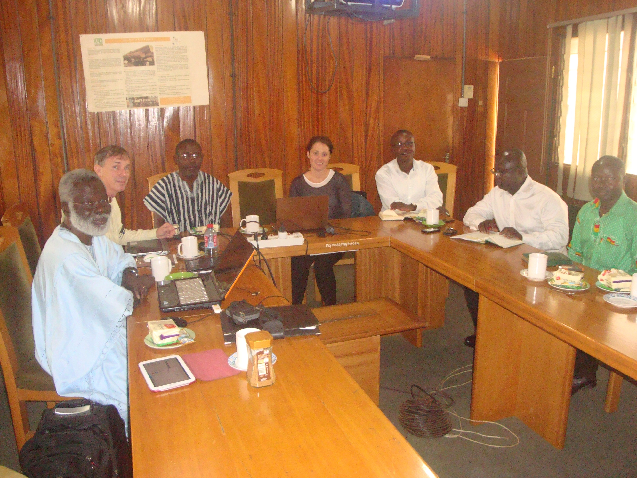
Summary - Ghana
Presenting the material in a more country specific contextualised way would improve accessibility to the guidance and assist countries to make confident design decisions related to MRV systems
More visual aides that present a series of options and information on how to select appropriate methods
Notes:
2m

Slide 13
Feedback – UNREDD Programme
Andrew Haywood - Pacific
MGD is valuable as it provides countries a published document upon which to reference their design decisions
Include more guidance related to steps wise design decisions based on a countries specific situation (existing data / purpose of NFMS / budgets)
Increase decision trees and improve structure so that users have better access to reference material relevant to their situation
Notes:
2m

Slide 14
Response
Respond positively and appropriately to feedback on experiences of using the MGD
Increase use of MGD
Improve linkages between the GFOI pillars:
to improve communication and co-ordination of materials/tools/country engagement
to communicate to countries the support available from GFOI
Develop useful tools for country engagement conducted by GFOI partners
Improve communication/feedback between MGD and country engagement programmes
MGD V2.0
The MGD Online Portal
Action
Notes:
1m

Slide 15
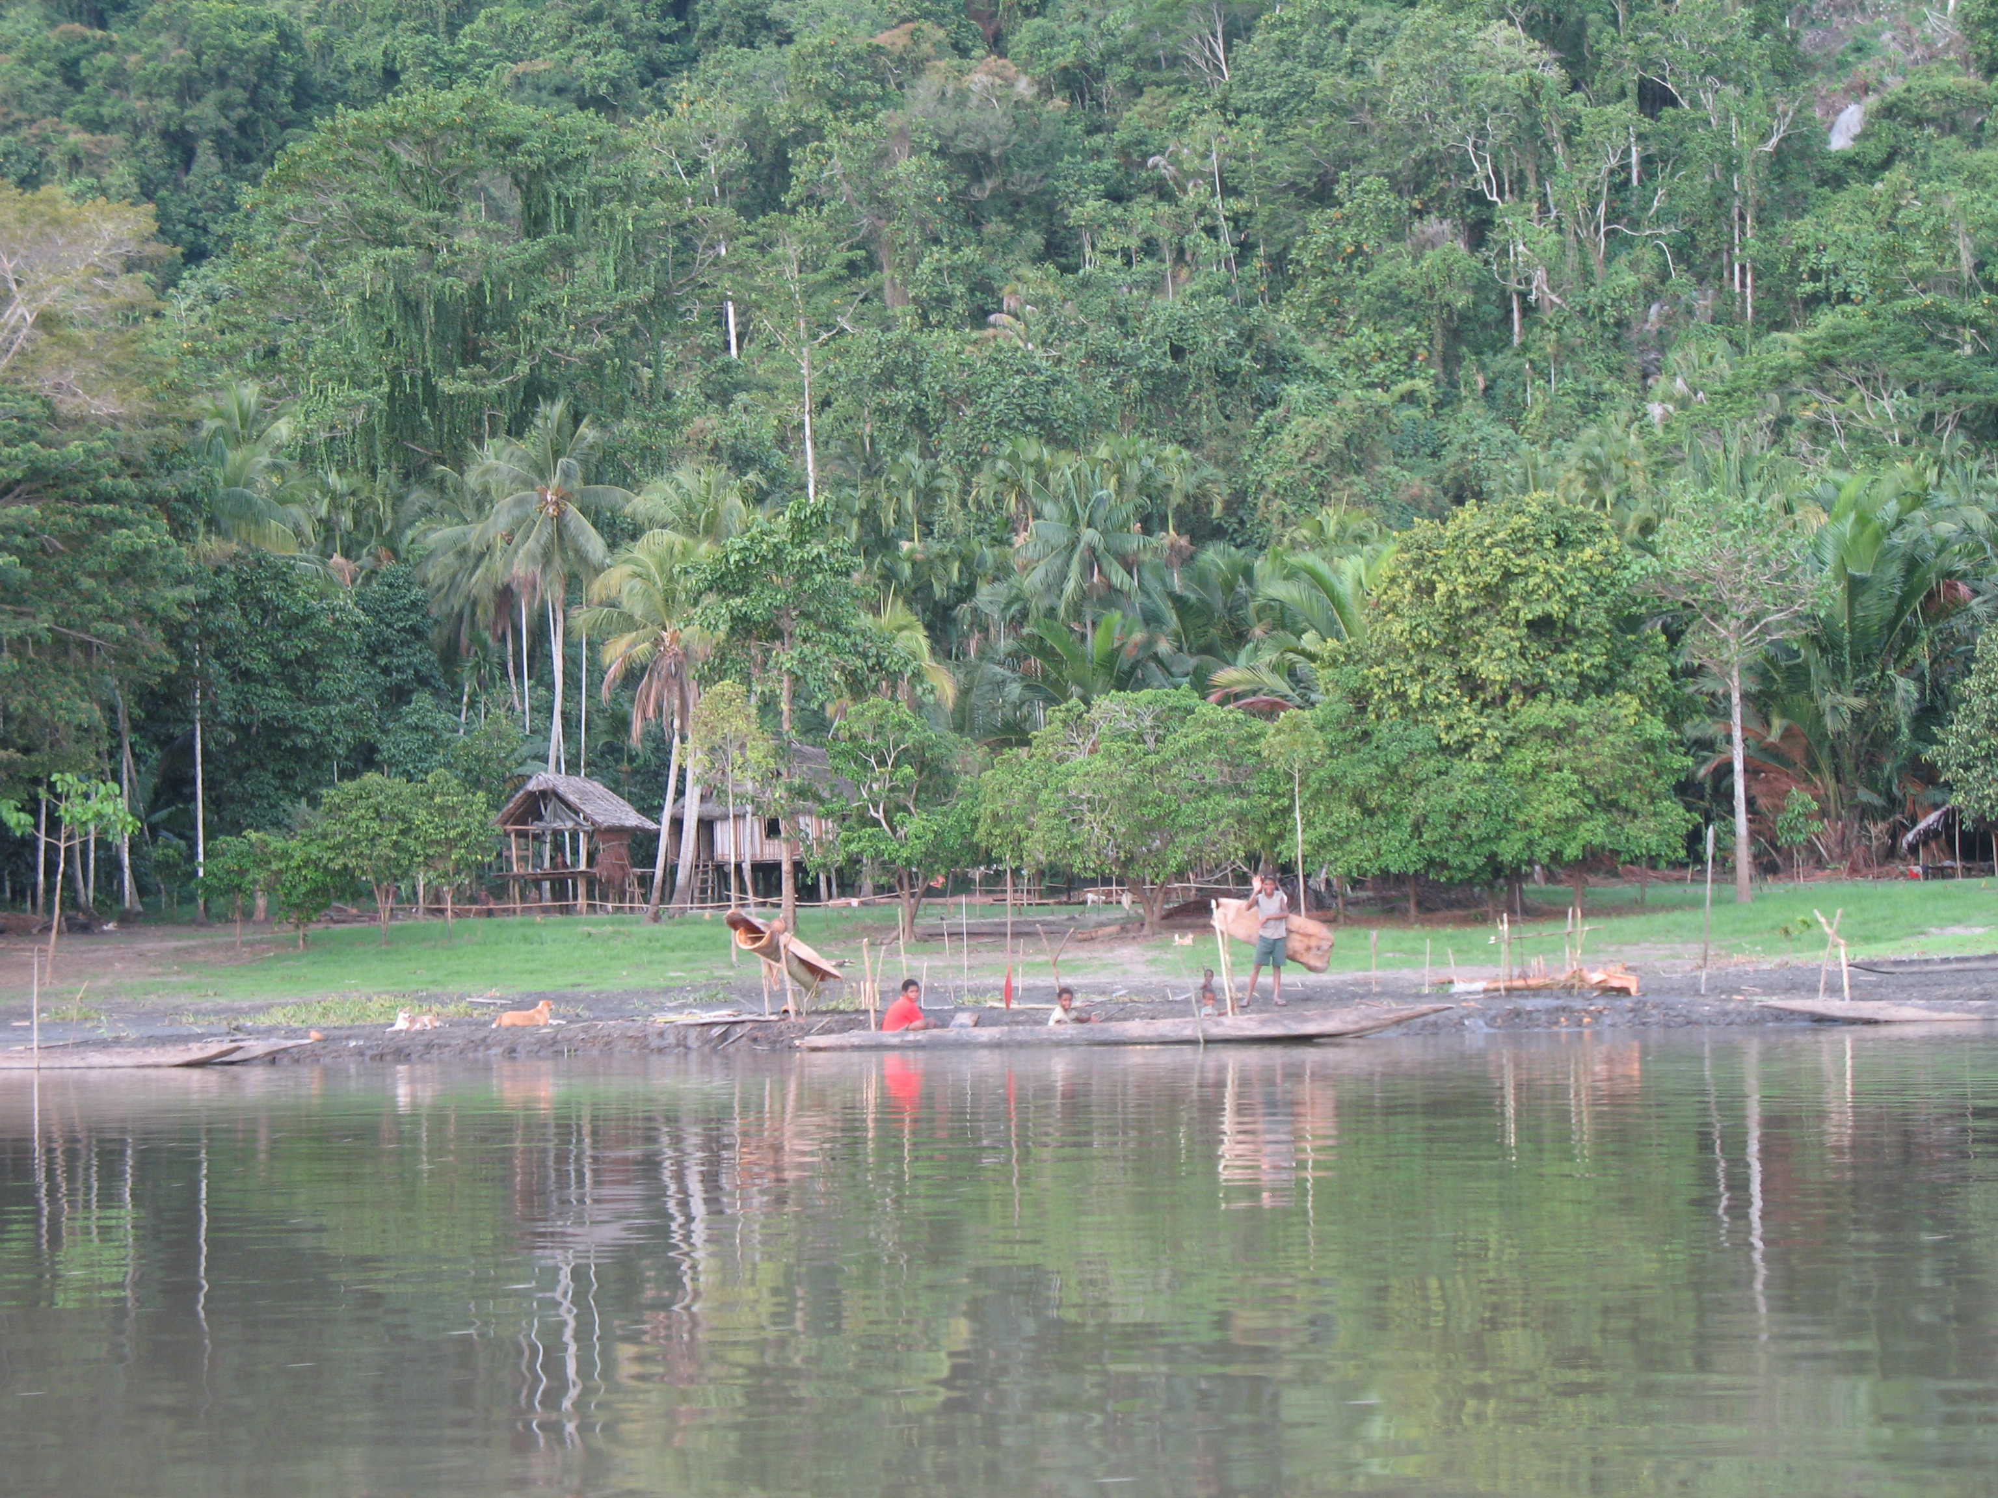
MGD 2.0 and Portal Prototype
Notes:
1m

Slide 16
MGD V2.0
Version 2.0 of the MGD will focus on improving the usability of the methods and guidance
The update will involve:
a review and re-structure of existing material
improved linkages to existing GFOI partner material and tools
development of new material including examples and case studies
focus on visual aides such as decision trees and flow charts
presentation of material in both a flat book structure and online portal format
Notes:
2m

Slide 17
The MGD Online Portal
Develop a software tool that increases the country specific relevance of the guidance presented in the MGD and;
Support countries through design decisions in developing MRV systems for REDD-plus
Provides intelligent indexing to access relevant and related guidance provided in the MGD and other GFOI member resources
Notes:
1m

Slide 18
The MGD Portal Development Phases
Prototype has been developed
Consultation and final design – Sydney / March
Development – April to November 2015 (subject to support)
Aiming for release with version MGD2.0 in late 2015/early 2016
Notes:
1m

Slide 19
Decision Support Tool - The MGD Portal Prototype
The following prototype screenshots:
DO present a prototype of the Portal concept and features
DO NOT necessarily present the final design or function
Notes:
1m

Slide 20
The MGD Portal Prototype Demonstration
Notes:
1m

Slide 21
The MGD Portal Prototype – Login
Users can create a profile and login to the portal to save information relating to:
their progress through the MRV design and implementation
data needs / requests
capacity building/training requests
R&D interests / activities
Notes:
1m

Slide 22
The MGD Prototype - Profile
User works through a series of decision trees and checklists to define circumstances and tailor guidance
This could be linked to Silvacarbon processes
Guidance is presented in a hierarchical framework of Themes, Concepts, Tasks and Actions
These match the MGD heading structure
Visual aides represented as progress pyramids and worksheets respond dynamically when tasks are commenced and completed
Notes:
Themes – user relevant – for example Institutional Arrangements or Policy and Design Decisions
Concepts – lover level detail and can cross themes for example Forest Definition
Tasks – Specific activity that relate
Actions – lowest level actions that need to be completed to complete the task

Slide 23
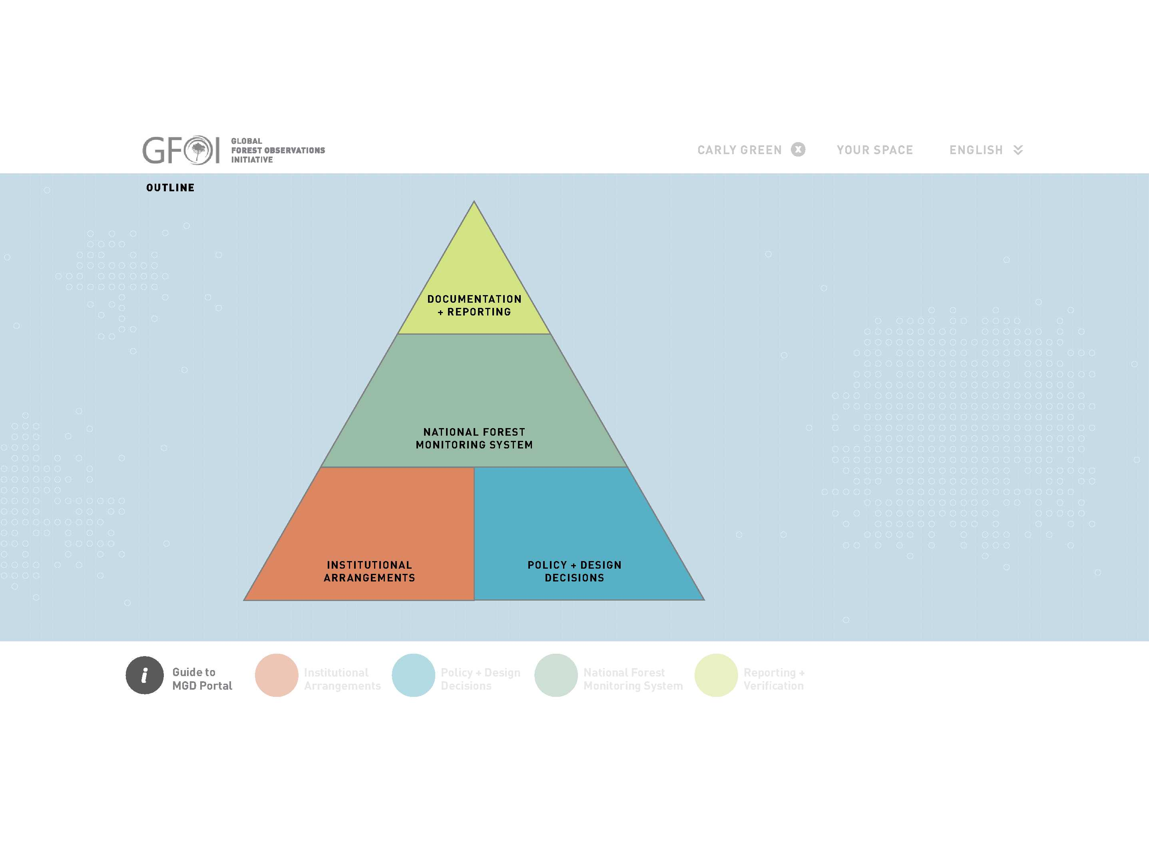
The MGD Portal Prototype – Themes
The Themes of the MRV system are consistent with the main headings of the MGD.
Notes:
1m

Slide 24
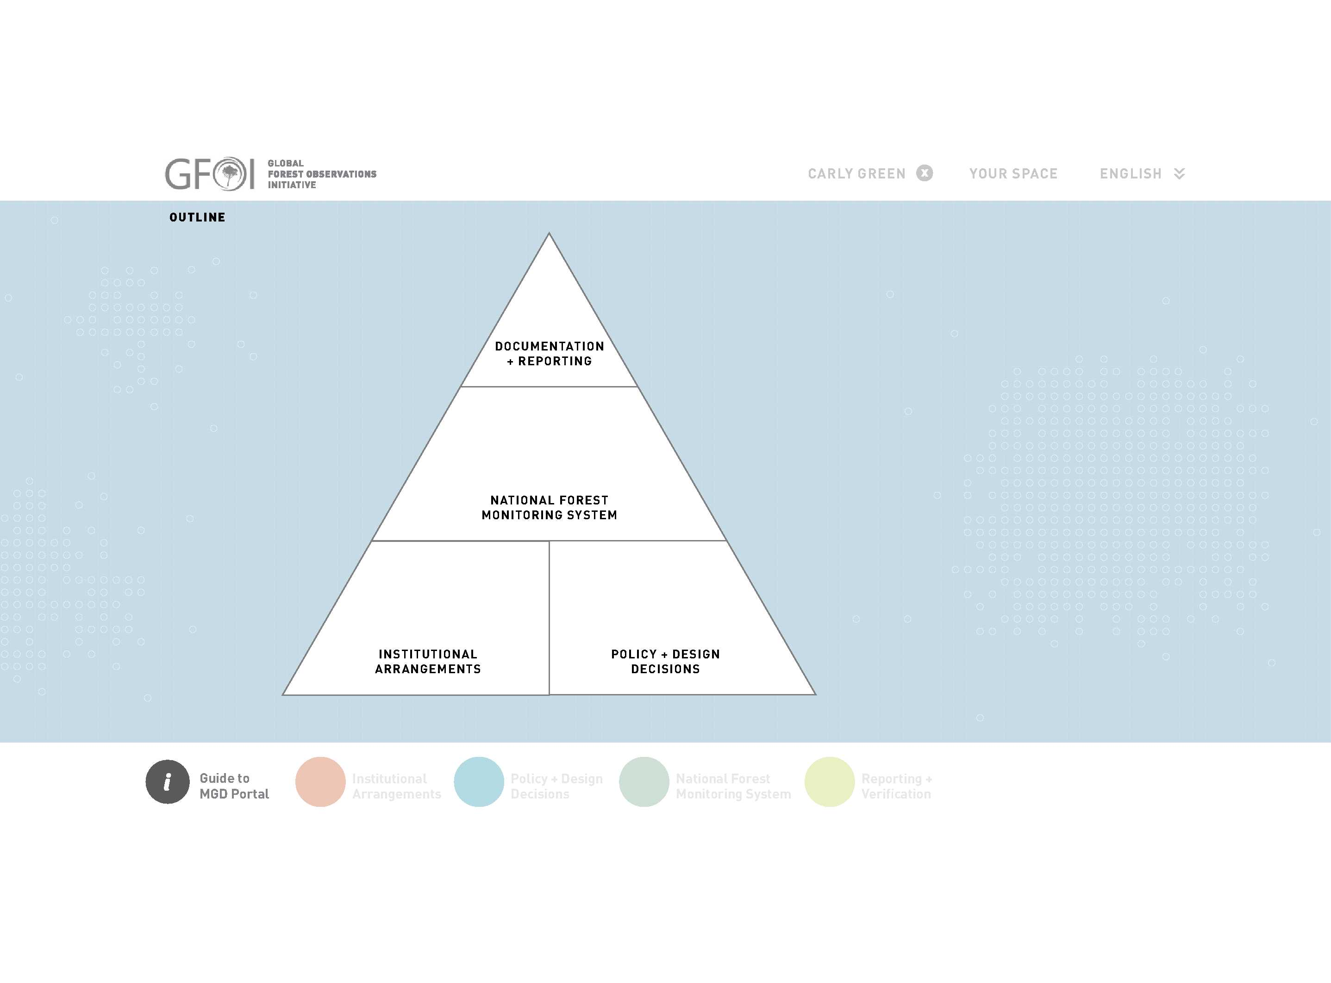
The MGD Portal Prototype – Themes
If themes are incomplete, segments of the pyramid remain white
The user can click on a theme to progress down a layer to concepts (second level headings)
Notes:
1m

Slide 25
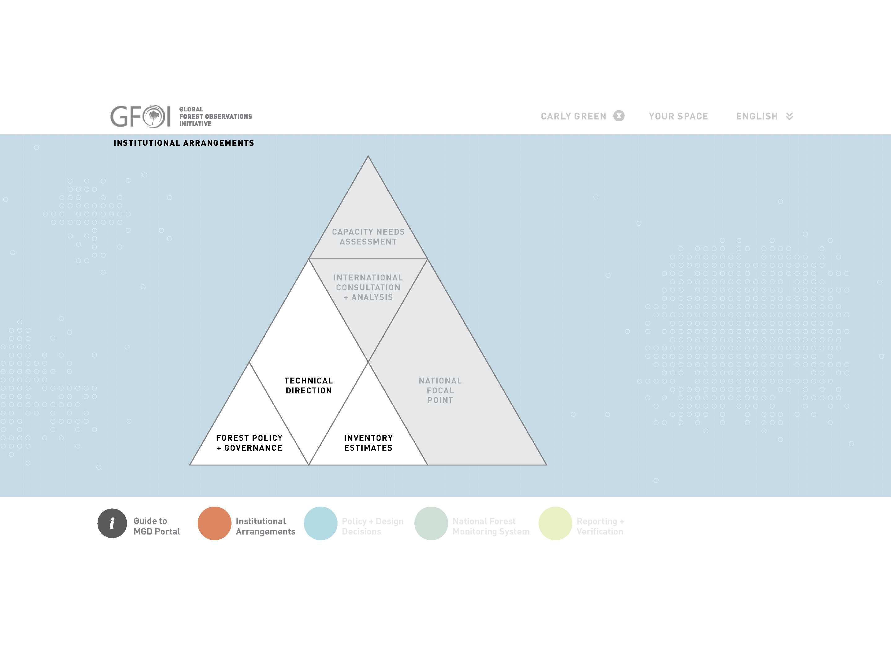
The MGD Portal Prototype – Concepts
The concept pyramids presents guidance on a logical order for completion.
For example: the theme of ‘Institutional Arrangements’ suggests that certain concepts (in white) should be completed before others (in grey).
Notes:
1m

Slide 26
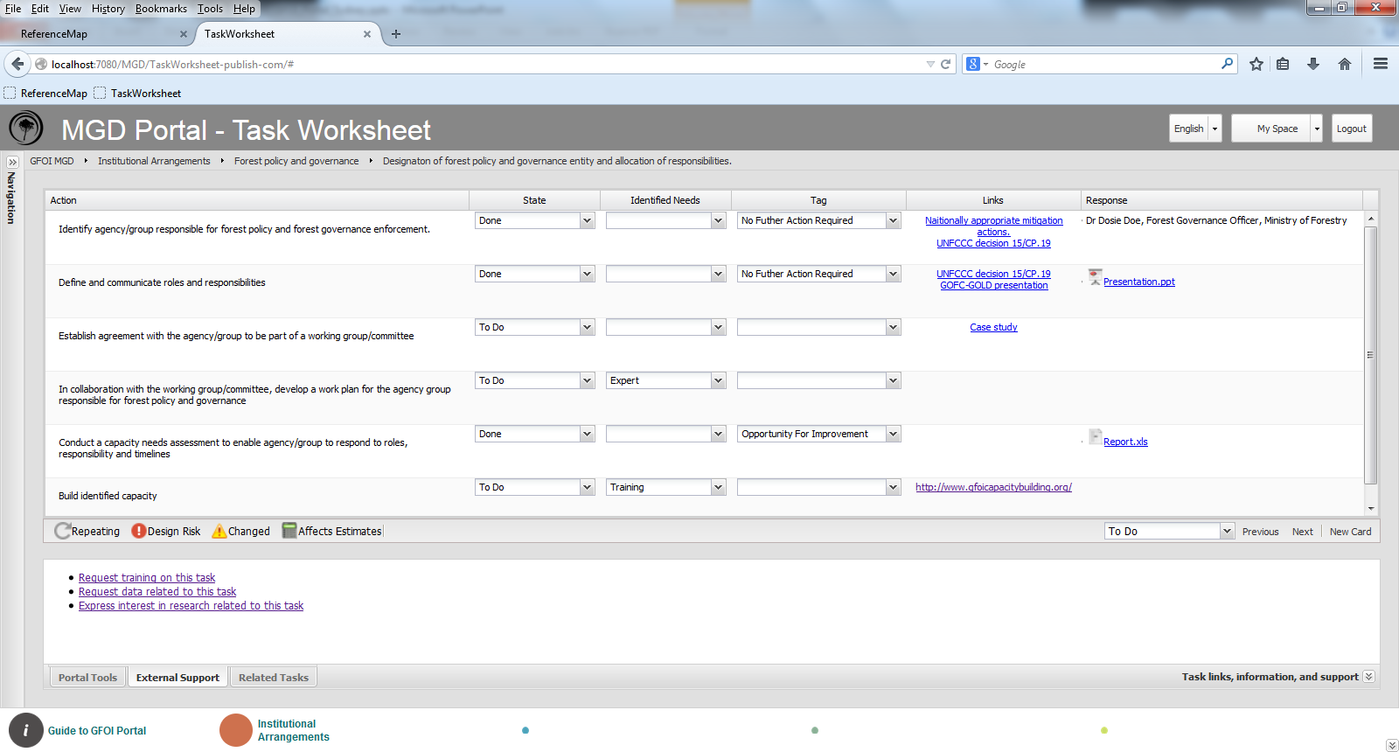
The MGD Portal Prototype – Worksheets
The user can click on a concept within the thematic pyramid and a task worksheet will load
Notes:
1m

Slide 27
The MGD Portal Prototype – Worksheets
Within this task worksheet the user can:
enter information about the status of certain actions
Can specify needs to complete the action
Allocate a tag
Access relevant supporting information
Write or upload a response
Notes:
1m

Slide 28
The MGD Portal Prototype – Worksheets
All the information entered is stored in the users profile
Notes:
1m

Slide 29
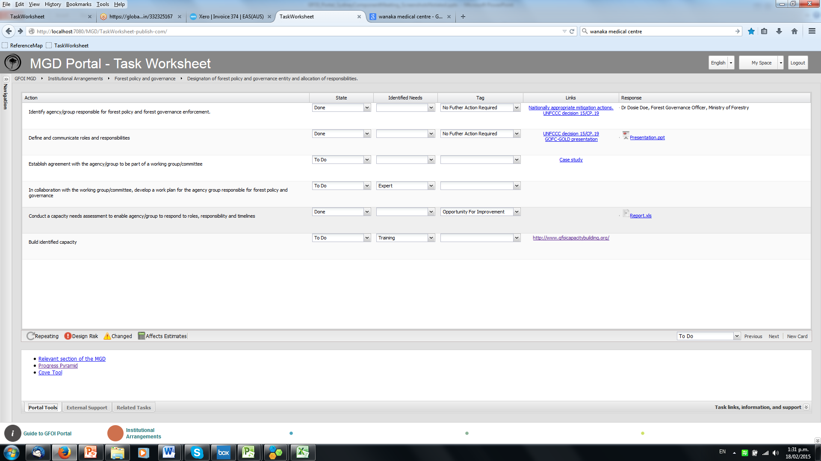
The MGD Portal Prototype – Worksheets
From the task page users will be directed to tools relevant to the active task.
For example a link to the COVE tool would be active on tasks related to defining remote sensing data sources
OR
Links to the GOFC-GOLD training material on decisions relating to Reference Levels
Notes:
1m

Slide 30
The MGD Portal Prototype – Worksheets
Users will be directed to external support relevant to the current task.
This could include links to or requests for space data tools / capacity building workshop information / training materials / detailed guidance modules / examples and case studies / R&D
Notes:
1m

Slide 31
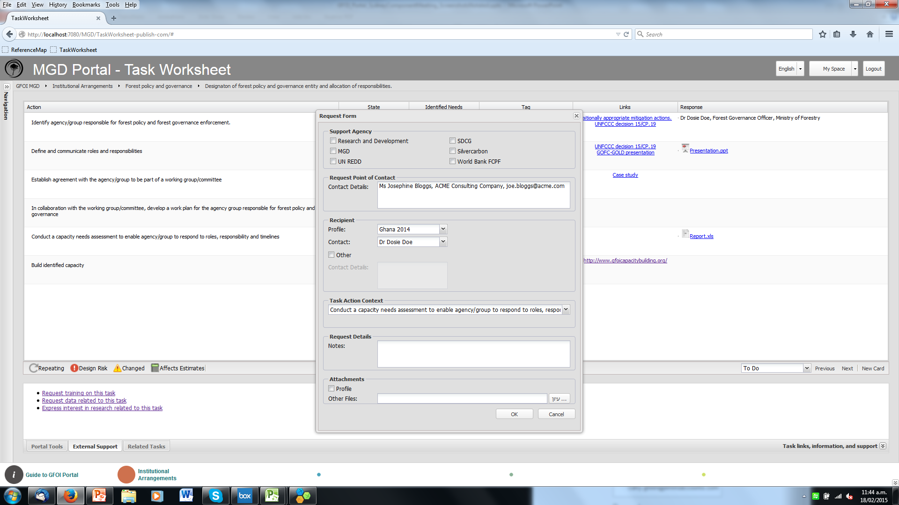
The MGD Portal Prototype – Worksheets
The users profile is provided with any requests to improve communication and appropriate responses between countries and GFOI partners
Notes:
1m

Slide 32
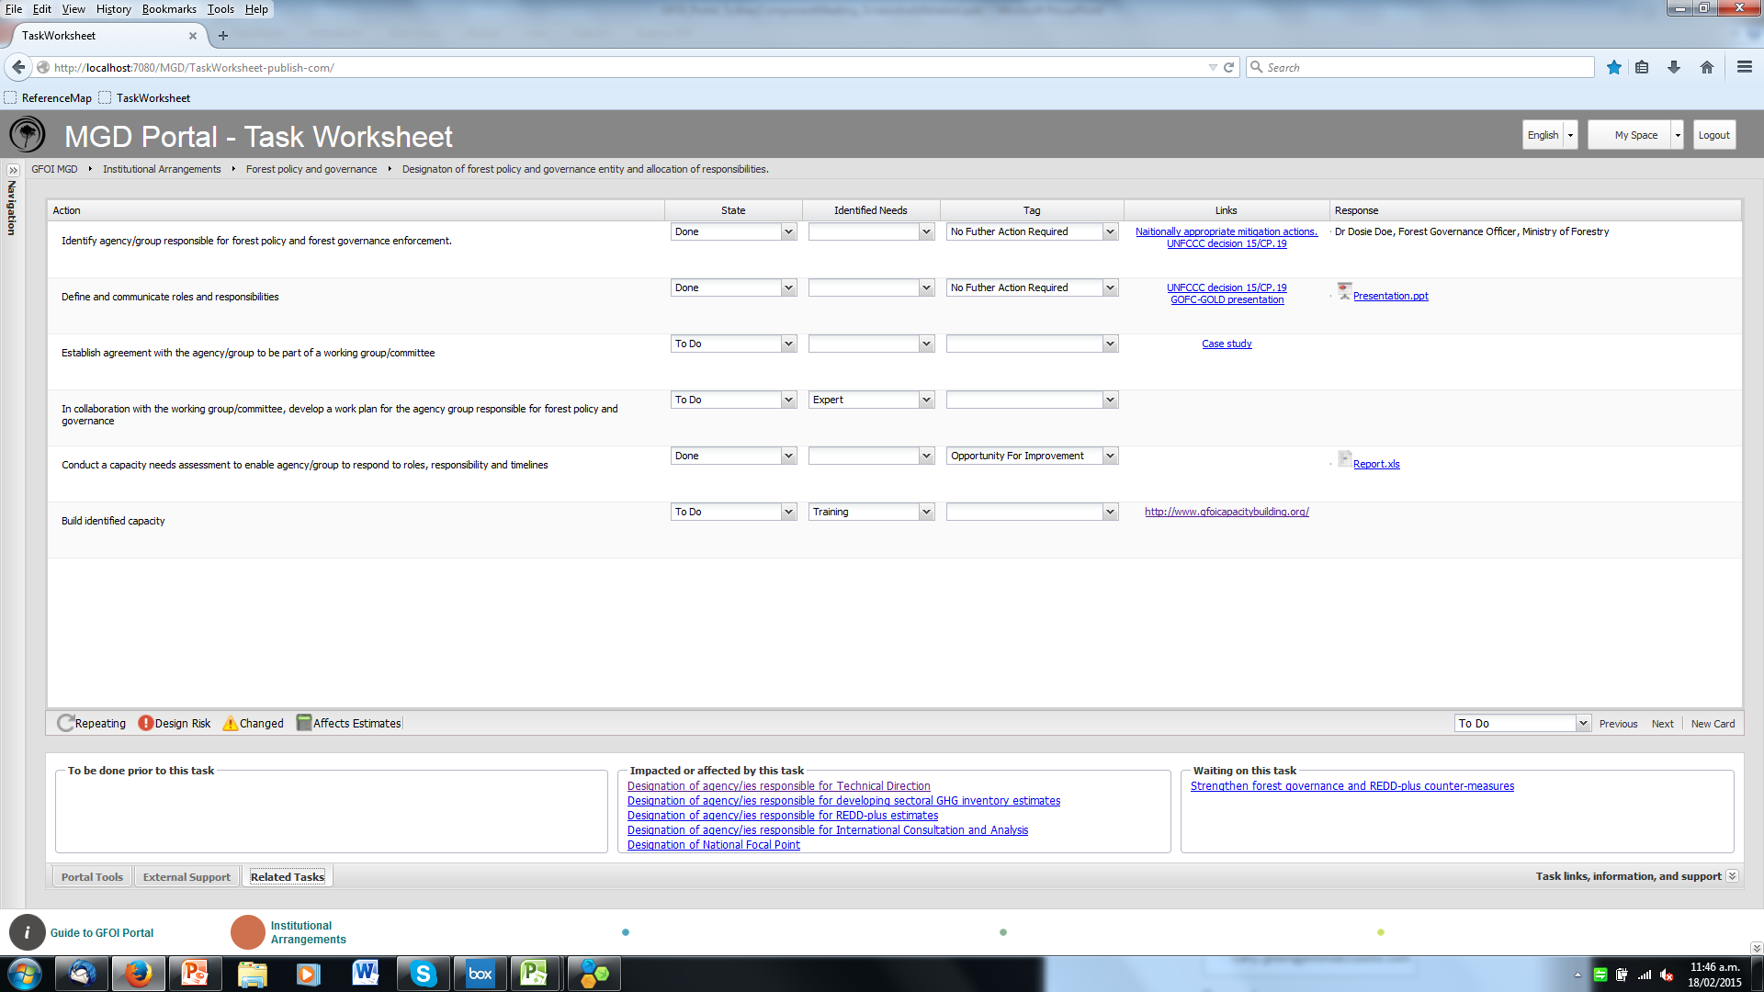
The MGD Portal Prototype – Worksheets
Users will also be able to see related tasks to the one they are working on to improve understanding of the impact on decisions on other elements of the MRV system.
Notes:
1m

Slide 33
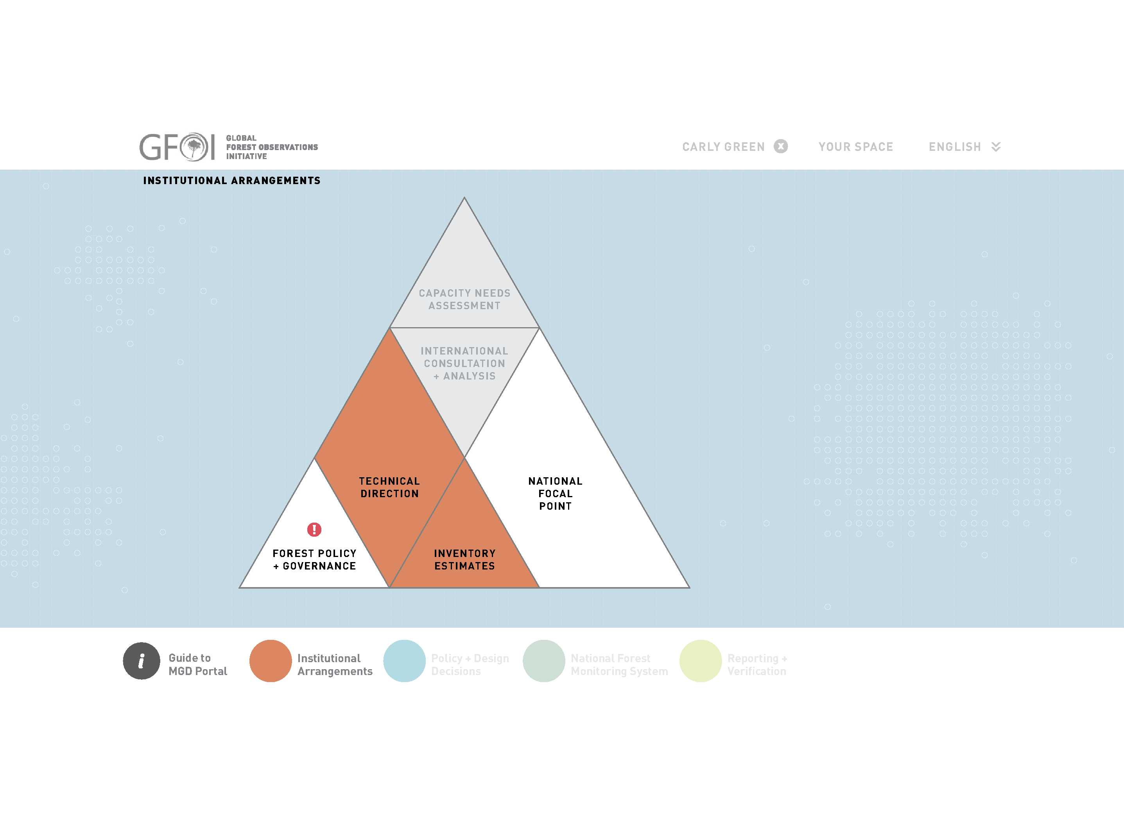
The MGD Portal Prototype – Concepts
Once the task worksheets are completed for each concept the progress pyramid is shaded and suggested next steps are shown as white.
Notes:
1m

Slide 34
The MGD Portal Prototype – Concepts
Design risks are highlighted to encourage action on tasks which have design decision implications on other concepts/task
Notes:
1m

Slide 35
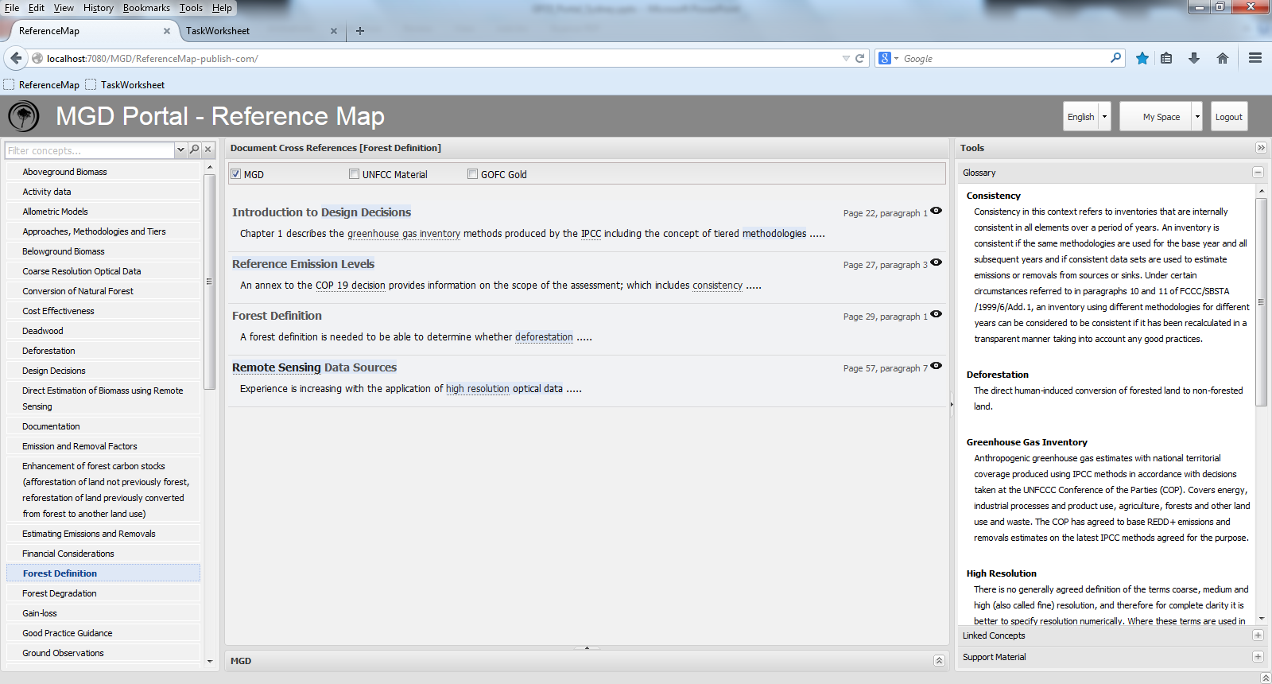
The MGD Portal Prototype – Reference Map
The Portal Reference Map is an intelligent index.
Notes:
1m

Slide 36
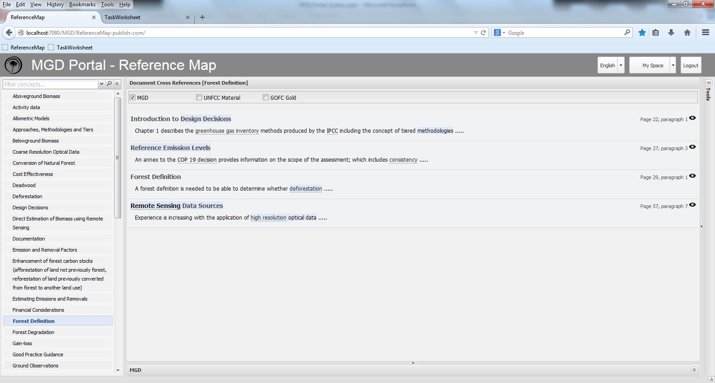
The MGD Portal Prototype – Reference Map
All the concepts in the MGD are listed in an index
Notes:
1m

Slide 37
The MGD Portal Prototype – Reference Map
Selection of an index concept runs an intelligent search that returns related concepts/tasks.
This search is more relevant and targeted than simply returning all instances where the word in mentioned in the MGD.
Notes:
1m

Slide 38
The MGD Portal Prototype – Reference Map
For example, a search of ‘Forest Definition’ will direct the reader where Forest Definition is covered but also to sections of the MGD which are influenced by decisions on ‘Forest Definition’
Notes:
1m

Slide 39
The MGD Portal Prototype – Reference Map
Selection of a particular section will direct the user to the specific text of the MGD.
Notes:
1m

Slide 40
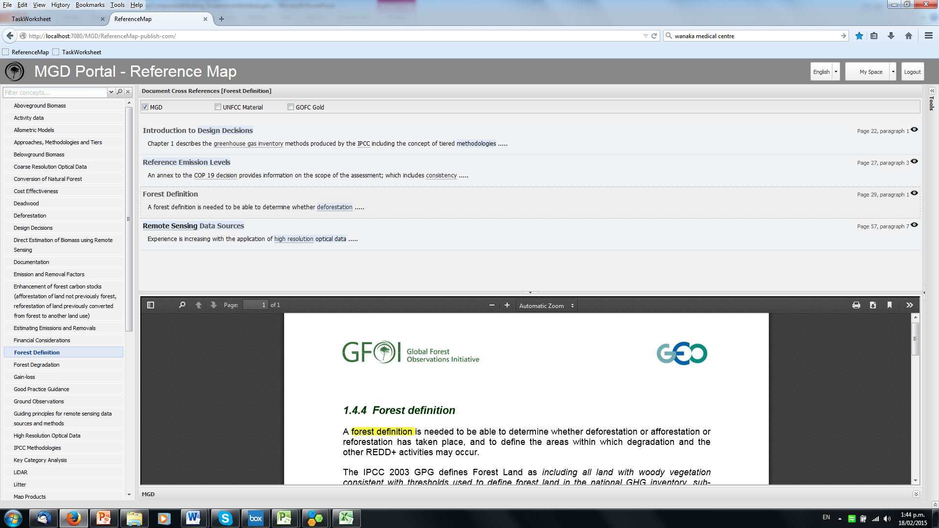
The MGD Portal Prototype – Reference Map
Notes:
1m

Slide 41
The MGD Portal Prototype – Reference Map
The index includes the glossary of terms
Notes:
1m

Slide 42
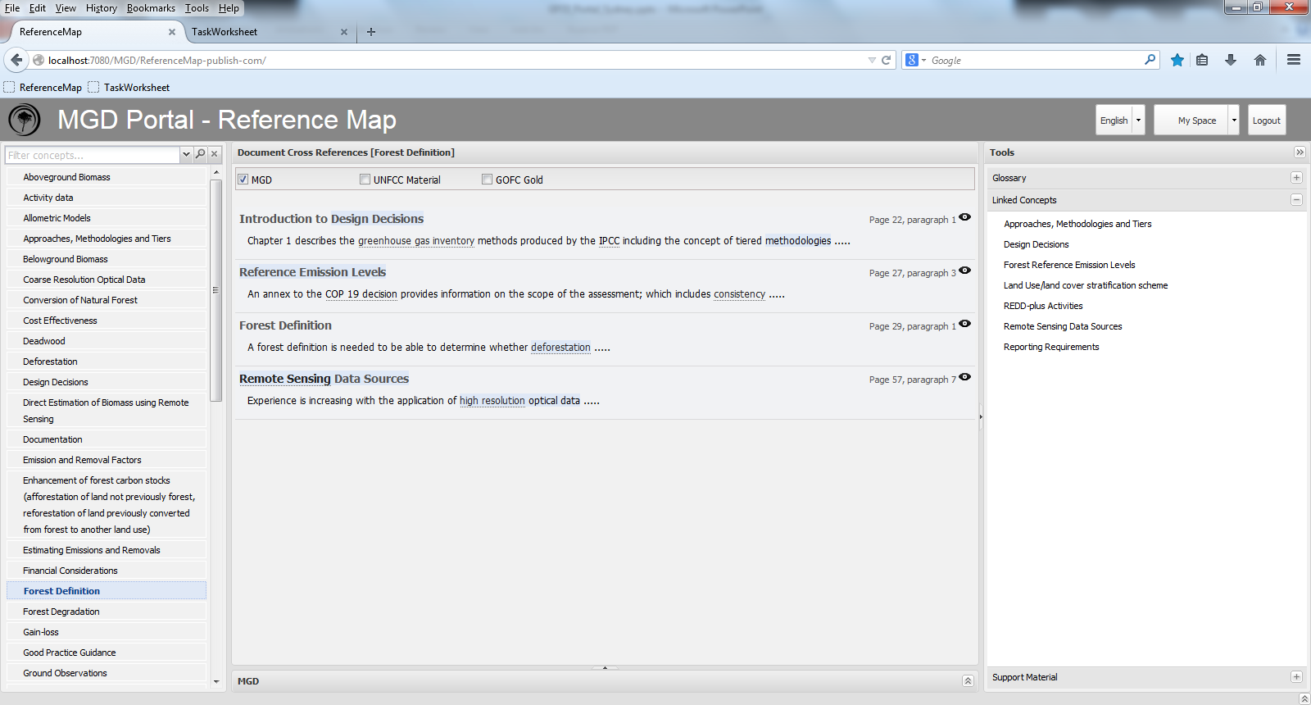
The MGD Portal Prototype – Reference Map
And linked concepts which are not directly linked to the searched word but are rather related concepts that the user should be considering
Notes:
1m

Slide 43
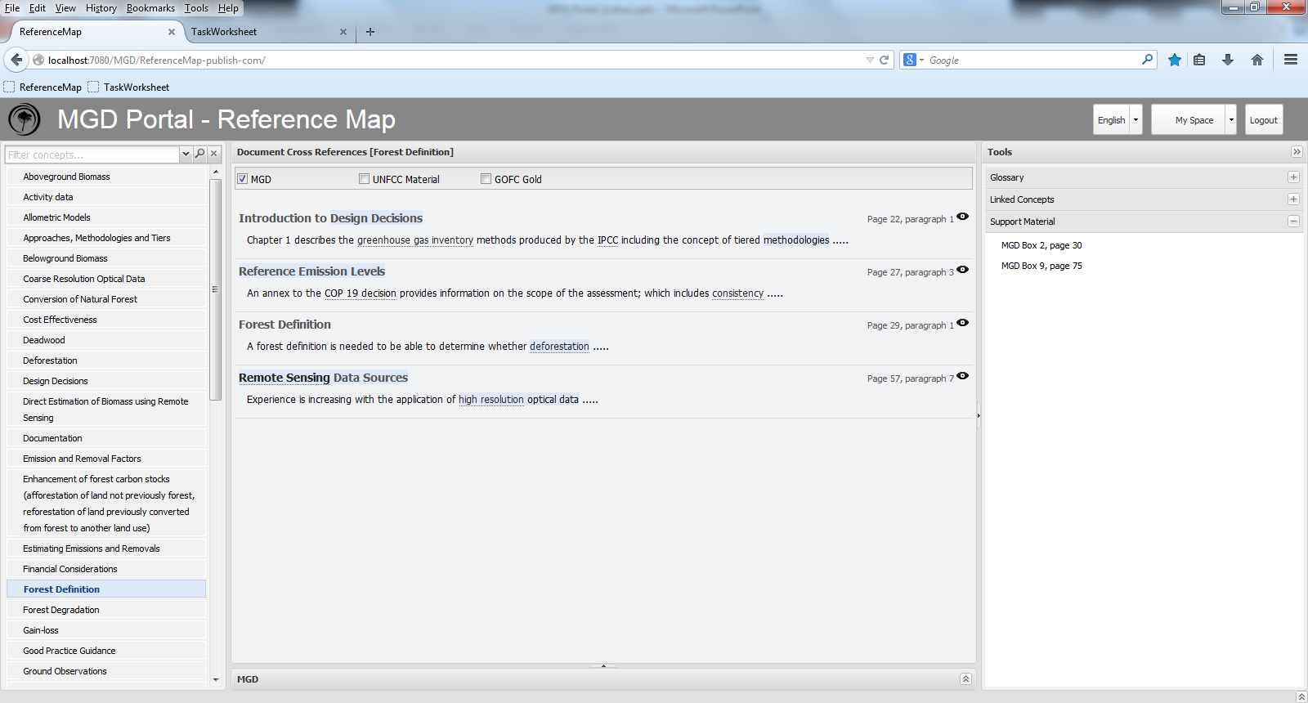
The MGD Portal Prototype – Reference Map
Finally the index includes links to other support material such as examples / training material / GFOI partner material / UNFCCC decisions
Notes:
1m

Slide 44
Questions / Contributions
Notes:
2m

